Slide 1
RAID (Redundant array of independent disks)
Team Albera:
Karl Escobar
JC Viray
Sofia Lopez

Slide 2
What is RAID?
RAID stands for Redundant array of independent disks
It is a way of storing data in different places on multiple hard disks to protect data in case of a drive failure.
It is also a way to improve data transfer speeds/throughput

Slide 3
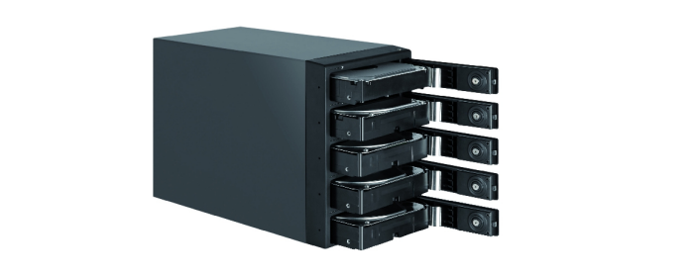
Hardware vs. Software RAID
Hardware RAID
It does all the management of the RAID arrays, providing logical disks to the system and it can provide many different types of RAID levels simultaneously to the system.
It has a dedicated RAID controller which works independently from the operating system. This means more speed and reliability is possible for this configuration.
In an event of a failure, swapping hard drives out is made easier as well, just pull it out and replace with a new one
Incurs additional cost due to needed hardware

Slide 4

Hardware vs. Software RAID
Software RAID
Implements various RAID levels in the kernel disk code (block device) and offers a much cheaper solution.
Cost is lower because no additional hardware is needed.
This gives better freedom with how you can setup your RAID arrays unlike with the hardware based where you are dependent with the type of controller that you have.
Since this is software based and relies entirely with the stability of your operating system, this is less reliable and can be a bit slower compared to hardware based. This is also specific to the operating system that you have and cannot be setup with other computer.
Disk replacement is a bit of a hassle too, as you have to set certain parameters to the software before you can pull out the erring hard drive.

Slide 5
Levels of RAID
Some of the common types of RAID used are:
- RAID 0
- RAID 1
- RAID 5
- RAID 6
- RAID 10
* There are many more types of RAID but are rarely used.

Slide 6
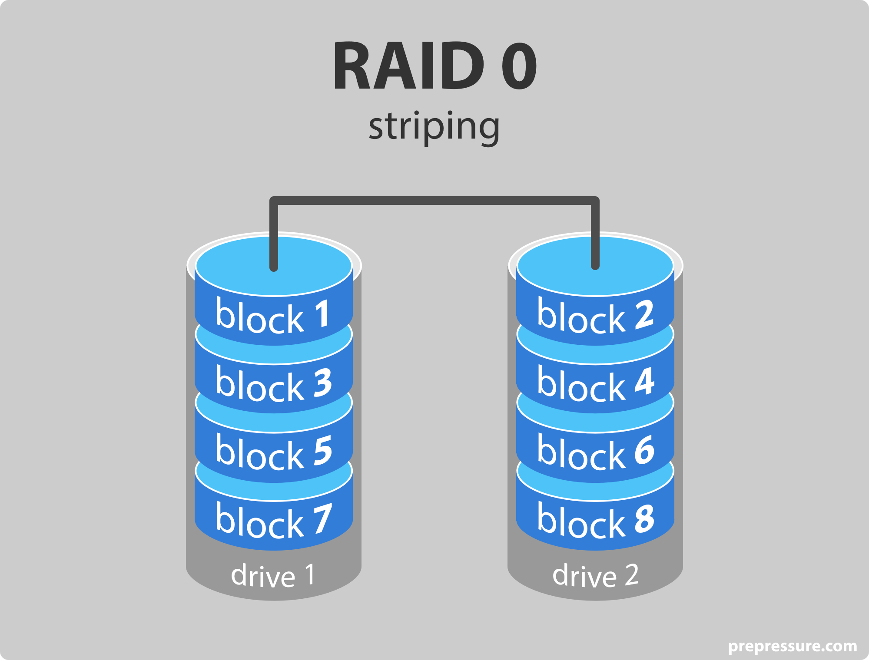
RAID 0
It consists of striping but not mirroring or parity. Good for Heavy read operations and has a high-performance speed. You get combined storage space off all hard drives that are in this array. Downside is data is divided amongst all hard drives and if one disk fails data can be lost.

Slide 7
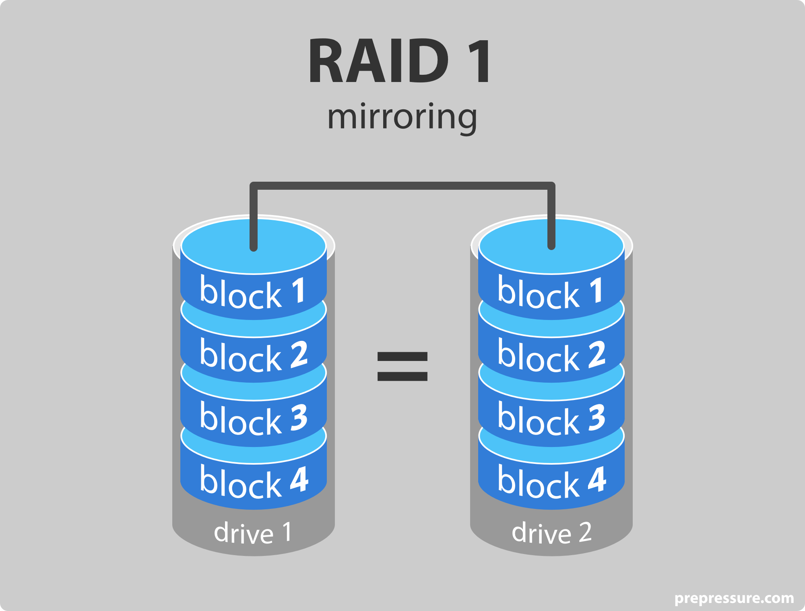
RAID 1
It consists of Mirroring. A literal 1:1 copy of your hard drive. Good for standard app servers, has a high fault tolerance and high read performance. Downside is lag for write ops, and storage is reduced by 1/2

Slide 8
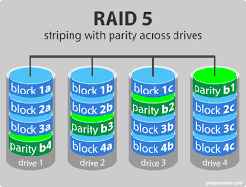
RAID 5
It consists of striping and parity. Good for normal file storage and App servers, has high speed and fault tolerance. A combination of the above raids. Downside is lag for write ops and storage is reduced by 1/3.

Slide 9
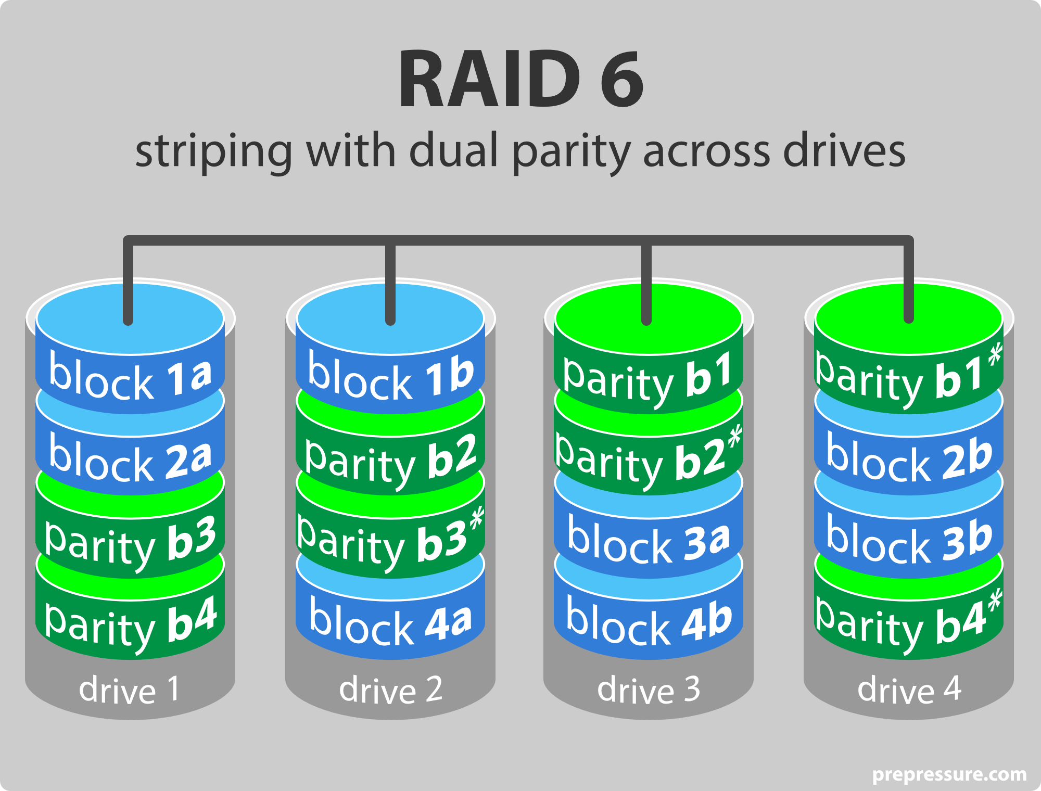
RAID 6
It consists of striping and double parity. Good for Large file storage and app servers, has extra level of redundancy and high read performance. Downside is low write performance and reduced storage by 2/5.

Slide 10
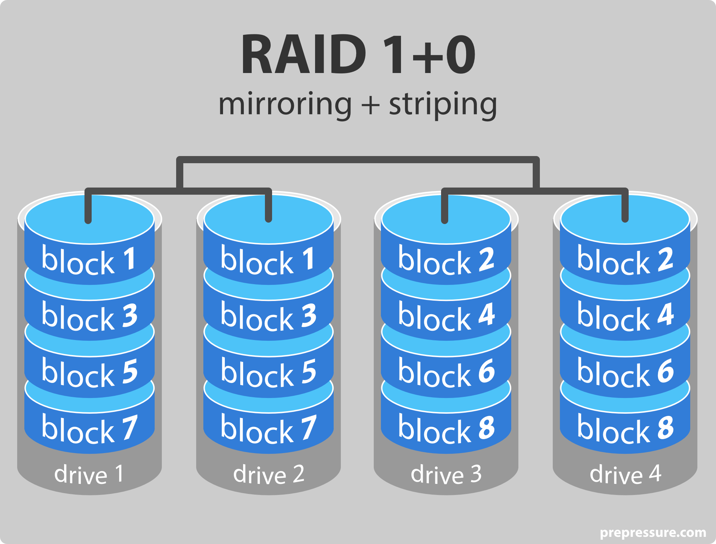
RAID 10
It consists of striping and mirroring. Good for Highly utilized database servers, has high write performance and strong fault tolerance. Better than RAID 5 in backing up a disk. Downside is limited scalability and storage is reduced by 1/2.

Slide 11
Conclusion
While RAID may seem like a good idea for backing up your data, it does not. What it does is, it protects your hard drive or gives you the possibility of swapping your hard drive and recover from complete failure.
A corrupted data stored in the hard drive will still be corrupted no matter what your RAID configuration will be. Redundancy is not the same as a backup. Even with a RAID you are still susceptible to viruses, accidental deletion, corrupted files or even human error.
RAID is perfect if you want to achieve better performance and/or better reliability.

