Slide 1
Phishing Awareness Presentation
A cybersecurity Awareness Training
Presented BY
Shedrack ekenomamwan
CodeAlpha Cyber security Internship
2026

Slide 2
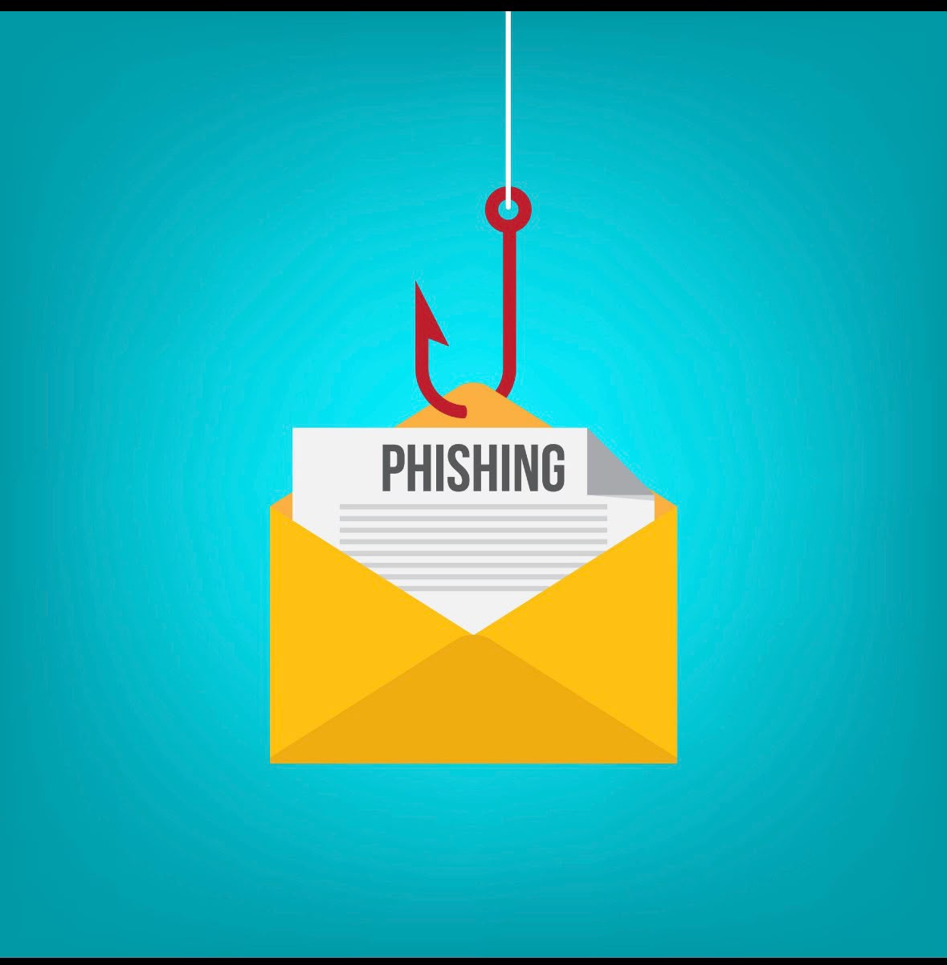
What is phishing
Phishing is a type of cyberattack in which criminals pretend to be trusted organizations or individuals to trick people into revealing sensitive information such as usernames, passwords, bank details, credit card information, or other personal data.
Phishing attacks are commonly carried out through emails, text messages (SMS), social media messages, phone calls, or fake websites that appear genuine.
The primary goal of phishing is to steal confidential information, commit financial fraud, or gain unauthorized access to personal or organizational accounts.

Slide 3
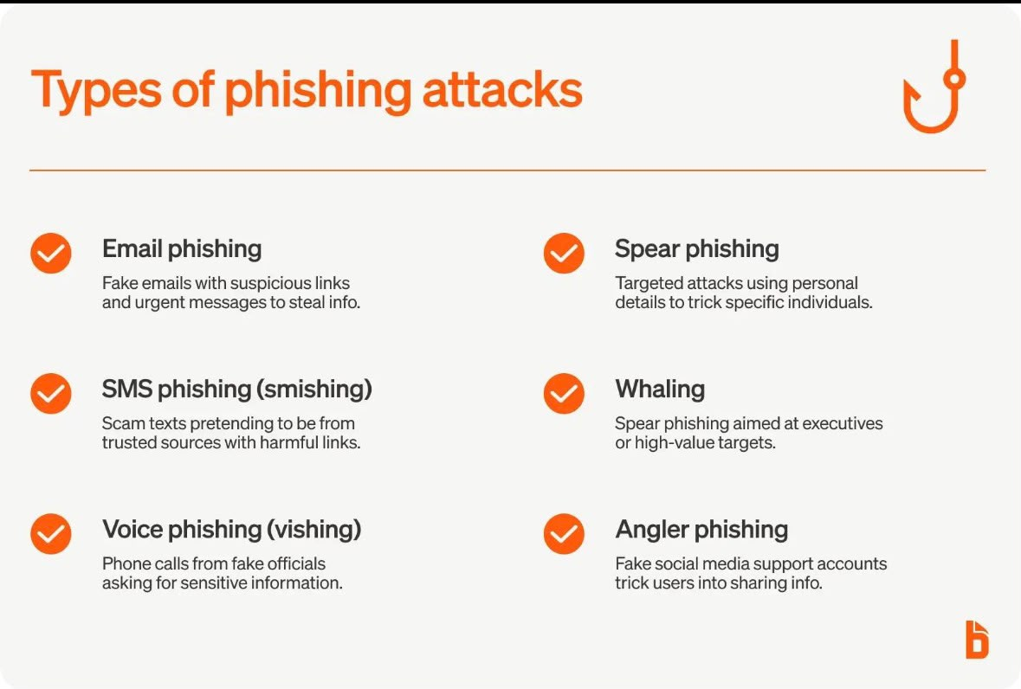
Types of Phishing
There are several common types of phishing attacks:
Email Phishing: Fraudulent emails that appear to come from trusted organizations to steal personal information.
Spear Phishing: Targeted phishing attacks aimed at a specific individual or organization using personalized information.
Smishing: Phishing attacks carried out through SMS or text messages.
Vishing: Phishing conducted through phone calls where attackers impersonate trusted individuals or organizations.
Clone Phishing: A legitimate email is copied and modified to include a malicious link or attachment.

Slide 4
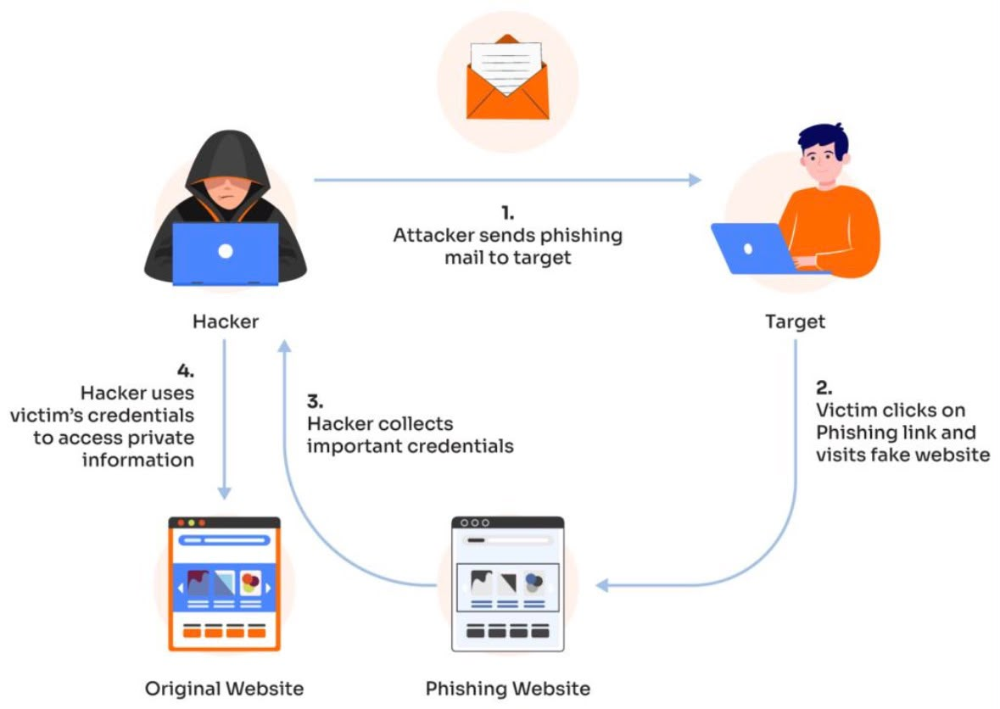
How Phishing Attacks work
Phishing attacks usually follow these steps:
1. The attacker creates a fake message that appears to come from a trusted source, such as a bank, company, or government agency.
2. The victim receives the message through email, SMS, social media, or a phone call.
3. The victim clicks a malicious link or opens an infected attachment.
4. The victim is redirected to a fake website or asked to enter sensitive information.
5. The attacker steals the information and may use it for identity theft, financial fraud, or unauthorized access to accounts.

Slide 5
How To Identify Phishing Email
Be cautious of emails that have the following warning signs:
Suspicious sender email address (it may look similar to a legitimate one but contain small changes).
Urgent or threatening language that pressures you to act immediately.
Spelling and grammar mistakes in the message.
Unexpected attachments or links that you were not expecting.
Requests for sensitive information, such as passwords, banking details, or personal information.
Generic greetings like “Dear Customer” instead of your actual name.

Slide 6
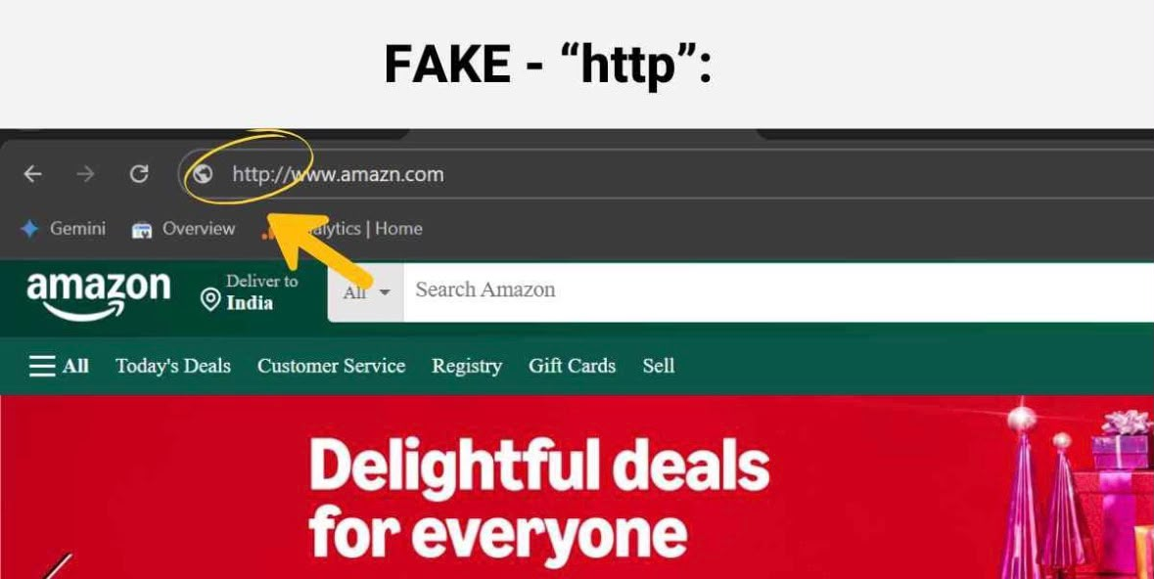
How To Spot Fake Website and URLs
Before entering personal information on any website, always check for these warning signs:
Look for HTTPS: Secure websites begin with https:// and display a padlock icon.
Check the domain name carefully: Attackers often create fake websites with slightly altered URLs (e.g., arnazon.com instead of amazon.com).
Beware of poor website design: Low-quality images, spelling mistakes, or broken links can indicate a fake site.
Avoid clicking suspicious links: Instead, type the official website address directly into your browser.
Verify before logging in: If a website asks for sensitive information unexpectedly, confirm its authenticity before proceeding.

Slide 7
Social Engineering Techniques
Social engineering is the use of psychological manipulation to trick people into revealing confidential information or performing actions that compromise security.
Common Social Engineering Techniques
Authority: The attacker pretends to be a bank official, manager, or IT support staff.
Urgency: The victim is pressured to act immediately to avoid negative consequences.
Fear: The attacker claims an account has been compromised or that the victim is in trouble.
Curiosity: The attacker uses messages such as “You’ve won a prize” or “See who viewed your profile” to encourage clicks.
Trust: The attacker impersonates a friend, colleague, or family member to gain confidence.

Slide 8
Best Practices to Stay Safe From Phishing
Follow these cybersecurity best practices to reduce the risk of phishing attacks:
Verify the sender’s email address before responding to any message.
Do not click suspicious links or download unexpected attachments.
Use strong, unique passwords for different online accounts.
Enable Multi-Factor Authentication (MFA) whenever possible.
Keep your operating system and applications updated with the latest security patches.
Think before you click. If a message seems suspicious, verify it through an official communication channel.

Slide 9
Interactive Quiz
Question 1
What is the main purpose of a phishing attack?
A. To improve internet speed
B. To steal sensitive information ✅
C. To update software
D. To block advertisements

Slide 10
Question 2
Which of the following is a warning sign of a phishing email?
A. Professional language
B. A trusted sender you know personally
C. Urgent requests for personal information ✅
D. A secure HTTPS website

Slide 11
Question 3
What should you do before clicking a link in an email?
A. Click it immediately
B. Check the URL and verify the sender ✅
C. Forward it to friends
D. Ignore all emails

Slide 12
Question 4
What does MFA stand for?
A. Multiple File Access
B. Multi-Factor Authentication ✅
C. Mobile File Application
D. Managed Firewall Access

Slide 13
Real-Life Example: Phishing Attack
Example: An employee receives an email claiming to be from their bank.
• The email says: “Your account will be suspended today. Click the link below to verify your account.”
• The link leads to a fake banking website designed to steal the employee’s username, password, and banking details.
• Warning signs: Urgent language, suspicious link, request for sensitive information, and a sender address that may look slightly different from the real bank.
• What to do: Do not click the link or provide any information. Verify the message through the bank’s official website or contact the bank directly.

Slide 14
Conclusion & Key Takeaway
Phishing remains one of the most common and dangerous cyber threats, affecting individuals and organizations worldwide. However, by staying informed and following cybersecurity best practices, we can significantly reduce the risk of becoming victims.
Key Takeaways
✅ Always verify the sender before responding to emails or messages.
✅ Never click suspicious links or download unknown attachments.
✅ Check website URLs carefully before entering sensitive information.
✅ Use strong passwords and enable Multi-Factor Authentication (MFA).
✅ Report phishing attempts to the appropriate organization or IT department.

Slide 15
Closing Statement
Cybersecurity starts with awareness. Stay alert, think before you click, and help create a safer digital world.

