Slide 1
Retail Inventory & Lost Sales Analytics Data Pipeline
Prepared By: Kesha Oza, Anita Burri
YID: Y00878953, Y00869033
Institution Affiliation: Youngstown State University
Course Title: Data Engineering Capstone
Faculty Advisor: Dr. Robert Gilliland
Course Professor: Dr. Goerge Yu
Date: April 17, 2026

Slide 2
Introduction
Stockouts lead to significant revenue loss in retail
Poor inventory planning impacts customer satisfaction
Products unavailability impacts business performance
Demand fluctuations make inventory management challenging
Data analytics helps optimize inventory decisions

Slide 3
Background
Walmart weekly sales dataset used for analysis
Contains store-level and time-based sales data
Includes external economic indicators (CPI, fuel price)
Covers multiple years of historical data
Suitable for trend analysis and demand forecasting

Slide 4
Problem Statement
How can stockouts be detected using sales data?
How much revenue is lost due to stockouts?
Which stores are most affected by inventory shortages?
How can inventory levels be optimized using data?
How to transform raw data into actionable insights?

Slide 5
Methodology
Data ingestion into MySQL from Excel dataset
Data cleaning and transformation using staging layer
Dimensional modeling using fact and dimension tables
SQL used for analytical calculations and aggregation
Power BI used for visualization and reporting
End-to-end pipeline from raw data to insights
MySQL (raw_walmart_sales)
↓
Staging Layer (stg_sales)
↓
Data Model (fact_sales + dimensions)
↓
Analytical Views (SQL)
↓
Power BI Dashboard

Slide 6
Data Model
Star schema used for efficient data modeling
Fact table stores transactional sales data
Dimension tables provide descriptive attributes
Improves query performance and scalability
Supports analytical reporting and dashboarding

Slide 7
Business Logic
Starting Inventory = Average Weekly Sales × Weeks of Cover Stockout when inventory ≤ 0
Inventory simulation based on historical demand
Stockout occurs when simulated inventory ≤ 0
Lost Sales represent unmet customer demand
Helps estimate revenue loss due to stockouts

Slide 8
SQL Implementation
Data cleaned and transformed using staging table
Created fact and dimension tables in MySQL
Developed analytical SQL views for KPIs
Implemented inventory simulation logic
Used aggregation functions for store-level analysis
Added dynamic parameter for flexible inventory modeling
# Top 10 stores by total sales
SELECT store_id, ROUND(SUM(weekly_sales), 2) AS total_sales
FROM fact_sales
GROUP BY store_id
ORDER BY total_sales DESC
LIMIT 10;

Slide 9
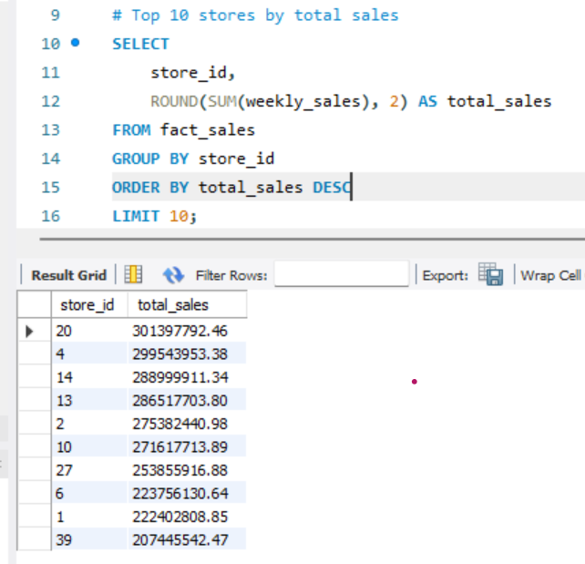
Experiments
Tested different inventory coverage levels
Analyzed impact on stockout frequency
Compared lost sales across stores
Evaluated store-level performance variations

Slide 10
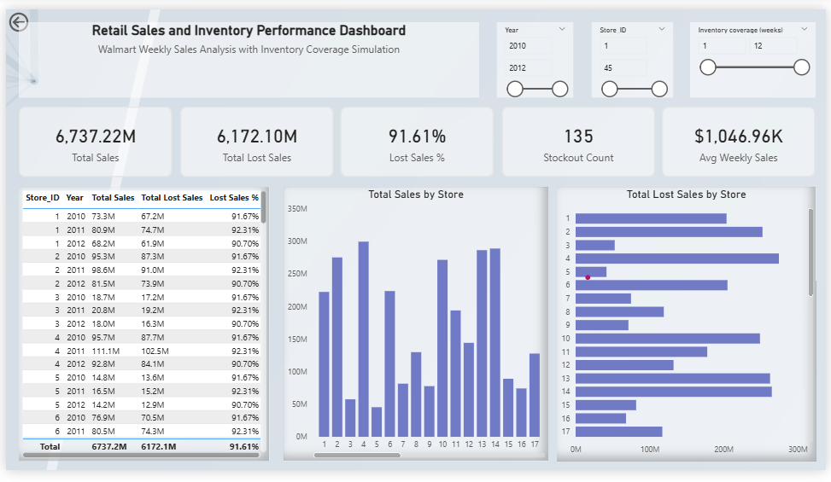
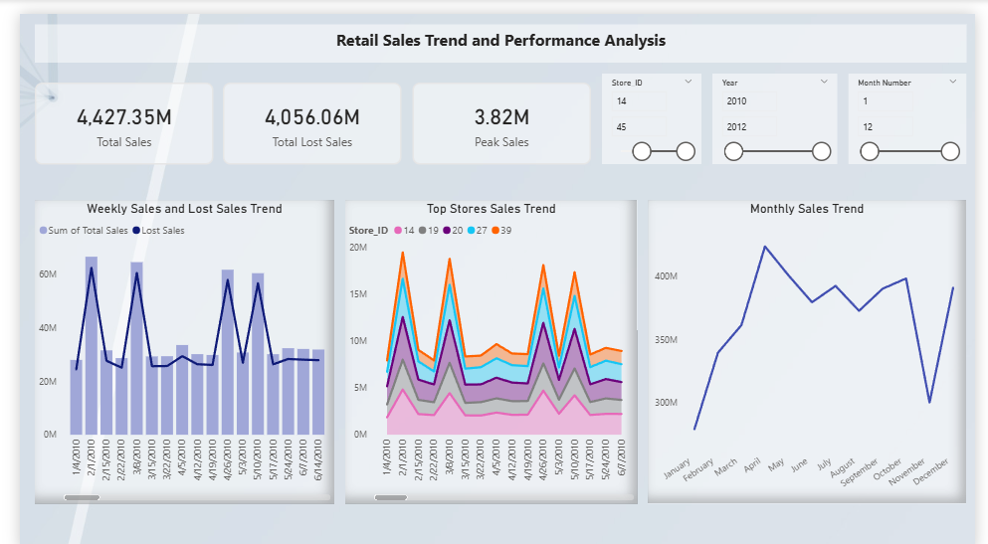
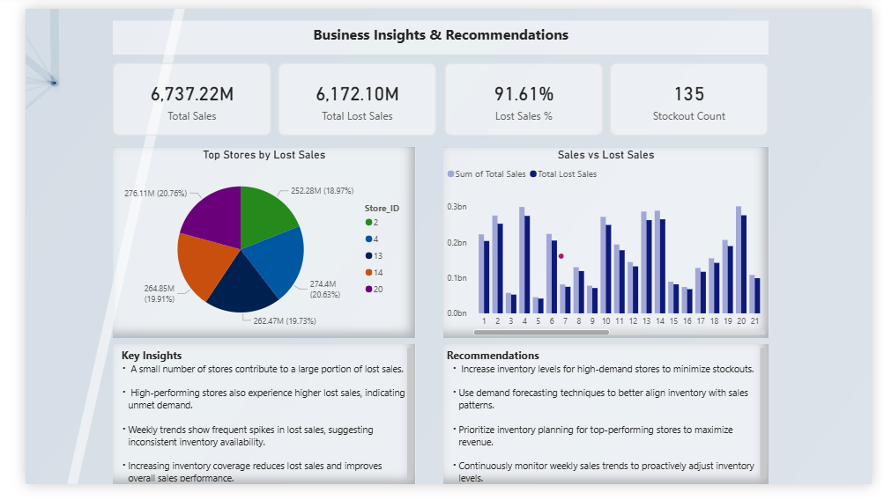
Dashboard Overview
Executive Summary for high-level KPIs
Trend Analysis for time-based insights
Business Insights for decision-making
Interactive filters for better exploration
Designed for business users and stakeholders

Slide 11
Discussion
High-demand stores experience frequent stockouts
Inventory levels are insufficient for peak demand
Lost sales are concentrated in top-performing stores
Seasonal trends impact sales performance
Data-driven decisions can reduce inventory risks

Slide 12
Conclusion
Developed an end-to-end data pipeline solution
Successfully identified stockout risks
Estimated lost sales using analytical modeling
Built an interactive dashboard for insights
Demonstrated integration of SQL and Power BI

Slide 13
Team Contribution
Kesha Oza
SQL data modeling and transformations
Power BI dashboard development
KPI calculation and analysis
Anita Burri
Data preparation and validation
Visualization support and formatting
Documentation and report writing

