Slide 1

A Project on Zomato newer restaurants suggestions
By Keshav kumar
Newton school 1st project.

Slide 2
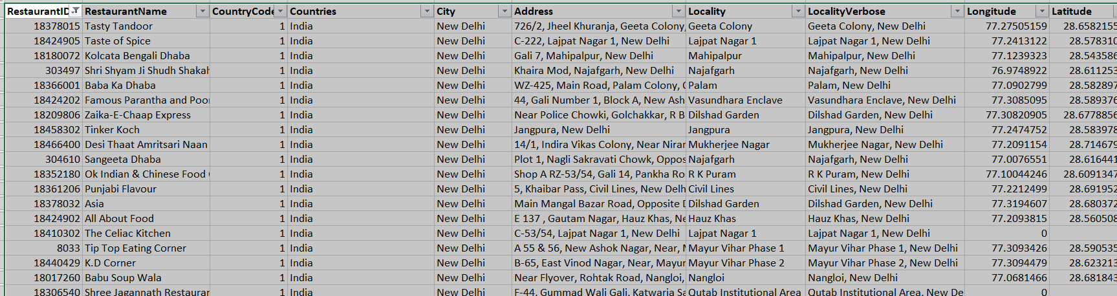
Introduction
Problem Statement I am hired as a consultant data analyst by Zomato where the team is looking for expansion and opening more restaurants. My task is to develop strategies/suggestions for opening newer restaurants.

Slide 3
Data Overview
Restaurant ID: Unique identifier for each restaurant.
Restaurant Name: The name of the restaurant.
Country Code: Country code of the location where the restaurant is situated.
City: The city where the restaurant is located.
Address: The specific address of the restaurant.
Locality: The locality or neighborhood where the restaurant is situated.
Locality Verbose: Detailed information about the locality.
Longitude: The geographical longitude coordinate of the restaurant.
Latitude: The geographical latitude coordinate of the restaurant.
Cuisines: The type of cuisine offered by the restaurant.
Currency: The currency used for transactions in the restaurant.

Slide 4
Data Overview
Has_Table_booking: Indicates whether the restaurant has a table booking option
(Yes/No).
Has_Online_delivery: Indicates whether the restaurant offers online delivery
(Yes/No).
Is_delivering_now: Indicates whether the restaurant is currently delivering
(Yes/No).
Switch_to_order_menu: Indicates whether users can switch to the order menu
(Yes/No).
Price_range: A numeric value indicating the price range category of the
restaurant.
Votes: The number of votes or ratings/(feedback) received by the
restaurant.
Average_Cost_for_two: The average cost for two people dining at the restaurant.
Rating: The overall rating of the restaurant is based on user reviews.
Datekey_opening: The date when the restaurant was opened.

Slide 5
Methodology
Data Cleaning: Utilized functions like LEFT() to extract year from date.
Data enrichment: Enhanced the dataset with additional variables like VLOOKUP to cross reference country.
Descriptive Analysis: Employed Pivot Tables for key metrics and identifying the competitor restaurants and top cuisines.
Competitor Analysis: Identifying the competitors in the suggested areas.
Visualisation: Created dynamic charts and dashboard for data representation, enabling interactive data exploration

Slide 6
Analysis of Objective Questions
Global restaurant distribution shows strategic expansion,
reflecting diverse markets chosen for growth opportunities.
India have more number of restaurant and Canada have less.
By comparing no of restaurants with each year able to find
the growth of competitive risks year wise .
Country Code | Country Name | NO of Restaurant opened
1 | India | 8651
14 | Australia | 24
30 | Brazil | 60
37 | Canada | 4
94 | Indonesia | 21
148 | New Zealand | 40
162 | Philippines | 22
166 | Qatar | 20
184 | Singapore | 20
189 | South Africa | 60
191 | Sri Lanka | 20
208 | Turkey | 34
214 | United Arab Emirates | 60
215 | United Kingdom | 80
216 | United States of America | 434
years | no of restaurant open
2010 | 1080
2011 | 1098
2012 | 1022
2013 | 1061
2014 | 1051
2015 | 1024
2016 | 1027
2017 | 1086
2018 | 1094

Slide 7
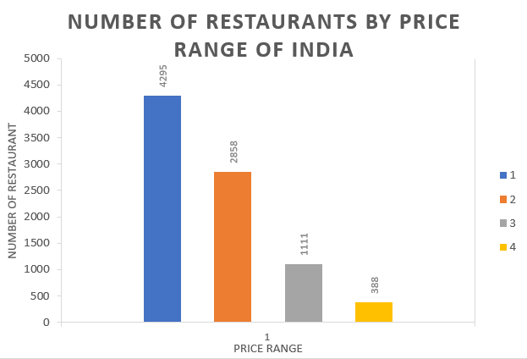
Analysis of Objective Questions Contd.
From the comparison, I found that costlier restaurants are less in India.
There are 388 restaurants in India in price range of 4.
Means number of cheaper restaurants are more in India.
able to identify the feedback rate of the customers.
In this Indonesia have high average no of votes
means no of customers rating the restaurants is high.
Singapore have very less average no of votes.
Row Labels | Average of Votes
Australia | 111.4166667
Brazil | 19.61666667
Canada | 103
India | 137.212552
Indonesia | 772.0952381
New Zealand | 243.025
Philippines | 407.4090909
Qatar | 163.8
Singapore | 31.9
South Africa | 315.1666667
Sri Lanka | 146.45
Turkey | 431.4705882
United Arab Emirates | 493.5166667
United Kingdom | 205.4875
United States of America | 428.2211982

Slide 8
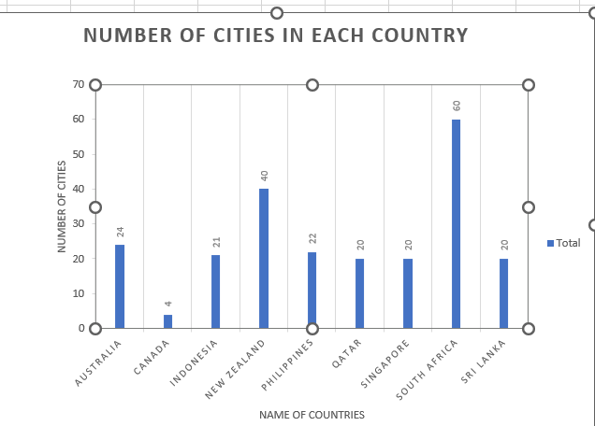
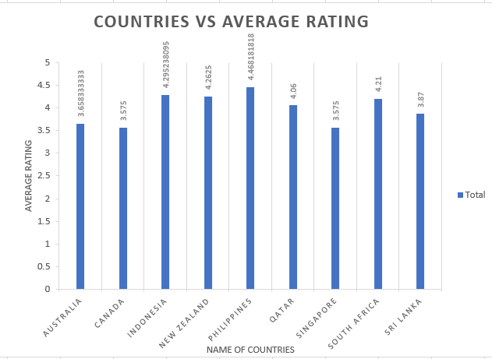
Insights from Subjective Questions
I have filter the 9 countries with lesser number of
restaurants for easy to comparison.
with less dense of restaurants and lower rating are found.
Philippines have lesser number of cities and higher
average rating.
Based on the above conditions countries like Canada,
Australia, Singapore and Sri Lanka have lesser competition.

Slide 9
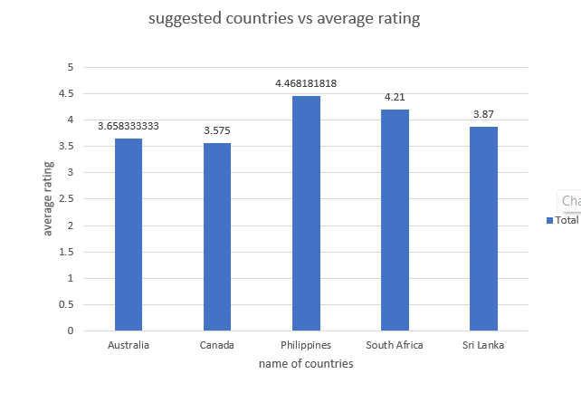
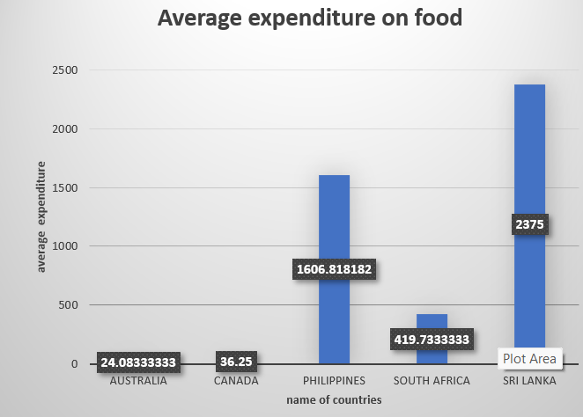
Insights from Subjective Questions
From the figure ratings for the suggested countries
are shown. Philippines has higher rating indicates
restaurants in that country are generally meeting
customer satisfaction and possibly intense competition
among the five countries.
From the figure Australia have Lesser expenditure and Sri
Lanka have higher expenditure.

Slide 10
Insights from Subjective Questions
Suitable Cities in the suggested countries are found based on their rating which are less than 4.5 easy to attract customers in that region.
Recommended cities in Australia are suggest Plam cove, Tanunda, phillip island and Beechworth.
Recommended cities in Canada are Consort, Chatham- Kent and Yorkton.
Recommended city in Philippines is Santa Rosa.
Recommended city in South America is Randburg.
The other countries in the analysis each feature unique cities, which suggests that further analysis may not be necessary

Slide 11
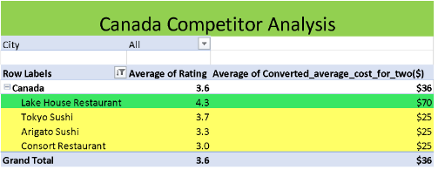
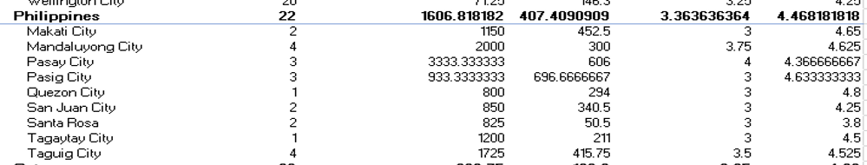
Insights from Subjective Questions
Biggest competitors from the suggested cities and
countries are identified by competitors analysis.
Here except Lake House Restaurant all cities have
Lesser average cost of expenditure.
Here from Philippines Santa Rosa city has lower average rating as well as lesser expenditure.
Similarly competitors in other
countries are found.

Slide 12
Insights from Subjective Questions
The selection of cuisines influences restaurant ratings, even when the expenditure remains constant. This indicates that the choice of cuisine plays a significant role in determining customer satisfaction and overall ratings.
Modern Australian, Australian, Mediterranean, Seafood, Pizza, Bar Food are the famous cuisines in Australia.
Italian, Mediterranean, Pizza are the famous Cuisines in Canada
American, Steak, Bakery, Italian are the famous Cuisines in Singapore
Seafood, Juices, Desserts are the top cuisines in Sri Lanka.
Refer: Cuisine Analysis sheet

Slide 13
Insights from Subjective Questions
Restaurants that offer table booking services enjoy a 23.8% higher rating compared to those that do not provide this option.
Restaurants that offer online delivery services tend to have a 19.6% higher rating, but currently, many of them are not providing delivery services
Consequently, there isn't a significant disparity in ratings between restaurants that offer delivery and those that don't.
Conclude that offering table booking services contributes to customer satisfaction

Slide 14
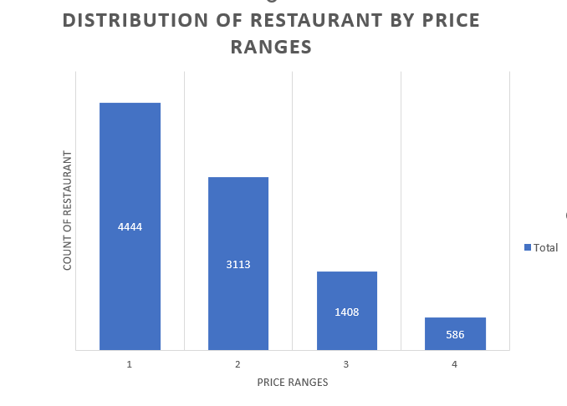
Insights from Subjective Questions
Reveals that a significant majority of restaurants fall within the low-price range, while a minimal fraction operates in the high-price segment, indicating a market skew towards affordability.

Slide 15
Strategic Recommendations
Implement Online Table Booking: Offer online table booking services to enhance convenience and attract more customers.
Maintain Medium Food Costs: Keeping food prices moderate can broaden market appeal and increase market size.
Tailor Cuisine Selection: Feature popular cuisines relevant to the location to maximize customer attraction and satisfaction.

Slide 16
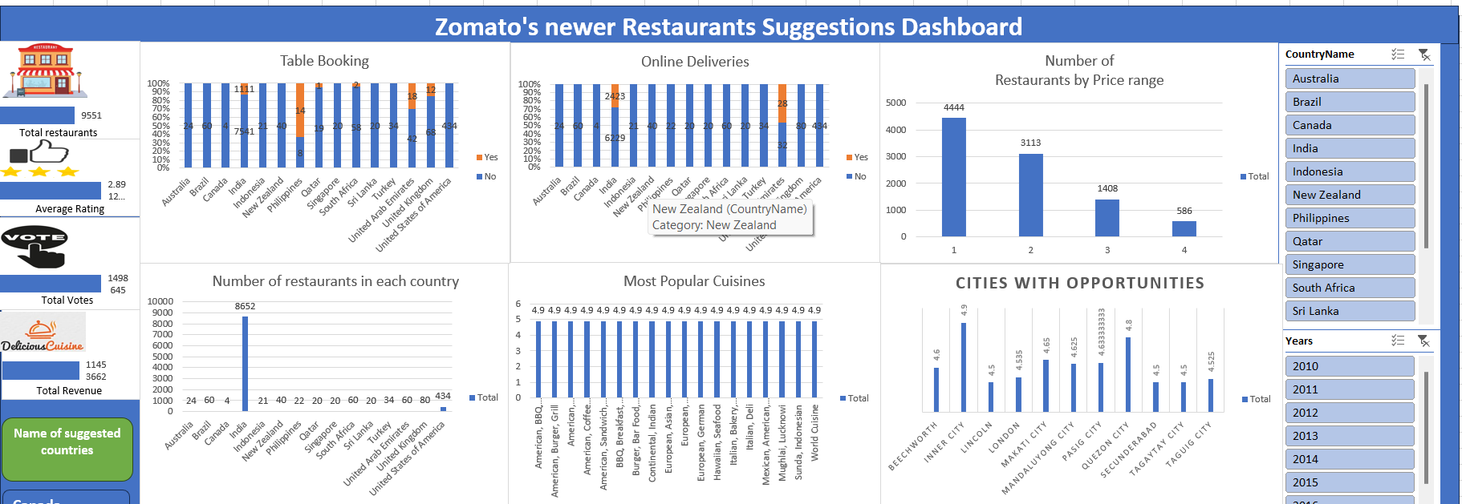
Final Dashboard

Slide 17
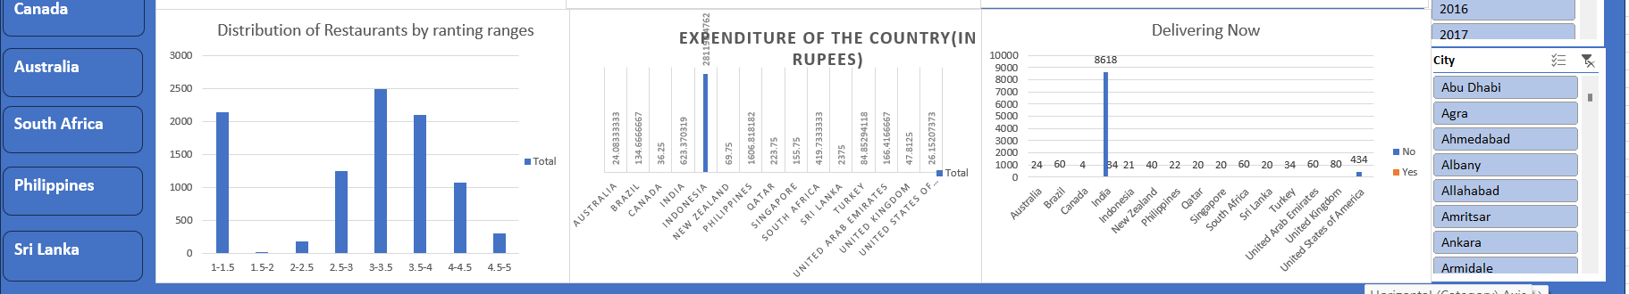

Slide 18
Conclusion
In conclusion, our analysis has pinpointed several key factors for successful restaurant expansion, focusing on countries with lower competition, cost-effectiveness, preference for online table booking, and careful selection of cuisines.
I suggest Australia, Canada, Philippines and South Africa for opening new restaurants.
By strategically selecting these countries, we can maximize our chances of success and minimize risks.

Slide 19


