Slide 1

Columbia Asia hospital project
BY
KESHAV KUMAR
02/03/2024

Slide 2
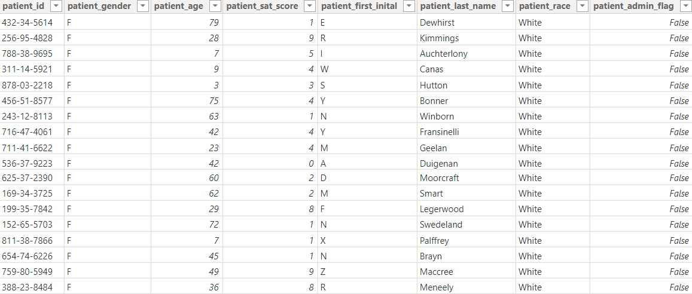
Introduction
I have been hired as a consultant data analyst by Columbia Asia Hospital. The Hospital is looking for the key insights for the following objectives:
1) Assess the hospital's revenue generation
2) Insights about suitable departments for new hires
3) Strategies and suggestions for patient discounts
Your task is to perform data analysis and come up with a report to help the organization with the mentioned objectives.

Slide 3
Data overview
1) Date: This column contains date and time information without specifying AM or PM. The format is DD-MM-YYYY HH:MM.
2) Patient ID: Each patient is assigned a unique identifier, which seems to be in the format 124-62-3289.
3) Patient Gender: This column records the gender of the patient, denoted by 'M' for male and 'F' for female.
4) Patient Age: The age of the patients is listed in years.
5) Patient Sat Score: It seems to represent a satisfaction score given by or for the patient. However, the scores are single-digit, and it's not clear what the scale is.
6) Patient First Initial: This column contains the first initial of the patient's first name.
7) Patient Last Name: The surname of the patient is listed in this column.

Slide 4
Data overview
8) Patient Race: The racial or ethnic background of the patient is recorded here, with categories such as 'White', 'African American', 'Asian', 'Native American/Alaska Native', and 'Two or More Races’.
9) Patient Admin Flag: This column contains boolean values ('TRUE' or 'FALSE') which might indicate whether the patient was admitted or some other administrative flag.
10) Patient Wait Time: Appears to indicate the time the patient waited, possibly in minutes, before being seen or processed.
11) Department Referral: This column lists the department to which the patient was referred, with entries such as 'General Practice', 'Orthopedics', 'Gastroenterology', or 'None' indicating no referral.
12) Doctor Name: Identifies the doctor who attended each patient.
Appointment Fees: The cost charged for a doctor's consultation.
13) Total Bill: The overall amount billed to the patient, including all services and charges.

Slide 5
Methodology
Data cleaning: includes removing duplicates, filtering rows, replacing values, converting data types, and handling missing values.
DAX: It allows users to create complex formulas for data manipulation, aggregation, and filtering for getting insights by using cards.
Descriptive Analysis: Taking out the insights of objective and subject question along with various KPI’s.
Interconnections: connect all the reports tab to change dynamically.
Visualization: There is main tab, doctor’s tab and patient’s tab for all information of hospital ,doctors and patients.

Slide 6
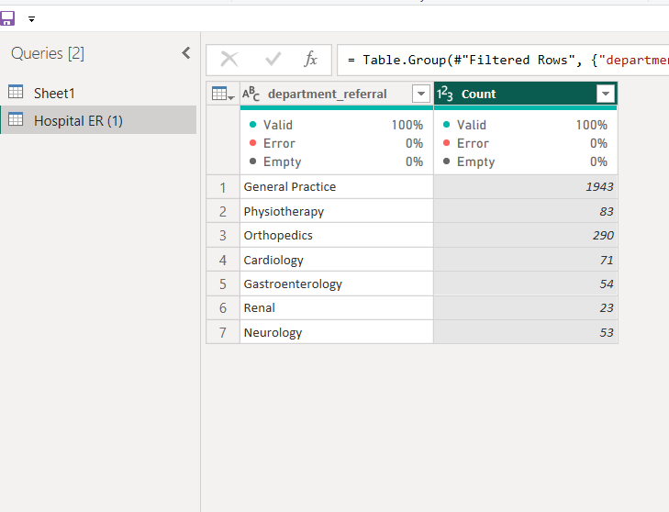
Analysis of Objective questions
The count of patients in General Practice at hospital
is higher i.e 1943.
Count of patient in Renal is the lowest at the hospital
i.e 23.
Count of patient in Orthopedics is 290, which is a good
amount.

Slide 7
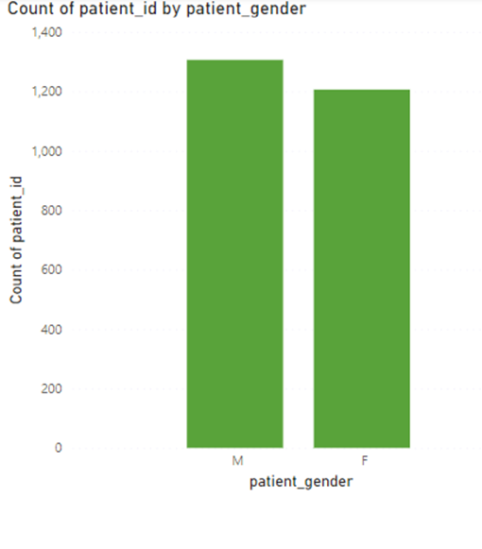
Analysis of Objective questions
To identify Null values in Power BI, use the "Data" view and look for blank cells in the respective columns.
The best way to handle Null values depends on the context. You can replace them with a specific value (e.g., 0), use the average or median value, or remove the rows with Null values using the "Remove Rows" transformation.
In this case, we opted to replace Null values with the average value for numerical columns and with a specific value for categorical columns, ensuring data integrity and analysis accuracy.
Form the figure we can say that the number of male
Patient visited in the hospital is more than the number
of female patient visited in the hospital.

Slide 8
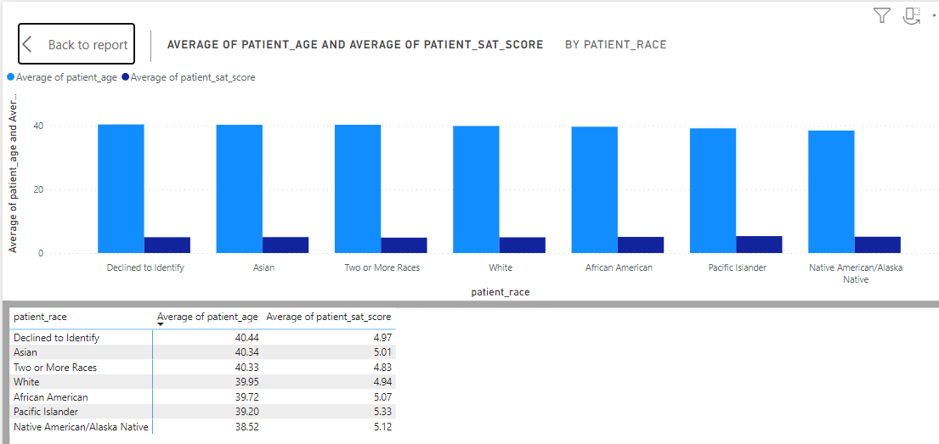
Analysis of Objective questions
Pacific islander race has the highest
Satisfaction score i.e 5.33 among 39.2
Average years of patients.
Two or more races race patients has
The lowest average score i.e 4.83
among 40.33 average year of patients
Over all we can say the satisfaction
Score of all races is very good i.e
more than 4.5.

Slide 9
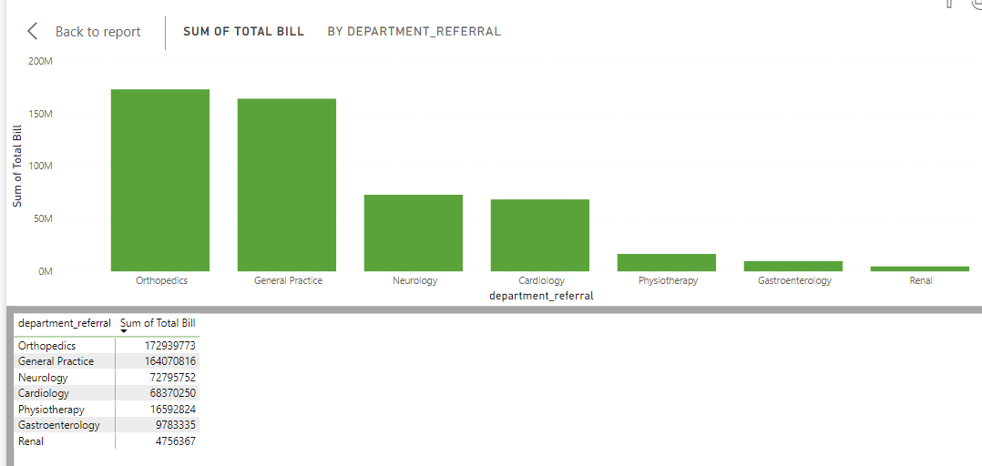
Analysis of Objective questions
Orthopedics and General practice
departments are the highest
revenue generation departments
among all.
Renal is the least revenue generating
department.
Neurology and cardiology are
generating half of the revenue
generating by orthopedics
department.

Slide 10

Analysis of Objective questions
DAX (Data Analysis Expressions) is a formula
language used in Power BI, Excel Power Pivot,
and Analysis Services to define custom
calculations in tables and pivot tables.
It allows users to create complex formulas for
data manipulation, aggregation, and filtering
Neurology has the highest appointment fees.

Slide 11
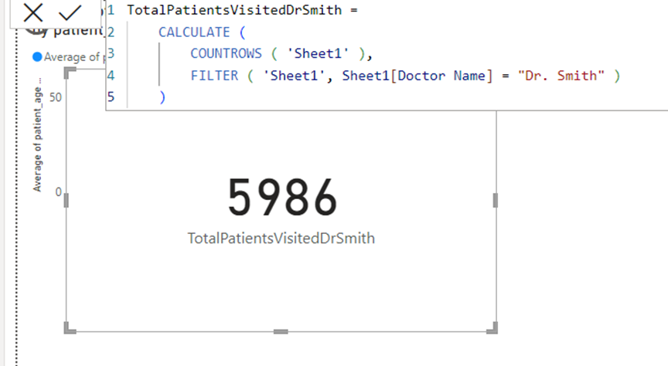
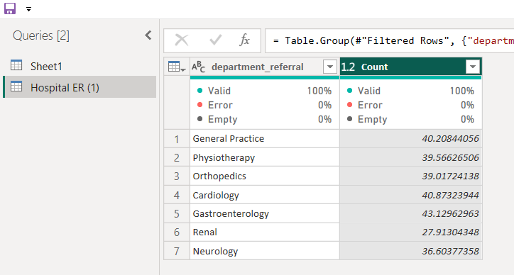
Analysis of Objective questions
The total number of patients visited by Dr. Smith is 5986.
the over all revenue generated my Dr. Smith is much higher
than other doctors.
I have used here DAX function and card to show my result.
The average age of patient visited in Orthopedics
Department is 39.02.
Rate of visiting of patients above 35 age group is more
In all departments as compare to the lower age group one.

Slide 12
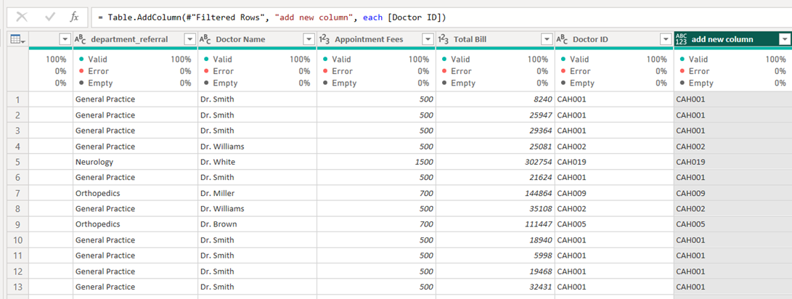
Analysis of Objective questions
M Query is a data query language used
in Power Query to retrieve, transform,
and load data from various sources.
The code that comes in M language in
formula bar is = Table.AddColumn(#”
Filered rows “, “add new column”,
each[doctor id])

Slide 13
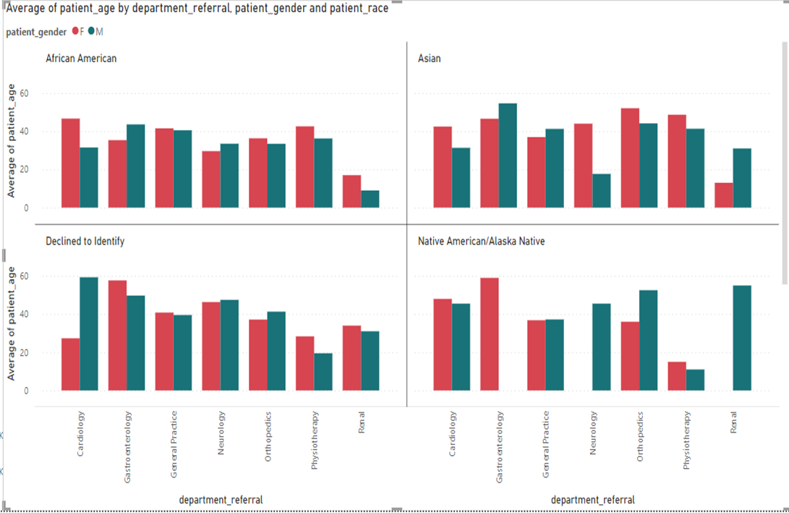
Insights from Subjective questions
Cardiology: female patient is more of race
African American , Asian and Native
American/Alaska Native.
Gastroenterology: the number of male
Patient in the race of Native American/
Alaska Native is null.
General practices: The number of male and
Female patient is almost equal.
Neurology: The no of female patient of
Native American /Alaska Native is null
Orthopedic: female patient are more in all
Races except native American / Alaska native
Physiotherapy: no of female is more in all races.
Renal: in native American only male patient.

Slide 14
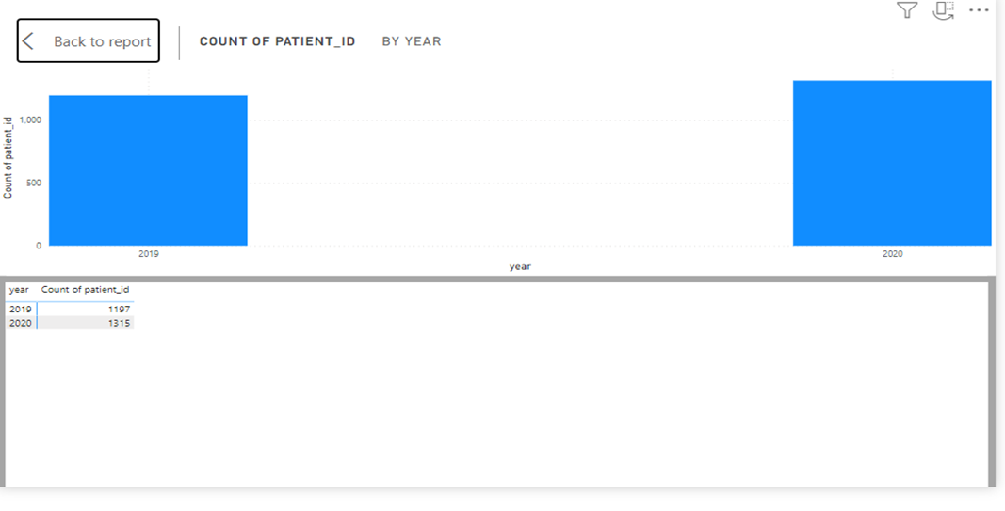
Insights from Subjective questions
The number of patients in year 2019 is 1197.
The number of patients in year 2020 is 1315.
There is 9.8% increment occurs in the number
of patient in an year.

Slide 15
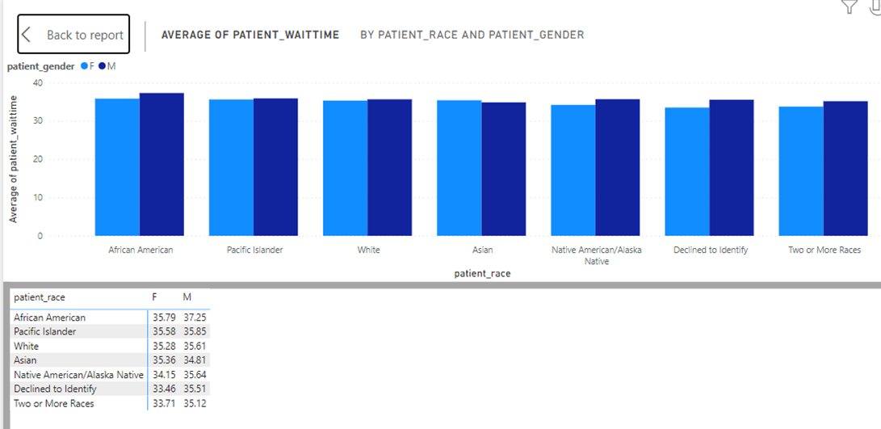
Insights from Subjective questions
Average of waiting time of male from all race
Is 34.76 and female is 35.68 means there is no
Discrimination by gender.
Renal: No of patients per doctors= 7
Physiotherapy: No of patients per doctors= 20
Neurology: No of patients per doctors= 17
General Practice: No of patients per doctors= 646
Orthopedics: No of patients per doctors= 72
Gastroenterology: No of patients per doctors= 13
Cardiology: No of patients per doctors= 23

Slide 16
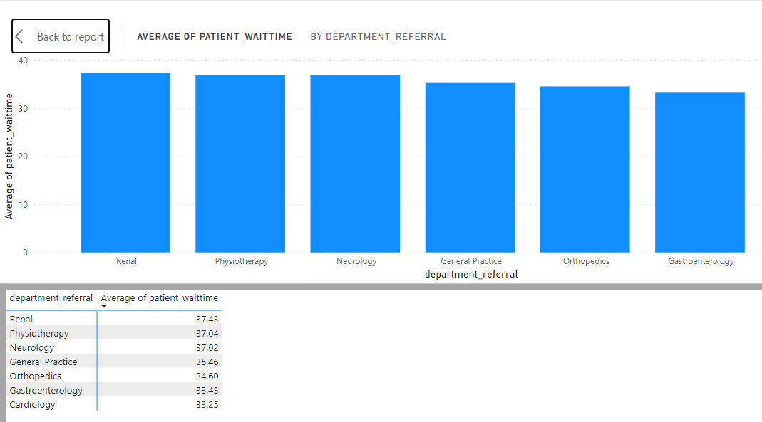
Insights from Subjective questions
The average waiting time is 35.46 and
hence all departments average waiting
time is closer to it there is not any oddly
large waiting time.

Slide 17
Reports
The hospital has asked for a report with three tabs:
Main Tab
2) Doctors’ Tab
3) Patients’ Tab

Slide 18
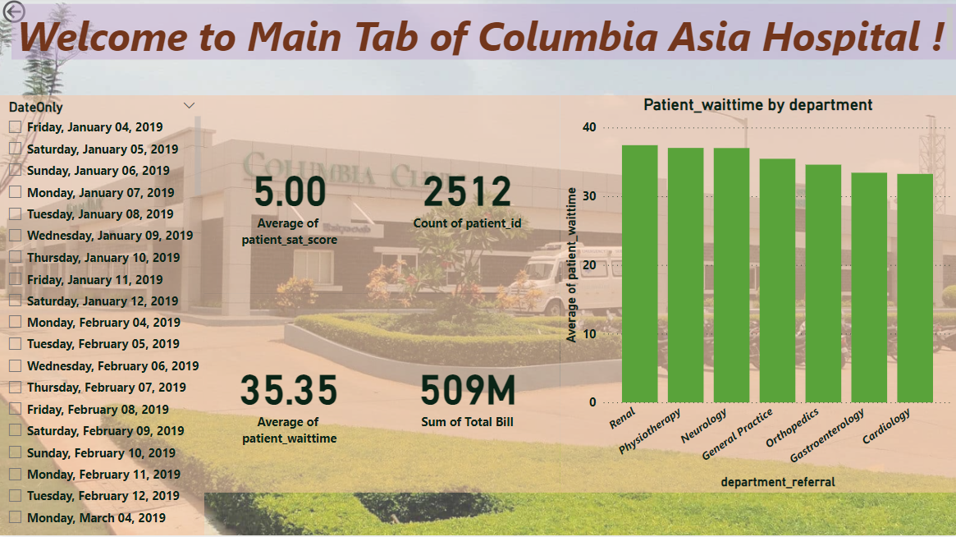
Main tab of Columbia asia hospital
Using the Main tab in the report, the hospital should be able to look at the overall metrics like the number of daily visits, revenue produced on that day, customer satisfaction, how busy are different departments on that day, and general waiting time on that day. This tab should have a slicer of date.

Slide 19
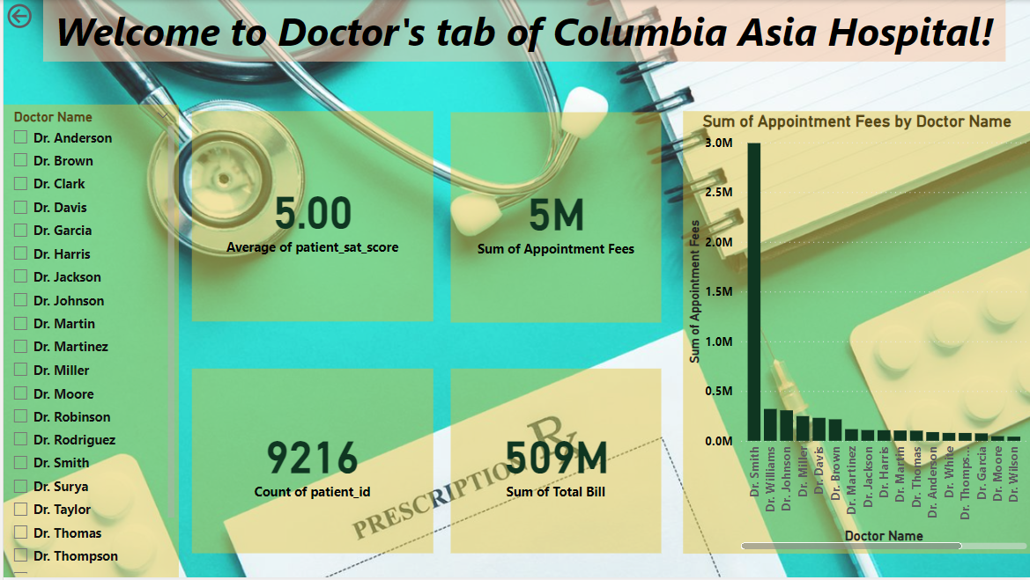
Doctor tab of Columbia asia hospital
Using the Doctors’ Tab, the Chief Of Staff at the hospital should be able to look at the individual doctor’s performance metrics like customer satisfaction, the number of patients he was visited by, the revenue he has generated, and his appointment fees. This tab should have a slicer of the Doctor's Name or ID.

Slide 20
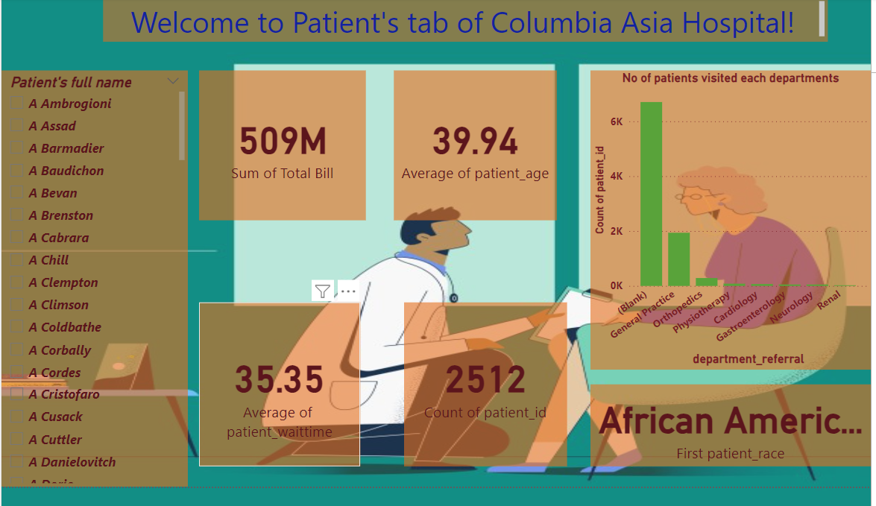
Patient tab of Columbia asia hospital
Using the Patients’ Tab, the Patient’s Care Chief at the hospital wants to look at a customer’s profile which would involve metrics like the most frequently visited department, their age, their race, their waiting time, number of visits, the total amount that they have paid to the hospital, etc. All the metrics using which they can address the patient very carefully in their visits. This tab should have a slicer of the Patient's Name or ID.

Slide 21
Conclusion
Columbia Asia Hospital is a moderately sized facility with a considerable number of patients per doctor. The appointment fees vary widely, and the satisfaction rate is below average, possibly indicating areas for improvement in patient care and services. The waiting time is relatively moderate.
To manage the high patient load effectively, I recommend hiring a general practitioner to handle a broad spectrum of medical issues and an orthopedic specialist to address musculoskeletal concerns. This approach ensures that patients receive specialized care while relieving the burden on existing staff, improving overall patient satisfaction.

Slide 22

keshav7295@gmail.com

