Slide 1
OBJECT ORIENTED PROGRAMMING IN JAVA (OOPs)

Slide 2
OOPs
The class is at the core of Java. It is the logical construct upon which the entire Java language is built because it defines the shape and nature of an object. As such, the class forms the basis for object-oriented programming in Java. Any concept you wish to implement in a Java program must be encapsulated within a class.

Slide 3
OOPs
Structured programming:
Algorithms + Data Structures = Programs
OOP reverses the order:
puts the data first, then looks at the algorithms to operate on the data.

Slide 4
Class
A class is the template or blueprint from which objects are made. Perhaps the most important thing to understand about a class is that it defines a new data type. Once defined, this new type can be used to create objects of that type. Thus, a class is a template for an object, and an object is an instance of a class. Because an object is an instance of a class, you will often see the two words object and instance used interchangeably.
A class is declared by using class keyword.

Slide 5
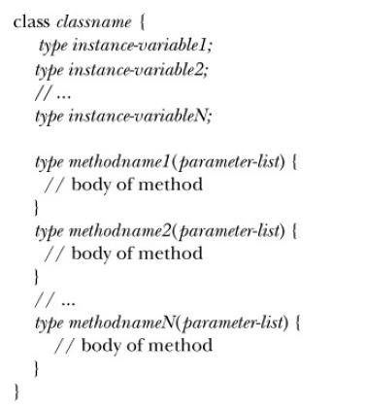
Class
Syntax:

Slide 6
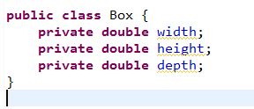
Class
Example:
As stated, a class defines a new type of data. In this case, the new data type is called Box. You will use this name to declare objects of type Box. It is important to remember that a class declaration only creates a template, it does not create an actual object. Thus, the preceding code does not cause any objects of type Box to come into existence.

Slide 8
Class
To actually create a Box object, you will use a statement like the following:
After this statement executes, mybox will be an instance of Box. Thus, it will have “physical” reality.
To assign the width variable of mybox the value 100
mybox.width = 100;

Slide 9
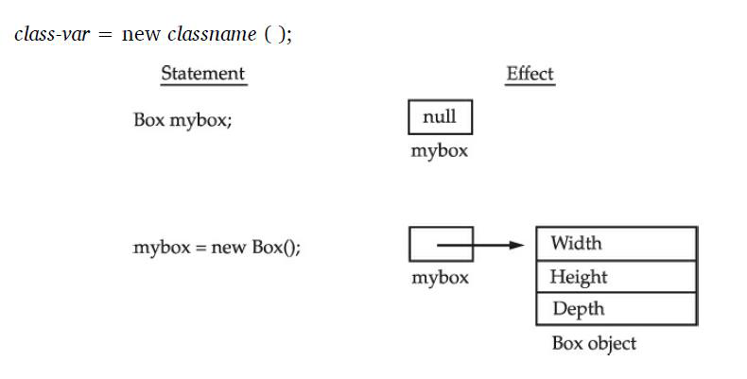
Class
Internal details of new operator:
the new operator dynamically allocates memory for an object. It has this general form:

Slide 10
Class
Here, class-var is a variable of the class type being created. The class name is the name of the class that is being instantiated. The class name followed by parentheses specifies the constructor for the class. A constructor defines what occurs when an object of a class is created. Constructors are an important part of all classes and have many significant attributes. Most real-world classes explicitly define their own constructors within their class definition. However, if no explicit constructor is specified, then Java will automatically supply a default constructor. This is the case with Box.

Slide 11
Objects
Objects represents the states and behaviors of class.
The three key characteristics of objects are:
object’s behavior—What can you do with this object, or what methods can you apply to it?
object’s state—How does the object react when you invoke those methods?
object’s identity—How is the object distinguished from others that may have the same behavior and state?

Slide 12
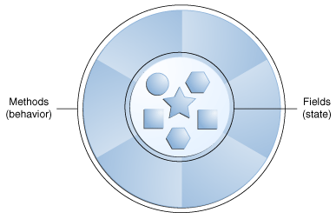
Objects
Fig. : A software object.

Slide 13
Objects
Syntax:
<class-name> ref-var = new <class-name>
Example:
for class Dog:
Dog myDog = new Dog();

Slide 14
Constructor
Constructor in java is a special type of method that is used to initialize the object.
Java constructor is invoked at the time of object creation. It constructs the values i.e. provides data for the object that is why it is known as constructor.

Slide 15
Rules for creating java constructor
There are basically two rules defined for the constructor.
1. Constructor name must be same as its class name .
2. Constructor must have no explicit return type .

Slide 16
Types of java constructors
There are two types of constructors:
1. Default constructor (no-arg constructor)
2. Parameterized constructor

Slide 17
Default Constructor
A constructor having no parameter is known as default constructor.
Syntax :
<class_name>(){ }

Slide 18
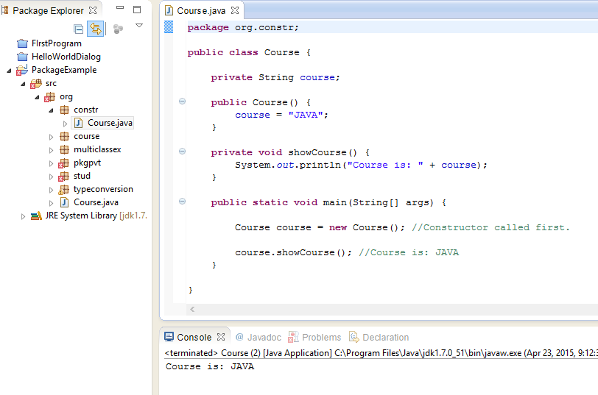
Example:

Slide 19
Q) What is the purpose of default constructor?
Default constructor provides the default values to the object like 0, null etc. depending on the data type.

Slide 20
Parameterized Constructor
A constructor having parameters is known as parameterized constructor.
Parameterized constructor is used to provide different values to the distinct objects.

Slide 21
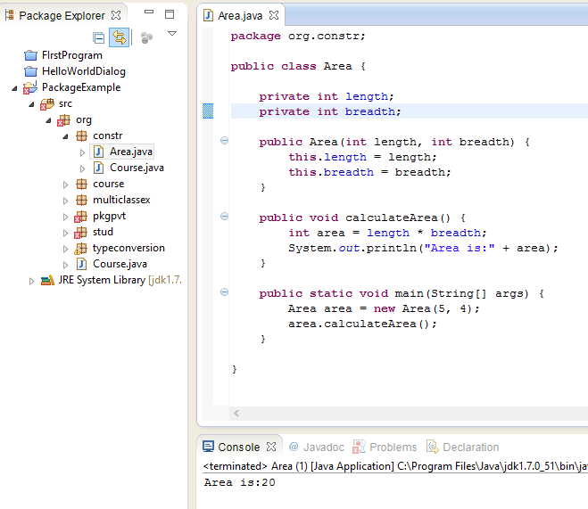
Example:

Slide 22
Constructor Overloading in Java
Constructor overloading is a technique in which a class can have any number of constructors that differ in parameter lists.
The compiler differentiates these constructors by taking into account the number of parameters in the list and their type.

Slide 23
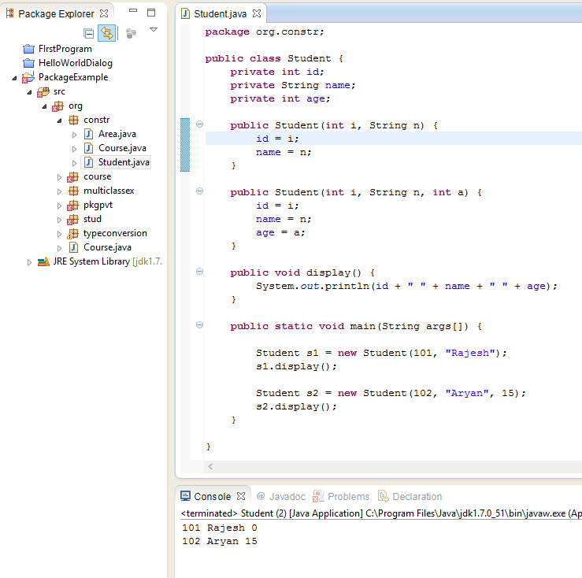
Example:

Slide 24
Difference between constructor and method in java
Java Constructor | Java Method
Constructor is used to initialize the state of an object. | Method is used to expose behaviour of an object.
Constructor must not have return type. | Method must have return type.
Constructor is invoked implicitly. | Method is invoked explicitly.
The java compiler provides a default constructor if you don't have any constructor. | Method is not provided by compiler in any case.
Constructor name must be same as the class name. | Method name may or may not be same as class name.

Slide 25
Q) Does constructor return any value?
yes, that is current class instance (You cannot use return type yet it returns a value).
Q)Can constructor perform other tasks instead of initialization?
Yes, like object creation, starting a thread, calling method etc. You can perform any operation in the constructor as you perform in the method.

Slide 26
‘this’ keyword in java
There can be a lot of usage of java this keyword.
In java, ‘this’ keyword represents the current object.

Slide 27
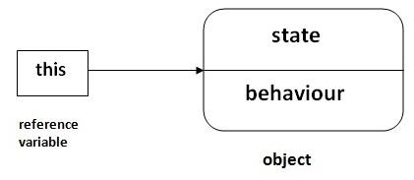
Usage of java this keyword
This keyword can be use to:
1. refer current class instance variable.
2. invoke current class constructor.
3. invoke current class method (implicitly)

Slide 28
The this keyword can be used torefer current class instance variable.
If there is ambiguity between the instance variable and parameter, this keyword resolves the problem of ambiguity.

Slide 29
Example:
1. class Student10{
2. int id;
3. String name;
4.
5. Student10(int id, String name){
6. id = id;
7. name = name;
8. }
9. void display(){System.out.println(id+" "+name);}
10.
11. public static void main(String args[]){
12. Student10 s1 = new Student10(111,"Karan");
13. Student10 s2 = new Student10(321,"Aryan");
14. s1.display();
15. s2.display();
16. }
17. }
Output:
0 null
0 null

Slide 30
In the above example, parameter (formal arguments) and instance variables are same that is why we are using this keyword to distinguish between local variable and instance variable.

Slide 31
Example
1. //example of this keyword
2. class Student11{
3. int id;
4. String name;
5.
6. Student11(int id,String name){
7. this.id = id;
8. this.name = name;
9. }
10. void display(){System.out.println(id+" "+name);}
11. public static void main(String args[]){
12. Student11 s1 = new Student11(111,"Karan");
13. Student11 s2 = new Student11(222,"Aryan");
14. s1.display();
15. s2.display();
16. }
17. }
Output:
111 Karan
222 Aryan

Slide 32
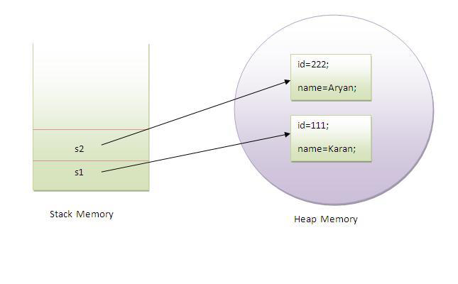

Slide 33
Program where this keyword is not required
If local variables(formal arguments) and instance variables are different, there is no need to use this keyword like in the following program:

Slide 34
Example:
1. class Student12{
2. int id;
3. String name;
4.
5. Student12(int i, String n){
6. id = i;
7. name = n;
8. }
9. void display(){System.out.println(id+" "+name);}
10. public static void main(String args[]){
11. Student12 e1 = new Student12(111,"karan");
12. Student12 e2 = new Student12(222,"Aryan");
13. e1.display();
14. e2.display();
15. }
16. }
Output:
111 Karan
222 Aryan

Slide 35
this() can be used to invoked current class constructor.
The this() constructor call can be used to invoke the current class constructor (constructor chaining). This approach is better if you have many constructors in the class and want to reuse that constructor.

Slide 36
Example:
1. //Program of this() constructor call (constructor chaining)
3. class Student13{
4. int id;
5. String name;
6. Student13(){System.out.println("default constructor is invoked");}
7.
8. Student13(int id, String name){
9. this ();//it is used to invoked current class constructor.
10. this.id = id;
11. this.name = name;
12. }
13. void display(){System.out.println(id+" "+name);}
14.
15. public static void main(String args[]){
16. Student13 e1 = new Student13(111,"karan");
17. Student13 e2 = new Student13(222,"Aryan");
18. e1.display();
19. e2.display();
20. }
21. }
Output:
default constructor is invoked
default constructor is invoked
111 Karan
222 Aryan

Slide 37
Rule: Call to this() must be the first statement in constructor.
1. class Student15{
2. int id;
3. String name;
4. Student15(){System.out.println("default constructor is invoked");}
5.
6. Student15(int id, String name){
7. id = id;
8. name = name;
9. this ();//must be the first statement
10. }
11. void display(){System.out.println(id+" "+name);}
12.
13. public static void main(String args[]){
14. Student15 e1 = new Student15(111,"karan");
15. Student15 e2 = new Student15(222,"Aryan");
16. e1.display();
17. e2.display();
18. }
19. }
Output:Compile Time Error

Slide 38
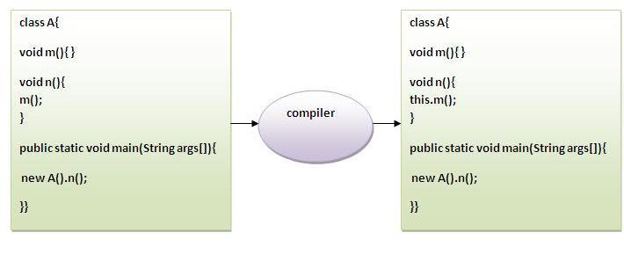
The this keyword can be used to invoke current class method (implicitly).
We may invoke the method of the current class by using the this keyword. If you don't use the this keyword, compiler automatically adds this keyword while invoking the method.
Let's see the example :

Slide 39
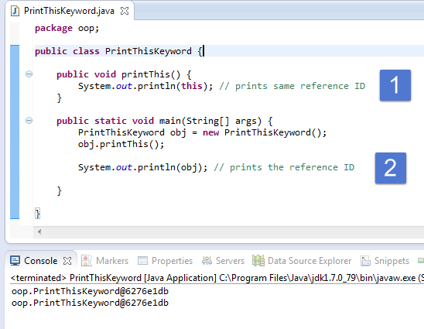
Let’s Prove this keyword
Let's prove that this keyword refers to the current class instance variable. In this program, we are printing the reference variable and this, output of both variables are same.

Slide 40
Java static keyword
The static keyword in java is used for memory management mainly. We can apply java static keyword with variables, methods, blocks and nested class. The static keyword belongs to the class than instance of the class.
The static can be:
1. variable (also known as class variable)
2. method (also known as class method)
3. block
4. nested class

Slide 41
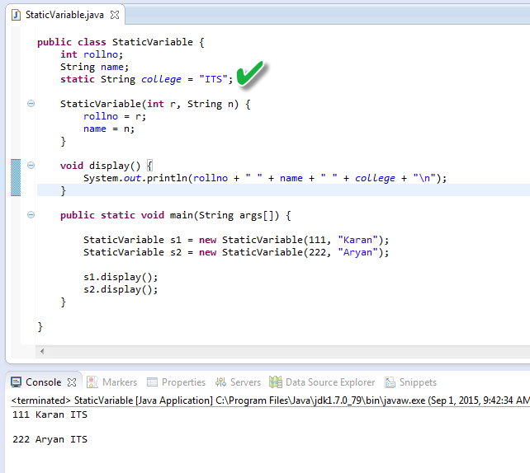
Example of static variable
Java static property is shared to all objects

Slide 42
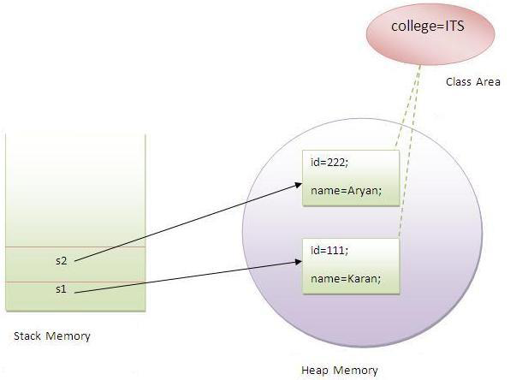
Example:

Slide 43
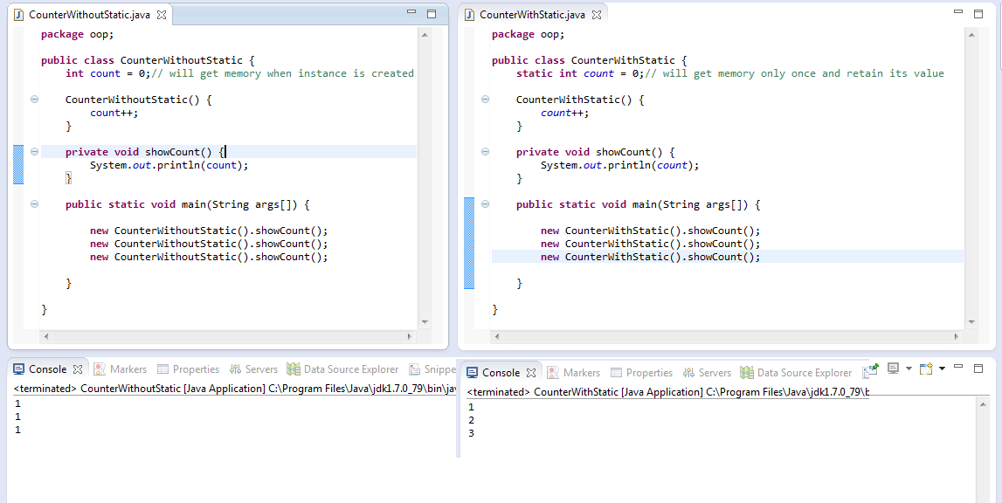
Program of counter with/without static variable
Without Static Variable: Variable will get memory when object is created.
With Static Variable: Variable will get memory when class is loaded and retain its value.

Slide 44
Java static method
If we apply static keyword with any method, it is known as static method.
A static method belongs to the class rather than object of a class.
A static method can be invoked without the need for creating an instance of a class.
static method can access static data member and can change the value of it.

Slide 45
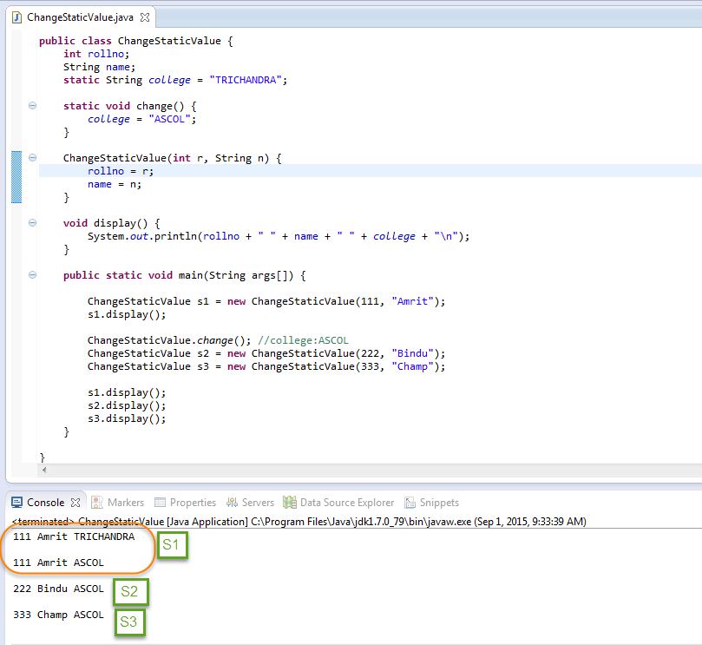
Example:

Slide 46
Some Restrictions for static method
1. The static method can not use non static data member or call non-static method directly.
2. this and super cannot be used in static context.

Slide 47
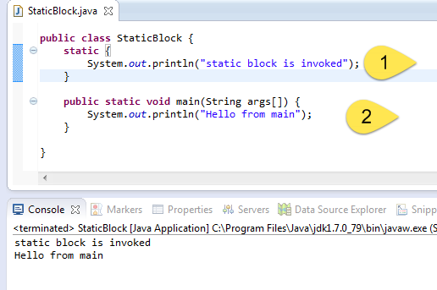
Java static block
Is used to initialize the static data member.
It is executed before main method at the time of class loading.

Slide 48
Q) Can we execute a program without main() method?
Yes, one of the way is static block but in previous version of JDK not in JDK 1.7.
class A3{
static{
System.out.println("static block is invoked");
System.exit(0);
}
}
Output: static block is invoked (if not JDK7)
Output:Error: Main method not found in class A3, please define the main method as: public static void main(String[] args)

Slide 49
Encapsulation
Encapsulation in Java is a mechanism of wrapping the data (variables) and code acting on the data (methods) together as a single unit also known as
data binding
In encapsulation the variables of a class will be hidden from other classes, and can be accessed only through the methods of their current class, therefore it is also known as data hiding.

Slide 50
Encapsulation
To achieve encapsulation in Java:
Declare the variables of a class as private.
Provide public setter and getter methods to modify and view the variables values.

Slide 51
Example:

Slide 52
Inheritance in Java
Inheritance in java is a mechanism in which one object acquires all the properties and behaviors of parent object.
The idea behind inheritance in java is that you can create new classes that are built upon existing classes.
When you inherit from an existing class, you can reuse methods and fields of parent class, and you can add new methods and fields also.

Slide 53
Inheritance in Java
Inheritance represents the IS-A relationship, also known as parent-child relationship.
Why use inheritance in java ?
For Method Overriding (so runtime polymorphism can be achieved).
For Code Reusability.

Slide 54
Syntax of Java Inheritance
class <Subclass-name> extends <Superclass-name> {
//methods and fields
}
The extends keyword indicates that you are making a new class that derives from an existing class.
In the terminology of Java, a class that is inherited is called a super class. The new class is called a subclass.

Slide 55
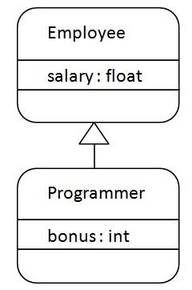
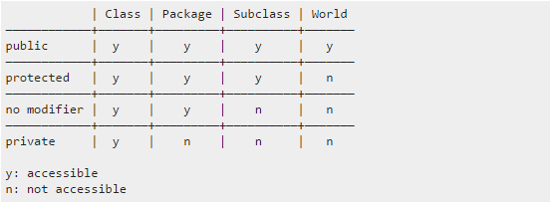
Understanding the simple example of inheritance

Slide 56
As displayed in the above figure, Programmer is the subclass and Employee is the super-class.
Relationship between two classes is Programmer IS-A Employee.
It means that Programmer is a type of Employee.

Slide 57
Example:
1. class Employee{
2. float salary=40000;
3. }
4. class Programmer extends Employee{
5. int bonus=10000;
6. public static void main(String args[]){
7. Programmer p=new Programmer();
8. System.out.println("Programmer salary is:"+p.salary);
9. System.out.println("Bonus of Programmer is:"+p.bonus);
10. }
11. }
Output:
Programmer salary is: 40000.0
Bonus of programmer is:10000
In the above example, Programmer object can access the field of own class as well as of Employee class i.e. code reusability.

Slide 58
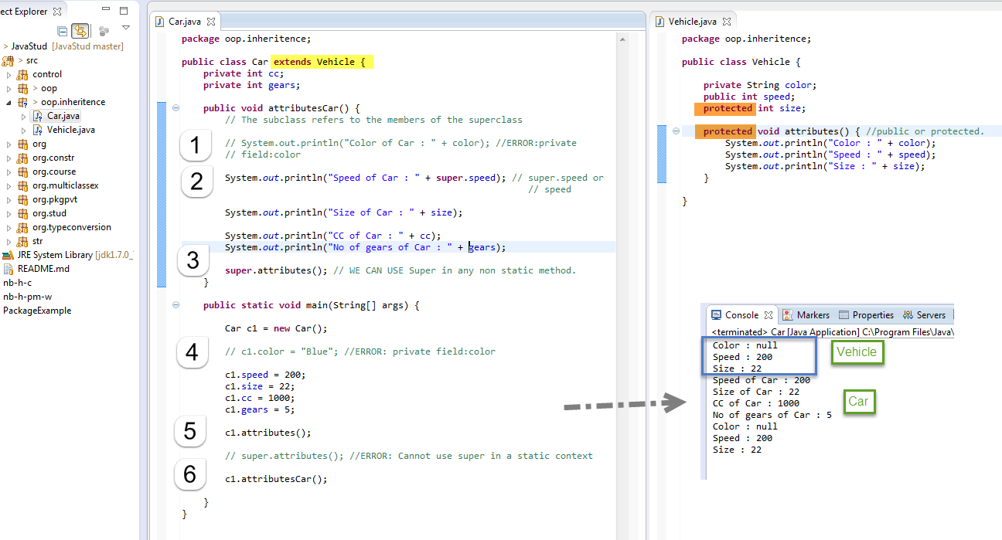
Example:

Slide 59
Types of Inheritance in java
On the basis of class, there can be three types of inheritance in java:
single,
multilevel and
hierarchical.
Note: Multiple inheritance is not supported in java through class.
In java programming, multiple and hybrid inheritance is supported through interface only. We will learn about interfaces later.

Slide 60
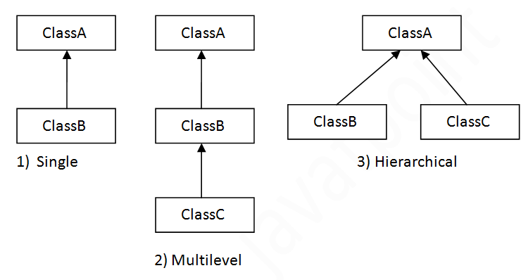
Types of Inheritance in java

Slide 61
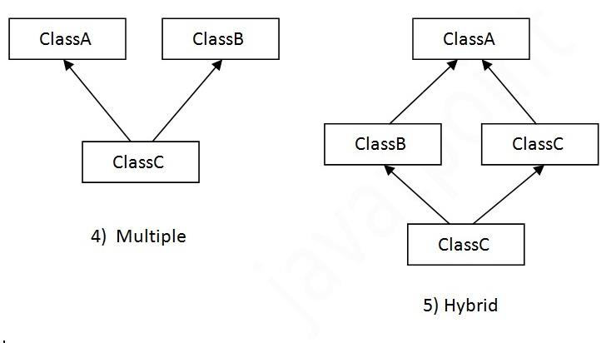
When a class extends multiple classes i.e. known as multiple inheritance.
For Example:

Slide 62
Q) Why multiple inheritance is not supported in java?
To reduce the complexity and simplify the language, multiple inheritance is not supported in java.
Consider a scenario where A, B and C are three classes. The C class inherits A and B classes. If A and B classes have same method and you call it from child class object, there will be ambiguity to call method of A or B class.
Since compile time errors are better than runtime errors, java renders compile time error if you inherit 2 classes. So whether you have same method or different, there will be compile time error now.

Slide 63
Example:
1. class A{
2. void msg(){System.out.println("Hello");}
3. }
4. class B{
5. void msg(){System.out.println("Welcome");}
6. }
7. class C extends A,B{//suppose if it were
8.
9. Public Static void main(String args[]){
10. C obj=new C();
11. obj.msg();//Now which msg() method would be invoked?
12. }
13. }
Compile Time Error

Slide 64
Method Overloading in Java
If a class have multiple methods by same name but different parameters, it is known as Method Overloading.
If we have to perform only one operation, having same name of the methods increases the readability of the program.
Suppose you have to perform addition of the given numbers but there can be any number of arguments, if you write the method such as a(int,int) for two parameters, and b(int,int,int) for three parameters
then it may be difficult for you as well as other programmers to understand the behavior of the method because its name differs. So, we perform method overloading to figure out the program quickly.

Slide 65
Different ways to overload the method
1. By changing number of arguments
2. By changing the data type
Method Overloading is not possible by changing the return type of the method.

Slide 66
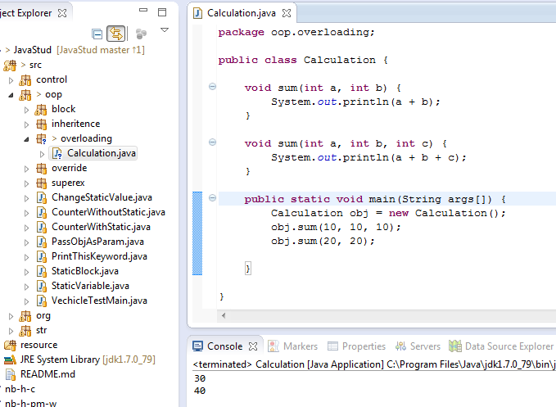
Example :
Method Overloading by changing the no. of arguments
In this example, we have created two overloaded methods, first sum method performs addition of two numbers and second sum method performs addition of three numbers.

Slide 67
Example:
Method Overloading by changing data type of argument
In this example, we have created two overloaded methods that differs in data type. The first sum method receives two integer arguments and second sum method receives two double arguments.

