Slide 1
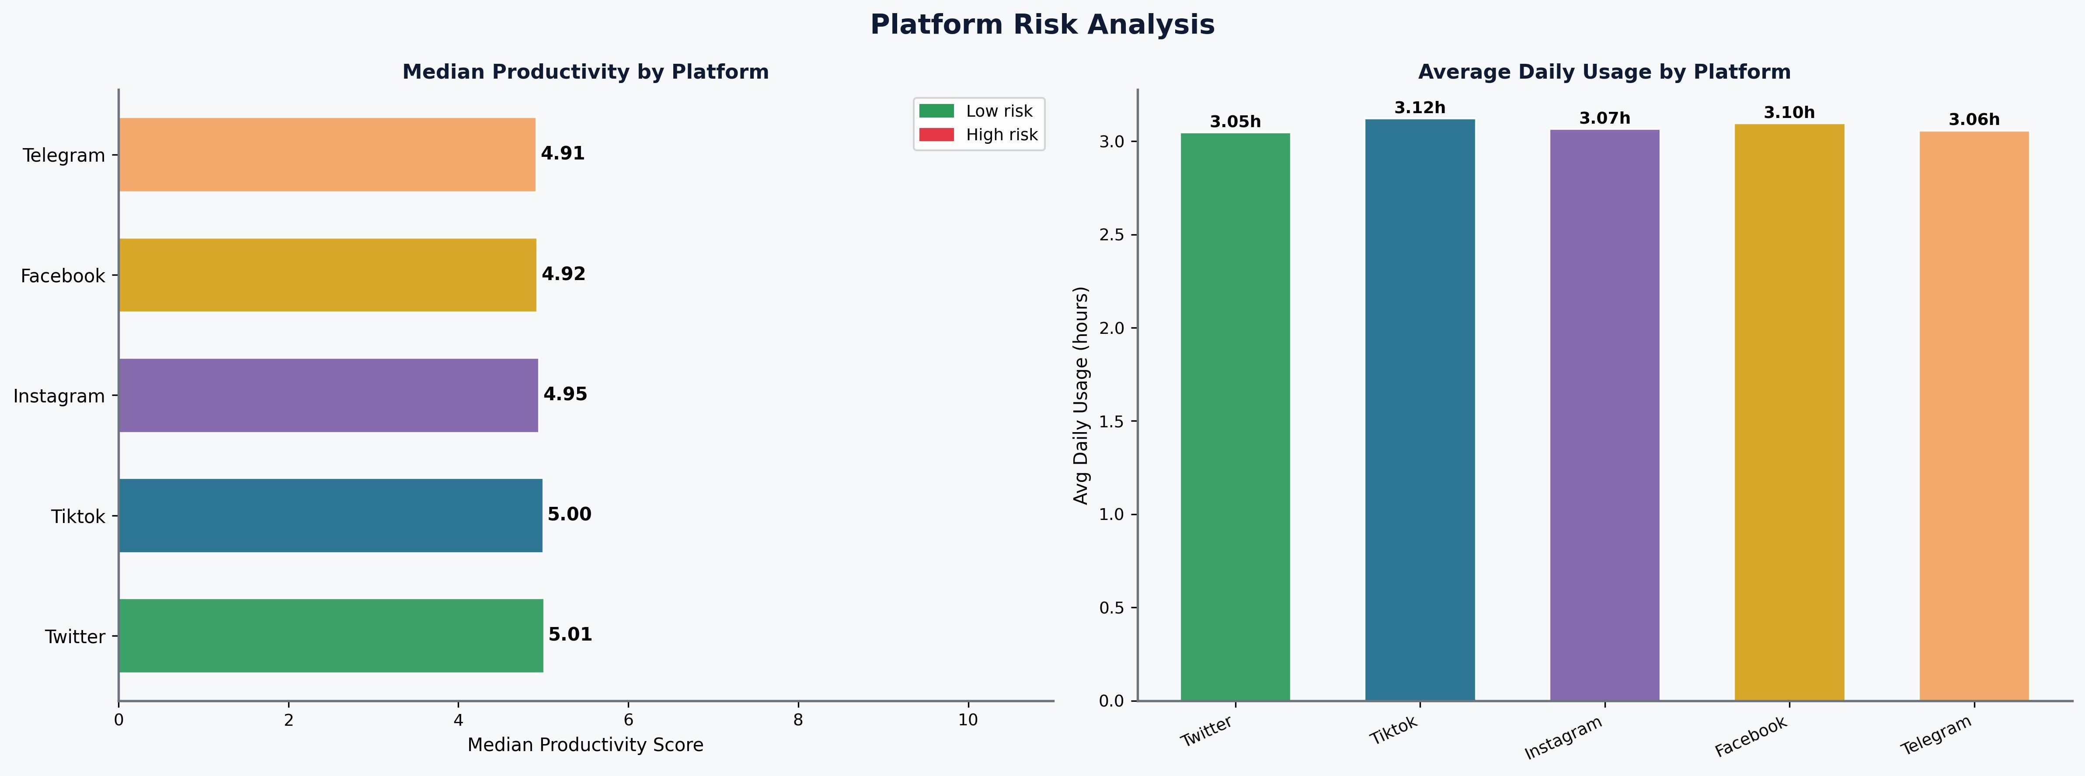
MSc Data Science · York St John University, London · June 2026
Social Media vs Productivity
A Comprehensive Data Science Investigation
Behavioural Patterns · Machine Learning Prediction · Evidence-Based Recommendations · 30,000 Participants
30,000
R²=0.7766
75.9%
r=+0.874
r=−0.007
3.75×
Participants
RF Regressor
Accuracy
Job Satisfaction
SM Usage
At-Risk Stress
1
🎯
AIM
3
📊
KEY VISUAL INSIGHTS
4
🤖
PREDICTIVE ANALYSIS
To investigate the relationship between social media usage and workplace/academic productivity, identifying the conditions under which social media becomes harmful and what protective factors exist.
Finding Highlights
Model Performance
r = −0.007
r = +0.874
RF Regressor R²
0.7766
SM usage alone vs productivity — near-zero. Harm is mediated, not direct.
Job satisfaction dominates — ~79% of RF feature importance.
5-Fold CV R² (±0.0028)
0.7769
2
🗄️
DATASET & PREPARATION
Ridge Regression R²
0.7619
~4h / day
1.1%
MAE / RMSE
0.685 / 0.864
30,000
records
Tipping point — flat below 4h, non-linear acceleration above.
Doomscrolling risk cohort. Wellbeing app = +1.4% recovery.
Classifier Accuracy
75.9%
Weighted F1-Score
0.76
19
raw variables
K-Means Silhouette (k=3)
0.55
32+
engineered features
Platform Risk Analysis — Actual EDA Output
⚡ RF explains 77.66% variance — strong for multifactorial behavioural data
7
novel features
Feature Importance — RF Regressor (Top 5)
job_satisfaction
0.795
Source: Mashayekhi (2024) Kaggle dataset · KNN imputation · Winsorisation 1–99% · 6 validation assertions
sleep_hours
0.016
work_hours
0.017
5
💡
KEY FINDINGS
notification_pressure
0.012
digital_addiction_idx
0.011
👥
Social media does not independently harm productivity
Job satisfaction alone explains ~79.5% of RF importance — dominates all digital behaviour features.
Near-zero bivariate r = −0.007 between daily usage and actual productivity score.
Twitter: 5.01 (highest) · Telegram: 4.91 (lowest) · All platforms near-identical (4.91–5.01). Usage 3.05–3.12h/day.
7
⚠️
LIMITATIONS
🏆
Job satisfaction is the dominant driver
Usage × Stress → Productivity (Mean Score)
Cross-sectional
Causation cannot be established — reverse causality possible.
r = +0.874 — far greater impact than any digital behaviour variable.
< 2h
Low stress
Med stress
High stress
Tipping point at ~4h/day usage
8.4
7.6
6.2
Self-report bias
Usage underestimated ~20–30% vs device logs.
🌍
Effect is flat below 4h then non-linearly accelerates. TikTok/Instagram show highest usage (3.07–3.12h/day).
2–4h
7.1
6.0
5.2
Generalisability
No country/occupation detail beyond broad job-type.
Sleep loss amplifies social media harm
4–8h
6.0
5.0
4.1
Model overfitting
RF training R²≈0.97 vs validation R²≈0.78.
⚖️
> 8h
5.2
4.3
3.2
Synthetic data
Near-zero correlations suggest limited real-world structure.
Optimal 7–8h sleep → productivity 8.0/10. Below 5h → 4.2/10. Synergistic not additive.
Best: <2h + low stress = 8.4/10 | Worst: >8h + high stress = 3.2/10
8
RECOMMENDATIONS
📈
At-Risk cluster: hidden burnout
Sleep Hours vs Productivity
✅
3.75× higher stress than Balanced users, identical output — unsustainable performance.
< 5h ⚠
4.2
5–6h
5.5
FOR INDIVIDUALS
6–7h
6.6
Protect 7–8h sleep — primary mediator of harm
6
🏁
CONCLUSION
7–8h ✓
8.0
> 8h
7.6
Optimal 7–8h sleep → mean productivity 8.0/10. Below 5h → 4.2/10. Sleep loss is the primary mediator of social media harm.
Keep usage under 2h/day; monitor DAI score
"Social media is a conditional amplifier — not an independent cause — of productivity loss."
User Personas — K-Means Clustering (k=3, Silhouette=0.55)
Address stress first — greater gains than usage restriction
BALANCED
AT-RISK
MODERATE
High usage
→
Sleep loss
→
Low output
Stress: 2.36
Stress: 8.82
Stress: 5.84
Prod: 4.95
Prod: 4.96
Prod: 4.96
The strongest predictor is job satisfaction (r=+0.874). Evidence-based interventions: protect sleep, address stress, improve job satisfaction.
Low usage · healthy sleep
3.75× higher stress
Best for intervention
FOR EMPLOYERS
Invest in job satisfaction (r=+0.874) — highest ROI
Screen stress+sleep+usage combined, not usage alone
Structured comms windows reduce Notification Pressure
FOR PLATFORM DESIGNERS
Design for intentional engagement — usage feedback
Default night-mode & DND to opt-out, not opt-in
Surface proactive break prompts for doomscrollers

