Slide 1

CS6316 Machine Learning Practical Project Key Results and Improvements
Keshara Weerasinghe, Jiho Lee, Rishabh Jain

Slide 2
Logistic Regression
Results and Analysis
* Weak regularization leads to overfitting
* Strong regularization leads to underfitting

Slide 3
K Nearest Neighbor
Results & Analysis
1 neighbor leads to overfitting – perfect accuracy on training
Large number of neighbors leads to underfitting

Slide 4
Decision Tree
Results & Analysis

Slide 5
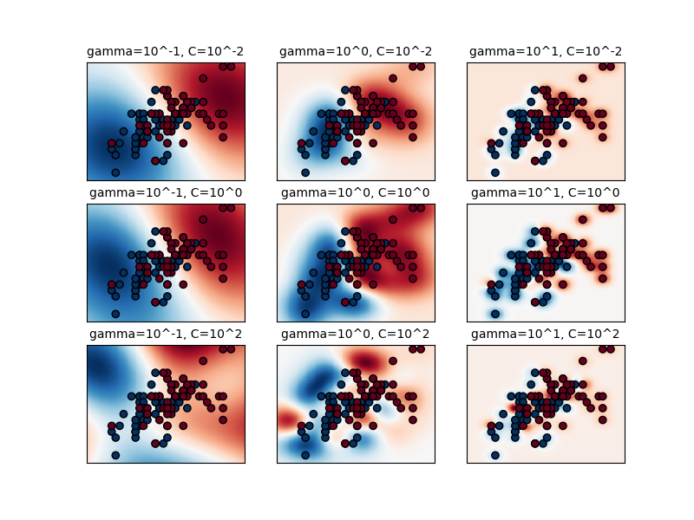
SVM – Support Vector Machines
Results & Analysis
Accuracy
Precision
Recall
F1 Score Graphs here..
Large value of C leads to overfitting
Small value of C leads to underfitting
Image Credits: Scikit learn RBF SVM Parameter Tuning

Slide 6
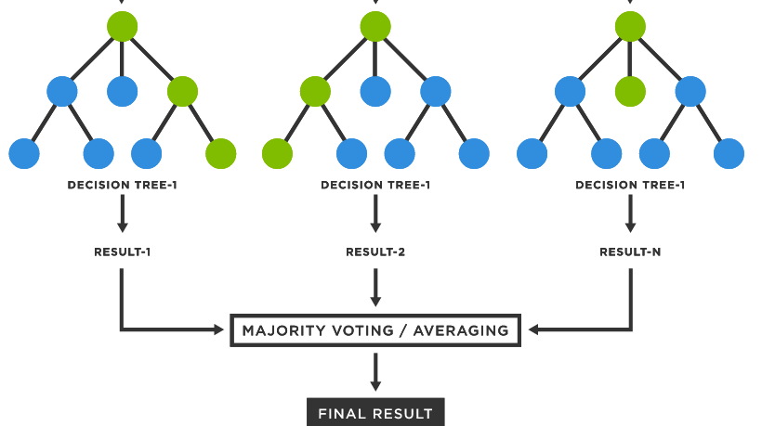
Random Forest
Results & Analysis
Accuracy
Precision
Recall
F1 Score Graphs here..
Large value of C leads to overfitting
Small value of C leads to underfitting
Image Credits: TIBCO Random Forest Glossary

Slide 7
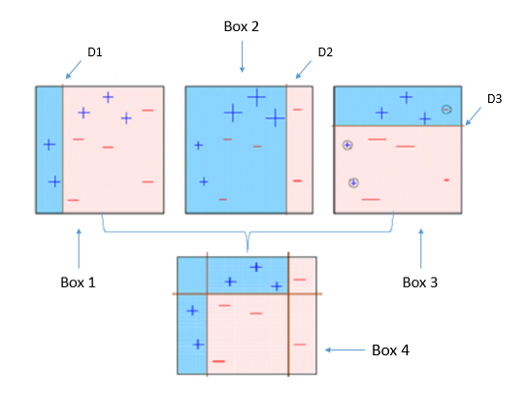
Boosting
Results & Analysis
Accuracy
Precision
Recall
F1 Score Graphs here..
Large value of C leads to overfitting
Small value of C leads to underfitting
Image Credits: Akash Desarda – Towards Data Science

Slide 8
Neural Networks

