Slide 1
The Science Of Happiness
Role of Personality traits in the Happiness, Creativity and Versatility of undergraduates
Shuvam Keshari
(Under the guidance of Prof. R Guha)

Slide 2
What is happiness?
Happiness is the ONLY thing that humans desire for ITS own sake, It’s the end node of all desires—riches, relationships, honor or health.
Nicomachean Ethics,
350 BCE, Aristotle

Slide 3
When we are talking of science, how can we not talk about Einstein
Einstein scribbled his theory of happiness in place of a tip to a messenger.
Recently it sold for more than $1 million !!

Slide 4

So what had he to say?
“A calm and modest life brings more happiness than the pursuit of success combined with constant restlessness”

Slide 5
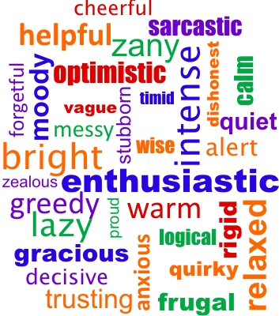
Personality traits therefore become vital for the study of happiness
In this regard we shall be
addressing these questions:-
1. Are some kinds of people
happier than others?
2. Is happiness linked to creativity?
3. Do personality traits affect
Creativity and Versatility?

Slide 6
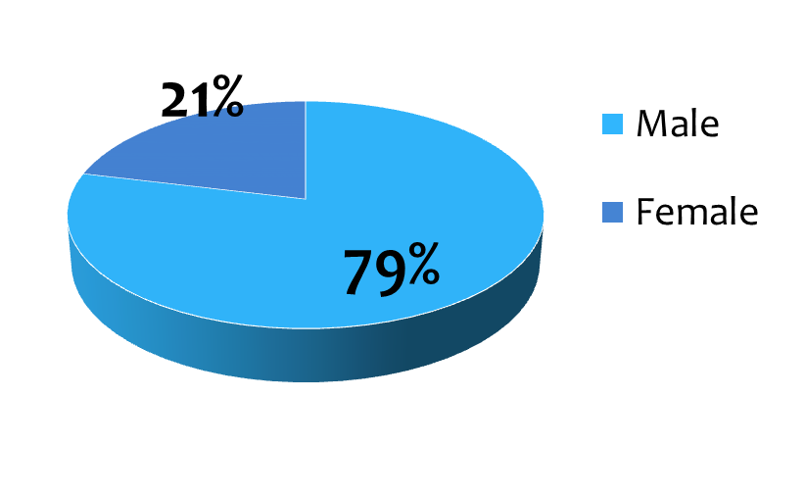
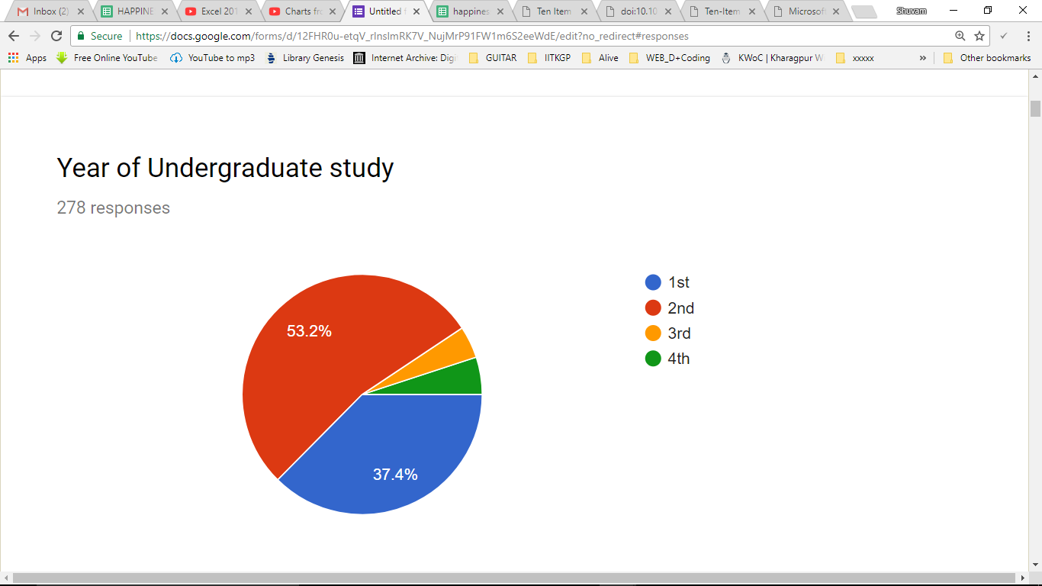
Plan of Study
Sample space for
the research
N=278

Slide 7
Methodology
A Questionnaire was made for addressing several aspects. It included :
the 10-item personality inventory (developed by Sam Gosling, University of Texas).
Life Satisfaction Index questionnaire.
Happiness, creativity and versatility rating.
Demographical questions.
Then the data was analyzed, comparisons were made and the conclusions were drawn
as mentioned in the following slides.

Slide 8
Results and discussion
Certain General results

Slide 9
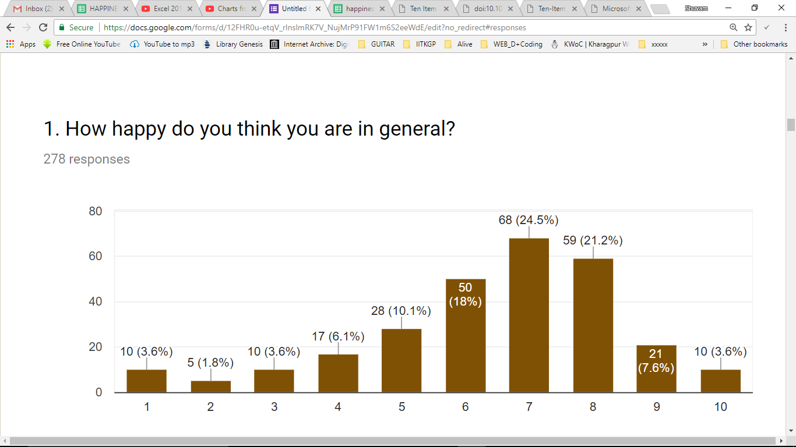
Happiness in General

Slide 10
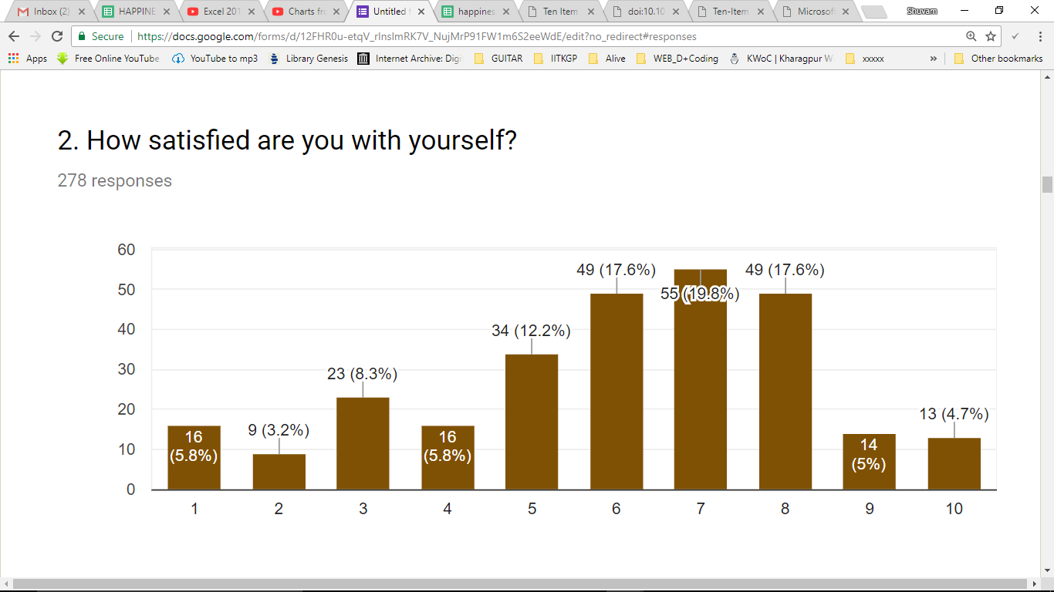
Satisfaction

Slide 11
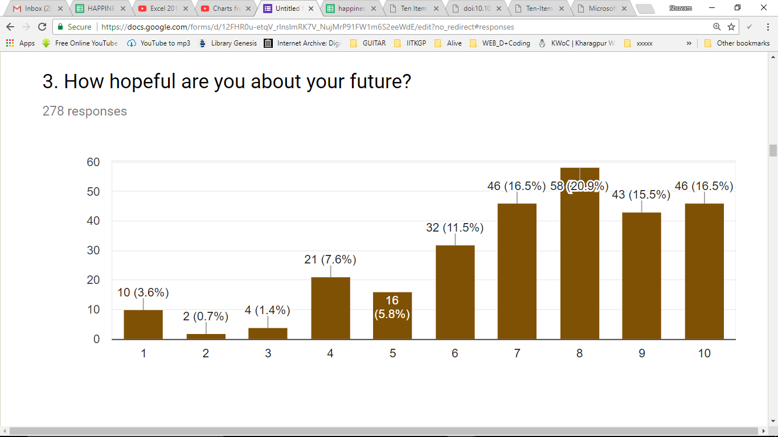
Hopefulness about the future

Slide 12
The Analysis
With respect to personality traits

Slide 13
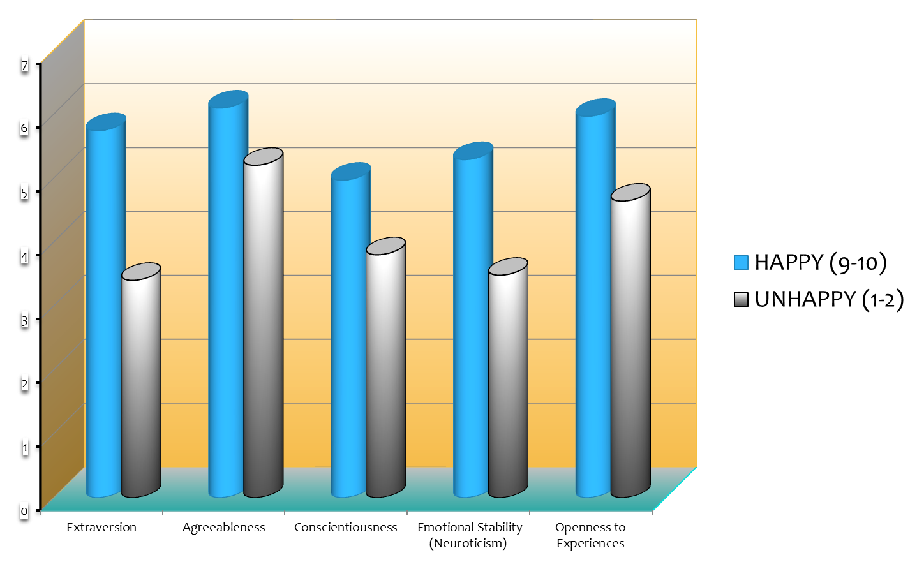
HAPPY v/s UNHAPPY
7
6
5
4
3
2
1
0

Slide 14
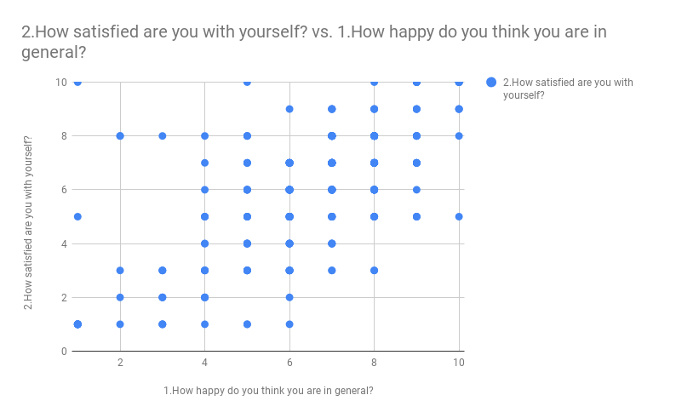
Satisfaction v/s Happiness
Shows approximately a LINEAR trend

Slide 15
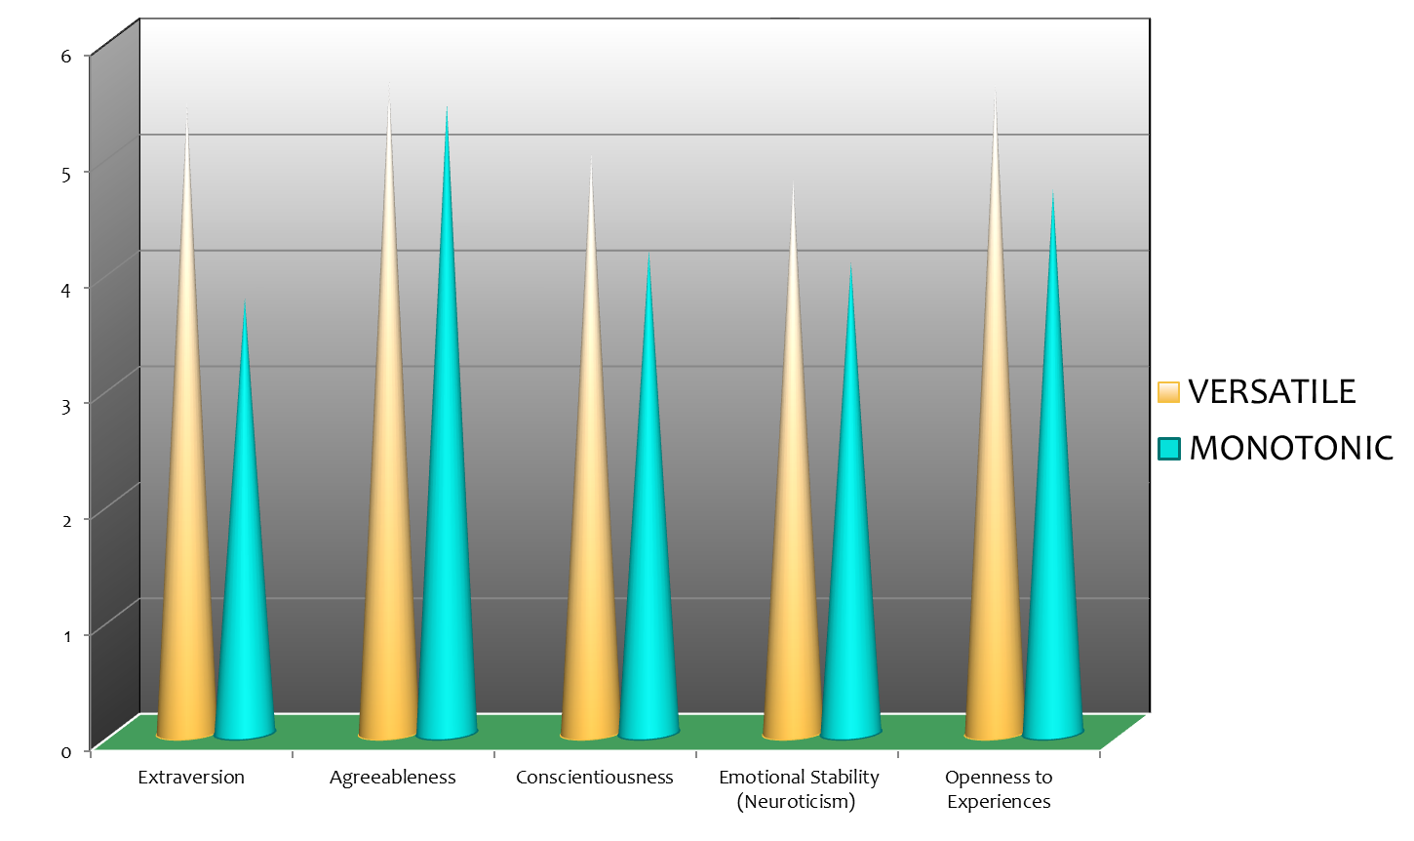
“ALL ROUNDERS” v/s “NERDS”
6
5
4
3
2
1
0
Agreeableness seems
to be independent

Slide 16
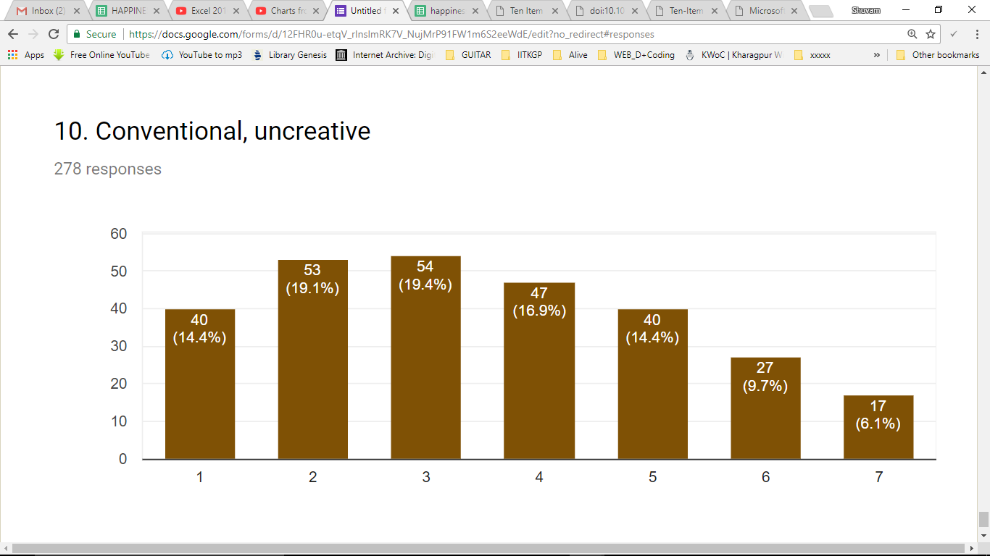
Is Creativity diminishing over time?
It was found that more undergraduates are
having a conventional and Un-creative outlook

Slide 17
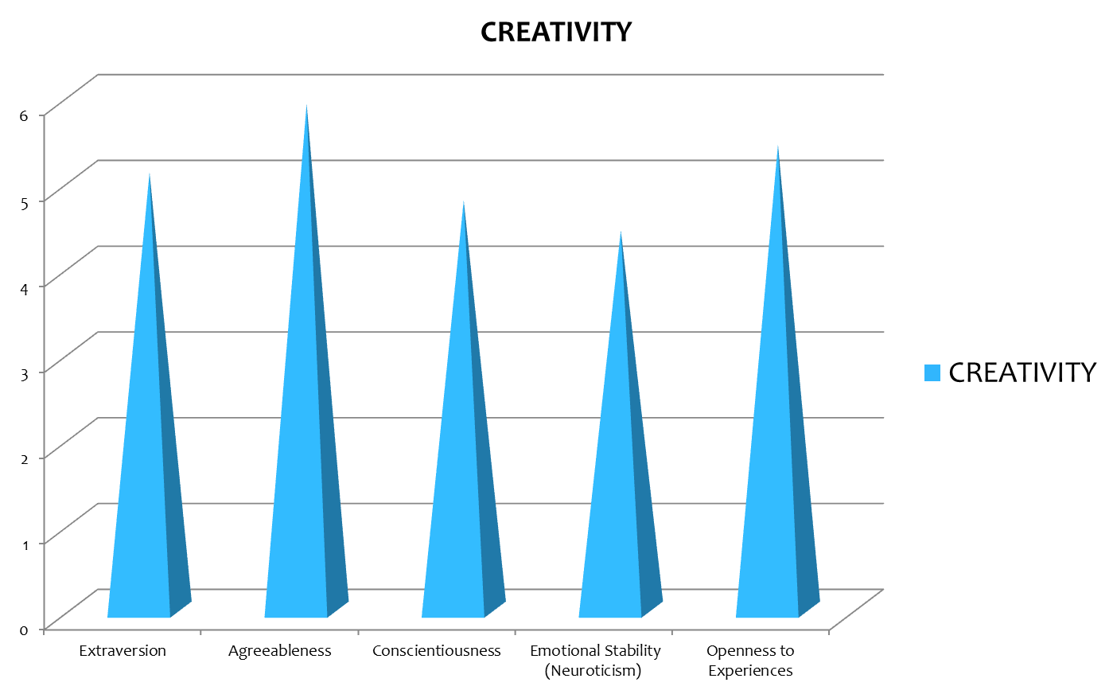
CREATIVITY
Traits observed
for creative
people

Slide 18
A by-product of this research
Sympathy

Slide 19
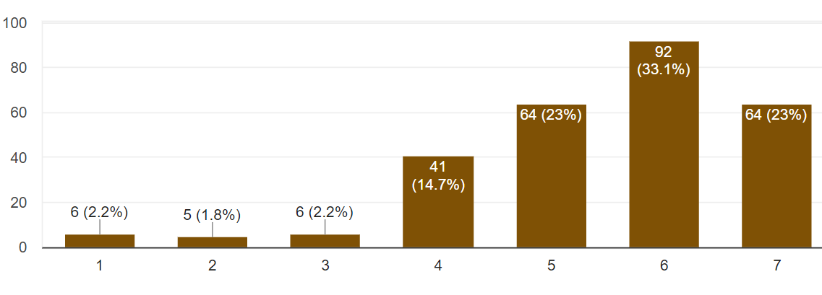
Being Sympathetic
This is the distribution of sympathetic
and warm people on a scale of 7

Slide 20
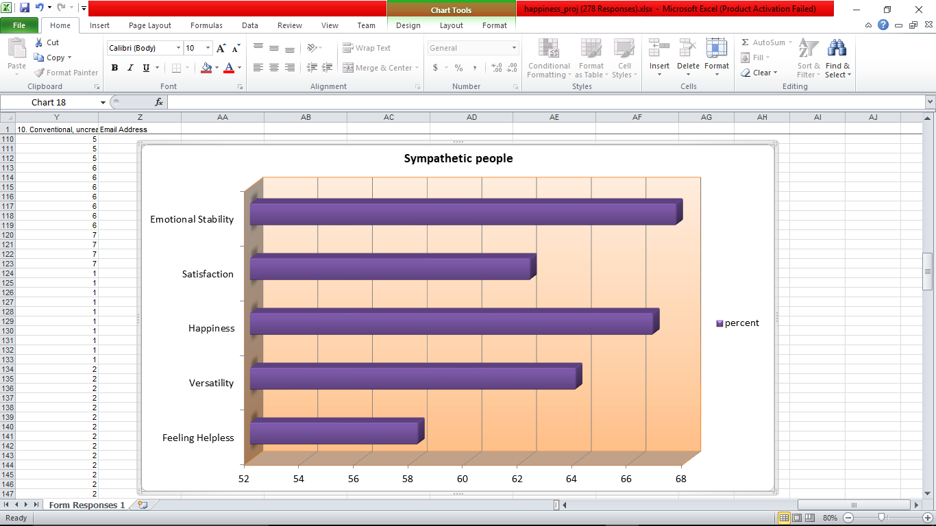
So what about sympathetic people ?

Slide 21
Conclusions
1. The peak of both the happiness and satisfaction curve occurs at around 70%.
2. Also Satisfaction is approximately linearly proportional to happiness.
3. Most of the undergraduates are very optimistic of the future.
4. Happy undergraduates have all traits higher than unhappy ones.
5. Difference in Extraversion is highest for happy and unhappy undergraduates
6. Versatile undergrads have much higher Extraversion than the others
7. Agreeableness is the highest for both versatility and creativity.
8. However, Versatility seems to be independent of agreeableness.
9. Creativity is diminishing in undergraduates.
10. Almost all the undergraduates claimed to be sympathetic and warm to others.

Slide 22
THANK YOU !!

Slide 23
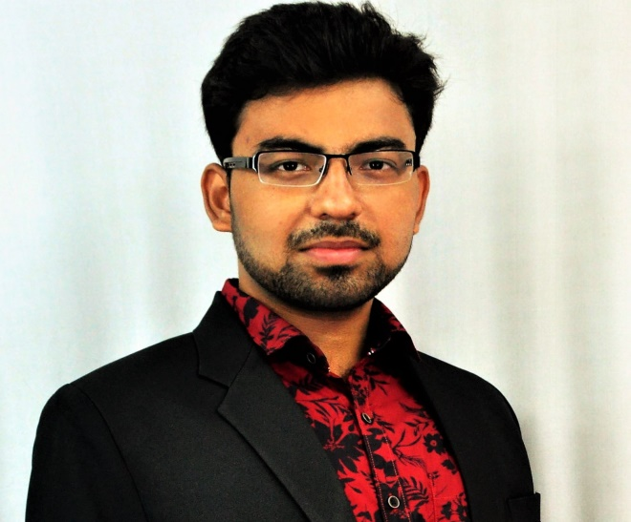
Shuvam Keshari
2nd year undergraduate
Dept. of Electrical Engineering
IIT Kharagpur

Slide 24
References
https://gosling.psy.utexas.edu/scales-weve-developed/ten-item-personality-measure-tipi/
https://en.wikipedia.org/wiki/Happiness
Gosling, S. D., Rentfrow, P. J., & Swann, W. B., Jr. (2003). A Very Brief Measure of the Big Five Personality Domains. Journal of Research in Personality, 37, 504-528.

