Slide 1
INFO_6105 Project Report
Kaggle Dataset - https://www.kaggle.com/paultimothymooney/chest-xray-pneumonia
Keshav K L
NUID - 001023885

Slide 2
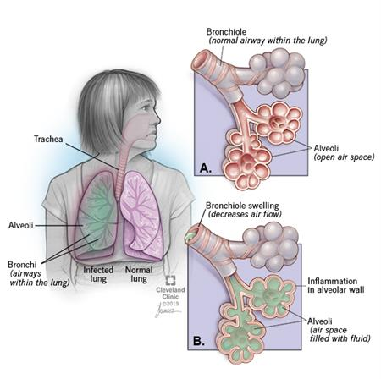
Pneumonia detection using deep learning
What is pneumonia?
Pneumonia is an infection of the lungs
Alveoli fill with fluid, making breathing more difficult.
Pneumonia is detected using X-Ray images of the chest

Slide 3
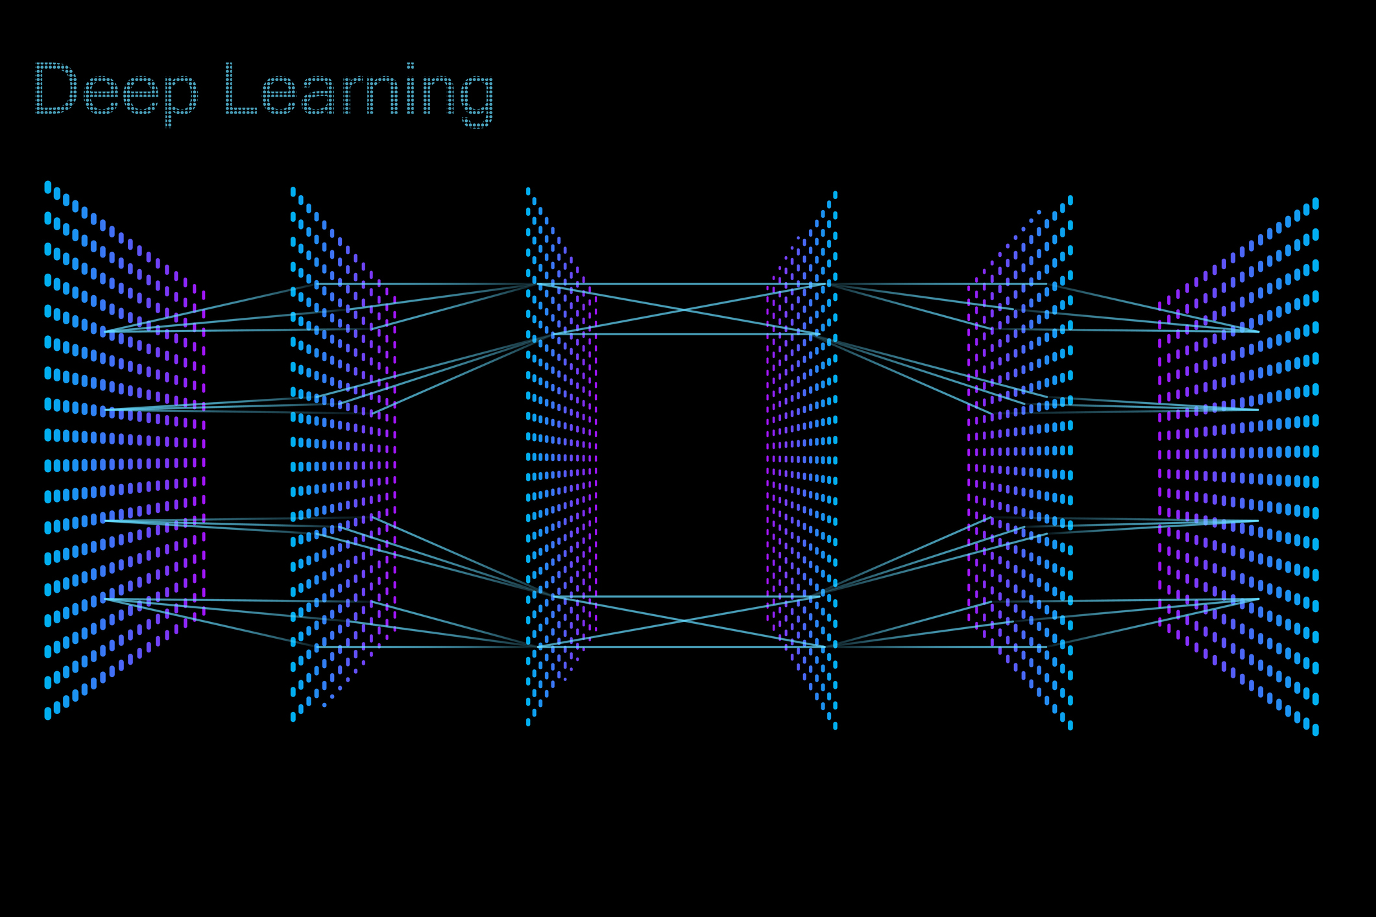
Problem statement
Every year, thousands of people die of pneumonia from all over the world
The purpose of this project is to see how accurately we can classify X-Ray Scans from Patients with Pneumonia using Deep Learning and Neural Networks

Slide 4
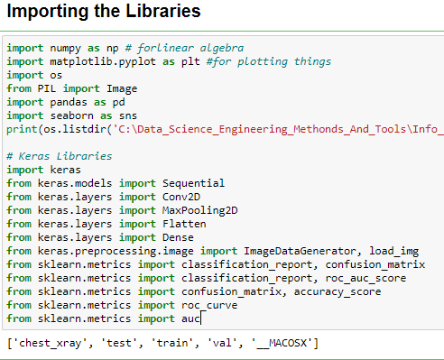
Getting Started - Importing Libraries
All the necessary libraries are imported.
Keras and TensorFlow for Deep Learning, sklearn, numpy, pandas and seaborn for visualization.

Slide 5
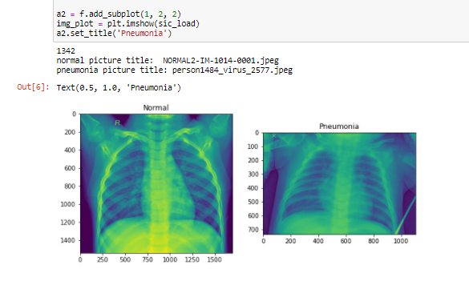
Reading in the data in
The data is located in three folders – train, test and val
Each of the folders have 2 different classes labelled – ‘Normal’ and ‘Pneumonia’
We read the data in using “os.listdir” by specifying directories and we generate the image to get the first look of the two classes

Slide 6
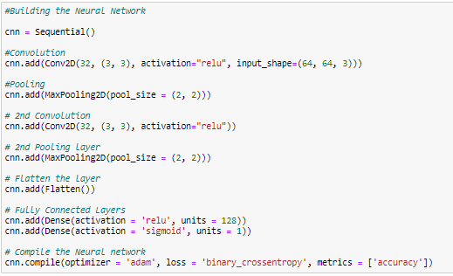
Building the neural network
The Convolution Neural Network implementation is used which uses a special mathematical matrix manipulation to process data from the images.
Sequential model with an input vector of batch size 32 subject to a 3x3 matrix with multiple layers
The model is compiled with the binary_crossentropy loss fuction and ‘adam’ optimizer

Slide 7
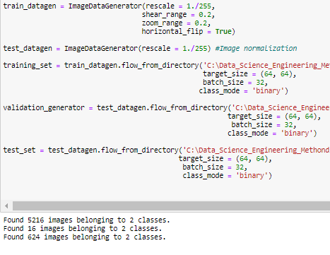
Preprocessing to dataset
Calling image_dataset_from_director(main_directory, labels = ‘inferred will return a tf.data.Dataset that yields batches of images from the subdirectories class_a and class_b, together with labels 0 and 1 (0 corresponding to class_a and 1 corresponding to class_b)

Slide 8
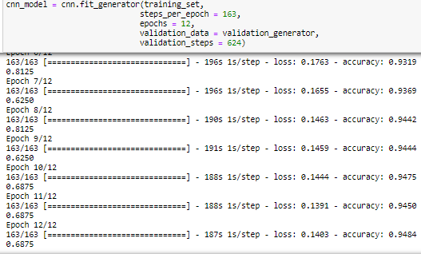
Training the model
The model is then trained using the fit_generator function and is subject to 12 epochs with 163 steps_per_epoch along with the validation data
The Accuracy and Loss with respect to number of Epochs are plotted and displayed.

Slide 9
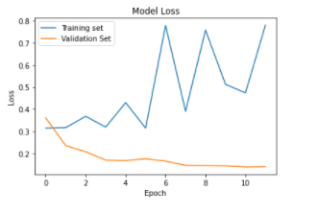
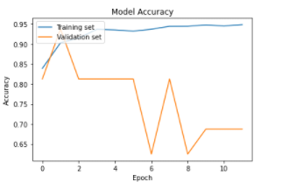
Evaluating model performance - 1
Loss vs Number of Epochs
Accuracy vs Number of Epochs

Slide 10
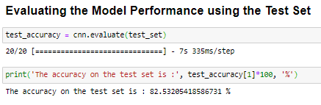
Evaluating test set accuracy
By training the model and running the test_set using the cnn.evaluate function on the trained model, an accuracy of 0.82 or 82% is acquired.

Slide 11
Thank you!

