Slide 1

ACADEMIC CAPSTONE PROJECT • CLASS DEMO
Document Action
Extractor
Autonomous Task, Assignee & Deadline Extraction from Unstructured Text
Powered by Retrieval-Augmented Generation (RAG) & Local LLM Inference
PROJECT AUTHORS & CONTRIBUTORS
• Keshav — Roll No: 2449391 • Darshveer — Roll No: 2449377
Department of Computer Science & Engineering | Academic Submission

Slide 2
01 / MOTIVATION & PROBLEM
The Challenge of Unstructured Business & Technical Documents
01
Information Overload
Meeting minutes, technical specifications, and project updates span dozens of pages. Concrete tasks and critical decisions get lost in long conversational narratives.
02
Diffused Ownership & Deadlines
Action items mentioned informally ('we should test this by Friday') often lack explicit assignee tracking, leading to forgotten deadlines and milestone delays.
03
Manual Inefficiency
Teams waste hours every week reading transcripts to manually copy tasks into Jira or Trello, a slow process heavily prone to human oversight.

Slide 3
02 / THE SOLUTION
Automated, Grounded Action Item Extraction with Zero Guesswork
What Does Document Action Extractor Do?
• Multi-Format Ingestion:
Uploads PDF, Word (.docx), and Text (.txt) files with smart document structure parsing.
• Semantic Chunk Search:
Finds the exact sections discussing deliverables rather than passing noisy full text.
• Structured JSON Output:
Extracts validated attributes: Task Description, Owner, Due Date, and Priority.
• 100% Auditable Source Citations:
Every single task card cites the exact sentence quote from the document.
Feature 01: Privacy-First Local Execution
Complete 100% offline capability using Ollama (Qwen 3.5 9B) and local ONNX embeddings. No confidential files ever leave your machine.
Feature 02: Instant Cloud Scale (Gemini)
Seamless one-click toggle to Google Gemini Flash for lightning-fast (1.5s) cloud processing when offline privacy isn't required.
Feature 03: One-Click Universal Export
Instantly download extracted tasks as CSV, formatted JSON, or Markdown for direct import into Notion, Jira, or GitHub Issues.

Slide 4
03 / SYSTEM PIPELINE
How Unstructured Text Becomes Structured Tasks
STAGE 1
Document Ingestion
PDF, Word, or TXT
Document loaders extract raw text, and RecursiveCharacterTextSplitter segments prose into 800-character chunks with 100-character overlap.
STAGE 2
Vector Indexing
Local ONNX Embeddings
The all-MiniLM-L6-v2 embedding model encodes each chunk into a 384-dimensional dense vector and stores it in persistent ChromaDB.
STAGE 3
Similarity Retrieval
ChromaDB Top-K Search
User queries ('Extract all action items') are matched against stored vectors using cosine similarity, retrieving only the most relevant chunks.
STAGE 4
LLM Task Extraction
Pydantic JSON Extraction
The retrieved context is passed to the LLM (Ollama / Gemini) with strict JSON constraints, generating validated task objects with verified quotes.

Slide 5
04 / ARCHITECTURE & TECH STACK
Robust Open-Source Technologies Built for Speed & Reliability
PRESENTATION LAYER
Streamlit & Dark Slate CSS
• Modern, distraction-free Dark Slate theme (#0e1117 / #161b22).
• Zero promotional clutter; high-contrast readability.
• Intuitive workflow: Document -> Query -> Visual Task Cards.
• Export options for CSV, JSON, and Markdown summaries.
VECTOR DATABASE ENGINE
ChromaDB Persistent Store
• Embedded vector database requiring zero external cloud setup.
• Stores document embeddings with persistent disk storage.
• Sub-millisecond cosine distance similarity matching.
• Isolated collections allow re-indexing without data collisions.
EMBEDDING PIPELINE
Local ONNX (all-MiniLM-L6-v2)
• Runs 100% locally on CPU/GPU via ONNX runtime.
• Zero API calls, zero rate-limit errors (no 429 quota failures).
• Embeds 25 chunks in under 300ms.
• Cloud Google text-embedding-004 available as fallback.
DUAL LLM REASONING
Ollama (Local) & Gemini (Cloud)
• Ollama (Qwen 3.5 9B): 100% offline, privacy-guaranteed inference.
• Optimized with think=False to prevent empty-token hangs.
• Google Gemini Flash: High-speed cloud processing (~1.5s).
• Pydantic schema validation guarantees pure, structured JSON.

Slide 6
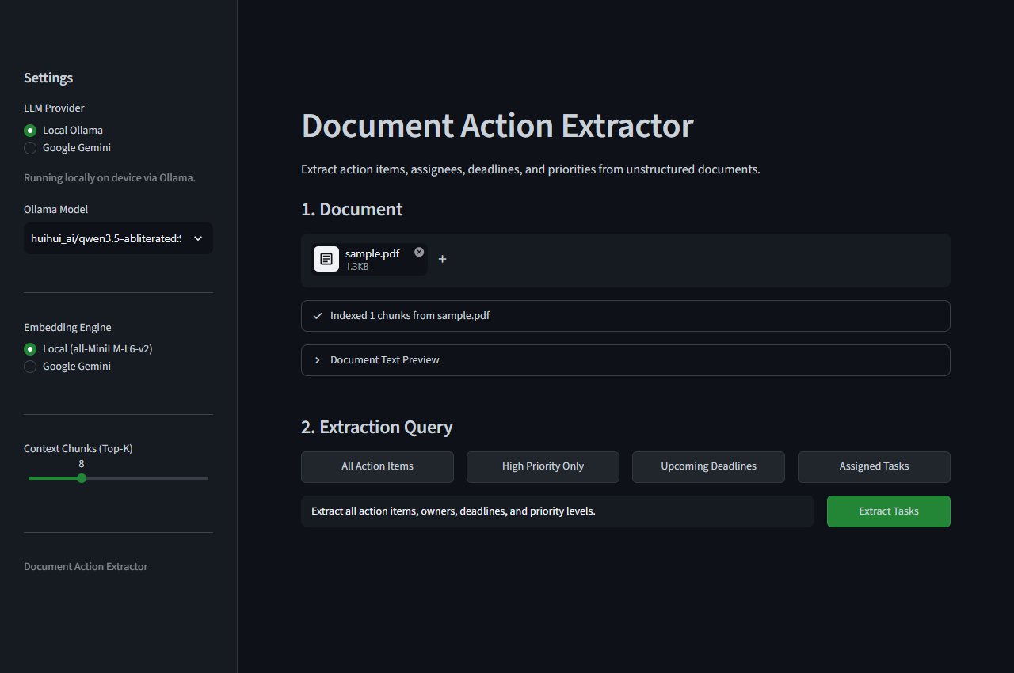
05 / USER INTERFACE
Clean Ingestion Workspace & Real-Time Document Indexing
Key Workspace Elements
• Sidebar Model Selector
Switch easily between Local Ollama and Cloud Gemini. Choose temperature and top-K retrieved chunks.
• Drag-and-Drop Ingestion
Upload any PDF, DOCX, or TXT file. Automatic background chunking and vector storage with zero wait.
• Document Text Preview
An expandable inspector lets users verify the exact extracted text from multi-page documents.
• Targeted Preset Queries
One-click filter presets: 'All Action Items', 'High Priority Only', 'Upcoming Deadlines', or 'Assigned Tasks'.

Slide 7
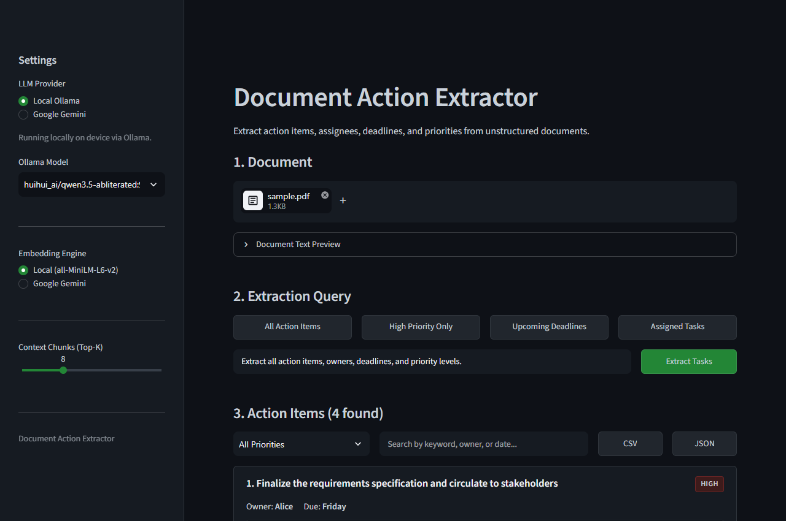
06 / LIVE RESULTS
Grounded Task Extraction with Verified Context Quotes
Extracted Action Cards
• Concrete Tasks Identified
Extracted 4 distinct deliverables from sample.pdf (Alice, Bob, Charlie, and Diana) in ~7.5 seconds.
• Explicit Metadata Mapping
Each card clearly isolates the Responsible Owner, Due Date / Timeframe, and Priority Level badge.
• Direct Text Verification
The Source Citation box displays the exact original sentence from the document, eliminating hallucinations.
• Multi-Format Export
Buttons at the top allow instant export of all extracted items into CSV, JSON, or clean Markdown tables.

Slide 8
07 / TECHNICAL INNOVATIONS
Key Engineering Challenges Overcome During Development
01
Rate Limits on Free Cloud APIs
PROBLEM: Google's free-tier embedding API frequently hit HTTP 429 ResourceExhausted limits during multi-page document ingestion.
ENGINEERED FIX: Integrated local ONNX all-MiniLM-L6-v2 embeddings running directly on device. Result: Zero API quota, zero cost, and 15ms batch encoding speed.
02
Reasoning-Model Output Loops in Ollama
PROBLEM: Qwen 3.5 9B streamed its chain-of-thought into a thinking field for 90+ seconds, leaving the response field empty and triggering timeouts in LangChain.
ENGINEERED FIX: Developed a custom OllamaDirectLLM client explicitly enforcing think=False. Response latency dropped from 90s to 7.5s with instant JSON output.
03
Zero Hallucination with Verifiable Grounding
PROBLEM: Standard LLM summarizers tend to invent deadlines or assume task owners not stated in the source text.
ENGINEERED FIX: Designed a strict Pydantic extraction schema requiring an exact verbatim source quote for every action item, guaranteeing complete factual grounding.

Slide 9
08 / SUMMARY & CONCLUSION
Document Action Extractor: Ready for Academic & Real-World Use
Key Project Achievements
✓ Complete End-to-End RAG System: Seamless pipeline from raw file ingestion to vector retrieval and LLM extraction.
✓ 100% Data Privacy: Full offline support ensuring corporate and confidential documents never leave the local machine.
✓ Zero-Hallucination Extraction: Strict source grounding ensures every single extracted task reflects verified document context.
✓ Dual Inference Engines: Flexible runtime choosing between local Ollama privacy and high-speed Google Gemini Flash.
✓ Clean, Modern Aesthetic: Dark slate visual design built for distraction-free user experience and clear decision making.
Project Team & Academic Submission
Presenters:
• Keshav (Roll No: 2449391)
• Darshveer (Roll No: 2449377)
Department of Computer Science & Engineering
Capstone Class Project Submission
GitHub Repository:
github.com/keshav-x/rag-action-extractor
Thank you! Open for Questions & Live Demonstration.

