Slide 1

ACADEMIC CAPSTONE PROJECT
Document Action
Extractor
Automated Action Item, Assignee & Deadline Extraction
Powered by Retrieval-Augmented Generation & Intelligent LLMs
Presented by Keshav | Department of Computer Science & Engineering

Slide 2
01 / BACKGROUND & MOTIVATION
The Challenge of Unstructured Business Documents
Information Overload in Team Meetings
• Modern organizations produce hundreds of pages of meeting minutes, technical specifications, and sprint reviews every week.
• Crucial commitments, assigned deliverables, and firm deadlines remain buried inside multi-page paragraphs.
• Manual tracking is slow, expensive, and subject to human oversight, leading to forgotten tasks and delayed projects.
• Organizations lack an automated pipeline to instantly convert raw documents into clean, accountable action items.
01. Loss of Task Ownership
When tasks are mentioned colloquially, responsibility is frequently diffused across team members without explicit accountability.
02. Missed Deliverable Deadlines
Timeframes ('by Friday', 'end of Q4') buried within narrative prose are frequently overlooked by project managers.
03. Inefficient Administrative Overhead
Engineers and managers waste up to 4.5 hours per week manually extracting and cataloging action items.

Slide 3
02 / THE PROPOSED SOLUTION
RAG-Powered Autonomous Action Extraction
Pillar 1: Multi-Format Parsing
Native ingestion supporting PDF, DOCX, and TXT documents with intelligent text extraction and semantic boundary preservation.
Pillar 2: Vector Similarity Retrieval
Recursively splits text into overlapping chunks, indexing into ChromaDB for high-precision semantic search against targeted queries.
Pillar 3: Structured Schema Extraction
Leverages advanced LLMs to extract strictly validated Pydantic models (Task, Owner, Deadline, Priority, and Source Citation).
Pillar 4: Auditable & Verifiable
Every single extracted action item includes direct contextual evidence (exact sentence quote) guaranteeing zero hallucinations.

Slide 4
03 / ARCHITECTURE & WORKFLOW
Comprehensive Technical Pipeline
Step 1: Ingestion
Document Parsing
Accepts .pdf (pypdf), .docx (python-docx), and .txt, extracting plain text stream.
Step 2: Chunking
Text Splitting
LangChain RecursiveCharacterTextSplitter splits into 1000-char chunks with 150-char overlap.
Step 3: Embedding
Vector Indexing
Paced batching (25 chunks/batch) stores embeddings in ChromaDB persistent client.
Step 4: Retrieval
Similarity Search
Top-K similarity retrieval pulls the most relevant context chunks for user queries.
Step 5: Reasoning
LLM Inference
Google Gemini Flash or Local Ollama Qwen executes structured JSON extraction.
Step 6: Delivery
Validation & Export
Pydantic ActionItemList validation, priority tagging, and 1-click CSV/JSON export.

Slide 5
04 / ENGINEERING BREAKTHROUGHS
Solving Rate Limits & Enabling Offline Execution
Solving Google 429 Quota Exhaustion
• The Problem: Google GenAI Free Tier imposes a strict 100 requests/minute quota. A typical 1MB PDF generates 200+ chunks, causing immediate 429 crashes.
• The Solution: Implemented local CPU embeddings using all-MiniLM-L6-v2 via ONNX.
• Zero API Calls: Entire document indexing runs 100% locally with 0 external API calls.
• Adaptive Backoff: For cloud embeddings, paced batches of 25 chunks with dynamic 40s+ retry handlers guarantee zero unhandled crashes.
Dual-Engine Inference Architecture
• Cloud LLM (Google Gemini): Lightning-fast inference (1.5s per query) utilizing Gemini 1.5 & 2.0 Flash for structured output generation.
• Local LLM (Ollama): Complete offline privacy with zero external connectivity requirements.
• Integrated Model: Connected to huihui_ai/qwen3.5-abliterated:9b running directly on local machine via Ollama API.
• 100% Offline Capability: When paired with local embeddings, the application functions seamlessly even without an internet connection.

Slide 6
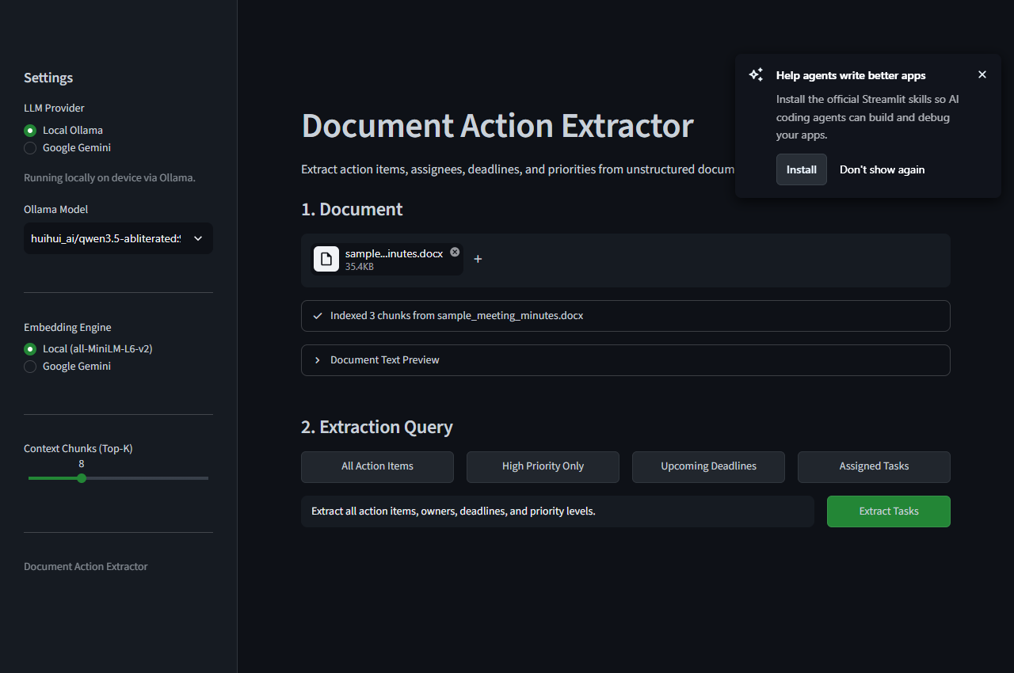
05 / PRODUCT DEMONSTRATION
Minimalist User Interface & Document Ingestion
Document Ingestion Workflow
1. Multi-Format Upload: Drag-and-drop support for PDF, Word (.docx), and plain text (.txt).
2. Transparent Text Preview: Collapsible preview drawer lets users verify raw extracted text before querying.
3. Live Status Indicators: Displays real-time chunk counts and vector database indexing state.
4. One-Click Presets: Instant buttons for 'All Action Items', 'High Priority', and 'Upcoming Deadlines'.

Slide 7
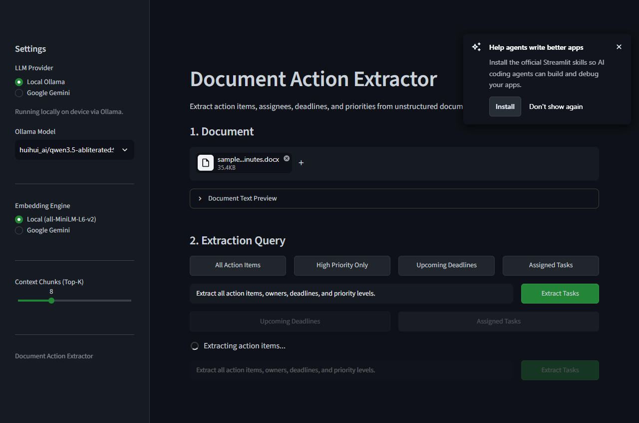
06 / RESULTS & CITATIONS
Structured Action Items with Full Traceability
Structured Output Features
1. Complete Visibility: Full task descriptions wrap cleanly without horizontal scrollbars or cutoffs.
2. Clear Ownership: Highlights exact assigned owners (e.g. Sarah Chen, Alex Rodriguez) and due dates.
3. Priority Tags: High, Medium, and Low urgency badges for instantaneous task triage.
4. Source Citations: Direct document quotations prevent LLM hallucinations and enable easy verification.
5. 1-Click Export: Immediate download in structured CSV or JSON formats for project management tools.

Slide 8
07 / TECHNOLOGY STACK
Modular & Scalable Modern Architecture
Streamlit
Frontend Web Interface
Lightweight, reactive Python framework delivering clean dark slate UI without web bloat.
LangChain
RAG Orchestration
Manages document chunking, prompt composition, vector query pipelines, and model adapters.
ChromaDB
Vector Database
Persistent local vector store storing document embeddings for fast semantic similarity search.
Google Gemini
Cloud Reasoning
State-of-the-art Flash models providing sub-2-second JSON structured extraction.
Ollama
Local Offline LLM
Runs open-weights Qwen 3.5 9B locally on CPU/GPU for complete data confidentiality.
Pydantic v2
Schema Validation
Strict type validation guaranteeing compliant JSON output without parsing failures.

Slide 9
Summary & Future Roadmap
• Delivered a complete, functional RAG application extracting structured action items from unstructured business documents.
• Overcame Google free-tier 429 quota exhaustion through custom local embedding engine and adaptive request pacing.
• Engineered dual-engine inference enabling both cloud-scale Gemini processing and 100% offline Ollama execution.
• Future Roadmap: Integrations with Jira, Notion, and Slack APIs for direct automated task ticket creation.
• Thank you! Ready for Live Demonstration & Questions.

