Slide 1
Intern Presentation AUTOMATED REGRESSION ENVIRONMENT FOR DESIGN VERIFICATION PRODUCTIVITY
11th November 2016
Keshav Rath

Slide 2
VHDL
UNIX
PERL
INITIAL LEARNING
UNIX
Basic Unix Shell Commands .
Makefile Structure: For any kind
PERL
Basic scripting syntax
Date and time
Error handling, file and excel operations
VHDL
Code structure of VHDL , data types , operators and attributes
Sequential and Concurrent code. Functions and Packages.
Examples and Counter design.

Slide 3
WORK DONE PREVIOUSLY

Slide 4
Script developed with User Input OPTIONS
OPTIONS
Single / Regression
Frtl
Ftb
Inclist
Deflist
Options
Tool
Timescale
Vip_library
Excel
Uvm_verbosity
Seed
Stop_time
Log
GUI
Sim_mode
Licenses
Help
NOTE
Bold represents the options which were working at that time
Normal once represent the options written in script but neither executed nor perfected

Slide 5
Example
USAGE $ : perl <prog_name> [.....- <option> ARG - <option> <ARG_LIST> -<flag>......]
Compile Single Case:
perl test.pl -vtimescale 1ns/10ps
-tool ncsim
-ftb tb_list.txt
-inc inclist.txt
-frtl files.f
-test testname
-sim_mode compile
Additionally
-options options.fl
-deflist deflist.fl
-seed RANDOM
-uvm_verbosity UVM_FULL
-stop_time 100000
-vip vip_lib
-log log_file_name
-gui
-excel

Slide 6
Execution Procedure
Enter the following commands:
cd <path>/scripts
Update all the filelists in the scripts directory.
Two choices
Writing the entire command on the terminal
perl test.pl -vtimescale 1ns/10ps -tool ncsim -ftb tb_list.txt -inc inclist.txt -frtl files.f -test testname -sim_mode compile -options options.fl -deflist deflist.fl
Using the makefile and writing the command on the terminal
make single “test = top_test10”

Slide 7
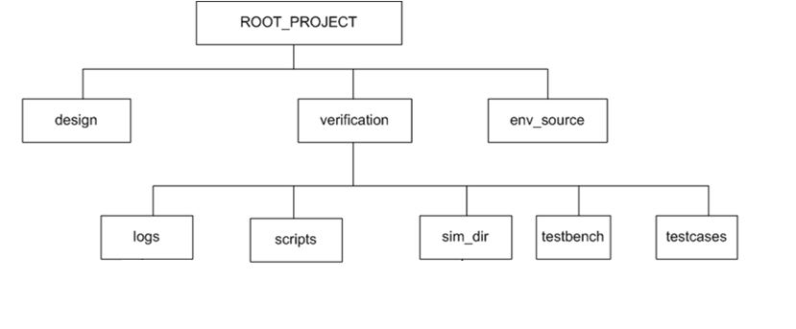
Directory Structure

Slide 8
Inside Scripts Directory
Scripts
Incdir List
Script (PERL)
Testbench Filelist
Mandatory Reg Options
RTL Filelist
Mandatory Single Options
Define List
Optional Reg Options
Extra Options List
Optional Single Options
Tcl Files
Mandatory Compile Options
Makefile
Help Text

Slide 9
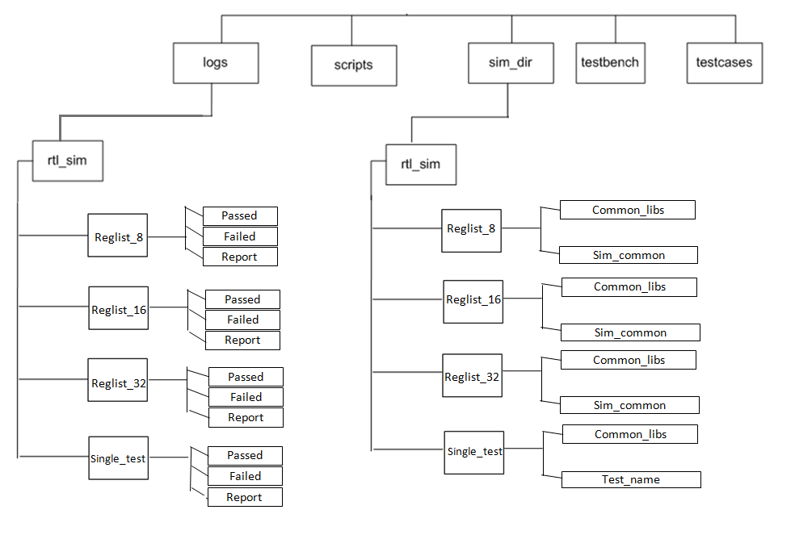
Verification Directory

Slide 10
COMPILATION AND SIMULATION DIRECTORIES
Common_libs
Compile.sh
INCA_LIBS
ncperfstat
Irun.log
Sim_common
Test1.sh
Test1.log

Slide 11
Logs Directory
Failed
Single_test
Passed
Report
Logs
Failed
Reglist_16
Passed
Report
Based on the number of errors in the log file, the log files are stored accordingly in the passed or failed directory. Here the reglist folder is created but the log files were not moved.
Format:
Testname_Seed_Date_Time.log

Slide 12

EXCEL REPORT GENERATED

Slide 13
WORK DONE BY ME

Slide 14
DIRECTORY STRUCTURE
ROOT PROJECT
Design
Verification
Env_source
Regression
Scripts
Sim_Dir
Testbenches
Testcases

Slide 15
OPTIONS
Options that can be given by users to execute this script
MANDATORY
Single / Regression
Timescale
Frtl
Ftb
Sim_mode
Tool
Inclist
NON MANDATORY (EXTRA)
Options (Extra)
Deflist
Vip_library
Optional Error
Optional Error Exclude
Seed
Verbosity
Stop Time
Log name
GUI
Excel
Dump
No of Licenses
PBS
Queue
Coverage
VIP Dir Change
Lib Link
Lib Link File
Language (Verification)
Help
Readme

Slide 16
EXECUTION PROCEDURE
Two methods of executing
Using the command line code
For Single Test
perl test.pl -vtimescale 1ns/100fs -tool ncsim -ftb tb_list.txt -inc inclist.txt -frtl files.f –test top_test -sim_mode ncsim -vip_library vip_lib_content.fl -deflist deflist.fl -options options.fl -opt_error error.fl -language UVM -gui -excel
For Regression
perl test.pl –vtimescale 1ns/100fs -tool ncsim -ftb tb_list.txt -inc inclist.txt -frtl files.f -reg reglist.fl -sim_mode modelsim -vip_library vip_lib_content.fl -deflist deflist.fl -options options.fl -opt_error error.fl -language OVM –pbs –no_of_licenses 2 -excel
Using the makefile/Makefile
make single
make reg_excel
make –C ../scripts reg_pbs_excel

Slide 17
FILES INSIDE SCRIPT DIRECTORY
Scripts
Incdir List
Script (PERL)
Testbench Filelist
Mandatory Reg Options
RTL Filelist
Mandatory Single Options
Define List
Optional Reg Options
Extra Options List
Optional Single Options
Tcl Files
Mandatory Compile Options
Makefile
Help Text
Optional Error
Optional Error Exclude
Imc_code.cmd (COVERAGE)
Clean.sh

Slide 18
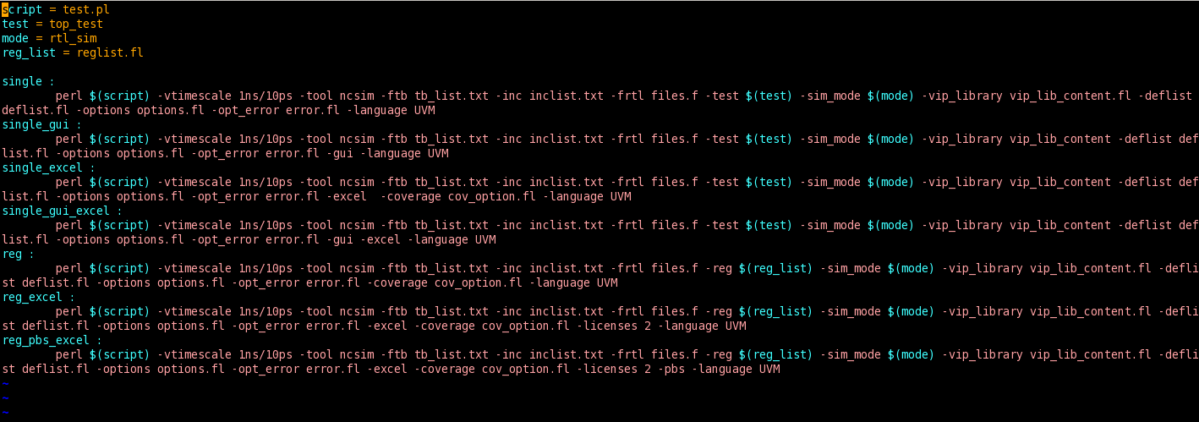
MAKEFILE
This is a feature of Linux that contains the command line code the file. This makes the execution easier as a lot is not necessary to be written in the command line.

Slide 19
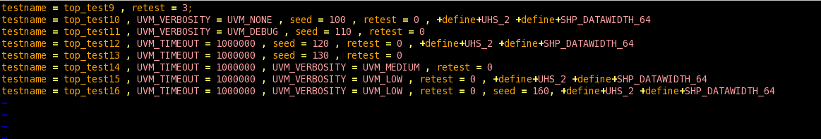
REGLIST
This contains the list of the testcases name that are to be used for running the regression list. This file can be stored in any kind of file extension.

Slide 20
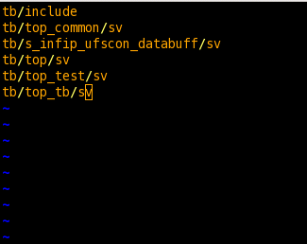
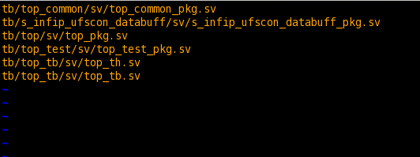
INCLIST AND TB LIST
INCLIST Contains the list of directories that have to be included.
TB List contains the list of the Verilog files required for the project to execute.
TB_LIST
INCLIST

Slide 21
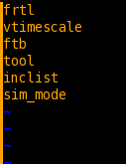
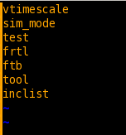
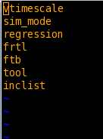
MANDATORY OPTIONS
This options is definitely required for script to execute properly.
MANDATORY COMPILE
MANDATORY SINGLE
MANDATORY COMPILE

Slide 22
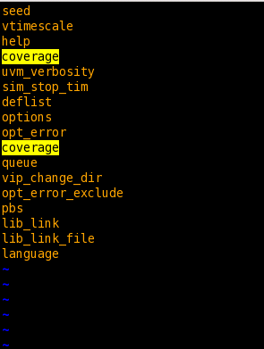
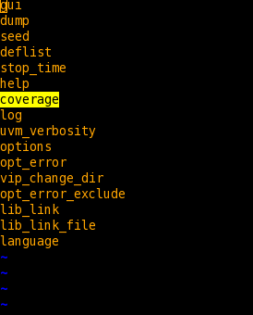
NON MANDATORY OPTIONS
These options can added extra by the user according to the project requirement. This consist of all the possible non-mandatory options.
OPTIONAL REGRESSION
OPTIONAL SINGLE

Slide 23
DIRECTORY STRUCTURE BEFORE EXECUTING SCRIPT
ROOT PROJECT
Design
Verification
Env_source
Scripts
Sim_Dir
Testbenches
Testcases

Slide 24
DIRECTORY STRUCTURE AFTER EXECUTING SCRIPT
ROOT PROJECT
Design
Verification
Env_source
Regression
Scripts
Sim_Dir
Testbenches
Testcases
Rtl_sim
Cov_sim
Vip_dir

Slide 25
SIMULATION DIRECTORY AFTER EXECUTION (DIRECTORIES CREATED)
Sim_Dir
Rtl_sim
Cov_sim
Vip_dir
create_vip.sh
Single Test
Reglist
Common_Libs
compile_ncsim.sh
Top_Test
top_test.sh
Top_Test1
top_test1.sh

Slide 26
REGRESSION DIRECTORY STRUCTURE
Regression
Rtl_sim
Cov_sim
Reglist
reglist1
Reg_temp
Failed
Contains log files that have failed
Passed
Contains log files that have passed
Report
Summary_Report.xls

Slide 27
ADVANTAGES

