Slide 1
Intern Presentation AUTOMATED REGRESSION ENVIRONMENT FOR DESIGN VERIFICATION PRODUCTIVITY
11th November 2016
Keshav Rath

Slide 2
Agenda
OBJECTIVE
BACKGROUND
AUTOMATION FRAMEWORK OVERVIEW
USER INPUTS OVERVIEW
USER INPUTS EXAMPLES
DIRECTORY STRUCTURE
EXECUTION PROCEDURE
RESULTS
GENERIC IMPROVEMENT
CHALLENGES FACED
WORK PENDING AND FUTURE WORK

Slide 3
OBJECTIVE
The main aim of this project is to write a common script which could work across all kinds of verification projects making it easier to operate and get the result without changing the script at all. This script is developed so as to get all the inputs from the user which would result in an OUTPUT which are similar in structure across all projects

Slide 4
BACKGROUND
Prior to this script, there used to be multiple scripts, each of them customized for a specific project. Each of these scripts used to produce an output which used to differ from the other.
Project 1
Project 2
Project 3
…………..
Project N
Script 1
Script 2
Script 3
…………..
Script N
Qualified Result 1
Qualified Result 2
Qualified Result 3
…………..
Qualified Result N
DISADVANTAGES
Script customized for each project
Not easy to maintain
Learning Cycles Huge.
Not PBS friendly
Longer Simulation Cycles

Slide 5
AUTOMATION FRAMEWORK OVERVIEW
To overcome this problem a script was developed which can work across all projects.
This script is developed so as to get most of the inputs from users.
Project 1
Project 2
Project 3
…………..
Project N
User Inputs 1
User Inputs 2
User Inputs 3
…………..
User Inputs N
Script
Qualified Result 1
Qualified Result 2
Qualified Result 3
…………..
Qualified Result N
SALIENT ATTRIBUTES OF SCRIPTS
Unified Features
User driven inputs
PBS friendly
Uniform Outputs as test results
Faster Simulation

Slide 6
USER INPUTS OVERVIEW
Options that can be given by users to execute this script
Dump
No of Licenses
PBS
Queue
Coverage
VIP Dir Change
Lib Link
Lib Link File
Language (Verification)
Help
Readme
Compile_again
Vcom_options
MANDATORY
test
Timescale
Frtl
Ftb
Sim_mode
Tool
Inclist
reg
NON MANDATORY (EXTRA)
Options (Extra)
Deflist
Vip_library
Optional Error
Optional Error Exclude
Seed
Verbosity
Stop Time
Log name
GUI
Excel
Vsim_do
Vsim_options
REGRESSION ONLY
SINGLE ONLY
MODELSIM ONLY

Slide 7
USER INPUTS OVERVIEW(Cntd…)
Deflist
This option is used to add all define statement for the compilation.
Frtl
This option is used to add all rtl files for compilation.
Ftb
This option is used to add all tb files for compilation.
Inclist
This option is used to add all the include directories list of the project.
Reglist
This option is used to load the regression list for regression.
Coverage
This option is used to add the coverage options for the simulation.
Options
This options that could be added by the users according to the project if required.

Slide 8
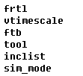
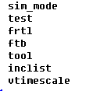
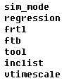
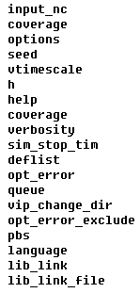
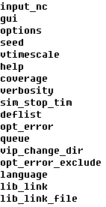
MANDATORY/OPTIONAL USER INPUT OPTIONS
This options is definitely required for script to execute properly.
MANDATORY COMPILE
MANDATORY SINGLE
MANDATORY REGRESSION
OPTIONAL REGRESSION
OPTIONAL SINGLE

Slide 9
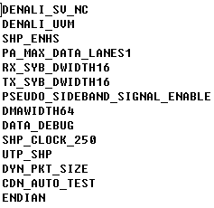
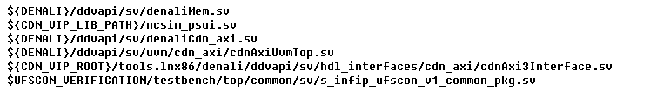
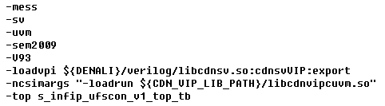
USER INPUTS EXAMPLES
Reglist
Reglist will have testname, verbosity, timeout, seed, retest, compile_again
Deflist
Frtl
Ftb
Options

Slide 10
DIRECTORY STRUCTURE
ROOT PROJECT
design
Verification
regression
scripts
sim
testbenches
testcases
Rtl_sim
Cov_sim
rtl_sim
cov_sim
vip_dir
create_vip.sh
Reglist
single test
reglist
Failed
Failed Logs
Common_Libs
Common_Libs
Passed
Passed Logs
Test12
Top_Test
Report
Summary_Report.xls
Top_Test1
SCRIPTS AND USER INPUT FILES
FOLDERS AND FILES CREATED AFTER EXECUTION

Slide 11
FILES INSIDE SCRIPT DIRECTORY
Scripts
Incdir List
Script (PERL)
Testbench Filelist
Mandatory Reg Options
RTL Filelist
Mandatory Single Options
Define List
Optional Reg Options
Extra Options List
Optional Single Options
Tcl Files
Mandatory Compile Options
Makefile
Help Text
Optional Error
Optional Error Exclude
Imc_code.cmd (COVERAGE)
Clean.sh

Slide 12
EXECUTION PROCEDURE
First go to the sim directory inside the project
Source environment source file
Two methods of executing
command line code
Single Test
perl test.pl -vtimescale 1ns/100fs -tool ncsim -ftb tb_list.txt -inc inclist.txt -frtl files.f –test top_test -sim_mode ncsim -vip_library vip_lib_content.fl -deflist deflist.fl -options options.fl -opt_error error.fl -language UVM -gui -excel
Regression
perl test.pl –vtimescale 1ns/100fs -tool ncsim -ftb tb_list.txt -inc inclist.txt -frtl files.f -reg reglist.fl -sim_mode modelsim -vip_library vip_lib_content.fl -deflist deflist.fl -options options.fl -opt_error error.fl -language OVM –pbs –no_of_licenses 2 -excel
makefile/Makefile
Make –C ../scripts single
Make –C ../scripts single_gui
Make –C ../scripts reg
Make –C ../scripts reg_excel
make –C ../scripts reg_pbs_excel

Slide 13
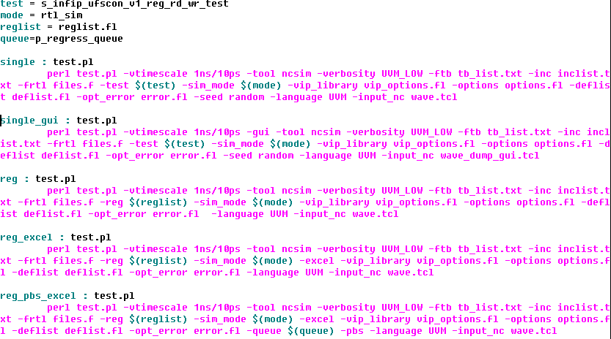
Make file Example
This is a feature of Linux that contains the command line code the file. This makes the execution easier as a lot is not necessary to be written in the command line.

Slide 14
COMPILATION DIRECTORY
Common_Libs
Compile_ncsim.sh
Wave_dump.tcl
INCA_LIBS
irun.log
Ncperfstat.out
During compilation, Elaboration is done to save the snapshot.
This INCA libs created is referred during simulation from the sim directory.
If INCA libs already exists, then irun takes care of the time stamp of files and then proceeds or skips the elaboration process
The INCA libs directories is not referred if define statement is given in the regression list
This INCA libs directories is also not referred if user has given an option to compile again

Slide 15
SIMULATION DIRECTORY
Top_Test
Top_test.sh
Top_test.log.gz
iruns
During simulation each test has a different directory which consists of the bash file (.sh) and the log file created
The log file is zipped after it is completely created.
The other files that are created during the execution are removed after the execution of the bash file is over
For regression, there are two methods to submit jobs, sequentially or parallel (PBS)

Slide 16
PBS
A salient attribute of this script is the use of PBS (Portable Batch System)
This makes execution of testcases simultaneously, which in turn makes the overall process faster.
qsub – to submit jobs
qstat – to check the number of jobs running, according to the given queue and no of licenses.
No of licenses - 5
Jobs submitted
TestN.sh
Test10.sh
Test9.sh
Test1.sh
Test8.sh
Test7.sh
Test6.sh
Test2.sh
Test5.sh
Test3.sh
Waiting in QUEUE
Test4.sh

Slide 17
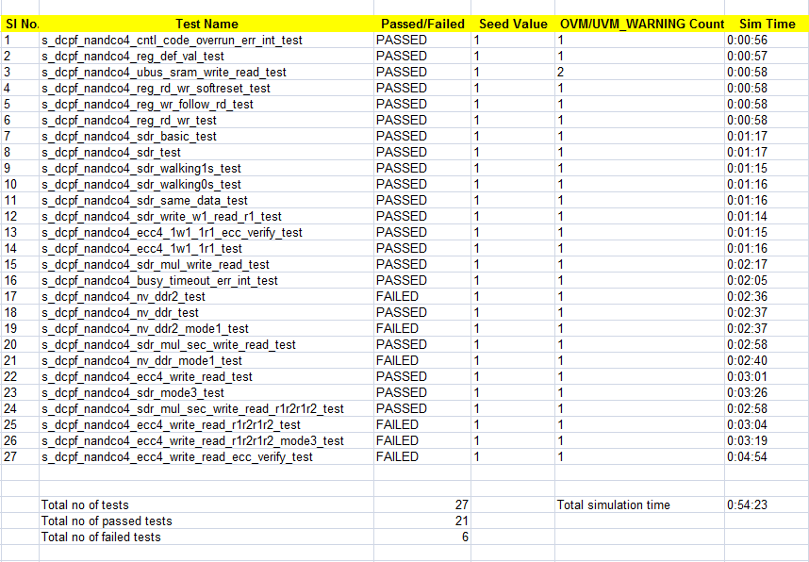
EXCEL SHEET REGRESSION

Slide 18
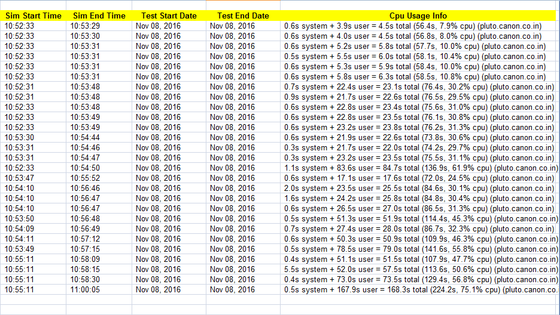
EXCEL REPORT REGRESSION(Cntd…)

Slide 19
RESULTS
PROJECT | ENVIRONMENT | KEY IMPROVEMENTS | TEST STATUS
UFSCON | SV/UVM/Cadence | Time reduced by 75% through pbs Current Simulation time : 7 min Previous Simulation time: 30 min ** | Completed 61/61
PHY@@ | Specman/Cadence | * | 2-3 test
NANDC | SV/UVM/Cadence | Time reduced by 75% through pbs Current Simulation time : 19 min Previous Simulation time: 79 min ** | Completed 37/37
ECC | OVM/Cadence | ** | Completed ECC bin test 101/101
SDCON | OVM/Modelsim | ** *** | Partial 2 / n
** Compilation done one time and library shared for regression
* Every testcases will be compiled again and simulated.
*** Compilation and simulation stages reduced.

Slide 20
GENERIC IMPROVEMENT
For regression, the compilation is done one time and the snapshots are stored in a shared library. This in turn saves time
With the help of PBS, submitting jobs in a parallel manner is possible, making more than one test possible to run simultaneously, saving time
Results are short and in a common format across all projects
With excel sheet, no need to wait for all the testcases to get over. Results for all the testcases that are over is available in the excel sheet
All the inputs are user defined, nothing been fixed in the script.

Slide 21
CHALLENGES FACED
Submitting jobs in the queue, checking every time when a job gets over
Counting all the types of errors in the log file. (UVM_ERROR, assertion error and optional error)
Differentiating between optional errors and optional errors that have to be excluded, especially errors containing escapes characters.
Make several steps of compilation in modelsim to a single step, same for simulation

Slide 22
WORK PENDING and Future Work
WORK PENDING
Making the simulation time column in the excel file dynamic.
For modelsim, printing the cpu usage info
Removing the extra dots that are present in seed value (PHY -Specman)
FUTURE WORK
The script can be made more generic if analyzed properly.
Unwanted variables and subroutines can be removed.
Variables can be assigned dynamically so as to reduce space complexity
GUI can be made to make user more comfortable rather than using Makefile, as no command would be required.
GUI can have the use of text boxes, radio buttons, check boxes, so that user can provided all the necessary files and values through the GUI

Slide 23
THANK YOU
Q&A

