Slide 1
Intern Presentation AUTOMATED REGRESSION ENVIRONMENT FOR DESIGN VERIFICATION PRODUCTIVITY
11th November 2016
Keshav Rath

Slide 2
VHDL
UNIX
PERL
INITIAL LEARNING
UNIX
Basic Unix Shell Commands .
Makefile Structure: For any kind
PERL
Basic scripting syntax
Date and time
Error handling, file and excel operations
VHDL
Code structure of VHDL , data types , operators and attributes
Sequential and Concurrent code. Functions and Packages.
Examples and Counter design.

Slide 3
WORK DONE PREVIOUSLY

Slide 4
Script developed with User Input OPTIONS
OPTIONS
Single / Regression
Frtl
Ftb
Inclist
Deflist
Options
Tool
Timescale
Vip_library
Excel
Uvm_verbosity
Seed
Stop_time
Log
GUI
Sim_mode
Licenses
Help
NOTE
Bold represents the options which were working at that time
Normal once represent the options written in script but neither executed nor perfected

Slide 5
Example
USAGE $ : perl <prog_name> [.....- <option> ARG - <option> <ARG_LIST> -<flag>......]
Compile Single Case:
perl test.pl -vtimescale 1ns/10ps
-tool ncsim
-ftb tb_list.txt
-inc inclist.txt
-frtl files.f
-test testname
-sim_mode compile
Additionally
-options options.fl
-deflist deflist.fl
-seed RANDOM
-uvm_verbosity UVM_FULL
-stop_time 100000
-vip vip_lib
-log log_file_name
-gui
-excel

Slide 6
Execution Procedure
Enter the following commands:
cd <path>/scripts
Update all the filelists in the scripts directory.
Two choices
Writing the entire command on the terminal
perl test.pl -vtimescale 1ns/10ps -tool ncsim -ftb tb_list.txt -inc inclist.txt -frtl files.f -test testname -sim_mode compile -options options.fl -deflist deflist.fl
Using the makefile and writing the command on the terminal
make single “test = top_test10”

Slide 7
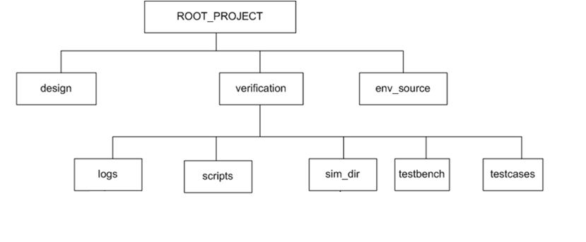
Directory Structure

Slide 8
Inside Scripts Directory
Scripts
Incdir List
Script (PERL)
Testbench Filelist
Mandatory Reg Options
RTL Filelist
Mandatory Single Options
Define List
Optional Reg Options
Extra Options List
Optional Single Options
Tcl Files
Mandatory Compile Options
Makefile
Help Text

Slide 9
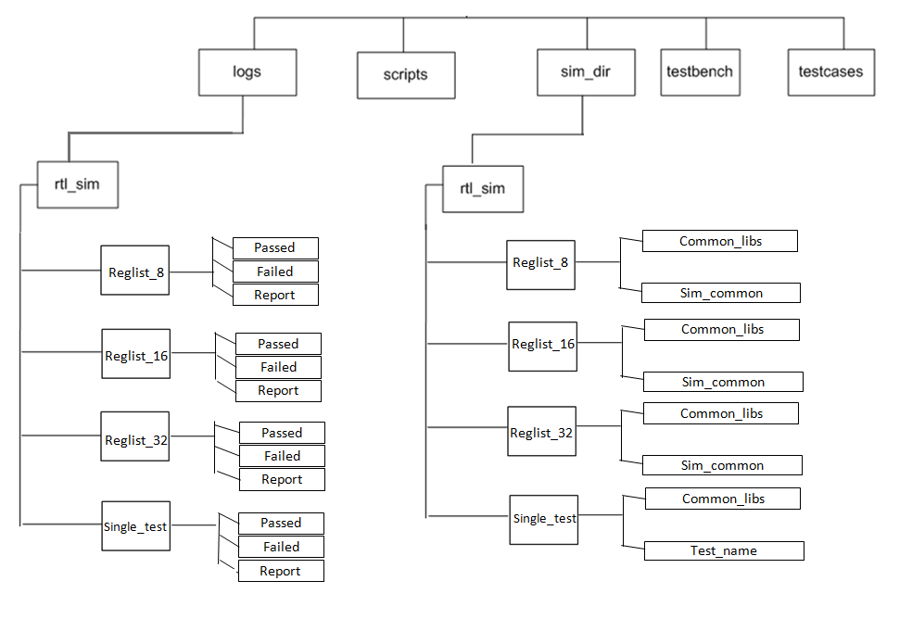
Verification Directory

Slide 10
COMPILATION AND SIMULATION DIRECTORIES
Common_libs
Compile.sh
INCA_LIBS
ncperfstat
Irun.log
Sim_common
Test1.sh
Test1.log

Slide 11
Logs Directory
Failed
Single_test
Passed
Report
Logs
Failed
Reglist_16
Passed
Report
Based on the number of errors in the log file, the log files are stored accordingly in the passed or failed directory. Here the reglist folder is created but the log files were not moved.
Format:
Testname_Seed_Date_Time.log

Slide 12

EXCEL REPORT GENERATED

Slide 13
WORK DONE BY ME

Slide 14
DIRECTORY STRUCTURE
ROOT PROJECT
Design
Verification
Env_source
Regression
Scripts
Sim_Dir
Testbenches
Testcases

Slide 15
OPTIONS
MANDATORY
Single / Regression
Timescale
Frtl
Ftb
Sim_mode
Tool
Inclist
NON MANDATORY (EXTRA)
Options (Extra)
Deflist
Vip_library
Optional Error
Optional Error Exclude
Seed
Verbosity
Stop Time
Log name
GUI
Excel
Dump
No of Licenses
PBS
Queue
Coverage
VIP Dir Change
Lib Link
Lib Link File
Language (Verification)
Help
Readme

Slide 16
EXECUTION PROCEDURE
Two methods of executing
Using the command line code
For Single Test
perl test.pl -vtimescale 1ns/100fs -tool ncsim -ftb tb_list.txt -inc inclist.txt -frtl files.f –test top_test -sim_mode ncsim -vip_library vip_lib_content.fl -deflist deflist.fl -options options.fl -opt_error error.fl -language UVM -gui -excel
For Regression
perl test.pl –vtimescale 1ns/100fs -tool ncsim -ftb tb_list.txt -inc inclist.txt -frtl files.f -reg reglist.fl -sim_mode modelsim -vip_library vip_lib_content.fl -deflist deflist.fl -options options.fl -opt_error error.fl -language OVM –pbs –no_of_licenses 2 -excel
Using the makefile/Makefile
make single
make reg_
make –C ../scripts reg_pbs_excel

Slide 17
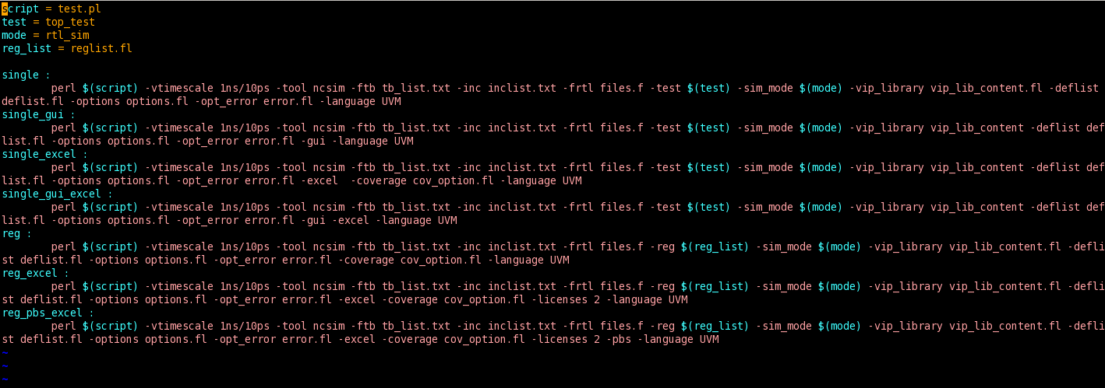
MAKEFILE
This is a feature of Linux that contains the command line code the file. This makes the execution easier as a lot is not necessary to be written in the command line.

Slide 18
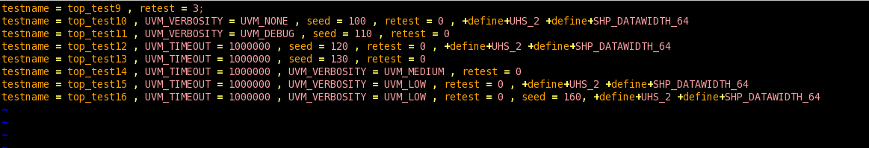
REGLIST
This contains the list of the testcases name that are to be used for running the regression list. This file can be stored in any kind of file extension.

Slide 19
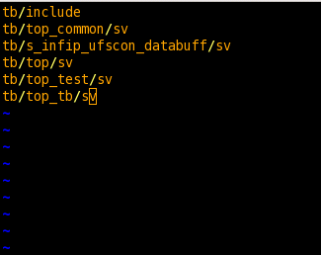
INCLIST
This is a file that contains the path of all the directories that have to be included.

Slide 20
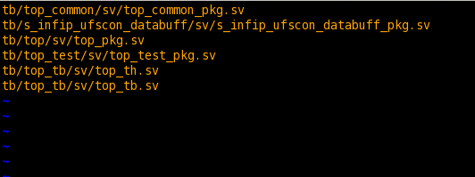
TB LIST
This contains the list of all the SystemVerilog codes to be used. This file looks like the following:

Slide 21
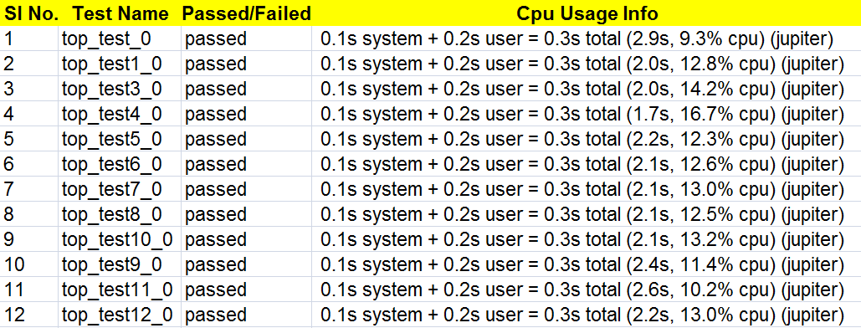
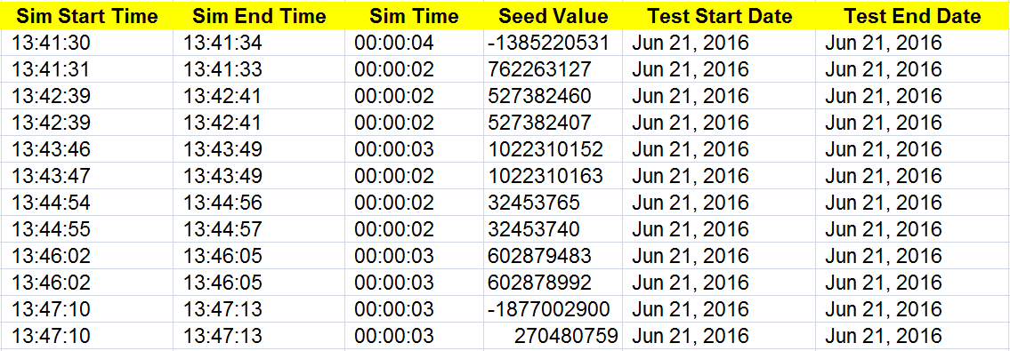
Report Generated
Report Generated (Cont..)

Slide 22
Verification Directory
2. Simulation is done

Slide 23
Compilation and Simulation Directory
Elaboration is done to save the snapshot.
This INCA libs created is referred during simulation from the sim directory.
If INCA libs already exists, then irun takes care of the time stamp of files and then proceeds or skips the elaboration process
Submitted as parallel jobs using qsub.
Qstat used to keep track of the running jobs.
The script mode will be in sleep mode if three jobs are running.
Once any one of the jobs finishes execution, the log file/s is/are grepped for info regarding date, time , cpu usage etc.

Slide 24
Future Work
Can expand to other tools – Synopsys and Mentor Graphics.
Use makefile for easy execution.
Can use Perl Tk to provide a GUI for the regression execution.
User can enter and update Inclist, deflist, rtl list, testbench list in the GUI itself instead of opening and searching which files are to updated.
They can enter seed, uvm_verbosity, timeout values in the GUI.
They can toggle on or off the flags and single options.
They can save their command or work related to different projects and re-open them as required.

Slide 25
References/Links
Perl
Perl Maven http://perlmaven.com/
Comprehensive perl archive network http://www.cpan.org/
Tutorial Point -http://tutorialspoint.com/perl/
Tutorial Point -http://tutorialspoint.com/unix
VHDL
Circuit Design with VHDL Volnei A. Pedroni – Ebook
Test Bench Example
http://www.csun.edu/edaasic/roosta/VHDL_Examples.pdf
System Verilog
http://www.testbench.in/
http://www.asic-world.com/systemverilog/tutorial.html/

Slide 26
References/Links
Excel VBA
http://www.excel-easy.com/vba.html
http://www.tutorialspoint.com/vba/vba_input_box.htm
http://www.globaliconnect.com/excel/
Perl TK
http://rio.murmansk.ru/doc/tk/index.htm
https://metacpan.org/pod/Tk
http://www.perl.com/pub/1999/10/perltk/sld001.htm

Slide 27
Thank You
Q & A

