Slide 1
Company Employee Analytics
An Employee Analytics project in Power BI uses employee data (demographics, performance, tenure) to create interactive dashboards. These dashboards visualize key metrics like:
Headcount & Demographics: Shows employee distribution by department, location, etc.
Turnover & Retention: Tracks employee departure rates and time spent at the company.
Performance Metrics: Displays sales, productivity, or other relevant performance indicators.
Engagement & Satisfaction: Potentially uses survey data to visualize employee morale.
Power BI's features enable data exploration, trend analysis, and actionable insights for HR and management.

Slide 2
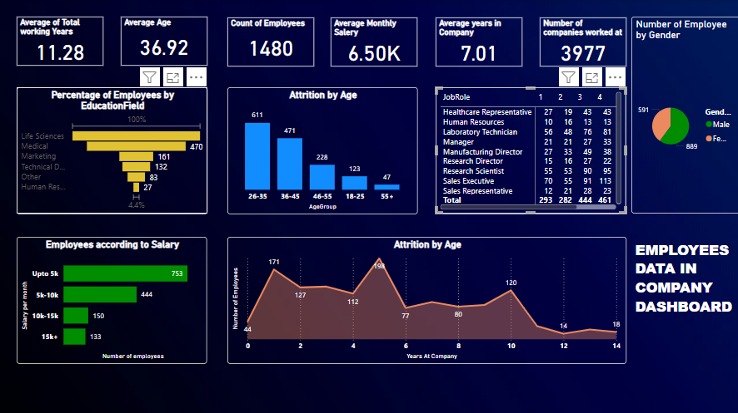
The overall Dashboard of this project

Slide 3
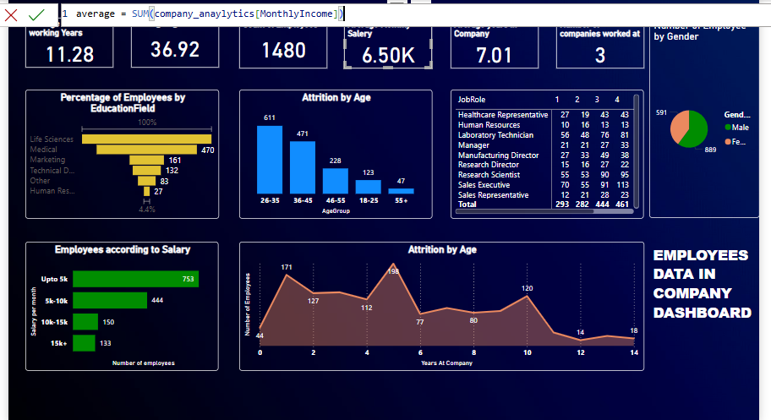
Average Income
Power BI Employee Analytics can display average salary by various categories like department or job role, showing salary trends and highlighting potential pay discrepancies through clear visualizations.

Slide 4
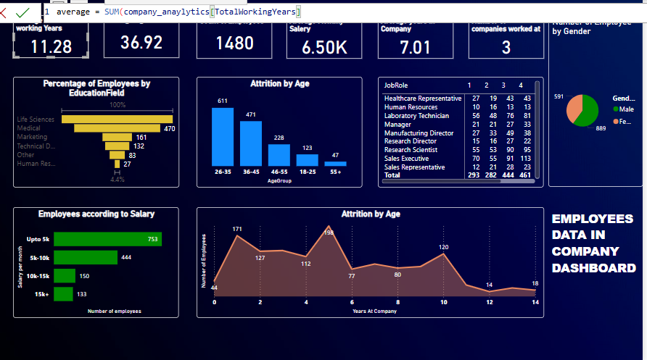
Average Working Years
Power BI calculates and visualizes average total working hours by team, role, or individual, revealing workload patterns.

Slide 5
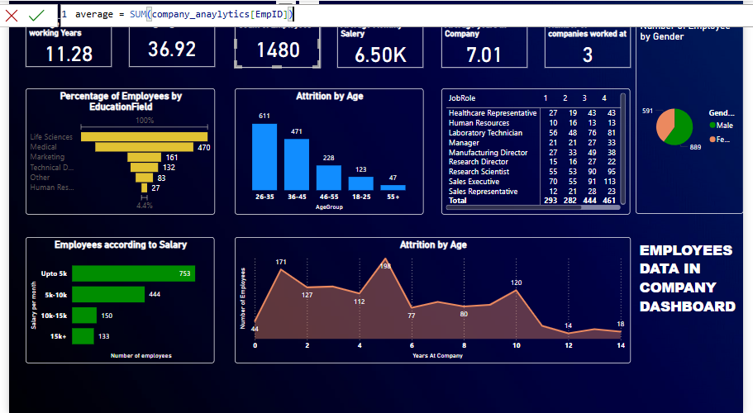
Total Employees
Power BI can quickly display the total employee count, broken down by various categories like department, location, or job role. This provides a clear overview of workforce size and distribution.

Slide 6
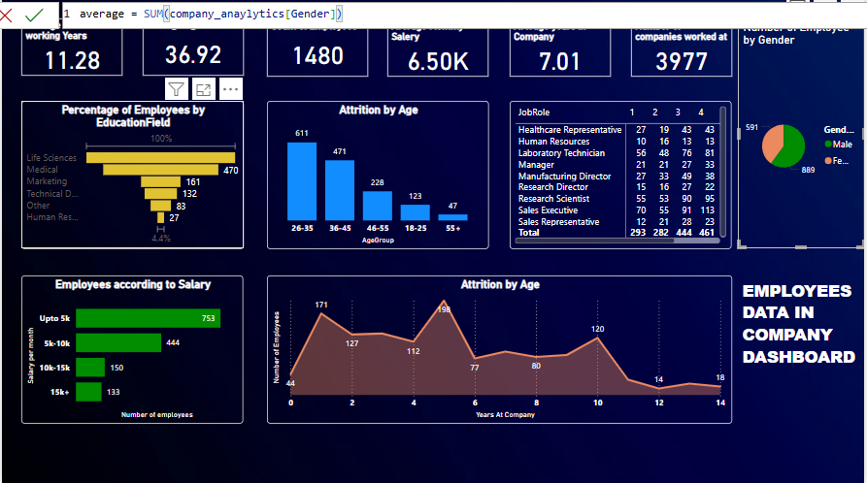
Different Gender
Power BI visualizes employee gender data: headcount, distribution across departments, salary comparisons, and performance metrics, highlighting diversity and potential disparities.

Slide 7
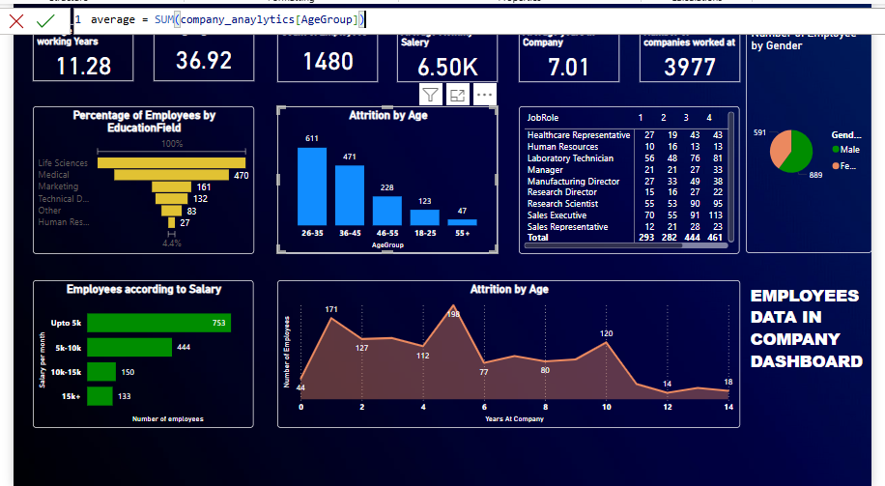
Age Group
Power BI visualizes employee age groups: headcount, salary, tenure, and performance, revealing age-related workforce patterns.

Slide 8
Project Overview
We used Power BI to take our employee data – things like who works here, how long they've been here, and how well they're doing – and made it visual. These charts and dashboards help us see important trends, like if people are leaving too quickly or if there are pay differences. This project gives us the tools to make better decisions about our workforce and improve our company.

Slide 9
Thank You!!

