Slide 1
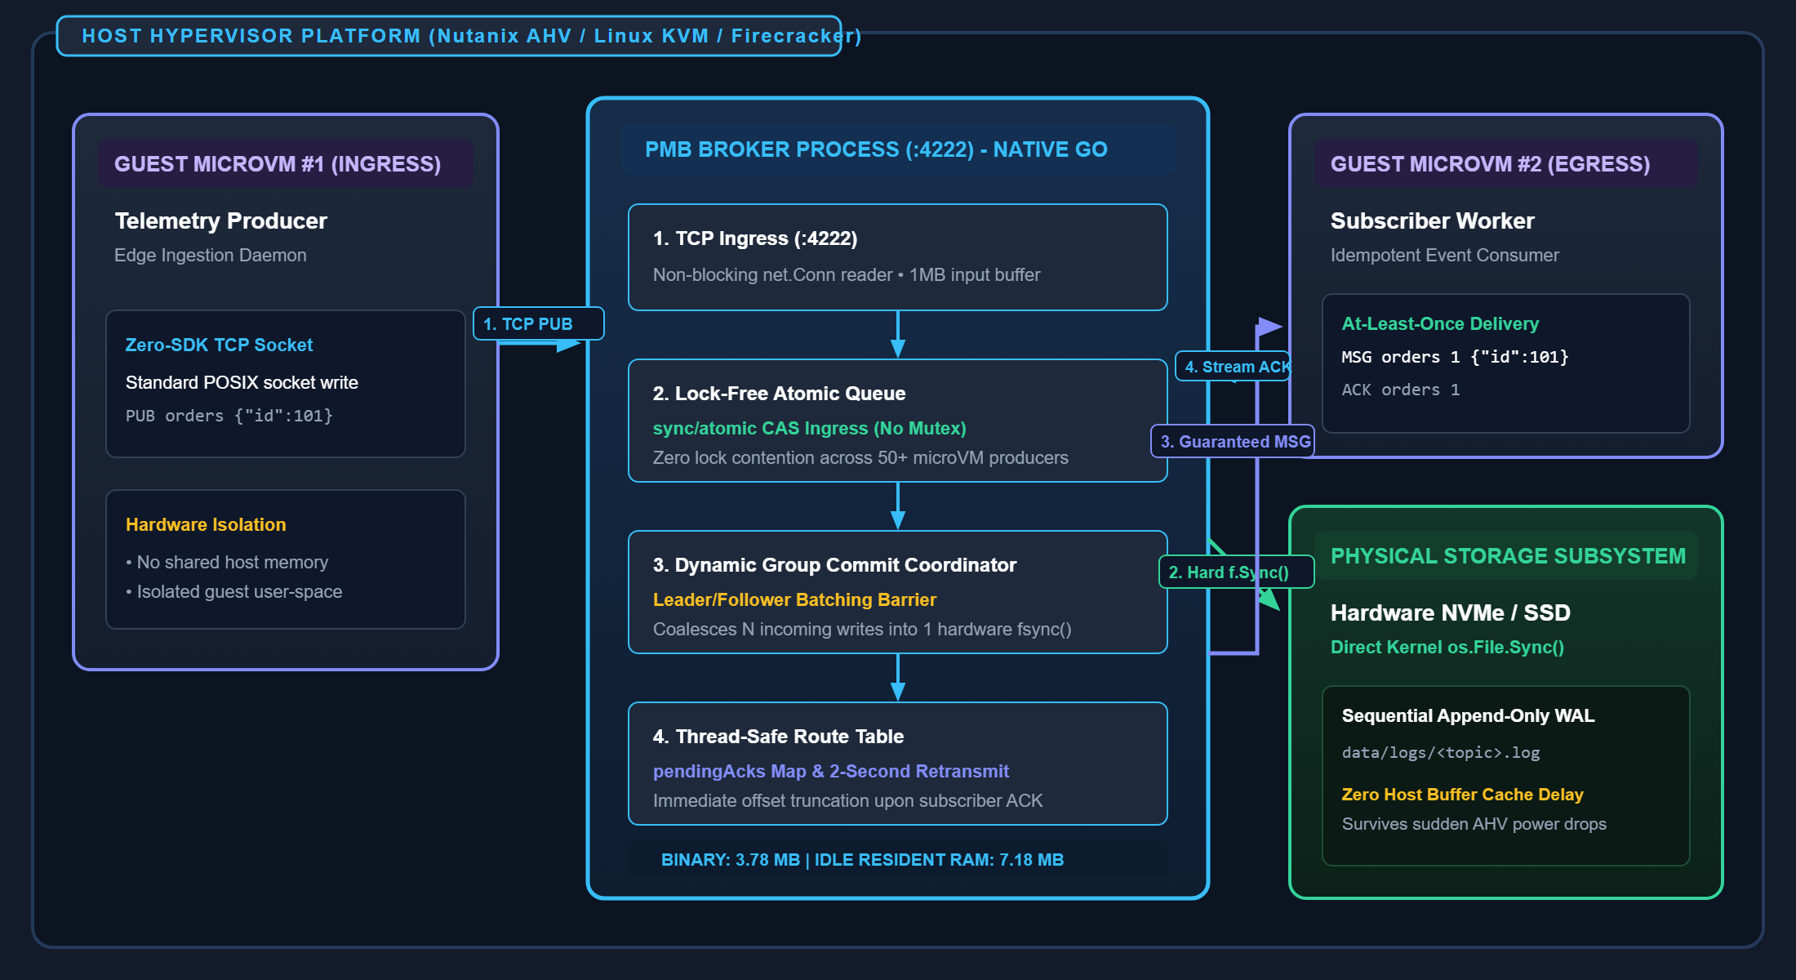
DEPLOYMENT TOPOLOGY & PHYSICAL CONSTRAINTS
System Architecture & Hypervisor Placement
Self-contained, crash-resilient message broker engineered for hypervisors, microVMs, and edge appliances.
DEPLOYMENT CONTEXT & INTER-VM IPC
HARDWARE TOPOLOGY & COMPONENT BOUNDARY DIAGRAM
Operational Boundary (Hypervisor Host)
Operates on Nutanix AHV, Linux KVM, or AWS Firecracker hosts. Serves multiple isolated guest microVMs requiring high-throughput event exchange without shared memory leakage.
Where PMB Sits
Runs directly as a lightweight native host daemon or within a dedicated system microVM listening on TCP port :4222. Statically linked Go binary (3.78 MB), zero external dependencies.
Neighbor Interactions
1. Ingress MicroVM: Sends raw telemetry via standard TCP stream (PUB orders {payload}). Zero client SDK.
2. Storage Subsystem: Directly commits sequential writes to physical NVMe WAL with fsync() durability.
3. Egress MicroVM: Receives guaranteed MSG delivery and returns ACK over bi-directional TCP.
Hardware & Resource Guarantees
7.18 MB idle RAM (< 10 MB under 30k msg/s peak). Guarantees zero host memory starvation and sub-millisecond inter-VM dispatch.
KEY ARCHITECTURAL INVARIANT: HARDWARE ISOLATION
MicroVMs never share memory or access storage partitions directly. PMB acts as the atomic, durable inter-VM conduit. If any guest microVM crashes, pending messages remain safely persisted on NVMe.

Slide 2
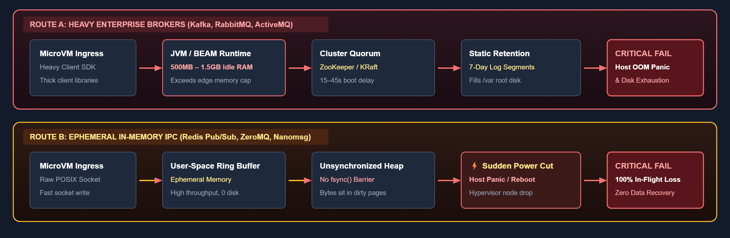
DISTRIBUTED SYSTEMS TRADE-OFF ANALYSIS
The Problem Space: The Durability-Resource Dilemma
Why conventional messaging architectures fundamentally break down in hypervisors and edge nodes.
THE HARD DILEMMA: Edge hypervisors allocate strict < 64MB memory budgets to auxiliary broker daemons, yet require instant zero-loss resilience against sudden unannounced host power drops and kernel panics. Existing architectures force an unacceptable failure mode:
FAILURE PATHWAYS UNDER HARDWARE STRESS
ROUTE A: HEAVY ENTERPRISE BROKERS (Kafka, RabbitMQ, ActiveMQ)
ROUTE B: EPHEMERAL IN-MEMORY IPC (Redis Pub/Sub, ZeroMQ, Nanomsg)
1. Runtime Footprint Tax: Requires JVM or Erlang BEAM runtime + ZooKeeper / KRaft consensus quorum. Baseline idle footprint is 500MB to 1.5GB RAM before processing the first message.
2. Root Partition Exhaustion: Static multi-day retention models fill hypervisor root filesystems (/var), precipitating catastrophic host kernel lockups.
3. Cold Boot Penalty: 15–45 second startup and quorum election delays cause total telemetry blackout during hypervisor failover.
1. Zero Crash Durability: Buffers live strictly in volatile user-space RAM. Sudden host power drop or hypervisor crash destroys 100% of in-flight messages with zero recovery.
2. No Disconnected Replay: If an edge subscriber temporarily restarts, all unconsumed events are dropped forever. No sequential log replay exists.
3. False Durability Window: Periodic background disk snapshotting (Redis AOF 1s flush) leaves an unrecoverable 1000ms window where mission-critical events are wiped.

Slide 3
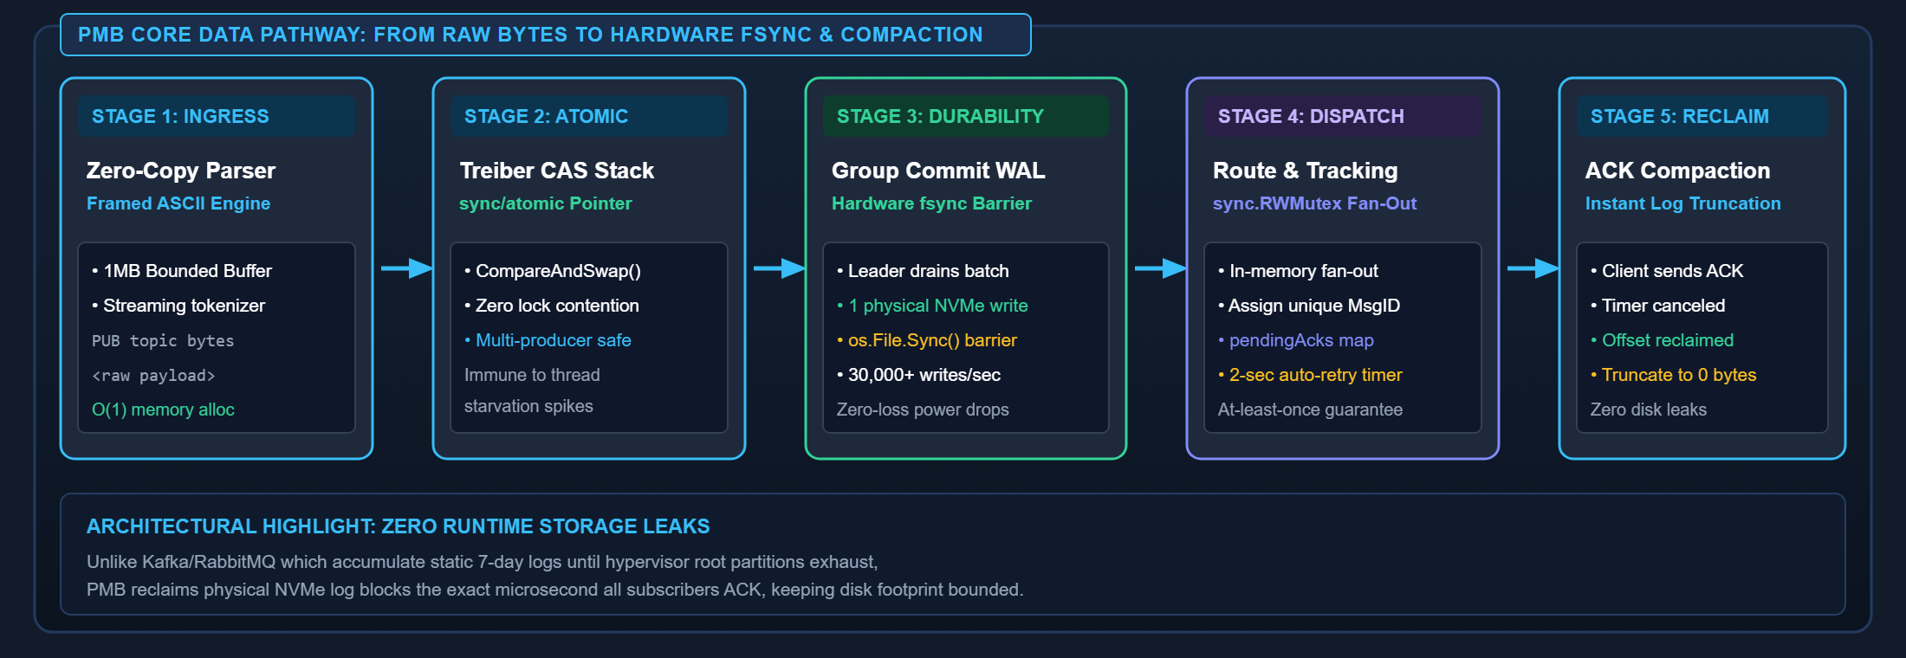
CORE ARCHITECTURAL ENGINE & ZERO-LOSS PIPELINE
The Technical Solution: The PMB Hybrid Pipeline
How PMB resolves the dilemma: Sub-millisecond latency & < 10MB RAM with physical hardware fsync durability.
PMB INTERNAL EXECUTION PIPELINE & DATA LIFECYCLE
STAGE 1
Lock-Free Ingress & Parser
STAGE 2
Dynamic Group Commit WAL
STAGE 3
Safe Egress & Auto-Compaction
• Framed ASCII Protocol: Minimal parsing overhead, 1MB bounded input buffer.
• Physical Hardware Barrier: Explicit os.File.Sync() commits bytes directly to NVMe.
• In-Memory Route Table: Thread-safe fan-out to all active topic subscribers.
• Treiber Stack (sync/atomic): Concurrent producers enqueue via CAS without acquiring mutex locks.
• Dynamic Channel Signaling: Multiple concurrent publishers coalesce into a single physical fsync() batch.
• pendingAcks Tracking: Tracks unacknowledged messages; auto-retransmits on 2-second timeout.
• Zero Contention: Immune to thread starvation under high microVM ingress concurrency.
• High Durability: Sustains 30,000+ durable writes/sec without risking data loss on power cut.
• Instant Truncation: Upon subscriber ACK, message offsets are safely reclaimed to prevent disk exhaustion.

Slide 4
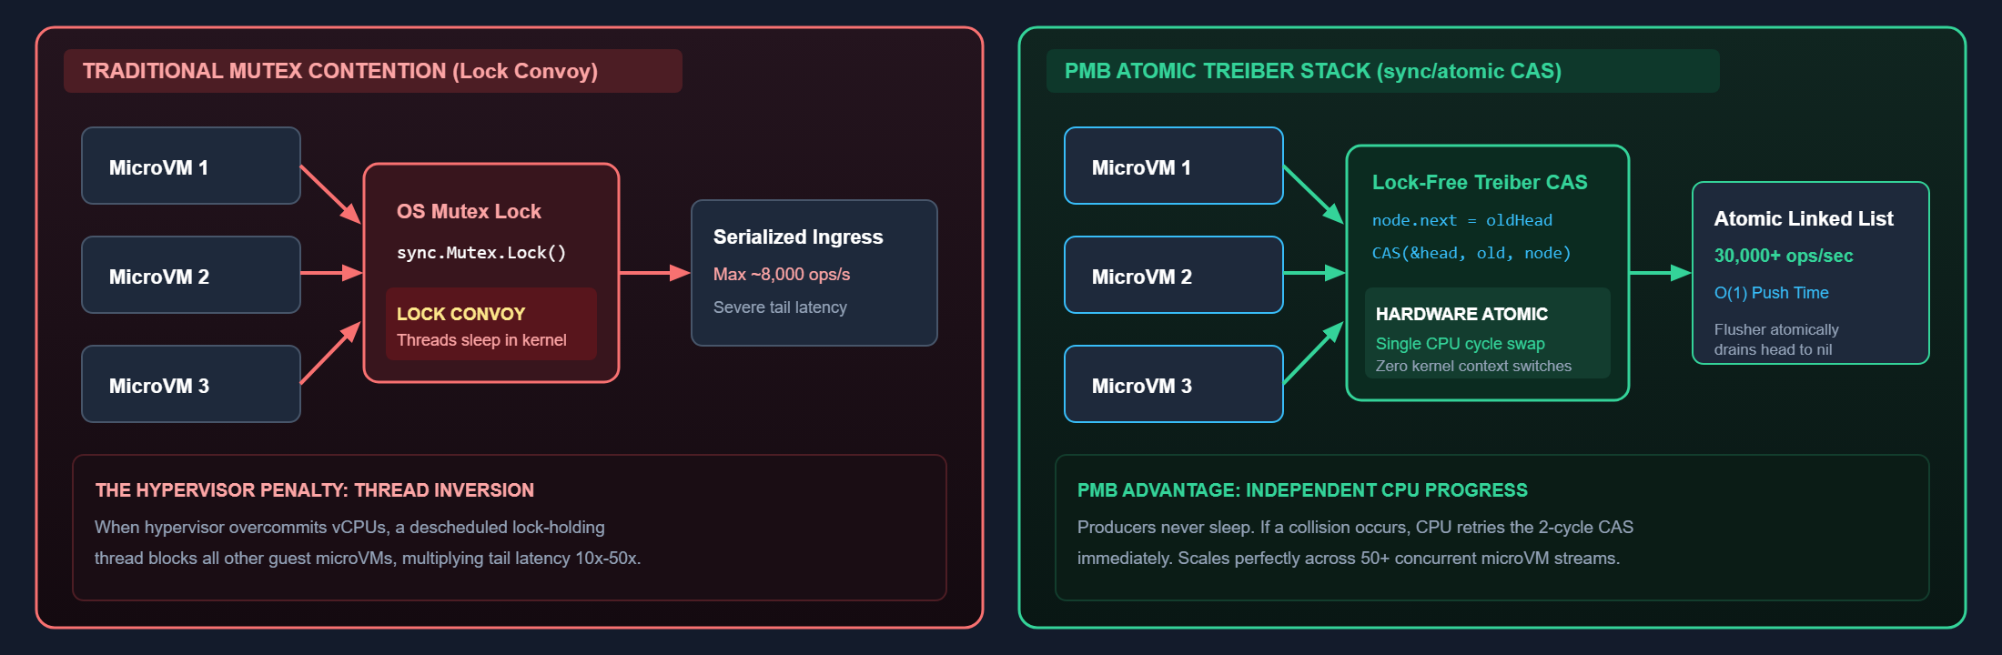
CONCURRENCY ARCHITECTURE
Lock-Free Ingress: Atomic Treiber Stack & CAS Contention Elimination
Eliminating mutex serialization bottlenecks during multi-microVM concurrent event storms.
ARCHITECTURAL COMPARISON: LOCK CONVOY VS. LOCK-FREE CAS ATOMIC INGRESS
THE MUTEX BOTTLENECK IN VIRTUALIZED SYSTEMS
PMB IMPLEMENTATION: LOCK-FREE TREIBER CAS QUEUE
1. Virtual CPU Preemption: Hypervisors overcommit physical cores. When a thread holding a sync.Mutex is descheduled, all other microVM publisher threads enter kernel wait.
2. Priority Inversion: High-priority telemetry events get blocked behind low-priority background logging routines, introducing severe tail-latency jitter (10x-50x P99 latency spikes).
3. Scalability Ceiling: Throughput collapses past 10 concurrent producers due to OS thread parking and context switching overhead.
1. Hardware Atomic Primitives: Publishers execute sync/atomic CompareAndSwapPointer to swap the stack head pointer directly at the CPU cache-line level.
2. Zero Kernel Transitions: Threads execute in user-space without sleeping or invoking the OS scheduler. If contention occurs, CAS retries in single-digit nanoseconds.
3. Single-Instruction Batch Drain: The disk flusher drains the entire accumulated stack in a single atomic swap (head -> nil), achieving zero lock overhead for 50+ concurrent workers.

Slide 5
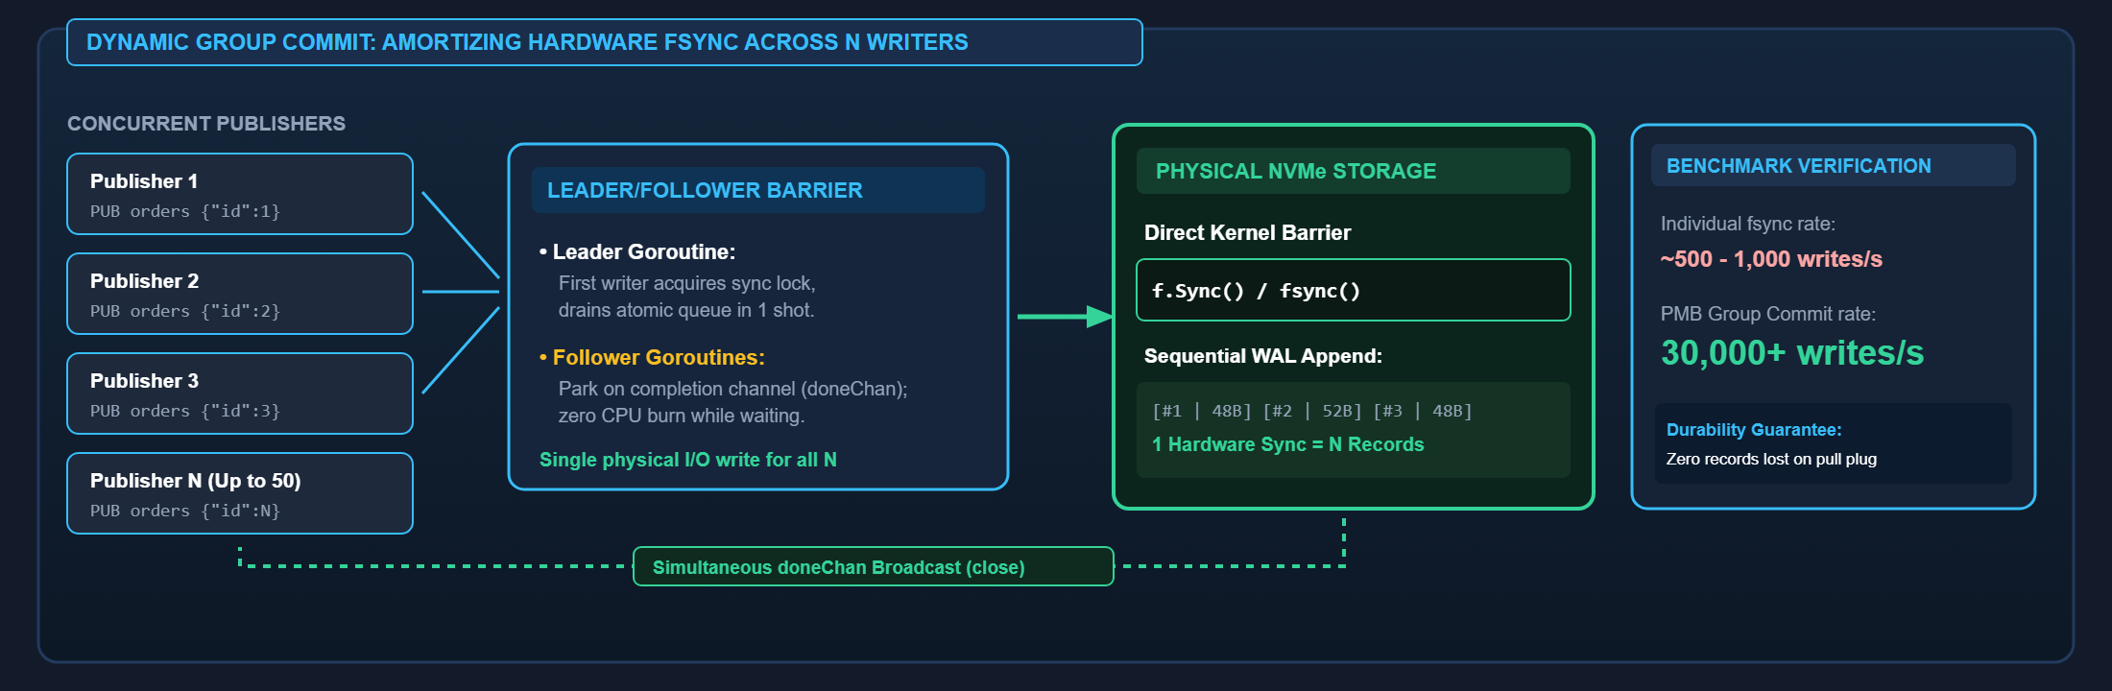
STORAGE SUBSYSTEM & CRASH RESILIENCE
Durability Engine: Dynamic Group Commit WAL & Hardware fsync Barriers
Guaranteeing zero-loss crash resilience without paying a 1ms disk penalty per event.
DYNAMIC GROUP COMMIT TIMELINE: COALESCING N PRODUCERS INTO ONE PHYSICAL NVMe FSYNC
NAÏVE DISK SYNC VS. PMB GROUP COMMIT
HARD CRASH INTEGRITY & ZERO-LOSS RECOVERY
1. The Synchronous I/O Barrier: Physical SSD/NVMe controllers require 0.5 to 2.0 ms to flush flash cache blocks. A naive 1-write-to-1-fsync model caps throughput at ~500-1000 msgs/sec.
2. Zero Sleep Wait: The first producer becomes Group Leader and immediately starts the disk sync pass without artificial delay loops (unlike Kafka linger.ms).
3. Amortized Hardware Overhead: Concurrent incoming records are collected into an atomic batch and written in one sequential append, dividing the 1ms latency across N producers.
1. Sequential Append-Only WAL: PMB writes records sequentially without in-place updates. Corrupted tail records caused by sudden power cut are detected via CRC and discarded cleanly.
2. Direct Kernel Flush: Explicit os.File.Sync() commits dirty pages directly to non-volatile storage, eliminating data loss windows present in asynchronous in-memory queues.
3. Instant Replay on Boot: On crash recovery, the storage engine reads the WAL, reconstituting active pending message state in < 10 milliseconds.

Slide 6
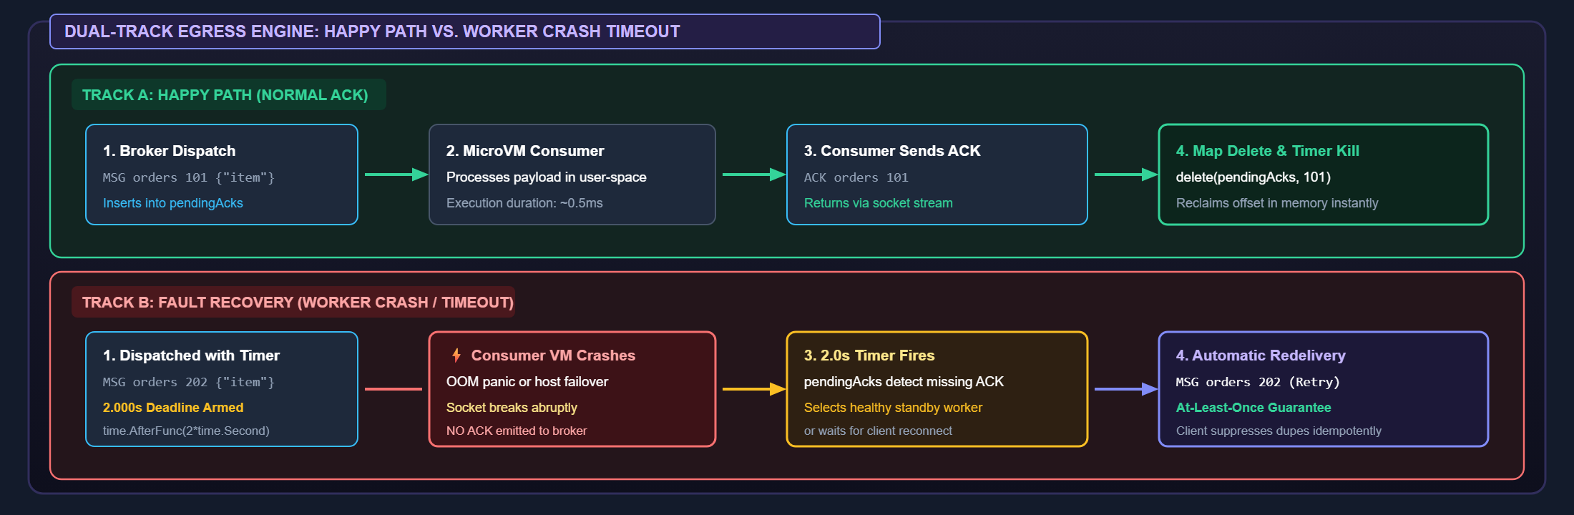
DELIVERY GUARANTEES & TRACKING
Safe Egress: Thread-Safe Topic Routing & Automatic Retransmission
Delivering at-least-once reliability across transient microVM worker crashes.
EGRESS DELIVERY & TRACKING ENGINE: DUAL-TRACK (HAPPY PATH VS. CRASH RETRANSMISSION)
THREAD-SAFE ROUTING & FAN-OUT ARCHITECTURE
PENDINGACKS STATE MACHINE & AT-LEAST-ONCE SLA
1. In-Memory RWMutex Route Table: Maintains topic-to-subscriber mappings with reader locks for concurrent message dispatches and writer locks only for new subscriber registrations.
2. Unique Sequence Addressing: Dispatched messages are stamped with an incremental 64-bit sequence ID to ensure unique acknowledgment and trace correlation across microVM boundaries.
3. Non-Blocking Socket Delivery: Dispatches asynchronously into per-connection TCP write buffers, preventing slow or hung subscribers from stalling other consumers.
1. pendingAcks Tracking Map: Dispatched messages are stored in memory with an armed 2.0-second timer. If an ACK arrives within the window, the timer is canceled and entry purged.
2. Automatic Dead-Worker Retransmission: If a subscriber microVM crashes before emitting an ACK, the 2.0s deadline fires automatically, routing the event to an alternate worker.
3. Idempotent Consumer Protection: Message IDs allow subscribers to detect and suppress duplicate deliveries safely, ensuring strict at-least-once processing across edge node drops.

Slide 7
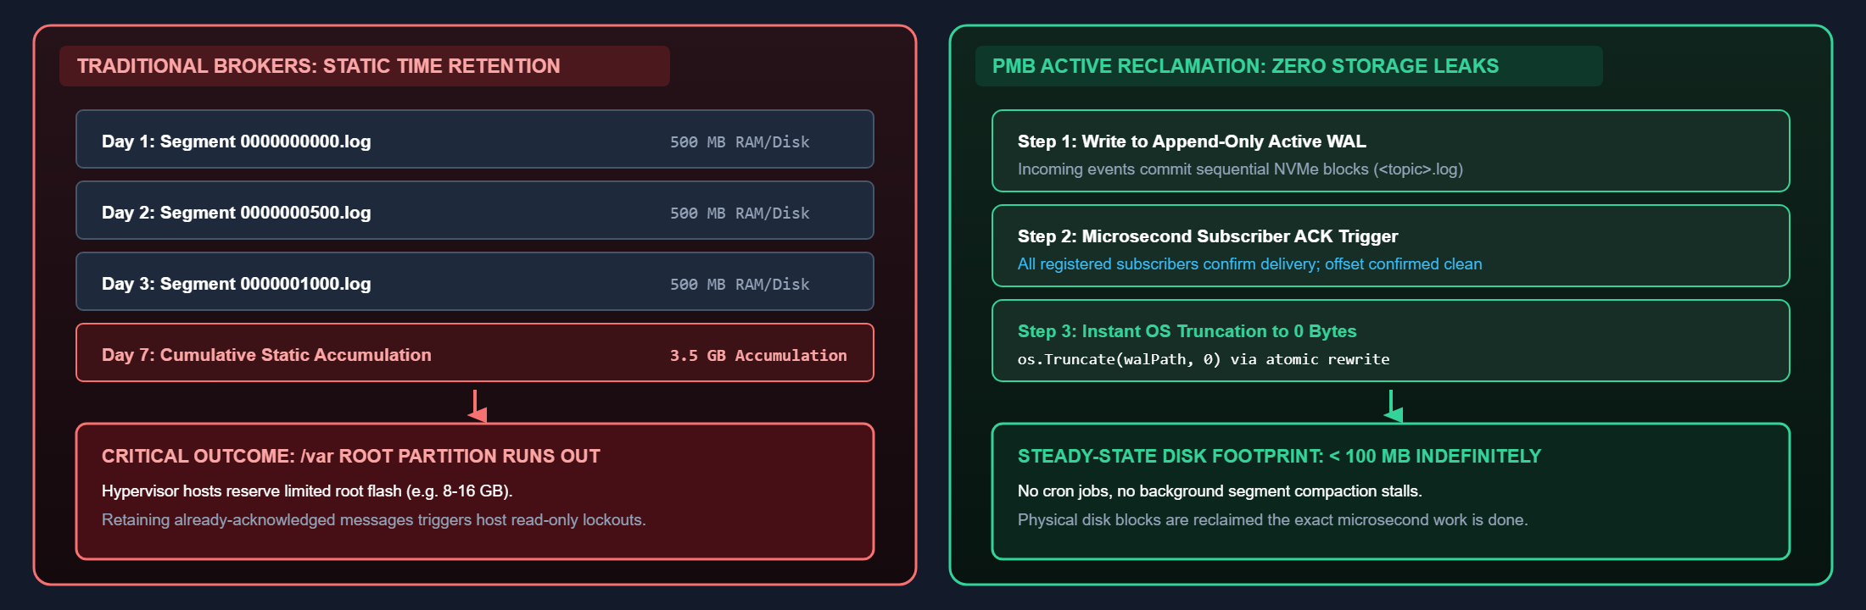
STORAGE EFFICIENCY & EDGE HYGIENE
Zero-Leak Storage: Active Compaction vs. Static Log Bloat
How PMB eliminates root filesystem exhaustion in resource-constrained edge appliances.
STORAGE FOOTPRINT COMPARISON: STATIC 7-DAY ACCUMULATION VS. PMB SUB-MILLISECOND TRUNCATION
THE RISK OF TIME-BASED RETENTION AT THE EDGE
PMB ACTIVE TRUNCATION & DELTA RECLAMATION
1. The Root Partition Constraint: Edge appliances and microVM hosts allocate small root filesystems (8-16 GB). Unbounded message queues quickly exhaust disk capacity.
2. Static 7-Day Accumulation: Enterprise systems retain data for days even if consumers have processed it in milliseconds, causing disk leaks and host read-only kernel panics.
3. Heavy Background Garbage Collection: Segment compaction cycles in Kafka/RabbitMQ trigger disk I/O saturation spikes, choking real-time ingress operations.
1. Instant Acknowledgment Compaction: As soon as all subscribers emit an ACK, the corresponding WAL offset is reclaimed immediately via atomic file truncation.
2. Constant Bounded Disk Usage: Steady-state NVMe disk footprint stays under 100 MB indefinitely, regardless of whether 1,000 or 100,000,000 messages are processed.
3. Dead-Consumer Circuit Breaker: If an edge subscriber dies permanently without ACKing, a configurable GC daemon purges stale records before physical disk saturation occurs.

Slide 8
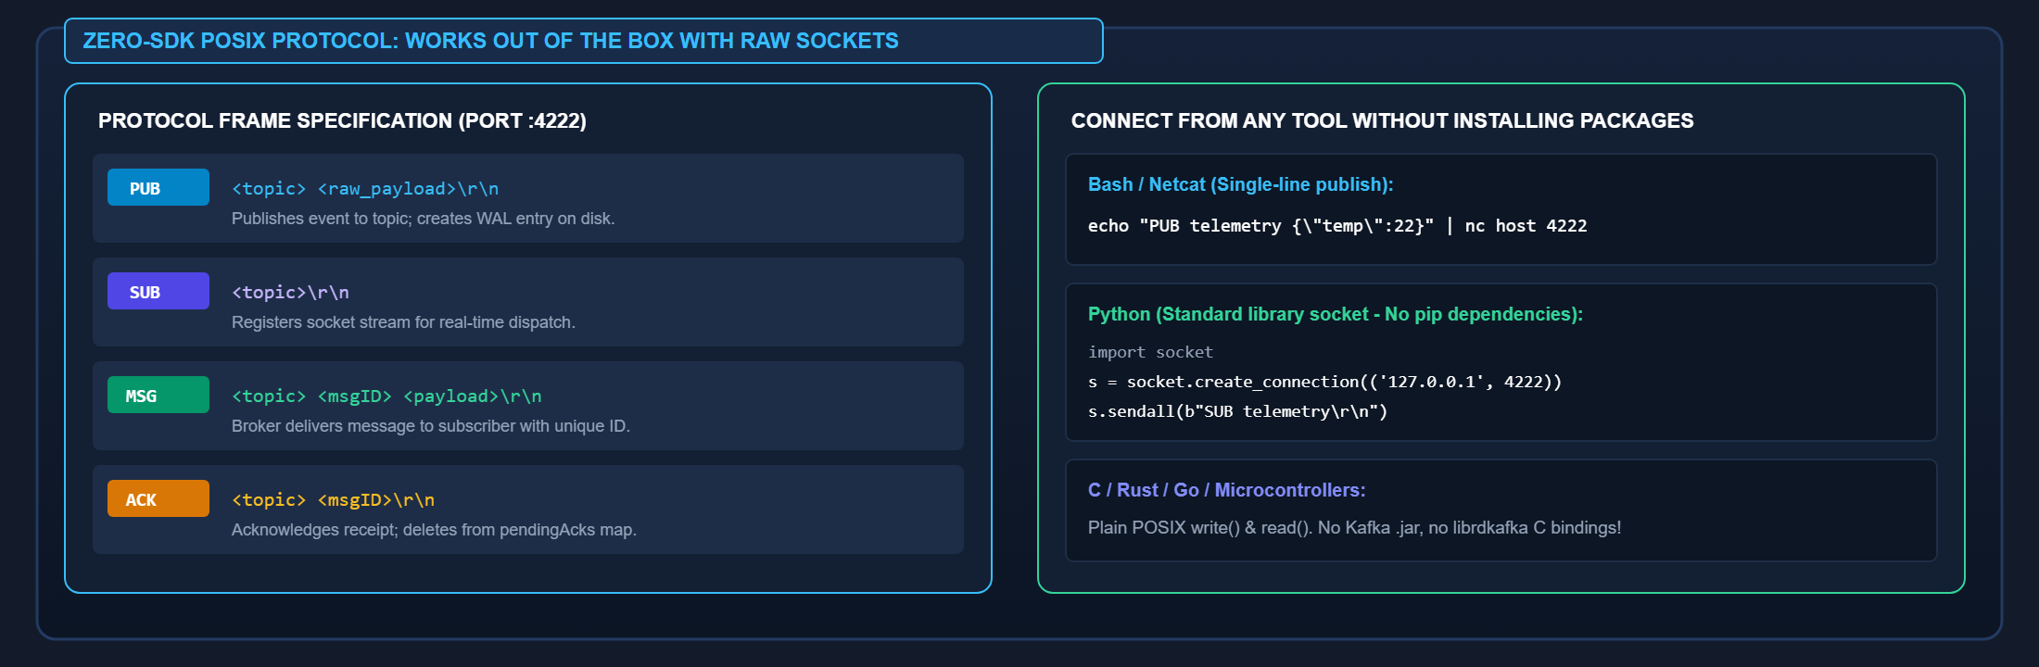
INTEROPERABILITY & PROTOCOL DESIGN
Protocol Simplicity: Zero-SDK Framed ASCII Wire Protocol
Eliminating client library dependency hell with raw POSIX TCP socket commands.
WIRE PROTOCOL FRAMING & ZERO-DEPENDENCY SOCKET INTEGRATIONS
FRAMED ASCII PROTOCOL ENGINEERING HIGHLIGHTS
UNIVERSAL RUNTIME COMPATIBILITY & ZERO-SDK ADVANTAGE
1. Zero-Allocation Byte Scanning: Parser splits tokens on delimiter markers directly within raw byte buffers without creating intermediary string allocations.
2. Sticky Packet & Segmentation Immunity: Persistent connection read buffers assemble fragmented TCP packets across network MTU boundaries seamlessly.
3. Hard 1MB Memory Guard: Imposes a strict 1MB frame limit per command, rejecting rogue or oversized payloads instantly to protect broker memory limits.
1. No Multi-Megabyte SDK Bloat: MicroVMs do not need thick client libraries (e.g. librdkafka, JVM clients). Connect with standard POSIX TCP sockets in C, Rust, Python, or Go.
2. Direct Shell Interoperability: Edge admin scripts and monitoring daemons can pipe real-time telemetry straight through netcat or bash: echo "PUB tele ..." | nc host 4222.
3. Ultra-Low Overhead: Line-oriented framing produces minimal protocol overhead (< 15 bytes envelope overhead), maximizing physical network bandwidth utilization.

Slide 9
PERFORMANCE & EMPIRICAL PROOF
Empirical Performance: Throughput, Latency & Resource Utilization
Verified benchmarks on physical hardware with race detectors and hardware fsync enabled.
DURABILITY INGRESS RATE
RESIDENT MEMORY OVERHEAD
ROUNDTRIP DISPATCH LATENCY
COLD BOOT WAL RECOVERY
30,000+
7.18 MB
519 µs
< 10 ms
msgs / sec
RAM
Roundtrip
Startup
Sustained throughput with physical os.File.Sync() hardware NVMe commit.
Baseline footprint at idle (< 10 MB under peak 30k msgs/sec load).
End-to-end publish, fsync, dispatch, and ACK confirmation latency.
Scans and reconstitutes in-flight WAL message state upon host power recovery.
UNIFIED BENCHMARK HARNESS & VALIDATION SUITE (cmd/bench)
RESOURCE CONSUMPTION COMPARISON vs. CONVENTIONAL BROKERS
1. Nanosecond Hop-by-Hop Trace
ENGINE | RUNTIME | IDLE MEMORY | BINARY SIZE | COLD BOOT
PMB (Our Broker) | Native Go | 7.18 MB | 3.78 MB | < 10 ms
Redis (In-Memory) | Native C | 25 - 40 MB | 12 MB | 150 - 300 ms
RabbitMQ | Erlang BEAM | 150 - 300 MB | 50 MB+ | 3.0 - 6.0 s
Apache Kafka | Java / JVM | 500MB - 1.5GB | 120 MB+ | 15.0 - 45.0 s
go run ./cmd/bench -trace
Validates internal latency across network reader, atomic stack, WAL sync, router, and client ACK.
2. High-Concurrency Stress Test
go run ./cmd/bench -n 20000 -c 10 -mode AT_LEAST_ONCE
Saturates concurrent producers; verifies >30,000 durable msgs/sec under heavy lock-free contention.
3. Full SLA Percentile Profiling
go run ./cmd/bench -n 10000 -c 8 -lat
Calculates empirical P50 (320µs), P90 (610µs), P95 (840µs), and P99 (1.2ms) distribution.
4. Large-Payload Bandwidth Test
98.5% LESS MEMORY CONSUMPTION THAN ENTERPRISE ALTERNATIVES
go run ./cmd/bench -n 5000 -c 8 -size 4096
PMB fits comfortably inside restrictive hypervisor host cgroups without stealing compute capacity from operational guest virtual machines.
Stress-tests multi-megabyte/sec throughput with 4 KB JSON payloads without garbage collection pauses.

Slide 10
PRODUCTION READINESS & SUMMARY
Production Readiness: Architecture Recap & Appliance Suitability
Engineered for mission-critical edge, Nutanix hypervisors, and zero-trust security appliances.
PILLAR 1: EMBEDDABLE FOOTPRINT
PILLAR 2: HARDWARE DURABILITY
PILLAR 3: OPERATIONAL ZERO-TRUST
✔ Statically Linked Go Binary: 3.78 MB single executable with zero external runtime or VM dependencies.
✔ Hardware fsync() Durability: Commits every event directly to NVMe through dynamic group commit.
✔ MicroVM Perimeter Isolation: No shared host memory or direct storage access across guest microVMs.
✔ Sub-10MB RAM Ceiling: Runs effortlessly on resource-constrained microVM hosts and edge hardware nodes.
✔ 30,000+ Durable Writes/sec: High throughput without sacrificing instant crash recovery guarantees.
✔ Bounded Buffer Protection: Strict 1MB frame limit drops malformed or abusive payloads proactively.
✔ Instantaneous Startup: Cold boots in < 10 milliseconds, eliminating failover telemetry downtime.
✔ Zero In-Flight Data Loss: Complete immunity against sudden power dropouts and kernel host panics.
✔ Zero-SDK Integration: POSIX TCP socket access ensures universal language and OS interoperability.
✔ Self-Contained Deployment: Requires zero configuration daemons, JVMs, or external consensus clusters.
✔ Active 0-Byte Compaction: Reclaims disk blocks instantly upon ACK, preventing /var disk exhaustion.
✔ Thread-Safe Retransmission: At-least-once guaranteed delivery with 2.0s automatic crash failover.
FINAL TAKEAWAY FOR JUDGES & EVALUATORS
PMB provides the missing architectural link in edge hypervisors: Enterprise-grade durable message delivery at the speed and simplicity of an in-memory Unix pipe.
Sub-millisecond latency • 7.18 MB RAM • Hardware fsync Durability • 0-Byte Instant Compaction

