Slide 1

CS209:Artificial Intelligence
Course Project Title: ChatGPT vs DeepSeek
Submitted by
1. Prakruthi KS CS23BT062
2. Aashutosh Kumar Yadav IS23BM028
3. Kallutla Veera Keshava Reddy MC23BT009
4. Sabde Tushar Ramakant CS23BT038
Team : 14
Course Instructor: Prof. Dileep. A.D Mentor Name: Suraj B Madagoankar

Slide 2
Content
Date:05/05/2025
Introduction
Correlation & Outlier detection
Graphical analysis for a certain trends
Forecasting AI Performance
KDE
Anomalies Detection

Slide 3
Introduction
The 14.csv DeepSeek vs. ChatGPT Performance dataset provides a synthetic comparison of AI performance between ChatGPT (GPT-4-turbo) and DeepSeek (DeepSeek-Chat 1.5) over a 1.5-year period (July 2023- February 2025). With over 10,000 rows, the dataset captures key metrics related to user engagement, AI response characteristics, and platform performance. The data enables in-depth time-series forecasting and trend analysis, allowing researchers to assess AI adoption patterns, user behaviour shifts, and model performance evolution.
About the dataset
Dataset consists of 10000 entries
Total number of attributes = 28
Number of numerical attributes = 16

Slide 4
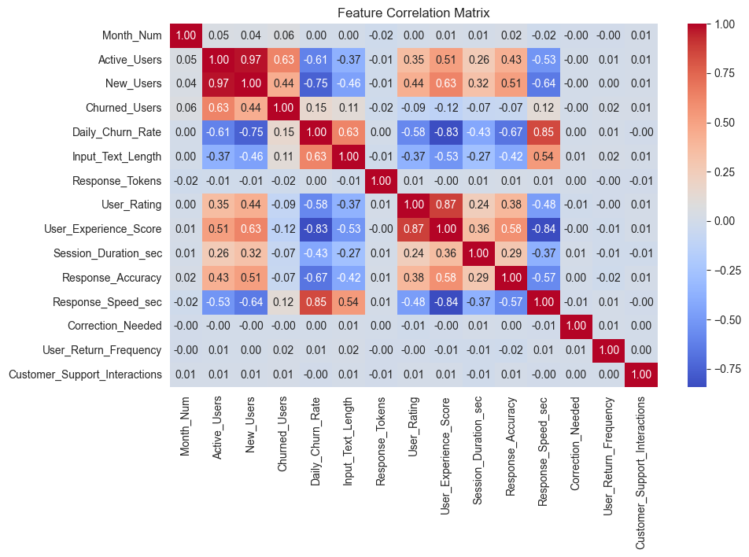
Correlation Heatmap (numeric attributes)

Slide 5
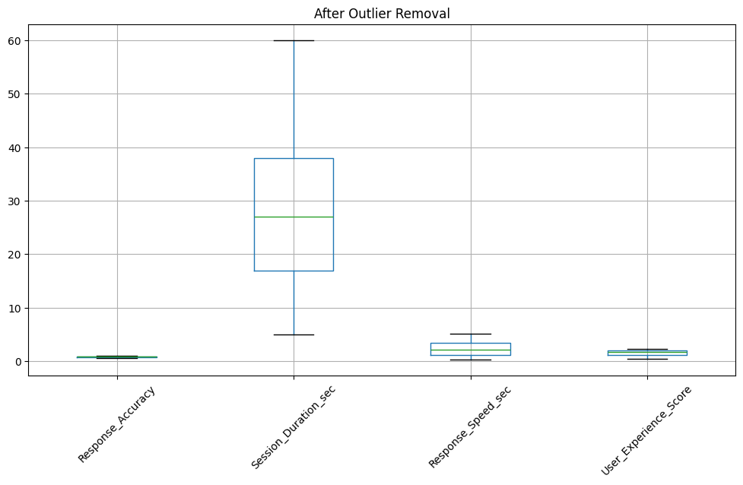
Visualized the distribution and outliers for important numerical features after outlier removal using the IQR method

Slide 6
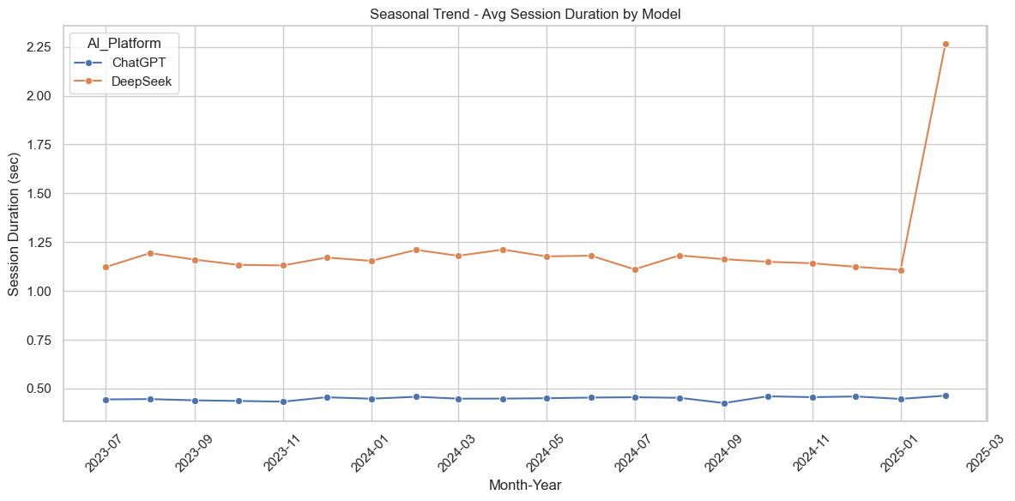
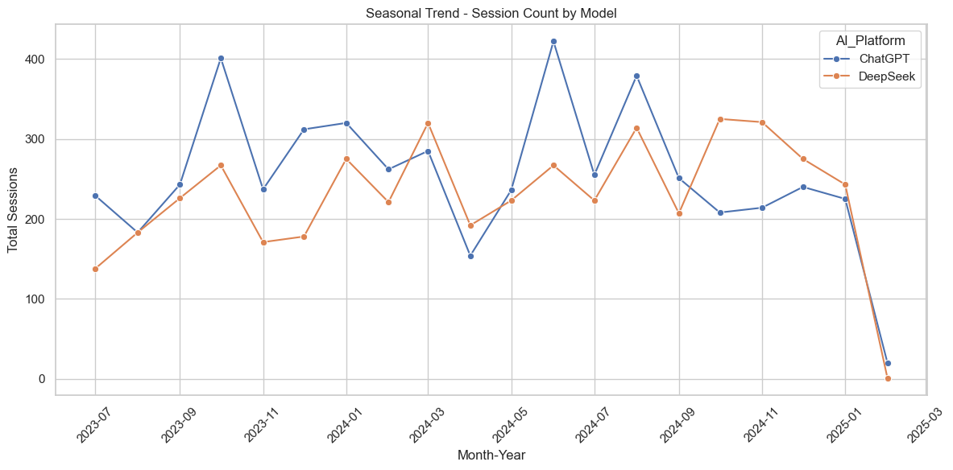
Analysing the total number of sessions and the session count aver the time period for each models

Slide 7
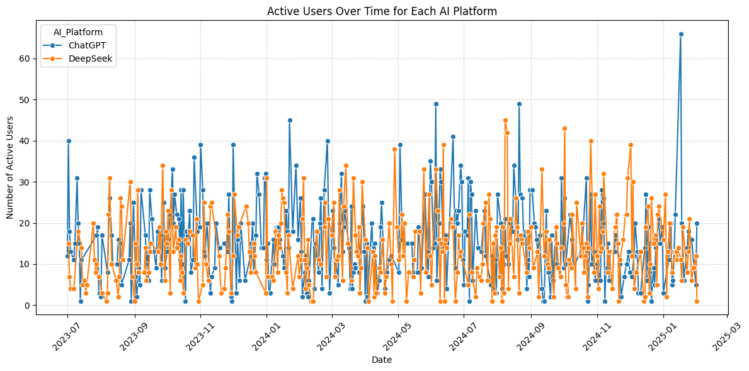
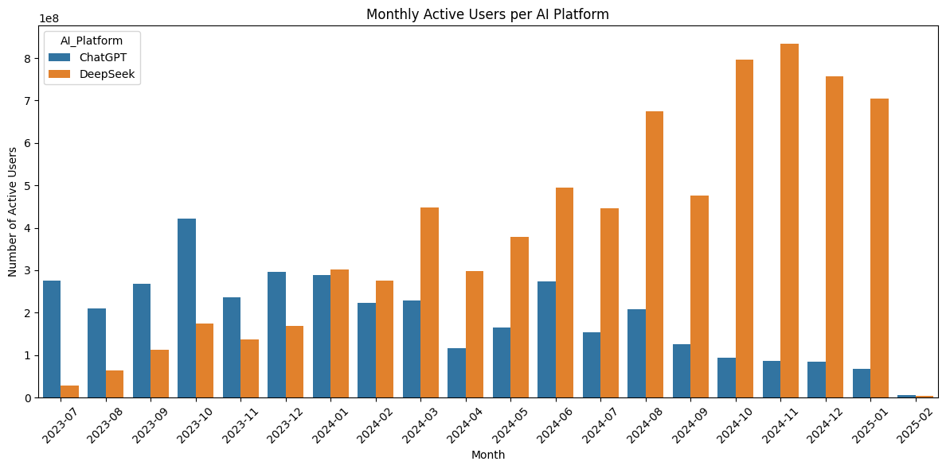
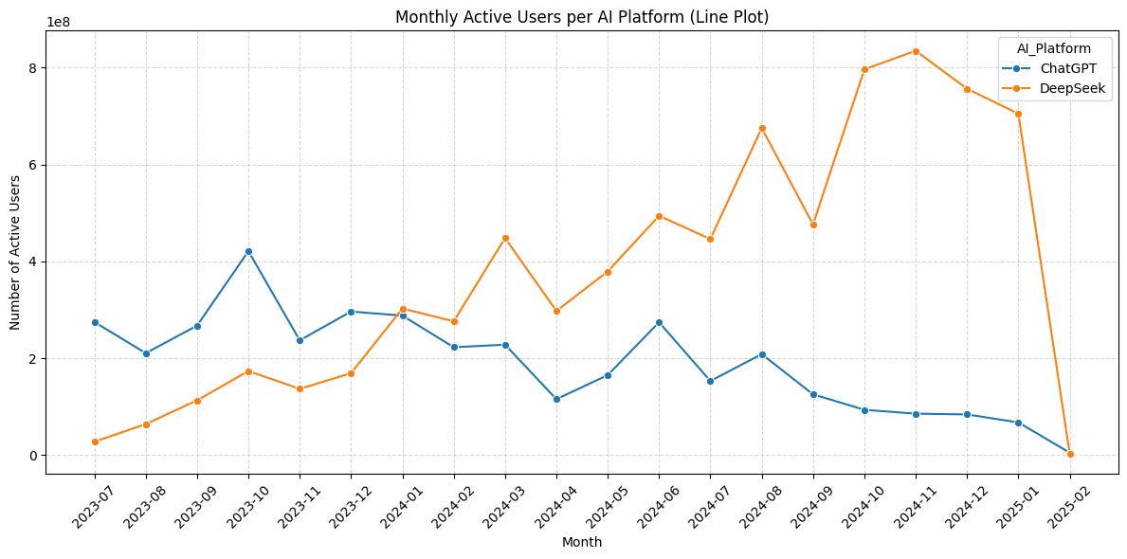
Monthly Active User trends for ChatGPT vs DeepSeek. This bar chart shows the number of active users (y-axis) for each platform per month (x-axis), illustrating usage trends over time

Slide 8
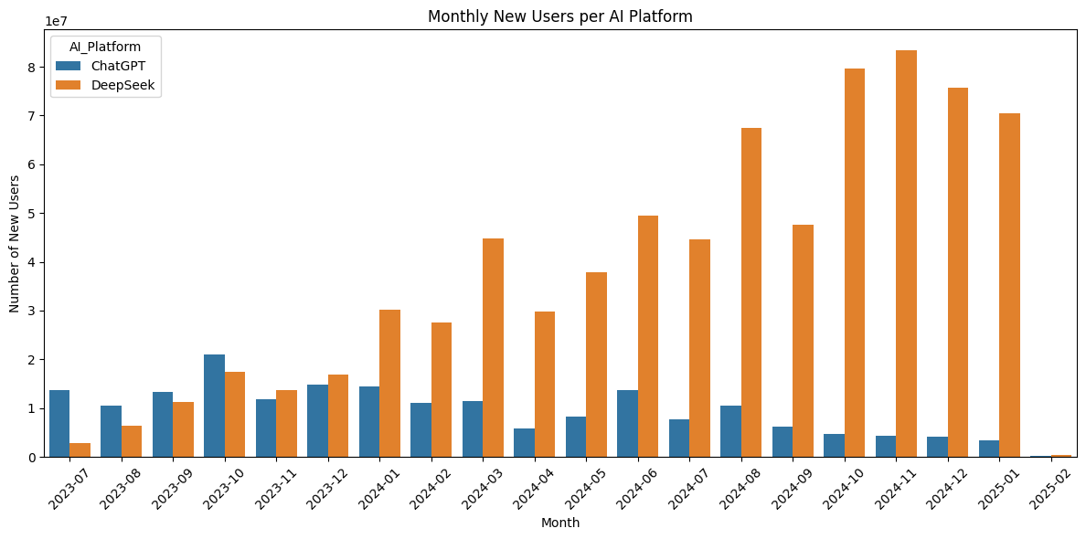
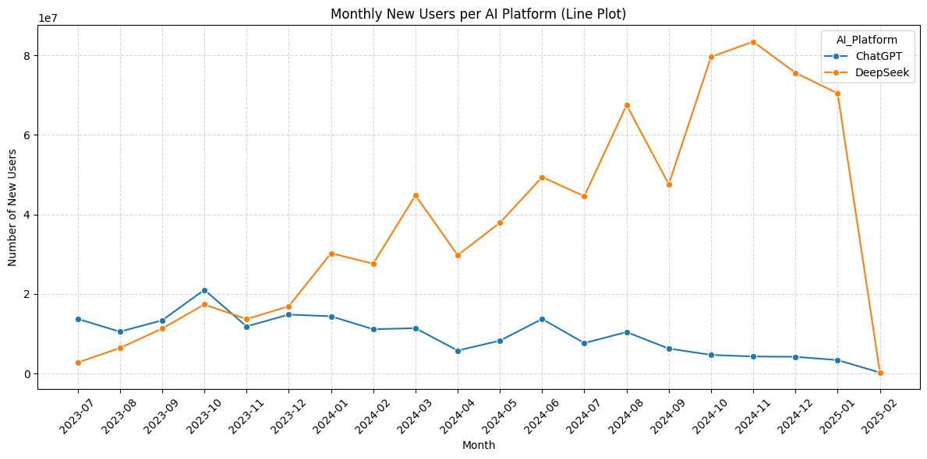
Analysing across years which platform is getting more popular

Slide 9
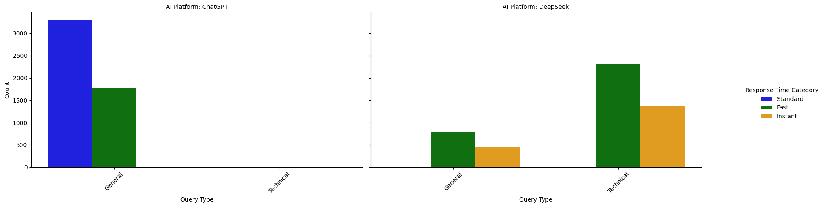
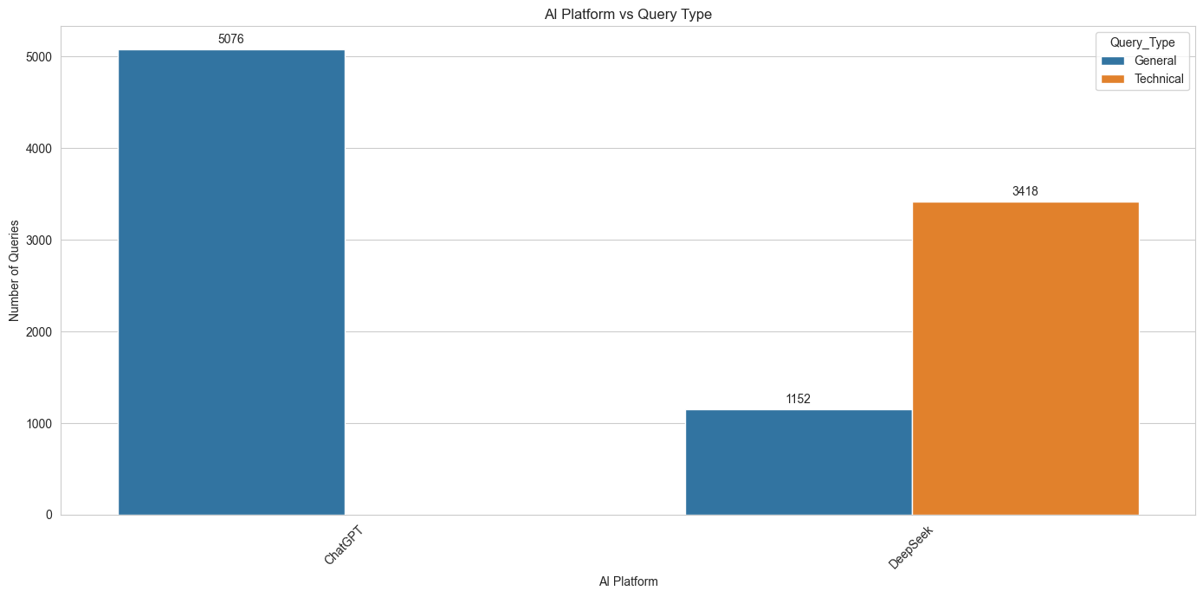
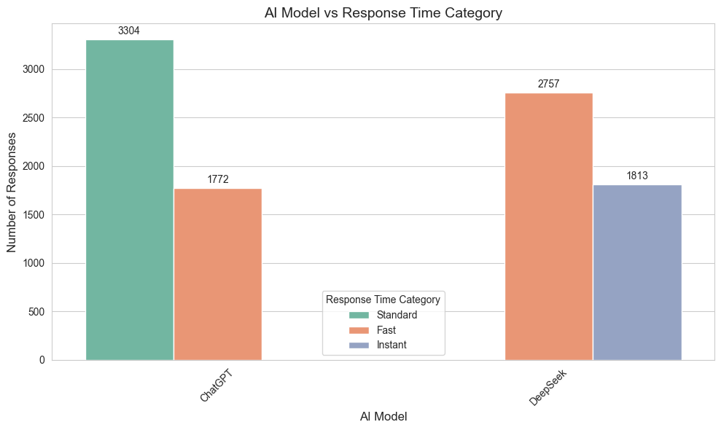
Analysing the query type and response time category and how they vary with each other

Slide 10
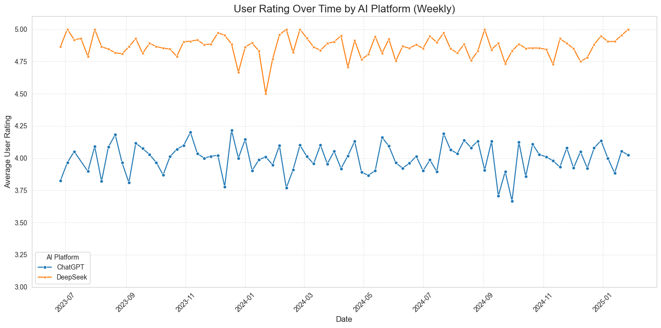
User rating overtime
Weekly Average User Rating Trend. This line graph shows how the average user rating (y-axis) changed over time, aggregated weekly (x-axis), indicating trends in user satisfaction.

Slide 11
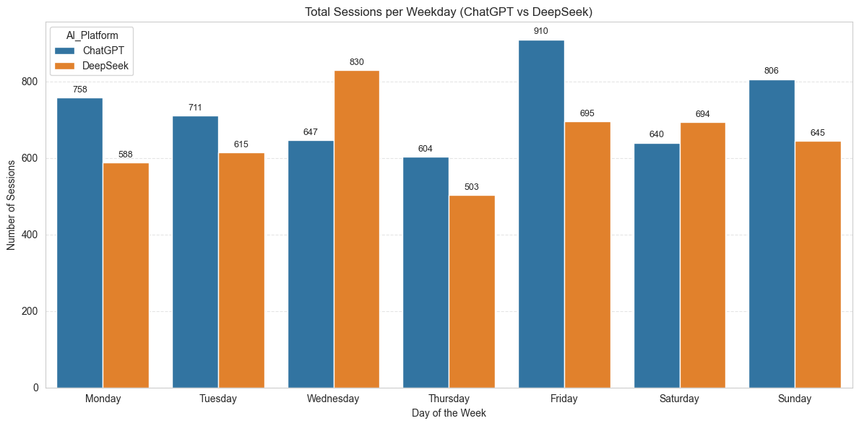
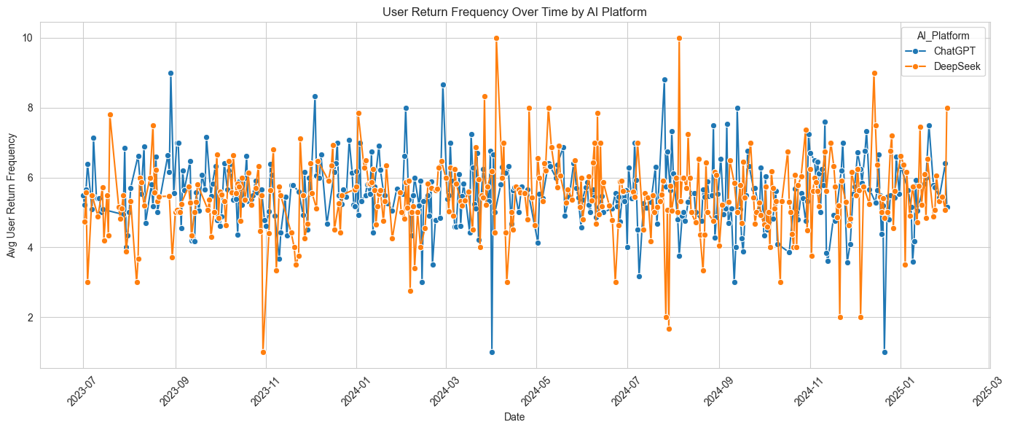
Analysing how the day of the week depends/ influences the number of sessions
Average user return frequency across the time period for both platforms

Slide 12
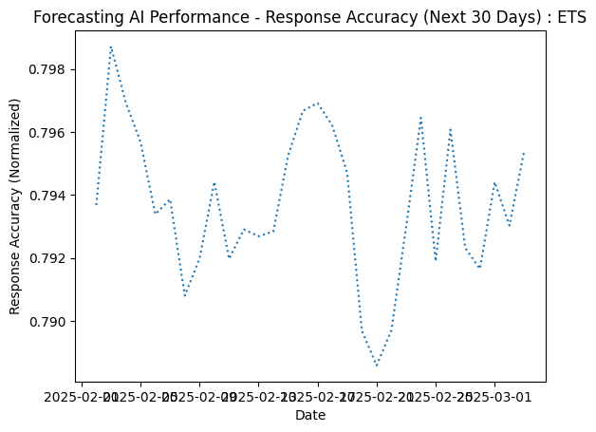
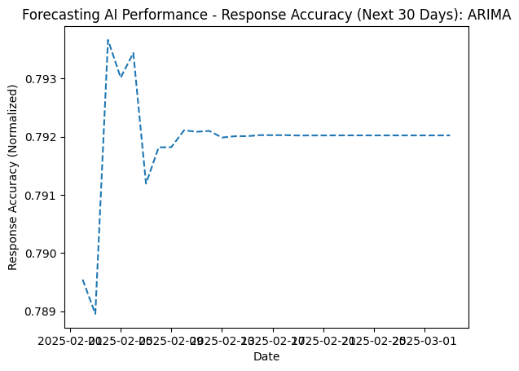
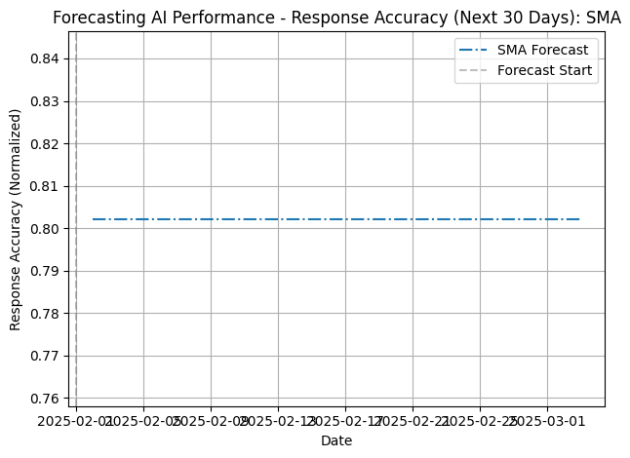
Forecasting AI Performance
Time series analysis (ARIMA,ETS,SMA)was performed on ‘ResponseAccuracy‘ to forecast future performance . Root Mean Squared Error (RMSE) values for these forecasts were calculated against actual data .The Simple Moving Average (SMA) forecast had the lowest RMSE (0.0473) in one analysis
ARIMA RMSE: 0.0519 (6.34%)
ETS RMSE: 0.0510 (6.23%)
SMA RMSE: 0.0473 (5.76%)

Slide 13
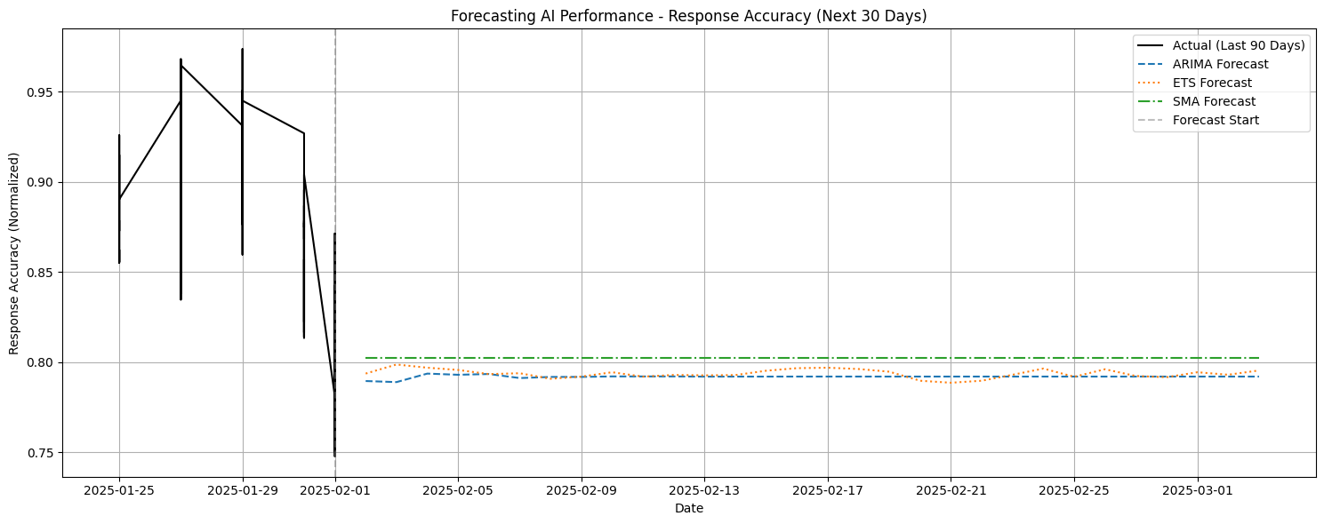
Forecasting AI Performance (for comparison)
ARIMA Accuracy Measures:
RMSE: 0.0519
RMSE (%): 6.3361
MAE: 0.0425
MAPE (%): 5.0535
ETS Accuracy Measures:
RMSE: 0.0510
RMSE (%): 6.2249
MAE: 0.0420
MAPE (%): 5.0030
SMA Accuracy Measures:
RMSE: 0.0473
RMSE (%): 5.7650
MAE: 0.0390
MAPE (%): 4.6772
Time Series Forecast for Response Accuracy. This plot compares the actual Response Accuracy over time (x-axis) against values predicted by forecasting models (e.g., ARIMA, ETS, SMA). The y-axis represents the Response Accuracy score

Slide 14
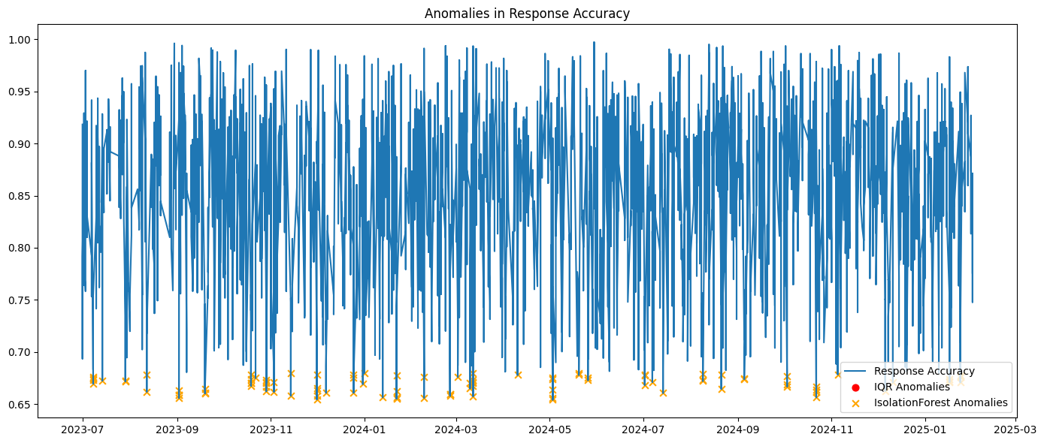
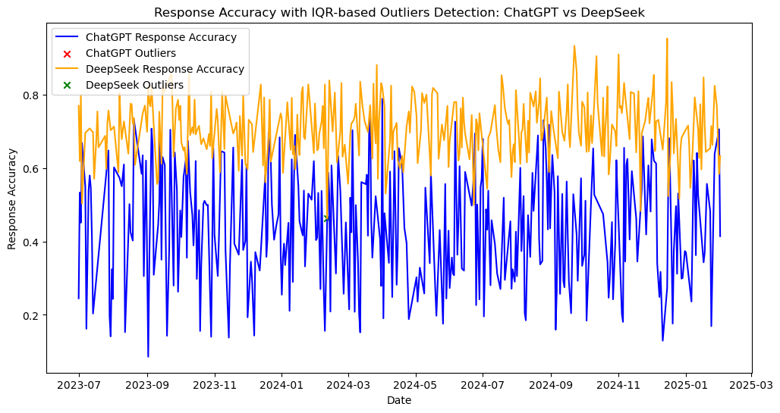
Anomalous values show wider spread and more extreme behavior than normal values , validating the IQR method's effectiveness in spotting irregular patterns.

Slide 15
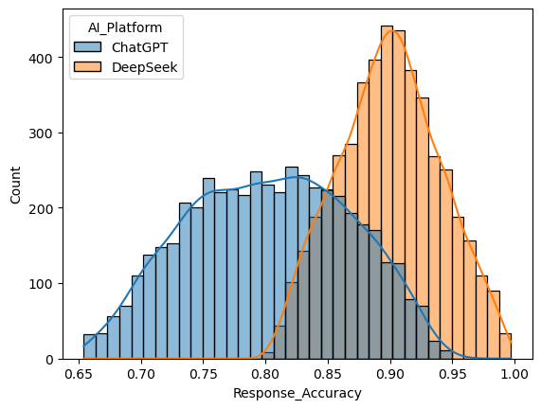
Distribution of Response Accuracy for ChatGPT and DeepSeek. This histogram displays the frequency (y-axis) of different Response Accuracy scores (x-axis) for each platform, revealing the shape and central tendency of their accuracy distributions.

Slide 16
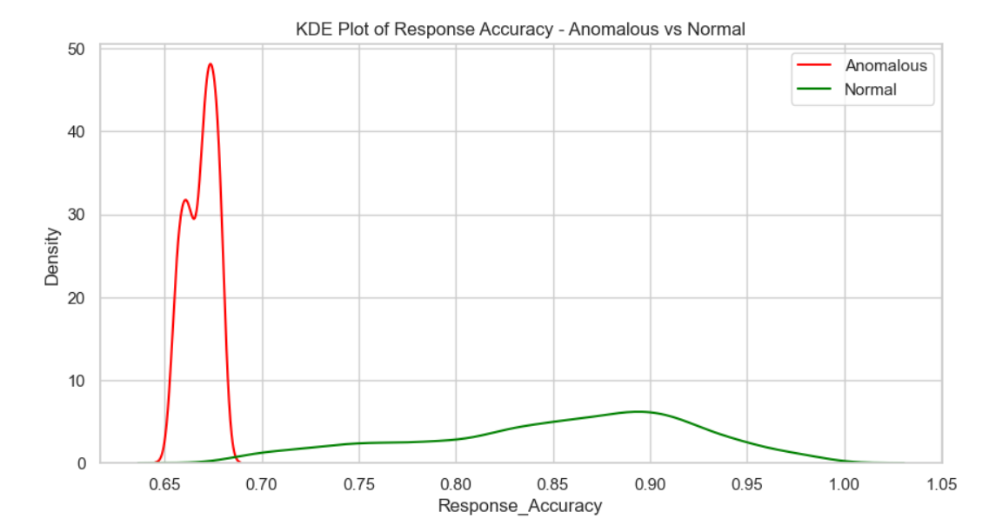
Distribution Comparison: Normal vs Anomalous Responses
.
This KDE (Kernel Density Estimation) plot contrasts the distribution of normal and anomalous response accuracies. Anomalies (red) are skewed and deviate significantly from the expected normal distribution (green), reinforcing the presence of outliers

Slide 17
AI Platform-wise Anomaly Detection
Each panel compares ChatGPT and DeepSeek across different anomaly types: - Left: Point & subsequence anomalies using statistical thresholds - Middle: Speed anomalies (IQR & Isolation Forest) - Right: Combined anomalies on response accuracy These highlight how different platforms behave under variable user loads and content complexities.

Slide 18
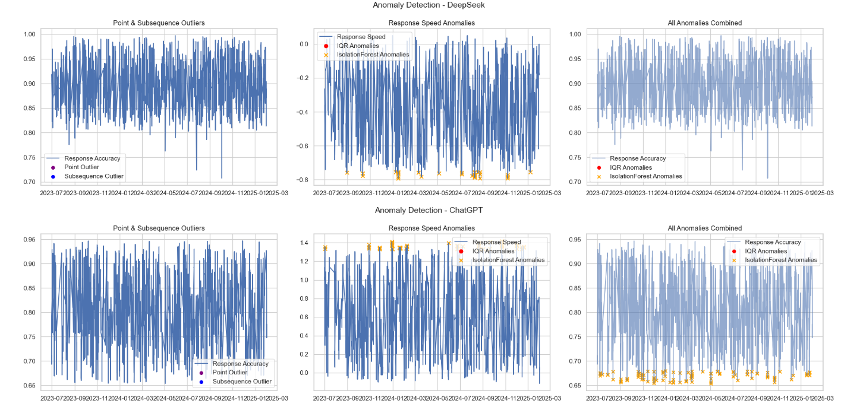
Anomalies Detection

Slide 19
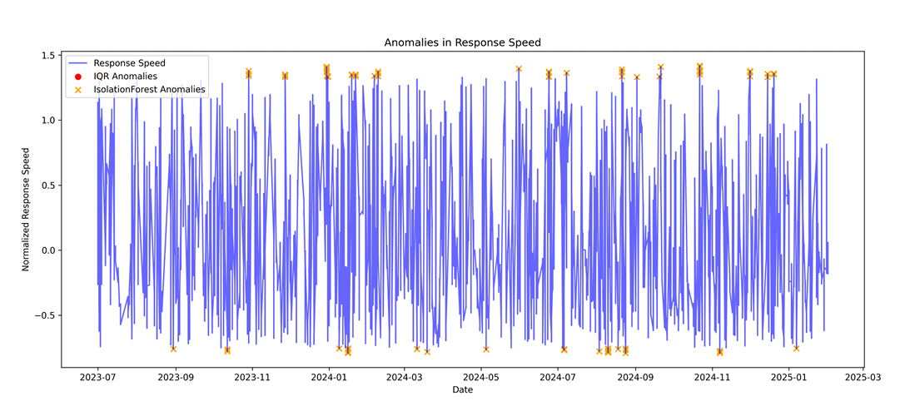
Anomalies in response speed
Anomalies identified in Response Speed using IQR / Isolation Forest. This plot displays Response Speed data points (y-axis, likely against index or time on x-axis), highlighting values identified as outliers (anomalies) by the chosen detection algorithm.

Slide 20
Conclusion
In this project, we conducted a comprehensive time-series analysis of AI performance and user behavior by comparing two large language models — ChatGPT (GPT-4-turbo) and DeepSeek (DeepSeek-Chat 1.5) — using a 1.5-year synthetic dataset. Our approach combined exploratory data analysis, visualization, statistical modeling, and anomaly detection to draw meaningful insights.
We implemented and evaluated three forecasting models — SMA, ETS, and ARIMA — on metrics such as Response Accuracy, User Ratings, and Session Duration
Based purely on the analyzed metrics within this specific dataset, DeepSeek (DeepSeek-Chat 1.5) demonstrated a clear advantage in terms of response speed.
A comprehensive verdict would necessitate assessing performance across a wider range of tasks, considering factors like reasoning complexity, creativity, cost-effectiveness, and potentially utilizing larger or more diverse datasets

Slide 21
THANK YOU!

