Slide 1
Ambient Back Scatter : Harvesting Power from Thin Air
By : Chetna (04311503010)
Instrumentation and Control Engineering.

Slide 2
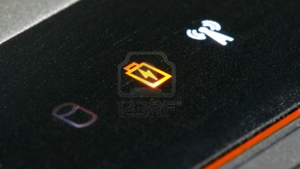
Introduction
Small computing devices are increasingly embedded in objects
and environments such as thermostats, books, furniture, and even
implantable medical devices . A key issue is how to
power these devices as they become smaller and numerous; wires
are often not feasible, and batteries add weight, bulk, cost, and require
recharging or replacement that adds maintenance cost and is
difficult at large scales .

Slide 3
Ambient Backscatter: Harvesting Power From Thin Air
A new system of wireless communication allows devices to interact and send data from one to another without having any source of power
The system is based on the new ambient backscatter technology, which practically harvests all the existing signals in the air and converts them into power for communication devices.
University of Washington researchers created the new system, which absorbs all the different kinds of transmissions all around us in the air, from radio waves, TV and cell signals to mobile networks and Wi-Fi, and transforms them to both a source of electricity and a medium for battery-free communication.
Basically, prototype devices using the technology are equipped with antennas to pick up the signals and reflect them back and forth Other devices equipped with similar antennas then intercept and decode the signal and send a response, allowing full communication without any exterior power source and without any human intervention.

Slide 4
What is this Technology
The new communication technique, which the researchers call “ambient backscatter,” takes advantage of the TV and cellular transmissions that already surround us around the clock. Two devices communicate with each other by reflecting the existing signals to exchange information. The researchers built small, battery-free devices with antennas that can detect, harness and reflect a TV signal, which then is picked up by other similar devices.
We can repurpose wireless signals that are already around us into both a source of power and a communication medium,” said lead researcher Shyam Gollakota, a UW assistant professor of computer science and engineering. “It’s hopefully going to have applications in a number of areas including wearable computing, smart homes and self-sustaining sensor networks.”
The researchers published their results at the Association for Computing Machinery’s Special Interest Group on Data Communication 2013 conference in Hong Kong, which began Aug. 13. They have received the conference’s best-paper award for their research.

Slide 5
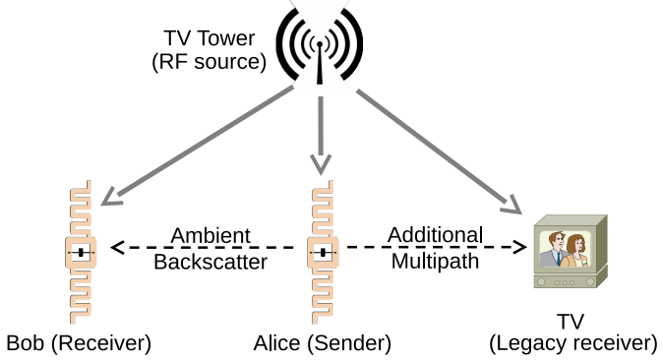
Communication Through Ambient Backscatter

Slide 6
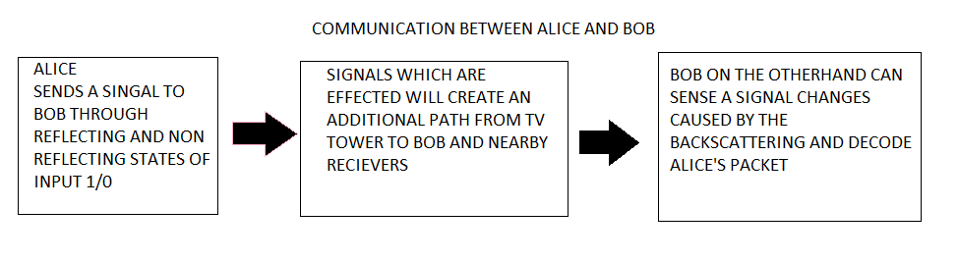
Achieves information rates of 1 Kbps over a distance of 2.5 feet while operating indoors
And over a distance of 1.5 feet outdoors
Is able to operate battery-free at distances of up to 6.5 miles from the tower

Slide 7
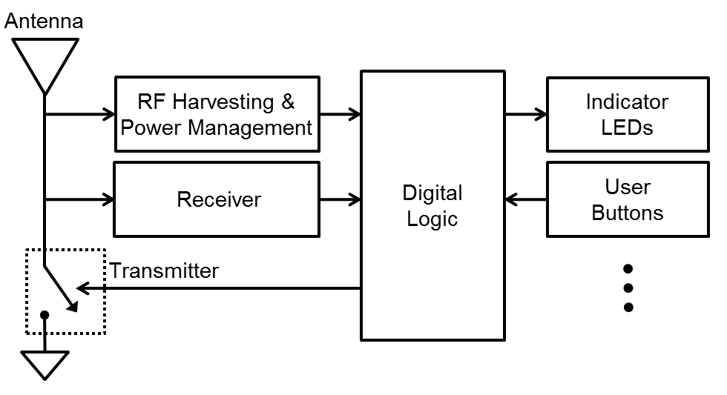
Block diagram of An Ambient Backscattering Device
The transmitter, receiver, and the harvester are all connected to a single antenna and use the same RF signals. The transmitter and receiver communicate by backscattering the ambient signals. The harvester collects energy from the ambient signals and uses it to provide the small amount of power required for communication and to operate the sensors and the digital logic unit.

Slide 8
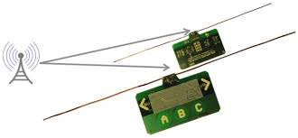
The researchers tested the ambient backscatter technique with credit card-sized prototype devices placed within several feet of each other. For each device the researchers built antennas into ordinary circuit boards that flash an LED light when receiving a communication signal from another device.
Groups of the devices were tested in a variety of settings in the Seattle area, including inside an apartment building, on a street corner and on the top level of a parking garage. These locations ranged from less than half a mile away from a TV tower to about 6.5 miles away.

Slide 9
Role of Tv Towers
TV towers transmit up to 1 MW effective radiated power (ERP) and can serve locations more than 100 m away from the tower in very flat terrain and up to 45 m in denser terrain
Firstly, TV towers broadcast uninterrupted, continuous signals at all hours of the day and night. Thus, they provide a reliable source of both power and signal for use in ambient backscatter. Secondly, TV transmissions are amplitude-varying signals that change at a fast rate.
Lastly, TV transmissions periodically encode special synchronization symbols that are used by the receiver to compute the multipath channel characteristics

Slide 10
3 Keys of Ambient Backscatter
It takes advantage of existing RF signals so it does not require the development of a special-purpose power Infrastructure
It has a very small environmental footprint because no additional energy is consumed beyond that which is already in the air.
3. Ambient backscatter provides device-to-device communication.

Slide 11
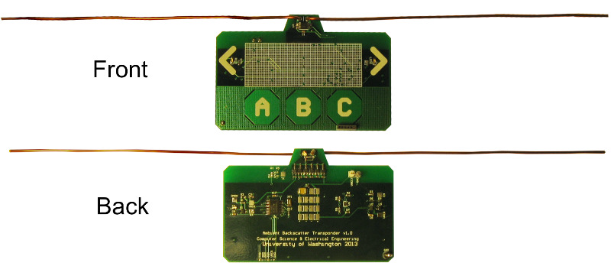
Prototype
A photo of prototype PCB that can harvest , transmit and receive without needing a battery or powered reader. It also includes touch sensors (the A, B and C buttons), and LEDs (placed near the two arrows) that operate using harvested energy and can be programmed by an onboard microcontroller.

Slide 12
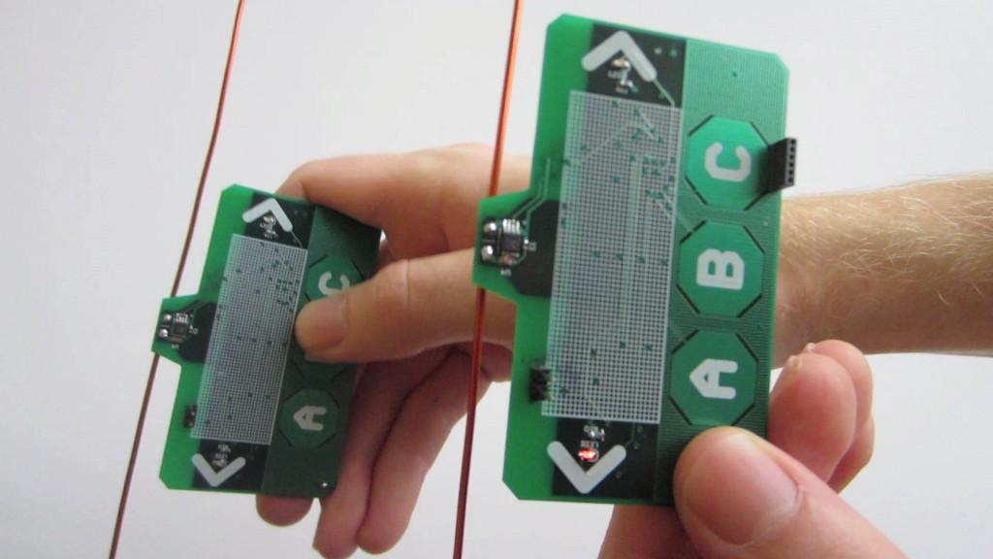
Hardware Prototype
Prototype approximately the size of a credit card includes a power harvester for TV signals, as
well as the ambient backscatter hardware that is tuned to communicate by using UHF TV signals in a 50 MHz wide frequency band centered at 539 MHz. The harvested energy is used to provide the small amounts of power required for ambient backscatter and to run
the microcontroller and the on-board sensors .
Prototype also
includes a low-power flashing LED and capacitive touch sensor for
use by applications.

Slide 13
Current Applications
1 . The first application is a bus pass that can also transfer
money to other cards anywhere, at any time. When a user swipes
the touch sensor in the presence of another card, it transmits the current
balance stored in the microcontroller and confirms the transaction
by flashing the LED.
2. The second is a grocery store application
where an item tag can tell when an item is placed in a wrong shelf.
We ask 10 tags to verify that they do not contain a misplaced tag
and flash the LED when they do.

Slide 14
Smart Card Applications
Prototype that comes complete with an ambient backscattering transmitter/
receiver, MSP430 microcontroller, capacitive touch sensor, and LEDs. When a user swipes the touch sensors (marked by A, B,C), in the presence of another card, it transmits the phrase "HelloWorld". The receiver on the other card decodes the transmission, and confirms a successful packet decoding
by flashing the LED.

Slide 15
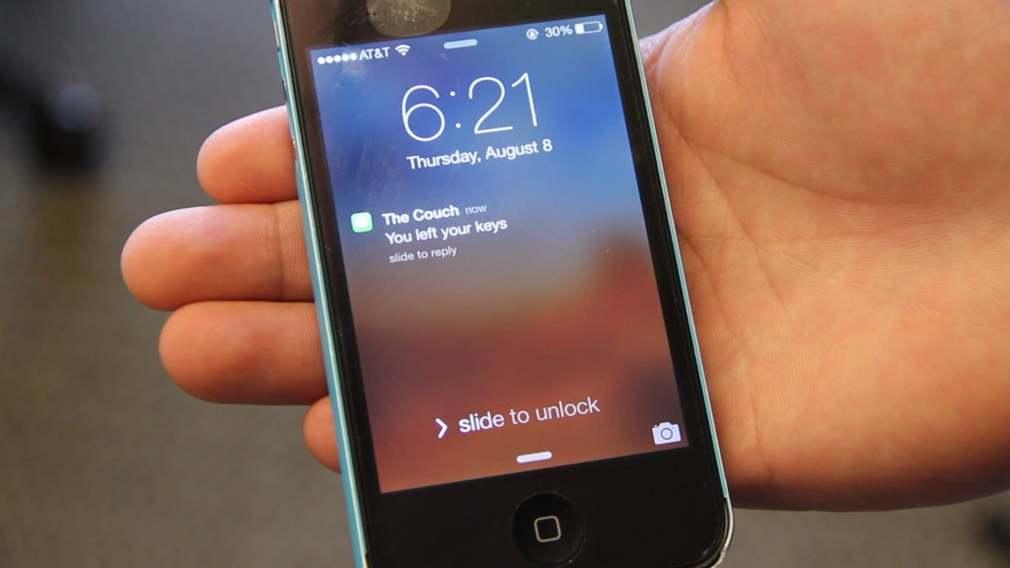
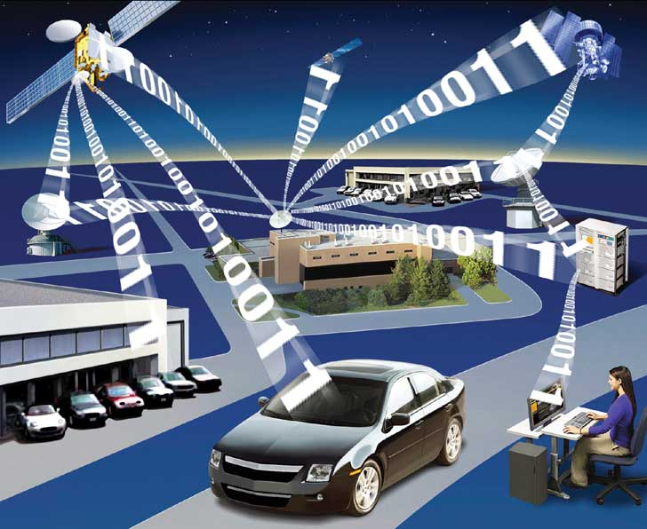
Future Applications
Smart sensors could be built and placed permanently inside nearly any structure, then set to communicate with each other. For example, sensors placed in a bridge could monitor the health of the concrete and steel, then send an alert if one of the sensors picks up a hairline crack. The technology can also be used for communication – text messages and emails, for example – in wearable devices, without requiring battery consumption.

Slide 16
Advantages
No Additional Battery or Power outlet required
function anywhere and with no maintenance
No pollutions
Compact in size
Can be used for Home monitering : The tech could also be used to allow smartphones to send text messages even if their battery is dead, or to tag various items such as keys, wallet or phone to transmit their location if they are lost
design avoids the expensive process of generating radio waves
devices communicate by backscattering ambient RF signals

Slide 17
Designing is challenging for three reasons.
Firstly the ambient signals are random and uncontrollable.
Thus, we need a mechanism to extract the backscattered information
from these random ambient signals.
Second, the receiver has to decode these signals on a battery-free device which significantly limits the design space by placing a severe constraint on the power requirements of the device.
Third, since there is no centralized controller to coordinate communications, these devices need to operate a distributed multiple access protocol and develop functionalities like carrier sense.

Slide 18
Refrences
Researchers involved are David Wetherall, a UW professor of computer science and engineering, Vincent Liu, a doctoral student in computer science and engineering, and Aaron Parks and Vamsi Talla, both doctoral students in electrical engineering.
The research was funded by the University of Washington through a Google Faculty Research Award and by the National Science Foundation’s Research Center for Sensorimotor Neural Engineering at the UW.

Slide 19
Conclusion
Ambient backscatter, a new form of communication that provides connectivity between computers out of what is essentially thin air. In this technique, TV signals and other source of RF signals serve as both the source of power and the means of communication. Because ambient backscatter avoids the maintenance-heavy batteries and dedicated power infrastructure of other forms of low-power communication (e.g., RFID), it enables a bevy of new applications that were previously impossible or at least impractical.
Ambient backscatter provides a key building block that enables communication (with no restrictions except the existence of ambient RF signals) among pervasive devices which are cheap and have near-zero maintenance

Slide 20
Thank you

