Slide 1

November 2024
NER for Hindi-English Code-Mixed
Social Media Text
Phase-II Presentation
Team Minors:
Abhinav Kumar
Anand Keshav
Sarvesh Gholap
Priyanshu Mahawar
210101003
210101014
210101043
210101082
CS529: Topics and Tools in Social Media Data Mining
Prof. Sanasam Ranbir Singh

Slide 2
Problem Statement
Social media text, especially on platforms like Twitter, often involves Hindi-English code-mixing, which combines linguistic elements of both languages in informal and unstructured ways.
Extracting Named Entities (NE) from such text is challenging due to:
Shortness and ambiguity in microblogs.
Non-standard grammar and heavy usage of emoticons, abbreviations, and hashtags.
Lack of structured resources for code-mixed text, especially in Indian languages.
Existing NER systems focus on resource-rich languages and formal domains, lacking support for informal, multilingual social media content.
The problem is to address these challenges by developing machine learning models to optimize NER performance.

Slide 3
Preprocessing
Noise Removal:
Tokenization & Normalization:
Non-Informative Tweets: Removed tweets with only hashtags, URLs, or minimal content.
Language & Script Filtering: Kept tweets in Romanized Hindi-English, excluded other scripts and languages.
Tokenization: Split tweets into tokens, handling hashtags, emojis, URLs.
Transliteration: Converted Devanagari Hindi text to Roman script for consistency.
Special Character Removal: Cleaned punctuation and symbols.

Slide 4
Dataset
Retrieved 110,231 tweets using the Twitter API
Filtered to 3,638 relevant code-mixed tweets
Annotated with 68,506 labeled tokens using CoNLL format
Named Entity tags:
Person (Per): for individual names.
Organization (Org): for organizations.
Location (Loc): for places.
Other tag for non-NE elements.
Inter-Annotator Agreement calculated with Cohen’s Kappa:
High agreement for B-Loc (0.98), B-Org (0.96), B-Per (0.94).
Slightly lower for I-Org (0.91) and I-Per (0.93) due to ambiguity.

Slide 5
SOTA Implementations
Three approaches, Conditional Random Field(CRF), Long Short Term Memory(LSTM), and Decision Tree for Hindi-English code mixed NER were discussed in the paper.
CRF, a sequential labelling model leveraging contextual dependencies gave accuracy of 0.9660.
LSTM, a Neural network model designed to capture long-term dependencies gave accuracy of 0.9257.
Decision Tree, a non-parametric model for classification based on feature splits gave accuracy of 0.9628.
Apart from these models, we also implemented Naive Bayes and Random Forest which gave accuracy of 0.9542 and 0.9648 respectively.

Slide 6
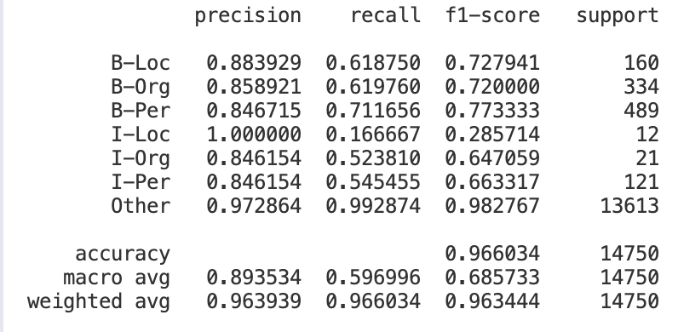

Conditional Random Field (CRF)
CRF is a statistical model for sequence labeling tasks which predicts the best sequence of tags by considering contextual dependencies between labels.
Probability of a tag sequence is given by:
CRF model captures the relationships between neighboring labels. But it struggles with capturing long range dependencies in sequences.

Slide 7
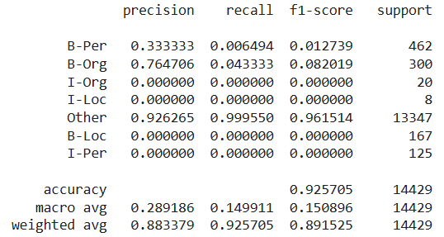
Long Short Term Memory (LSTM)
LSTM is a type of Recurrent Neural Network (RNN) which overcomes the vanishing gradient problem in traditional RNNs, making it effective for long-range dependencies.
It captures long term dependencies in data by retaining information in a memory cell over long time steps.
LSTM uses gates to manage input and memory retention.

Slide 8
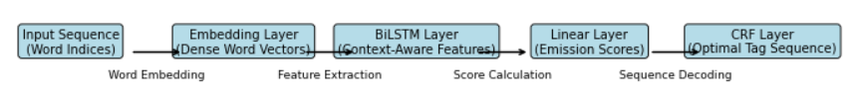
New Models
BiLSTM CRF
BiLSTM CRF model combines Bidirectional Short-Term Memory(BiLSTM) for capturing contextual dependencies in sequential data with CRF (Conditional Random Fields) for modeling label correlations and ensuring valid tag sequences.
The BiLSTM layer encodes input sequences considering both past (left) and future (right) context.
The CRF layer decodes the optimal tag sequence while enforcing label dependencies.
The BiLSTM-CRF model effectively handles long-range dependencies via BiLSTM, enforces structured prediction using CRF for sequence labeling tasks, and performs well on noisy, code-mixed data such as Hindi-English NER.

Slide 9
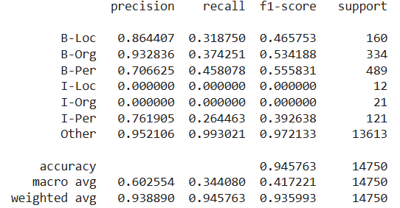
BiLSTM CRF model gave accuracy of 0.9457.
The model improved the accuracy over simple LSTM model which gave accuracy of 0.9257.
However it performed poorly compared to the CRF model with accuracy 0.9660.

Slide 10
Bi-LSTM
The Bi-LSTM model uses a Dense Layer to predict the classes instead of using CRF, also has random dropout to reduce overfitting.
Architecture
Input Layer: Accepts integer-encoded sentences.
Embedding Layer: Converts words to dense vectors to capture semantic meaning.
SpatialDropout1D: Randomly drops entire word embeddings (10%) to prevent overfitting.
Bidirectional LSTM: Processes sequences in both directions, capturing full context.
TimeDistributed Dense: Applies softmax at each word position to predict entity tags.
Model Compilation
Optimizer: AdamW – efficient and generalizes well.
Loss: Categorical Crossentropy – computes multi-class error.
Metric: Accuracy – measures proportion of correctly tagged words.

Slide 11
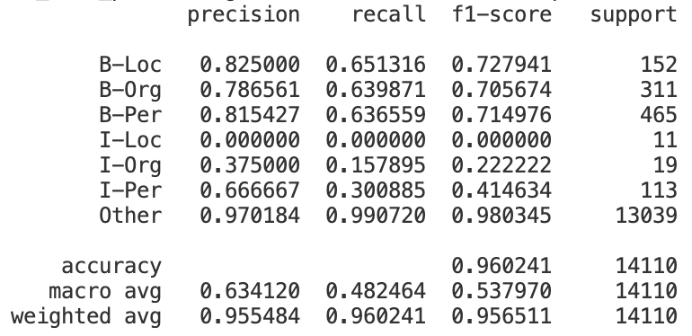
BiLSTM model gave accuracy of 0.9602.
The model improved the accuracy over simple LSTM model which gave accuracy of 0.9257 and also over Bi-LSTM CRF with accuracy 0.9457.
However it performed poorly compared to the CRF model with accuracy 0.9660.

Slide 12
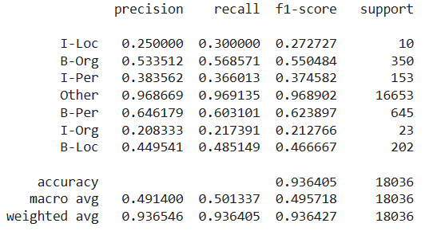
Decision Tree
A supervised learning algorithm which works by recursively splitting data into subsets based on the most informative attribute at each node. Each leaf node corresponds to a class label.
Attribute selection is done based on information gain, estimating the information contained in an attribute, and the Gini index, measuring the likelihood of incorrect classification for a randomly chosen element.

Slide 13
Improvements
Decision Tree, Naive Bayes and Random Forest
Notable improvements in all the metrics like accuracy, F1 score etc. were observed when hyperparameters for these models were hyperparameter tuned and only certain parameters were used for classification.
In particular, adjusting the smoothing parameter and focusing on key parameters in Naive Bayes led to a much better classification accuracy.
Model | Baseline Accuracy | Improved Accuracy | Difference
Decision Tree | 0.9364 | 0.9629 | +0.0265
Naive Bayes | 0.7414 | 0.9543 | +0.2129
Random Forest | 0.9397 | 0.9648 | +0.0251

Slide 14
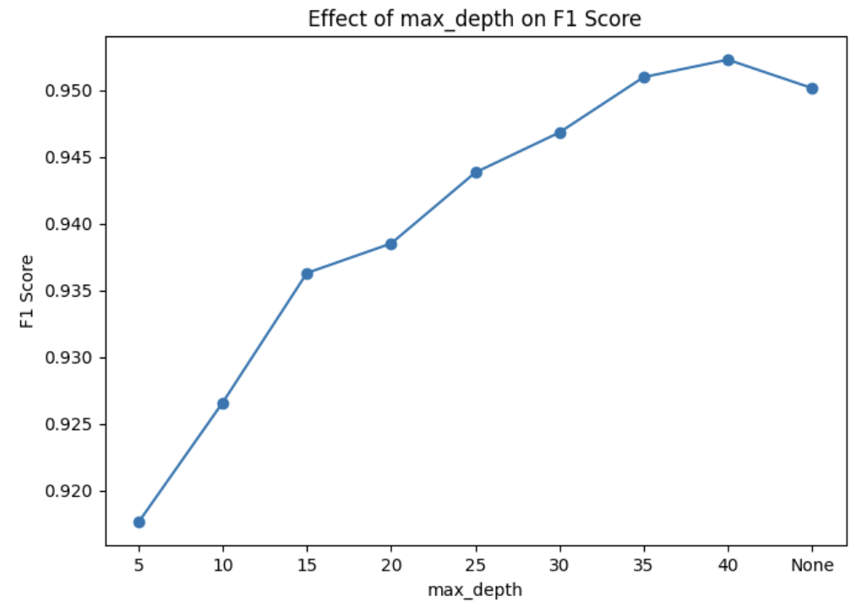
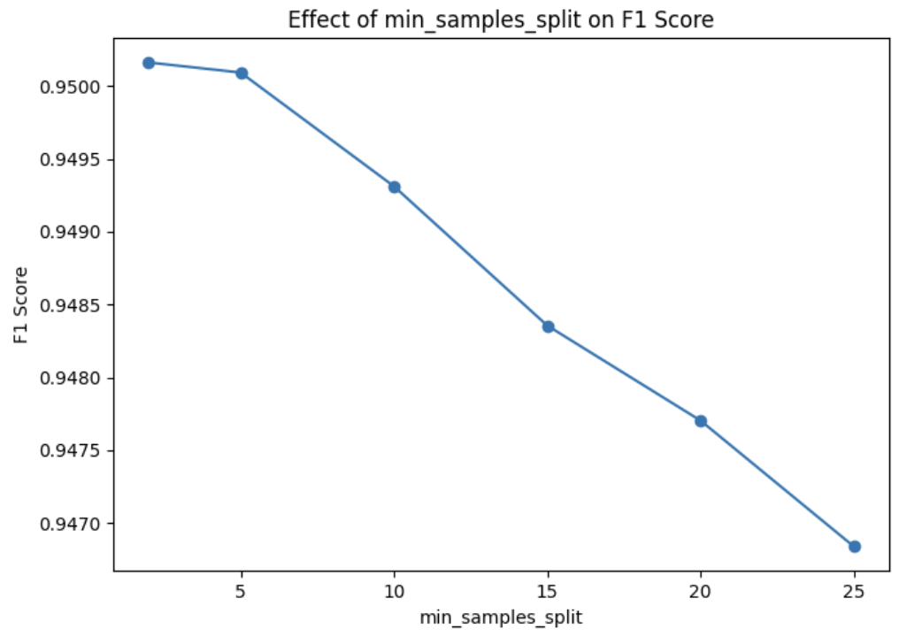
Decision Tree, Naive Bayes and Random Forest

Slide 15
Word2Vec Embedding: Decision Tree, Naive Bayes and Random Forest
Word2Vec captures the meanings of words by mapping them into a vector space, where words with similar meanings are closer together. It helps models understand the relationships between words based on context, enhancing their ability to correctly label entities in code-mixed texts.
We observed notable improvements in accuracy for DTC and RF, while GNB underperformed with Word2Vec embeddings. This can be attributed to the inherent limitations of GNB, particularly its assumptions of feature independence and specific distributional requirements, which are not well-suited to the complex, high-dimensional nature of Word2Vec features.
Model | Baseline Accuracy | Word2Vec Accuracy | Difference
Decision Tree | 0.9364 | 0.9578 | +0.0214
Random Forest | 0.9397 | 0.9536 | +0.0139
Naive Bayes | 0.7414 | 0.3249 | -0.4165

Slide 16
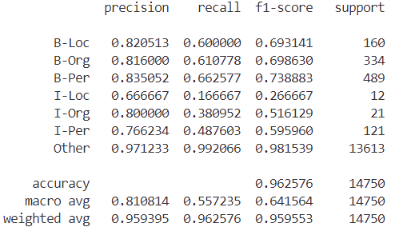
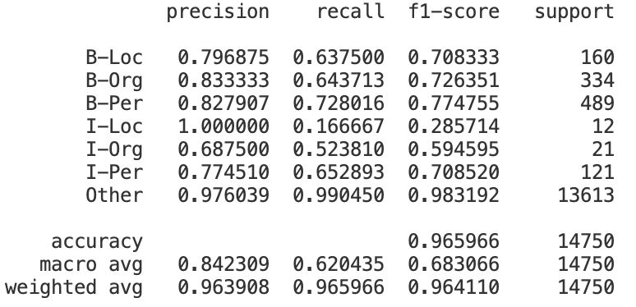
Other Models
CRF with POS tagging
CRF with Word Embedding
This model uses Part of Speech tags as additional features, helping CRF model identify named-entity structure enhancing its ability to distinguish entity boundaries.
Used Spacy library for getting POS tag.
CRF with GloVe embeddings combines word-level features and 300-dimensional pre-trained embeddings, enabling better semantic understanding and context-aware predictions in sequence labeling tasks.

Slide 17
We used the features as in the CRF model and then experimented with various classification algorithms to assign tags based on these features, getting the following results :
Classifier | Baseline Accuracy | With Targeted Features
Decision Tree | 0.9364 | 0.9628
Naive Bayes | 0.7414 | 0.9542
Random Forest | 0.9397 | 0.9648
Logistic Regression | N.A | 0.9681
Support Vector Classifier | N.A | 0.9638
K-Neighbours | N.A | 0.9563

Slide 18
Results
Model Name | Accuracy
CRF | 0.9660
Decision Tree | 0.9364
Naive Bayes | 0.7414
Random Forest | 0.9397
LSTM | 0.9257
CRF with POS | 0.9625
CRF with Word Embed | 0.9659
Model Name | Accuracy
Enhanced Decision Tree | 0.9472
Enhanced Naive Bayes | 0.8982
Enhanced Random Forest | 0.9527
BI-LSTM | 0.9602
BI-LSTM CRF | 0.9457
Classification with Targeted Features | 0.9681

Slide 19
Observation
We observed some interesting details about this problem statement.
The accuracy of models increase as we increase the train-test split indicating that the models are not well trained and there is a lack of data for better performance.
The features extracted from pre-trained data such as word2vec, pos and word embedding could only increase the model accuracy to a limited value and is not effective further. This is mainly because these pre-trained modules are mostly trained in English, also our dataset contains many spelling errors and conjoined words because it is taken from Twitter(now X) where people do not tend to use correct spellings.
The best performing models were those when we added the features on our own rather than using convolution to extract it.
The dataset was a bit erroneous in the case that the same word were tagged differently. For example #dhoni was tagged B-per everywhere but was tagged as B-org in one case, there are similar examples for many words. We thought of filtering the dataset by removing these words but realized that it would be incorrect because the same words could have different meaning in different context (though the #dhoni one meant the same everywhere).

Slide 20
Conclusion
In this work, we addressed the challenge of Named Entity Recognition (NER) in Hindi-English code-mixed tweets.
We performed extensive preprocessing to clean and prepare the data, including noise removal, tokenization, and transliteration. The annotated dataset of 3,638 code-mixed tweets was used to train and evaluate machine learning models.
Through our experiments, we demonstrated that algorithms such as Decision Trees and Conditional Random Fields (CRFs) were effective in identifying entities in code-mixed text, with high inter-annotator agreement and a robust classification performance.
We used various measures such as hyperparameter tuning, word2vec embedding, pos embedding, word embedding to try increase our accuracy. Though it did help in increasing the accuracy of models like Decision Tree, Random Forest and Naive Bayes, it was ineffective for other models which were already performing with high accuracies.
Notes:
dgb

Slide 21
Thank You!

