Slide 1

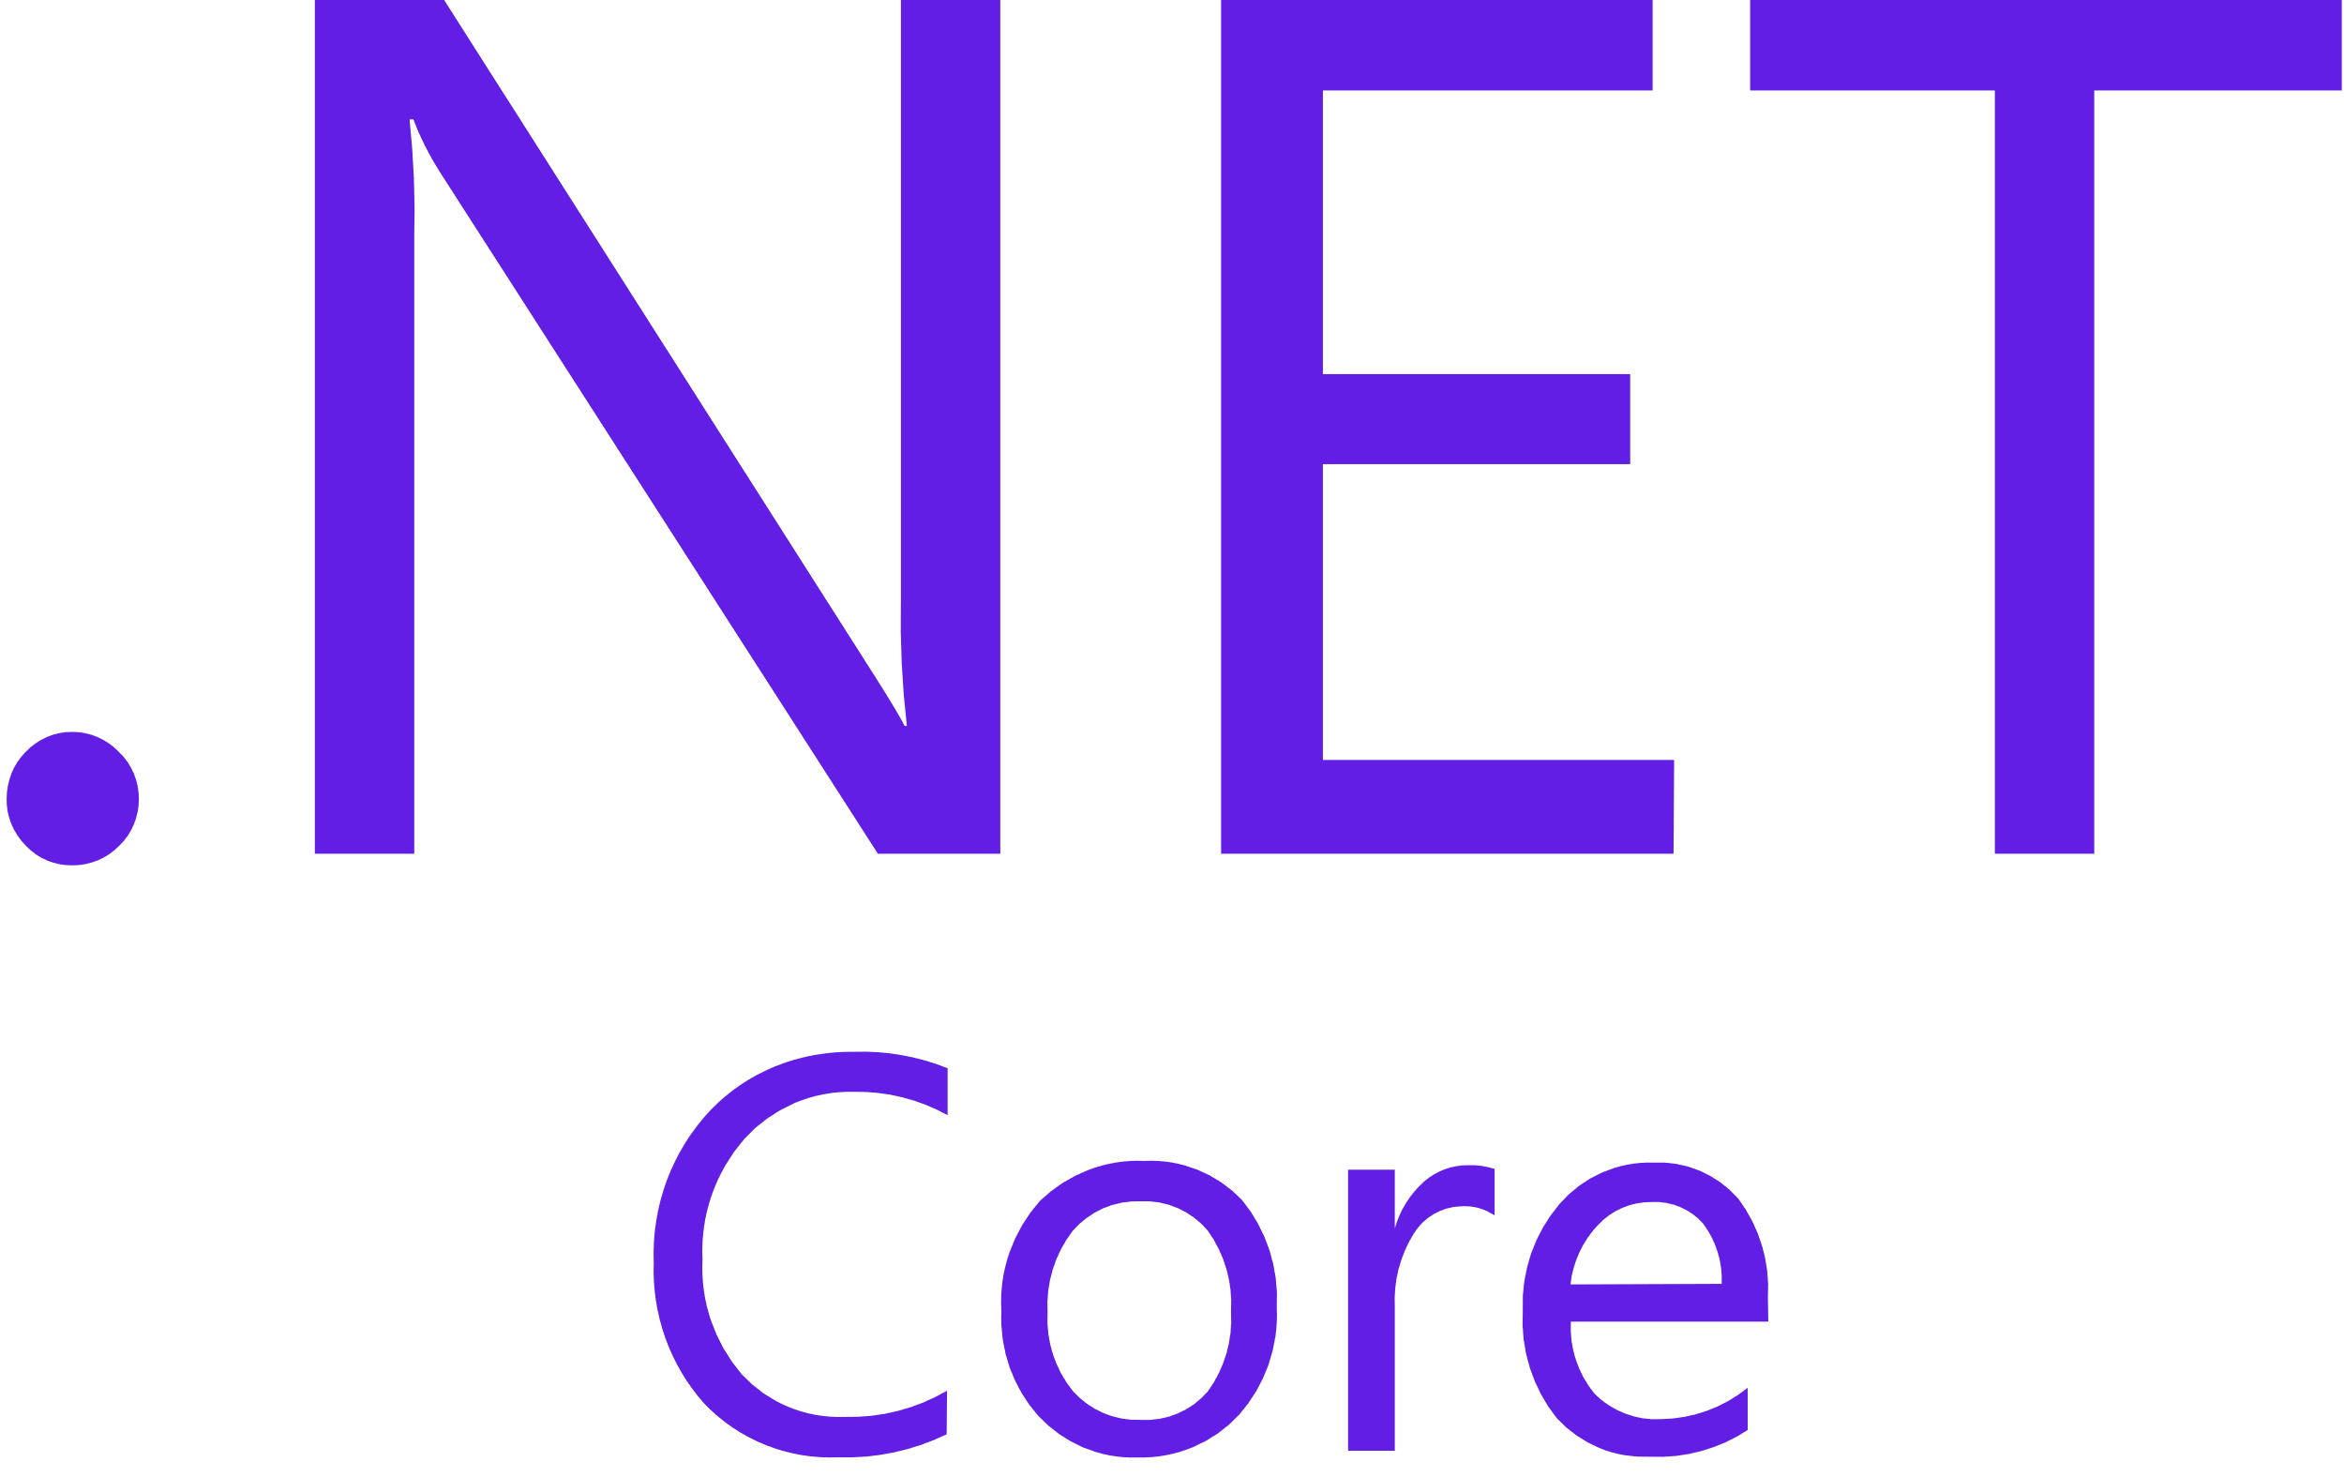
How to use GraphQL in .NetCore

Slide 2
What is GraphQL?
GraphQL is a query language for your API, and a server-side runtime for executing queries by using a type system you define for your data.
GraphQL isn't tied to any specific database or storage engine and is instead backed by your existing code and data.
Source: graphql.org

Slide 3
Benefits of GraphQL
GraphQL Is Less Chatty than REST
Endpoint Overload
Overfetching/Underfetching Data
Versioning is Easier

Slide 4
Benefits of GraphQL
GraphQL Is Less Chatty than REST
One fact of life with REST is that it requires multiple roundtrips between the client and individual resource endpoints on the server to fetch all the data needed to render a view or page in our app.
GraphQL solves the roundtrip problem by allowing the client to create a single query which calls several related functions (or resolvers) on the server to construct a response with multiple resources - in a single request.

Slide 5
Benefits of GraphQL
Endpoint Overload
As our application grows, the number of REST endpoints we must build and maintain starts to explode. A growing number of endpoints demands more and more time and effort to test and support - on both the client and server.
In GraphQL, we can define Query types in our Schema to retrieve (or mutate) any combination of types in our system through one endpoint i.e /api/graphql.

Slide 6
Benefits of GraphQL
Overfetching/Underfetching Data
Because REST APIs return rigid data structures it's very hard to design an API flexible enough to fulfill every client's precise data needs. This can lead to two conditions known as Overfetching and Underfetching.
GraphQL at its simplest is about asking for specific fields on objects. This core principle solves both the over- and underfetching problem by giving the client complete control over the data it receives.

Slide 7
Benefits of GraphQL
Versioning is Easier
Versioning REST APIs is a tricky topic. However, there are a few common approaches for acheiving this:
URL versioning is probably the most popular method and simply involves publishing the unique version of the API as part of the resource URL
Another approach is for the client to specify the API version as part of the request header
key difference in GraphQL is that the client dictates the shape of the response it expects. This attribute eases the pain of versioning because new properties can easily be added to a query with no impact to existing consumers.

Slide 8
Suggested structure
Models
Data (Repositories)
Services
GraphQLSchema (Instead of controllers)

Slide 9
Dependencies
GraphQL
GraphQL.Server.Transports.AspNetCore
GraphQL.Server.Ui.Playground

Slide 10

Models
StarWarsCharacter
Droid
Human

Slide 11
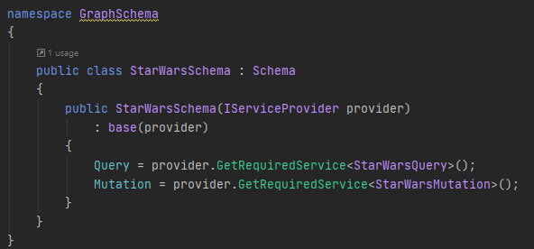
How to create queriable endpoint?
Create project schema:

Slide 12
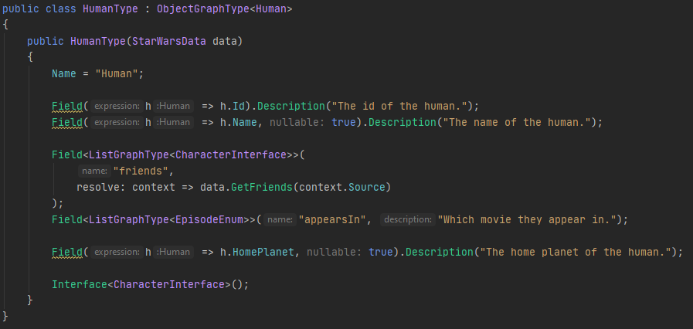
How to create queriable endpoint? (Cntd.)
Create ObjectGraphTypes:

Slide 13
How to create queriable endpoint? (Cntd.)
Create ObjectGraphTypes:

Slide 14
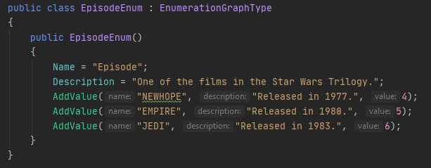
How to create queriable endpoint? (Cntd.)
Create EnumerationGraphType:

Slide 15
Talk is cheap show me the code!

