Slide 1


PROJECT:
ZELTA TECH’S
PROBLEM STATEMENT
IIT KANPUR

Slide 2

CONTENT
01
TEAM
02
PROBLEM DESCRIPTION
03
DEVELOPMENT PROCESS
04
STRATEGY OVERVIEW
05
TECHNICAL INDICATORS
06
RISK MANAGEMENT
07
RESULTS OF THE STRATEGY

Slide 3

TEAM
Keshav
Bansal
Anurag Thakur
Aarush
Singh
Aarnav
Gupta
Kushagra
Tiwari
Remy Marsh
Everest Cantu

Slide 4
PROBLEM DESCRIPTION
In this problem statement we have to develop algorithmic trading strategies for the BTC/USDT cryptocurrency market, aiming to outperform benchmark returns.
We have to develop a trading strategy for the BTC-USDT market that maintains narrow drawdowns with a good time to recovery rate and beats benchmarks 50-70% of the time.

Slide 5

DEVELOPMENT PROCESS
We began first by analyzing the stock data provided . The data was of the period 2020-2023.
The close price plot of the data showed that the BTC-USDT market was very volatile during this period , the market first rose and achieved its peak then it began falling , but rose again and achieved a new global peak and then again started falling .
Analyzing the data we interpreted that volume change plays a very important role in identifying strong trends as trend reversals are accompanied by drastic changes in volume .
Therefore we developed a new indicator which detects a drastic change in volume by taking the difference of ratio of a fast exponential moving average to a slow exponential moving average . This indicator helped us to identify the various points of trend reversals . Now to identify the trend , we combined this Volume Indicator with OBV and Ichimoku Cloud Indicator to generate long and short signals .
STEP 1
STEP 2
Optimization - The final step of the development process was Strategy Optimization .
1) We optimized the various indicators to suit the BTC-USDT market by tweaking the various parameters of these indicators .
2) We developed new risk management methods like Intraday price change limit , Daily price change limit , trailing stop loss and take profit to protect the capital and make the strategy more robust and profitable.
Then we used combinations of other technical indicators like MACD , RSI , Bollinger Bands , ATR to identify trends and generate signals accordingly.
STEP 4
STEP 3

Slide 6

STRATEGY OVERVIEW
1)For our strategy , we have used a combination of various indicators like Ichimoku Cloud , MACD , RSI , Bollinger Bands , OBV , Volume Indicator , ATR
2)We have also used Regime Switching technique , which helps us to change the span or window period of various indicators based on the current volatility.
We have selected indicators that help in identification of the trend and its strength.
3)To denoise the data we have used Heikin Ashi Candles .
4)For our strategy , we have used the following Risk Management Methods -
Normal take profit , Trailing take profit , ATR stop loss , Max drawdown limit to close trades on next day , Intraday price change limit , Daily close change limit .

Slide 7
TECHNICAL INDICATORS
We have used the following technical indicators for our strategy:
MACD (moving average convergence divergence) :
long period span - 26 , short period span - 12 , signal line span - 8 .
2.Ichimoku Cloud: We have used two types of Ichimoku Cloud indicators with different spans
according to the volatility .
1) Tenkan-sen window - 9 , Kijun-sen window - 12 , Senkou Span A shift - 12 ,
Senkou Span B shift - 26 .
2) Tenkan-sen window - 9 , Kijun-sen window - 30 , Senkou Span A shift - 26 ,
Senkou Span B shift - 58 .
3.OBV(On Balance Volume):
span - 12 (to calculate the exponential moving average of obv) .
4. RSI (Relative strength index):
window period - 14 .
5.Bollinger Bands:
window period - 20 , standard deviation - 1.8 .
6.ATR (Average True Range):
window period - 14 , multiplier - 2 .
7.Volume Indicator:
short span - 5 (to calculate the exponential moving average of volume) .
long span - 14 (to calculate the exponential moving average of volume) .

Slide 8
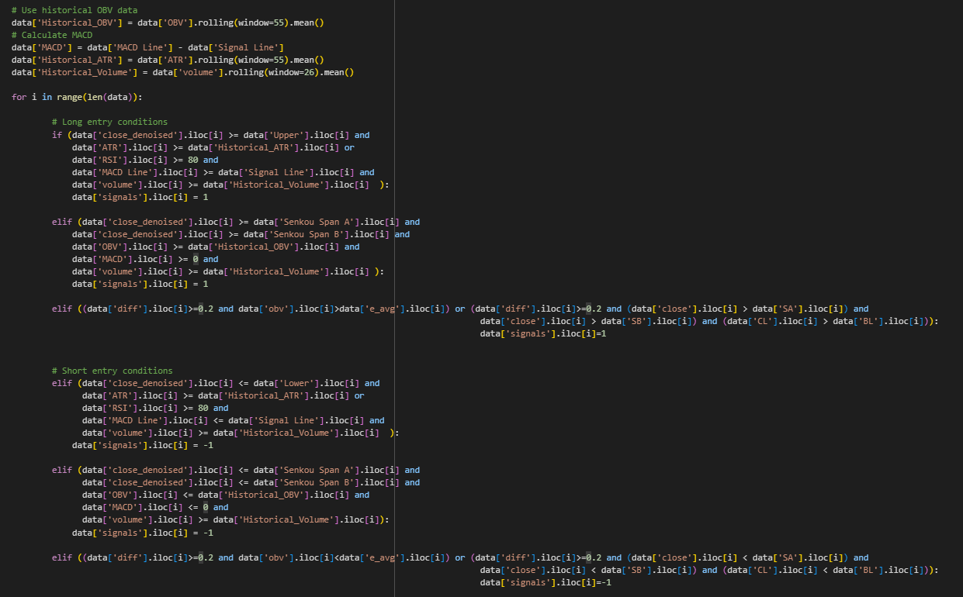
MAIN STRATEGY

Slide 9
STRATEGY EVOLUTION
(Different Stages of our Final Strategy)
Stage - 1 -> Strategy-2 which is combination of different indicators like MACD , Bollinger Bands , RSI , ATR , OBV , Ichimoku Cloud
Stage - 2 -> Strategy-1 which is The Volume indicator along with OBV and Ichimoku Cloud .
Stage - 3 -> Combination of Strategy 1 and Strategy 2 along with Risk Management measures such as Trailing take-profit , normal rake-profit , ATR stop-loss .
Stage - 4 -> Added new risk management measure - Max Drawdown Limit and Intraday Price Change Limit .
Stage - 5 -> Added another risk management measure - Daily Close Change Limit .

Slide 10
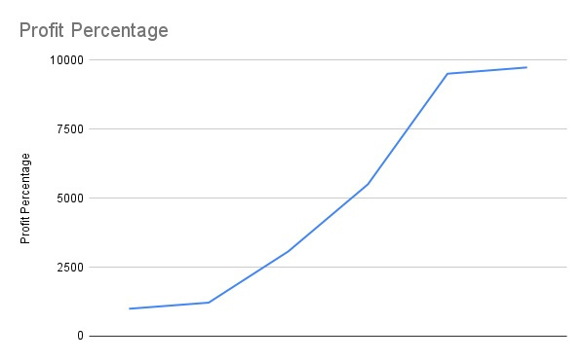
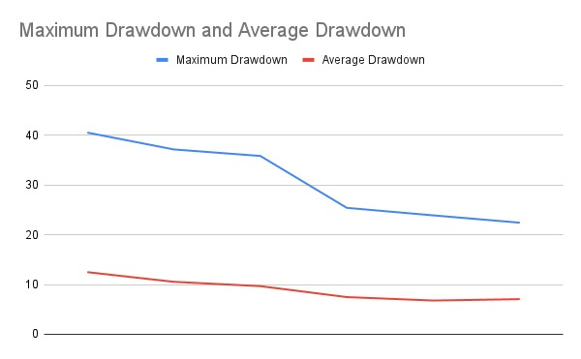
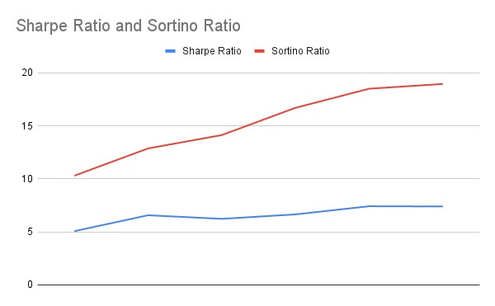
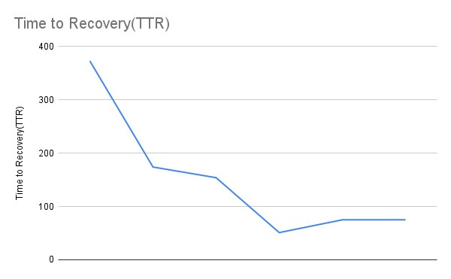
STRATEGY EVOLUTION
Graph of Profit Percentage v/s Different stages of our strategy .
Graph of Max Drawdown v/s Different stages of our strategy .
Graph of Sharpe and Sortino Ratio v/s Different stages of our strategy .
Time to Recovery v/s Different stages of our strategy .

Slide 11
OTHER APPROACHES
(Could not implement due to lack of time)
Position Sizing
This is a method of Risk Management particularly for reducing drawdowns.
In this method we change the investing capital for the next trade based on the returns from the previous trade . For example if our strategy catches a false trend may be due to noise in data and suppose this trade results in negative return , then we can set a limit such that if the returns of a trade is less than the limit then we invest only a fraction of our current capital in the next trade . This method can help in reducing the drawdowns significantly as we are not investing our entire capital in the market conditions which are not suitable for our strategy .

Slide 12
OTHER APPROACHES
(Could not implement due to lack of time)
Alternating Framework Strategy
In financial markets, certain strategies excel in specific market conditions while others thrive in different environments.
In this method we develop an alternating framework involving two strategies or more strategies, A and B. The framework operates as follows: we begin with strategy A, and upon completing a trade based on strategy A (i.e., squaring off the equity we've either longed or shorted), we simultaneously assess the performance of strategy B during the same timeframe. If strategy B outperforms strategy A, we switch to using strategy B for the next trade.
Instead of just two , we can also alternate between more than two strategies or combinations of different strategies.

Slide 13
RISK MANAGEMENT
Risk Management is the process of identifying, assessing, and controlling threats to capital and earnings.
Risk Management is very crucial in developing robust and profitable strategies. It helps us to exit a losing trade early when our strategy catches a false trend due to noise in data thus protecting our capital from huge losses whereas it also helps to square off a trade after booking a certain amount of profit before the trend reverses.

Slide 14
THE VARIOUS RISK MANAGEMENT MEASURES FOR OUR TRADING STRATEGY ARE ->
1)Trailing Take-Profit -> Trailing stop loss prevented us from booking sufficient profits in short trades. The stop loss gets triggered too soon everytime there is a fall. In trailing take-profit the boundary is set at above the portfolio price rather than below it.This helps us minimize the loss in short trades. As the portfolio value rises, the exit condition remains constant. It falls as soon as there is a dip in price.
For our strategy we have set the Trailing Take-Profit percentage to 10% .
2)Normal Take-Profit -> In this risk management method we set a fixed price above the entry price for long trades and below for short trades according to the percentage set for the take profit and we exit the trade as soon as the close price crosses the take profit price.
This helps in booking a certain amount of profit before the trend reverses.
For our strategy we have set the Take-Profit percentage to 10% .
3)ATR Stop-Loss -> ATR stop loss is a market volatility based stop loss indicator. When volatility increases, the ATR value rises, and the stop-loss widens to accommodate larger price swings. Conversely, during periods of lower volatility, the stop-loss tightens. Using ATR allows us to set levels that are proportional to the current volatility, helping to account for the varying ranges of price movement.
For our strategy we have set the multiplier value to 1 .

Slide 15
THE VARIOUS RISK MANAGEMENT MEASURES FOR OUR TRADING STRATEGY ARE ->
4)Max Drawdown Limit -> An increased drawdown indicates a risky trade. Drawdowns will anyway be high in a volatile market. Our work should be to minimize the risk. This we can do by using a max drawdown limit. As soon as this limit is reached, the trade is squared off. This will ensure we don’t lose too much on the trade.
For our strategy we have set the Drawdown limit to 15
5)Intraday Change -> In this risk management method we set a percentage limit of change in
close[i]-low[i]/close[i] for long trades
and
2. high[i]-close[i]/close[i] for short trades
and whenever the set limit is reached we close the trade on that day.
This risk management helps us to detect potential trend reversal on the basis of intraday prices of the stock that are ‘high’ and ‘low’ .
For our strategy we have set this limit to 7% .

Slide 16
THE VARIOUS RISK MANAGEMENT MEASURES FOR OUR TRADING STRATEGY ARE ->
6)Daily Close Price Change -> In this risk management method we set a percentage limit of change in close price that is ->
(close[i-1]-close[i])/close[i] for long trades
and
(close[i]-close[i-1])/close[i] for short trades
and whenever the set limit in daily close price change is reached we close the trade on that day .
This risk management helps us to detect potential trend reversal on the basis of large changes in close price as compared to previous day in the opposite direction of the identified trend .
For our strategy we have set this limit to 7% .
7)Trailing Stop-Loss -> A stop-loss is a pre-set order to sell a security when it reaches a specified price, minimizing potential losses for an investor or trader. A trailing stop loss is a dynamic risk management strategy where the stop loss level adjusts automatically based on the asset’s price movement, helping to lock in profits or limit losses. The trade is closed when the market price decreases by more than a defined percent from the current high.
For our strategy we have set the Trailing Stop-Loss percentage to 8% .

Slide 17
RISK MANAGEMENT
These risk management methods have greatly helped us in increasing returns , beating quarterly benchmarks and maintain a low max drawdown.

Slide 18
RESULTS OF OUR STRATEGY
(Backtested on Zelta's Jupyter Platform)
Data -> 2020-2023 (Daily data , interval = '1d')
1) Returns - 9,740%
2) Maximum Drawdown - 22
3) Strategy beats benchmark 10 out of 15 times which is about 67 % in Quarterly Analysis.

Slide 19
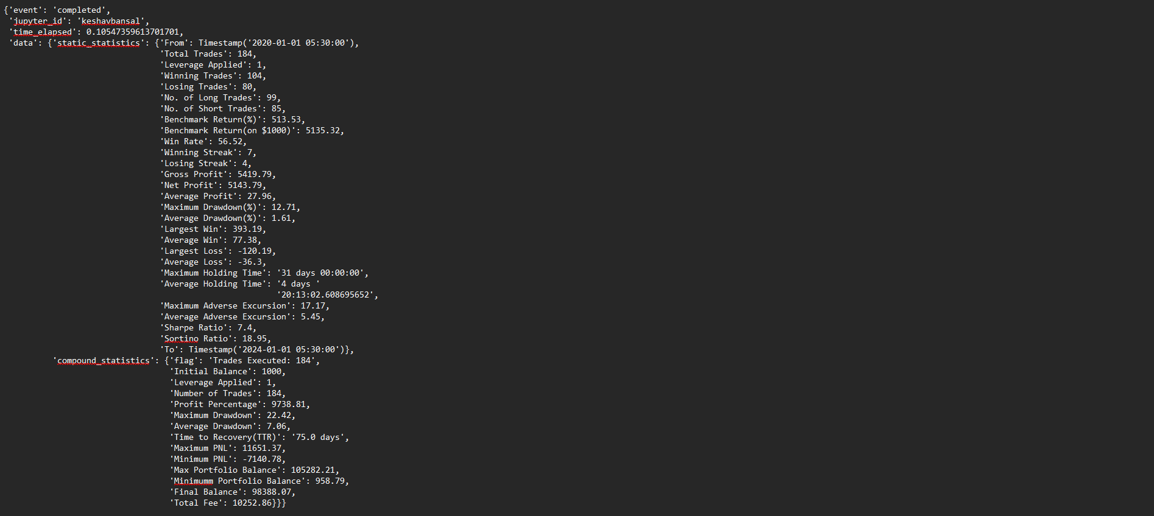
DETAILED RESULTS
Daily Data -> interval(1d) (2020-2023)
Normal Results

Slide 20
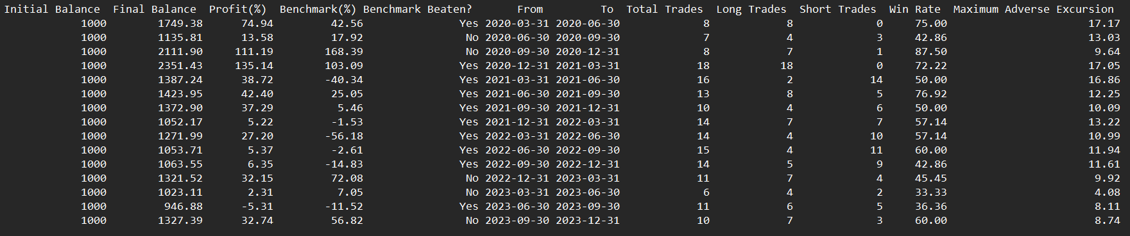
DETAILED RESULTS
Daily Data -> interval(1d) (2020-2023)
QUARTERLY RESULTS AND YEARLY RESULTS
QUARTERLY RESULTS
YEARLY RESULTS

Slide 21

THANK YOU

