Slide 1

ATTENDANCE
SYSTEM
Submitted by:
Bhavya (102303643)
Keshav (102303647)
Keshee (102303650)

Slide 2

ABSTRACT
An AI-based real-time face recognition system offers a contactless, automated, and secure alternative to traditional attendance systems. This project utilizes computer vision and pre-trained models for accurate and efficient recognition.
Reduces manual effort and eliminates proxy attendance
Uses webcam input to detect and recognize faces
Recognized individuals are marked present in a CSV file
Unknown faces are detected but excluded from attendance
Applicable in schools, offices, and institutions

Slide 3
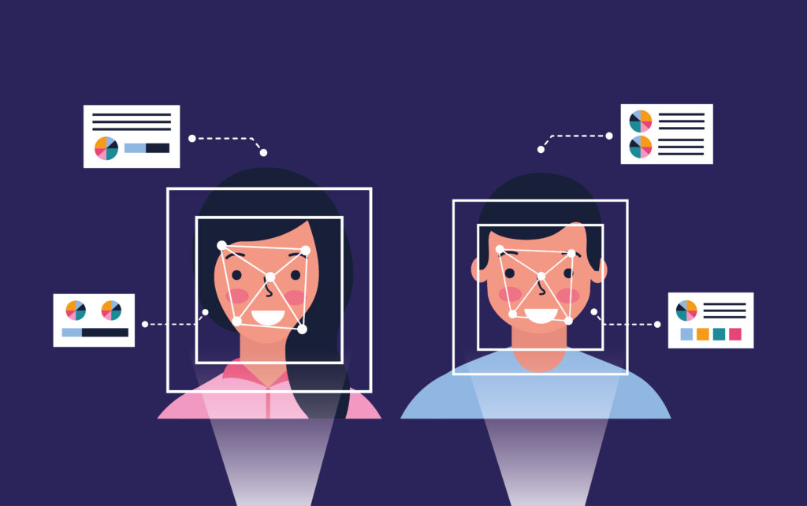
INTRODUCTION
Traditional attendance methods are time-consuming and error-prone. The proposed system replaces manual methods with AI-based facial recognition for improved efficiency and hygiene.
Eliminates human error and proxy issues
Contactless, non-intrusive, and faster
Based on Python, OpenCV, and face_recognition
Stores attendance with timestamps in CSV format
Easily scalable by adding new users dynamically

Slide 4
PROBLEM
STATEMENT
Traditional attendance systems face several critical limitations that hinder efficiency, accuracy, and scalability—especially in large organizations. These challenges highlight the urgent need for a modern, AI-powered alternative.
Manual Attendance is Inefficient and Error-Prone
Recording attendance by hand or through spreadsheets is time-consuming, prone to human error, and lacks real-time monitoring.
Hygiene Concerns with Biometric Devices
Fingerprint scanners require physical contact, raising serious hygiene issues—especially in a post-pandemic environment.
Poor Scalability for Large Populations
Managing attendance records for hundreds or thousands of individuals becomes complex and inefficient in conventional systems.
Risk of Proxy Attendance
Traditional methods are easily bypassed, allowing individuals to mark attendance for others, which compromises system integrity and accountability.

Slide 5
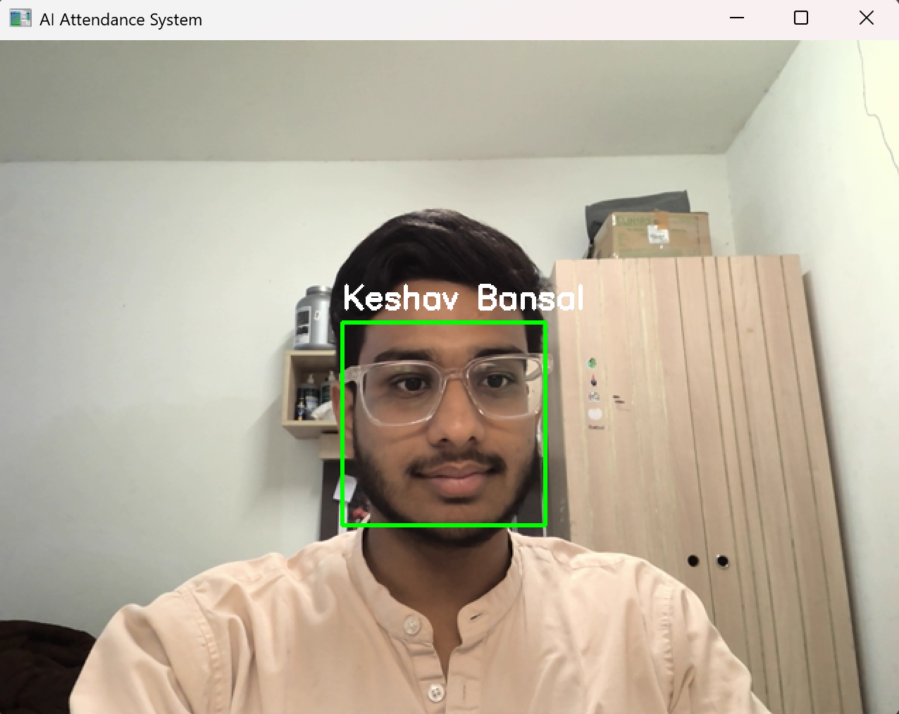
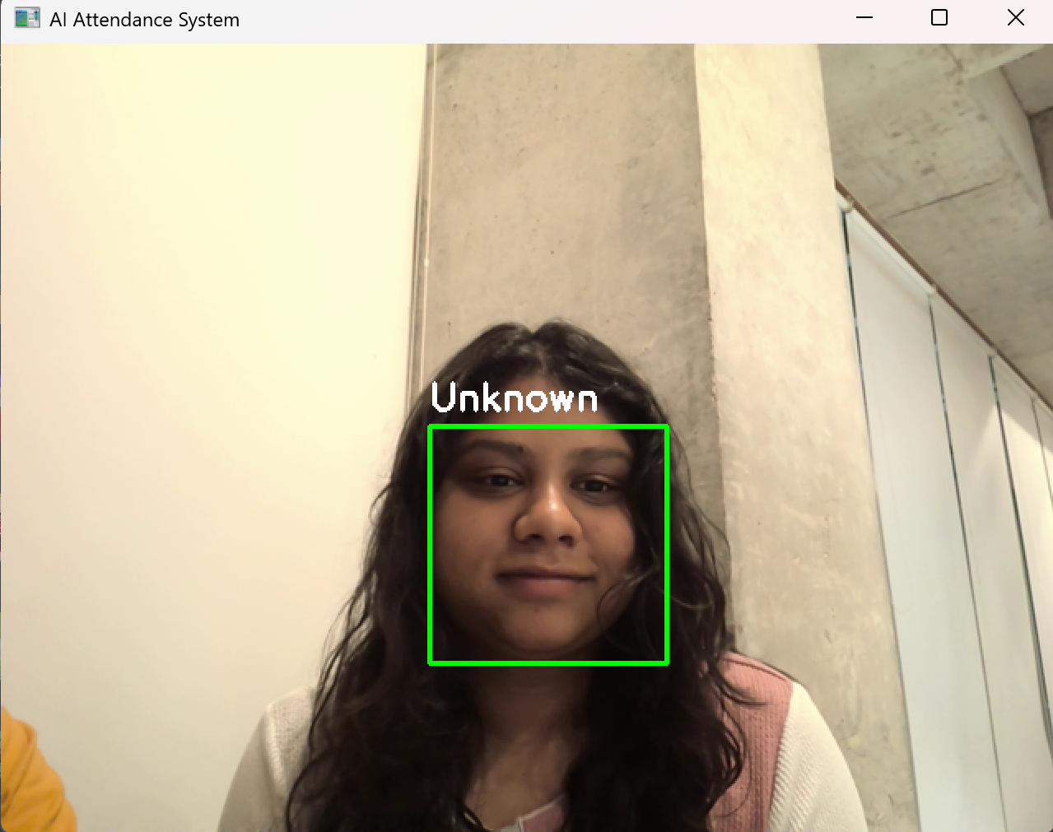
OBJECTIVE
The system aims to automate and improve attendance accuracy through real-time face recognition.
Real-time face detection and recognition
Mark attendance for known individuals only
Exclude unknowns to maintain data integrity
Allow seamless addition of new users
Achieve at least 80% recognition accuracy

Slide 6
SYSTEM
ARCHITECTURE
Webcam
Input
Frame capture using openCV
Face Encoding using face_detection
Compare encoding with trained data
Export to
CSV file
Mark attendance
YES
Match?
Display only on screen
Label as ‘Unknown’
NO

Slide 7
TOOLS AND TECHNOLOGIES
The system uses Python and open-source libraries for seamless integration and performance.
Tool/Library | Purpose
Python 3.x | Programming
OpenCV | Image processing, webcam feed
face_recognition | Face detection, encoding
NumPy | Data handling, arrays
CSV Module | Attendance data storage
HOG+CNN Model | Image Classification

Slide 8
METHODOLOGY
Start the System
Block 1:Load Train Dataset
Encode Faces
Store encodings and names
Block 2:Real time Recognition
Capture frame from webcam
Detect Faces
Encode Faces
Compare with known Faces
Face Matches?
Mark Attendance
Save in CSV
Label as “Unknown”
Do not save in CSV
Block 3:Add New Faces
Capture new faces
Split(80%train,20%test)
Update reference dataset
End

Slide 9

IMPLEMENTATION
DETAILS
Built using Python and powerful models for accuracy and speed.
Python 3.8+ used for development
HOG + CNN model for detection
Matching threshold: 0.45
Attendance saved in CSV with timestamps
Supports dynamic dataset updates

Slide 10
DATASET
PREPERATION
dataset/
├── train/
│ ├── <person_name>/
│ │ ├── person_name_1.jpg
│ │ ├── person_name_2.jpg
│ │ └── ...
│ └── ...
├── test/
│ ├── <person_name>/
│ │ ├── person_name_12.jpg
│ │ ├── person_name_27.jpg
│ │ └── ...
│ └── ...
Properly curated training and testing datasets are key to accuracy.
100 images per person in varied lighting and poses
Testing dataset with unseen images (20%)
100+ unknown face samples added for robustness
Images standardized to 256x256 RGB
Potential for future data augmentation

Slide 11
ACCURACY
ANALYSIS
The system was tested on 1000+ images, showing high accuracy for both known and unknown individuals.
Known Face Accuracy: 80%–90%
Unknown Detection Accuracy: 80%–90%
Influencing factors:
  Lighting and resolution
  Face angle and position
  Background clutter

Slide 12
CHALLENGES AND SOLUTIONS
Challenges | Solutions
Low-resolution images | Captured higher-quality images
Poor lighting | Recommended well lit environments
Dataset imbalance | Collected 80+ images per person
Threshold tuning | Set optimal value to 0.45

Slide 13
RESULTS AND
OBSERVATIONS
Real-time performance with minimal delay and high reliability.
Detection Speed: 24–30 FPS
Attendance Marking: ~1–2 seconds per face
Accurate unknown face handling
Example:
      Keshav Bansal present at 2025-04-26 10:21:30
  Unknown face detected but not marked

Slide 14
CONCLUSION
The proposed AI-based Face Recognition Attendance System presents a modern and effective alternative to traditional manual methods. It streamlines the attendance process, improves accuracy, and reduces administrative workload. Key highlights of the system include:
High Accuracy & Automation:
The system marks attendance automatically with an accuracy exceeding 80%, minimizing human error and saving valuable time.
Modular, Scalable, and Secure Design:
Built with a modular structure, it allows for easy upgrades, scalability across departments, and data protection through secure storage and access protocols.
Easy Integration:
The system is designed to be easily deployable in various environments such as schools, colleges, corporate offices, and government institutions with minimal setup effort.
Support for Expansion:
It supports continuous updates, real-time face additions, and seamless user management, making it future-ready for growing organizations.

Slide 15
FUTURE SCOPE
The project holds strong potential for real-world deployment and can be significantly enhanced to meet industrial-grade standards. Planned future improvements include:
Integration of Advanced Deep Learning Models
Leverage powerful CNN architectures like ResNet, MobileFaceNet, or FaceNet to boost recognition accuracy and handle diverse lighting and angles.
Mobile Application Development
Implement a lightweight, on-device attendance solution using TensorFlow Lite, enabling real-time face recognition on smartphones and tablets.
Cloud-Based Centralized Tracking
Enable a central server to handle attendance data from multiple locations, ensuring real-time synchronization and centralized management.
Robust Anti-Spoofing Mechanisms
Add advanced liveness detection features such as blink detection, 3D facial depth sensing, or movement analysis to prevent misuse through photos or videos.
Multimodal Authentication
Combine face recognition with voice commands, ID card scanning, or PIN entry for enhanced security in sensitive environments.
Automated Data Management & Retraining
Implement tools for automatic dataset evaluation, cleaning, and model retraining, ensuring the system adapts over time to new faces and conditions.

Slide 16
Thanks!
Do you have any questions?

