Slide 1
PACT — Protocols for Agent Coordination in Trading
A Coordination-and-Attribution Study of Multi-Agent LLM Trading Systems
Keshav Dalmia · Prateek Verma · Drumil Mehta · Tasnia Islam
Gies College of Business · University of Illinois Urbana-Champaign
Master's Project — Track 4 (Coordination & Attribution Research) · May 2026
Code: github.com/keshavdalmia10/PACT

Slide 2
Multi-agent LLM trading systems report Sharpe > 6 — but rarely test against the no-communication baseline
• TradingAgents (2024): debate-style, Sharpe 6+ on a 3-month, 5-stock window
• FinCon, FinMem, HedgeAgents, MarketSenseAI 2.0: each proposes one architecture, reports one strong number
• FINSABER (2025): simple ARIMA / rule-based timing competes with LLM agents on long horizons
• Stop Overvaluing MAD (2025): multi-agent debate gains evaporate under proper baselines
• CPH taxonomy (2026): calls for direct comparison of coordinated vs no-communication ensembles
Xiao et al. (2024); Yu et al. (2024); Li et al. (2025); Zhang et al. (2025); Nguyen and Pham (2026).

Slide 3
We ask: does coordination add value beyond a no-communication ensemble of the same specialists?
Does multi-agent coordination in LLM trading systems add value beyond a single-agent baseline and a no-communication ensemble of the same specialists, after controlling for transaction costs and lookahead bias?
• H1: coordinated multi-agent > no-communication ensemble (net of cost)
• H4: attention + event-probability alt-data improves Sharpe by ≥ 0.05 (frontier)
• H5: removing one specialist changes Sharpe by ≥ 0.10 for at least one agent
Pre-registered on the Open Science Framework before running the headline matrix.

Slide 4
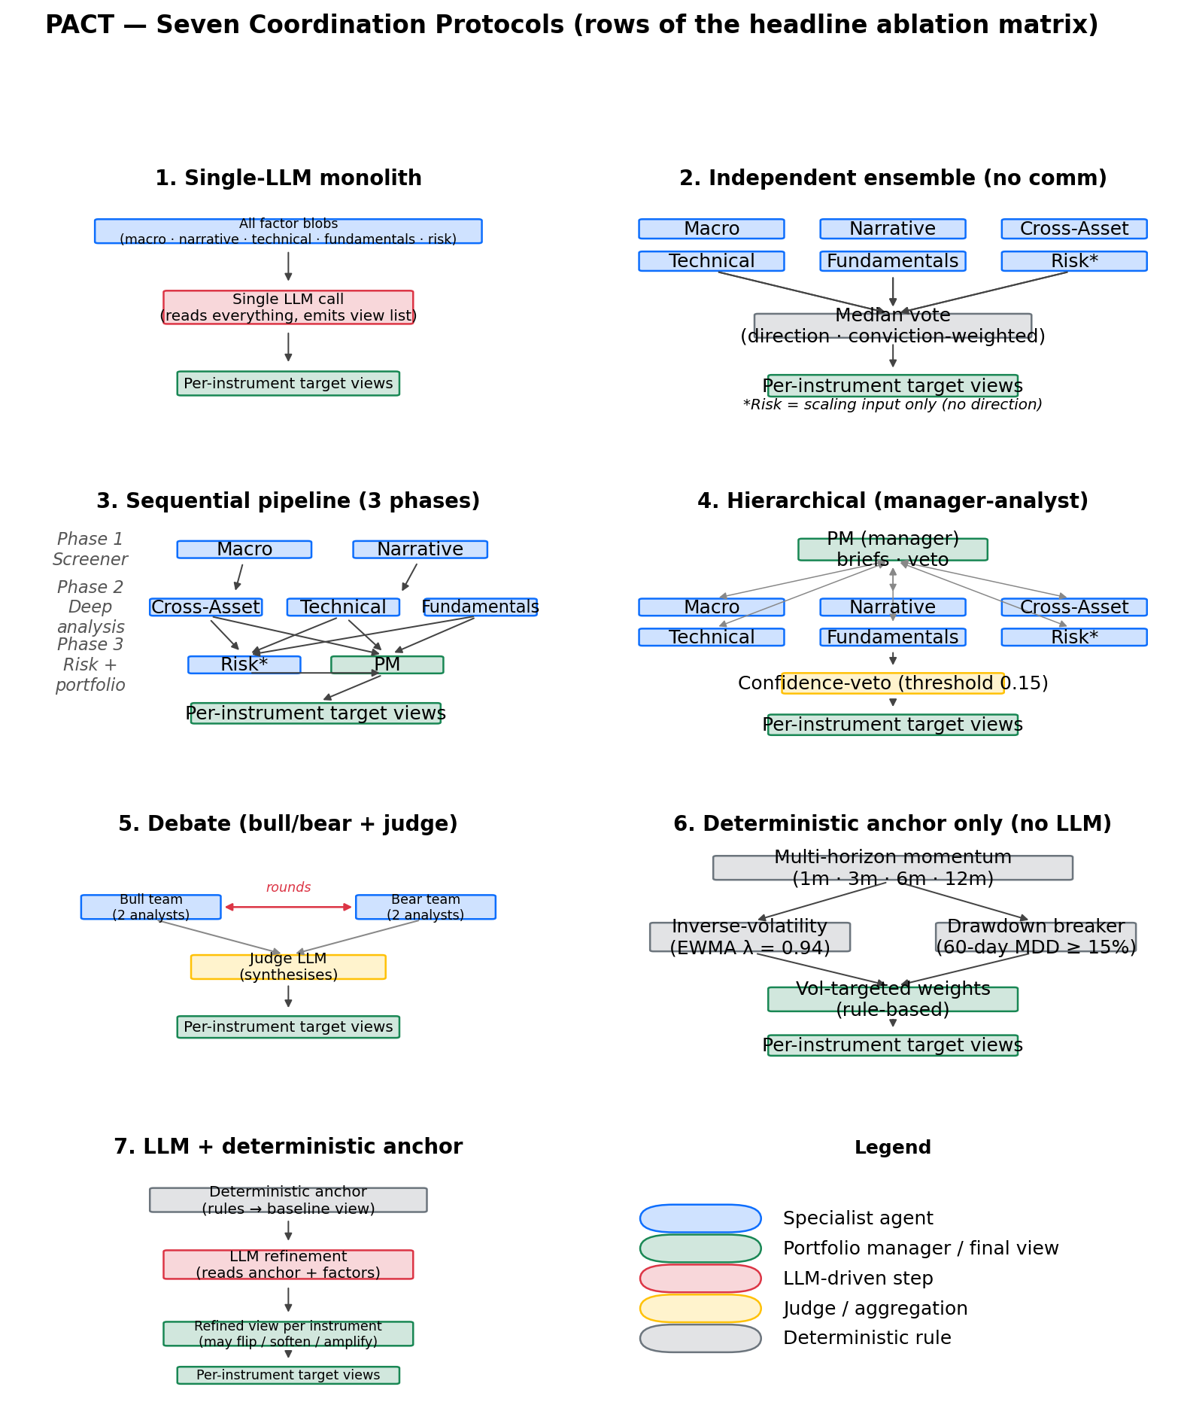
PACT runs a 7 × 2 ablation across coordination protocols and LLM regimes
• 7 protocols
• × 2 LLM regimes (frontier / none)
• × 10-instrument universe
• × weekly rebal 2022-2024
Specialist agents in blue; LLM steps red; aggregators gold; deterministic rules grey; final views green.

Slide 5
Cross-asset universe with strict leakage controls and rolling walk-forward
Universe (10 instruments)
Leakage controls
• Equities: SPY, QQQ, IWM
• Treasuries: IEF, SHY
• Commodities: GLD, USO
• FX / EM / BTC: UUP, EEM, BTC
• ALFRED: first-release vintages only
• EDGAR: 17:30-ET cutoff rule
• GDELT: 30-minute intraday lag
• Wikipedia / Polymarket: 48-hour lag
• ChronoGPT: year-pinned commit SHA
Walk-forward: rolling 3-year IS / 6-month OOS; $1M capital; 30 bps round-trip; weekly Friday rebalance.

Slide 6
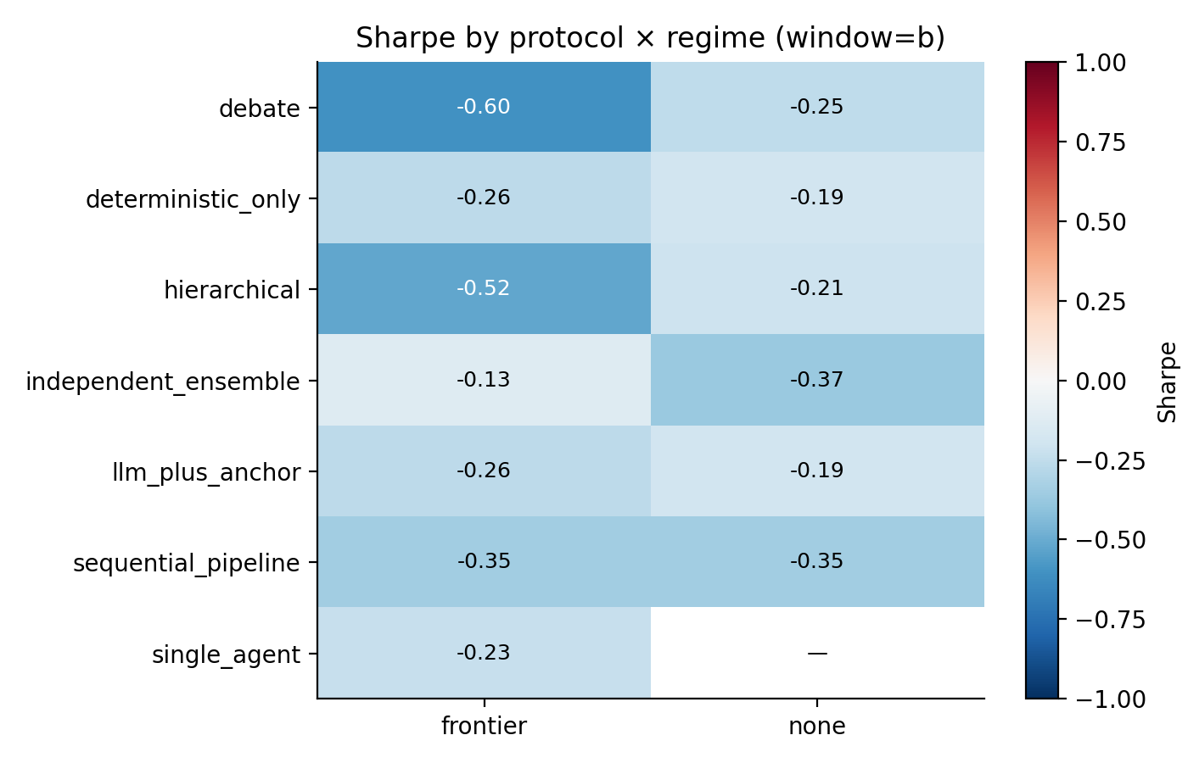
No frontier-LLM coordination protocol beats Sharpe 0; the best LLM cell is the no-communication ensemble
What to take away
• Best frontier: ind. ensemble at −0.13
• Every coord. protocol: below the ensemble
• Best matrix overall: none + debate at +0.27
• H1 rejected in this window
Window B 2022-2024, 10 instruments, with +instrument alt-data variant active.

Slide 7
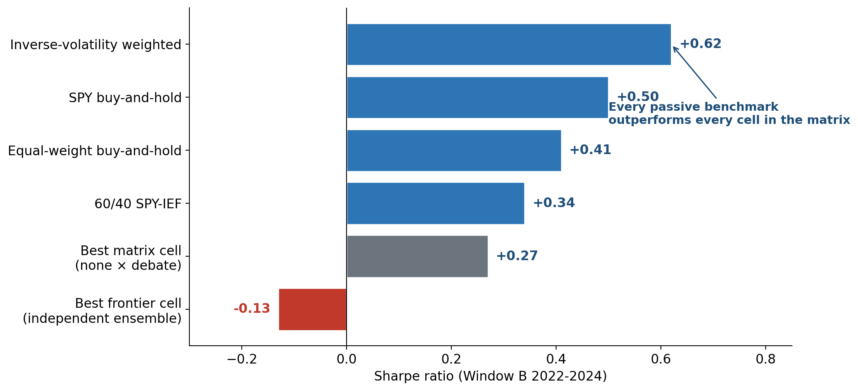
Four passive benchmarks outperform every cell in the matrix
A one-line inverse-volatility weighting of the same universe (Sharpe 0.62) beats every matrix cell.
Same Window B universe; no LLM, alt-data, or fundamentals signal — passive constructions on price data only.

Slide 8
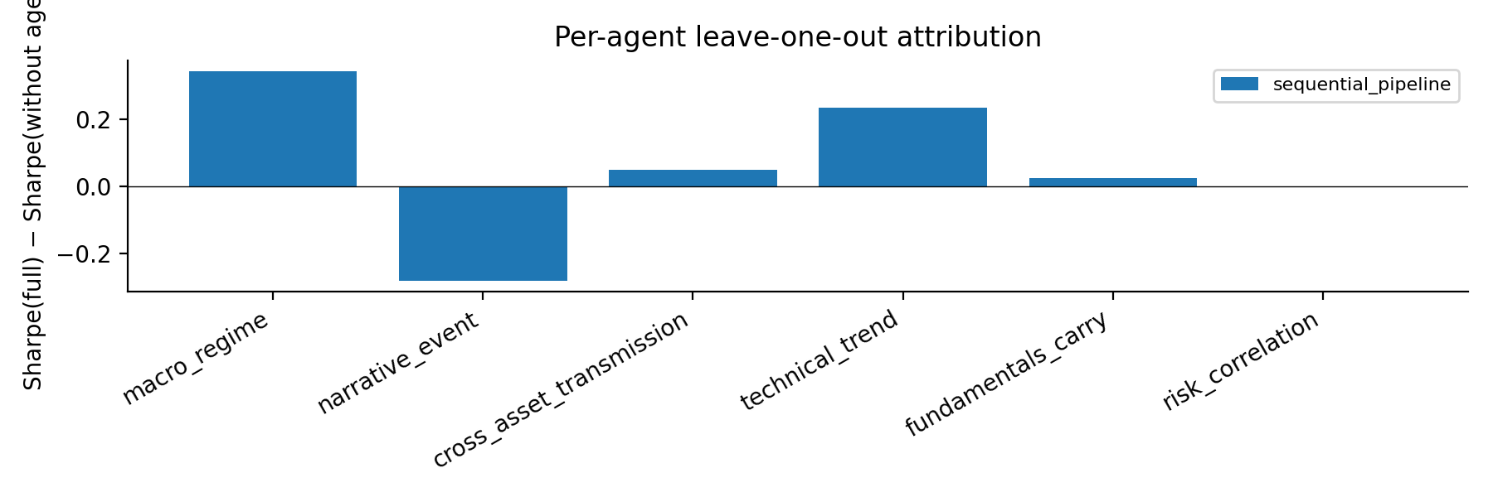
Narrative agent hurts most (Δ = −0.28); macro regime helps most (+0.34)
Per-agent LOO
• narrative_event: −0.28 (hurts)
• macro_regime: +0.34 (helps)
• technical_trend: +0.23 (helps)
• risk_correlation: 0 (scaling-only)
LOO on b__frontier__sequential_pipeline; Sharpe(full) = −0.4447 reproduces the matrix-run cell.

Slide 9
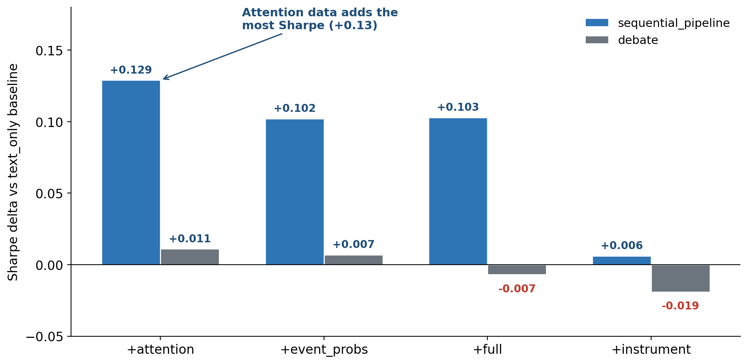
Attention data adds Sharpe (+0.13); instrument-specific alt-data does not
5 variants × 2 protocols × frontier regime; deltas vs text_only baseline. None matters in regime=none.

Slide 10
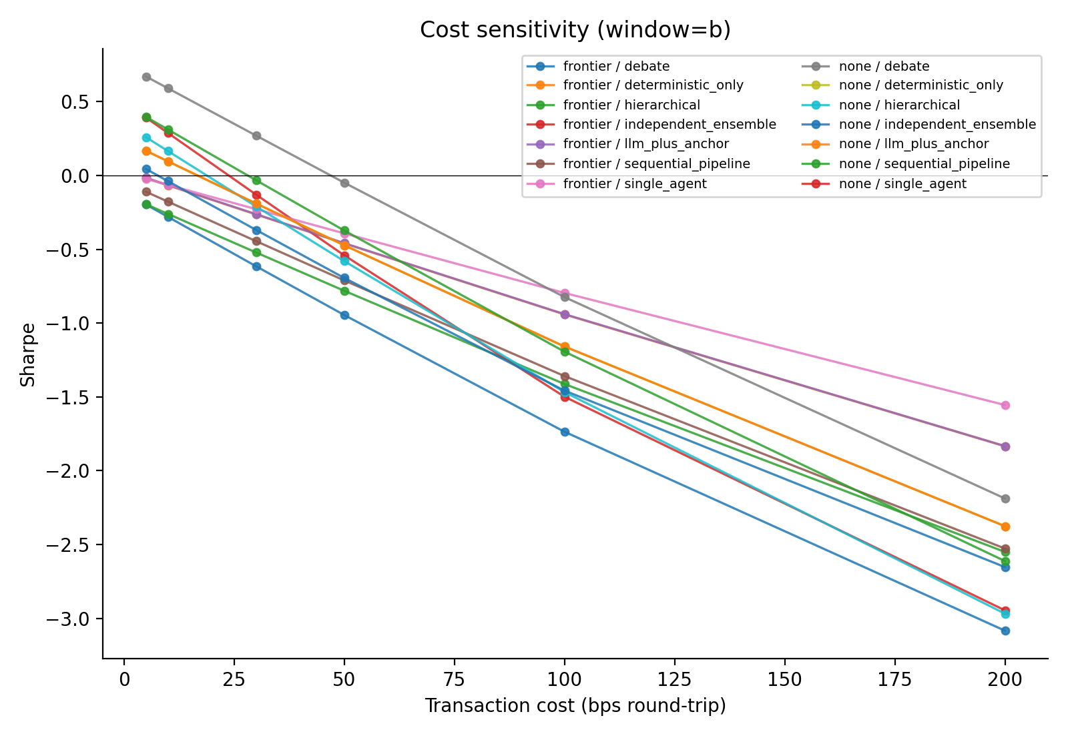
All differences significant at FDR 5%, but bootstrap CIs and sub-period instability flag short-sample uncertainty
Statistical signals
• LW Sharpe test: 12/12 reject H₀ at FDR 5%
• Bootstrap 95% CIs: wide; span 0 for most cells
• Sub-period: no-LLM cells flip sign 2022 → 2023-24
• Cost sensitivity: all but ind. ensemble negative ≥ 30 bps
Ledoit-Wolf (2008) HAC + Benjamini-Hochberg (1995) FDR; Politis-Romano (1994) block bootstrap.

Slide 11
The architecture that benefits from LLM is the one that does NOT coordinate
• Parallel filter > coordination substrate: ind. ensemble + LLM is the only frontier cell where adding LLM helps (Δ = +0.24)
• Cascading context amplifies disagreement: sequential and hierarchical generate more turnover, no extra return
• Narrative LLM in volatile macro regimes: GDELT-driven sentiment lagged price action at every Fed pivot
• FINSABER alignment: simple beats complex on this window's risk-adjusted metrics
• Practical implication: always run the no-communication baseline and a passive benchmark
FINSABER: Li et al. (2025); Stop Overvaluing MAD: Zhang et al. (2025).

Slide 12
Conclusions
• 1. H1 rejected on Window B: every coordinated frontier protocol underperforms the no-communication ensemble
• 2. Passive beats every cell: inverse-vol (0.62), SPY BAH (0.50), 60/40 (0.34) all > best matrix cell (0.27)
• 3. Narrative-LLM combination hurts: removing the GDELT-driven narrative agent improves Sharpe by +0.28
• 4. Attention data is the most useful alt-data axis: +0.13 on sequential_pipeline; instrument-specific alt-data ≈ 0
github.com/keshavdalmia10/PACT · dalmia4@illinois.edu
Open dataset · pinned model SHAs · all caches reproducible bit-for-bit

