Slide 1
AI Talks Campaign Insights
Auto-generated deck with KPIs and key visuals

Slide 2
Key KPIs
total_videos: 5.0
total_views: 20.0
total_likes: 0.0
avg_view_duration_sec: 2445.2
subs_total_gain: 0.0
subscribed_view_share: 1.0

Slide 3
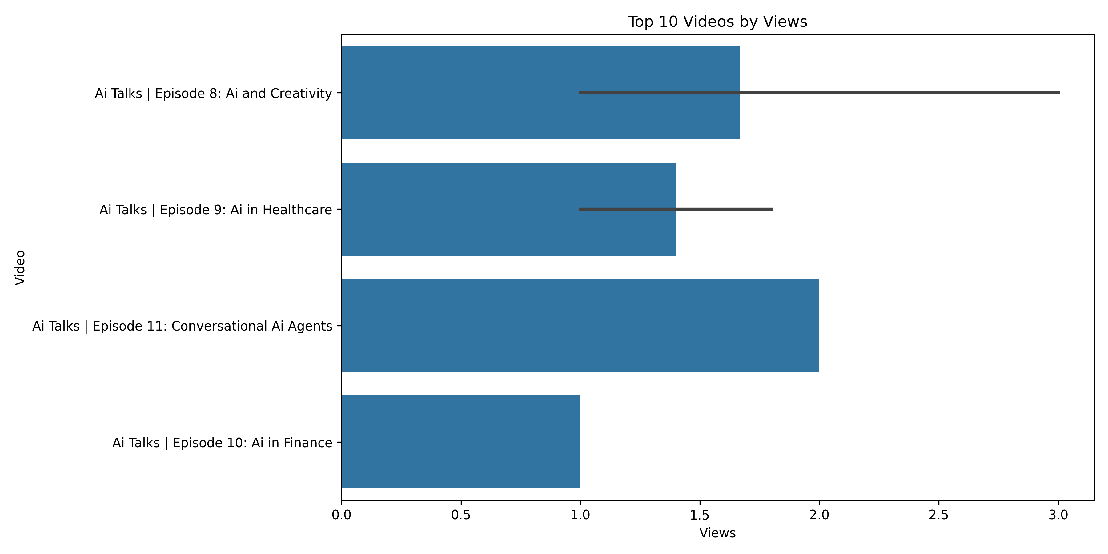
Top Videos by Views

Slide 4
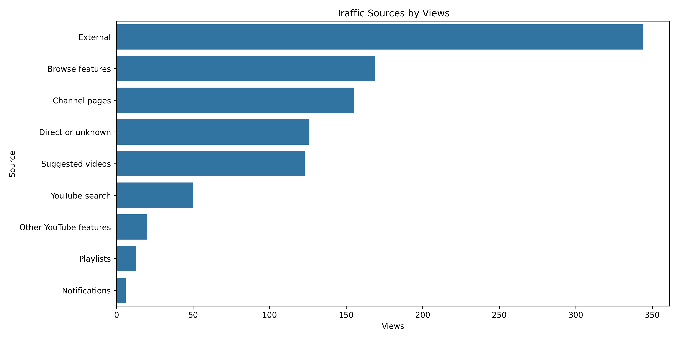
Traffic Sources

Slide 5
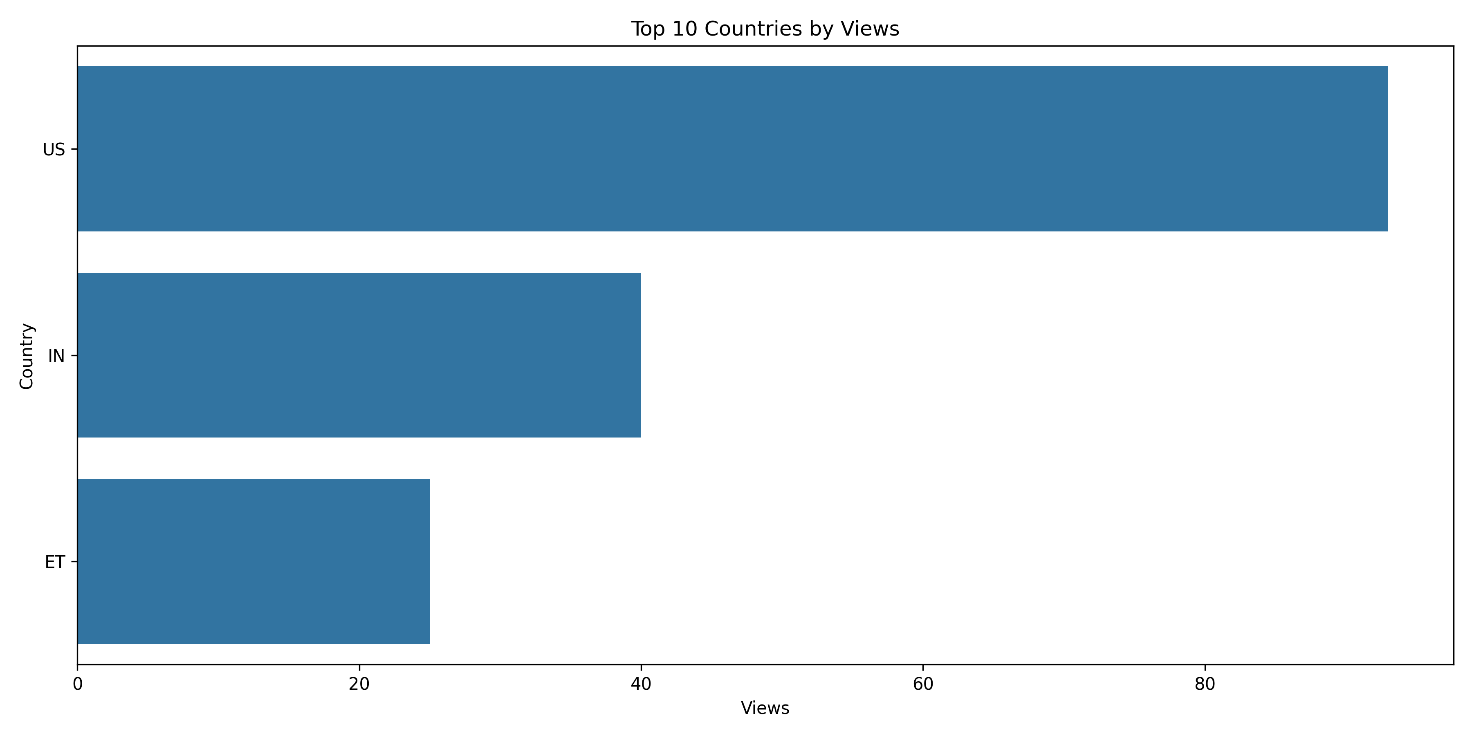
Top Countries

Slide 6
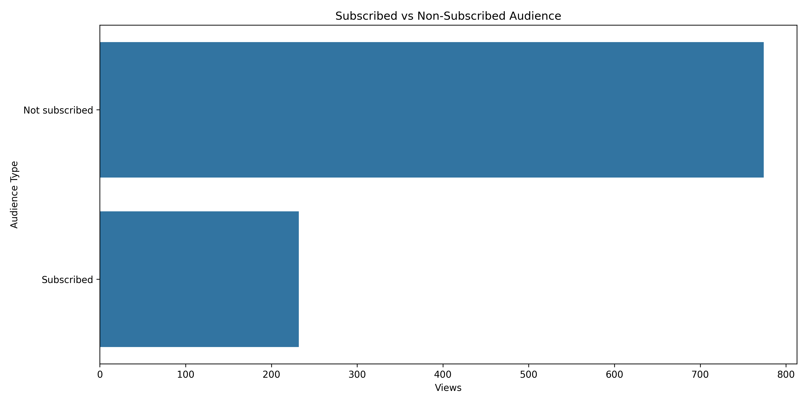
Subscriber Breakdown

