Slide 1
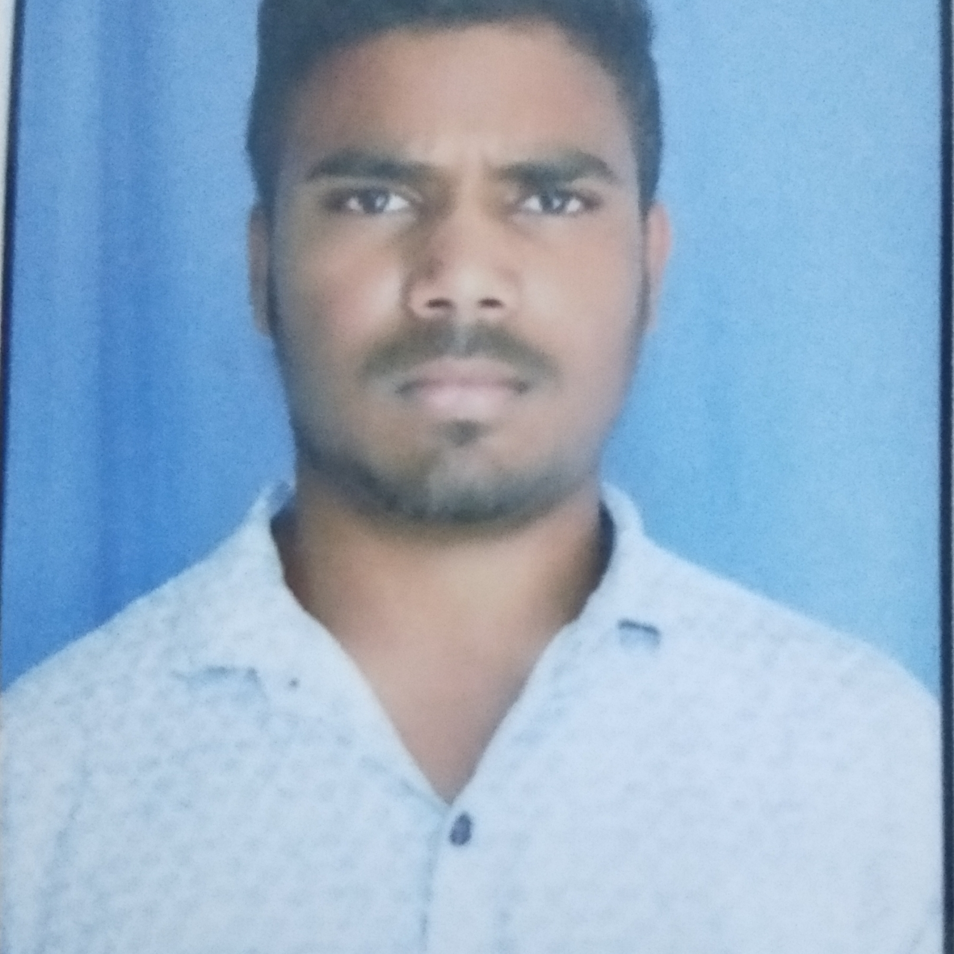



PABBA KESHAVARDHAN GOUD
Analyst/Software Engineer
Bachelor of Engineering
Mechanical Engineering
: 2017 - 2021
Skills
Java 8 /J2EE | Java Basics, OOPS, Generics, Collections, Arrays, Loops, Lambda Exp, Stream API Junit, Servlets
Spring core | IOC & Dependency Injection, Autowire
Spring REST | REST controllers, Implementation of GET, POST, PUT & DELETE, Bean Validation & Exception Handling, Testing Services, Controller & Repository layer
Spring Data JPA | Implement DAO layer using spring Data repositories, Transaction Management
Spring Boot Microservices | Spring Boot Starters, annotations, Messaging Service
Spring Cloud | Eureka, Netflix Ribbon, Feign Client, Netflix Hystrix, Netflix Zuul & Config Server
React | Components, Hooks, Event handling, Redux, Reducers
Database | My SQL RDS Basics
UI Tech | HTML 5 & CSS 3,JavaScript, ES6 & TypeScript Reusable templates, Optimized UI Designed
Tools | Git, Postman, Maven, IDE
Add On skills | Communications, Team management. Peer learning
Hyderabad
PABBA-KESHAVARDHAN.GOUD@CAPGEMINI.COM
+91 7780302871
A4
Full Stack Developer
Hands on experience in creating microservices with Spring boot, Spring Security, Netflix Zuul API Gateway, Eureka server
Hands on experience in creating DDL, DML, DCL, DQL in Postgres SQL
Git & GitHub knowledge on an intermediate level
Knowledge on HTML, CSS and React
Ready to learn new technologies and implement them to further improve my knowledge
Neo bookstore
Backend Developer:
In our project we have used Spring Boot Framework of core java for backend development. Our application allows administrator to add, modify book, delete book. User can be able to add a book to cart and buy the product.
Designed UML diagrams based on given requirements. Used Spring boot to perform backend tasks. We used Spring data JPA for creation of entities in PostgreSQL. Done unit testing for all the possible use cases by postman tool
Expense Tracker
Front Developer:
In our project we have used HTML, CSS, JS and ReactJs for front development. We can add new expense to expenses tracker, and we can see all expenses in the expense tracker. We used vscode and node.js to create the expense tracker project.
Check out my work on GitHub & Video Profile

