Slide 1
Customer Churn Prediction
Using Machine Learning on Telco Customer Dataset
Logistic Regression
Decision Tree
Random Forest
XGBoost
LightGBM
Team: Keshav Gupta & Mudassir Iftikhar

Slide 2
Agenda
What we cover in this presentation
01
Problem & Dataset
05
Evaluation
Telco churn, 7K customers, class imbalance
Accuracy, Precision, Recall, F1, ROC-AUC
02
Exploratory Data Analysis
06
Hyperparameter Tuning
Key patterns and churn drivers in the data
GridSearchCV on top models
03
Feature Engineering
07
SHAP Explainability
Encoding, scaling, SMOTE for class balance
Feature importance and business insights
04
Model Training
08
Conclusions
5 ML classifiers trained and compared
Recommendations for churn reduction
2 / 10

Slide 3
Dataset & Problem Statement
Telco Customer Churn
7,043
19
26.5%
11
Customers
Features
Churn Rate
Missing values
(fixed)
Demographics
Services
Contract
Billing
gender, SeniorCitizen,
Partner, Dependents
Phone, Internet, Security,
Backup, Streaming…
Type, PaperlessBilling,
PaymentMethod
MonthlyCharges,
TotalCharges, tenure
Key Challenge: Class Imbalance — 73.5% No Churn vs 26.5% Churn → SMOTE applied during training
3 / 10

Slide 4
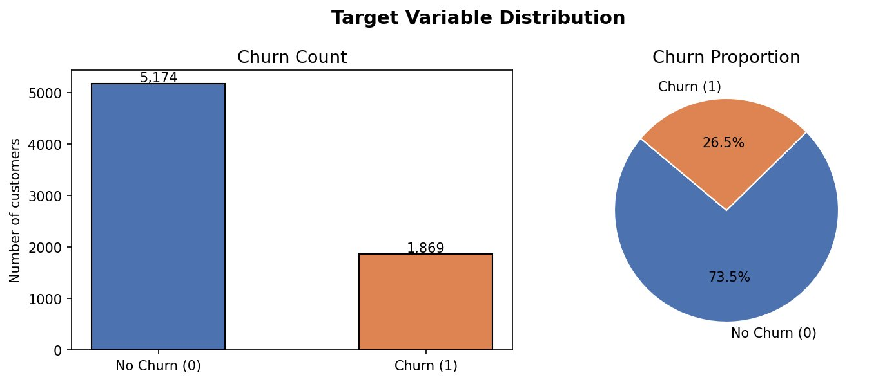
Exploratory Data Analysis
What the data reveals about churn behaviour
Contract Type
Class Balance
Month-to-month customers churn at 42% vs just 3% on 2-year contracts
Tenure
Churned customers have median tenure of ~10 months vs ~38 months retained
Monthly Charges
Churned customers pay more per month — concentrated in $60–$100 range
Internet Service
Correlation insight
Fiber optic users churn at 41% — highest of any internet tier
tenure vs Churn: r = −0.35 TotalCharges vs tenure: r = +0.83 MonthlyCharges vs Churn: r = +0.19
Payment Method
Electronic check payers churn at 45% — highest of all payment types
Support Add-ons
Customers without Online Security or Tech Support churn 3× more
4 / 10

Slide 5
Feature Engineering Pipeline
Transforming raw data into model-ready arrays
Raw Data
Type Fix
Encode &
Scale
Train/Test
Split
SMOTE
7,043 rows
20 features
TotalCharges
whitespace → NaN
OrdinalEncoder
StandardScaler
80 / 20
Stratified
Balance minority
class (churn)
▶
▶
▶
▶
Train set (after SMOTE)
Test set (unchanged)
Feature matrix
Balanced 50/50 minority oversampled
1,409 samples, real distribution 26.5% churn
19 features (numeric + ordinal-encoded categorical)
The preprocessor (ColumnTransformer) is fitted only on the training set to prevent data leakage.
5 / 10

Slide 6
Models Trained
5 classifiers compared on the same test set
Logistic
Regression
Decision
Tree
Random
Forest
Library: scikit-learn
Library: scikit-learn
Library: scikit-learn
Type: Linear
Type: Tree-based
Type: Ensemble (Bagging)
max_iter=1000
class_weight=balanced
max_depth=10
class_weight=balanced
200 trees
n_jobs=−1
XGBoost
LightGBM
Library: xgboost
Library: lightgbm
Type: Ensemble (Boosting)
Type: Ensemble (Boosting)
lr=0.1, depth=5
eval_metric=logloss
lr=0.1, depth=5
num_leaves=31
All models saved as .joblib files · Trained on SMOTE-balanced data · Evaluated on the original test distribution
6 / 10

Slide 7
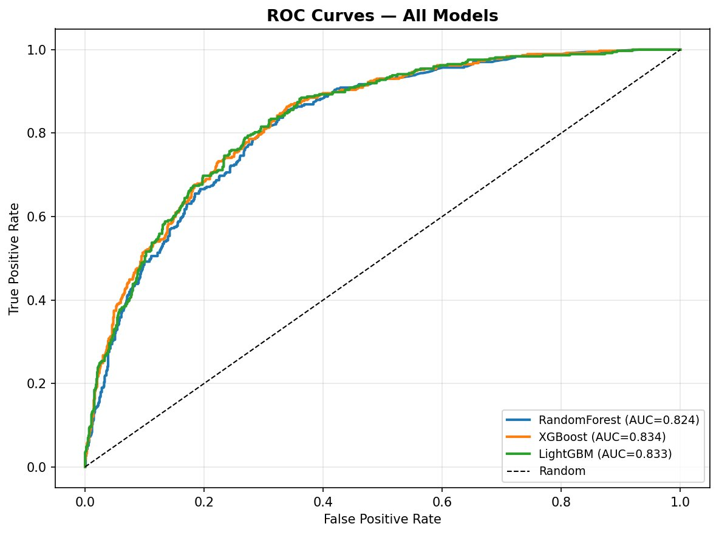
Model Evaluation Results
Tested on 1,409 held-out samples
Model | Accuracy | Precision | Recall | F1-Score | ROC-AUC
XGBoost ★ | 0.781 | 0.583 | 0.610 | 0.596 | 0.834
LightGBM | 0.782 | 0.586 | 0.612 | 0.599 | 0.833
Random Forest | 0.774 | 0.575 | 0.575 | 0.575 | 0.824
Log. Regression | ~0.74 | ~0.51 | ~0.79 | ~0.62 | ~0.820
Decision Tree | ~0.74 | ~0.52 | ~0.64 | ~0.57 | ~0.710
ROC Curves — All Models
★ Best model: XGBoost (ROC-AUC = 0.834) · LightGBM is a very close second (0.833) · Both gradient boosting models outperform simpler classifiers
7 / 10

Slide 8
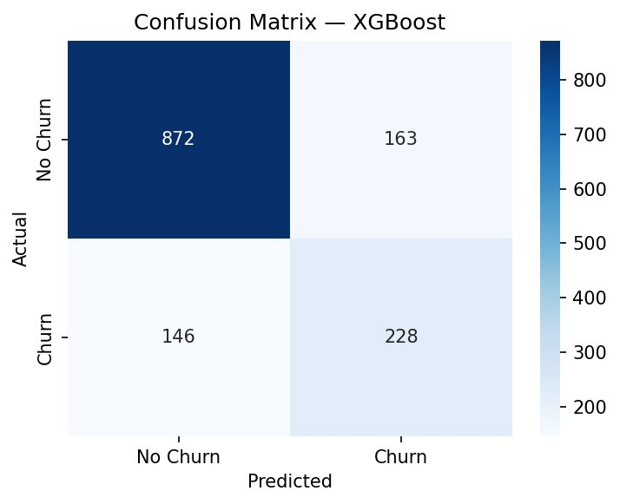
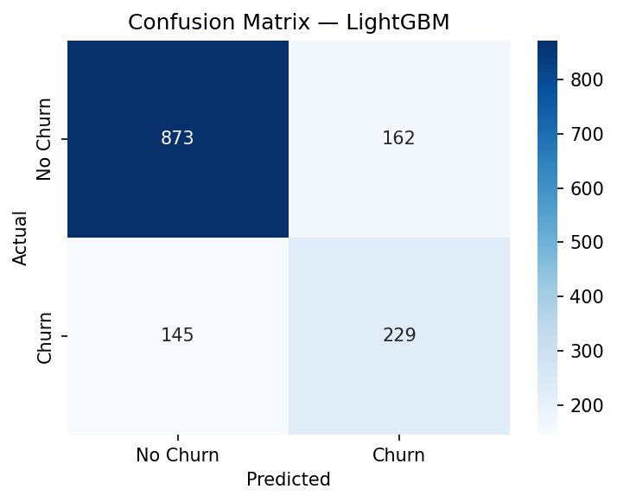
Confusion Matrices — Best Models
XGBoost vs LightGBM on the test set (1,409 samples)
XGBoost
LightGBM
872 TN
228 TP
163 FP
146 FN
Correctly predicted no churn
Churners correctly caught
False alarms raised
8 / 10
Churners missed (costly!)

Slide 9
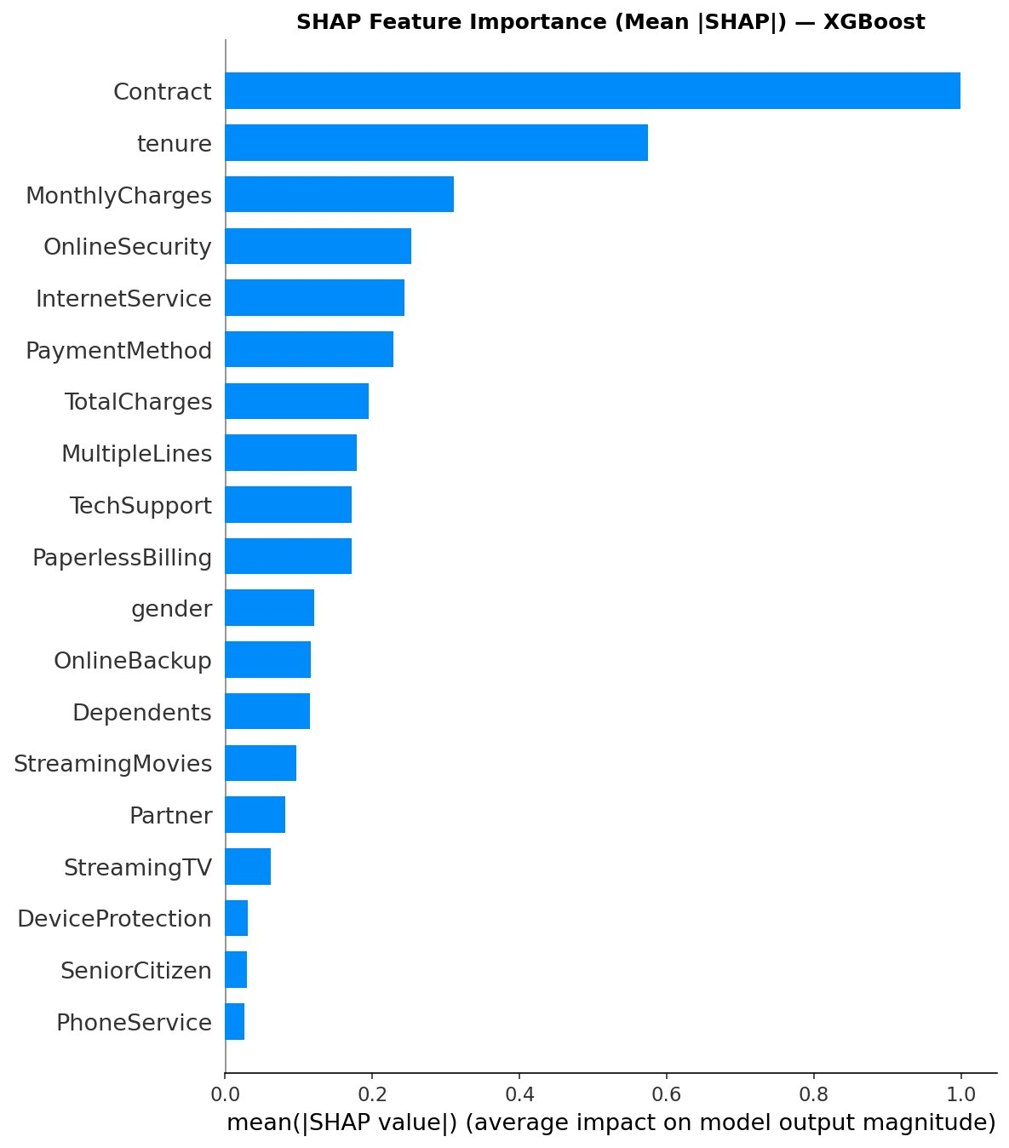
Feature Importance & SHAP Analysis
What drives churn — XGBoost & LightGBM agree
Top Churn Drivers
#1 Contract Type
Month-to-month → 42% churn
Two-year → only 3% churn
#2 Tenure
Short-tenured customers are
high churn risk (< 12 months)
#3 Monthly Charges
Higher bills strongly correlate
with increased churn
#4 Payment Method
Electronic check users churn
at 45% — highest of all types
#5 Online Security
SHAP = SHapley Additive exPlanations — measures each feature's contribution to every individual prediction
No security add-on → 3× higher
churn rate vs subscribers
9 / 10

Slide 10
Conclusions & Recommendations
Best Model
Early Intervention
XGBoost achieved the highest ROC-AUC of 0.834, closely followed by LightGBM (0.833). Both are recommended for production deployment.
Customers with tenure < 12 months and high monthly charges via electronic check are the highest-risk segment. Target them first.
Top Insight
Next Steps
Contract type is the #1 churn driver. Migrating month-to-month customers to annual contracts is the single most impactful retention action.
Deploy the XGBoost model, score all customers monthly, adjust the decision threshold to balance precision vs recall per campaign budget.
SMOTE Works
Applying SMOTE to the training set improved recall for the minority churn class without overfitting to synthetic samples on the test set.
Thank you · Questions welcome

