Slide 1
Impact of Preprocessing Choices on
Classical NLP Sentiment Analysis
Mudassir Iftikhar & Keshav Gupta
IMDB Movie Reviews | Binary Sentiment Classification
1. Dataset & EDA
2. Methodology
3. Experiments
4. Tuning
5. Findings
1 / 5

Slide 2
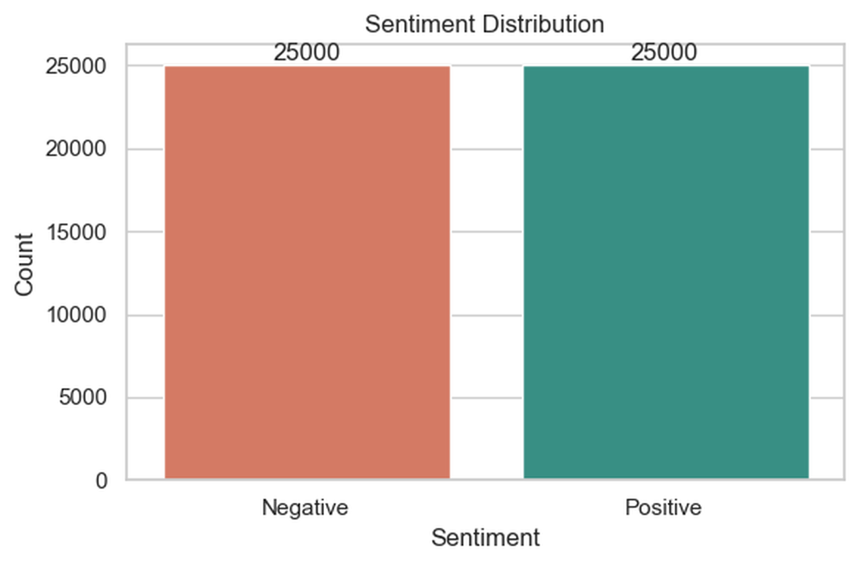
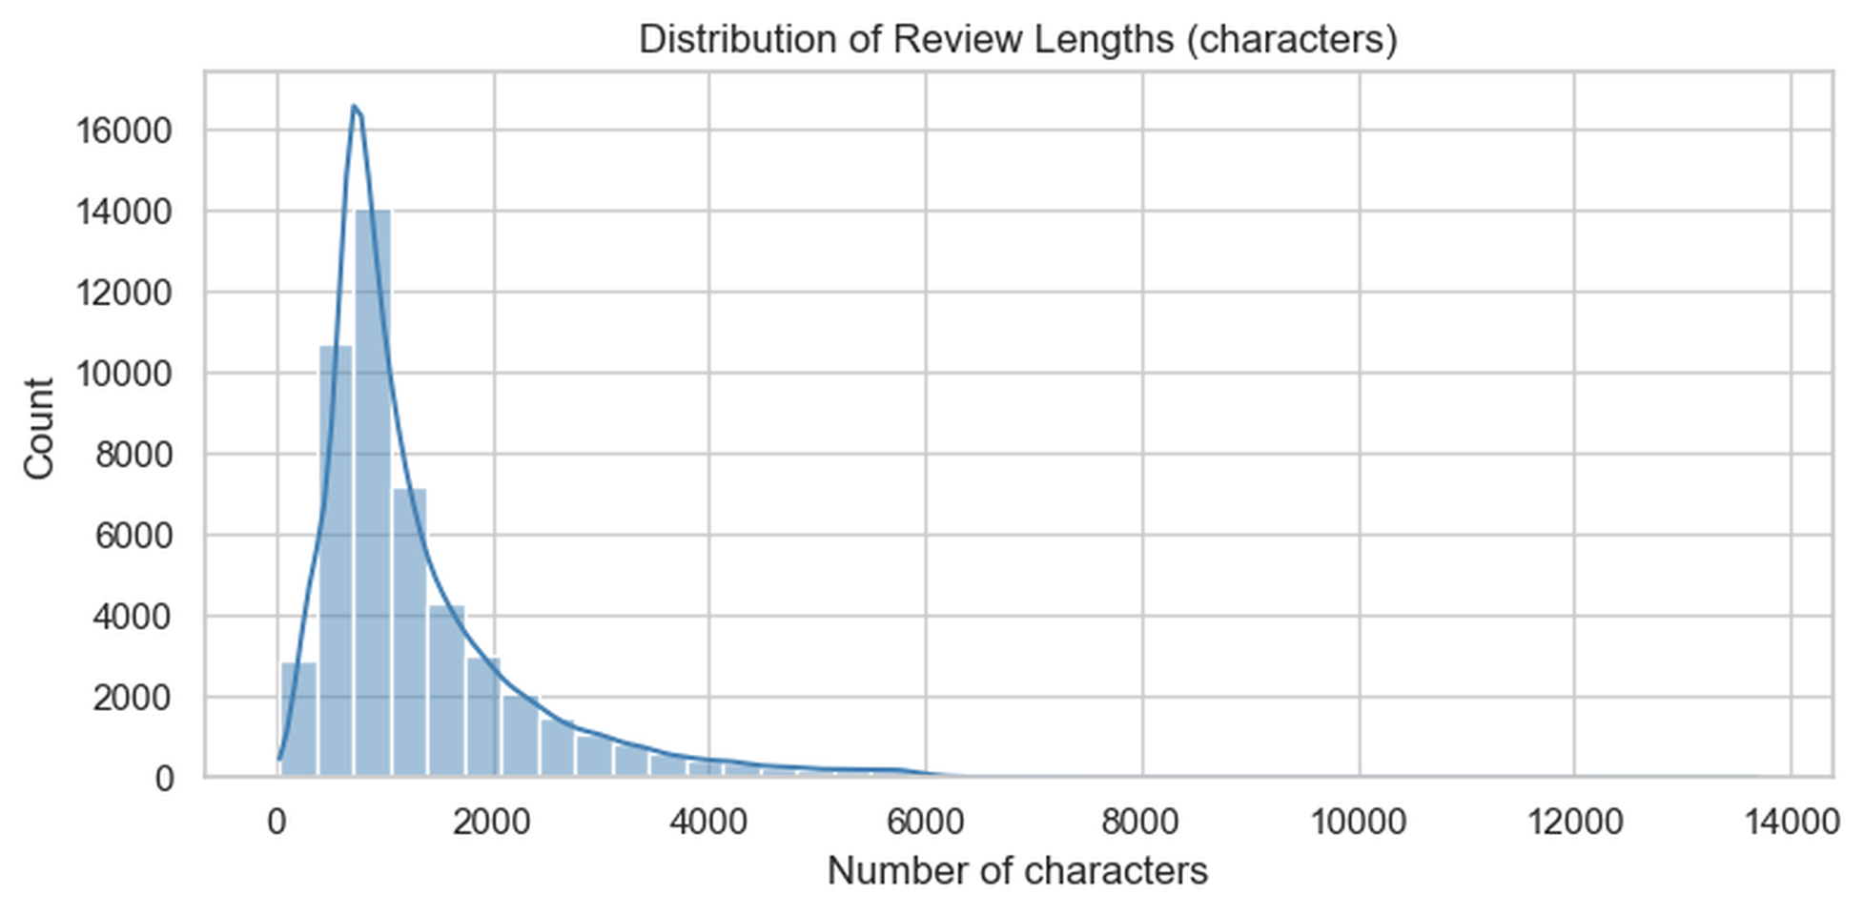
2 / 5
BACKGROUND
Dataset & Methodology
50,000
80 / 20
50 / 50
Total Reviews
Train / Test
Classes
Balanced dataset
40k train · 10k test
Perfectly balanced
Fig 1: Perfectly balanced class distribution
Fig 2: Review length — right-skewed (median 970 chars)
Mudassir Iftikhar & Keshav Gupta | IMDB Sentiment Analysis

Slide 3

3 / 5
EXPERIMENTS
5 Preprocessing Experiments & Results
Exp 1
Exp 2
Exp 3
Exp 4
Exp 5
Basic
Tokenization
+Stopword
Removal
+Porter
Stemming
+Stopwords
& Stemming
+Stopwords
& Bigrams
Experiment | Accuracy | Precision | Recall | F1-Score
Exp5: Stopwords + Bigrams | 0.8985 | 0.8906 | 0.9086 | 0.8995
Exp1: Basic Tokenization | 0.8968 | 0.8913 | 0.9038 | 0.8975
Exp2: +Stopword Removal | 0.8961 | 0.8884 | 0.9060 | 0.8971
Exp3: +Stemming | 0.8947 | 0.8879 | 0.9034 | 0.8956
Exp4: +Stopwords & Stemming | 0.8934 | 0.8851 | 0.9042 | 0.8945
Mudassir Iftikhar & Keshav Gupta | IMDB Sentiment Analysis

Slide 4
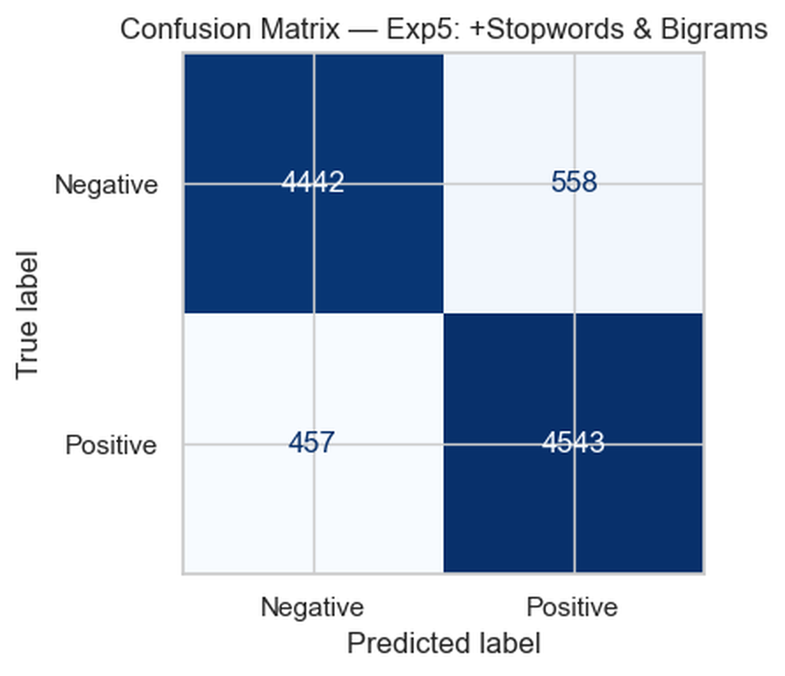
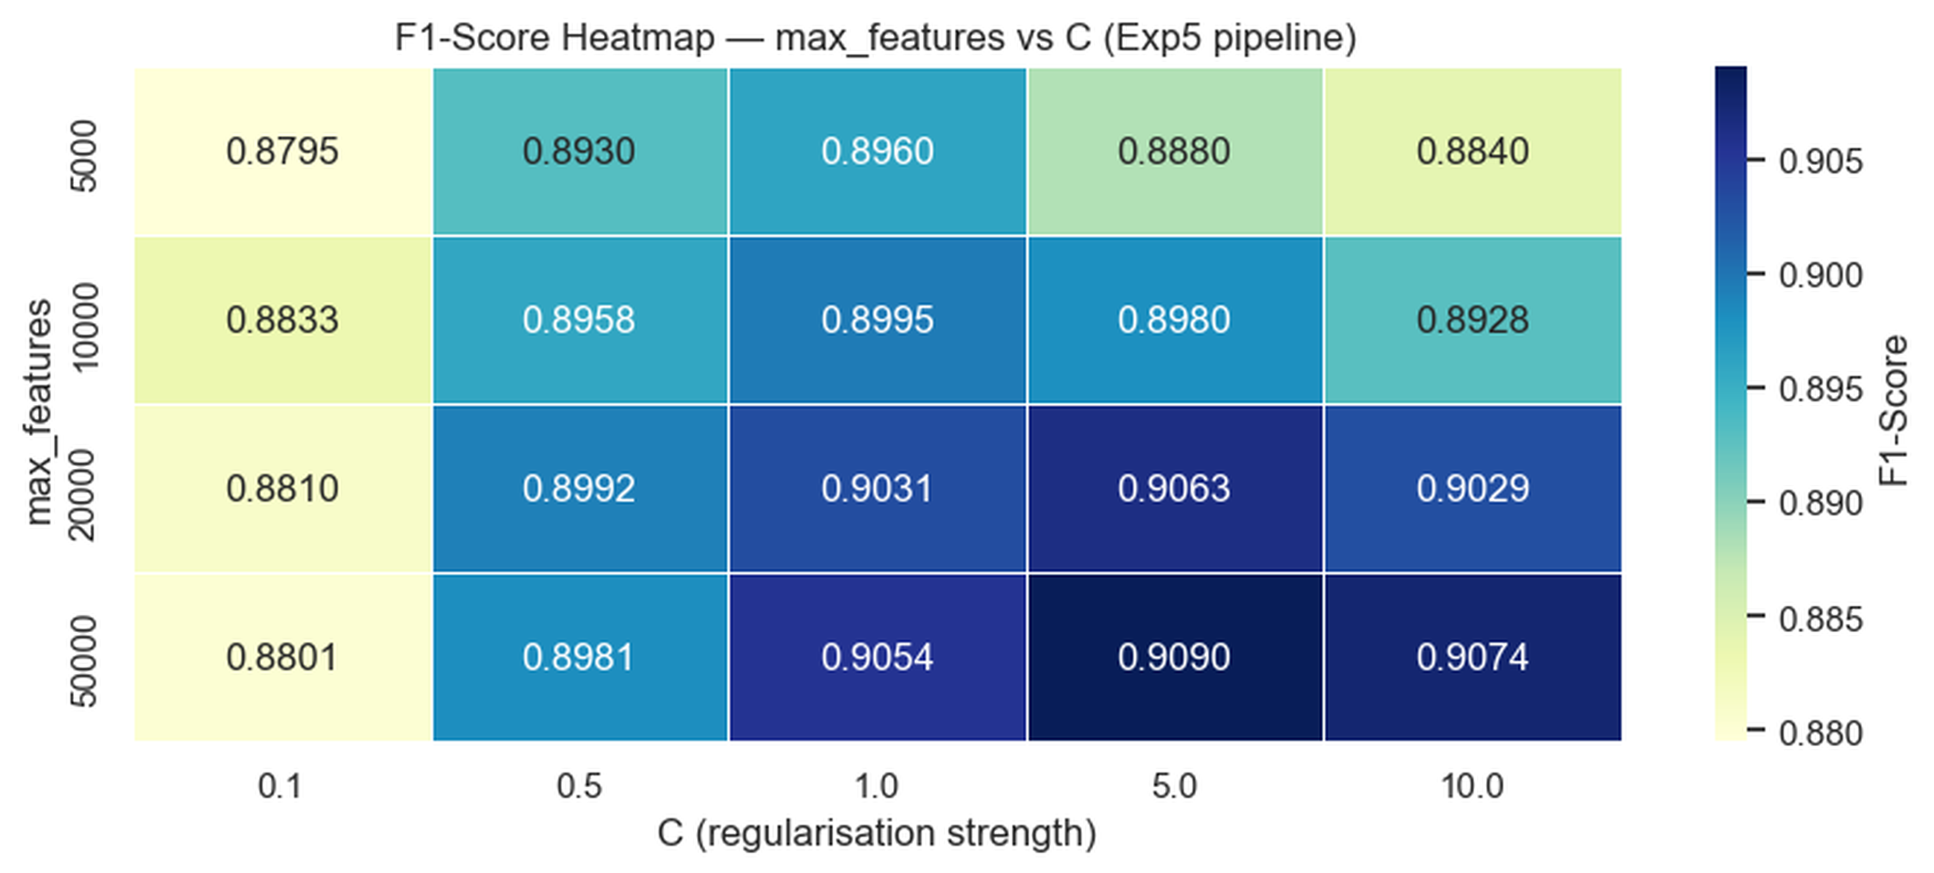

4 / 5
DEEP DIVE
Best Model Analysis & Hyperparameter Tuning
Confusion Matrix — Exp5 (Best Model)
F1-Score Heatmap — max_features × C
Best: max_features=50,000 · C=5.0
Accuracy: 90.85% F1-Score: 0.9090
Specificity: 0.8884
NPV: 0.9067
Mudassir Iftikhar & Keshav Gupta | IMDB Sentiment Analysis

Slide 5




KEY FINDINGS
Conclusions
Basic pipeline is very competitive
Stemming consistently hurts
Exp1 (minimal preprocessing) ranked 2nd overall. Heavy cleaning is not always better — start simple.
Porter stemmer is too aggressive. It merges distinct words (good vs goods), destroying useful signal.
Bigrams gave the biggest gain
Vocabulary size is the key tuning lever
Exp5 was the best preprocessing setup. Bigrams capture negation ("not good") that unigrams miss.
Raising max_features to 50k improved F1 by +0.006. Tuning C added +0.002. Final accuracy: 90.85%.
Mudassir Iftikhar & Keshav Gupta | IMDB Sentiment Analysis
5 / 5

