Slide 1
Dense vs Sparse vs Hybrid RAG
Multi-Dataset Benchmarking: SQuAD & TriviaQA
Team members: Keshav Gupta and Mudassir Iftikhar
Dense (FAISS)
Sparse (BM25)
Hybrid (RRF)
Extractive QA Generator: deepset/roberta-base-squad2 | 300 queries per dataset | 95% Bootstrap CI

Slide 2
Project Objective
The Core Question
Why Two Datasets?
Which retrieval strategy works best for RAG?
Dense retrieval uses semantic embeddings (FAISS)
Sparse retrieval uses exact keyword matching (BM25)
Hybrid fuses both via Reciprocal Rank Fusion (RRF)
Do results generalise across different QA styles?
SQuAD: written while reading the passage → high lexical overlap → BM25 expected to win
TriviaQA: trivia-style, paraphrased questions → semantic matching needed → Dense expected to win
Running both tests whether findings generalise
Avoids cherry-picking results from one favourable dataset

Slide 3
RAG Pipeline Structure
1
2
3
4
Data Loading
Chunking
Retrieval
Generation
SQuAD / TriviaQA
Unified loader
(same schema)
Token-window splitter
250 tokens / 50 overlap
Dense: FAISS + MiniLM
Sparse: BM25 Okapi
Hybrid: RRF fusion
roberta-base-squad2
Extractive span selection
Cannot hallucinate
Evaluation: Exact Match (EM) | F1 Score | Retrieval Hit Rate (RHR) | Bootstrap 95% CI (n=1000)

Slide 4
Dataset Details
SQuAD
TriviaQA
Stanford Question Answering
Trivia-Style RC Dataset
Questions written while reading the passage
High lexical overlap between question & answer context
Answers are verbatim text spans from the passage
600 corpus passages · 300 evaluation queries
Validation split used
Expected winner: BM25 (keyword matching advantage)
Trivia-style questions, independently composed
Paraphrased phrasing – exact keywords rarely shared
Answers include canonical value + all aliases
600 Wikipedia passages · 300 evaluation queries
rc.wikipedia split used
Expected winner: Dense (semantic matching advantage)

Slide 5
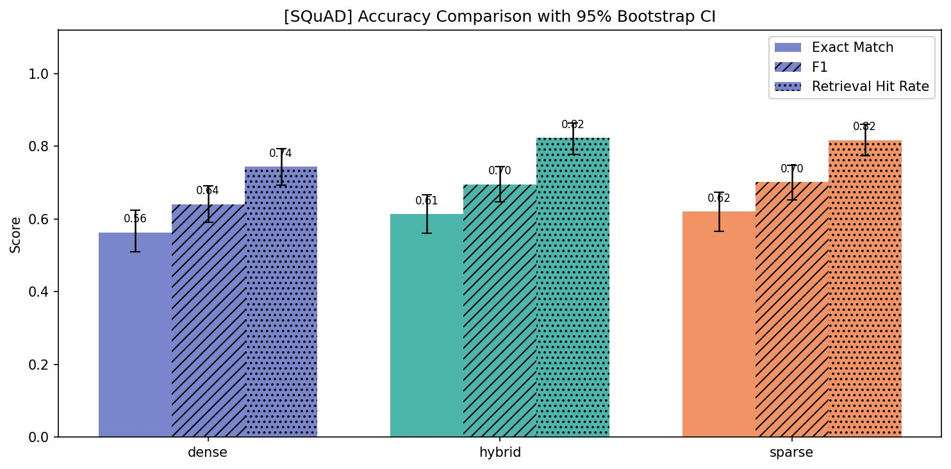
SQuAD Results
Key Numbers
Pipeline
EM
F1
RHR
Dense
0.56
0.64
0.74
Hybrid
0.61
0.70
0.82
Sparse
0.62
0.70
0.82
✓ Sparse & Hybrid tie on F1 (0.70)
✓ Hybrid & Sparse lead RHR (0.82)
✗ Dense lags 6pp in F1 vs others
BM25 hypothesis confirmed on SQuAD: lexical overlap benefits keyword retrieval

Slide 6
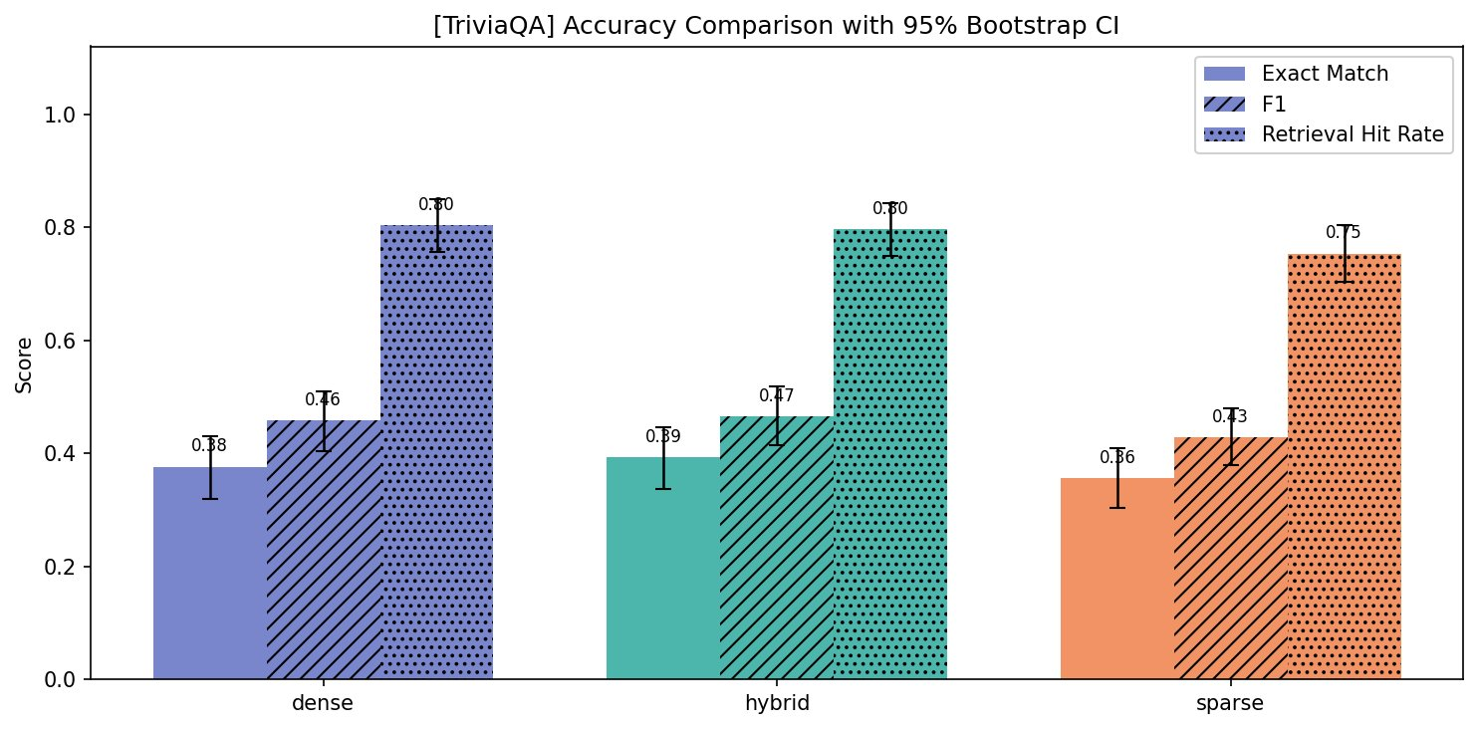
TriviaQA Results
Key Numbers
Pipeline
EM
F1
RHR
Dense
0.38
0.46
0.80
Hybrid
0.39
0.47
0.80
Sparse
0.36
0.43
0.75
✓ Dense leads F1 (0.46) & RHR (0.80)
✓ Hybrid close behind (F1 0.47 ≈ Dense)
✗ Sparse drops 3pp vs Dense in F1
Dense hypothesis confirmed on TriviaQA: semantic matching handles paraphrased questions

Slide 7
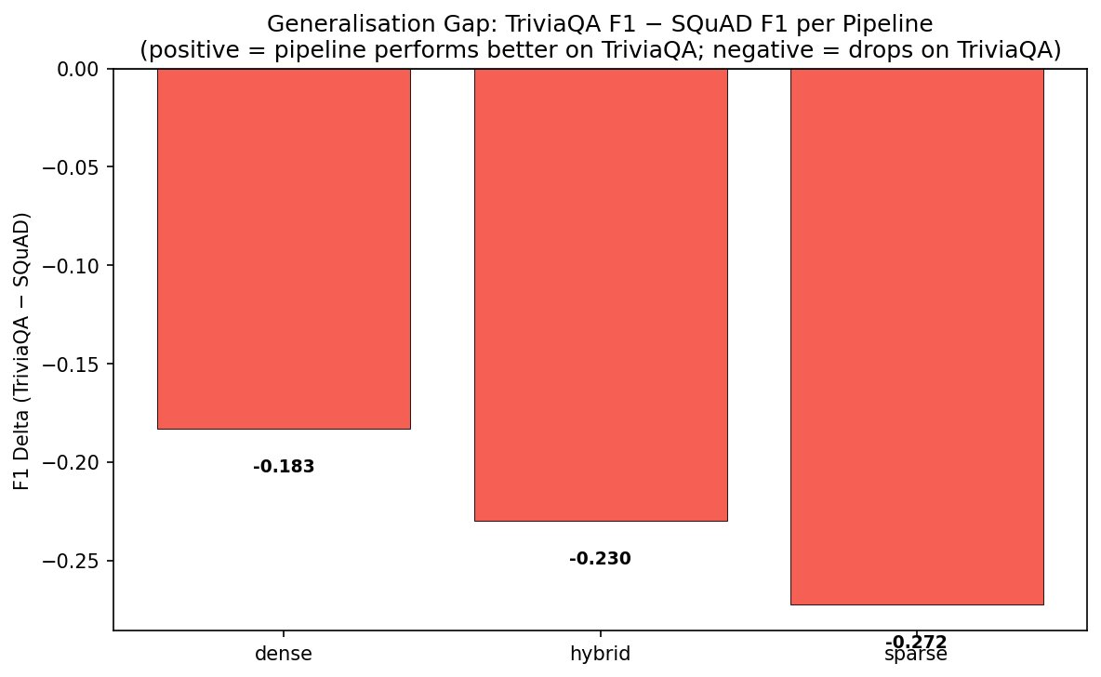
Generalisation Gap: TriviaQA − SQuAD F1
What This Tells Us
Dense: −0.183
Hybrid: −0.230
Sparse: −0.272
All pipelines score lower on TriviaQA — paraphrased QA is inherently harder
Sparse suffers the most (−0.272): BM25 keyword advantage disappears completely
Dense is the most robust across datasets
Hybrid falls between — RRF couldn't fully recover from BM25's TriviaQA weakness
Sparse retrieval is the least generalisable pipeline — avoid for paraphrased or semantic QA tasks

Slide 8
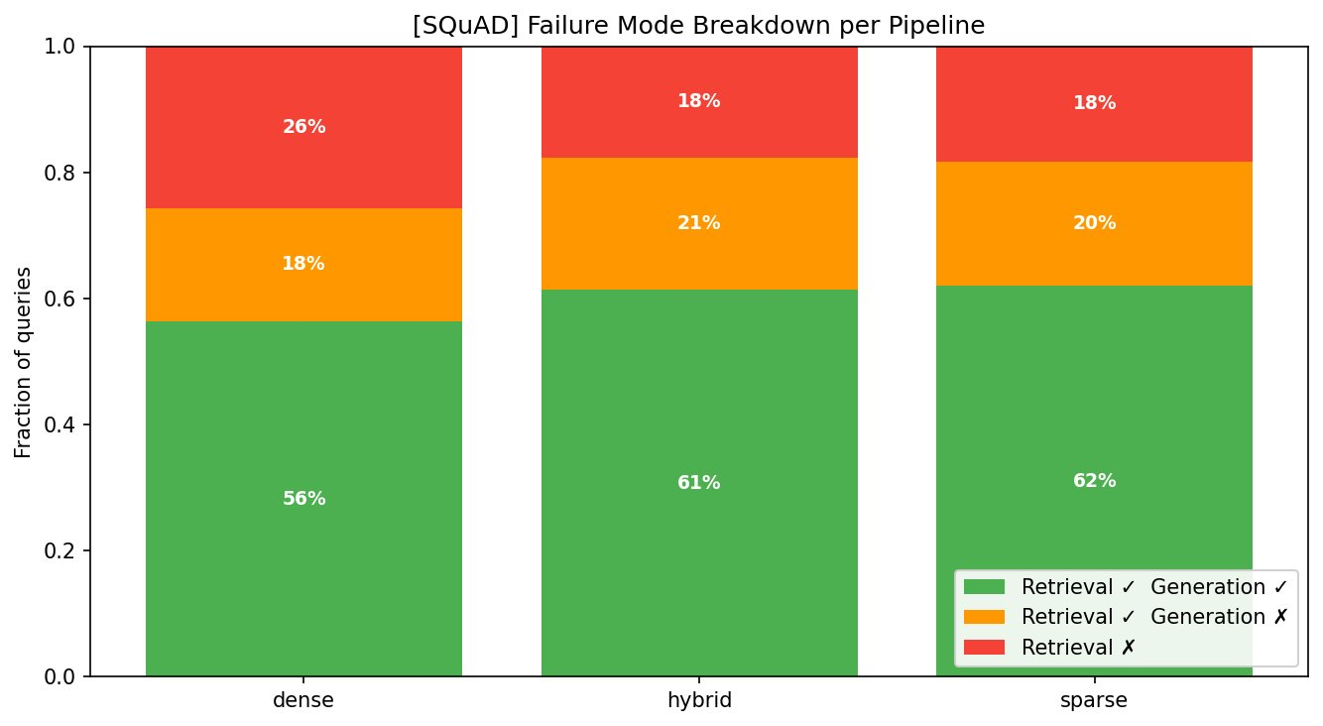
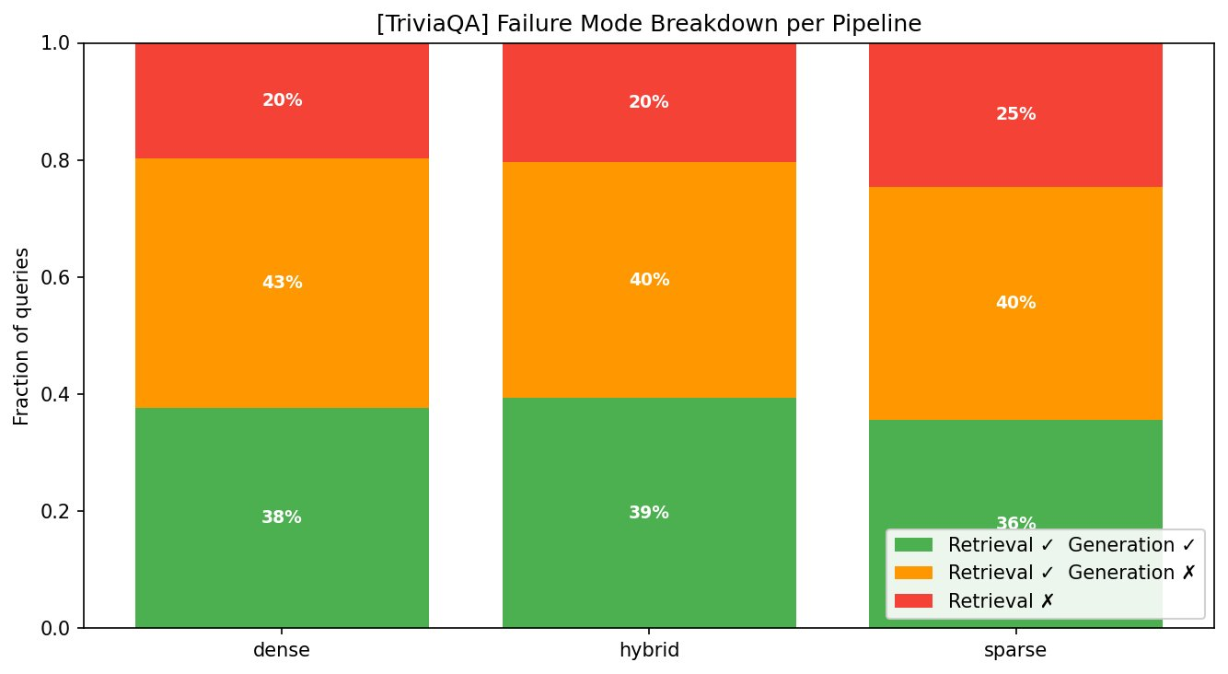
Failure Mode Analysis
SQuAD
TriviaQA
SQuAD: Retrieval succeeds 61–82% of the time; generator fails on 18–21% of hits → generator is the bottleneck. TriviaQA: Only 36–39% end-to-end success; 40–43% of queries have correct retrieval but failed generation → TriviaQA is much harder for the extractive model.

Slide 9
Key Takeaways
1. Dataset matters
2. Hybrid is the safe bet
3. Sparse doesn't generalise
Sparse/BM25 wins on SQuAD (lexical overlap). Dense wins on TriviaQA (semantic). No single retriever dominates both.
RRF hybrid ties for best on SQuAD and near-best on TriviaQA. Best overall mean F1 (0.58) with only 4% latency overhead.
Sparse has the largest generalisation gap (−0.272). Avoid for diverse or paraphrased query types.
4. Generator is a bottleneck
5. Latency is almost equal
6. RHR vs F1 gap
On TriviaQA: 40–43% of queries have correct retrieval but wrong generation. Upgrading the generator may matter more than improving retrieval.
Dense: 1.03s | Hybrid: 1.07s | Sparse: 1.08s. Retrieval cost is negligible vs generation. Hybrid adds no meaningful overhead.
High RHR but low F1 confirms the generator, not the retriever, is the main source of failure on both datasets.

