Slide 1
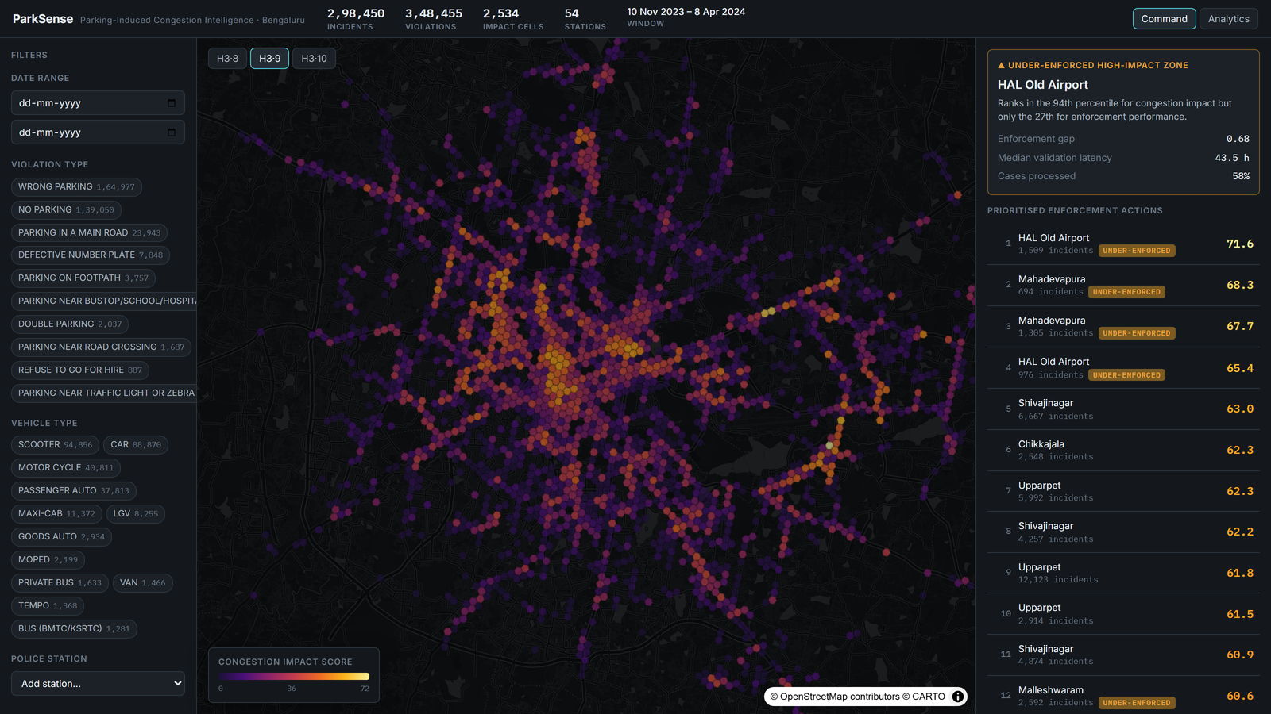
PARKSENSE
Congestion Impact Scoring for Targeted Parking Enforcement
Turning 298,450 Bengaluru parking-violation records into a ranked enforcement decision tool.
Flipkart Gridlock 2.0 · Theme: Poor Visibility on Parking-Induced Congestion

Slide 2
THE PROBLEM
Detection is solved. Prioritisation isn't.
Every violation in this dataset is already detected and labelled. A command centre cannot act on 298k dots on a map.
298,450
incidents analysed
It needs to know which locations do the most damage to traffic flow — and where enforcement effort fails to match that damage.
348,455
The problem statement asks to “quantify impact on traffic flow to enable targeted enforcement.” That quantification is the product.
violations (multi-label, exploded)
2,534
H3 impact cells

Slide 3
OUR APPROACH
Three computed instruments, one action list
01
Congestion Impact Score
A transparent per-cell score that weights what the violation is, not just how many — severity, vehicle footprint, density, persistence and peak pressure.
02
Enforcement Efficiency Gap
Impact vs. enforcement performance per station. Surfaces the high-impact, under-enforced zones — the single most actionable insight.
03
Hotspot Forecasting
A backtested per-cell LightGBM model on lag, calendar and spatial-neighbour features. Reports its naïve baseline, so the gain is never overstated.

Slide 4
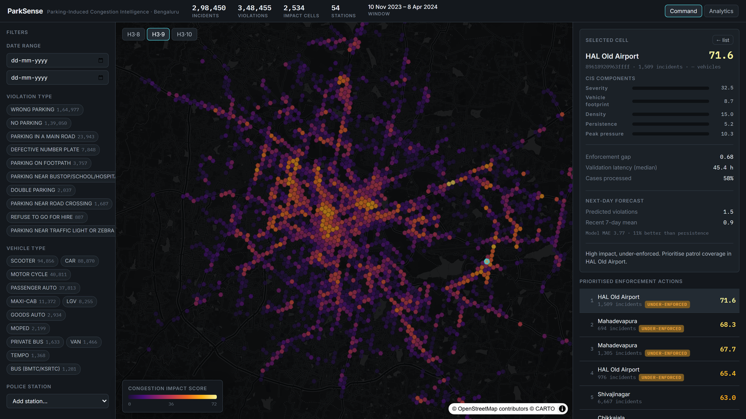
INSTRUMENT 01 · CONGESTION IMPACT SCORE
A principled score, not a black box
CIS = (Σ wᵢ·componentᵢ / Σw) · 100 · n/(n+k)
0.35
Severity
footpath / main-road obstruction ≫ no-parking
0.20
Vehicle footprint
a bus or LGV consumes far more carriageway
0.20
Density
incident volume per cell (log-compressed)
0.10
Persistence
chronic cells vs. one-off events
Live component breakdown for a selected cell — auditable in one glance.
0.15
Peak pressure
share in data-derived peak windows
A recurrence-confidence factor n/(n+k) stops a single high-severity one-off from ranking beside a chronic hotspot. Every component is shown on hover.

Slide 5
INSTRUMENT 02 · ENFORCEMENT EFFICIENCY GAP
Where impact and enforcement diverge
For every police station we compare congestion impact against enforcement performance (cases processed and turnaround speed), then rank the divergence.
WORKED EXAMPLE — HAL OLD AIRPORT
94th
27th
0.68
percentile for
congestion impact
percentile for
enforcement performance
enforcement gap
(impact − performance)
“This zone ranks near the top for impact but near the bottom for enforcement.” The product flags 18 such under-enforced stations — a ready-made patrol-reallocation list.

Slide 6
INSTRUMENT 03 · HOTSPOT FORECASTING
Accurate — and honestly reported
A daily per-cell LightGBM model (Tweedie objective) on lag, rolling, calendar and H3 ring-1 neighbour features. Validated on a held-out final 21 days — the model never sees the test window.
3.77
Model MAE
4.23
We publish the persistence baseline alongside the model so the gain is provable, not asserted. Emerging-hotspot detection (rolling z-score) flags 28 watch zones before they peak.
Naïve persistence MAE
+11%
Skill vs. baseline

Slide 7
WHY IT'S CREDIBLE
Built like an internal tool a department paid for
Zero hardcoding
Intellectual honesty
Peak hours, score thresholds, quantile breaks and every filter list are derived at runtime. All tunables sit in one config module.
action_taken / closed timestamps are 100% empty — so we built enforcement analytics on the populated validation lifecycle instead of inventing metrics.
Reproducible pipeline
Real engineering stack
One command rebuilds Parquet, scores and the model from the raw CSV in ~30s. Unit tests cover the parsing and scoring core.
FastAPI + DuckDB + Uber H3 backend with OpenAPI; React + TypeScript + MapLibre / deck.gl command console. Server-side aggregation throughout.

Slide 8
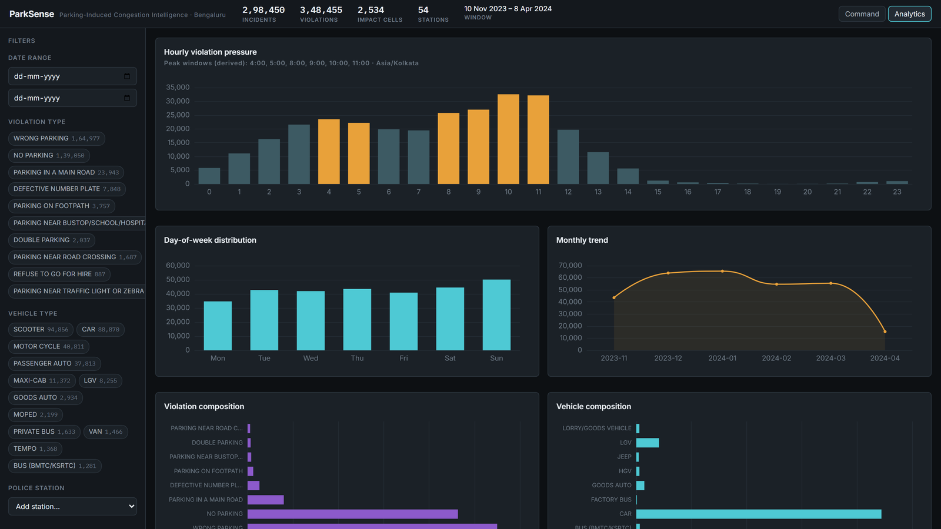
From a 298k-row log to a daily patrol plan.
Open one screen, read where to act first, see why each location ranks there, and get warned about emerging hotspots before they peak.
Repository github.com/keshavhacker1609/parksense

