Slide 1
TDMA Schedule Planner and Optimizer
Distance-2 graph colouring with EMANE integration
Keshav Singla | Wireless Protocol Development Internship task | Vaan Megam Networks
Notes:
Introduce the task in one sentence: plan collision-free time slots for radios sharing one frequency, reuse slots where radios are far apart, and enforce the schedule in EMANE.

Slide 2
The problem
• Radios share one frequency and transmit in numbered time slots
• Radios close together must use different slots, or they interfere
• Radios far apart may reuse a slot: spatial reuse
• Goal: fewest slots per frame, zero collisions
• Minimum slot count is NP-hard, so heuristics plus a quality bound
Part 1 (mandatory)
Python scheduler: graph model + colouring
Part 2 (bonus)
EMANE TDMA emulation of the schedule
Documentation
Design, thought process, final values
2
Notes:
Explain TDMA: one frequency, radios take turns. Close radios must not share a slot; far radios can. The goal is the shortest repeating frame with no collisions. Mention that the minimum is NP-hard so heuristics are needed.

Slide 3
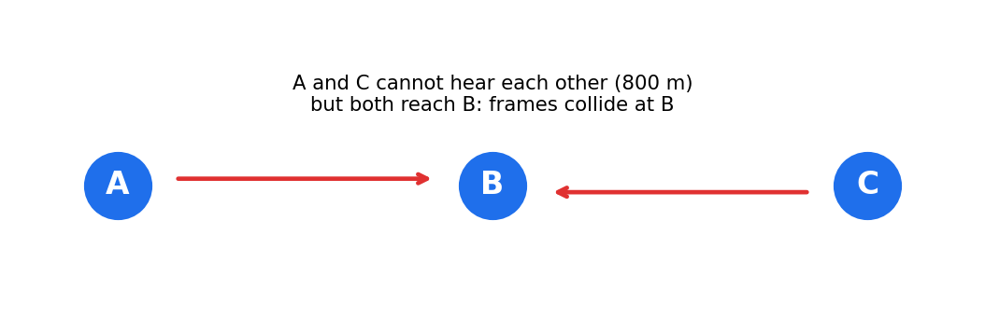
Why two hops, not one
Conflict graph = G squared
edge if 1 or 2 hops apart in G
Slot = colour
proper colouring of G squared
• Direct link (1 hop): A and B must differ
• Hidden terminal (2 hops): A and C must differ
• 3 or more hops apart: free to share a slot
Spatial reuse
comes from the model itself
3
Notes:
A and C cannot hear each other but both reach B, so their frames collide at B. A one-hop rule misses this. This is the hidden-terminal problem and the reason for distance-2 colouring.

Slide 4
Optimisation pipeline
Clique bound
lower bound
DSATUR + 2 greedy
constructive
Random restarts
300 x DSATUR
TabuCol
remove one colour
Exact search
prove or improve
▶
▶
▶
▶
• Stops as soon as colours = lower bound: result is provably optimal
• Otherwise the report prints the interval [lower bound, result]: never over-claims
• Seeded randomness: every run is reproducible
4
Notes:
Each stage keeps the best colouring so far. The clique lower bound tells us when we are provably optimal. Be ready to explain DSATUR (colour the vertex that sees most distinct neighbour colours), TabuCol (fix k = best-1 colours, move conflicting nodes, tabu list), and the exact search.

Slide 5
Correctness: an independent checker
• verify.py works only from coordinates
• For every pair in the same slot: in range? share a neighbour in range?
• Reports the exact offending pair and reason, exit code 1
• "Verified conflict-free" printed only after the check passes
• 29 automated tests including 40 random topologies
29 tests
all passing
0 collisions
in every verified schedule
Strict input checks
bad JSON, NaN, wrong arity
5
Notes:
The verifier shares no code with the optimizer, so a bug cannot hide itself. Mention 29 tests: boundary at exactly 500 m, isolated nodes, full mesh, 40 random topologies, bad input, CLI.

Slide 6
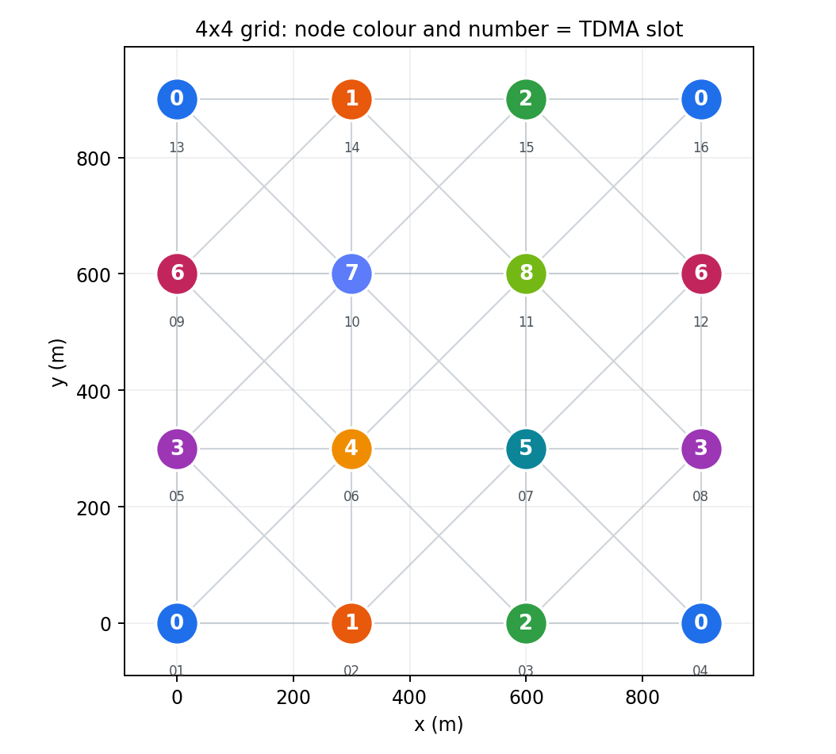
Part 1 results (16 nodes, 500 m)
Topology | Links | Slots | Bound | Status
4x4 grid, 300 m | 42 | 9 | 9 | optimal
Random layout | 39 | 10 | 10 | optimal
Two clusters + isolated | 47 | 8 | 8 | optimal
Slot-level replay of the grid (84 links):
distance-2 schedule: 84 delivered, 0 collided
plain distance-1 colouring: 20 delivered, 64 collided
6
Notes:
The grid reaches the lower bound of 9, so it cannot be improved. Slot 0 carries four radios at once. Point at colours in the figure: same colour means same slot.

Slide 7
Part 2: from schedule to EMANE
Coordinates
JSON
Python optimizer
Part 1
schedule.json
contract
bridge.py
XML + EEL
EMANE 1.5.3
16 radios
▶
▶
▶
▶
• One network namespace and one emane process per radio, in a single Docker container
• emaneevent-tdmaschedule delivers each NEM its own slots
• Pathloss events (80 dB in range, 250 dB beyond) reproduce the 500 m disk model exactly
• Default slot length 1 ms as specified; frame = number of colours
7
Notes:
The bridge is the only link between the parts and contains no scheduling logic; it also refuses to export a schedule that breaks the two-hop rule. One container, one namespace per radio.

Slide 8
Schedule mapping
<structure frames="1" slots="9"
slotduration="1000" bandwidth="1M"/>
<multiframe frequency="2.4G" ...>
<frame index="0">
<slot index="0" nodes="1,4,13,16">
<tx/>
</slot>
<slot index="0" nodes="2,3,5,6,...">
<rx/>
</slot>
...
• Slot 0: Node_01, 04, 13, 16 transmit together
• Everyone else listens in slot 0
• 1 ms slots, one frame, one frequency
• Test checks XML against the Python schedule
8
Notes:
Each node transmits in its colour's slot and listens in every other slot. Nodes with the same colour appear in one nodes list: that is spatial reuse expressed in EMANE's format.

Slide 9
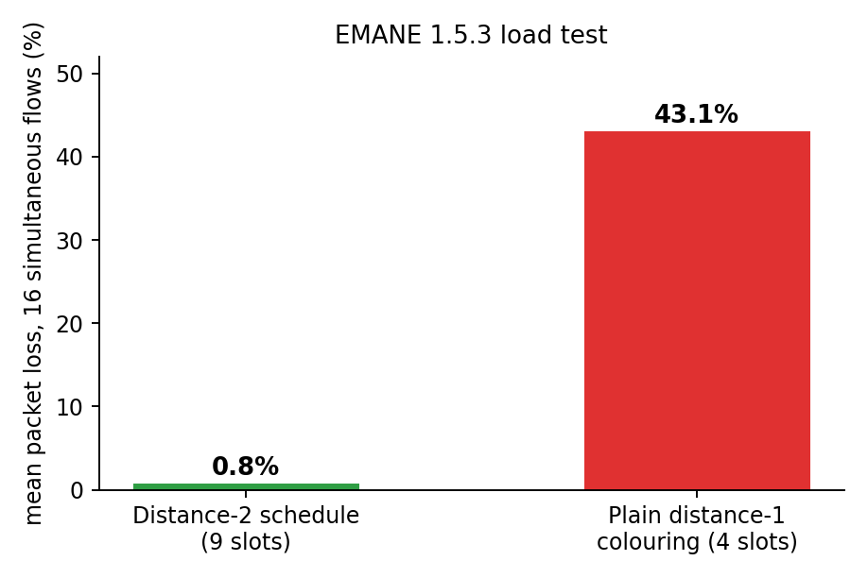
EMANE results
• 120 / 120 node pairs follow the 500 m topology
• NEM 1 neighbour table: exactly NEMs 2, 5, 6
• This schedule: 0.8 % loss (9 slots)
• Plain distance-1: 43.1 % loss (4 slots)
• 1 ms slots need realtime scheduling: 92 / 120 on a laptop, so tests ran at 10 ms
9
Notes:
Real run on EMANE 1.5.3. 120 of 120 pairs behaved per the 500 m topology at 10 ms slots. Under 16 simultaneous flows the distance-2 schedule lost 0.8 percent against 43.1 percent for the naive one. At 1 ms slots, laptop containers without realtime scheduling miss slot boundaries: 92 of 120. Say this openly.

Slide 10
What the real run taught me
• PHY profile needs a subid parameter
• EEL timestamps reject -Inf; use 0.0
• emane --pidfile (not -p, which is realtime priority)
• Event service resolves scenario.eel relative to its working directory
• Slot length must match what the host can time; the schedule logic is unchanged
10
Notes:
Be ready to discuss each of these: writing configuration from documentation was not enough; EMANE rejected it several times and each failure was fixed.

Slide 11
Limitations and next steps
• Unit-disk range model; real RF has fading and capture
• One slot per node: weighted colouring for per-node demand
• Static positions: incremental recolouring for mobility
• Multi-frequency schedules to shorten the frame further
• Faithful 1 ms emulation on a realtime-capable host
11
Notes:
Show you understand the model's boundaries: unit-disk range, equal airtime, static positions, clique bound not always tight.

Slide 12
Live demo plan
• python schedule_optimizer.py --nodes-file examples/grid_16.json
• python emane/slot_sim.py examples/grid_16.schedule.json
• python emane/bridge.py ... then inspect tdmaschedule.xml
• SLOT_US=10000 sh emane/run_in_docker.sh examples/grid_16.json
• python -m pytest -q
Summary
Part 1 complete and verified
Part 2 executed
on EMANE 1.5.3
Documentation
day-wise report + README
12
Notes:
1) run the CLI on the grid, 2) show matrix and slot reuse, 3) show slot_sim comparison, 4) show bridge output, 5) show EMANE log. Keep a recorded fallback in case Docker is slow.

