Slide 1

2021
NEU Hospital Database
INFO6210 Data Management and Database Design
TEAM 10: Zijian Zhang
Keshav Kaanth Kumar
Yang Liu

Slide 2

01
Objectives
Summary of the problems being addressed, goals
02
High Level Design & E-R Diagram
Design considerations and approach
CONTENTS
03
Database Objects
DDLs, Stored Procedures, Views, Triggers, Encryption

Slide 3



01 Objectives - Northeastern University' Hospital
Topic: Design a database and an application for Northeastern University’s hospital.
Patient | Doctor | Department | Appointment | ……
001 | Ann | General surgery | 2021/04/24 | ……
002 | Julia | Internal medicine | 2021/03/05 | ……
003 | Jack | Stomatology | 2021/01/23 | ……
…… | …… | …… | …… | ……
Purpose:
Build a database for school hospitals that stores all patient and doctor data, as well as treatment history.
This database can provide query functions for staff as well as students.
Users can track inventory levels of medicine or vaccines in database

Slide 4

02 High Level Design & E-R Diagram
Mission:
Store hospital-related data more efficiently.
Students are able to query data
Medical staff can inquire about the patient's historical condition
Ability to effectively download and transfer data.
Managing inventory of vaccine and medical items
Find the people who are tested positive
People are able download and customize the app
Ability to effectively download and transfer data
Solved Business Problems:
1
2
3
Doctor's time Schedule
It can query the doctor's time schedule through the database so as to provide the patient with the proper appointment;
Drug Inventory Situation
Query the status of drug item inventory in the hospital, and according to the inventory situation to decide whether to make orders;
Patient Information and Data
Facilitate the inquiry and statistics of basic patient information and data, corresponding prescriptions and billing invoice data;

Slide 5
02 Entity - E-R Diagram
Entity:
Hospital
Doctor
Supplier
Appointment
Bill
Zip
PatientHasAddress
Medical
OrderItem
Department
Patient
Item
Prescription
Payment
Address
MedicalOrder
Supplier
SuppliesItem
CREATE --> INSERT : According to the Entities and Relationships in the E-R Diagram

Slide 6
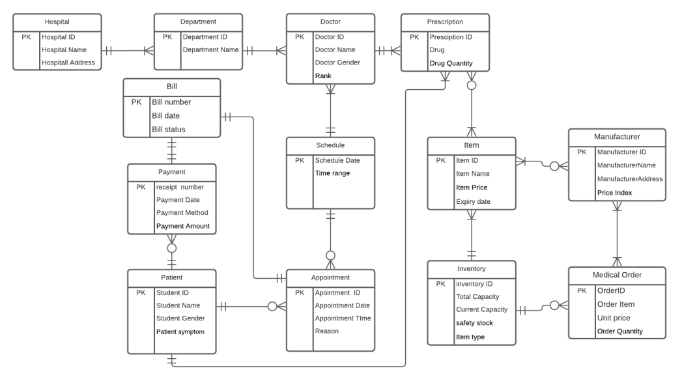
02 Final E-R Diagram
Final E-R Diagram:

Slide 7
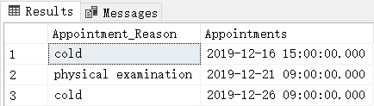
03 Database Objects - Procedures
Create Procedure to get All Appointments of a patient:
EXEC Procedure：
CREATE PROCEDURE GetPatientAppointments
(
@patient INT,
@appointmentReason VARCHAR(40) OUTPUT,
@appointmentStartTime DATETIME OUTPUT
)
AS
BEGIN
Select Appointment.Appointment_Reason as Appointment_Reason, Appointment.Start_Time as Appointments from Appointment
inner join Patient on Patient.Patient_ID = Appointment.Patient_ID
where Patient.Patient_ID=@patient;
END
DECLARE
@patient_id INT,
@appointment_reason VARCHAR (40),
@appointment_start DATETIME
EXEC GetPatientAppointments
@patient = 102,
@appointmentReason = @appointment_reason OUTPUT,
@appointmentStartTime= @appointment_start OUTPUT;

Slide 8
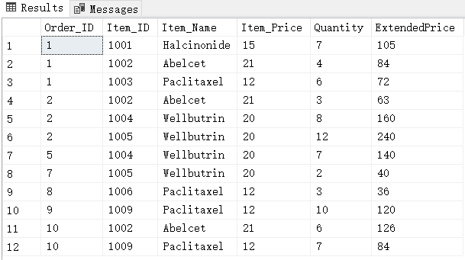
03 Database Objects - Views
View to get the Medical Order Deatils:
CREATE VIEW MedicalOrderDetails AS
SELECT MedicalOrderItem.Order_ID, MedicalOrderItem.Item_ID, Item.Item_Name, Item.Item_Price, MedicalOrderItem.Quantity,
ROUND(Item.Item_Price * MedicalOrderItem.Quantity,0) AS "ExtendedPrice"
FROM Item
JOIN MedicalOrderItem
ON Item.Item_ID = MedicalOrderItem.Item_ID;
EXEC View：
EXEC('SELECT * FROM MedicalOrderDetails;')

Slide 9
03 Database Objects - Triggers
Trigger to get an Update on Stock Quantity
CREATE TRIGGER UpdateItemStockQuantity
ON MedicalOrder
AFTER UPDATE
AS
BEGIN
UPDATE Item
SET Item.Stock_Quantity = Item.Stock_Quantity + MedicalOrderItem.Quantity
FROM MedicalOrder
INNER JOIN MedicalOrderItem
ON MedicalOrderItem.Order_ID = MedicalOrder.Order_ID
INNER JOIN Item
ON Item.Item_ID = MedicalOrderItem.Item_ID
where MedicalOrder.Status='Completed' AND EXISTS (SELECT 1 FROM inserted i WHERE i.Order_ID=MedicalOrder.Order_ID)
END

Slide 10

Conclusions
WHAT DO WE FOUND?

Slide 11
2021
THANKS FOR COMING
INFO6210 Data Management and Database Design
TEAM 10: Zijian Zhang
Keshav Kaanth Kumar
Yang Liu

