Slide 1
DATA3 · NF270 SINGLE-SALT CAMPAIGN
Choosing the B(c) correlation
for identifiable fits and contour seeding
Why B and σ hit the walls — and the solute-permeability equation that fixes the contours, the seeds, and the fits.
Keshav Kasturi Rangan
Follow-up to the June 11 collaborator meeting · June 2026

Slide 2
01
Where we left off
The June 11 result — and the problem it left open
DATA3 single-salt · choosing B(c) for identifiable fits · June 2026
2 / 24

Slide 3
01 · RECAP
Identifiability degraded with cation valence
Forward-simulated WSSE contours over θ = (Lₚ, B, σ) sorted 11 single-salt sheets into three stages
STAGE 1 · WELL-IDENTIFIED
STAGE 2 · INCONSISTENT
STAGE 3 · NOT ESTIMABLE
2 sheets · NaCl
7 sheets · NaCl + CaCl₂
2 sheets · LaCl₃
Sharp interior minimum. Lₚ pinned; σ leaves a real fingerprint. Trustworthy fit.
Lₚ tight, but σ (often B) pinned at a wall — channels minimise at different walls.
No coherent basin; WSSE ~20× the NaCl reference. Constant-(σ,B) model cannot fit.
fit: GOOD
fit: OKAY
fit: POOR
Monotonic trend: each added cation charge pushed the fit from a clean interior optimum toward the bounds.
DATA3 single-salt · choosing B(c) for identifiable fits · June 2026
3 / 24

Slide 4
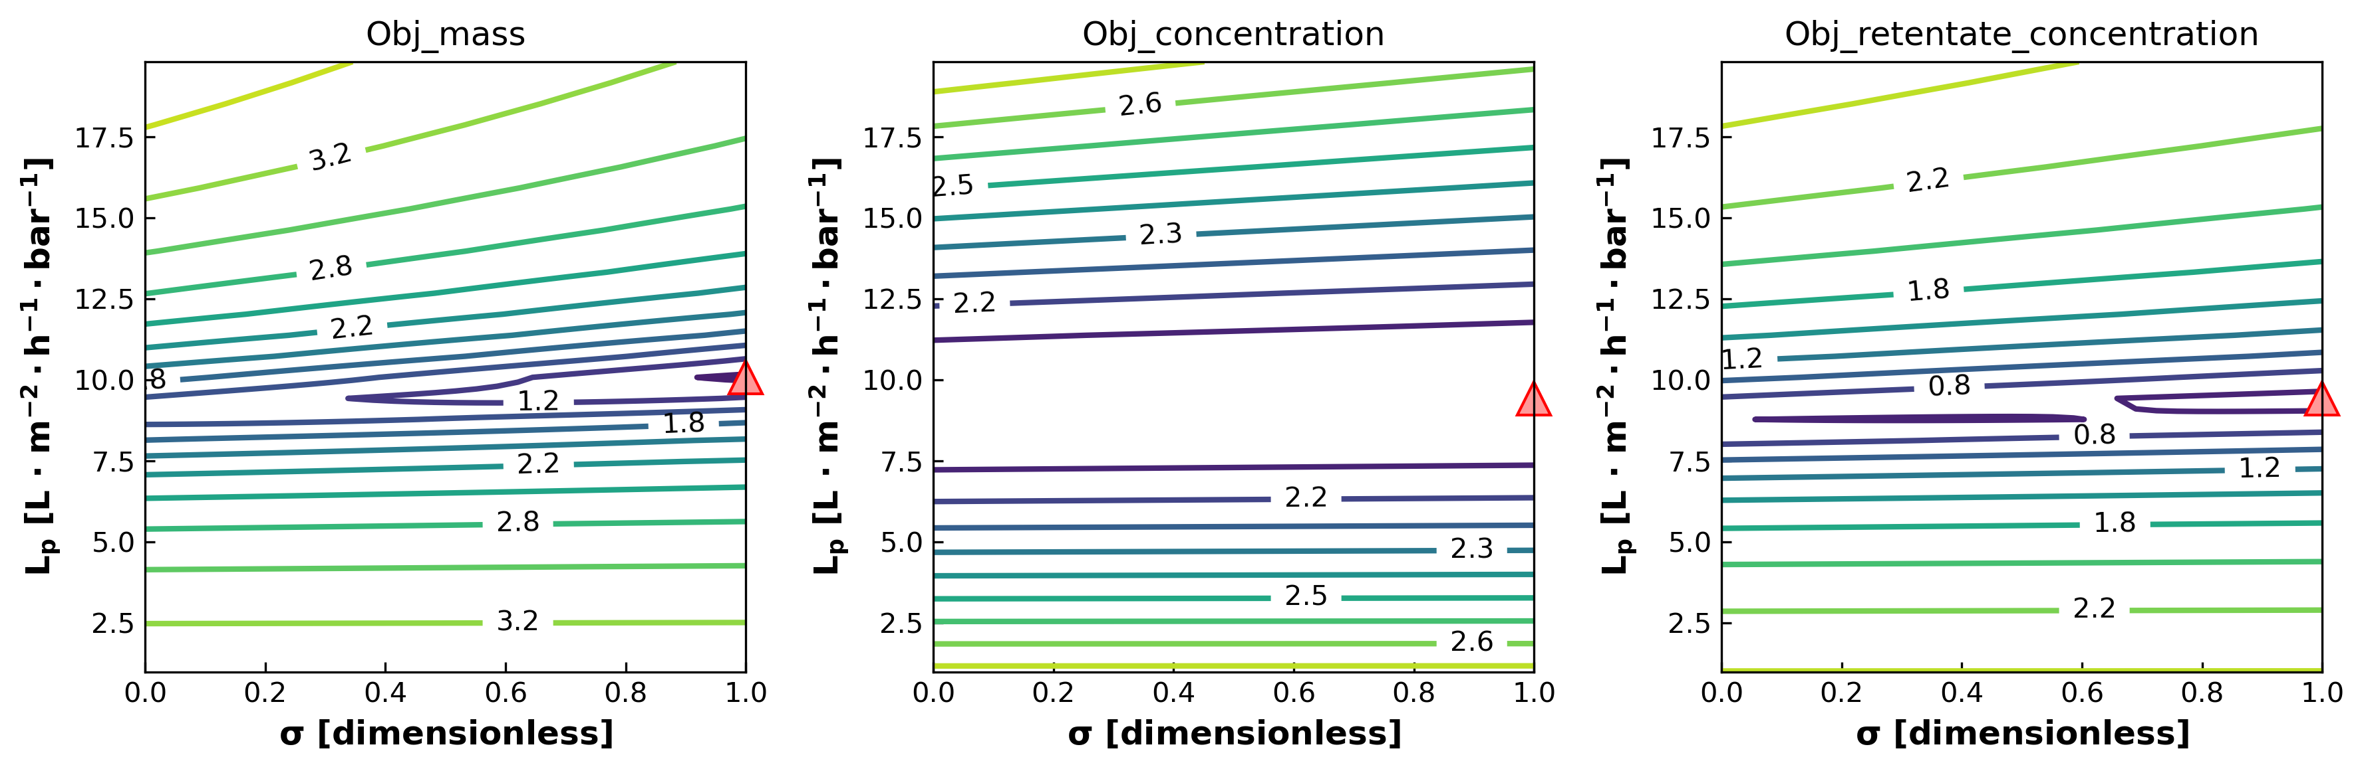
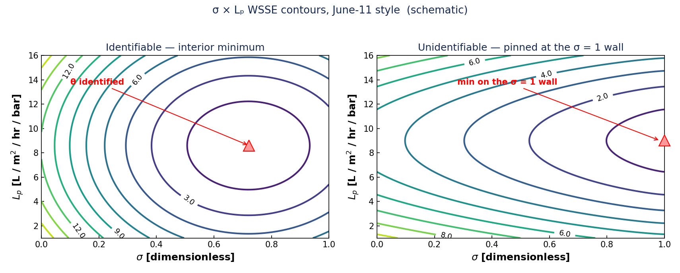
01 · THE OPEN PROBLEM
B and σ were unidentifiable or pinned at the bounds
Across most single-salt sheets the optimizer landed on a wall, not an interior optimum
σ → 1 wall — On most NaCl / CaCl₂ sheets σ railed to its upper bound.
B → bound — B floated to 0 or to its per-salt ceiling (e.g. 30 µm/s).
Valley, not a point — Channels each found a minimum — at different (σ, Lₚ) walls.
Worse with valence — LaCl₃: no stationary basin under either parameter sweep.
The question this raised: is this a data-geometry problem, or are we fitting the wrong B?
σ × Lₚ WSSE contour — interior optimum (left) vs pinned at the σ = 1 wall (right)
DATA3 single-salt · choosing B(c) for identifiable fits · June 2026
4 / 24

Slide 5
02
Why — data geometry, or model form?
Reading the walls as a symptom of a mis-specified B(c)
DATA3 single-salt · choosing B(c) for identifiable fits · June 2026
5 / 24

Slide 6
02 · DIAGNOSIS
A wall is what a mis-specified B(c) looks like
If B truly varies across a run but the model holds it constant/linear, σ and B absorb the mismatch
Within one diafiltration run the feed-side concentration sweeps over a wide range, so the true B changes during the run. A constant or single-slope B cannot follow it — the optimizer compensates by driving σ to 1 and B to a bound. The fix is not more freedom in σ; it is the right functional form for B(c).
Symptom
Usual reading
This work’s reading
• σ pinned at 1
• B at 0 or ceiling
• channels disagree
• “σ, B unidentifiable”
• add data / constraints
• re-weight channels
• B(c) form is wrong
• tie B to concentration
• walls relax
DATA3 single-salt · choosing B(c) for identifiable fits · June 2026
6 / 24

Slide 7
02 · WHAT B IS
The same B across all three papers
Solute permeability = membrane diffusion × partition, per unit thickness — a definition, not a new model
$$B=\frac{D_{m} H}{ℓ}=P_{0} K$$
$$J_{s}=B (c_{in}−c_{H})$$
Dₘ membrane diffusivity · H partition coefficient · ℓ active-layer thickness · P₀ = Dₘ/ℓ · K = salt partition
DATA1 / DATA2
Transport SI (collaborators)
This work (global)
B = Dₘ H / ℓ
Bᵢᵢ = Dᵢ Hᵢ / ℓ
B = P₀ · K, K from partition
Same symbol, three notations. All the concentration dependence lives in the partition H.
DATA3 single-salt · choosing B(c) for identifiable fits · June 2026
7 / 24

Slide 8
03
The right equation for B(c)
From the shape of the partition to the form you fit
DATA3 single-salt · choosing B(c) for identifiable fits · June 2026
8 / 24

Slide 9
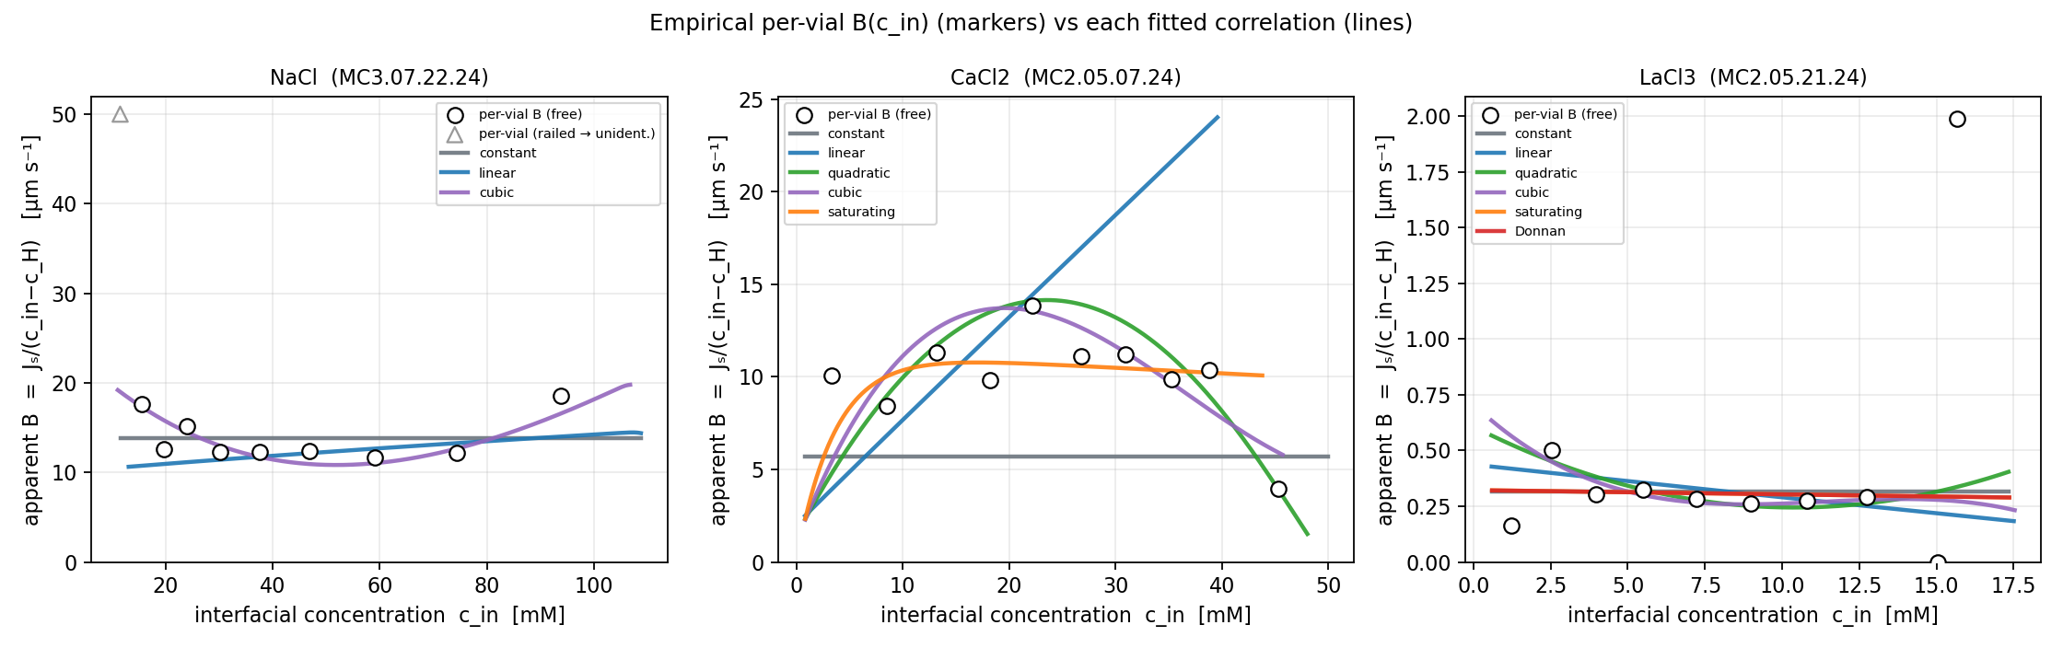
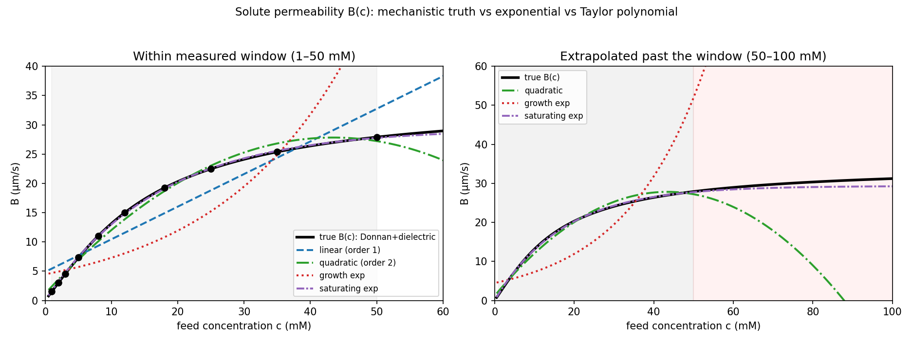
03 · THE SHAPE
B(c) is a saturating partition — Donnan + dielectric
Near-zero at infinite dilution, steep through the middle, plateau once the fixed charge is screened
$$B(c)=P_{0} \frac{−X+\sqrt{X^{2}+4k^{2}c^{2}}}{2c}$$
$$c​→​0: B≈\frac{P_{0}k^{2}}{X} c c​→​∞: B→P_{0}k$$
Two physical knobs: P₀·k sets the high-salt plateau, X sets the concentration of the knee where Donnan exclusion gives way.
Monotonic and concave — the opposite curvature of a growth exponential.
Mechanistic B(c): saturating, not exponential, not an unbounded polynomial
DATA3 single-salt · choosing B(c) for identifiable fits · June 2026
9 / 24

Slide 10
03 · WHICH FORM TO FIT
Inside the window: a low-order Taylor. Across it: saturating.
Campaign DAE fits across the single-salt sheets — in-window from per-sheet WSSE, extrapolation from the fitted partition curves
Form
in-window
extrapolation
Verdict
B=Jwi​βi cin i
Linear (order 1)
good
unbounded ↑
interp.
Quadratic (order 2)
better
B < 0 (unphys.)
interp.
$$B=B_{∞} (1−e^{−c/c^{*}})$$
Cubic (order 3)
best in-win.
diverges
interp.
Saturating exp
near-best
bounded ✓
robust
On DATA3 (per-sheet WSSE): B(c) matters most for CaCl₂ — quadratic / cubic / saturating all cut the error ≈ 33 % vs constant B (220 → 146). Higher-order Taylor edges the in-window fit but extrapolates to unphysical B (the quadratic bends to B < 0); saturating matches it and stays bounded — the practical form. NaCl is fine with ~constant B; LaCl₃ stays poor under every B(c), pointing past B(c) alone.
Don't extrapolate it — a negative c² term bends B downward, which is unphysical.
For transfer across the campaign — fit the saturating / mechanistic form.
Mechanistic Donnan
near-best
bounded ✓
mechanistic
DATA3 single-salt · choosing B(c) for identifiable fits · June 2026
10 / 24

Slide 11
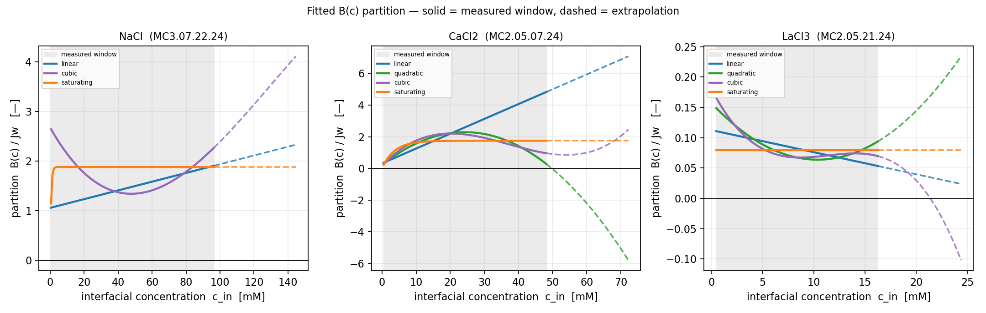
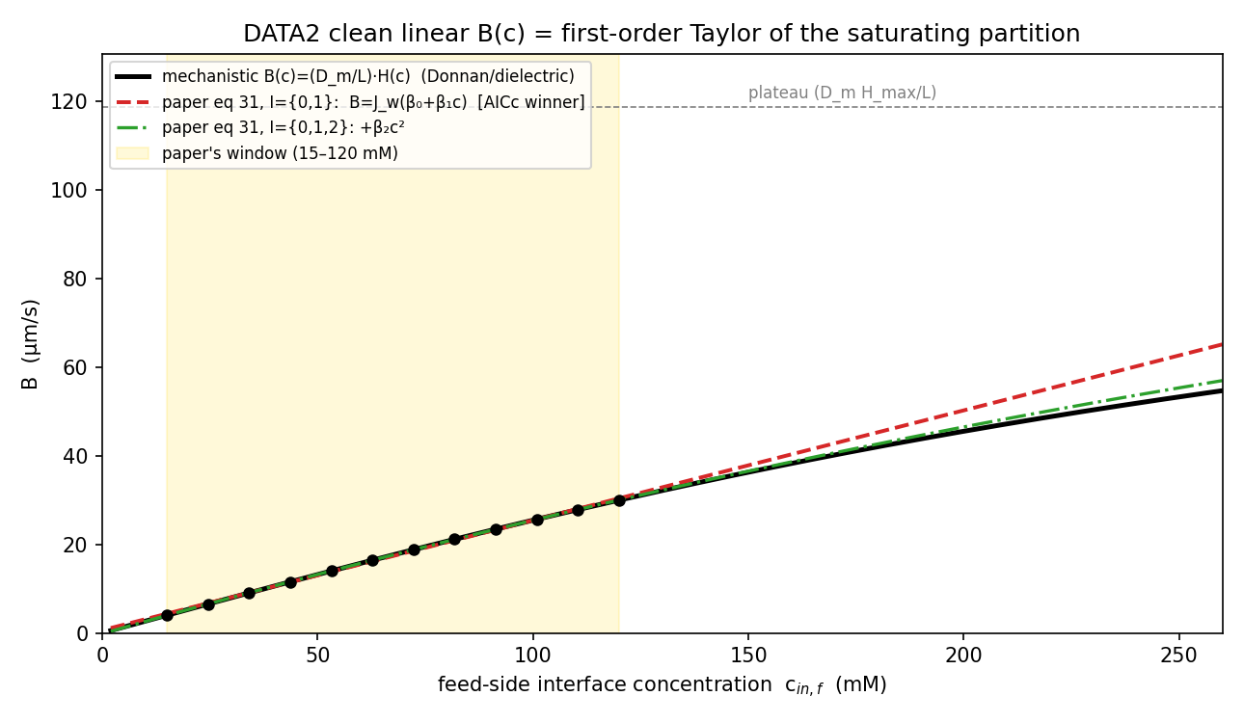
03 · RECONCILED WITH DATA2
The DATA2 linear B is the first-order Taylor of this curve
Their clean correlation and the saturating partition are the same object — local vs global
$$B≈β_{0}+β_{1}c, β_{1}=\frac{dB}{dc}$$
DATA2 fits B = Jw·Σβᵢcⁱ — a truncated Taylor series of the partition H(c).
Matched to their 15–120 mM window, the fitted slope β₁ = 0.248 equals the curve's derivative dB/dc = 0.250.
Their AIC pick (linear) is reproduced: with realistic noise, linear wins 82% / quadratic 12%.
Local polynomial and global mechanistic are two faces of one B(c).
Linear fit hugs the curve in-window, peels off outside
DATA3 single-salt · choosing B(c) for identifiable fits · June 2026
11 / 24

Slide 12
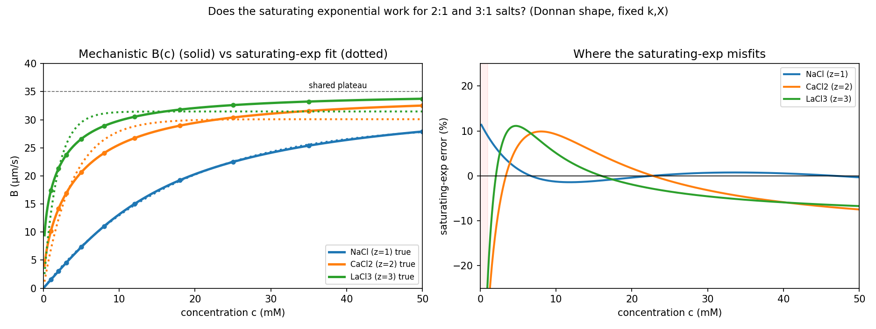
03 · WHY VALENCE DEGRADES THE FIT
Higher valence sharpens the knee and lowers the plateau
Exactly the LaCl₃ Stage-3 result — a model-form limit, not just thin data
$$B∝c^{ 1/z} (1:1→c, 2:1→\sqrt{c}, 3:1→\sqrt[3]{c})$$
The low-c rise steepens from c (1:1) to √c (2:1) to ∛c (3:1) — a near-vertical knee.
A constant or linear B cannot represent that knee, so CaCl₂ rails σ and LaCl₃ shows no basin.
Dielectric (Born) exclusion also lowers the plateau as charge rises — your fitted β₀ ordering NaCl ≫ CaCl₂ ≫ LaCl₃ (∝ e^(−0.32 z²)).
So Stage 3 is the model talking, not the data failing.
Knee sharpens with z; a single curvature can't fit all three
DATA3 single-salt · choosing B(c) for identifiable fits · June 2026
12 / 24

Slide 13
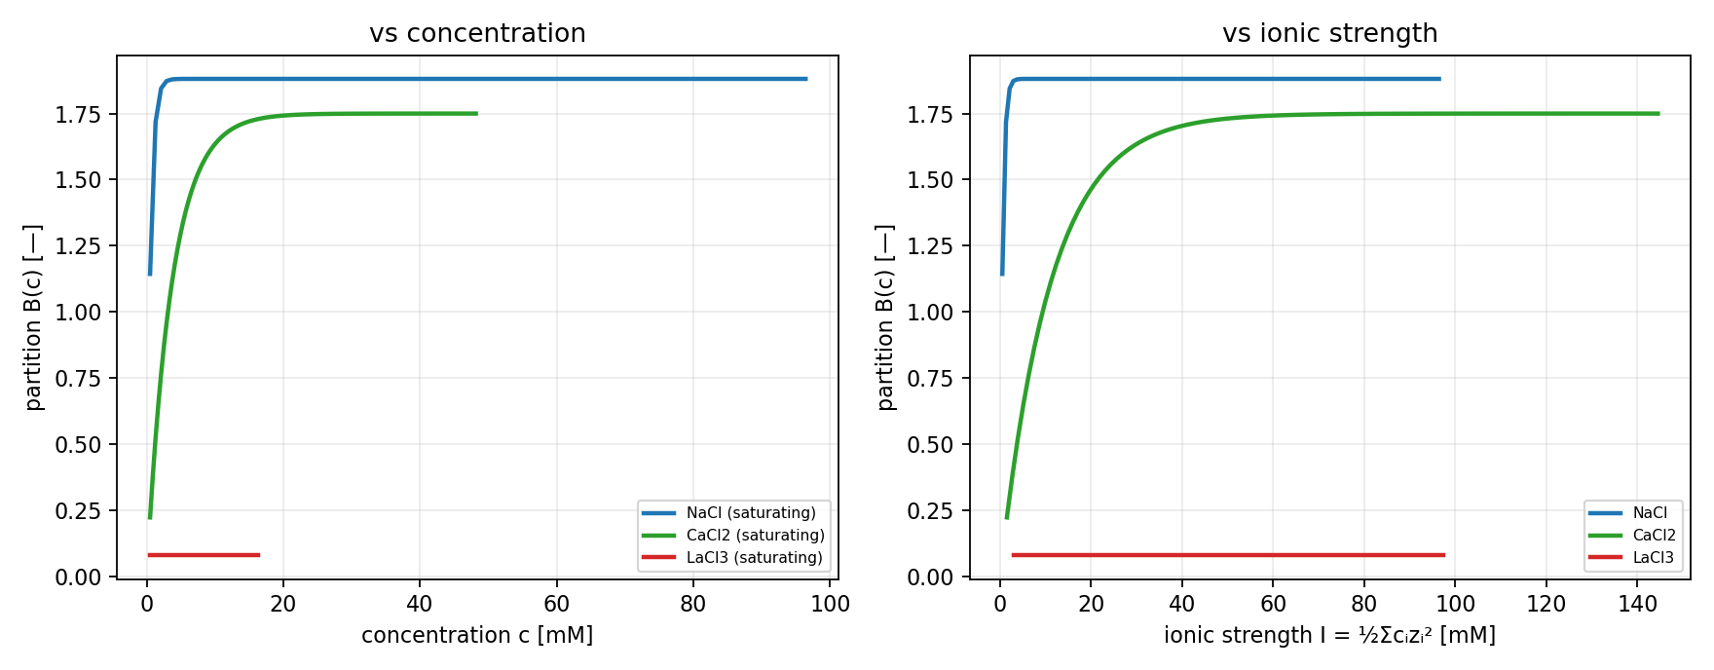
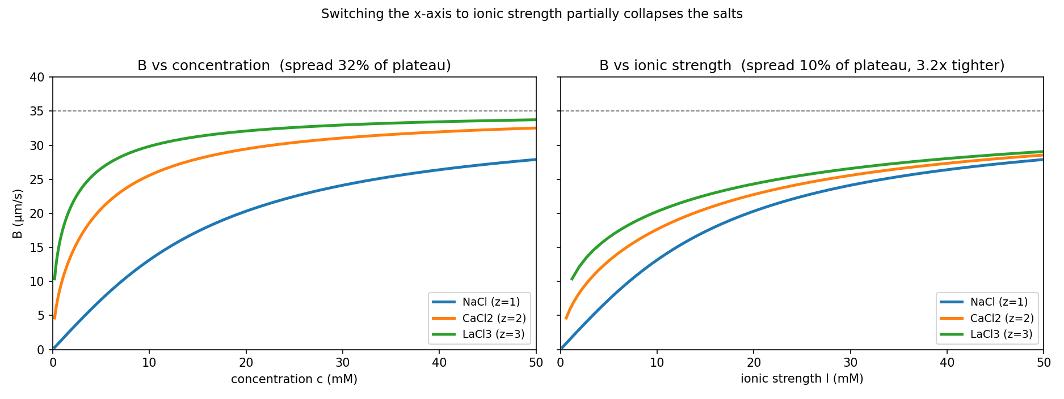
03 · CONCENTRATION vs IONIC STRENGTH
Single-salt: a relabel. Multisalt: the only common axis.
Ionic strength is what sets Donnan screening — keep it ready for the mixtures
I=12i​cizi2=cNa+3cCa+6cLa
For one salt I ∝ c, so B-vs-I is B-vs-c relabeled — no change to a single-salt fit.
Switching the axis to I pulls the salts ~3× closer together (partial collapse).
For a mixture there is no single c — I is the only well-defined abscissa.
Single-salt focus now; this is the bridge to the multisalt phase.
Same curves on a c-axis (left) vs an I-axis (right): tighter on I
DATA3 single-salt · choosing B(c) for identifiable fits · June 2026
13 / 24

Slide 14
04
Using B(c) in the contours
How the right form fixes seeding and identifiability
DATA3 single-salt · choosing B(c) for identifiable fits · June 2026
14 / 24

Slide 15
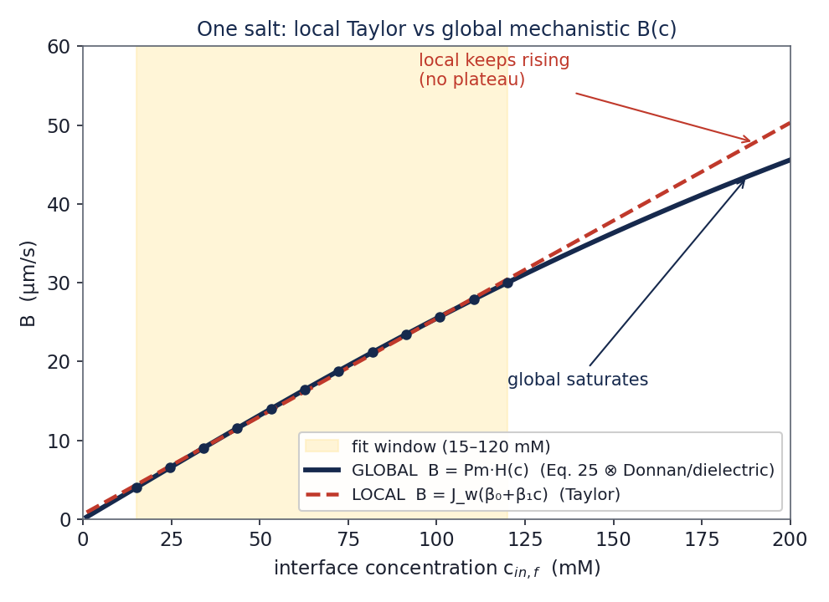
04 · WHY THIS FIXES THE CONTOURS
Tie B to concentration and it stops floating to a wall
One physical function replaces a free B per range or per vial — fewer parameters, sharper basins
Before — free constant/linear B
B is unconstrained across the run, so it slides to a bound and drags σ with it.
After — B = P₀·K(c)
B is fixed by concentration through one physical curve; only P₀, X (k) and σ remain free.
Initial guesses
The “group by range / by vial” question becomes one B(c) — basins from different ranges line up.
Local (linear) vs global (saturating) B(c) for one salt
DATA3 single-salt · choosing B(c) for identifiable fits · June 2026
15 / 24

Slide 16
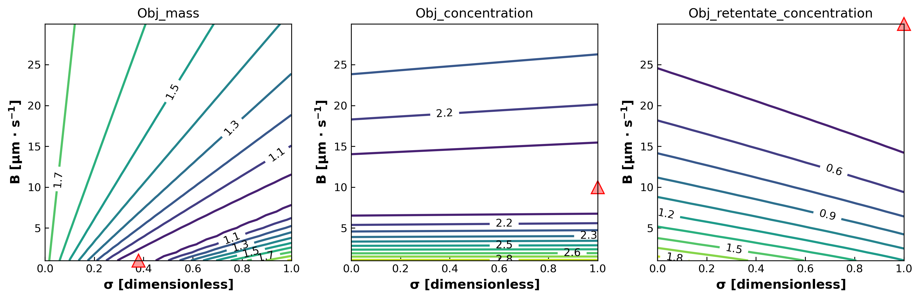
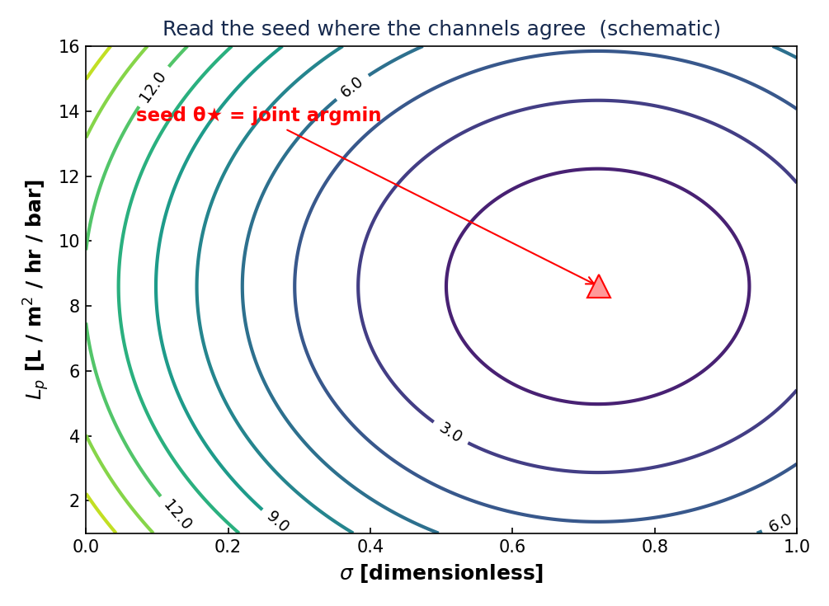
04 · THE WORKFLOW
Read the seed off the contour, then fit
WSSE contour (forward-sim, no fitting) → joint argmin → seed θ → optimize
1
2
3
4
→
→
→
Map
Read
Seed
Fit
Sweep the grid; score WSSE per channel
Joint 2-D minimum where channels agree
Use that θ as the initial guess
Optimize with B = B(c) fixed by the curve
WSSE=ch​t​wch(ych,t−ych,t)2
Forward simulation, no fitting. Where the channels agree on an interior minimum, θ is identified — and that point seeds the optimizer.
Read the joint minimum straight off the contour
DATA3 single-salt · choosing B(c) for identifiable fits · June 2026
16 / 24

Slide 17
04 · INITIAL-GUESS STRATEGY
From “guess per range / per vial” to one B(c)
The grouping question answers itself once B is tied to a physical variable
Per-vial free B
many parameters, overfits, no transfer
Grouped by range
linearizes a curve the polynomial should already capture
B(c) — one function
ties every vial's B to its concentration; multistart seeds from the curve
Keep LHS multistart — but seed it from the contour argmin and the B(c) curve, not a blind start.
DATA3 single-salt · choosing B(c) for identifiable fits · June 2026
17 / 24

Slide 18
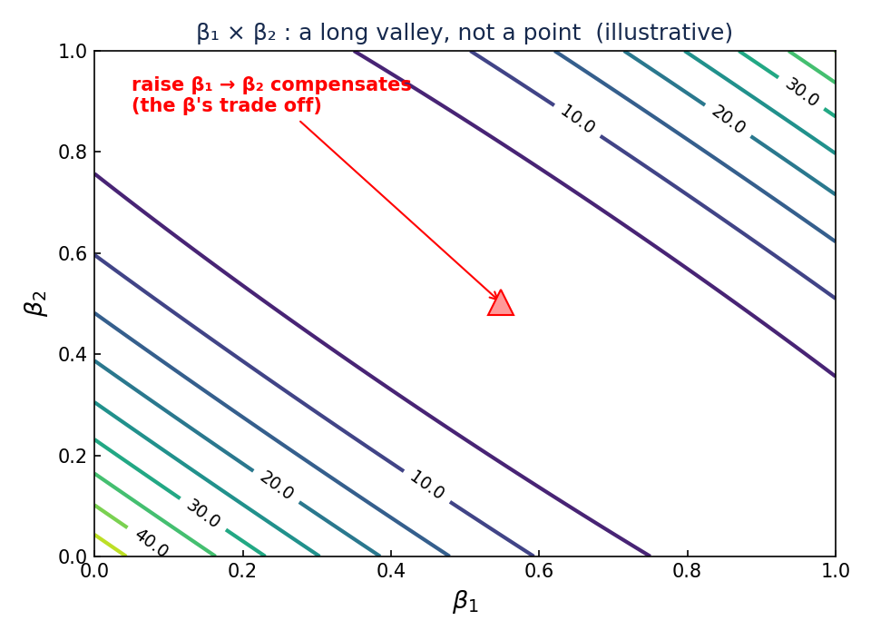
04 · WHY NOT A MAP PER β
Why we don't map each β against Lₚ
The β's are coupled pieces of one curve — not independent dials
One curve, not three knobs — B(c) = Jw(β₀ + β₁c + β₂c²) is a single curve; the β's are its pieces.
They lean on each other — Raise β₁ and the fit pushes β₀ and β₂ back to keep the curve through the data — so the β's are correlated.
So the slice is an artifact — An Lₚ × β₁ map must freeze β₀ and β₂. What you see depends on where you froze them — not on β₁.
Lₚ is the clean one — Lₚ is set by the water flux and barely moves with the β's — so every Lₚ × β looks the same: Lₚ pinned.
Analogy: judging one singer with the rest of the choir muted — you mostly hear your choice of who to mute.
β₁ × β₂ : a long valley, no single point — that's the correlation
DATA3 single-salt · choosing B(c) for identifiable fits · June 2026
18 / 24

Slide 19
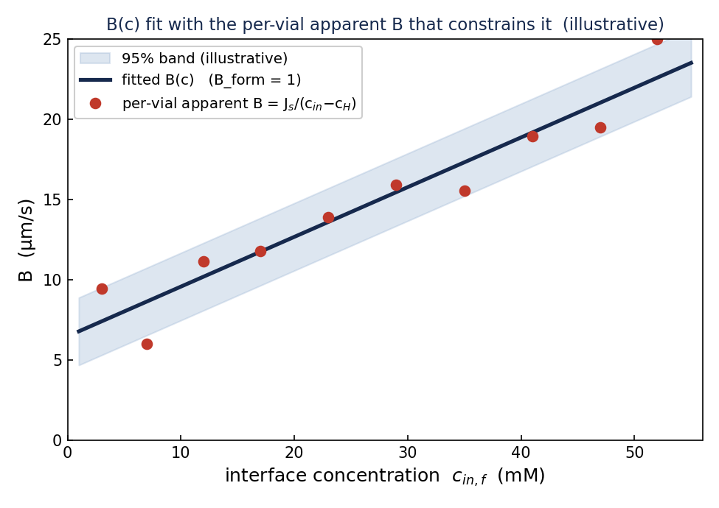
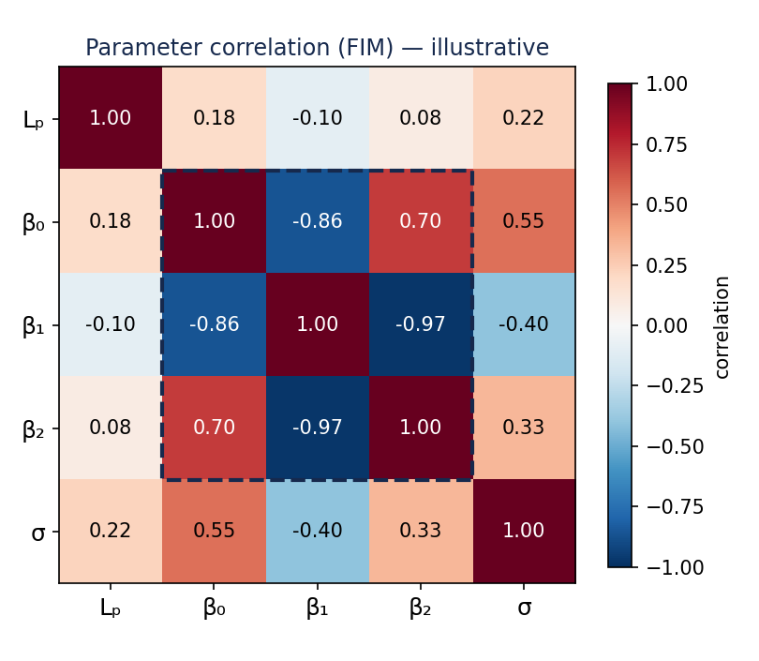
04 · THE RIGHT β DIAGNOSTICS
What to plot for the β's instead
Two views carry all the β information — no per-β maps needed
The B(c) curve + per-vial apparent B that constrains it (illustrative)
FIM correlation matrix — identifiability & β coupling, exact (illustrative)
Full set: keep σ×Lₚ, B×Lₚ, B×σ for Lₚ and σ; these two cover the B-function. The β's live on the curve and in the matrix — never in one-β-at-a-time slices.
DATA3 single-salt · choosing B(c) for identifiable fits · June 2026
19 / 24

Slide 20
05
Predictions vs measured states
Mass and concentration, model against experiment
DATA3 single-salt · choosing B(c) for identifiable fits · June 2026
20 / 24

Slide 21
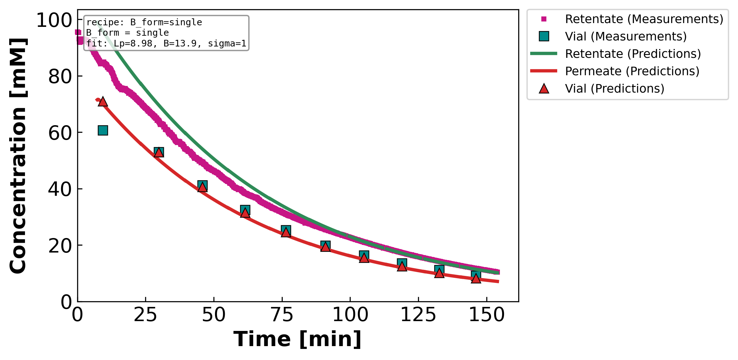
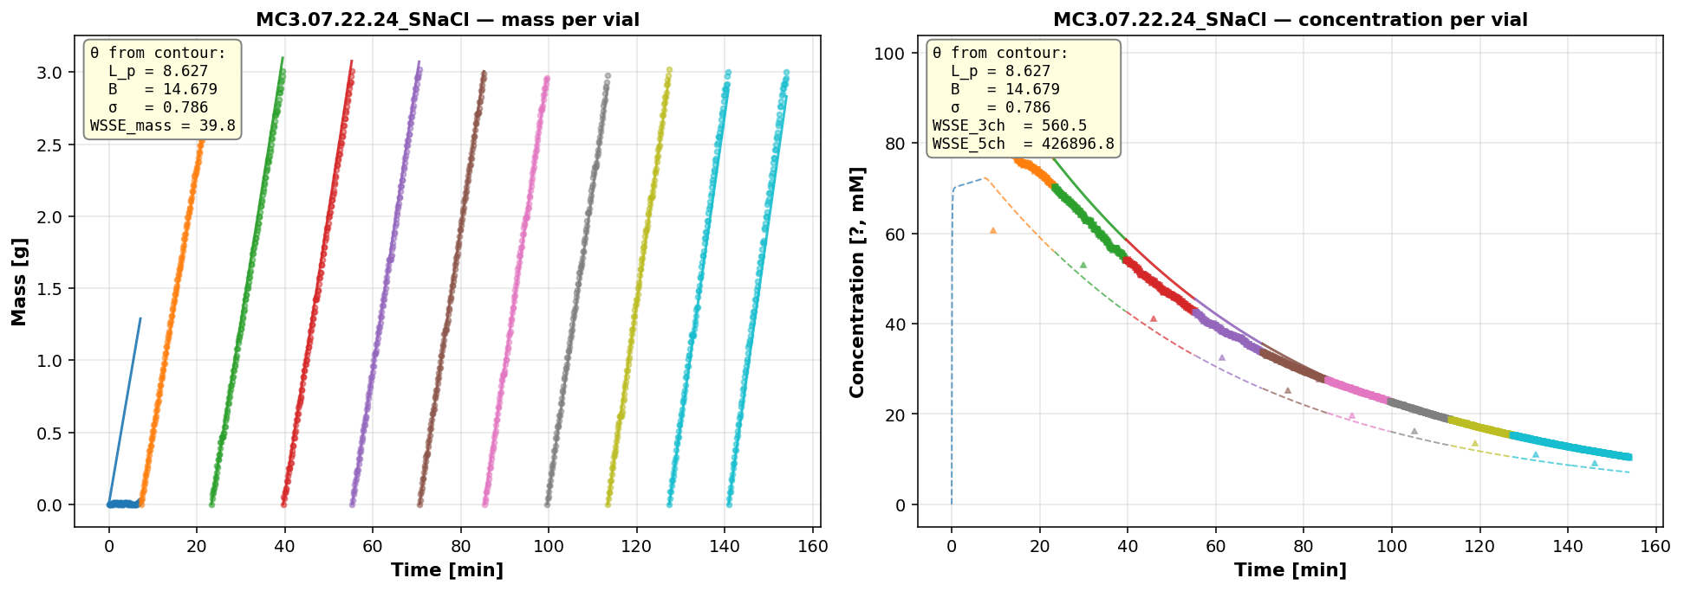
05 · NaCl — WELL-IDENTIFIED
NaCl: model tracks mass and both concentrations
MC3 · 07.22.24 · SNaCl — constant-B fit (B_form = single)
θ (contour seed)
Lₚ 8.98
B 13.88 µm/s
σ 1.00
WSSE₃ch 42
GOOD
B is ~constant for NaCl over this range — the constant-B fit already tracks mass and both concentrations (the per-vial B is flat, slide 9).
● experiment —— model · mass (left) and retentate/permeate concentration (right)
DATA3 single-salt · choosing B(c) for identifiable fits · June 2026
21 / 24

Slide 22
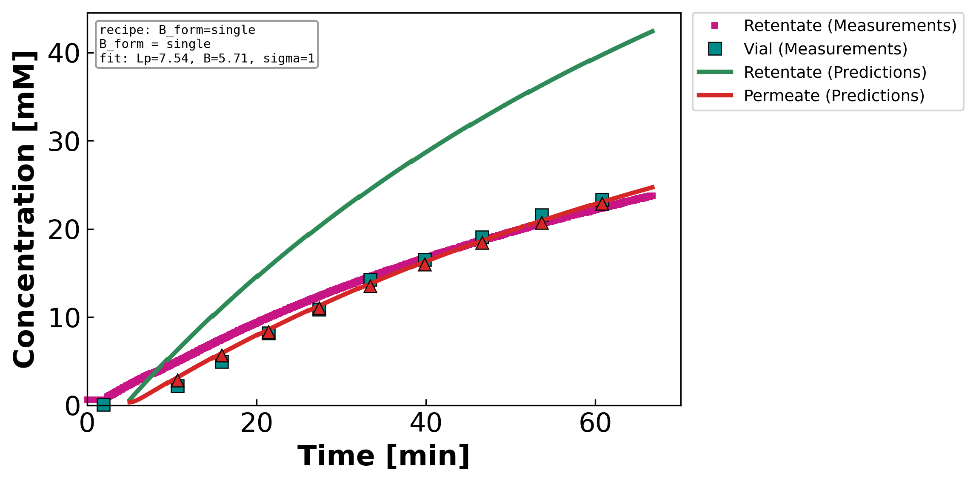
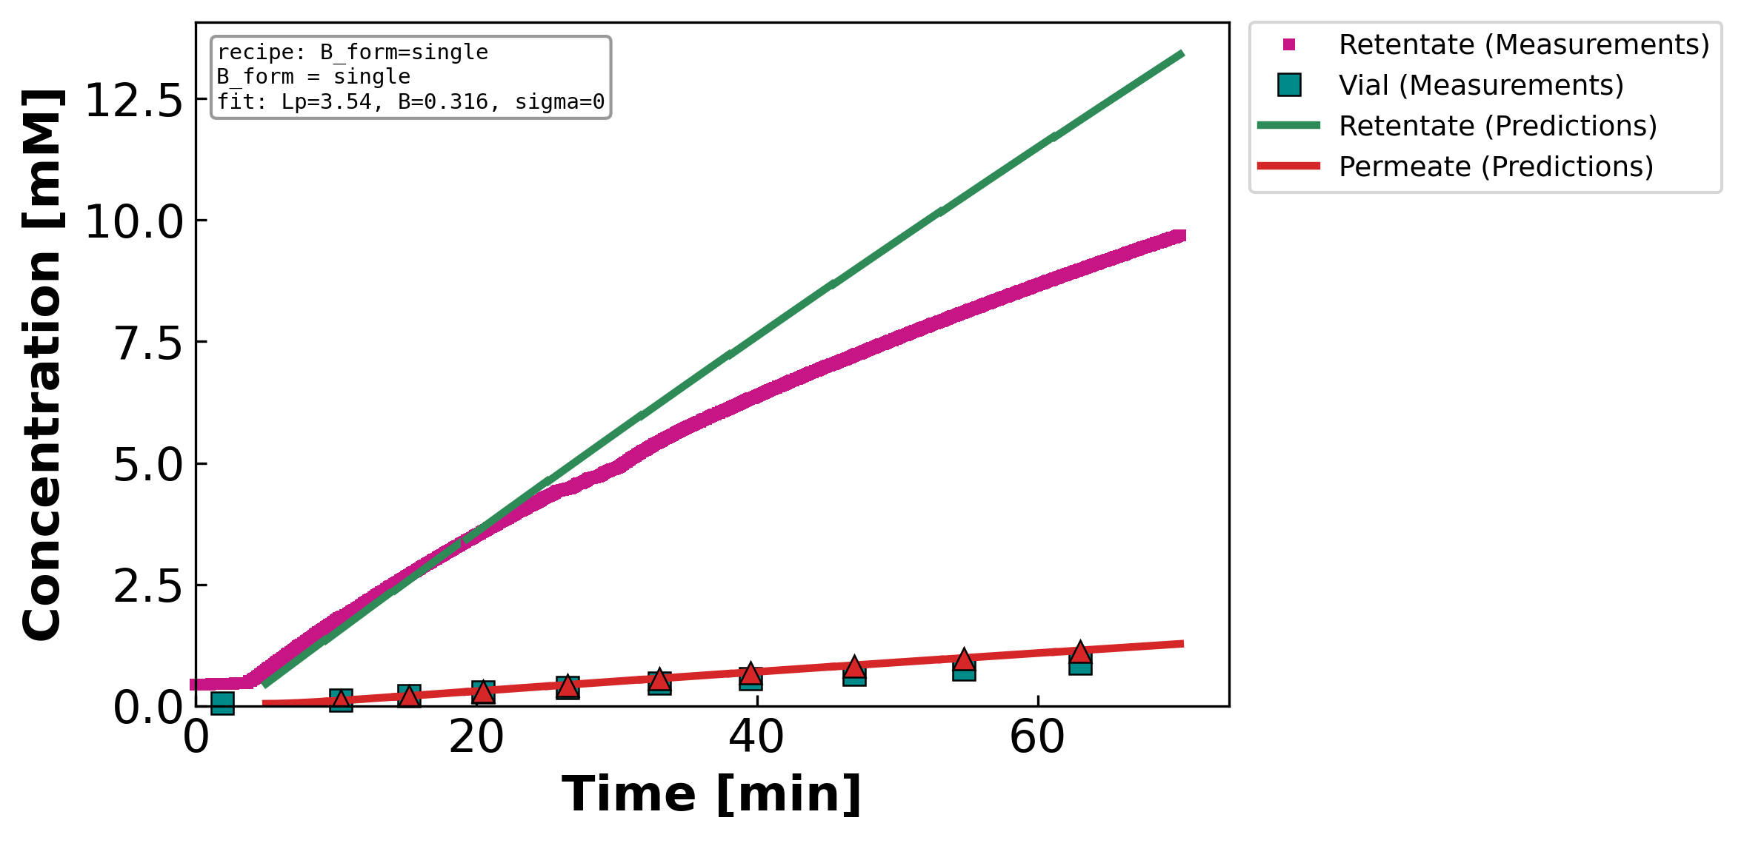
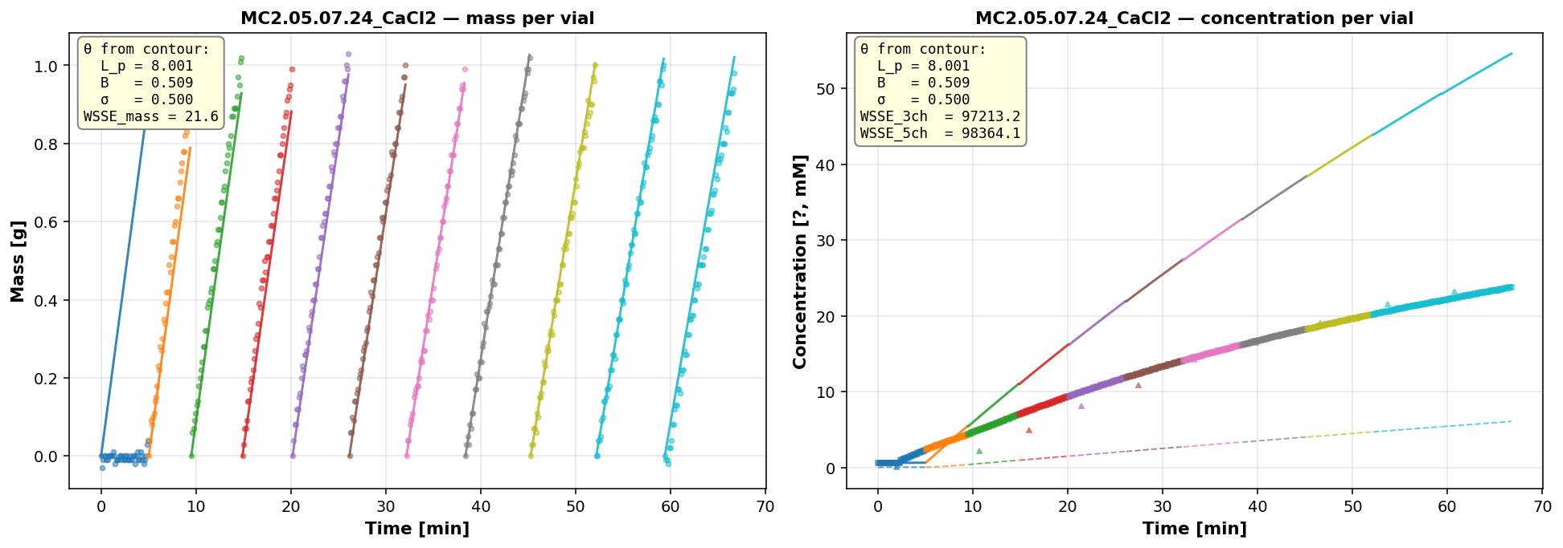
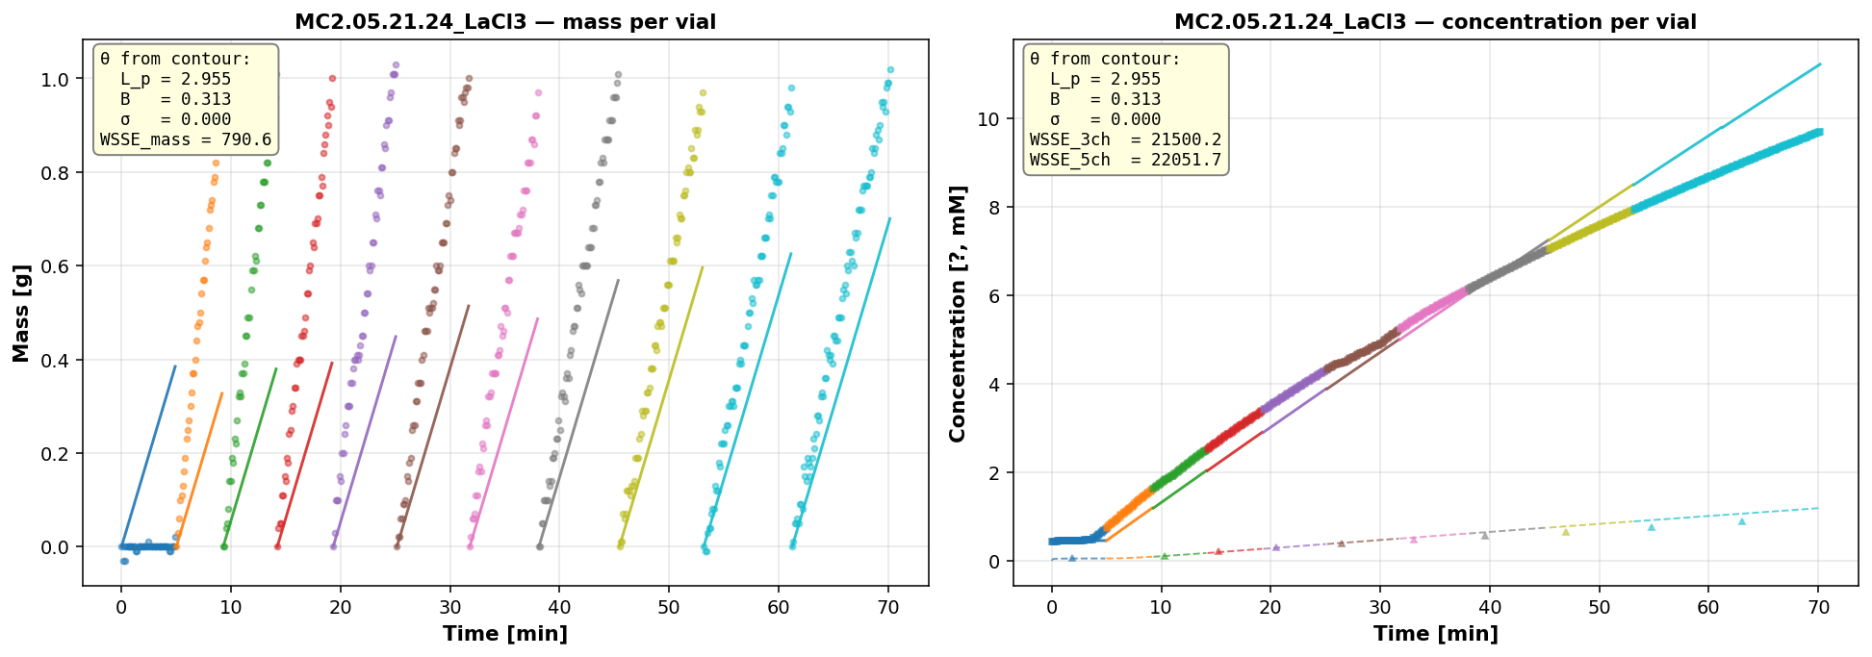
05 · CaCl₂ & LaCl₃ — WHERE FORM STILL LIMITS
Divalent fits with σ railed; trivalent the model can't track
The case for B(c): the constant-(σ,B) form runs out as valence rises
CaCl₂ · MC2 · 05.07.24
Lₚ 7.54
B 5.71 µm/s
σ 1.00 ↑
WSSE₃ch 220
OKAY
σ railed at 1; the saturating B(c) cuts WSSE 220 → 146 (slide 10).
LaCl₃ · MC2 · 05.21.24
Lₚ 3.54
B 0.32 µm/s
σ 0.00 ↓
WSSE₃ch 1244
POOR
Model-limited — every B(c) form stays ~1240; B(c) alone can't rescue it.
DATA3 single-salt · choosing B(c) for identifiable fits · June 2026
22 / 24

Slide 23
06
Takeaways & next steps
What to change before the re-run
DATA3 single-salt · choosing B(c) for identifiable fits · June 2026
23 / 24

Slide 24
06 · TAKEAWAYS
The B(c) form is the lever for identifiable fits
B is a saturating partition
Pick by purpose
B = DₘH/ℓ; H rises then plateaus (Donnan + dielectric).
In-window: Taylor B_form (1–2). Across the campaign: saturating / mechanistic.
Valence = model form
Seed from B(c)
Sharper knee + lower plateau with z explains CaCl₂ walls and LaCl₃.
Tie B to concentration → walls relax, contours sharpen, seeds transfer.
NEXT STEPS
Now (single-salt): re-fit with the chosen B_form seeded from the contours. Soon (multisalt): move to B(I) on the shared ionic-strength axis.
DATA3 single-salt · choosing B(c) for identifiable fits · June 2026
24 / 24

