Slide 1
Fitting the four representative DATA3 NF270 experiments
Measured vs predicted at the optimized parameters — NaCl (diluting & concentrating), CaCl₂, LaCl₃

Slide 2
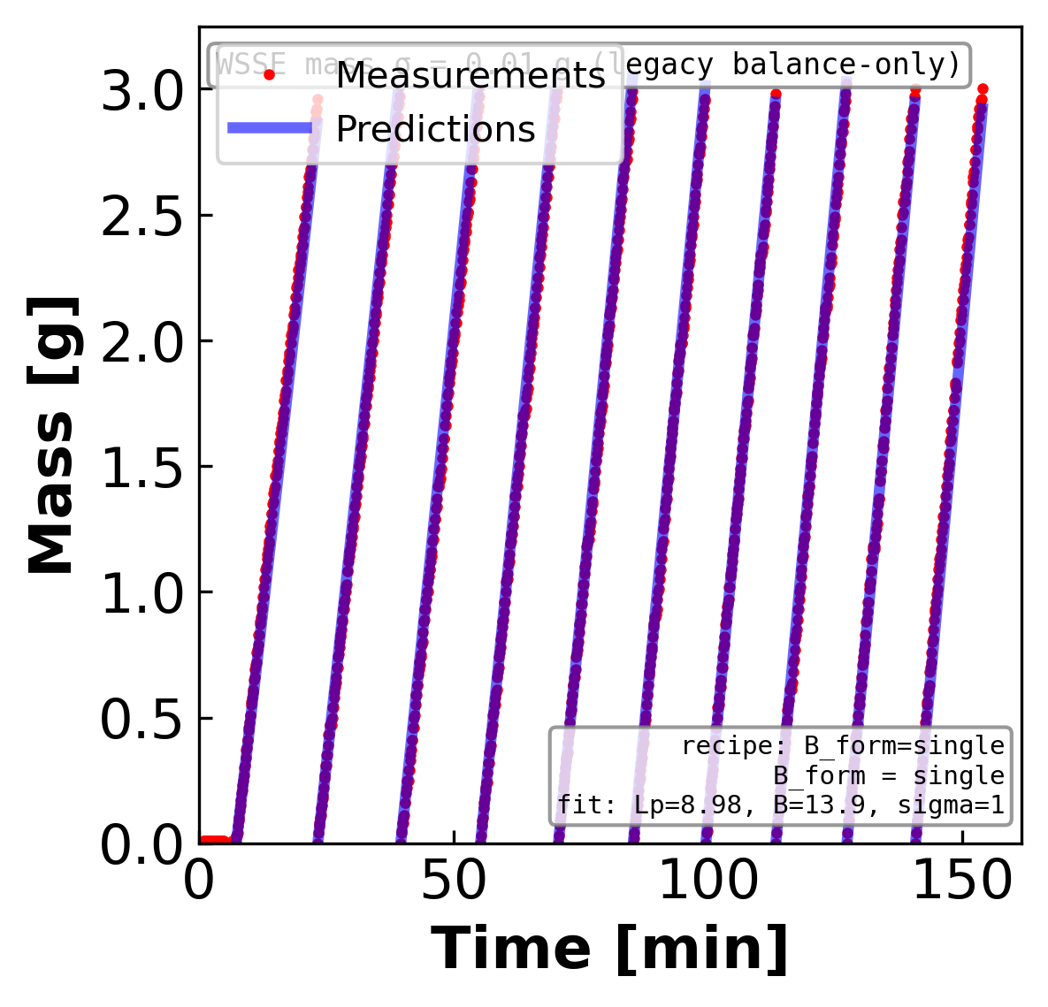
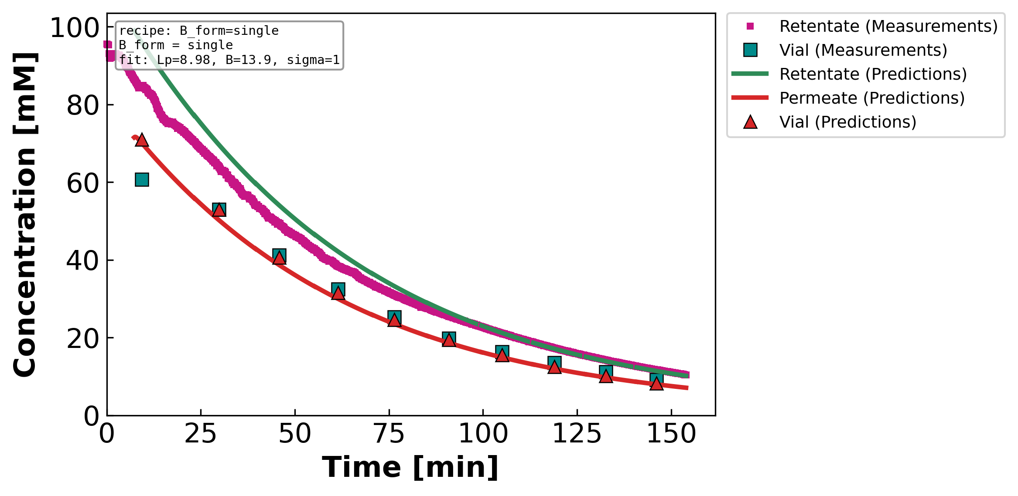
NaCl — diluting regime (MC3 · 07.22.24)
fit form: constant B
Mass — measured (points) vs predicted (line)
Concentration — retentate / permeate
Optimized parameters
Lₚ = 8.98 L m⁻² h⁻¹ bar⁻¹
B = 13.88 µm s⁻¹
σ = 1.00
WSSE₃ = 42
→ B is flat over the range — constant B already tracks mass and both concentrations (WSSE₃=42).

Slide 3
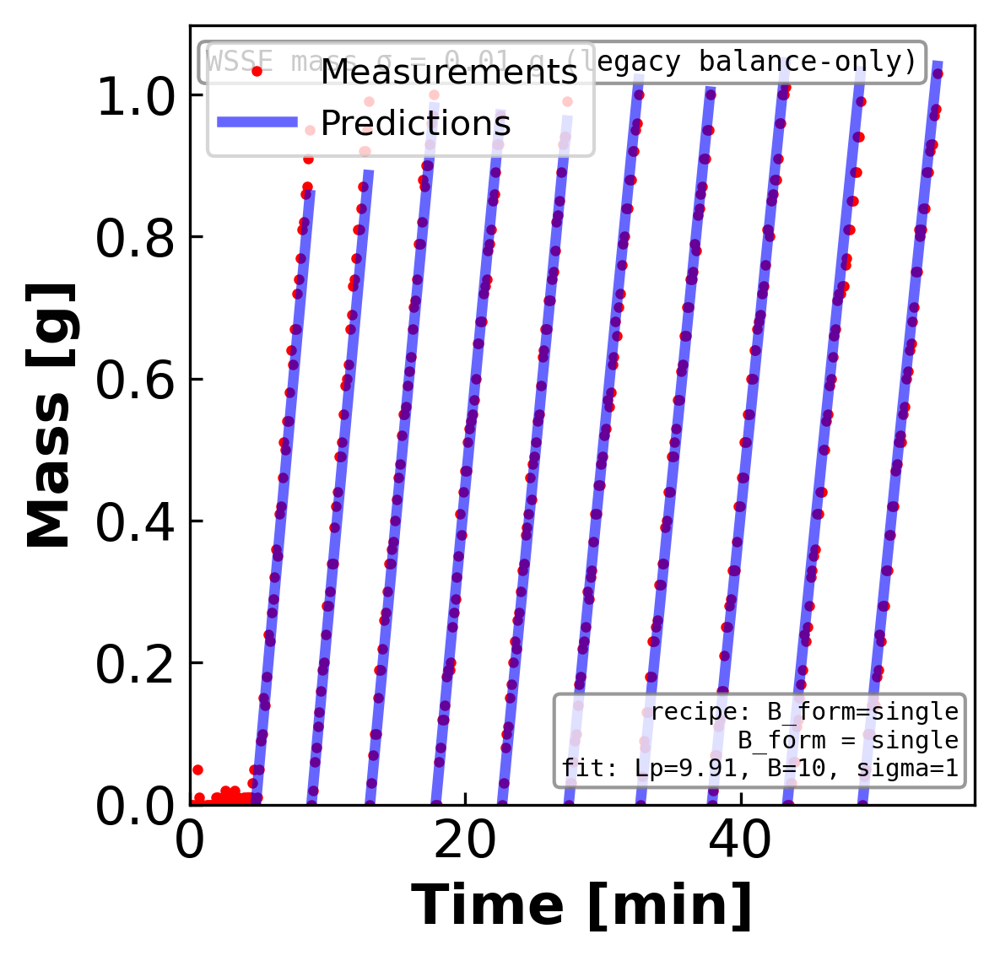
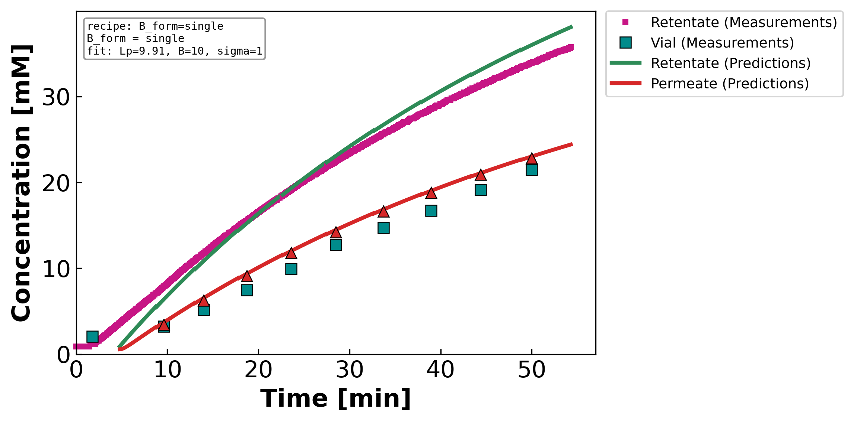
NaCl — concentrating regime (MC2 · 05.07.24)
fit form: constant B
Mass — measured (points) vs predicted (line)
Concentration — retentate / permeate
Optimized parameters
Lₚ = 9.91 L m⁻² h⁻¹ bar⁻¹
B = 10.00 µm s⁻¹
σ = 1.00
WSSE₃ = 114
→ Constant B is adequate for NaCl (WSSE₃=114); B is essentially concentration-independent.

Slide 4
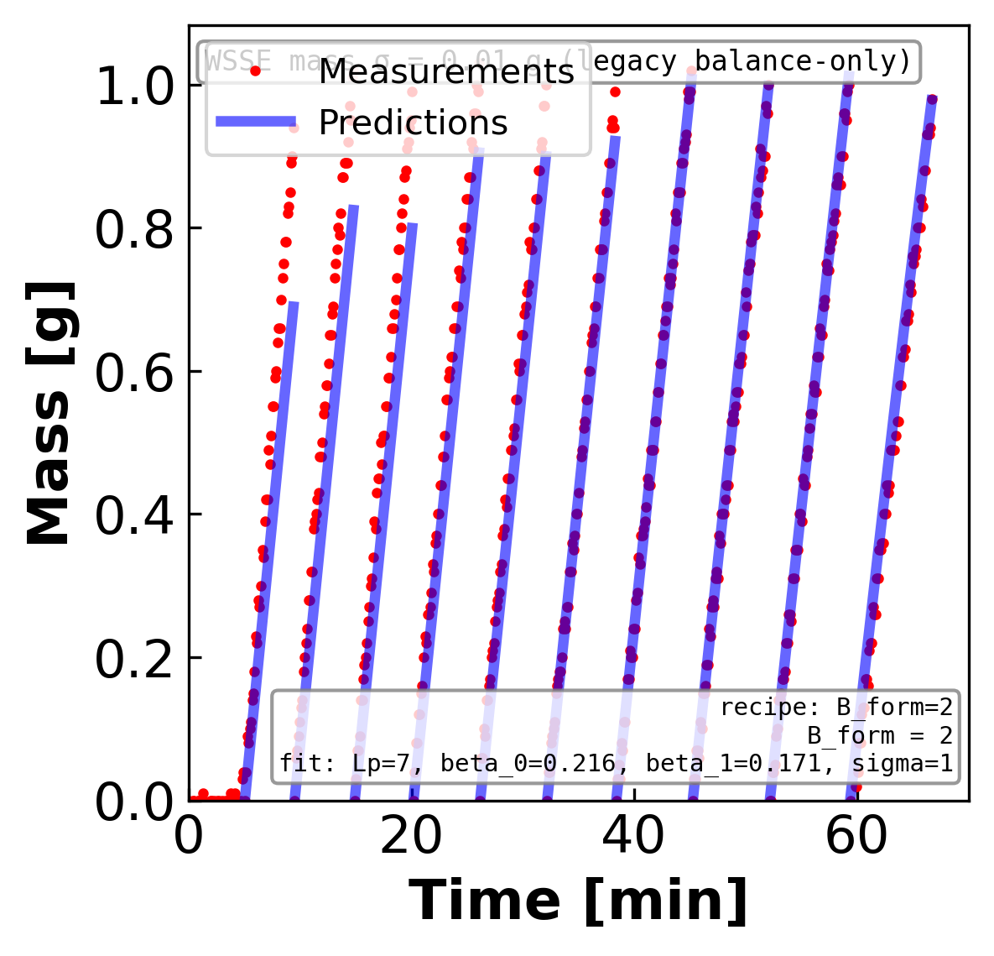
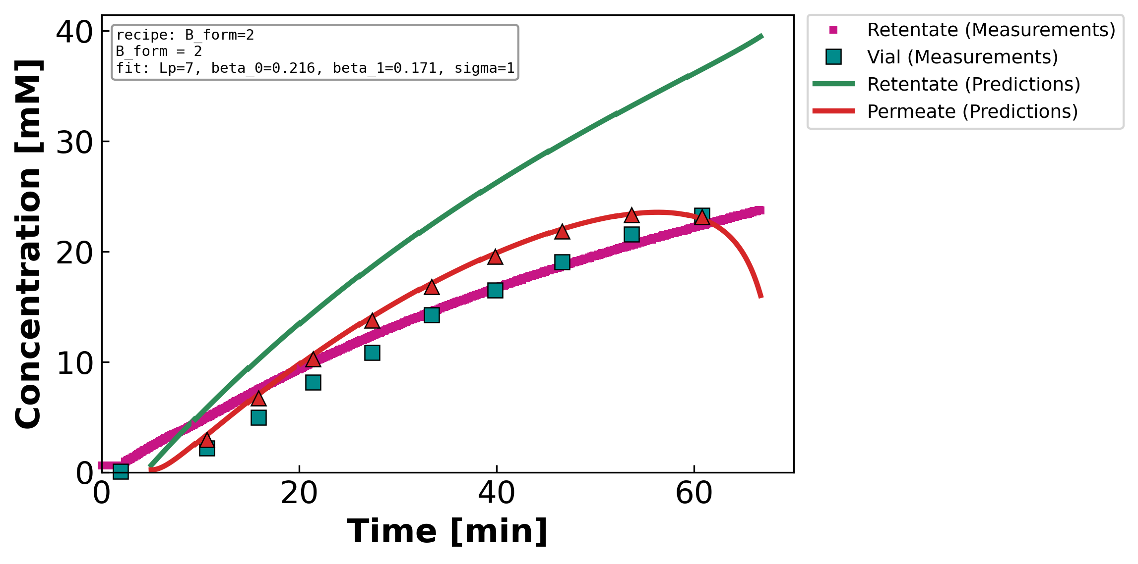
CaCl₂ (MC2 · 05.07.24)
fit form: quadratic B = Jw(β₀+β₁c+β₂c²)
Mass — measured (points) vs predicted (line)
Concentration — retentate / permeate
Optimized parameters
Lₚ = 7.00 L m⁻² h⁻¹ bar⁻¹
β₀=0.216 β₁=0.171 β₂=-0.0035
σ = 1.00
WSSE₃ = 147
→ B(c) is required: quadratic tracks the permeate (direct solute signal) and cuts WSSE₃ 220→147 (~33%); the retentate is still over-predicted at high c → σ(c)/polarization beyond B(c).

Slide 5
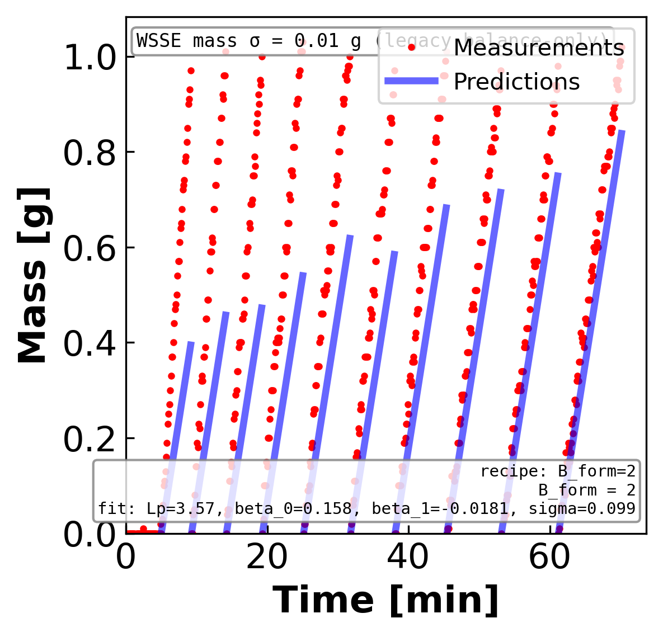
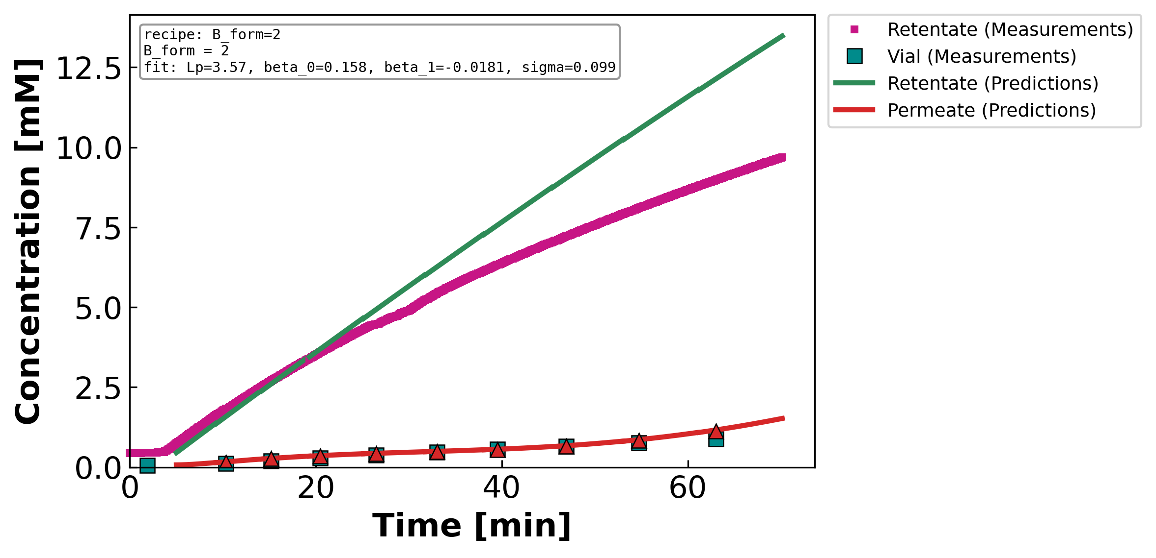
LaCl₃ (MC2 · 05.21.24)
fit form: quadratic B = Jw(β₀+β₁c+β₂c²)
Mass — measured (points) vs predicted (line)
Concentration — retentate / permeate
Optimized parameters
Lₚ = 3.57 L m⁻² h⁻¹ bar⁻¹
β₀=0.158 β₁=-0.018 β₂=0.0009
σ = 0.10
WSSE₃ = 1192
→ Model-limited: no B(c) form captures the trivalent — mass under- and retentate over-predicted (WSSE₃~1190–1244); the residual points past B(c) alone (σ(c), ion-pairing).

Slide 6
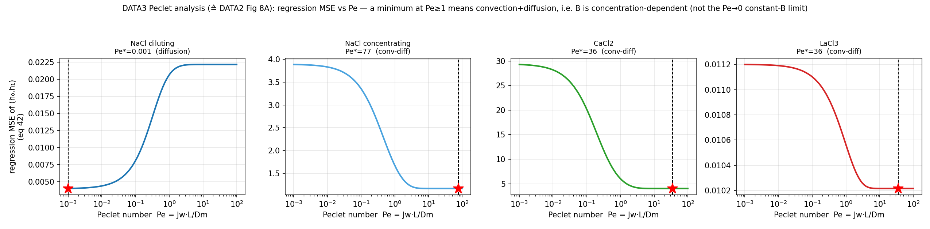
Why B depends on concentration — the Peclet regime
Regression MSE vs Pe (≙ DATA2 Fig 8): which transport regime each salt sits in
→ Diluting NaCl → Pe→0 (diffusion-limited, B = DₘH/L = constant). CaCl₂ / concentrating-NaCl / LaCl₃ → Pe≫1 (convection+diffusion → B = Jw·Σβᵢcⁱ). The Peclet number is WHICH salts need a concentration-dependent B.

Slide 7
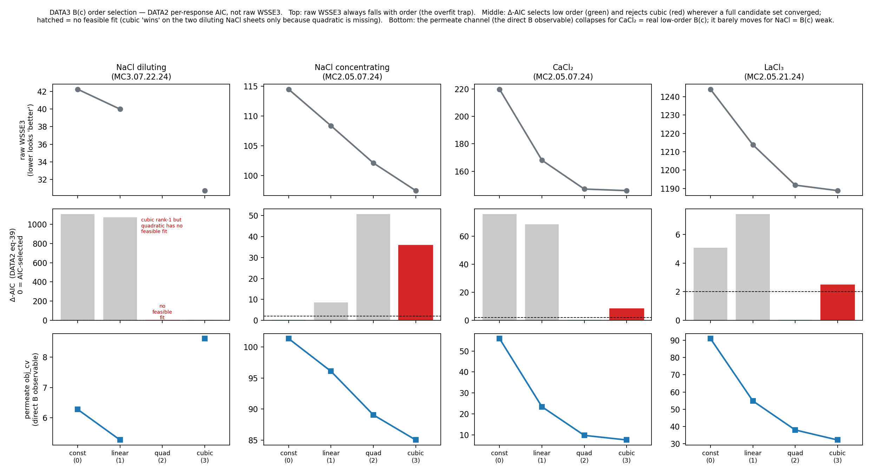
Which B(c) order — the DATA2 per-response AIC (not raw fit)
Order chosen by the per-channel AIC (eq 39); raw WSSE3 always over-selects more parameters
→ CaCl₂ → quadratic / linear, cubic REJECTED (Δ=8–25); NaCl B is flat (constant). The per-response AIC is the honest criterion — the pooled single-n AIC stored in the JSONs over-picks cubic.

Slide 8
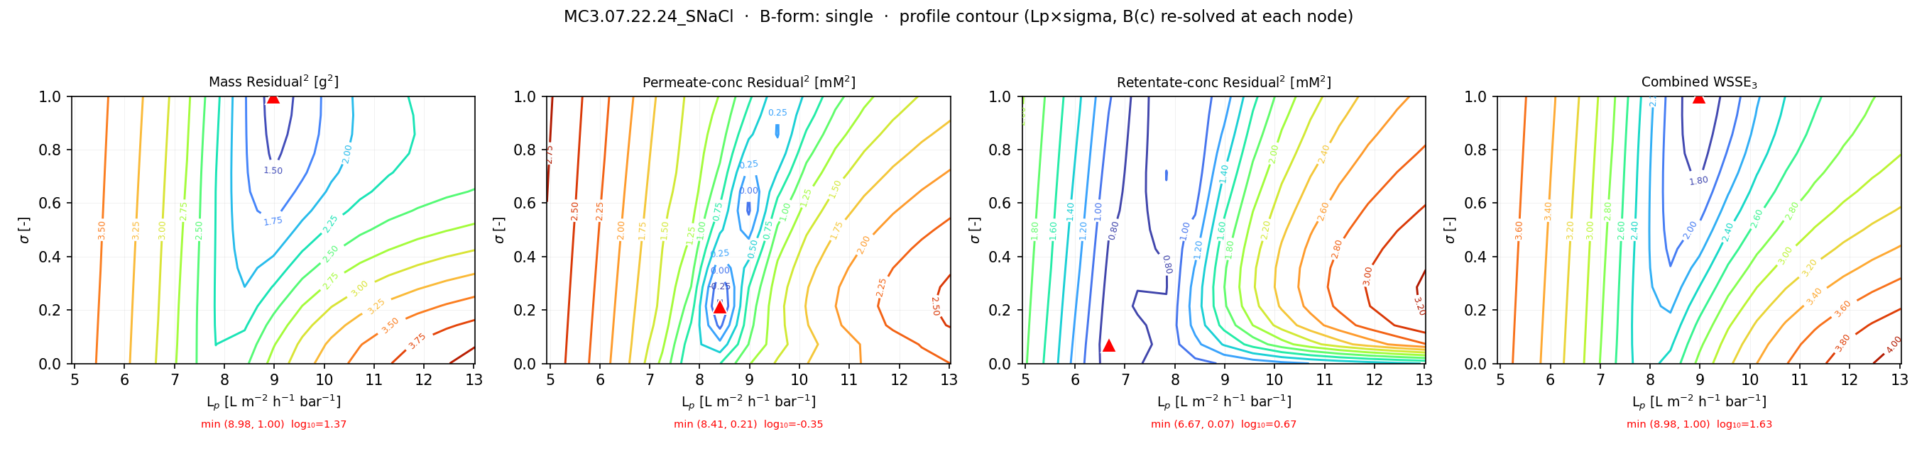
Supporting contour — NaCl — diluting regime
σ×Lₚ objective contour · constant B
Objective landscape per channel (mass | permeate | retentate | combined), other params re-solved at each node; red ▲ = minimum. A sharp minimum = identified; a flat valley along σ = the σ-rail.
→ clear Lₚ minimum; σ rails (flat valley) but B is flat so the rail is harmless.

Slide 9
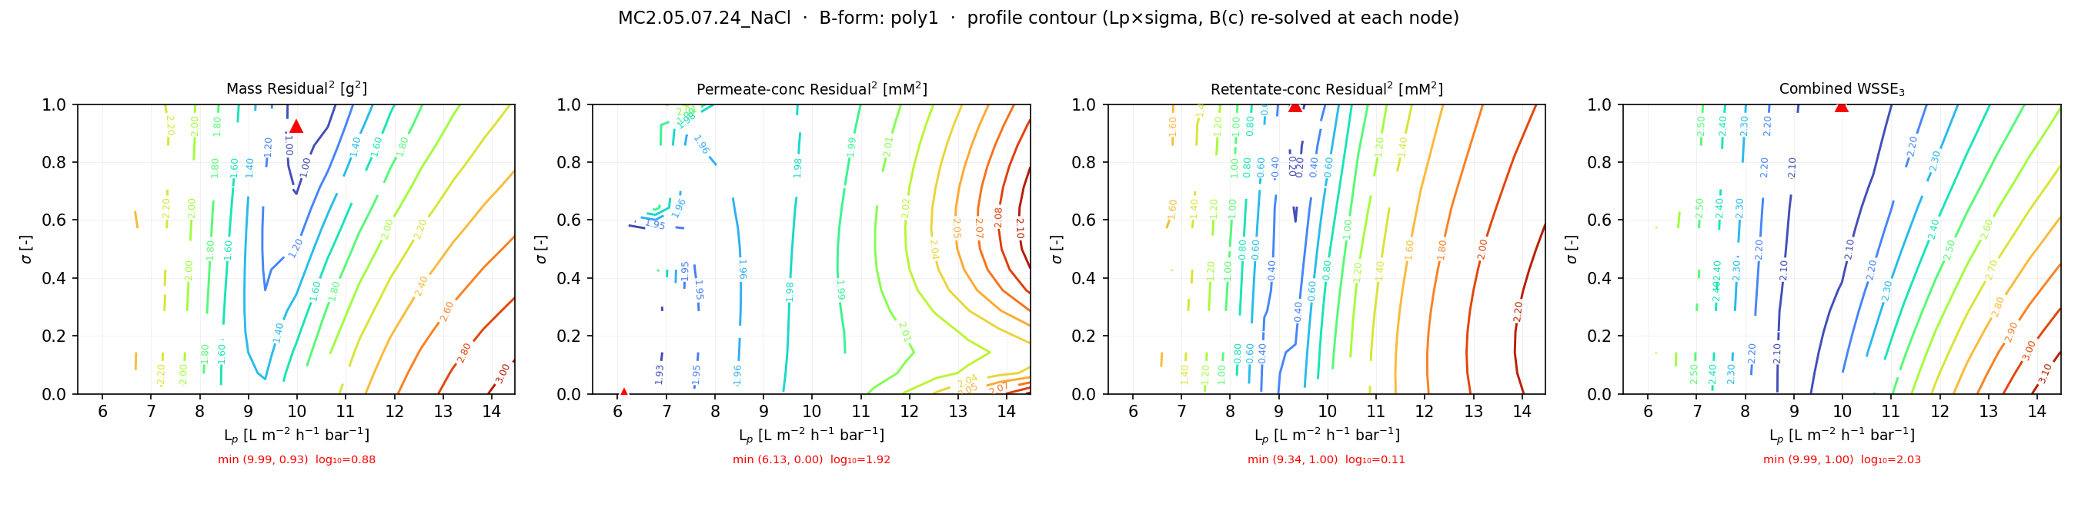
Supporting contour — NaCl — concentrating regime
σ×Lₚ objective contour · linear B(c) (nearest available form/plane)
Objective landscape per channel (mass | permeate | retentate | combined), other params re-solved at each node; red ▲ = minimum. A sharp minimum = identified; a flat valley along σ = the σ-rail.
→ constant-B identifiable in B–Lₚ; σ rails — adequate because B is concentration-independent.

Slide 10
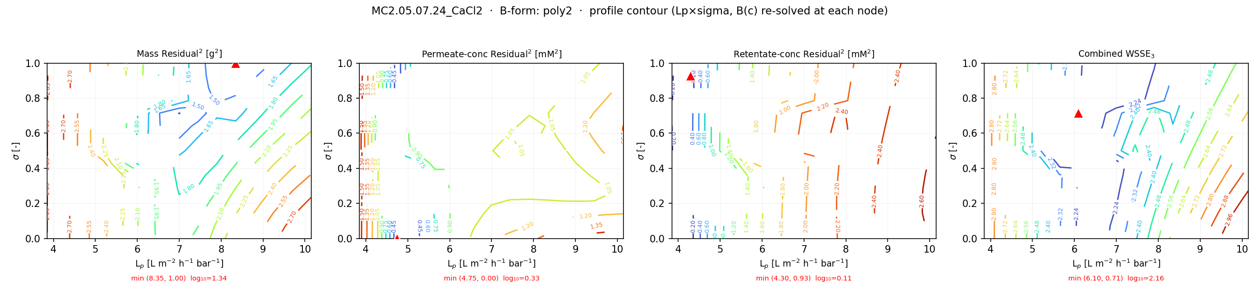
Supporting contour — CaCl₂
σ×Lₚ objective contour · quadratic B(c)
Objective landscape per channel (mass | permeate | retentate | combined), other params re-solved at each node; red ▲ = minimum. A sharp minimum = identified; a flat valley along σ = the σ-rail.
→ with quadratic B(c) profiled, the permeate/retentate channels pin the landscape — the B(c) win.

Slide 11
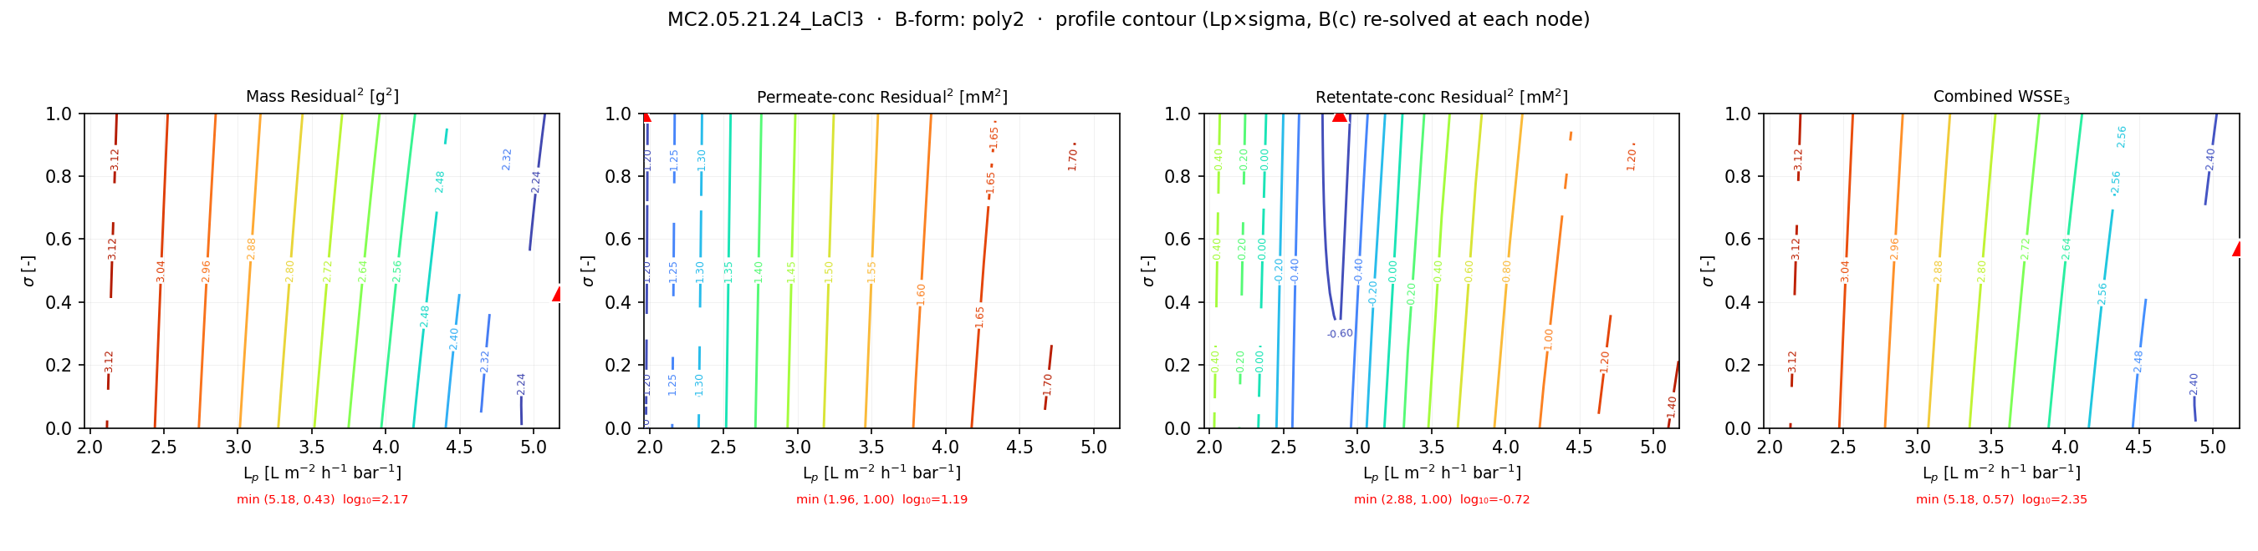
Supporting contour — LaCl₃
σ×Lₚ objective contour · quadratic B(c)
Objective landscape per channel (mass | permeate | retentate | combined), other params re-solved at each node; red ▲ = minimum. A sharp minimum = identified; a flat valley along σ = the σ-rail.
→ shallow/flat objective — the model-limited case; the landscape itself shows poor identifiability.

Slide 12
What the four fits show
• NaCl (both regimes): constant B is sufficient — B is concentration-independent (Peclet → 0, diffusion-limited
for the diluting case). Mass and both concentrations are tracked at WSSE₃ ≈ 42 / 114.
• CaCl₂: constant B fails (σ rails, WSSE₃=220). A quadratic B(c) is required and cuts the error ~33% to 147 —
consistent with convection+diffusion transport (Pe ≫ 1) and the DATA2 per-response AIC selecting quadratic.
• LaCl₃: model-limited — every B(c) form sits at WSSE₃ ≈ 1190–1244; the residual points past B(c) alone
(e.g. σ(c) / ion-pairing for the trivalent).
• Across the campaign: same NF270 membrane → Lₚ is consistent; the next step is the multi-experiment pooled fit
(shared σ + B(c)) that resolves the per-experiment σ-identifiability.

