Slide 1
DATA3 NF270 — Choosing B(c), the transport regime,
and whether experiments inform each other
Single-salt diafiltration: NaCl · CaCl₂ · LaCl₃ | per-response AIC · Peclet regime · multi-experiment pooling
Generated from the session analyses — auto-updates as the contour campaign completes

Slide 2
01 · THE QUESTION
What sets the solute permeability B, and does it depend on concentration?
• B is the membrane solute permeability: Jₛ = Jw·B·(c_in − c_H).
• DATA1/DATA2 transport theory: B = Dₘ·H/L — a partition (H) and a diffusion length.
• Whether B is constant or concentration-dependent is set by the Peclet number Pe = Jw·L/Dₘ:
– Pe → 0 (diffusion-dominated): B = DₘH/L = CONSTANT
– Pe ~ 1+ (convection + diffusion): B = Jw·Σ βᵢ cⁱ (concentration-dependent Taylor form)
• Under a constant-B fit, σ and B and Lₚ are coupled and σ rails — the identifiability problem we solve here.
→ Three threads: which B(c) form (AIC), why it depends on c (Peclet), and can pooling experiments fix identifiability.

Slide 3
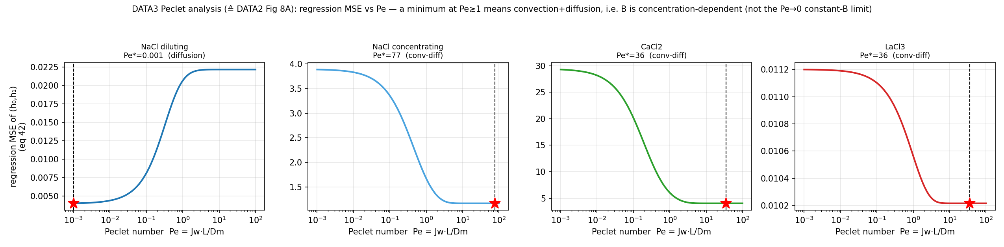
02 · WHY B DEPENDS ON c — THE PECLET REGIME
Regression MSE vs Pe (≙ DATA2 Fig 8): which regime each salt is in
→ Diluting NaCl → Pe→0 (diffusion, B≈const). CaCl₂ / concentrating-NaCl / LaCl₃ → Pe≫1 (convection+diffusion, B(c)). The regime direction is the robust signal.

Slide 4
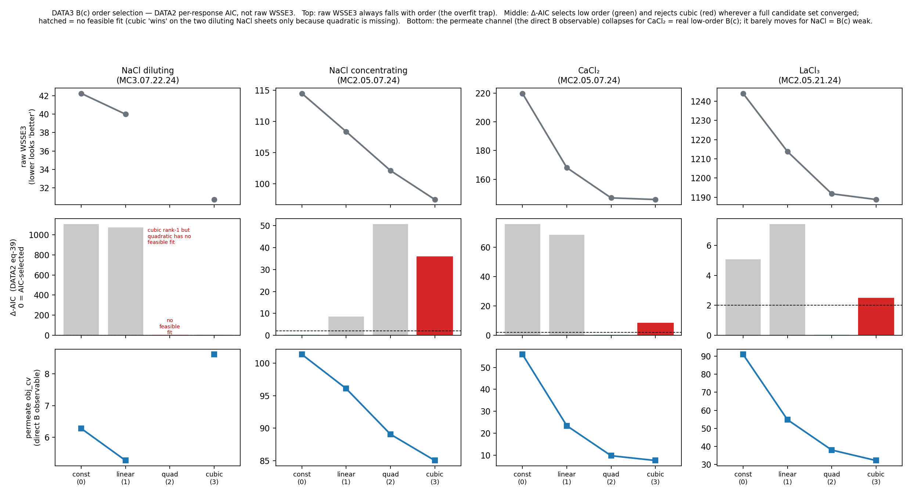
03 · WHICH B(c) ORDER — DATA2 PER-RESPONSE AIC
Order chosen by the per-channel AIC (eq 39), not raw WSSE3
→ CaCl₂ → quadratic/linear, cubic REJECTED (Δ=8–25). NaCl cubic 'wins' are mass-channel/convergence artifacts. Use the per-response AIC, not the pooled JSON AIC.

Slide 5
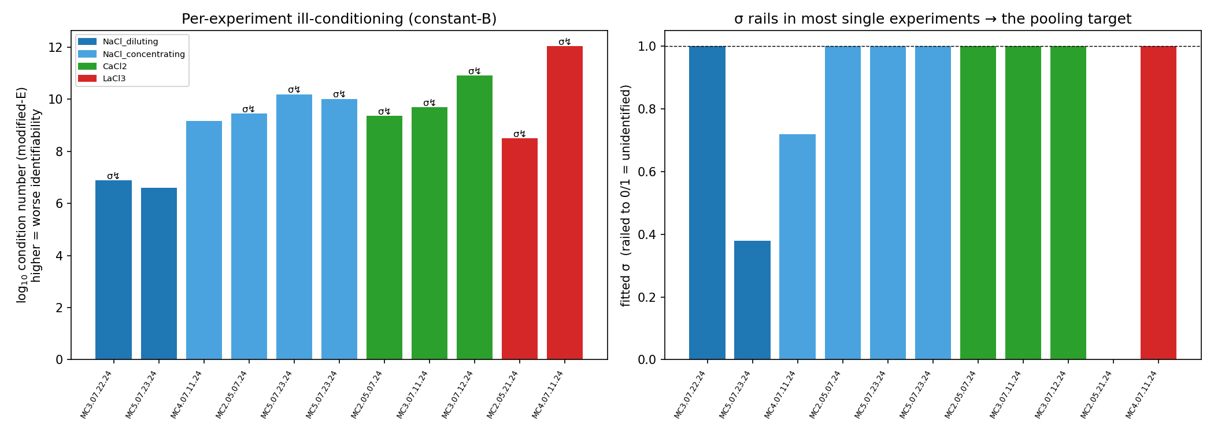
04 · THE IDENTIFIABILITY PROBLEM
Per-experiment σ rails; the σ–B–Lₚ landscape is ill-conditioned
→ σ rails in 9/11 single experiments; condition numbers 10⁶–10¹². A single experiment cannot pin σ.

Slide 6
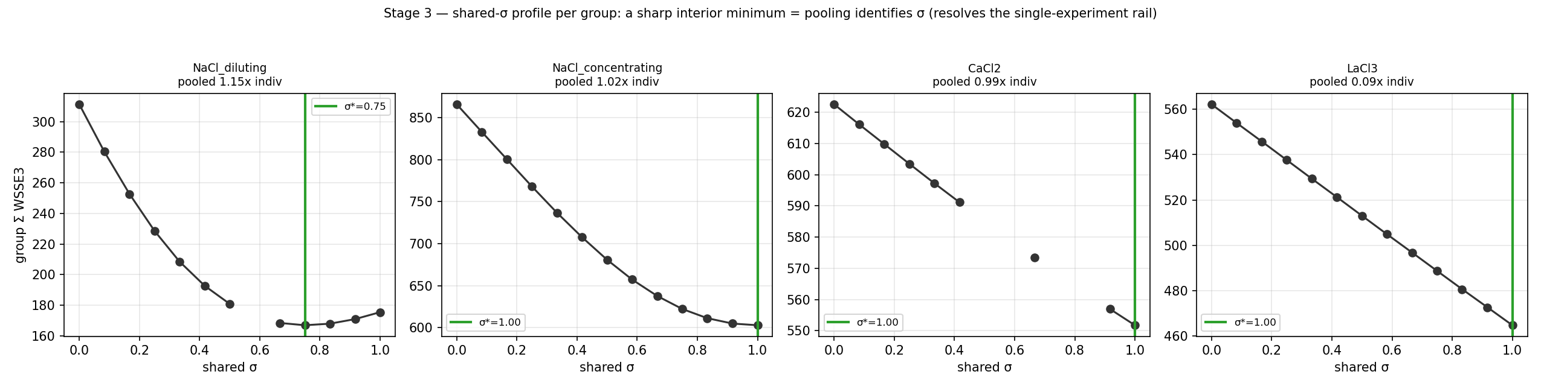
05 · POOLING RESOLVES IT — SHARED σ
One shared σ per salt-regime group costs ~nothing — and comes off the rail
→ Cost ≈1× (sharing σ is nearly free → σ is a salt property). Diluting-NaCl identifies σ*=0.75, OFF the individual rails (1.0/0.38).

Slide 7
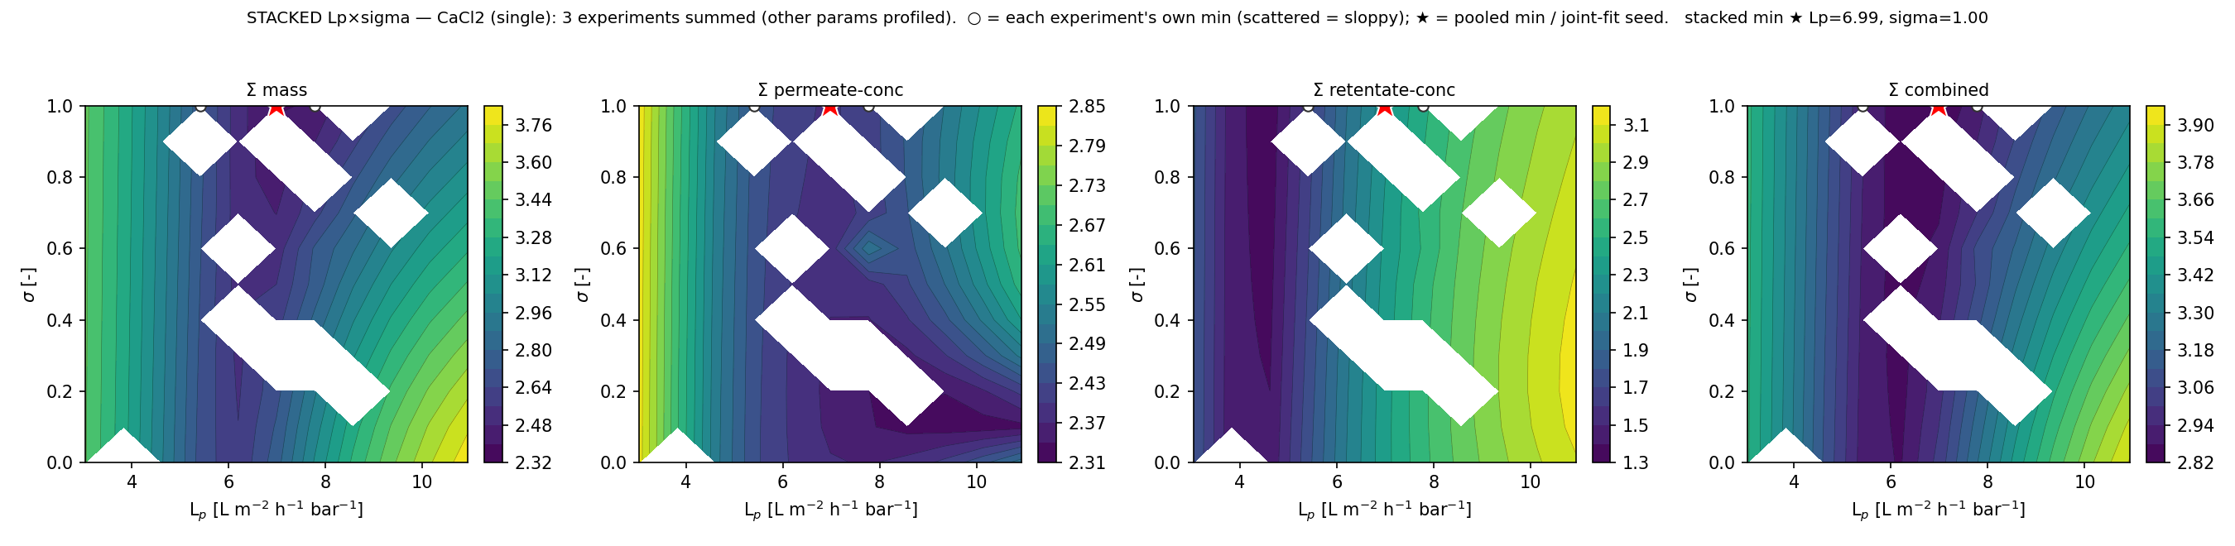
06 · EXPERIMENTS INFORM EACH OTHER — STACKED LANDSCAPES
Summing the objective surfaces = summing Fisher information → a sharper pooled minimum
Per channel across a group: Σ mass → Lₚ, Σ permeate-conc → B, Σ retentate-conc → σ. White ○ = each experiment's scattered own minimum; red ★ = the pooled minimum (joint-fit seed). The transport model is evaluated at every node (slice = forward-sim, legacy calc_contour_2d; profile = re-solve B(c)).
→ Where individuals are sloppy, the summed surface localizes — the visual proof that pooling improves identifiability.

Slide 8
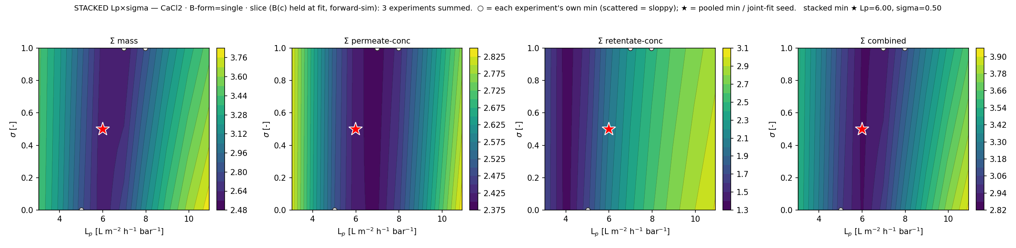
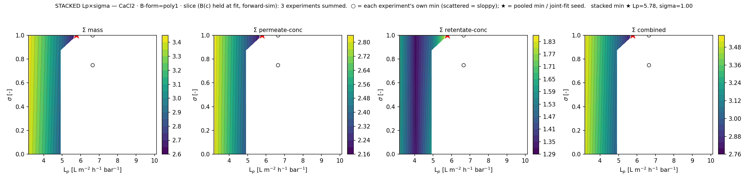
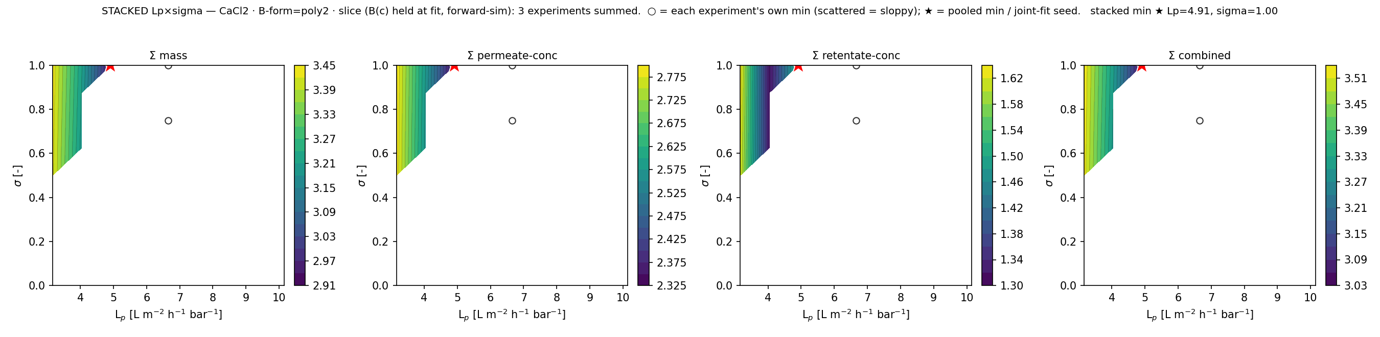
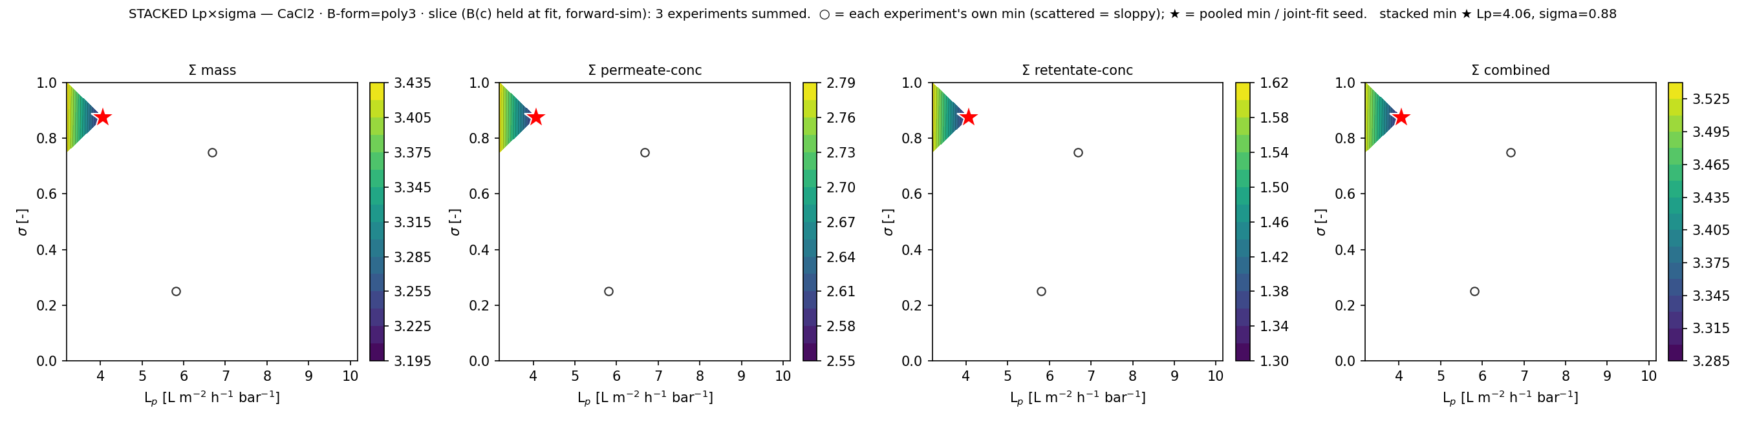
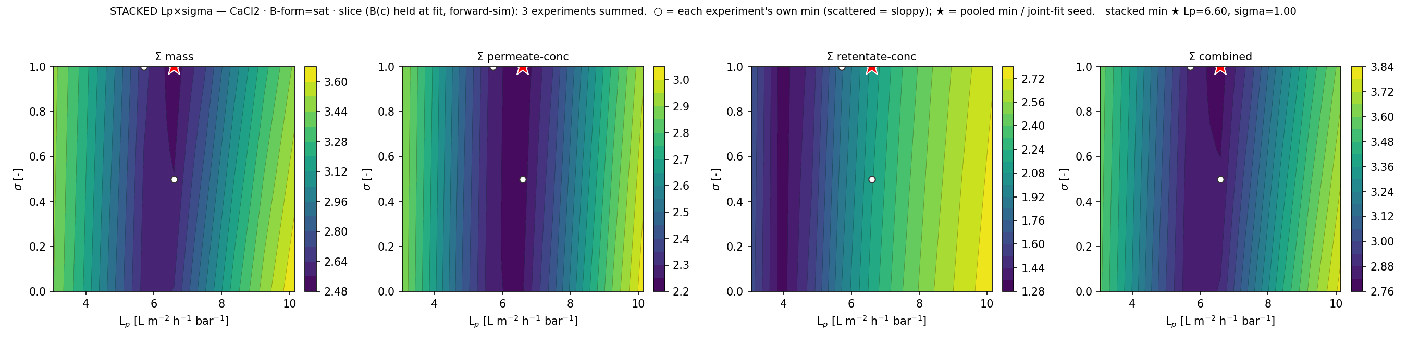
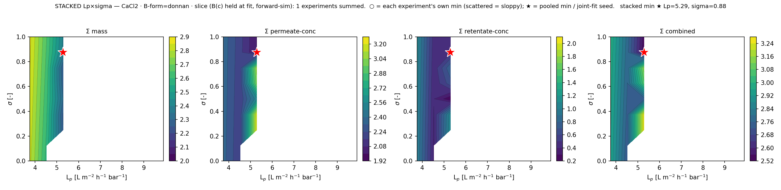
07 · PER B(c)-FORM σ×Lₚ MAPS
Each concentration-function of B reshapes the σ/Lₚ identifiability (CaCl₂)
constant
linear
quadratic
cubic
saturating
Donnan
→ Comparing forms: constant rails σ; the concentration-dependent forms relax the σ/Lₚ trade-off differently.

Slide 9
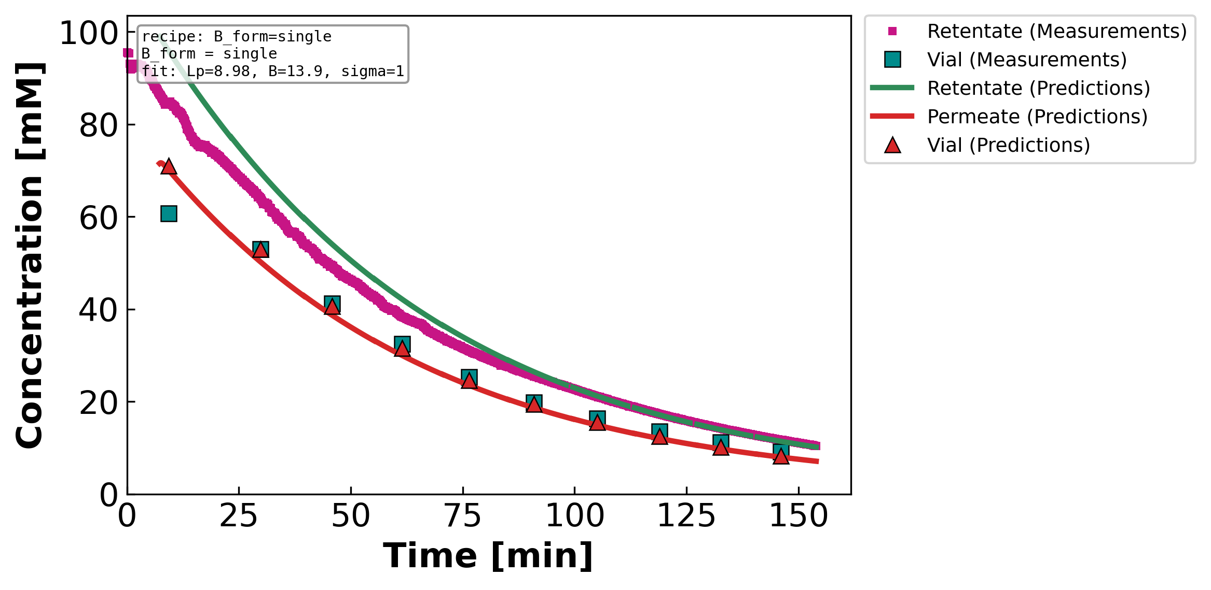
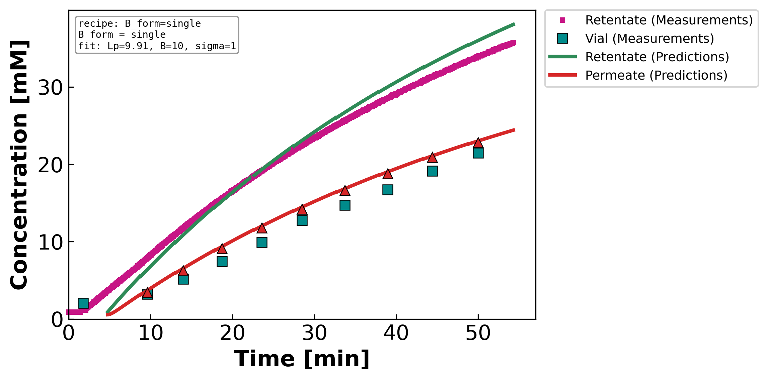
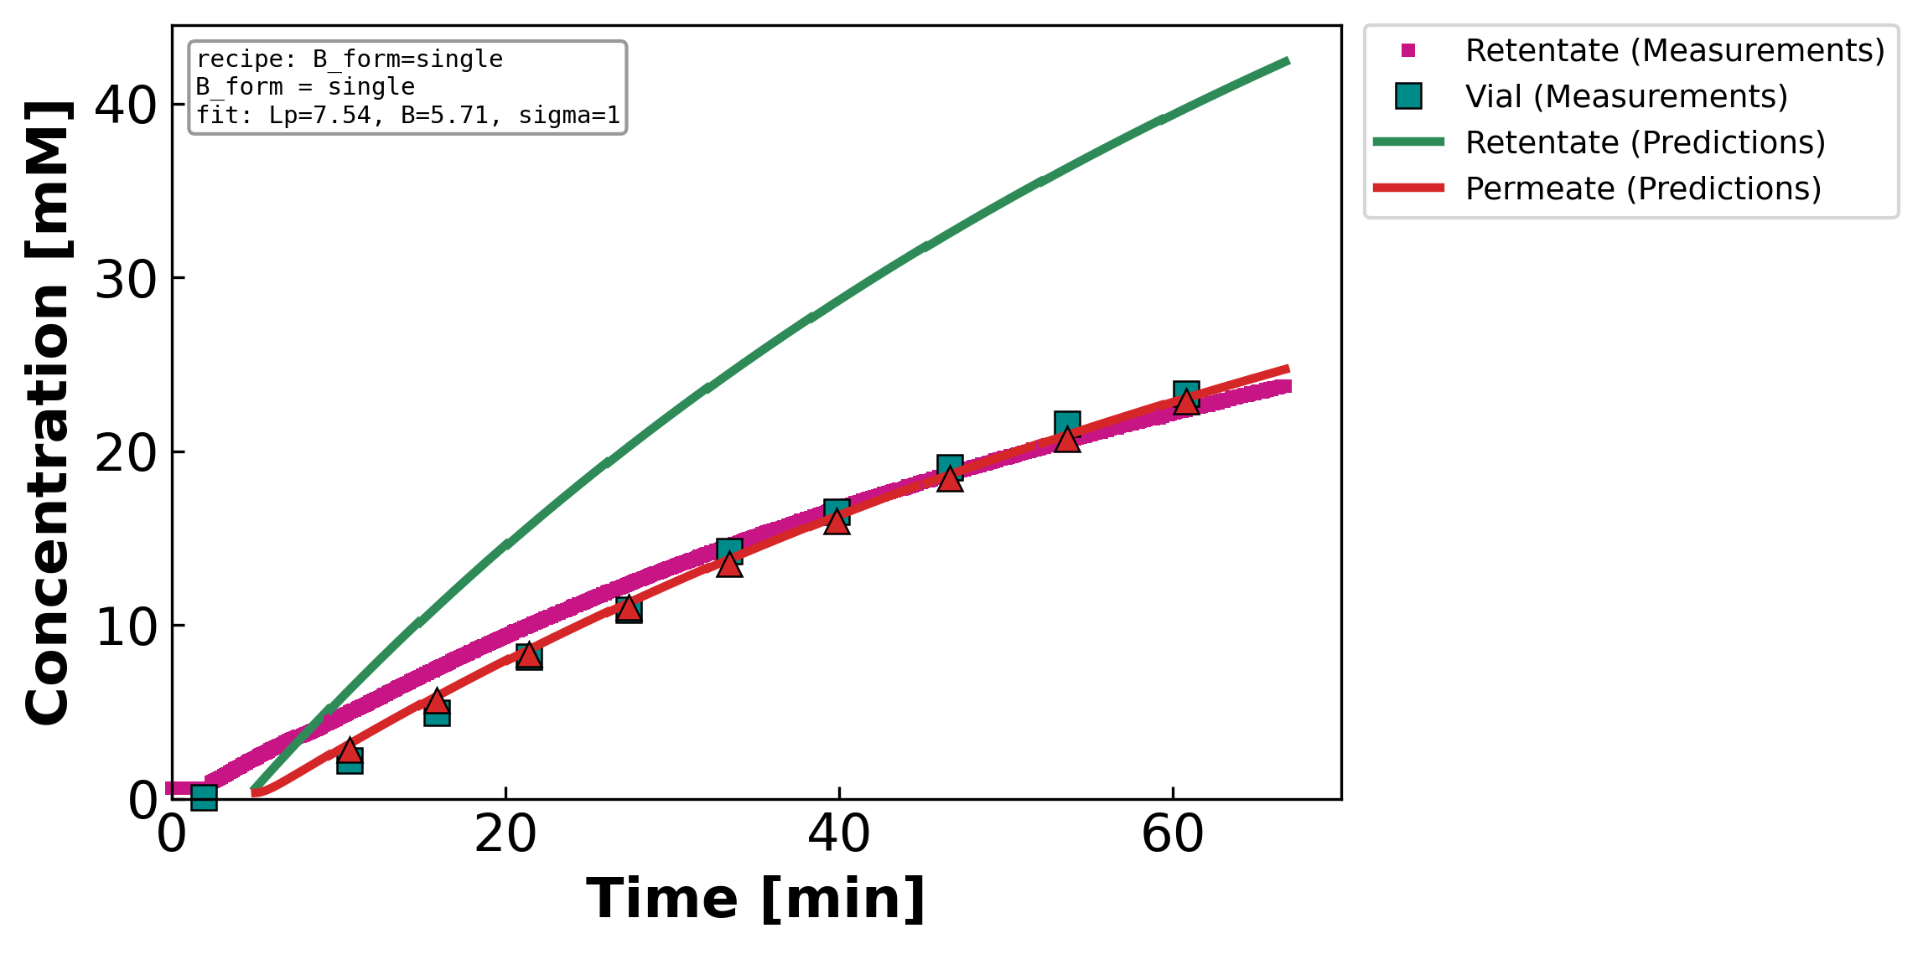
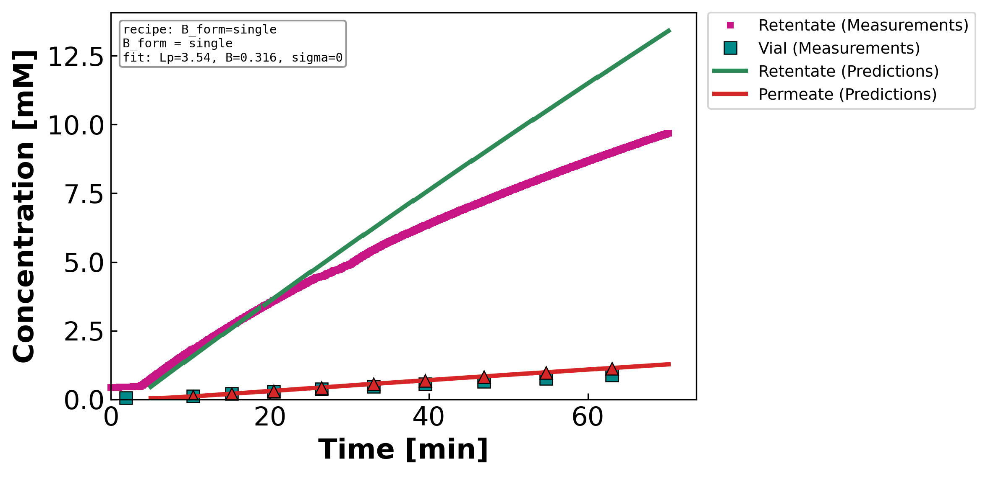
08 · CONSTANT-B FIT — MEASURED vs PREDICTED
The first B-form (constant B) at the optimized parameters
NaCl diluting
NaCl concentrating
CaCl2
LaCl3
→ Constant-B tracks NaCl well (flat B); for CaCl₂/LaCl₃ the constant-B residual motivates B(c).

Slide 10
09 · THE COHERENT STORY
1. B is constant when diffusion dominates (Pe→0) and concentration-dependent when convection matters (Pe≫1).
The Peclet analysis separates the salts: diluting-NaCl diffusion-limited; CaCl₂/LaCl₃/conc-NaCl convection.
2. Among concentration-functions of B, the DATA2 per-response AIC selects LOW order — quadratic/linear for CaCl₂,
cubic rejected. Raw WSSE3 over-selects; the per-channel likelihood is the honest criterion.
3. A single experiment cannot identify σ (it rails; cond 10⁶–10¹²). Pooling experiments of the same salt+regime
shares σ at ~zero cost and resolves the rail (diluting-NaCl σ*=0.75). Stacked objective landscapes show the
experiments informing each other: the summed surface has a sharper minimum than any individual.
4. Same NF270 membrane across DATA3 → Lₚ is consistent; the within-group scatter was identifiability noise that
pooling removes. The stacked minimum is the warm-start for the joint multi-experiment fit.

