Slide 1

DATA3: Single-Salt NF270 Diafiltration
Concentration-dependent solute permeability & the Donnan–dielectric model
Collaborator update · June 24, 2026
Keshav Kasturi Rangan · University of Notre Dame

Slide 2
Feedback from Friday — addressed
Time-series correction: permeate ICP now anchored at vial close (DATA2 convention); mass, retentate, and permeate share one time axis — the invented tube-transit placement is retired.
Identifiability contours: σ×B log-WSSE surfaces generated per response (mass / permeate / retentate) at the identified L_{p}.
Color coding: fit/data plots follow the DATA2 convention (retentate vs permeate vs model).
Scope: all changes are DATA3 / NF270-only; DATA1, DATA2, and the legacy MATLAB are untouched.
DATA3 single-salt NF270 diafiltration · collaborator update
2026-06-24 · 2

Slide 3
Topics I need help with
Prioritization: which question below is the right one to chase first?
Donnan–dielectric equation: the partition form, its assumptions, and the derivation of B(c).
Interfacial concentration: what range of membrane-interface concentration do the experiments actually probe?
Péclet framing: the Péclet number and the rejection law R(σ, Pe) — is this the right lens?
Transport components: dielectric exclusion, cross-coefficients D_{ij}, B(c), and activity coefficients — which to include?
Identifiability: given σ is unidentified single-experiment, how far can B(c) claims go?
DATA3 single-salt NF270 diafiltration · collaborator update
2026-06-24 · 3

Slide 4
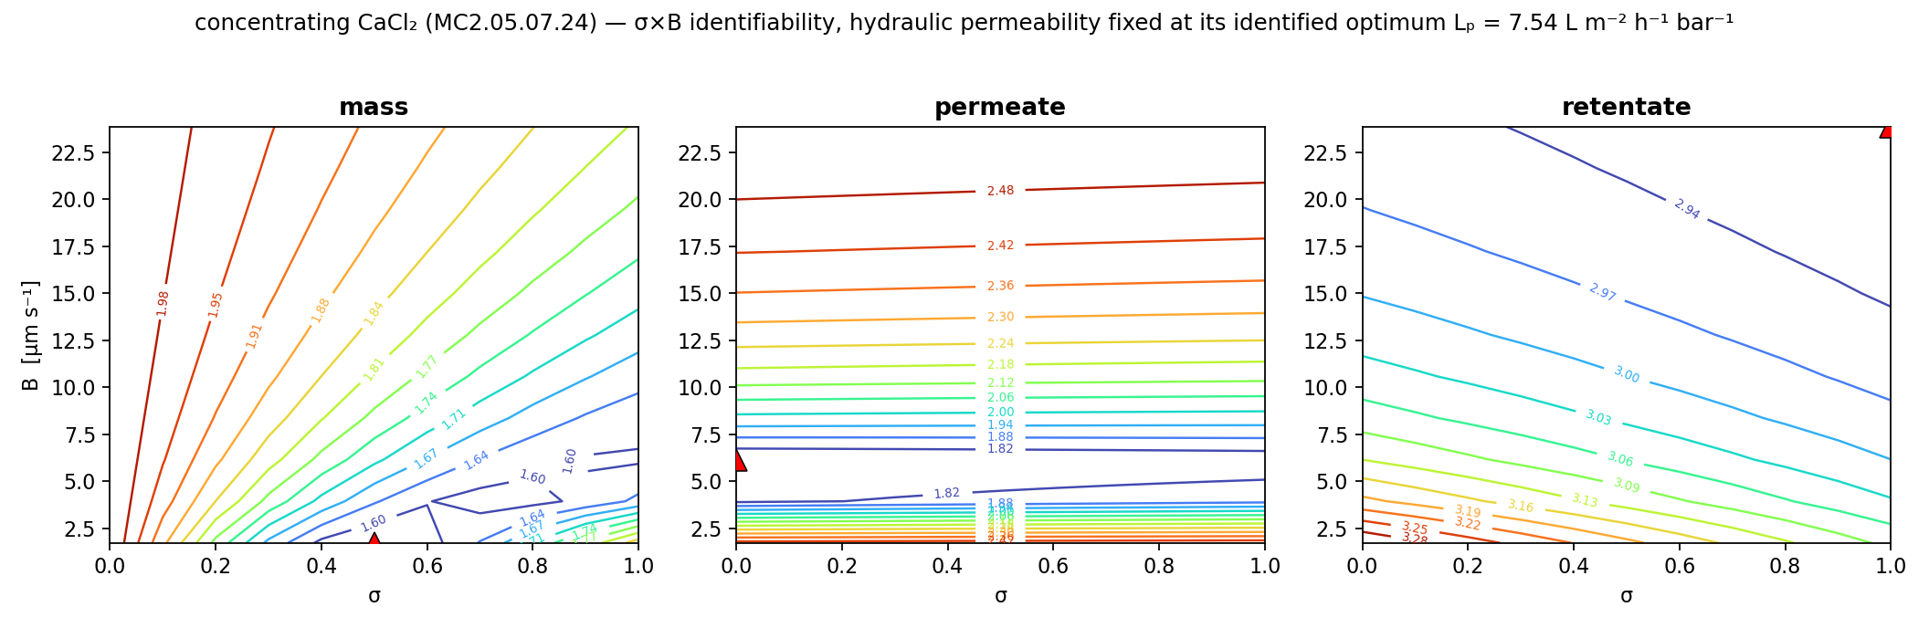
Single experiments determine B, not σ
Each response’s log-WSSE has a narrow valley in B but is nearly flat in σ (representative concentrating CaCl₂; L_{p} fixed at its identified optimum).
σ rails to its bound while B stays well-determined — the two are correlated, so one experiment cannot recover σ.
Consequence: “is B concentration-dependent?” must be posed carefully — we lean on mechanism, not fit alone.
DATA3 single-salt NF270 diafiltration · collaborator update
2026-06-24 · 4

Slide 5
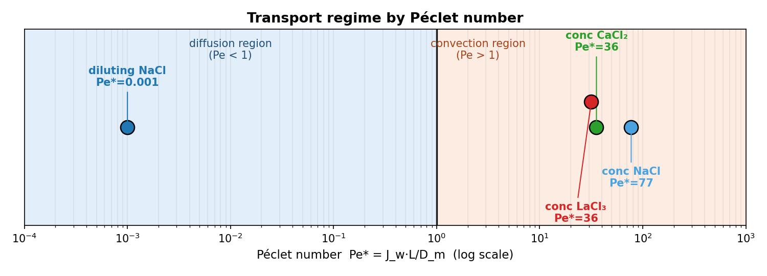
The same membrane spans diffusion- and convection-limited regimes
$$Pe=\frac{\text{convection}}{\text{diffusion}}=\frac{J_{w} L}{D_{m}}$$
$$R=\frac{σ\left(1−e^{−Pe}\right)}{1−σ e^{−Pe}}$$
where Pe — Péclet number; Jw — water (volume) flux through the membrane; L — membrane thickness; D_{m} — solute diffusivity in the membrane; R — salt rejection; σ — reflection coefficient (0 = no rejection, 1 = complete).
Diluting NaCl is diffusion-limited (Pe* ≈ 10⁻³); concentrating NaCl / CaCl₂ / LaCl₃ are convection-dominated (Pe* ≈ 77 / 36 / 36).
Mechanistic inference, not a direct demonstration: Pe and B come from the same fitted model — this motivates B(c), it does not prove it.
To tabulate for review: water flux Jw, membrane length-scale L, and diffusivity D_{m} per salt.
Refs — Pe = JwL/Dm: DATA2, Liu et al., Ind. Eng. Chem. Res. 64 (2025) 12111 (eq 25); Spiegler–Kedem rejection: Spiegler & Kedem, Desalination 1 (1966) 311; solution-diffusion (Lp, B, σ): Kedem & Katchalsky, Biochim. Biophys. Acta 27 (1958) 229; framework: Ouimet et al., J. Membr. Sci. 641 (2022) 119743 (DATA1).
DATA3 single-salt NF270 diafiltration · collaborator update
2026-06-24 · 5

Slide 6
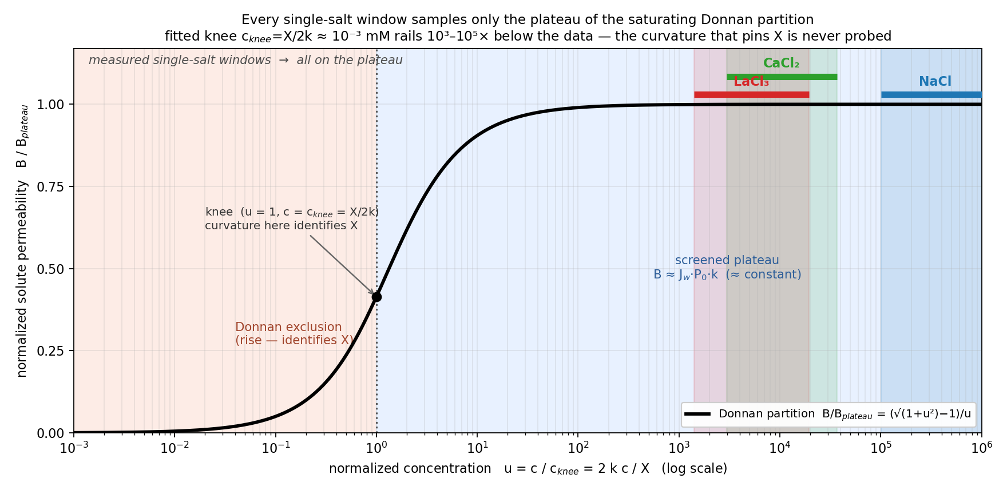
All single-salt windows sit on the Donnan plateau
$$B(c)=\frac{J_{w} P_{0}\left(−X+\sqrt{X^{2}+4k^{2}c^{2}}\right)}{2c}$$
$$B_{\text{plateau}}=J_{w}P_{0}k, c_{\text{knee}}=\frac{X}{2k}, u=\frac{c}{c_{\text{knee}}}=\frac{2kc}{X}$$
where B(c) — solute permeability at interfacial concentration c; c — membrane-interface salt concentration; Jw — water flux; P₀ — intrinsic permeability prefactor; X — effective membrane fixed-charge density; k — lumped Donnan–dielectric partition factor; B_plateau — high-c plateau value; c_knee = X/2k — regime knee; u = c/c_knee — screening parameter.
B(c) collapses onto one master curve; every measured window is at u ≈ 10³–10⁵ (screened plateau) → B is ≈ constant in-window (the screened-plateau value).
The knee c_knee = X / 2k rails 10³–10⁵× below the data → the fixed-charge scale X is not identified from one salt.
Refs — Donnan–dielectric B(c): Yaroshchuk, Adv. Colloid Interface Sci. 85 (2000) 193; Bandini & Vezzani, Chem. Eng. Sci. 58 (2003) 3303 (DSPM-DE); Donnan-equilibrium partition cf. Bolt, J. Colloid Sci. 10 (1955) 206 (as in DATA2).
DATA3 single-salt NF270 diafiltration · collaborator update
2026-06-24 · 6

Slide 7
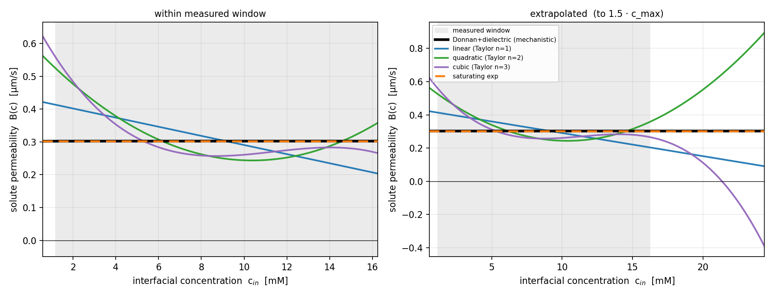
B(c): in-window agreement, out-of-window divergence — LaCl₃
$$B(c)=β_{0}+β_{1}c+β_{2}c^{2}+β_{3}c^{3}$$
$$B(c)=B_{∞}\left(1−e^{−c/c^{*}}\right)$$
where B(c) — solute permeability; c — interfacial concentration; β₀–β₃ — polynomial (Taylor) expansion coefficients; B∞ — saturating permeability as c → ∞; c* — characteristic saturation concentration.
Within the measured window, constant / linear / quadratic / cubic / saturating-exp all agree (B ≈ 0.3 µm·s⁻¹).
Extrapolated, the polynomials diverge unphysically (cubic → negative); Donnan and saturating-exp stay bounded.
The Donnan–dielectric is the mechanistically-grounded, physically-bounded form — the data do not discriminate it from a constant in-window.
Refs — empirical B(c): polynomial (multiplicative) form per DATA2, Liu et al., Ind. Eng. Chem. Res. 64 (2025) 12111 (eq 31); saturating-exp & Donnan-bounded forms: this work (DATA3).
DATA3 single-salt NF270 diafiltration · collaborator update
2026-06-24 · 7

Slide 8
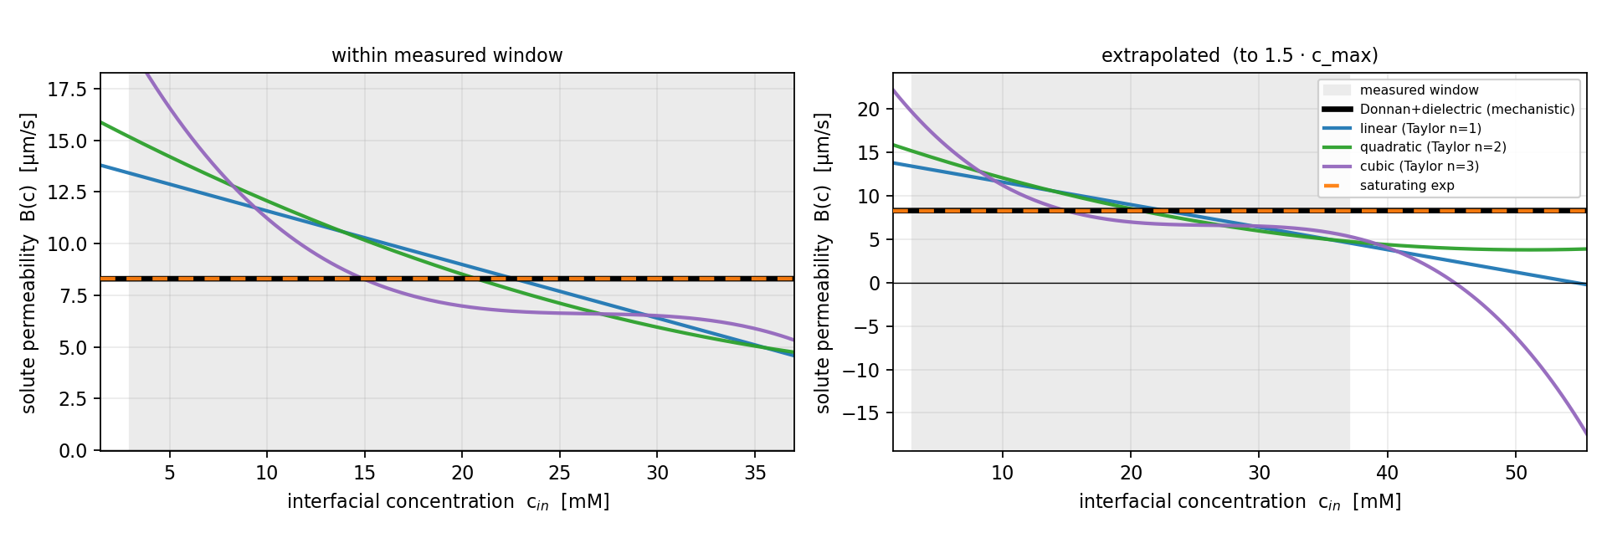
Same behavior for CaCl₂
Identical picture: in-window agreement, out-of-window polynomial divergence, Donnan bounded.
On parsimony (AIC) a constant fits as well in-window — prefer Donnan for mechanism and physical extrapolation, not in-window fit.
Next step to pin X: a joint multi-salt fit (re-parameterized by ionic strength) reaches lower u and probes the knee.
DATA3 single-salt NF270 diafiltration · collaborator update
2026-06-24 · 8

