Slide 1
Backup — Supporting Figures
Fits, full σ×B contours, Péclet regression, NaCl B(c), concentration–flux

Slide 2
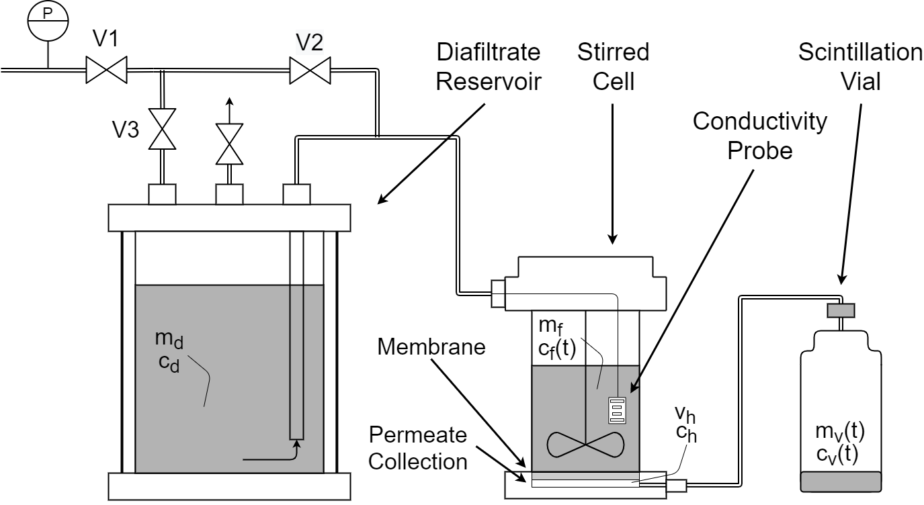
Backup — Physics-Based Model Links Data to Transport Parameters
DATA3 single-salt NF270 diafiltration · collaborator update
2026-06-24 · 2

Slide 3
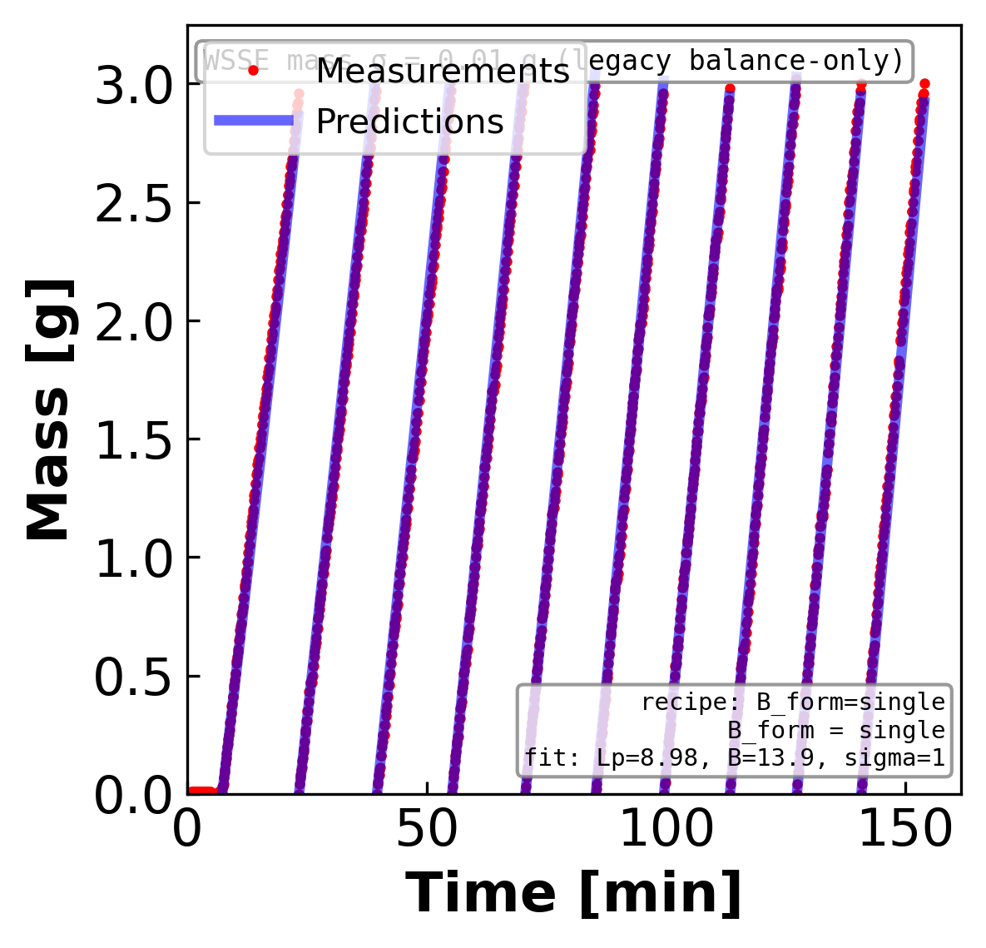
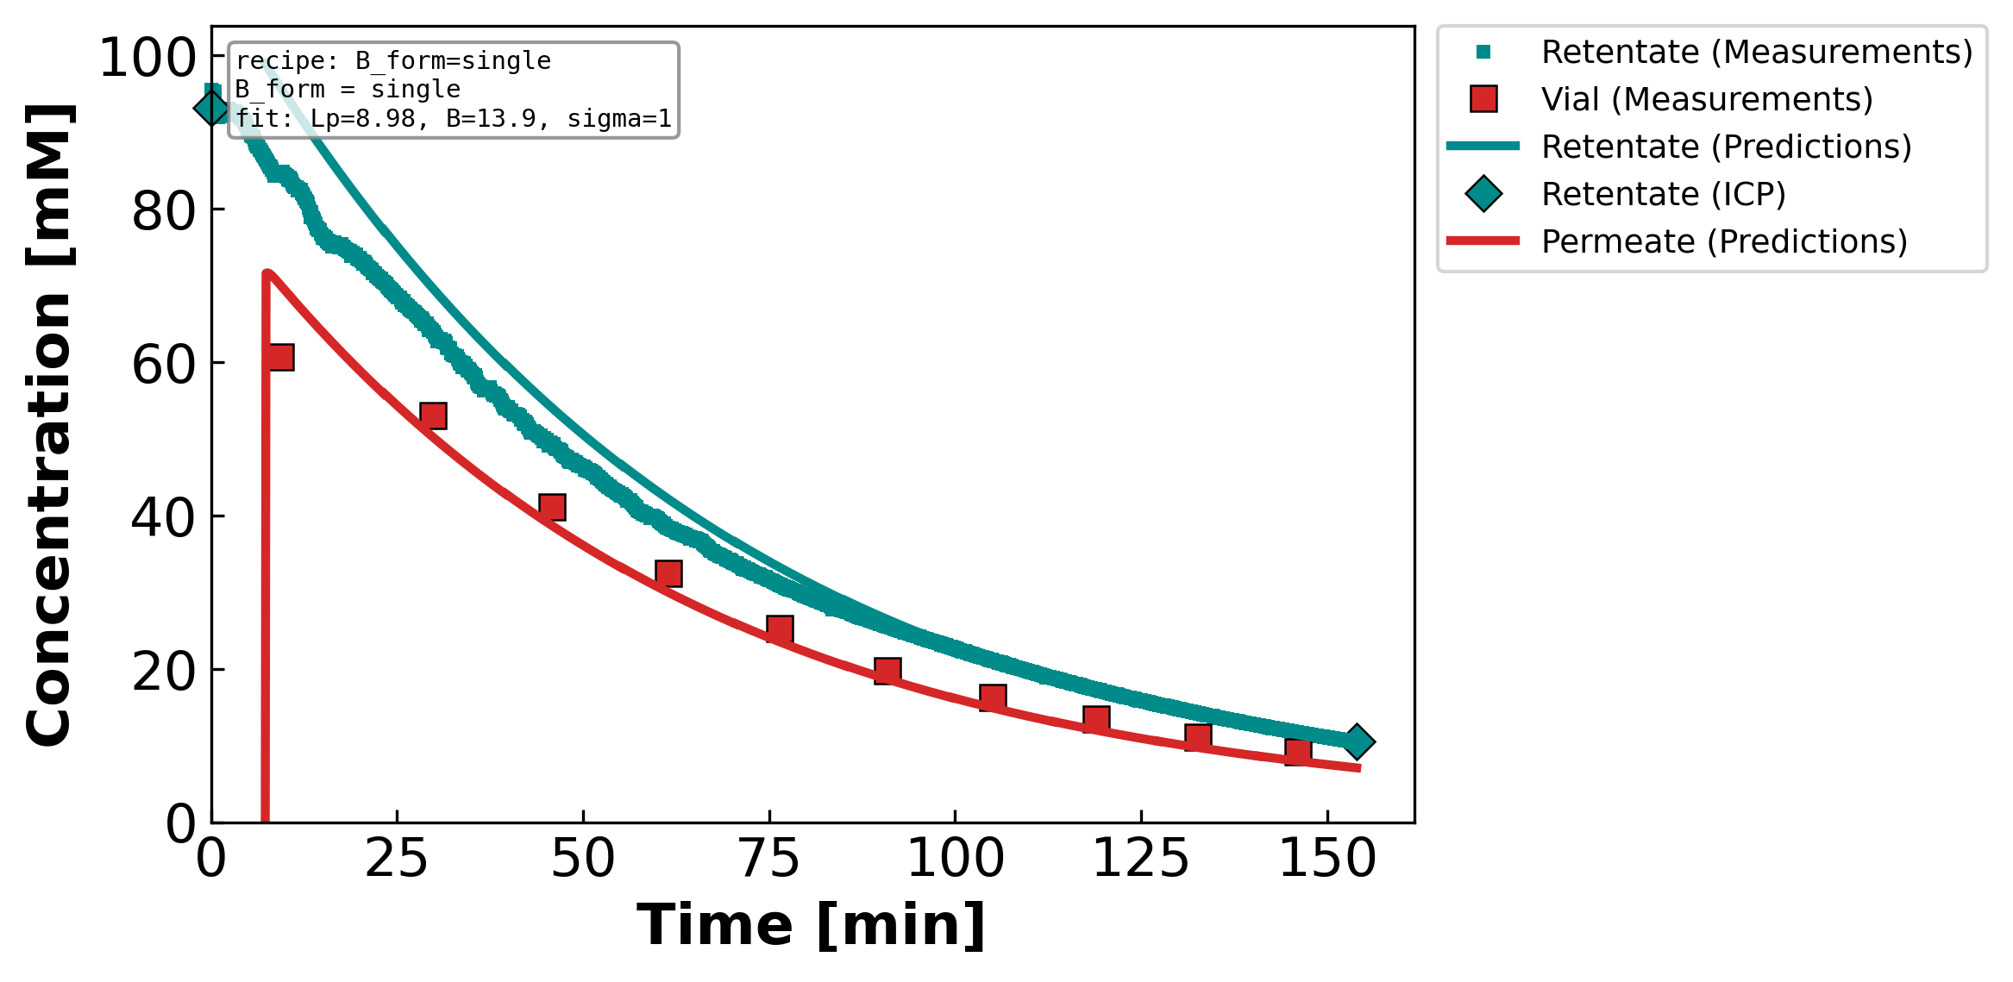
Backup — Figure 1. Measured and model-predicted time profiles for a representative…
DATA3 single-salt NF270 diafiltration · collaborator update
2026-06-24 · 3

Slide 4
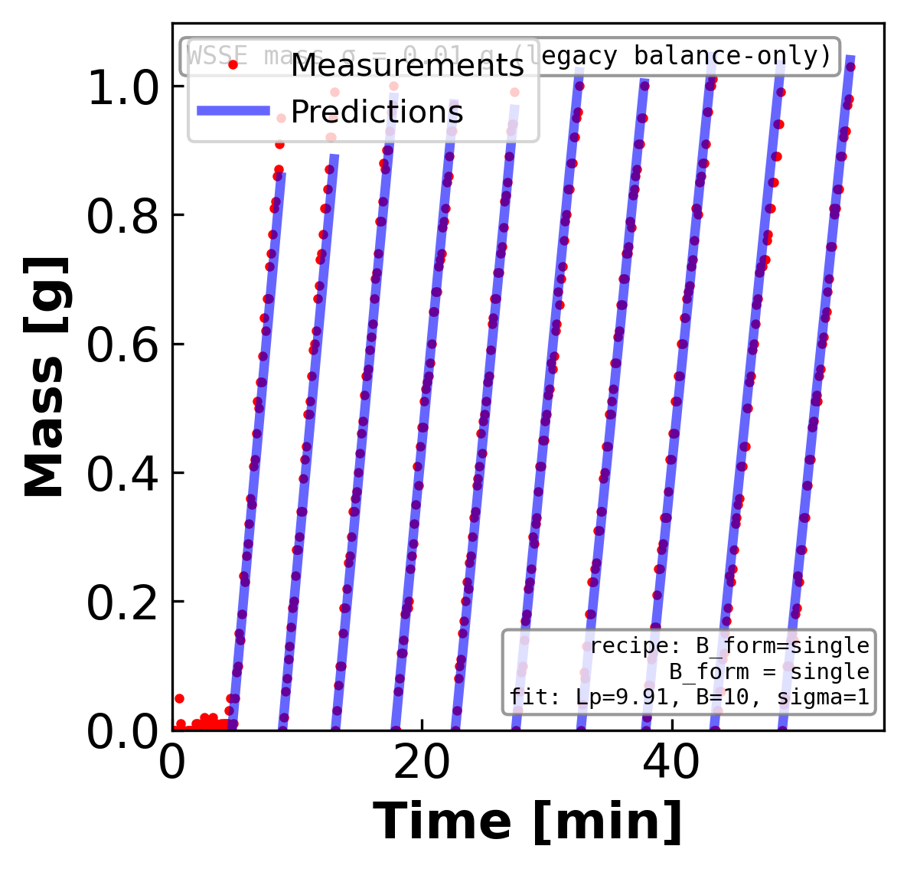
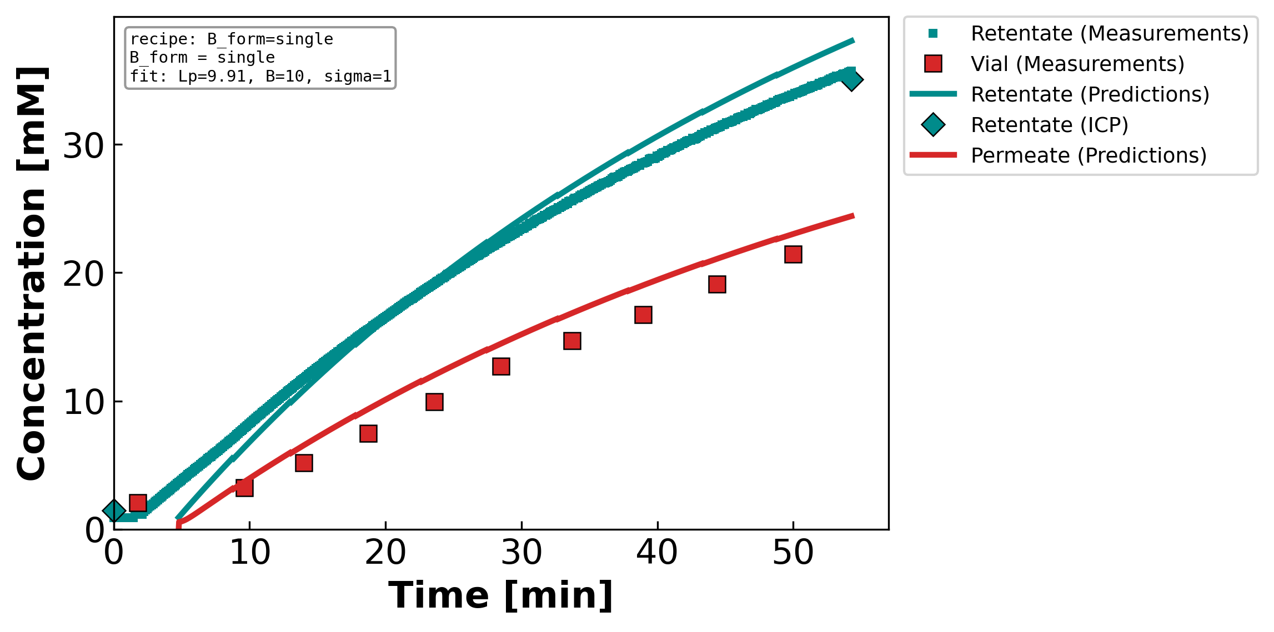
Backup — Figure 2. Measured and model-predicted time profiles for a representative…
DATA3 single-salt NF270 diafiltration · collaborator update
2026-06-24 · 4

Slide 5
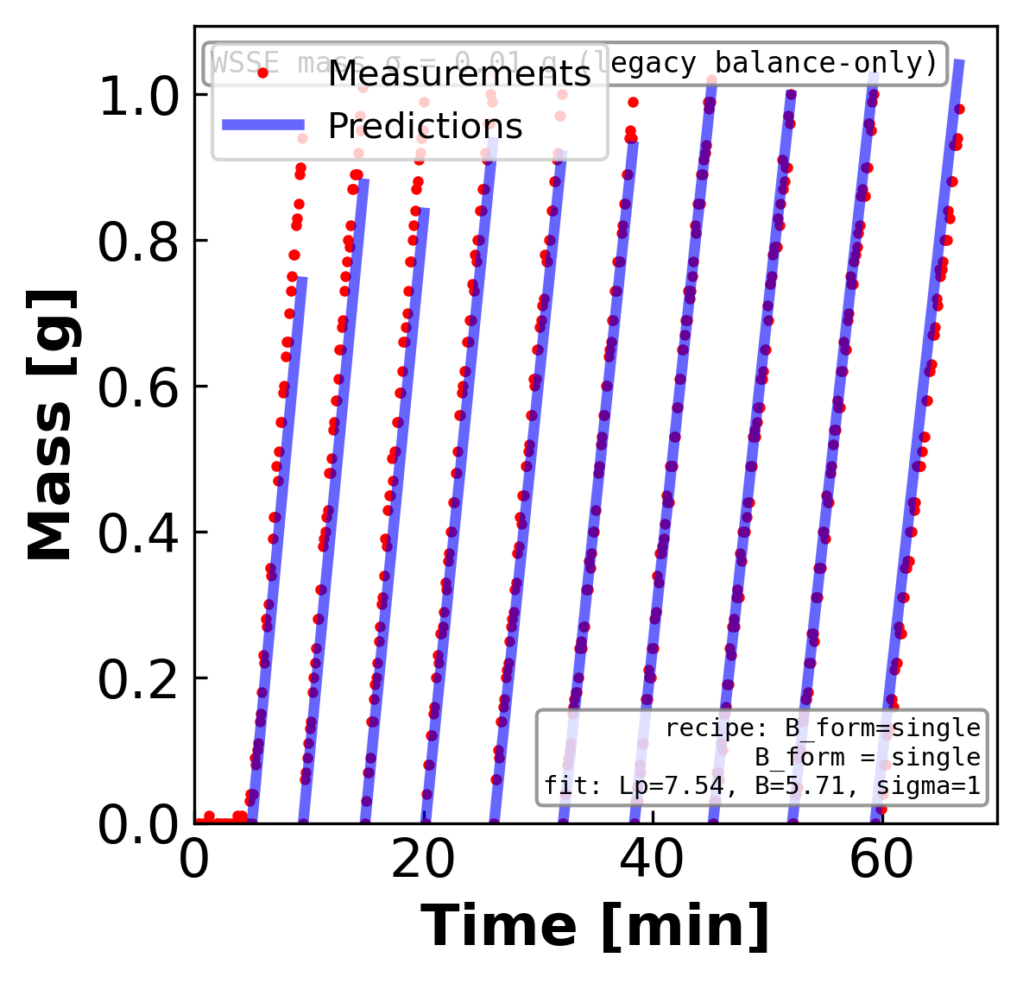
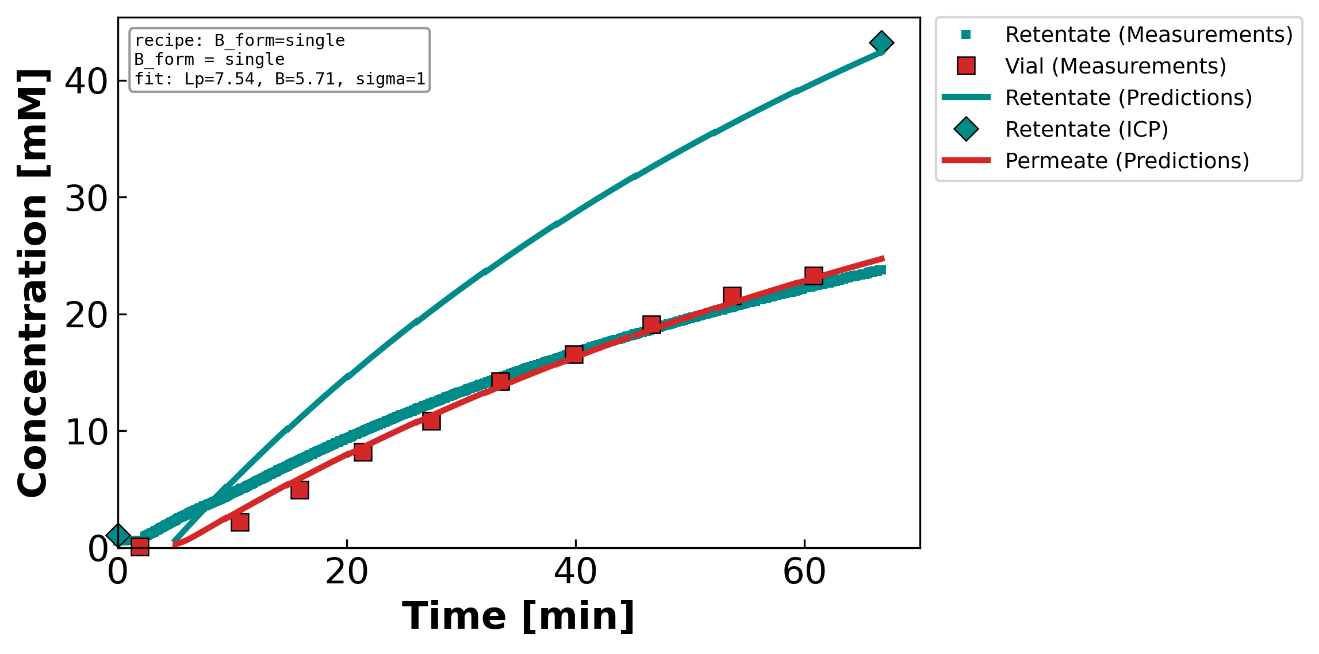
Backup — Figure 3. Measured and model-predicted time profiles for a representative…
DATA3 single-salt NF270 diafiltration · collaborator update
2026-06-24 · 5

Slide 6
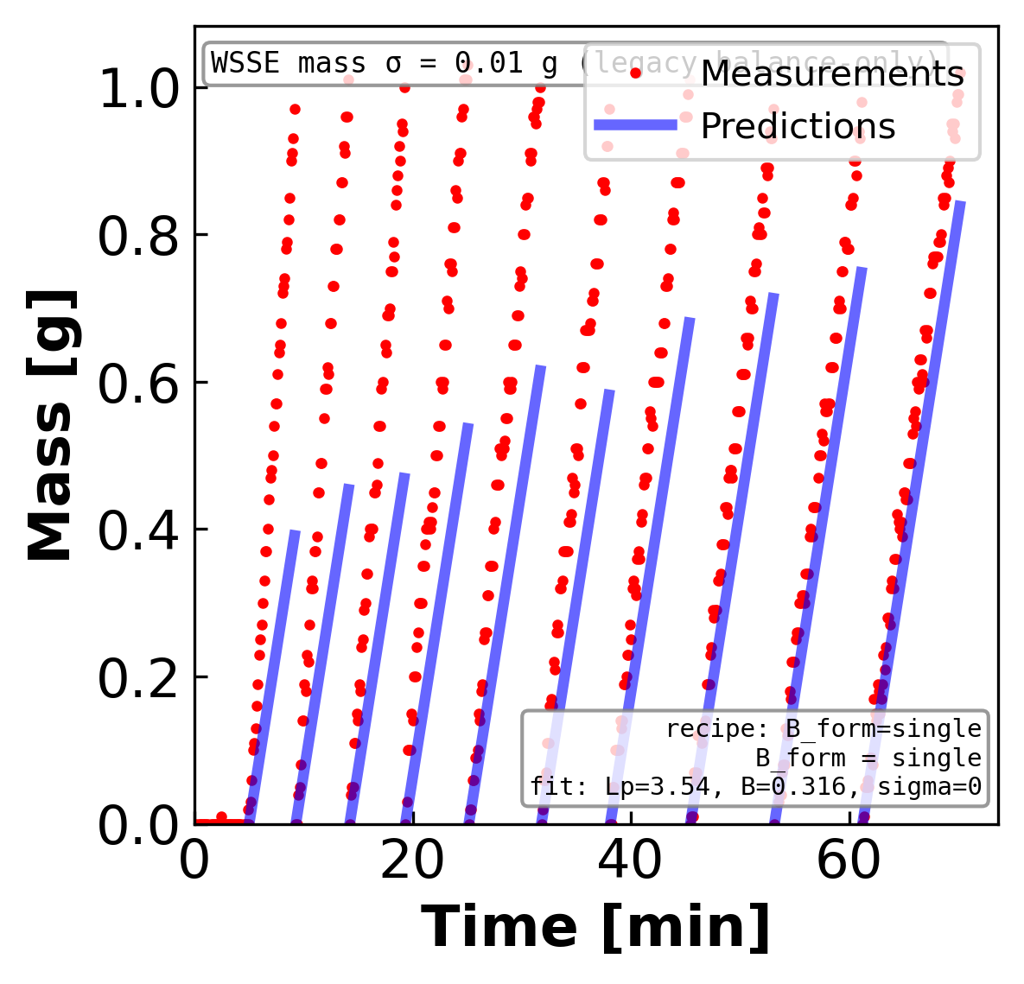
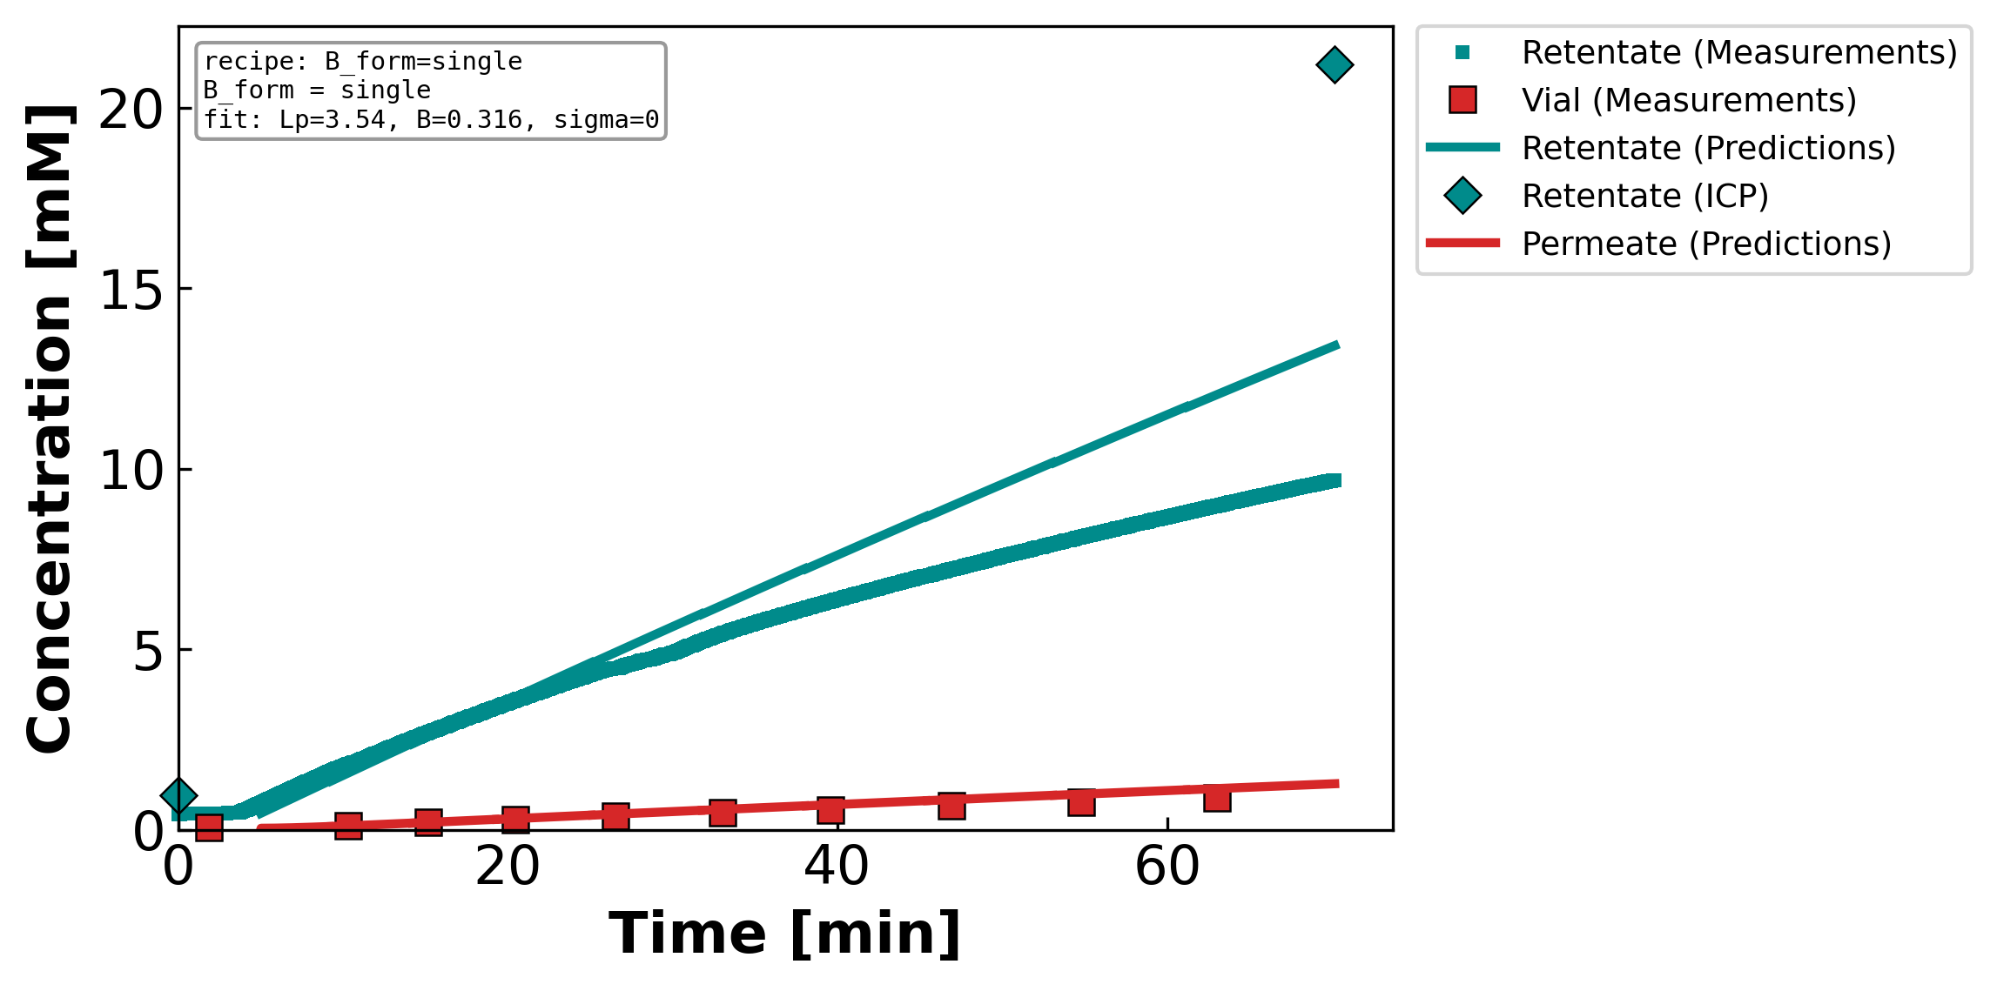
Backup — Figure 4. Measured and model-predicted time profiles for a representative…
DATA3 single-salt NF270 diafiltration · collaborator update
2026-06-24 · 6

Slide 7
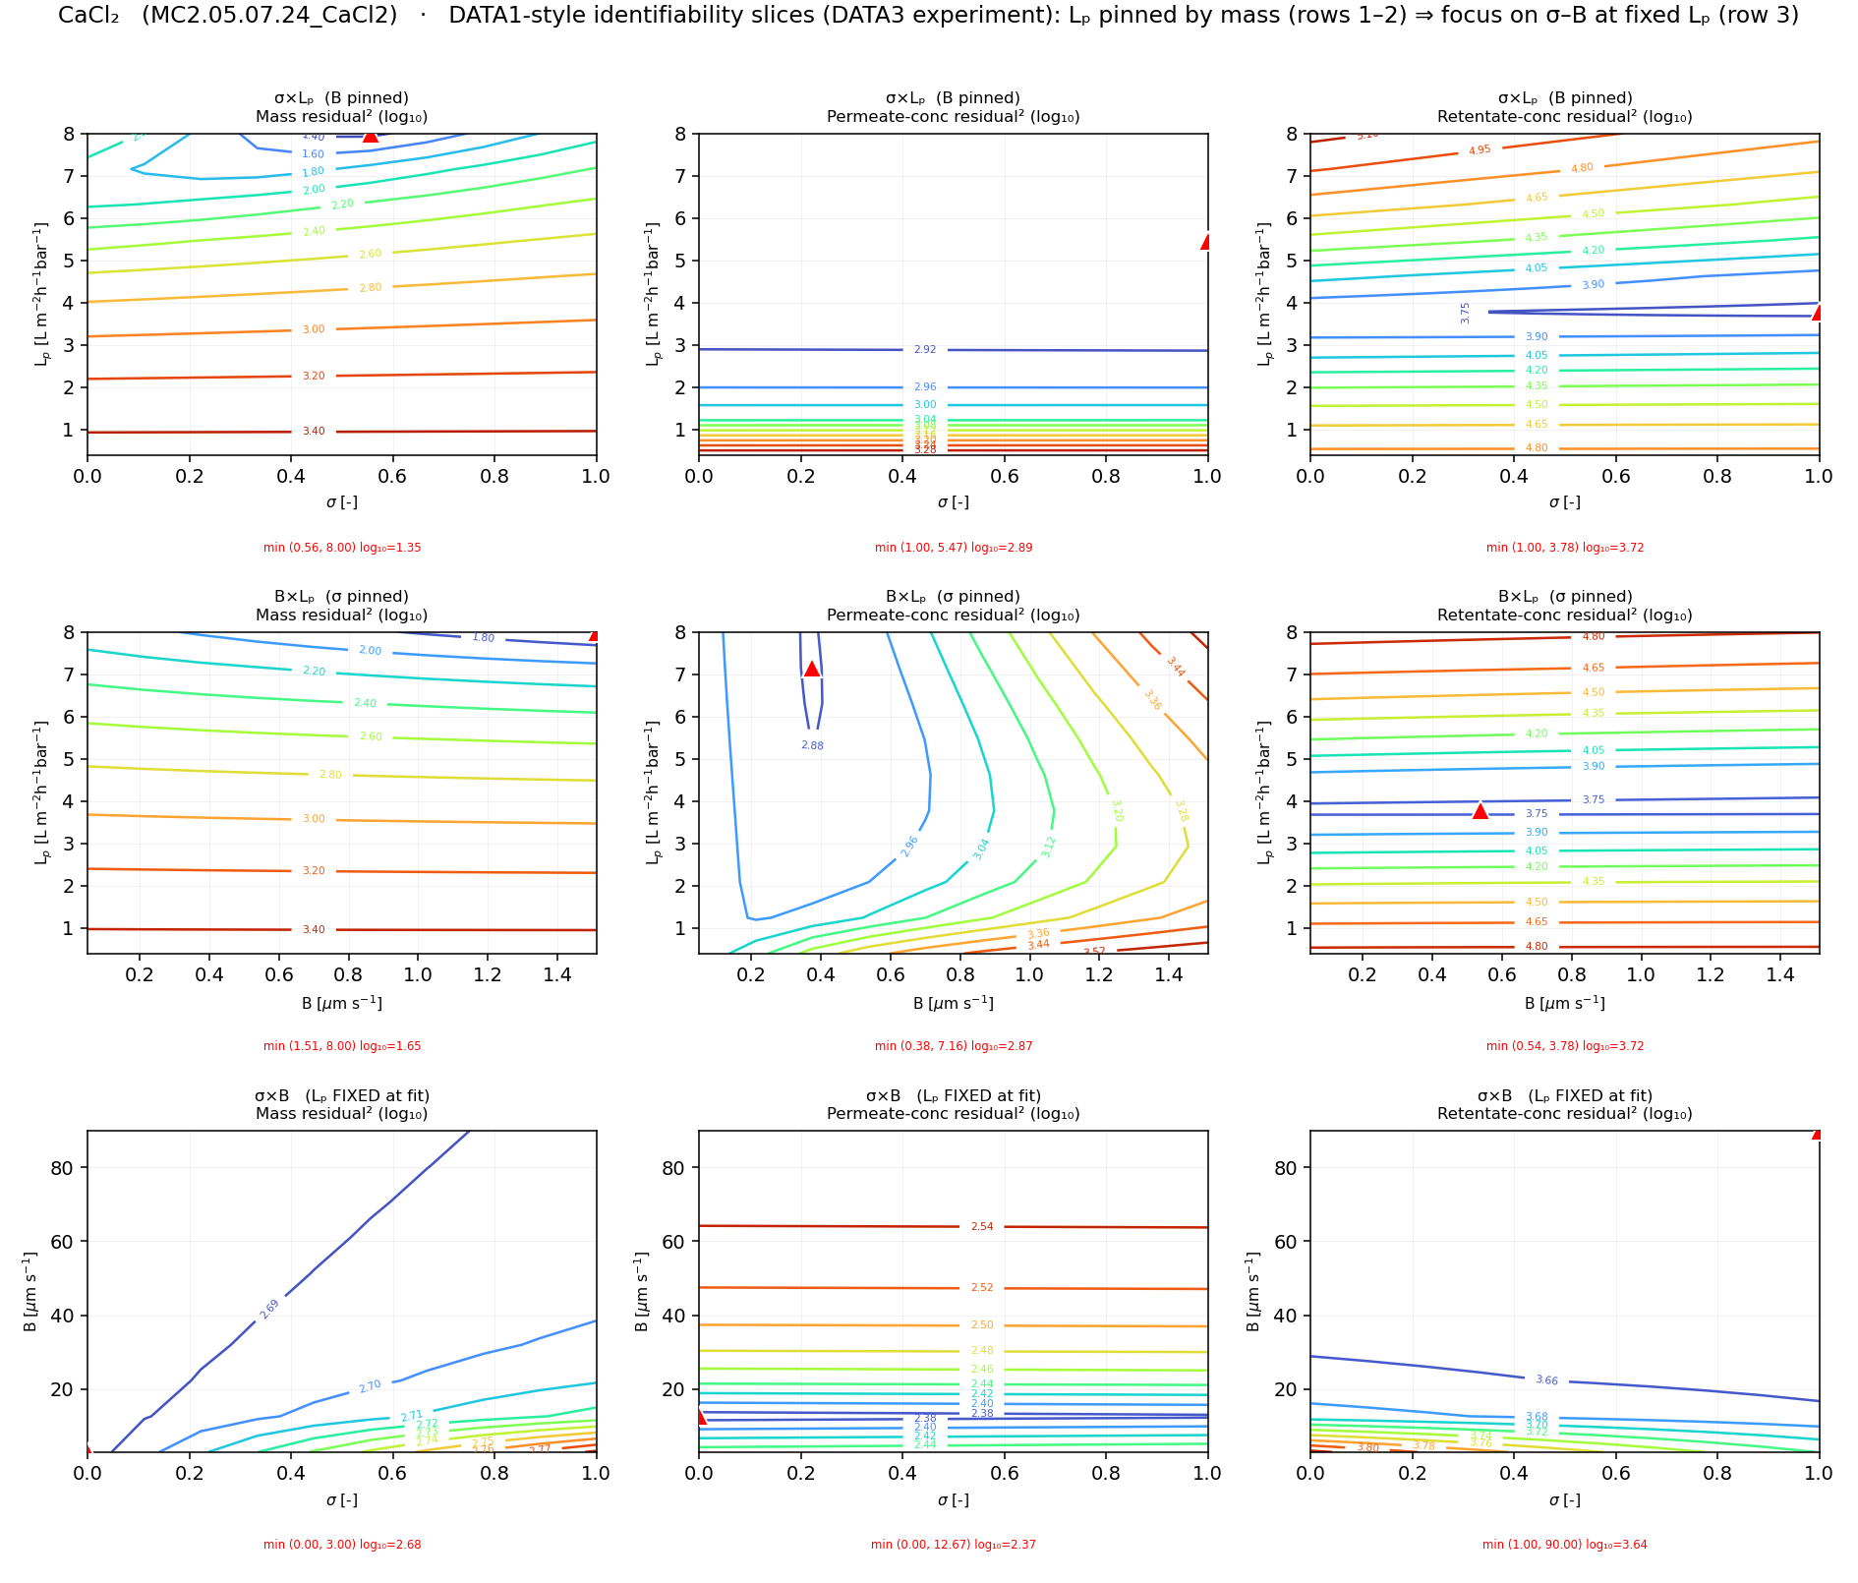
Backup — Figure 5. Log-transformed residual-squared contours for a representative…
DATA3 single-salt NF270 diafiltration · collaborator update
2026-06-24 · 7

Slide 8
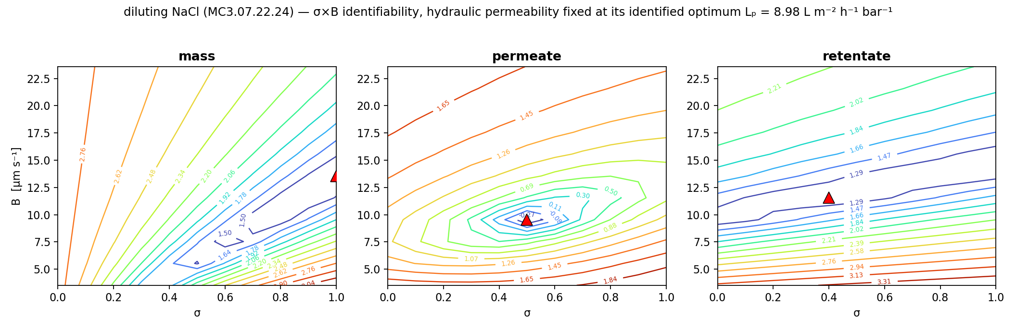
Backup — Figure 6. Identifiability of the reflection coefficient σ and the solute…
DATA3 single-salt NF270 diafiltration · collaborator update
2026-06-24 · 8

Slide 9
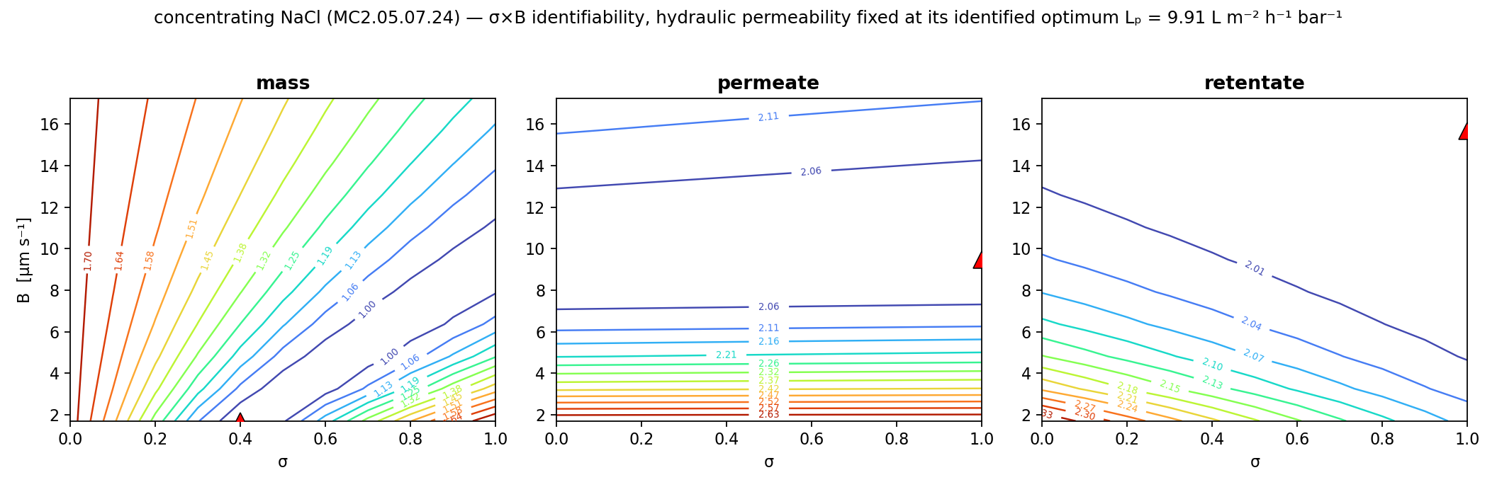
Backup — Figure 7. Identifiability of the reflection coefficient σ and the solute…
DATA3 single-salt NF270 diafiltration · collaborator update
2026-06-24 · 9

Slide 10
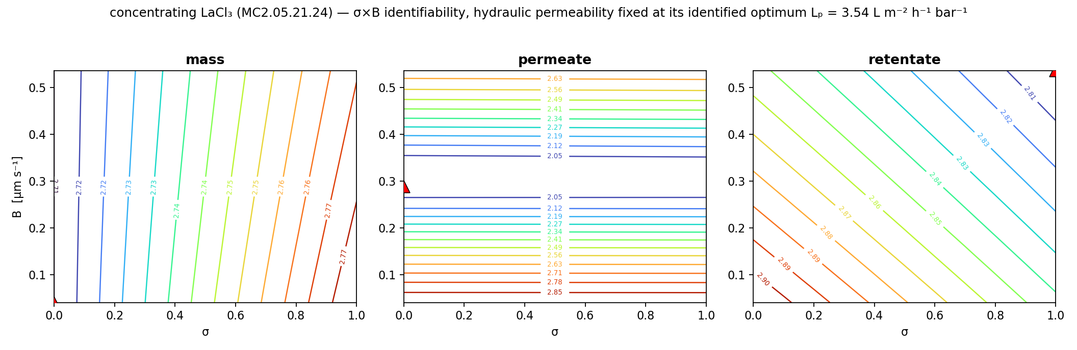
Backup — Figure 9. Identifiability of the reflection coefficient σ and the solute…
DATA3 single-salt NF270 diafiltration · collaborator update
2026-06-24 · 10

Slide 11
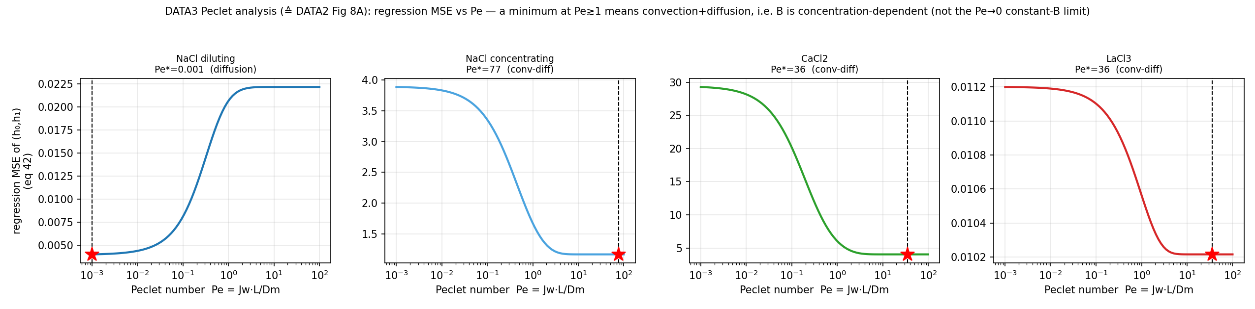
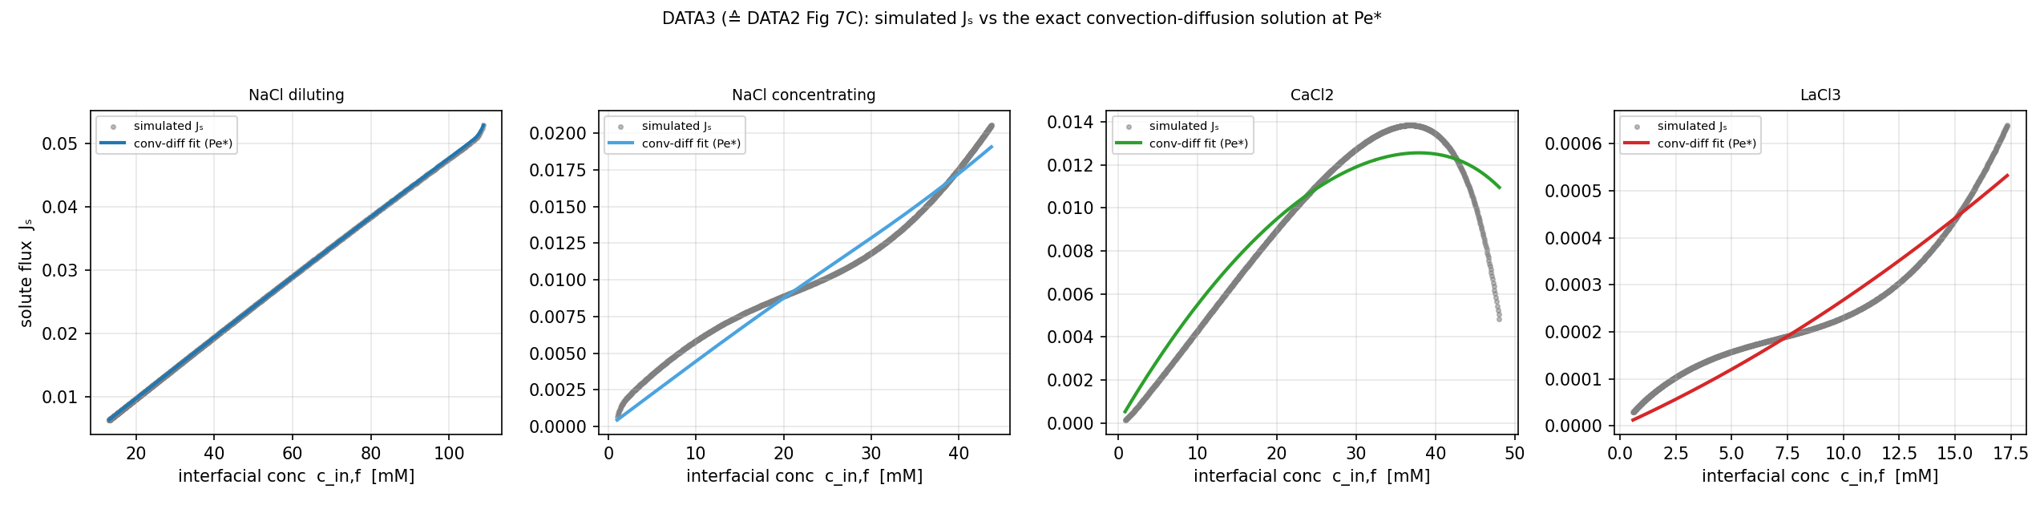
Backup — Figure 10. (Left) Mean squared error of the convection–diffusion…
DATA3 single-salt NF270 diafiltration · collaborator update
2026-06-24 · 11

Slide 12
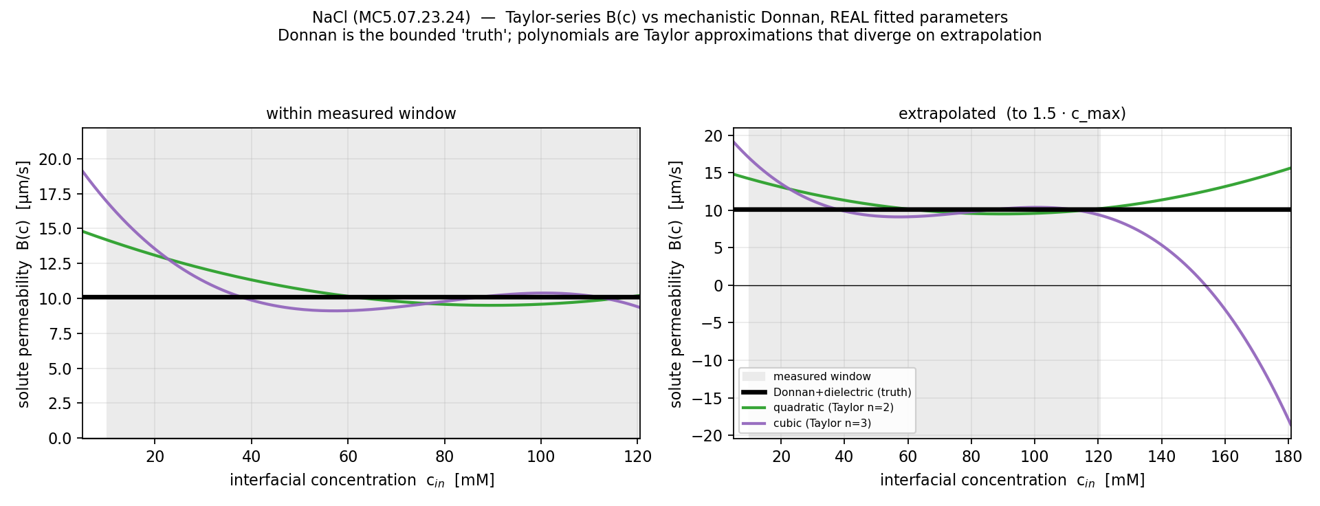
Backup — Figure 15. Solute permeability B as a function of interfacial concentration for…
DATA3 single-salt NF270 diafiltration · collaborator update
2026-06-24 · 12

Slide 13
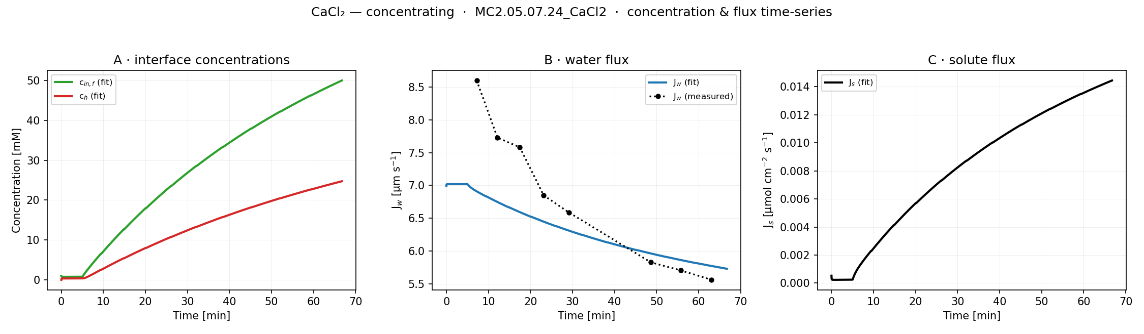
Backup — Figure 16. Forward-simulated membrane-interface concentration c_{in},f and bulk…
DATA3 single-salt NF270 diafiltration · collaborator update
2026-06-24 · 13

Slide 14
Backup — Shifting Transport Dominance (Extended Nernst–Planck)
$$J_{i}=v_{s} C_{i} K_{i,v} − D_{i} ∇C_{i} − z_{i} C_{i} D_{i} \frac{F}{RT} ∇ψ$$
Convection
Diffusion
Electromigration
Low Molarity (~0.01–0.1 M)
Moderate Molarity (~0.1–0.5 M)
High Molarity (~0.5–2+ M)
Contributions to flux (J_{i})
Contributions to flux (J_{i})
Contributions to flux (J_{i})
10%
20%
70%
20%
35%
45%
60%
30%
10%
Contribution (%)
Contribution (%)
Contribution (%)
– – – – – –
– – – – – –
– – – – – –
+
–
+
+
–
+
–
+
+
–
+
–
+
–
+
–
–
+
–
–
+
–
+
–
–
+
–
+
–
+
–
+
– – – – – –
– – – – – –
– – – – – –
Pore cross-section — fixed (–) wall charges, mobile ions (+/–), flux arrows sized by contribution; flow is Feed → Permeate (left → right)
Electromigration (dominant)
Convection (increasing)
Convection (dominant)
Diffusion (secondary)
Diffusion (comparable)
Diffusion (secondary)
Convection (minor)
Electromigration (significant)
Electromigration (minor)
ψ
Role of fixed negative charges & the Donnan potential. Negatively charged pore walls repel co-ions and attract counter-ions, creating a Donnan potential ψD that drives electromigration. At low molarity the low ionic strength magnifies ψD, making electromigration the primary driver; as molarity rises, charge screening by abundant ions shrinks ψD, so convection increasingly governs transport.
DATA3 single-salt NF270 diafiltration · collaborator update
2026-06-24 · 14

