Slide 1

DATA3: Single-Salt NF270 Diafiltration
Concentration-dependent solute permeability & the Donnan–dielectric model
Collaborator update · June 24, 2026
Keshav Kasturi Rangan · University of Notre Dame

Slide 2
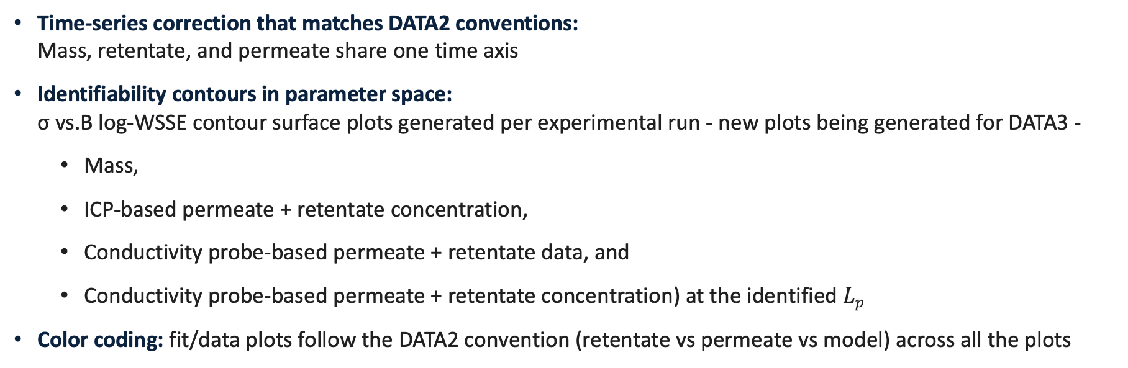
Feedback from Dowling Lab group meeting on 06/19/2026 — In Progress
Time-series correction that matches DATA2 conventions: Mass, retentate, and permeate share one time axis
Identifiability contours in parameter space: σ vs.B log-WSSE contour surface plots generated per experimental run - new plots being generated for DATA3 -
Mass,
ICP-based permeate + retentate concentration,
Conductivity probe-based permeate + retentate data, and
Conductivity probe-based permeate + retentate concentration) at the identified $Lp$
Color coding: fit/data plots follow the DATA2 convention (retentate vs permeate vs model) across all the plots
DATA3 single-salt NF270 diafiltration · collaborator update
2026-06-24 · 2

Slide 3

Topics I need help with – Overview points with plots to follow
Prioritization based on impact:
Accuracy of process model: Extended Nernst-Planck Equation $J_{i}=v_{s}⋅C_{i}⋅K_{\left(i,v\right)}−D_{i}⋅∇C_{i}−z_{i}⋅C_{i}⋅D_{i}⋅F/RT⋅∇ψ$
Interfacial concentration: what range of membrane-interface concentration do the experiments actually probe? How does this impact our correlation B with the interfacial concentration?
Peclet framing: the Peclet number and the rejection law R(σ, Pe) - Is this the right perspective?
Transport components: dielectric exclusion, cross-coefficients D_{ij}, B(c), and activity coefficients — which to include?
Identifiability: given σ is unidentified in most single-salt experiments, how far can B(c) claims go?
DATA3 single-salt NF270 diafiltration · collaborator update
2026-06-24 · 3

Slide 4
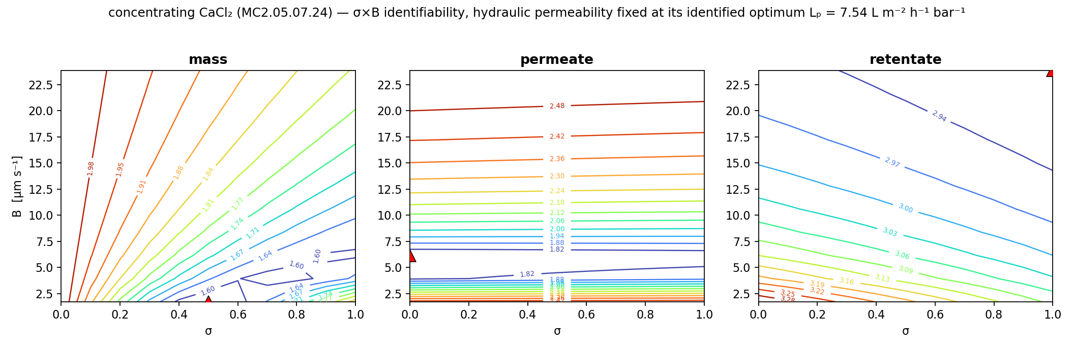
Single experiments determine B, not σ
Each response’s log-WSSE has a narrow valley in B but is nearly flat in σ (representative concentrating CaCl₂; L_{p} fixed at its identified optimum).
σ rails to its bound while B stays well-determined — the two are correlated, so one experiment cannot recover σ.
Consequence: “is B concentration-dependent?” must be posed carefully — we lean on mechanism, not fit alone.
DATA3 single-salt NF270 diafiltration · collaborator update
2026-06-24 · 4

Slide 5
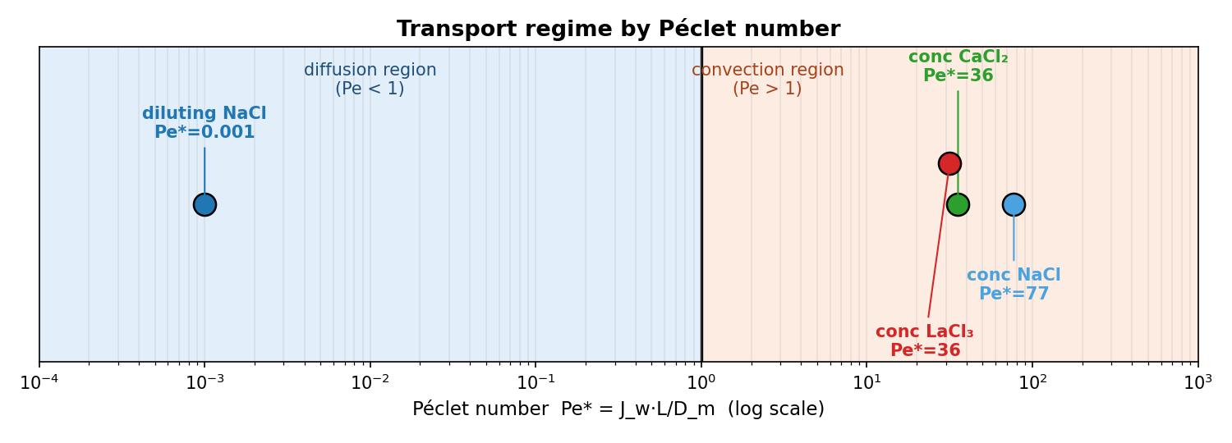
Membrane spans diffusion- and convection-limited regimes
$$Pe=\frac{\text{convection}}{\text{diffusion}}=\frac{J_{w} L}{D_{m}}$$
$$R=\frac{σ\left(1−e^{−Pe}\right)}{1−σ e^{−Pe}}$$
Diluting NaCl is diffusion-limited (Pe* ≈ 10⁻³); concentrating NaCl / CaCl₂ / LaCl₃ are convection-dominated (Pe* ≈ 77 / 36 / 36).
Mechanistic inference, not a direct demonstration: Pe and B come from the same fitted model — this motivates B(c), it does not prove it.
To tabulate for review: water flux Jw, membrane length-scale L, and diffusivity D_{m} per salt.
DATA3 single-salt NF270 diafiltration · collaborator update
2026-06-24 · 5

Slide 6
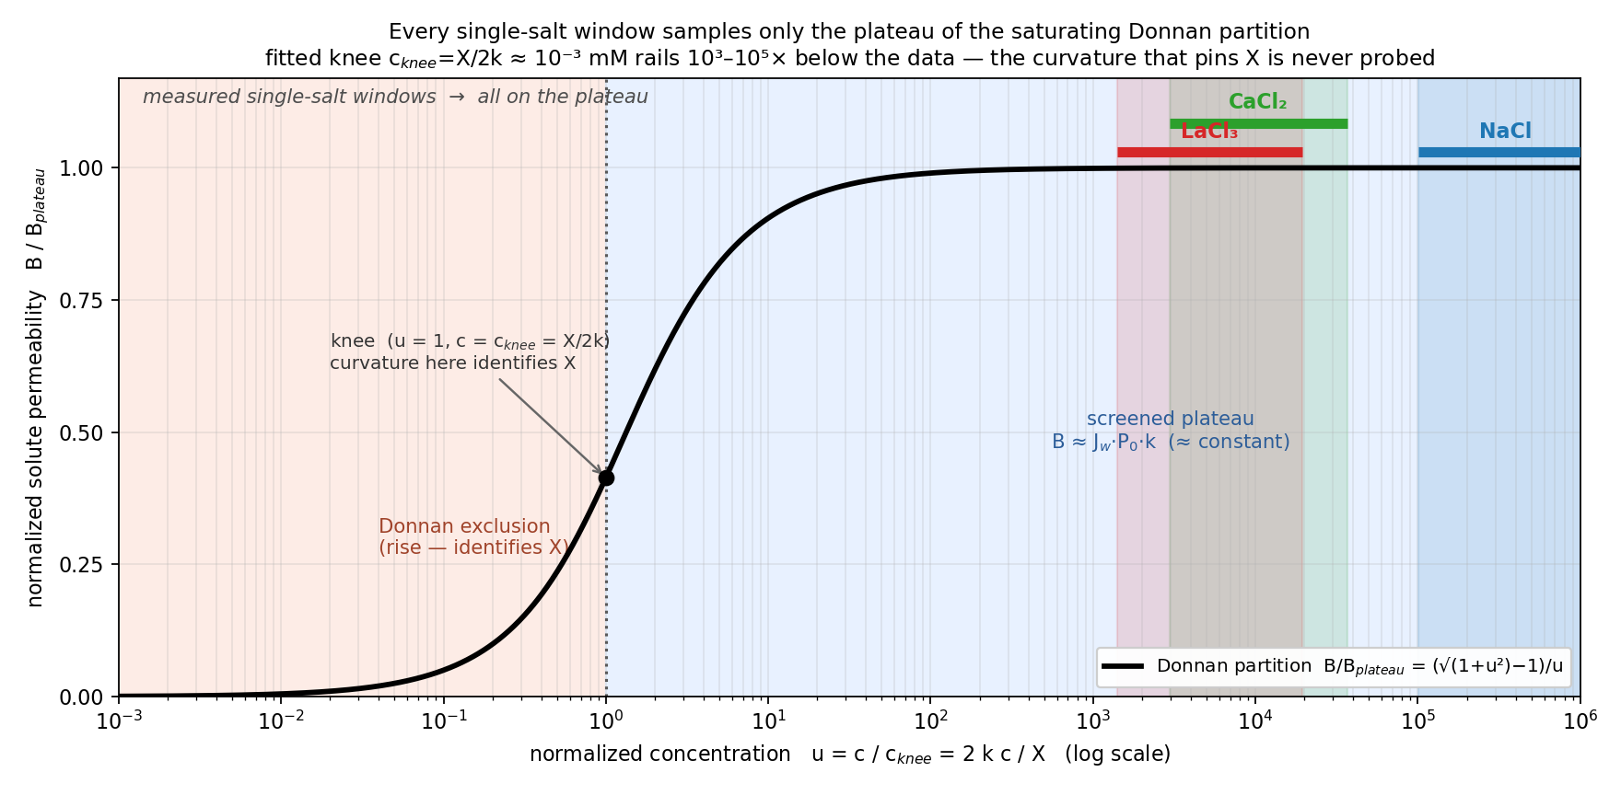
All single-salt windows sit on the Donnan plateau
$$B(c)=\frac{J_{w} P_{0}\left(−X+\sqrt{X^{2}+4k^{2}c^{2}}\right)}{2c}$$
$$B_{\text{plateau}}=J_{w}P_{0}k, c_{\text{knee}}=\frac{X}{2k}, u=\frac{c}{c_{\text{knee}}}=\frac{2kc}{X}$$
B(c) collapses onto one master curve; every measured window is at u ≈ 10³–10⁵ (screened plateau) → B is ≈ constant in-window (the screened-plateau value).
The knee c_knee = X / 2k rails 10³–10⁵× below the data → the fixed-charge scale X is not identified from one salt.
DATA3 single-salt NF270 diafiltration · collaborator update
2026-06-24 · 6

Slide 7
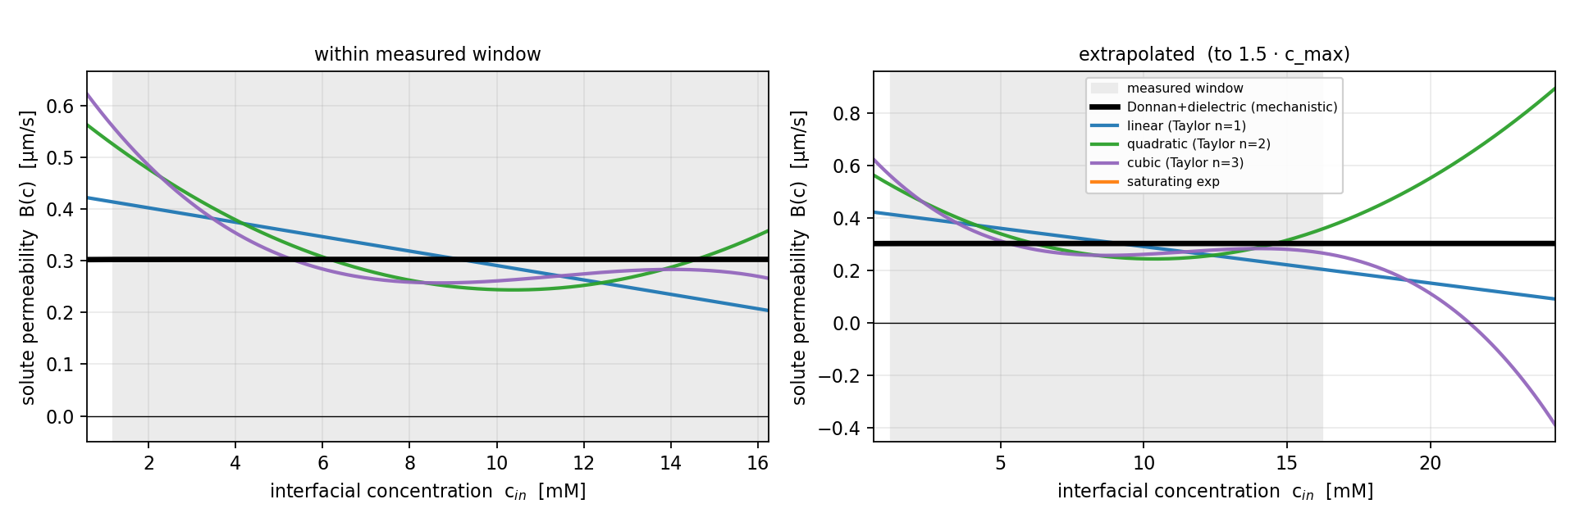
B(c): in-window agreement, out-of-window divergence — LaCl₃
$$B(c)=β_{0}+β_{1}c+β_{2}c^{2}+β_{3}c^{3}$$
$$B(c)=B_{∞}\left(1−e^{−c/c^{∗}}\right)$$
Within the measured window, constant / linear / quadratic / cubic / saturating-exp all agree (B ≈ 0.3 µm·s⁻¹).
Extrapolated, the polynomials diverge unphysically (cubic → negative); Donnan and saturating-exp stay bounded.
The Donnan–dielectric is the mechanistically-grounded, physically-bounded form — the data do not discriminate it from a constant in-window.
DATA3 single-salt NF270 diafiltration · collaborator update
2026-06-24 · 7

Slide 8
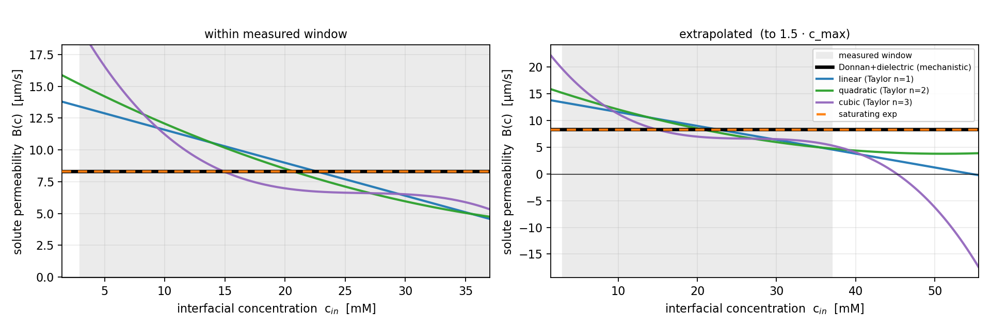
Same behavior for CaCl₂
Identical picture: in-window agreement, out-of-window polynomial divergence, Donnan bounded.
On parsimony (AIC) a constant fits as well in-window — prefer Donnan for mechanism and physical extrapolation, not in-window fit.
Next step to pin X: a joint multi-salt fit (re-parameterized by ionic strength) reaches lower u and probes the knee.
DATA3 single-salt NF270 diafiltration · collaborator update
2026-06-24 · 8

