Slide 1

DATA3: Single-Salt NF270 Diafiltration Analysis
Collaborator update · June 24, 2026
Keshav Kasturi Rangan · University of Notre Dame

Slide 2
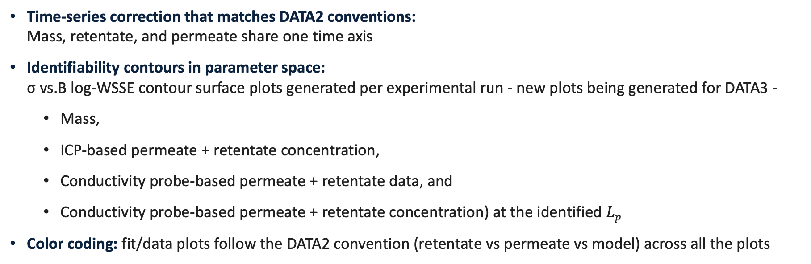
Feedback from Friday — addressed
Time-series correction that matches DATA2 conventions: Mass, retentate, and permeate share one time axis
Identifiability contours in parameter space: σ vs.B log-WSSE contour surface plots generated per experimental run - new plots being generated for DATA3 -
Mass,
ICP-based permeate + retentate concentration,
Conductivity probe-based permeate + retentate data, and
Conductivity probe-based permeate + retentate concentration) at the identified $Lp$
Color coding: fit/data plots follow the DATA2 convention (retentate vs permeate vs model) across all the plots
DATA3 single-salt NF270 diafiltration · collaborator update
2026-06-24 · 2

Slide 3
Where the optimizer landed on every sheet
↑/↓ = parameter pinned at a bound.
Sheet
Lₚ
B [µm/s]
σ
WSSE₃ch
Stage assignment
MC3 · 07.22.24 · SNaCl
8.63
14.68
0.79
560
Stage 1A · interior σ — gold standard
MC5 · 07.23.24 · S2NaCl
7.75
10.14
0.29
888
Stage 1B · diluting, σ harmless
MC4 · 07.11.24 · SNaCl
11.35
2.02
0.50
19,508
Stage 1B-ish · diluting BUT poor WSSE ⚠
MC2 · 05.07.24 · NaCl
10.45
9.73
1.00 ↑
4,528
Stage 2 · σ wall, concentrating
MC5 · 07.23.24 · NaCl
10.52
3.70
0.79
7,024
Stage 2 · σ wall, concentrating
MC5 · 07.23.24 · SNaCl
8.64
3.07
0.57
5,870
Stage 2 · σ wall, concentrating
MC2 · 05.07.24 · CaCl₂
8.00
0.51
0.50
97,213
Stage 2 · channels split by side
MC3 · 07.11.24 · SCaCl₂
6.56
9.11
1.00 ↑
6,139
Stage 2 · σ at wall
MC3 · 07.12.24 · S2CaCl₂
5.49
30.00 ↑
1.00 ↑
9,774
Stage 2 · σ AND B at walls
MC2 · 05.21.24 · LaCl₃
2.95
0.31
0.00 ↓
21,500
Stage 3 · wrong model — all channels disagree
MC4 · 07.11.24 · SLaCl₃
5.55
0.17
0.93
75,080
Stage 3 · wrong model — replicate
DATA3 single-salt NF270 diafiltration · collaborator update
16 / 42

Slide 4

Topics I need help with
Prioritization based on impact:
Accuracy of process model: Extended Nernst-Planck Equation $J_{i}=v_{s}⋅C_{i}⋅K_{\left(i,v\right)}−D_{i}⋅∇C_{i}−z_{i}⋅C_{i}⋅D_{i}⋅F/RT⋅∇ψ$
Interfacial concentration (supported by plots): What range of membrane-interface concentration do the experiments actually probe? How does this impact our correlation B with the interfacial concentration?
Peclet framing (supported by plots): The Peclet number and the rejection law R(σ, Pe) - Is this the right perspective?
Transport components yet to be modeled: cross-coefficients D_{ij}, B(c), and activity coefficients — which to include?
Péclet framing: the Péclet number and the rejection law R(σ, Pe) — is this the right lens?
Transport components: dielectric exclusion, cross-coefficients D_{ij}, B(c), and activity coefficients — which to include?
Identifiability: given σ is unidentified single-experiment, how far can B(c) claims go?
DATA3 single-salt NF270 diafiltration · collaborator update
2026-06-24 · 3

Slide 5
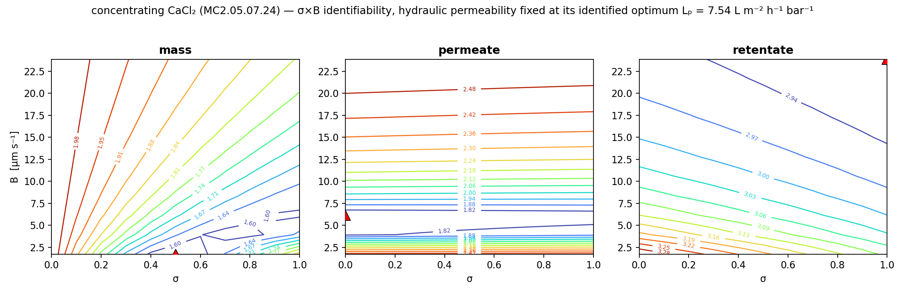
Single experiments determine B, not σ
Each response’s log-WSSE has a narrow valley in B but is nearly flat in σ (representative concentrating CaCl₂; L_{p} fixed at its identified optimum).
σ rails to its bound while B stays well-determined — the two are correlated, so one experiment cannot recover σ.
Consequence: “is B concentration-dependent?” must be posed carefully — we lean on mechanism, not fit alone.
DATA3 single-salt NF270 diafiltration · collaborator update
2026-06-24 · 4

Slide 6
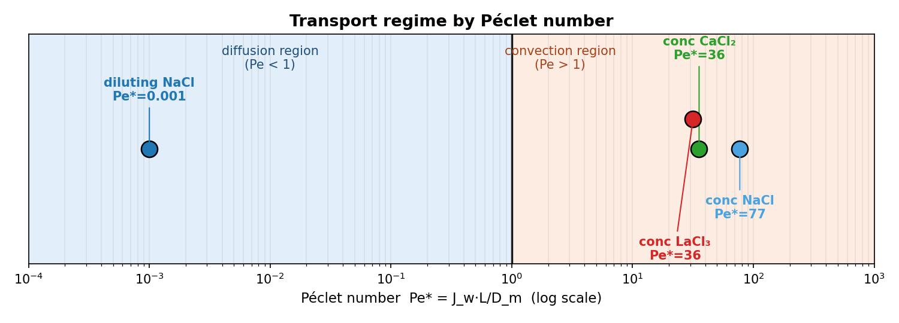
The same membrane spans diffusion- and convection-limited regimes
$$Pe=\frac{\text{convection}}{\text{diffusion}}=\frac{J_{w} L}{D_{m}}$$
$$R=\frac{σ\left(1−e^{−Pe}\right)}{1−σ e^{−Pe}}$$
Plotted Pe* = the regression-optimal Péclet per experiment (argmin over Pe of the convection–diffusion partition-fit MSE) - NOT Jw·L/Dm evaluated directly. where Pe — Péclet number; Jw — water flux; L — membrane thickness; Dm — solute diffusivity; R — salt rejection; σ — reflection coefficient (0–1).
Diluting NaCl is diffusion-limited (Pe* ≈ 10⁻³); concentrating NaCl / CaCl₂ / LaCl₃ are convection-dominated (Pe* ≈ 77 / 36 / 36).
Mechanistic inference, not a direct demonstration: Pe and B come from the same fitted model — this motivates B(c), it does not prove it.
To tabulate for review: water flux Jw, membrane length-scale L, and diffusivity D_{m} per salt.
Refs — Pe = JwL/Dm: DATA2, Liu et al., Ind. Eng. Chem. Res. 64 (2025) 12111 (eq 25); Spiegler–Kedem rejection: Spiegler & Kedem, Desalination 1 (1966) 311; solution-diffusion (Lp, B, σ): Kedem & Katchalsky, Biochim. Biophys. Acta 27 (1958) 229
DATA3 single-salt NF270 diafiltration · collaborator update
2026-06-24 · 5

Slide 7
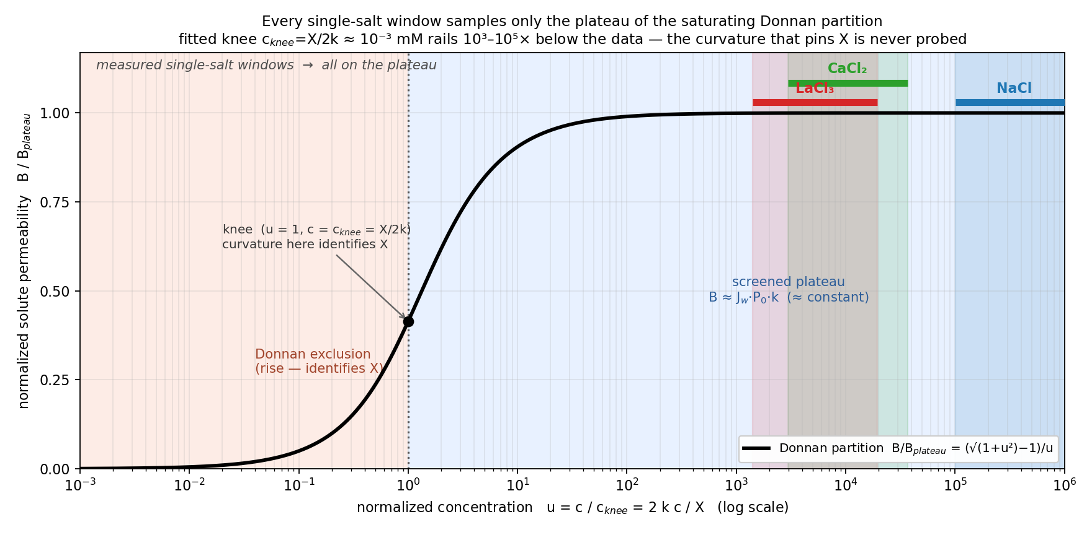
All single-salt windows sit on the Donnan plateau
$$B(c)=\frac{J_{w} P_{0}\left(−X+\sqrt{X^{2}+4k^{2}c^{2}}\right)}{2c}$$
$$B_{\text{plateau}}=J_{w}P_{0}k, c_{\text{knee}}=\frac{X}{2k}, u=\frac{c}{c_{\text{knee}}}=\frac{2kc}{X}$$
where B(c) — solute permeability at interfacial concentration c; c — membrane-interface salt concentration; Jw — water flux; P₀ — intrinsic permeability prefactor; X — effective membrane fixed-charge density; k — lumped Donnan–dielectric partition factor; B_plateau — high-c plateau value; c_knee = X/2k — regime knee; u = c/c_knee — screening parameter.
B(c) collapses onto one master curve; every measured window is at u ≈ 10³–10⁵ (screened plateau) → B is ≈ constant in-window (the screened-plateau value).
The knee c_knee = X / 2k rails 10³–10⁵× below the data → the fixed-charge scale X is not identified from one salt.
Refs — Donnan–dielectric B(c): Yaroshchuk, Adv. Colloid Interface Sci. 85 (2000) 193; Bandini & Vezzani, Chem. Eng. Sci. 58 (2003) 3303 (DSPM-DE); Donnan-equilibrium partition cf. Bolt, J. Colloid Sci. 10 (1955) 206 (as in DATA2).
DATA3 single-salt NF270 diafiltration · collaborator update
2026-06-24 · 6
Notes:
The feed-side interfacial concentration c_in,f starts at the initial feed concentration (tens of mM) and is pushed higher still by concentration polarization: c_in,f = (c_F − c_h)·e^(J_w/k) + c_h ≥ c_h. At t = 0 the stirred cell already sits at feed concentration, so c_in,f is nonzero from the first instant (and for a diluting run it starts high and falls).

Slide 8
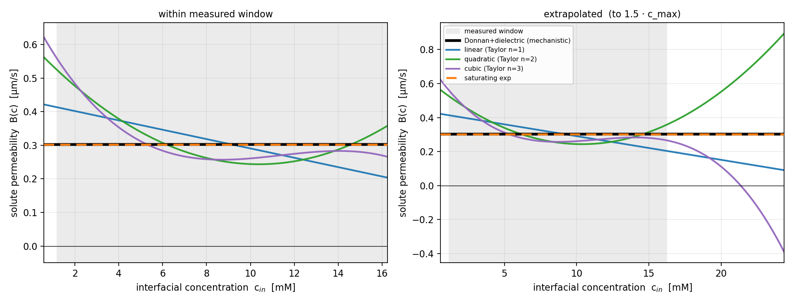
B(c): in-window agreement, out-of-window divergence — LaCl₃
$$B(c)=β_{0}+β_{1}c+β_{2}c^{2}+β_{3}c^{3}$$
$$B(c)=B_{∞}\left(1−e^{−c/c^{∗}}\right)$$
where B(c) — solute permeability; c — interfacial concentration; β₀–β₃ — polynomial (Taylor) expansion coefficients; B∞ — saturating permeability as c → ∞; c* — characteristic saturation concentration.
Within the measured window, constant / linear / quadratic / cubic / saturating-exp all agree (B ≈ 0.3 µm·s⁻¹).
Extrapolated, the polynomials diverge unphysically (cubic → negative); Donnan and saturating-exp stay bounded.
The Donnan–dielectric is the mechanistically-grounded, physically-bounded form — the data do not discriminate it from a constant in-window.
Refs — empirical B(c): polynomial (multiplicative) form per DATA2, Liu et al., Ind. Eng. Chem. Res. 64 (2025) 12111 (eq 31); saturating-exp & Donnan-bounded forms: this work (DATA3).
DATA3 single-salt NF270 diafiltration · collaborator update
2026-06-24 · 7

Slide 9
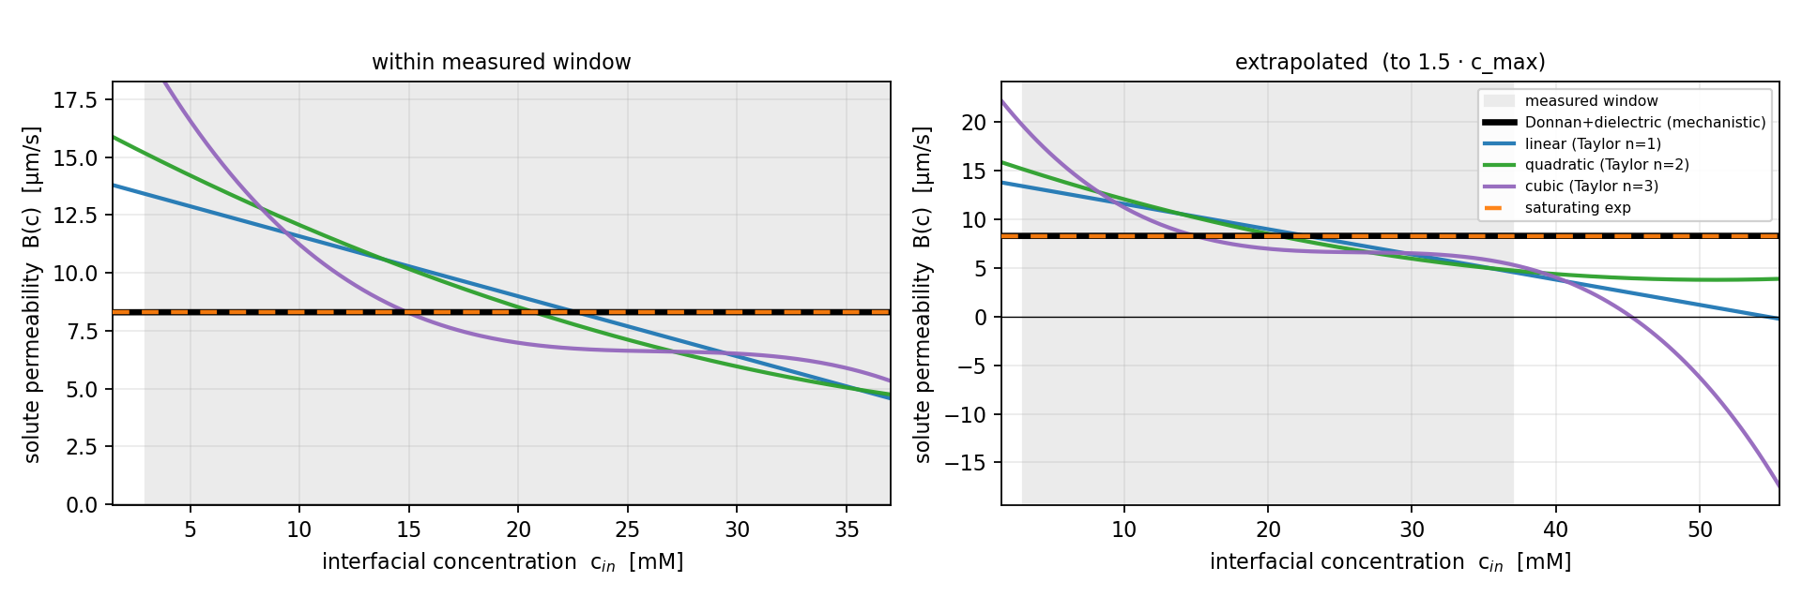
Same behavior for CaCl₂
Identical picture: in-window agreement, out-of-window polynomial divergence, Donnan bounded.
On parsimony (AIC) a constant fits as well in-window — prefer Donnan for mechanism and physical extrapolation, not in-window fit.
Next step to pin X: a joint multi-salt fit (re-parameterized by ionic strength) reaches lower u and probes the knee.
DATA3 single-salt NF270 diafiltration · collaborator update
2026-06-24 · 8

Slide 10
Backup Slides

Slide 11
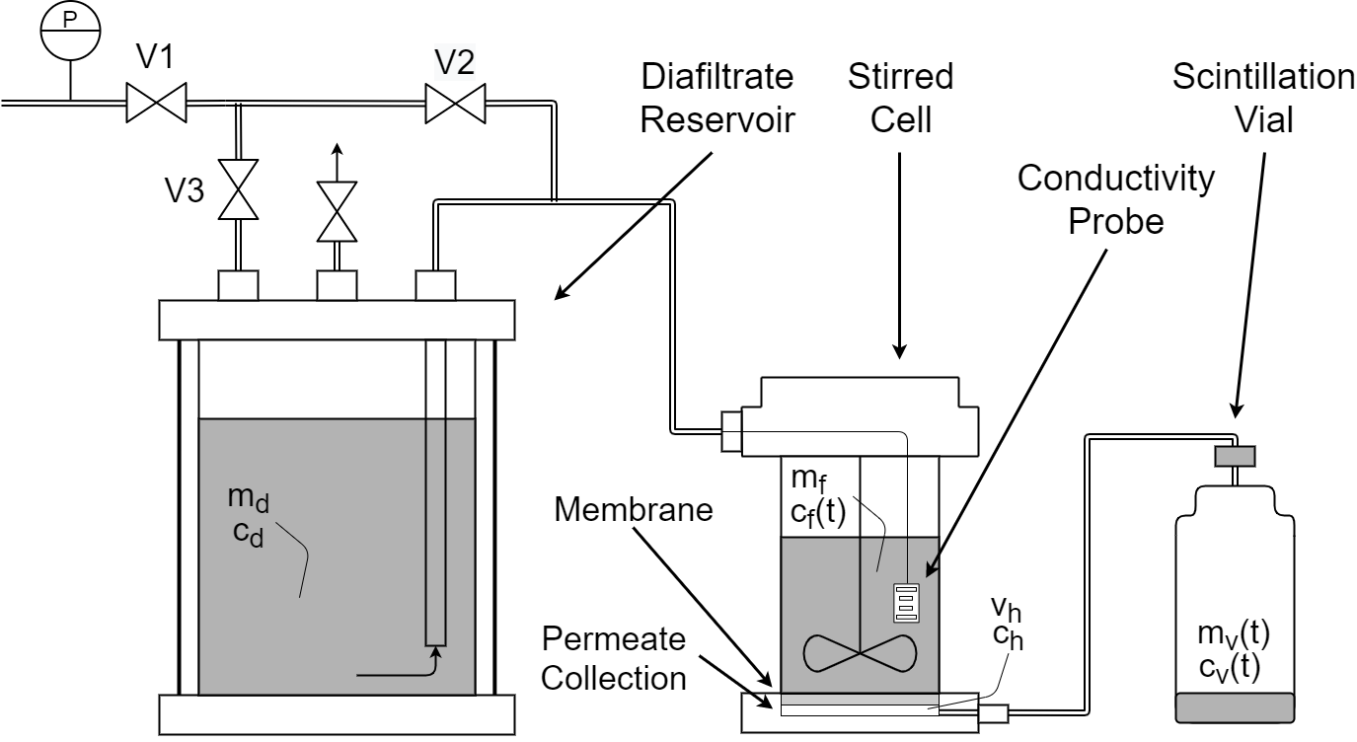
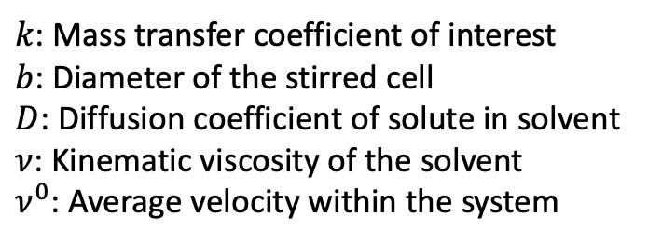
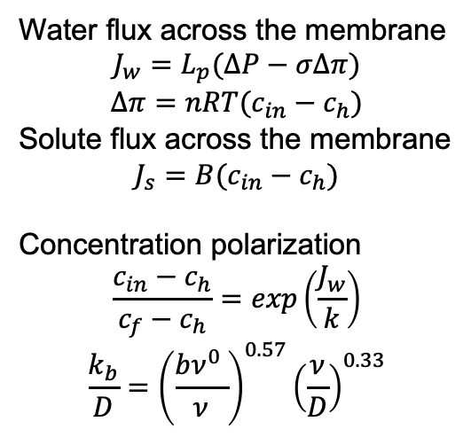
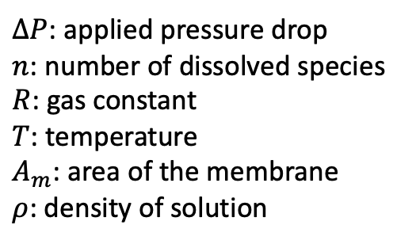
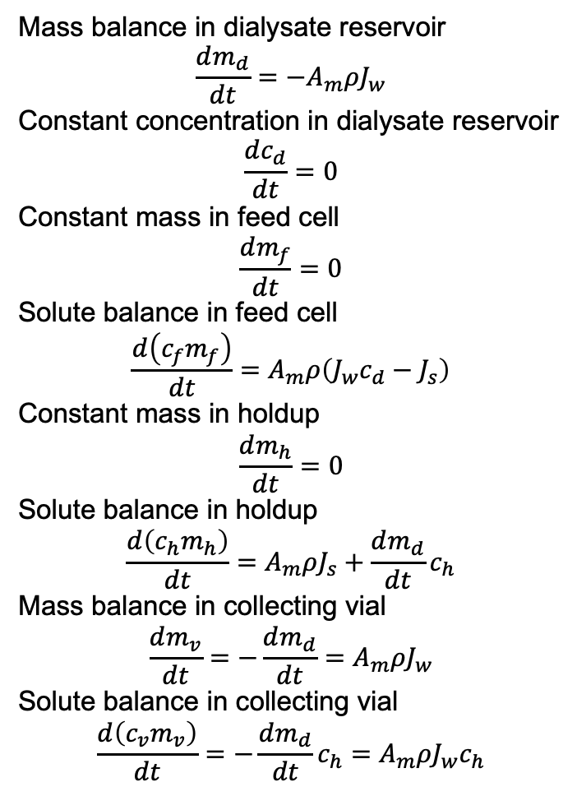
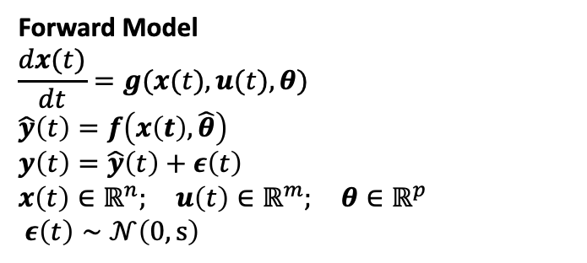
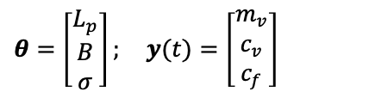
Physics-Based Model Links Data to Transport Parameters
Forward Model
$$\frac{dx(t)}{dt}=g(x(t),u(t),θ) \\ \hat{y}\left(t\right)=f\left(x\left(t\right),\hat{θ}\right)$$ $y\left(t\right)=\hat{y}\left(t\right)+ε\left(t\right)$ $$x\left(t\right)∈ℝ^{n}; u\left(t\right)∈ℝ^{m}; θ∈ℝ^{p} \\ ε\left(t\right)∼𝒩\left(0,s\right)$$
Mass balance in dialysate reservoir
$$\frac{dm_{d}}{dt}=−A_{m}ρJ_{w}$$
Constant concentration in dialysate reservoir
$$\frac{dc_{d}}{dt}=0$$
Constant mass in feed cell
$$\frac{dm_{f}}{dt}=0$$
Solute balance in feed cell
$$\frac{d\left(c_{f}m_{f}\right)}{dt}=A_{m}ρ\left({J_{w}c}_{d}−J_{s}\right)$$
Constant mass in holdup
$$\frac{dm_{h}}{dt}=0$$
Solute balance in holdup
$$\frac{d\left(c_{h}m_{h}\right)}{dt}=A_{m}ρJ_{s}+\frac{dm_{d}}{dt}c_{h}$$
Mass balance in collecting vial
$$\frac{dm_{v}}{dt}=−\frac{dm_{d}}{dt}=A_{m}ρJ_{w}$$
Solute balance in collecting vial
$$\frac{d\left(c_{v}m_{v}\right)}{dt}=−\frac{dm_{d}}{dt}c_{h}=A_{m}ρJ_{w}c_{h}$$
$$θ=\left[\begin{aligned}L_{p} \\ B \\ σ\end{aligned}\right]; y(t)=\left[\begin{aligned}m_{v} \\ c_{v} \\ c_{f}\end{aligned}\right]$$
$ΔP$: applied pressure drop
$n$: number of dissolved species
$R$: gas constant
$T$: temperature
$A_{m}$: area of the membrane
$ρ$: density of solution
Water flux across the membrane
$$J_{w}=L_{p}(ΔP−σΔπ)$$
$$Δπ=nRT(c_{in}−c_{h})$$
Solute flux across the membrane
$$J_{s}=B(c_{in}−c_{h})$$
Concentration polarization
$$\frac{c_{in}−c_{h}}{c_{f}−c_{h}}=exp\left(\frac{J_{w}}{k}\right)$$
$$\frac{k_{b}}{D}={\left(\frac{bν^{0} }{ν}\right)}^{0.57}{\left(\frac{ν}{D}\right)}^{0.33}$$
$k$: Mass transfer coefficient of interest
$b$: Diameter of the stirred cell
$D$: Diffusion coefficient of solute in solvent
$ν$: Kinematic viscosity of the solvent
$ν^{0}$: Average velocity within the system
[Fig.] Ouimet, J. A. et. al., (2022). Journal of Membrane Science, 641, 119743.
Notes:
Say:
“To connect the data to parameters, we use a physics-based lumped parameter model.”
— Left side (forward model)
Say:
“We describe the system dynamics using a state-space model, where the outputs depend on unknown transport parameters.”
— Parameter vector (IMPORTANT)
θ=[Lp, B, σ]
Say:
“The key parameters we estimate are:
hydraulic permeability Lp
solute permeability B
reflection coefficient σ”
— Center (transport physics)
:point_right: Point to flux equations:
Say:
“These parameters enter through standard transport relations for water flux and solute flux across the membrane.”
— Right side (balances)
:point_right: Gesture broadly to right column (DO NOT trace equations)
Say:
“These fluxes are coupled with dynamic mass balances to describe the full system behavior.”
Final transition (look at audience)
Say:
“So this model maps experimental trajectories to parameters.”
“The question is: how well can we estimate these parameters from different experiments?”

Slide 12
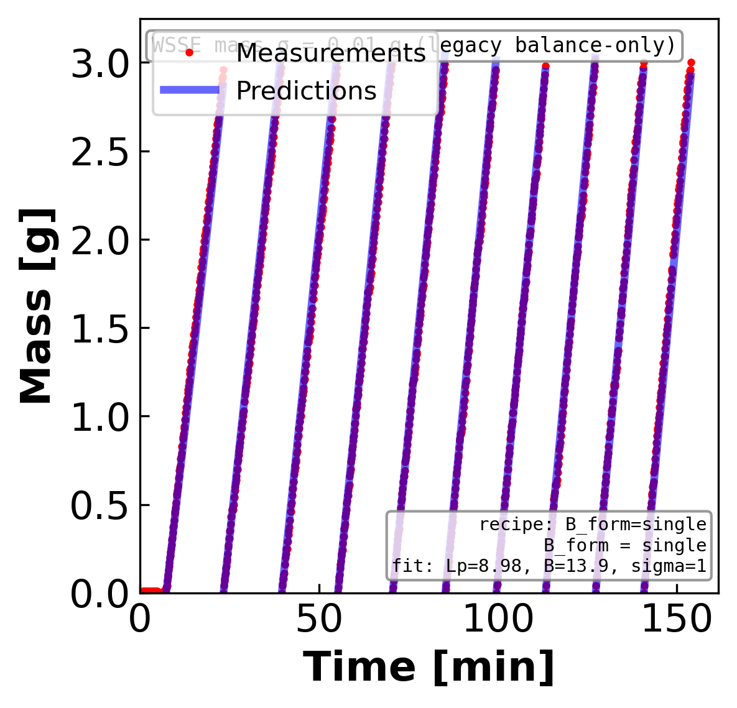
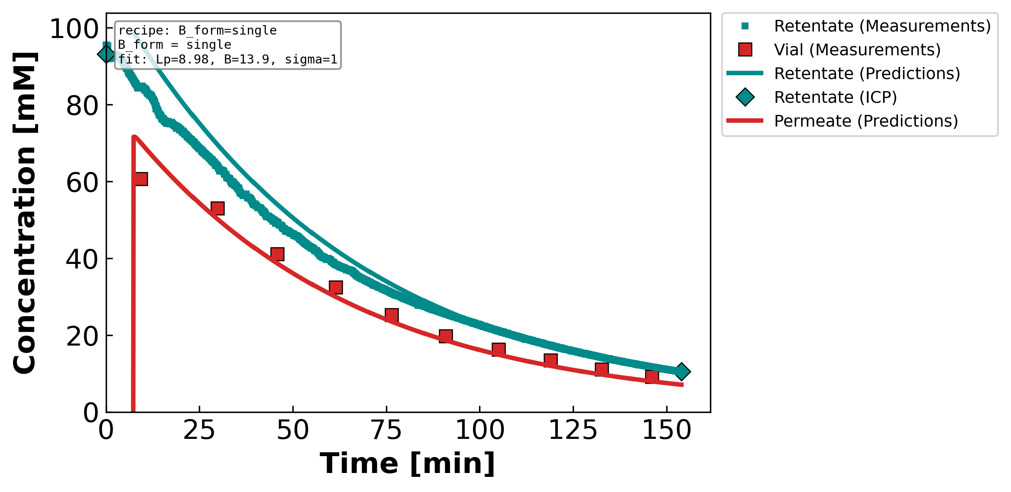
Figure 1. Measured and model-predicted time profiles for a representative diluting NaCl diafiltration experiment. (Left) total retentate mass and (right) solute concentration in the retentate and permeate streams versus time; symbols are measurements — the retentate inductively-coupled-plasma (ICP) reference points and the time-resolved permeate vial samples — and the curves are the lumped-parameter model evaluated at the fitted parameters reported in the inset (Lₚ = 8.98 L m⁻² h⁻¹ bar⁻¹, B = 13.88 µm s⁻¹, σ = 1). A single concentration-independent solute permeability reproduces the mass decline and both concentration histories, with the retentate and permeate plotted in distinct colors; the reflection coefficient is forced to its upper bound (σ = 1).
Notes:
FIT CHECK — diluting NaCl. Does the model reproduce the experiment?
What it shows: lines = model, symbols = measurements. LEFT = retentate mass vs time; RIGHT = concentration vs time (TEAL = retentate, RED = permeate; teal diamonds = retentate ICP at start & end).
Simple steps: (1) choose Lp, σ, B; (2) march the equations forward in time; (3) overlay on the data. The inset box reports the best-fit values.
Coffee-filter example: as water is pushed out, the cup (retentate) gets saltier and lighter while the drips (permeate) carry a little salt.
Core model (3 fitted parameters Lp, σ, B):
Water flux Jw = Lp·(ΔP − σ·Δπ) [net push = applied − osmotic back-push]
Osmotic Δπ = i·R·T·(cF − cP) [i = ions/molecule: NaCl 2, CaCl₂ 3, LaCl₃ 4]
Salt flux Js = B·(cF − cP) + (1−σ)·Jw·c̄ [diffusion term + convection term]
Mass balance dM/dt = −ρ·A·Jw [retentate lightens as permeate leaves]
This run: Lp = 8.98, B = 13.88 µm/s, σ = 1 (σ forced to its upper bound).
Running picture — squeezing salty water through a coffee filter:
• Lp = how EASILY water passes (bigger Lp → more water per push)
• σ = how well the filter BLOCKS salt by osmosis (σ=1 blocks all, σ=0 lets salt ride along)
• B = how much salt LEAKS through by diffusion
• ΔP = how hard you push; Δπ = the osmotic 'back-push' from the salt difference

Slide 13
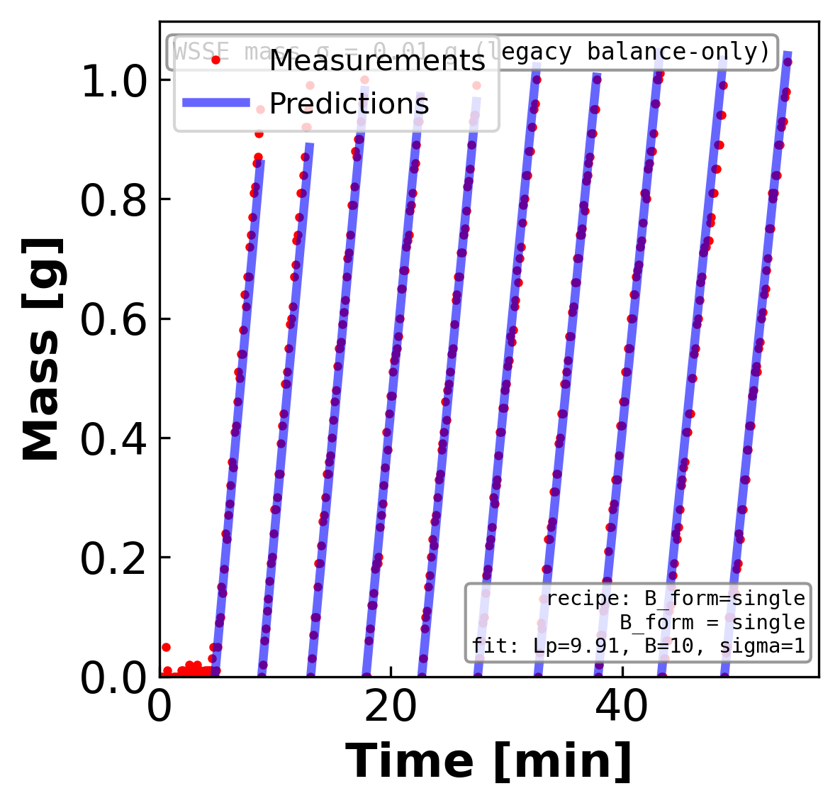
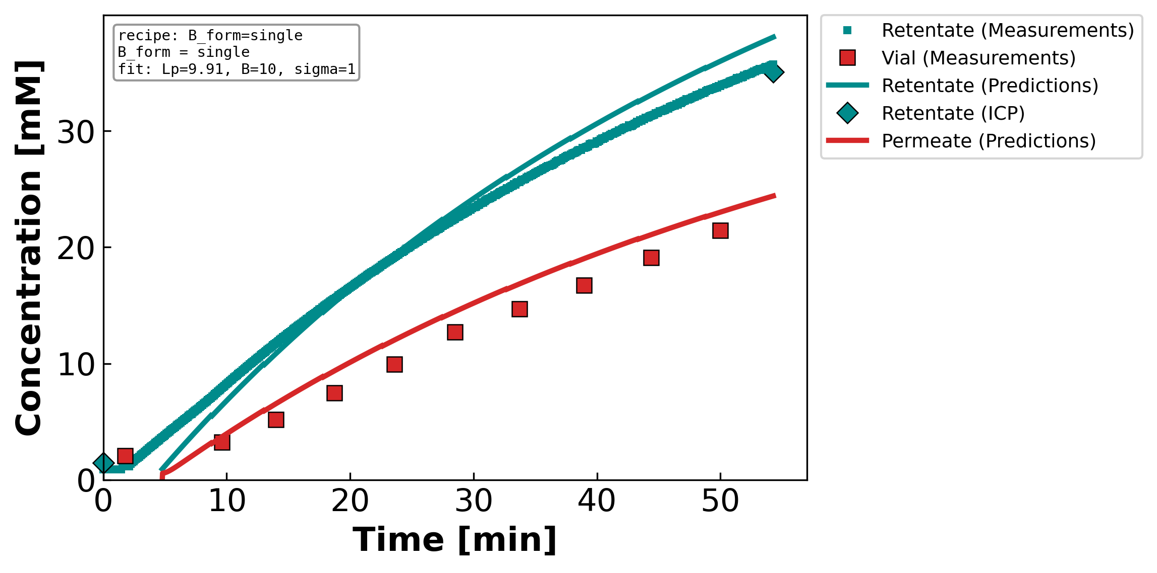
Figure 2. Measured and model-predicted time profiles for a representative concentrating NaCl diafiltration experiment. (Left) total retentate mass and (right) solute concentration in the retentate and permeate streams versus time; symbols are measurements — the retentate inductively-coupled-plasma (ICP) reference points and the time-resolved permeate vial samples — and the curves are the lumped-parameter model evaluated at the fitted parameters reported in the inset (Lₚ = 9.91 L m⁻² h⁻¹ bar⁻¹, B = 10.00 µm s⁻¹, σ = 1). A single concentration-independent solute permeability reproduces the mass decline and both concentration histories, with the retentate and permeate plotted in distinct colors; the reflection coefficient is forced to its upper bound (σ = 1).
Notes:
FIT CHECK — concentrating NaCl. Does the model reproduce the experiment?
What it shows: lines = model, symbols = measurements. LEFT = retentate mass vs time; RIGHT = concentration vs time (TEAL = retentate, RED = permeate; teal diamonds = retentate ICP at start & end).
Simple steps: (1) choose Lp, σ, B; (2) march the equations forward in time; (3) overlay on the data. The inset box reports the best-fit values.
Coffee-filter example: as water is pushed out, the cup (retentate) gets saltier and lighter while the drips (permeate) carry a little salt.
Core model (3 fitted parameters Lp, σ, B):
Water flux Jw = Lp·(ΔP − σ·Δπ) [net push = applied − osmotic back-push]
Osmotic Δπ = i·R·T·(cF − cP) [i = ions/molecule: NaCl 2, CaCl₂ 3, LaCl₃ 4]
Salt flux Js = B·(cF − cP) + (1−σ)·Jw·c̄ [diffusion term + convection term]
Mass balance dM/dt = −ρ·A·Jw [retentate lightens as permeate leaves]
This run: Lp = 9.91, B = 10.00 µm/s, σ = 1 (σ forced to its upper bound).
Running picture — squeezing salty water through a coffee filter:
• Lp = how EASILY water passes (bigger Lp → more water per push)
• σ = how well the filter BLOCKS salt by osmosis (σ=1 blocks all, σ=0 lets salt ride along)
• B = how much salt LEAKS through by diffusion
• ΔP = how hard you push; Δπ = the osmotic 'back-push' from the salt difference

Slide 14
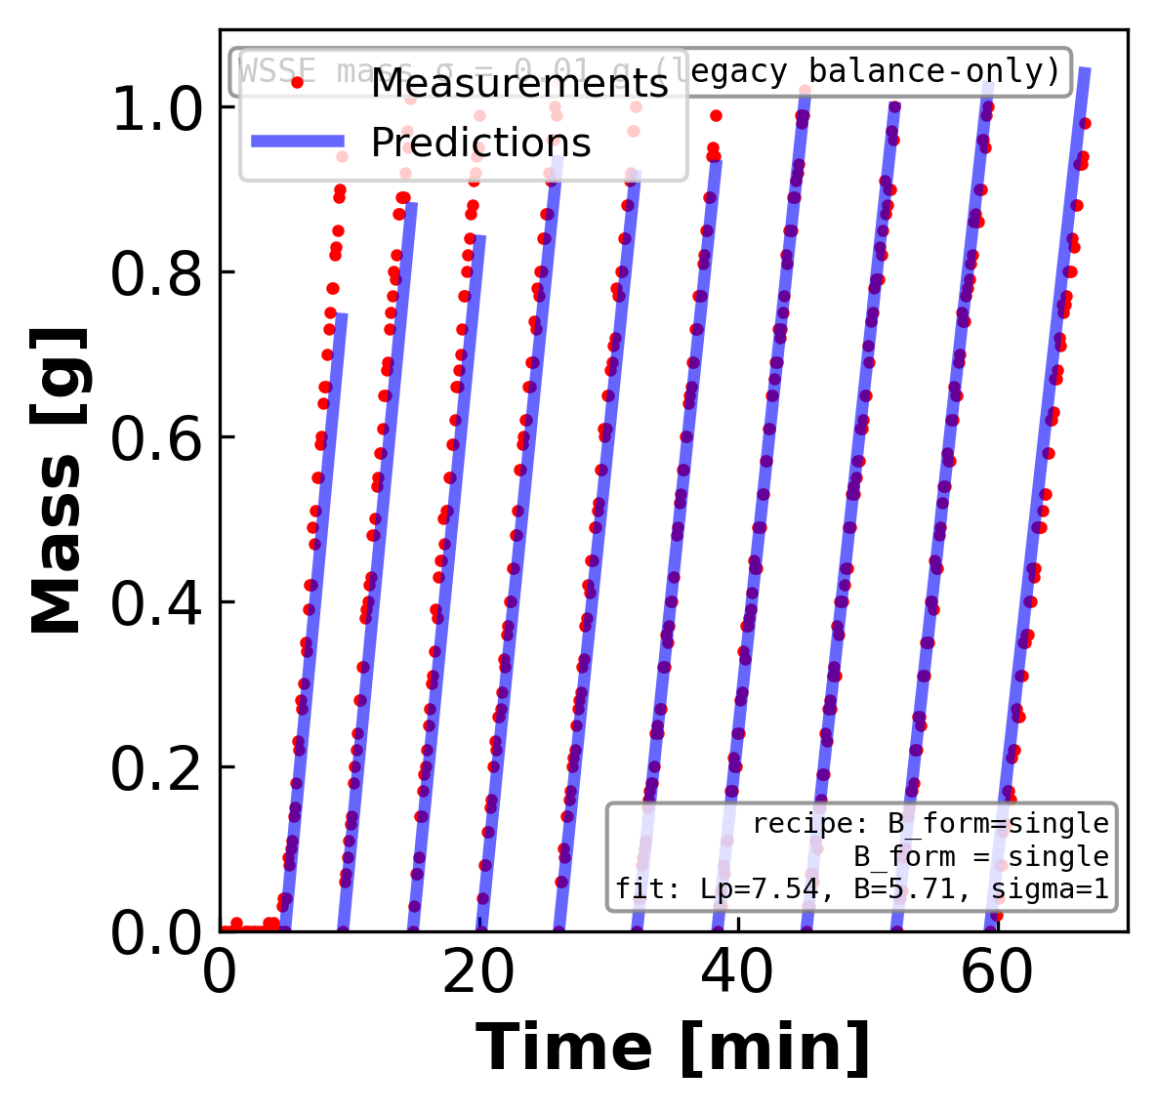
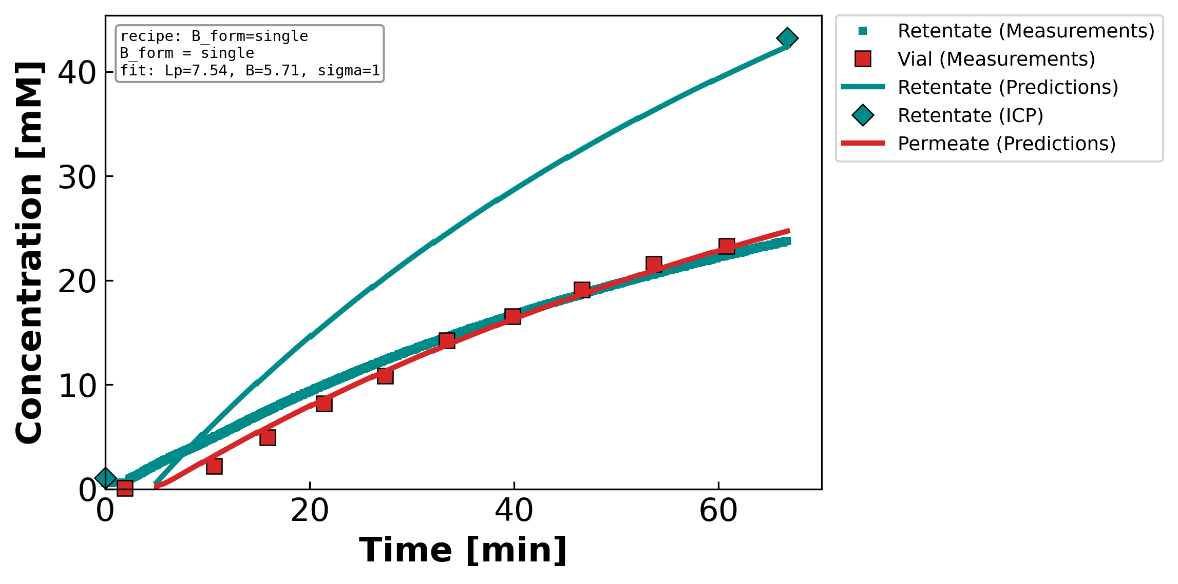
Figure 3. Measured and model-predicted time profiles for a representative concentrating CaCl₂ diafiltration experiment. (Left) total retentate mass and (right) solute concentration in the retentate and permeate streams versus time; symbols are measurements — the retentate inductively-coupled-plasma (ICP) reference points and the time-resolved permeate vial samples — and the curves are the lumped-parameter model evaluated at the fitted parameters reported in the inset (Lₚ = 7.54 L m⁻² h⁻¹ bar⁻¹, B = 5.71 µm s⁻¹, σ = 1). A single concentration-independent solute permeability reproduces the mass decline and both concentration histories, with the retentate and permeate plotted in distinct colors; the reflection coefficient is forced to its upper bound (σ = 1).
Notes:
FIT CHECK — concentrating CaCl₂. Does the model reproduce the experiment?
What it shows: lines = model, symbols = measurements. LEFT = retentate mass vs time; RIGHT = concentration vs time (TEAL = retentate, RED = permeate; teal diamonds = retentate ICP at start & end).
Simple steps: (1) choose Lp, σ, B; (2) march the equations forward in time; (3) overlay on the data. The inset box reports the best-fit values.
Coffee-filter example: as water is pushed out, the cup (retentate) gets saltier and lighter while the drips (permeate) carry a little salt.
Core model (3 fitted parameters Lp, σ, B):
Water flux Jw = Lp·(ΔP − σ·Δπ) [net push = applied − osmotic back-push]
Osmotic Δπ = i·R·T·(cF − cP) [i = ions/molecule: NaCl 2, CaCl₂ 3, LaCl₃ 4]
Salt flux Js = B·(cF − cP) + (1−σ)·Jw·c̄ [diffusion term + convection term]
Mass balance dM/dt = −ρ·A·Jw [retentate lightens as permeate leaves]
This run: Lp = 7.54, B = 5.71 µm/s, σ = 1 (σ forced to its upper bound).
Running picture — squeezing salty water through a coffee filter:
• Lp = how EASILY water passes (bigger Lp → more water per push)
• σ = how well the filter BLOCKS salt by osmosis (σ=1 blocks all, σ=0 lets salt ride along)
• B = how much salt LEAKS through by diffusion
• ΔP = how hard you push; Δπ = the osmotic 'back-push' from the salt difference

Slide 15
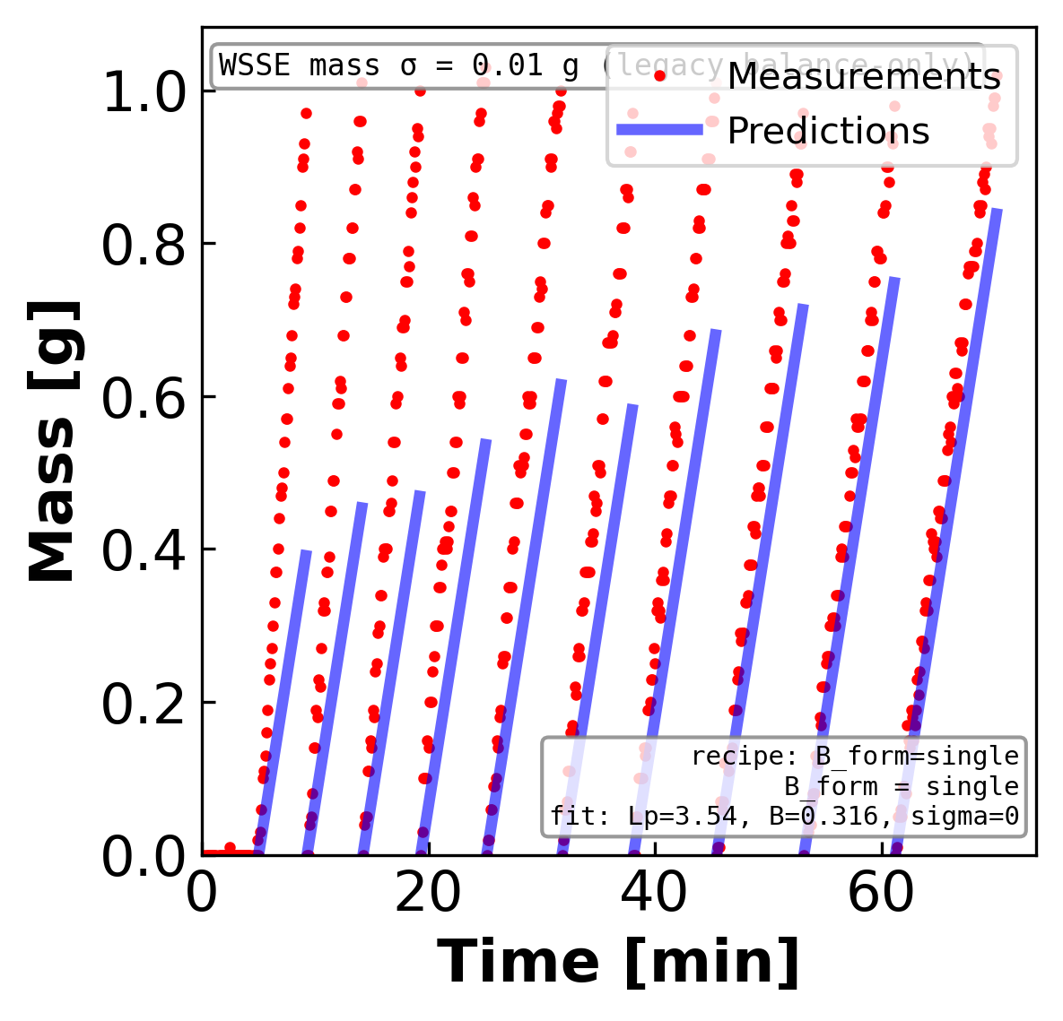
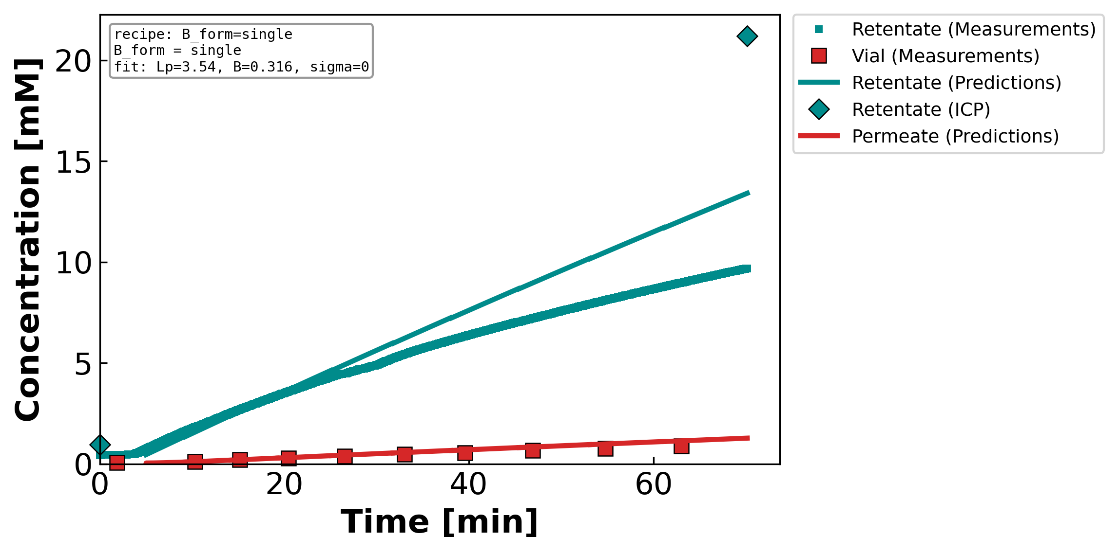
Figure 4. Measured and model-predicted time profiles for a representative concentrating LaCl₃ diafiltration experiment. (Left) total retentate mass and (right) solute concentration in the retentate and permeate streams versus time; symbols are measurements — the retentate inductively-coupled-plasma (ICP) reference points and the time-resolved permeate vial samples — and the curves are the lumped-parameter model evaluated at the fitted parameters reported in the inset (Lₚ = 3.54 L m⁻² h⁻¹ bar⁻¹, B = 0.32 µm s⁻¹, σ = 0). A single concentration-independent solute permeability reproduces the mass decline and both concentration histories, with the retentate and permeate plotted in distinct colors; the reflection coefficient is forced to its lower bound (σ = 0). This trivalent-salt experiment is the most demanding case in the campaign and shows the largest residuals of the four.
Notes:
FIT CHECK — concentrating LaCl₃. Does the model reproduce the experiment?
What it shows: lines = model, symbols = measurements. LEFT = retentate mass vs time; RIGHT = concentration vs time (TEAL = retentate, RED = permeate; teal diamonds = retentate ICP at start & end).
Simple steps: (1) choose Lp, σ, B; (2) march the equations forward in time; (3) overlay on the data. The inset box reports the best-fit values.
Coffee-filter example: as water is pushed out, the cup (retentate) gets saltier and lighter while the drips (permeate) carry a little salt.
Core model (3 fitted parameters Lp, σ, B):
Water flux Jw = Lp·(ΔP − σ·Δπ) [net push = applied − osmotic back-push]
Osmotic Δπ = i·R·T·(cF − cP) [i = ions/molecule: NaCl 2, CaCl₂ 3, LaCl₃ 4]
Salt flux Js = B·(cF − cP) + (1−σ)·Jw·c̄ [diffusion term + convection term]
Mass balance dM/dt = −ρ·A·Jw [retentate lightens as permeate leaves]
This run: Lp = 3.54, B = 0.32 µm/s, σ = 0 (σ forced to its lower bound). This trivalent salt is the hardest case — largest residuals of the four.
Running picture — squeezing salty water through a coffee filter:
• Lp = how EASILY water passes (bigger Lp → more water per push)
• σ = how well the filter BLOCKS salt by osmosis (σ=1 blocks all, σ=0 lets salt ride along)
• B = how much salt LEAKS through by diffusion
• ΔP = how hard you push; Δπ = the osmotic 'back-push' from the salt difference

Slide 16
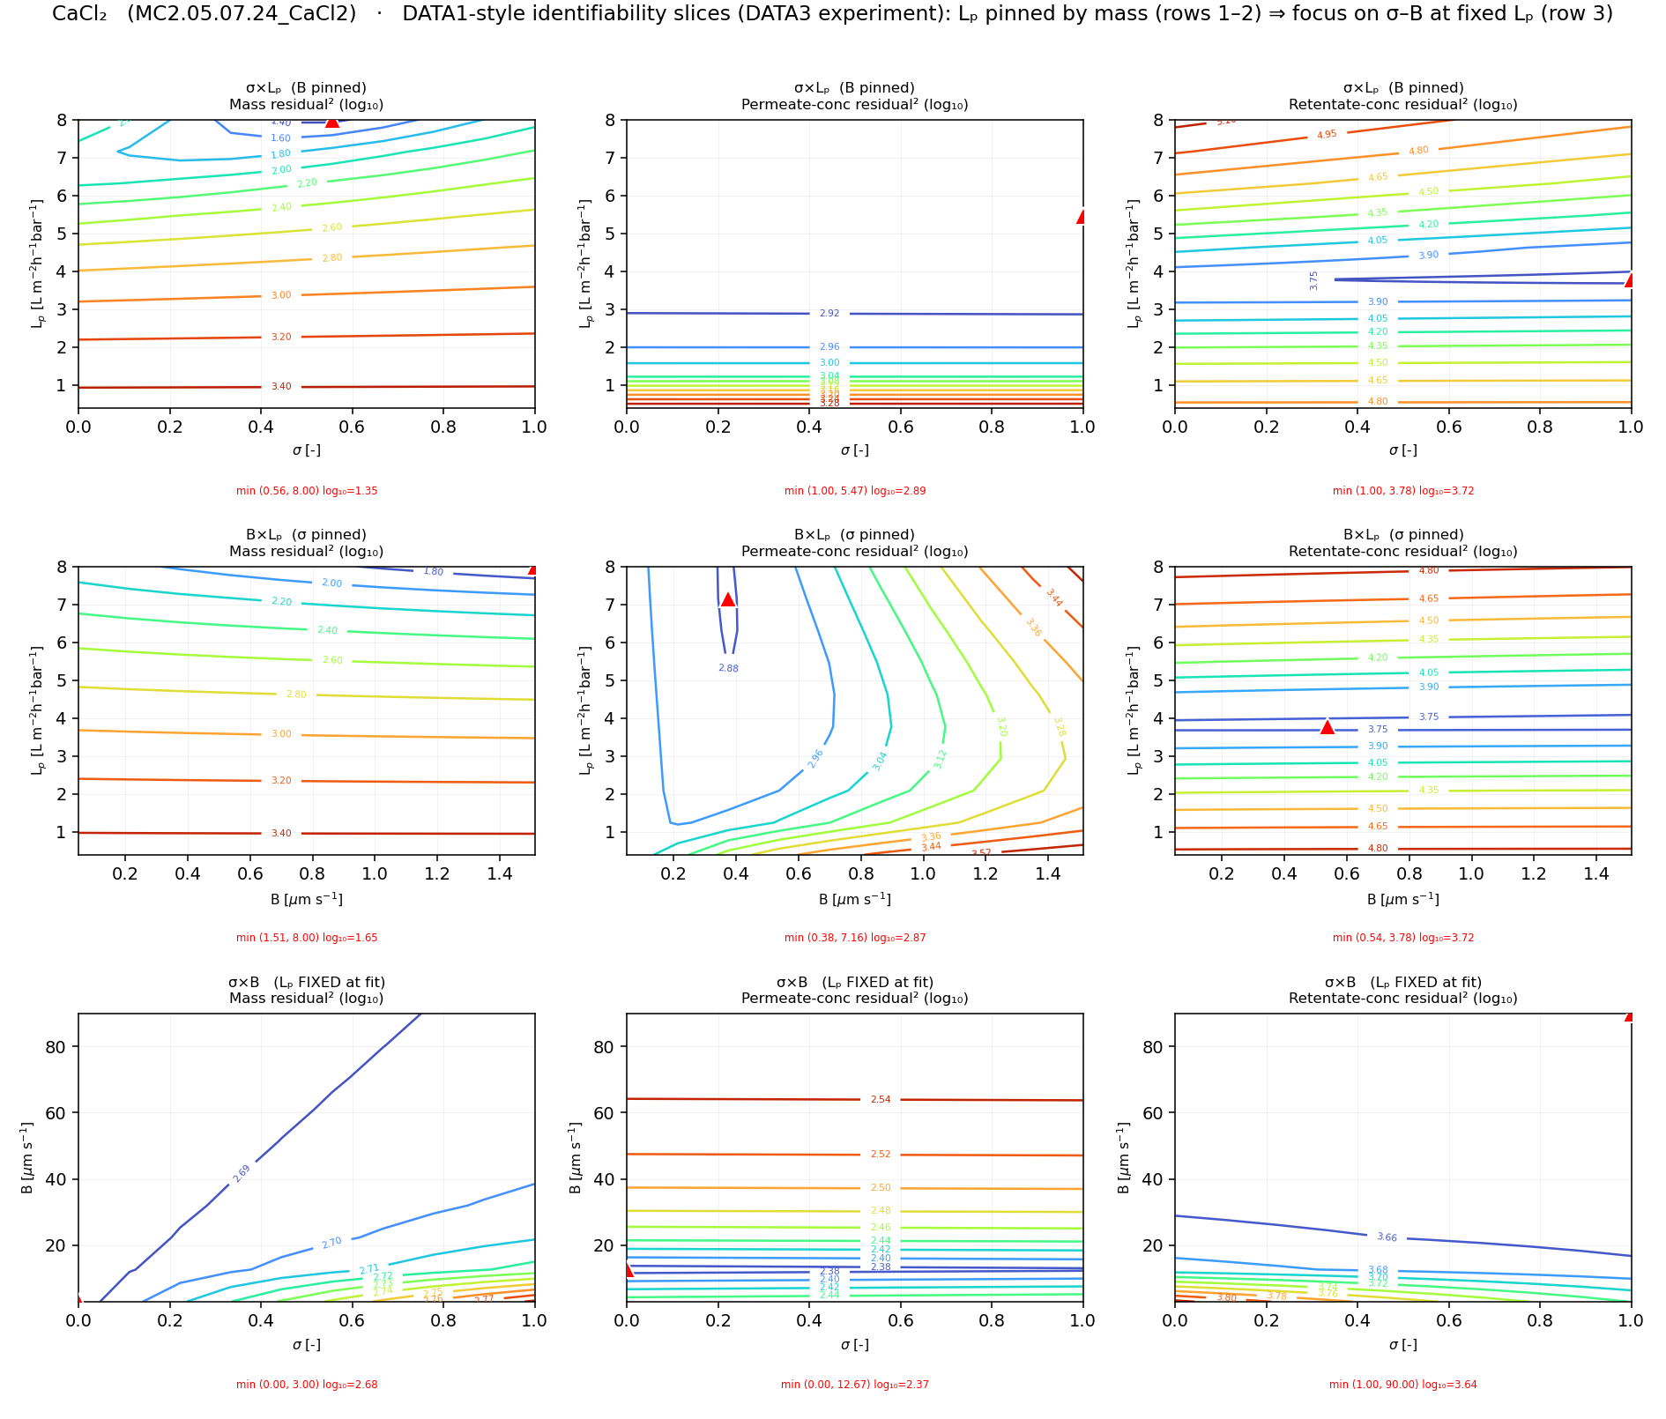
Figure 5. Log-transformed residual-squared contours for a representative concentrating CaCl₂ diafiltration experiment, generated by a 2-D grid search in which model predictions are computed for all combinations of two lumped transport parameters while the third is held at its fitted value. Columns correspond to the mass, permeate-concentration, and retentate-concentration objectives; rows correspond to the σ×Lₚ, B×Lₚ, and σ×B planes. The red triangle marks the minimum of each surface. The horizontal iso-residual bands in the upper two rows localize a unique hydraulic permeability Lₚ that is insensitive to σ and B, whereas the σ×B plane (bottom row) displays an extended valley, indicating that the reflection coefficient and solute permeability trade off and are not jointly identified from a single experiment. This well-determined Lₚ is what licenses fixing it in the σ×B maps that follow.
Notes:
WHY WE CAN FIX Lp. This 3×3 map proves the water permeability Lp is pinned down.
What it shows: 9 error maps. COLUMNS = the 3 measured responses (mass, permeate, retentate). ROWS = parameter pairs (σ–Lp, B–Lp, σ–B). Color = log of fit error; red triangle = best.
Simple steps: (1) sweep two parameters on a grid, hold the third at its best value; (2) simulate & score the error at each grid point; (3) plot the surface.
How to read it: a tight HORIZONTAL band in the top two rows means Lp lands at the same value no matter what σ and B do → Lp is identifiable. The bottom row (σ–B) is a long diagonal VALLEY → σ and B trade off and can't be separated.
Coffee-filter example: if many different filter settings give the same drip pattern, you can't tell them apart — that flat valley is exactly that.
Why it matters: because Lp is well pinned, we are ALLOWED to fix it and just study σ-vs-B in the next four slides.
Math: error = WSSE = Σ[(model − data)/noise]²; we plot log₁₀(WSSE).

Slide 17
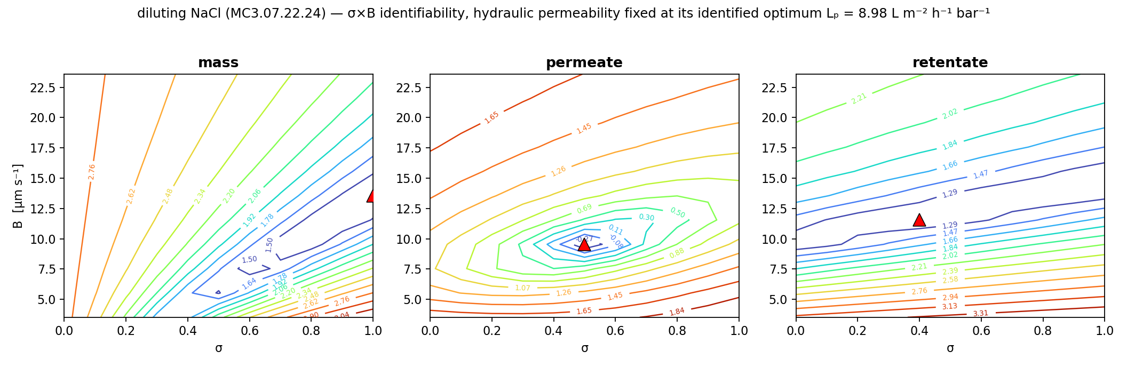
Figure 6. Identifiability of the reflection coefficient σ and the solute permeability B for a representative diluting NaCl experiment, with the hydraulic permeability fixed at its identified optimum Lₚ = 8.98 L m⁻² h⁻¹ bar⁻¹ (well determined and insensitive to σ and B; Figure 5). The three panels are the base-10 logarithm of the weighted sum-of-squared-error (WSSE) surface for each measured response — labelled mass, permeate, and retentate — computed by forward simulation over the σ×B grid at that fixed Lₚ; the red triangle marks each surface's minimum. Each surface constrains B through a narrow valley but is only weakly sensitive to σ, so the three responses reach their minima at different σ values along the boundaries; the reflection coefficient is therefore not jointly identified, and the single-experiment optimum places σ at its upper bound (σ = 1). The solute permeability is well determined while σ is not recoverable from one experiment.
Notes:
IDENTIFIABILITY MAP — diluting NaCl. Can the data tell σ and B apart?
What it shows: with Lp FIXED at its identified value (Lp = 8.98), we map the fit error over σ (x-axis) and B (y-axis). Three panels = the three things we measure (mass, permeate, retentate). Red triangle = best fit.
Simple steps: (1) fix Lp; (2) try every (σ, B) on a grid; (3) simulate, score the error, color the map (blue = good fit, red = bad). Titles say mass/permeate/retentate; the color is log₁₀ of the weighted error (WSSE).
How to read it: the contours run nearly FLAT along the σ direction → moving σ barely changes the error → σ is NOT identifiable and is forced to its upper bound (σ = 1). The error DOES change with B → B is well determined.
Coffee-filter example: the filter blocks salt so completely that you can't measure exactly how well — σ just pegs at 'fully blocking.'
Math: WSSE = Σ[(model − data)/noise]², plotted as log₁₀. A long flat valley = many equally-good answers = not identifiable; a tight bowl = identifiable.

Slide 18
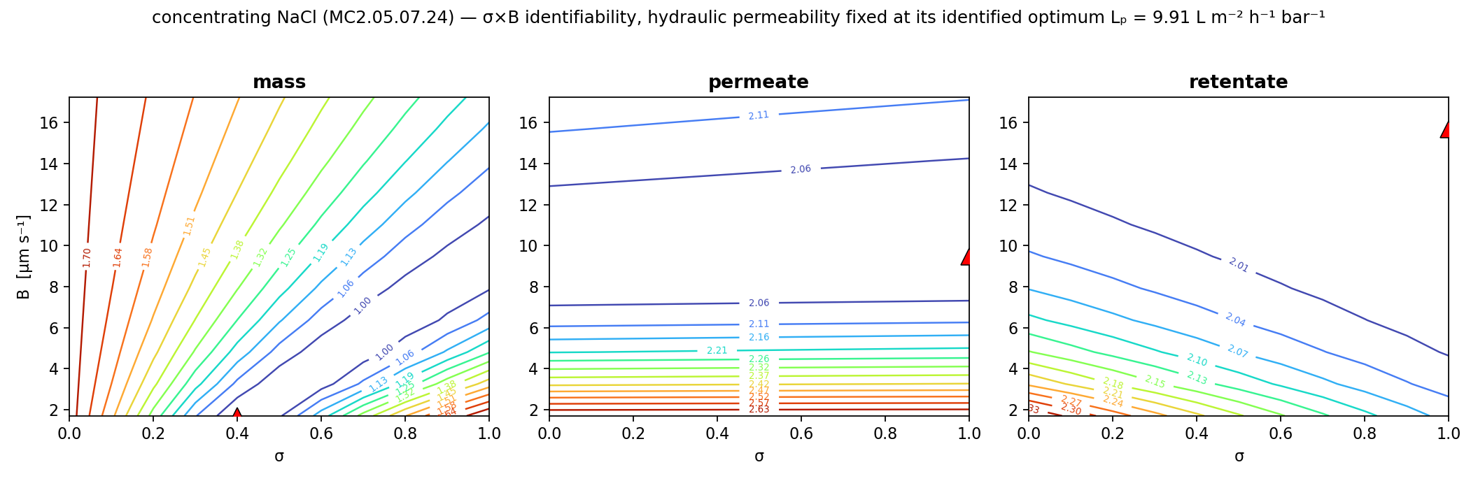
Figure 7. Identifiability of the reflection coefficient σ and the solute permeability B for a representative concentrating NaCl experiment, with the hydraulic permeability fixed at its identified optimum Lₚ = 9.91 L m⁻² h⁻¹ bar⁻¹ (well determined and insensitive to σ and B; Figure 5). The three panels are the base-10 logarithm of the weighted sum-of-squared-error (WSSE) surface for each measured response — labelled mass, permeate, and retentate — computed by forward simulation over the σ×B grid at that fixed Lₚ; the red triangle marks each surface's minimum. Each surface constrains B through a narrow valley but is only weakly sensitive to σ, so the three responses reach their minima at different σ values along the boundaries; the reflection coefficient is therefore not jointly identified, and the single-experiment optimum places σ at its upper bound (σ = 1). The solute permeability is well determined while σ is not recoverable from one experiment.
Notes:
IDENTIFIABILITY MAP — concentrating NaCl. Can the data tell σ and B apart?
What it shows: with Lp FIXED at its identified value (Lp = 9.91), we map the fit error over σ (x-axis) and B (y-axis). Three panels = the three things we measure (mass, permeate, retentate). Red triangle = best fit.
Simple steps: (1) fix Lp; (2) try every (σ, B) on a grid; (3) simulate, score the error, color the map (blue = good fit, red = bad). Titles say mass/permeate/retentate; the color is log₁₀ of the weighted error (WSSE).
How to read it: the contours run nearly FLAT along the σ direction → moving σ barely changes the error → σ is NOT identifiable and is forced to its upper bound (σ = 1). The error DOES change with B → B is well determined.
Coffee-filter example: the filter blocks salt so completely that you can't measure exactly how well — σ just pegs at 'fully blocking.'
Math: WSSE = Σ[(model − data)/noise]², plotted as log₁₀. A long flat valley = many equally-good answers = not identifiable; a tight bowl = identifiable.

Slide 19
Figure 8. Identifiability of the reflection coefficient σ and the solute permeability B for a representative concentrating CaCl₂ experiment, with the hydraulic permeability fixed at its identified optimum Lₚ = 7.54 L m⁻² h⁻¹ bar⁻¹ (well determined and insensitive to σ and B; Figure 5). The three panels are the base-10 logarithm of the weighted sum-of-squared-error (WSSE) surface for each measured response — labelled mass, permeate, and retentate — computed by forward simulation over the σ×B grid at that fixed Lₚ; the red triangle marks each surface's minimum. Each surface constrains B through a narrow valley but is only weakly sensitive to σ, so the three responses reach their minima at different σ values along the boundaries; the reflection coefficient is therefore not jointly identified, and the single-experiment optimum places σ at its upper bound (σ = 1). The solute permeability is well determined while σ is not recoverable from one experiment.
Notes:
IDENTIFIABILITY MAP — concentrating CaCl₂. Can the data tell σ and B apart?
What it shows: with Lp FIXED at its identified value (Lp = 7.54), we map the fit error over σ (x-axis) and B (y-axis). Three panels = the three things we measure (mass, permeate, retentate). Red triangle = best fit.
Simple steps: (1) fix Lp; (2) try every (σ, B) on a grid; (3) simulate, score the error, color the map (blue = good fit, red = bad). Titles say mass/permeate/retentate; the color is log₁₀ of the weighted error (WSSE).
How to read it: the contours run nearly FLAT along the σ direction → moving σ barely changes the error → σ is NOT identifiable and is forced to its upper bound (σ = 1). The error DOES change with B → B is well determined.
Coffee-filter example: the filter blocks salt so completely that you can't measure exactly how well — σ just pegs at 'fully blocking.'
Math: WSSE = Σ[(model − data)/noise]², plotted as log₁₀. A long flat valley = many equally-good answers = not identifiable; a tight bowl = identifiable.

Slide 20
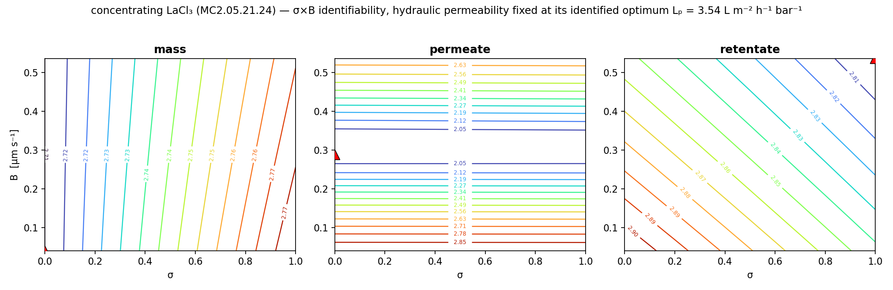
Figure 9. Identifiability of the reflection coefficient σ and the solute permeability B for a representative concentrating LaCl₃ experiment, with the hydraulic permeability fixed at its identified optimum Lₚ = 3.54 L m⁻² h⁻¹ bar⁻¹ (well determined and insensitive to σ and B; Figure 5). The three panels are the base-10 logarithm of the weighted sum-of-squared-error (WSSE) surface for each measured response — labelled mass, permeate, and retentate — computed by forward simulation over the σ×B grid at that fixed Lₚ; the red triangle marks each surface's minimum. Each surface constrains B through a narrow valley but is only weakly sensitive to σ, so the three responses reach their minima at different σ values along the boundaries; the reflection coefficient is therefore not jointly identified, and the single-experiment optimum places σ at its lower bound (σ = 0). The solute permeability is well determined while σ is not recoverable from one experiment.
Notes:
IDENTIFIABILITY MAP — concentrating LaCl₃. Can the data tell σ and B apart?
What it shows: with Lp FIXED at its identified value (Lp = 3.54), we map the fit error over σ (x-axis) and B (y-axis). Three panels = the three things we measure (mass, permeate, retentate). Red triangle = best fit.
Simple steps: (1) fix Lp; (2) try every (σ, B) on a grid; (3) simulate, score the error, color the map (blue = good fit, red = bad). Titles say mass/permeate/retentate; the color is log₁₀ of the weighted error (WSSE).
How to read it: the contours run nearly FLAT along the σ direction → moving σ barely changes the error → σ is NOT identifiable and is forced to its lower bound (σ = 0). The error DOES change with B → B is well determined.
Coffee-filter example: the filter blocks salt so completely that you can't measure exactly how well — σ just pegs at 'fully blocking.'
Math: WSSE = Σ[(model − data)/noise]², plotted as log₁₀. A long flat valley = many equally-good answers = not identifiable; a tight bowl = identifiable.

