Slide 1
DATA3 — Contour-Derived Consistent Initial Guesses
θ from joint argmin of mass + perm_conc + ret_conc WSSE per sheet, forward-simulated
Meeting prep · 2026-06-10 Left panel: mass per vial (exp vs sim). Right panel: cF + cV (exp) vs cF + cH (sim). Text box: θ + WSSE.

Slide 2
Stage 1A · Path A · concentrating + interior σ

Slide 3
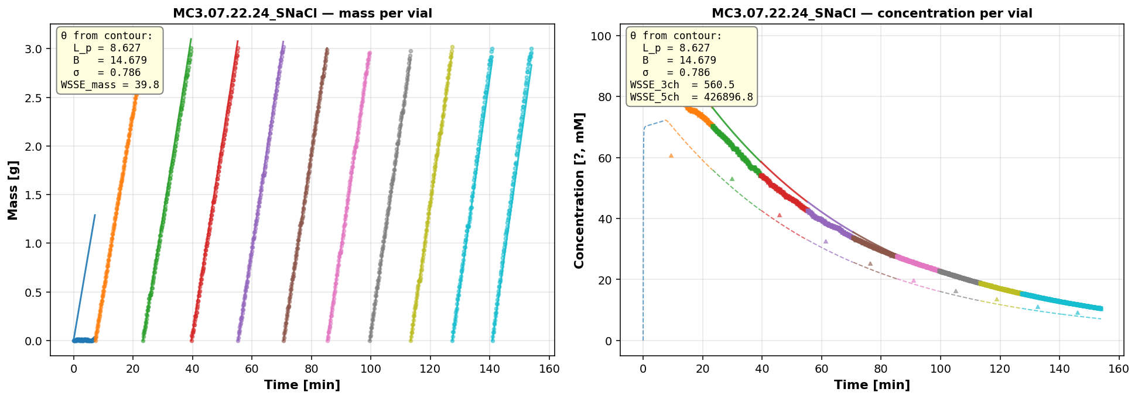
MC3.07.22.24_SNaCl
Stage 1A · Path A · concentrating + interior σ
θ_consistent (from 2D contour argmin of mass+cp+cr): L_p=8.627 B=14.679 σ=0.786 WSSE_3ch=560.5 WSSE_5ch=426896.8

Slide 4
Stage 1B · Path B · diluting (σ-wall)

Slide 5
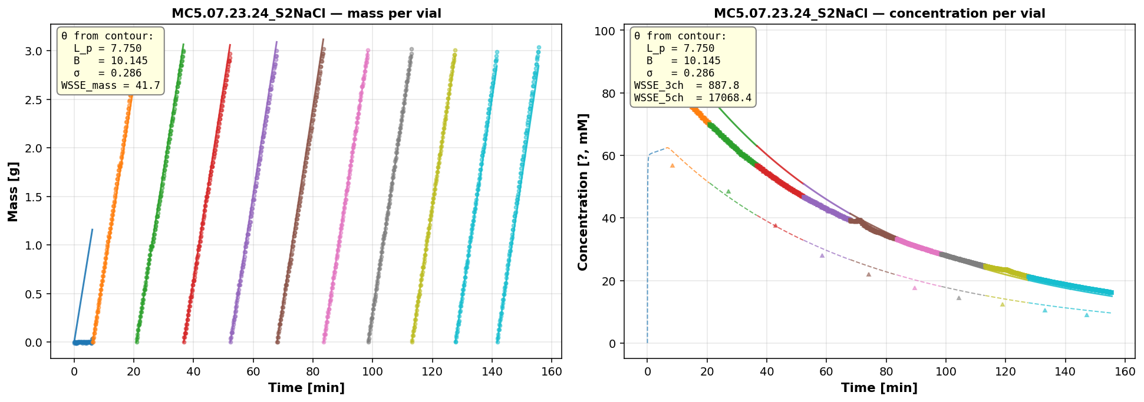
MC5.07.23.24_S2NaCl
Stage 1B · Path B · diluting (σ-wall)
θ_consistent (from 2D contour argmin of mass+cp+cr): L_p=7.750 B=10.145 σ=0.286 WSSE_3ch=887.8 WSSE_5ch=17068.4

Slide 6
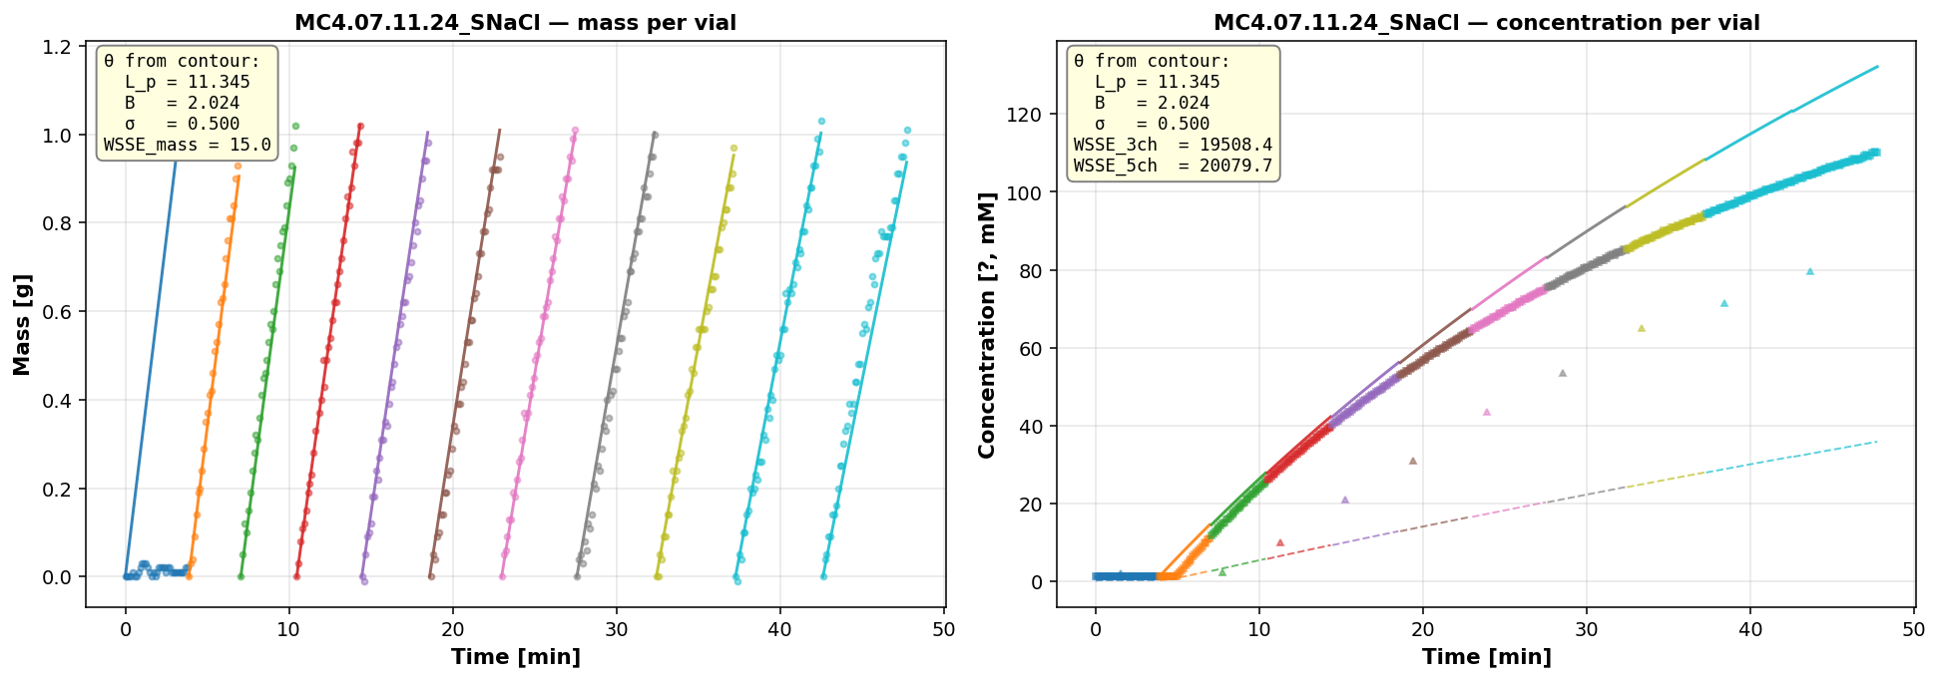
MC4.07.11.24_SNaCl
Stage 1B · Path B · diluting (σ-wall)
θ_consistent (from 2D contour argmin of mass+cp+cr): L_p=11.345 B=2.024 σ=0.500 WSSE_3ch=19508.4 WSSE_5ch=20079.7

Slide 7
Stage 2 · NaCl concentrating (σ pinned at 1)

Slide 8
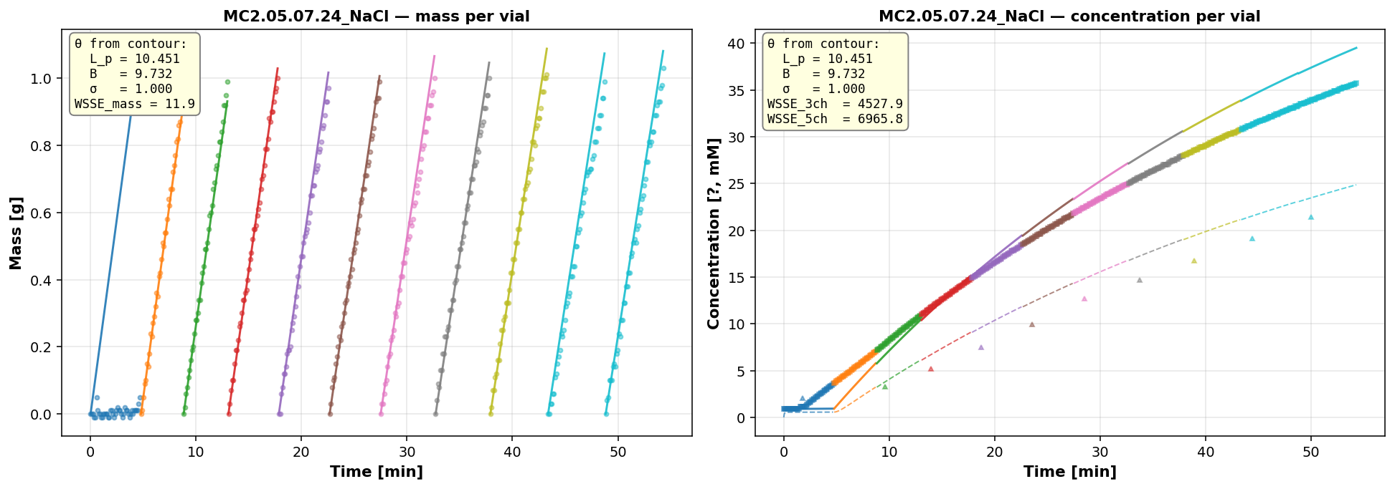
MC2.05.07.24_NaCl
Stage 2 · NaCl concentrating (σ pinned at 1)
θ_consistent (from 2D contour argmin of mass+cp+cr): L_p=10.451 B=9.732 σ=1.000 WSSE_3ch=4527.9 WSSE_5ch=6965.8

Slide 9
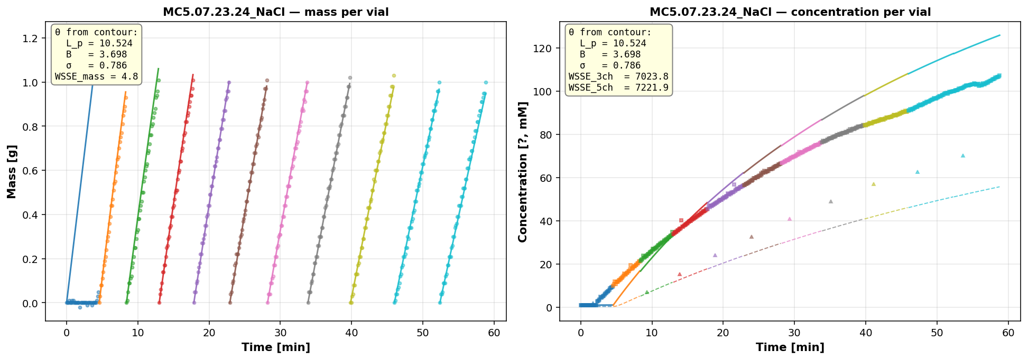
MC5.07.23.24_NaCl
Stage 2 · NaCl concentrating (σ pinned at 1)
θ_consistent (from 2D contour argmin of mass+cp+cr): L_p=10.524 B=3.698 σ=0.786 WSSE_3ch=7023.8 WSSE_5ch=7221.9

Slide 10
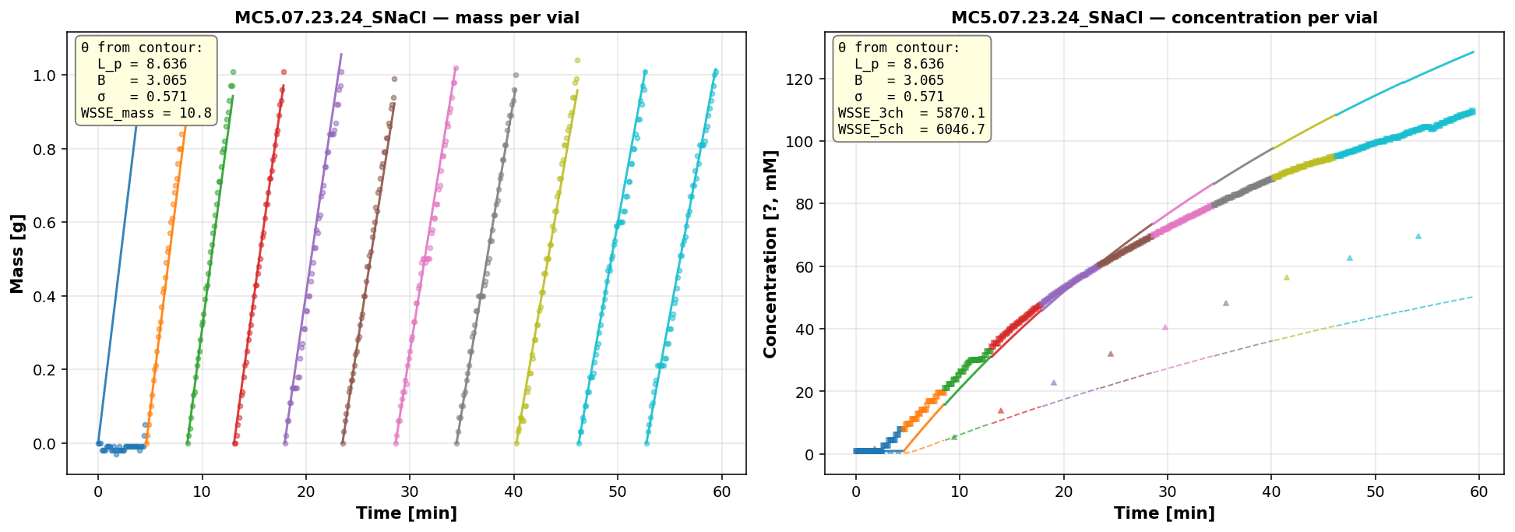
MC5.07.23.24_SNaCl
Stage 2 · NaCl concentrating (σ pinned at 1)
θ_consistent (from 2D contour argmin of mass+cp+cr): L_p=8.636 B=3.065 σ=0.571 WSSE_3ch=5870.1 WSSE_5ch=6046.7

Slide 11
Stage 2 · CaCl₂ (σ pinned, channel split)

Slide 12
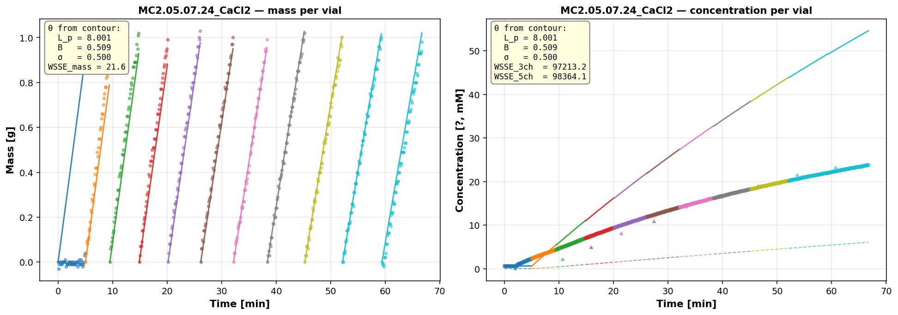
MC2.05.07.24_CaCl2
Stage 2 · CaCl₂ (σ pinned, channel split)
θ_consistent (from 2D contour argmin of mass+cp+cr): L_p=8.001 B=0.509 σ=0.500 WSSE_3ch=97213.2 WSSE_5ch=98364.1

Slide 13
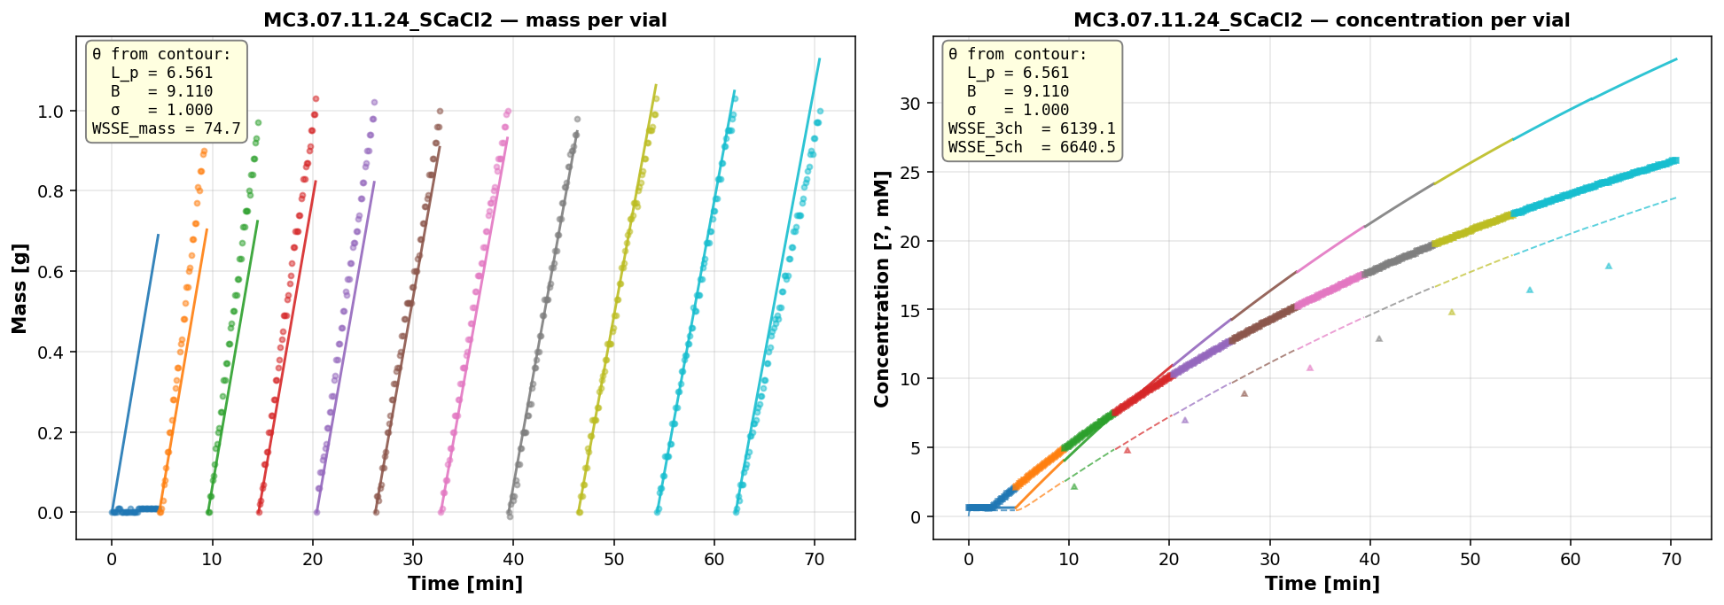
MC3.07.11.24_SCaCl2
Stage 2 · CaCl₂ (σ pinned, channel split)
θ_consistent (from 2D contour argmin of mass+cp+cr): L_p=6.561 B=9.110 σ=1.000 WSSE_3ch=6139.1 WSSE_5ch=6640.5

Slide 14
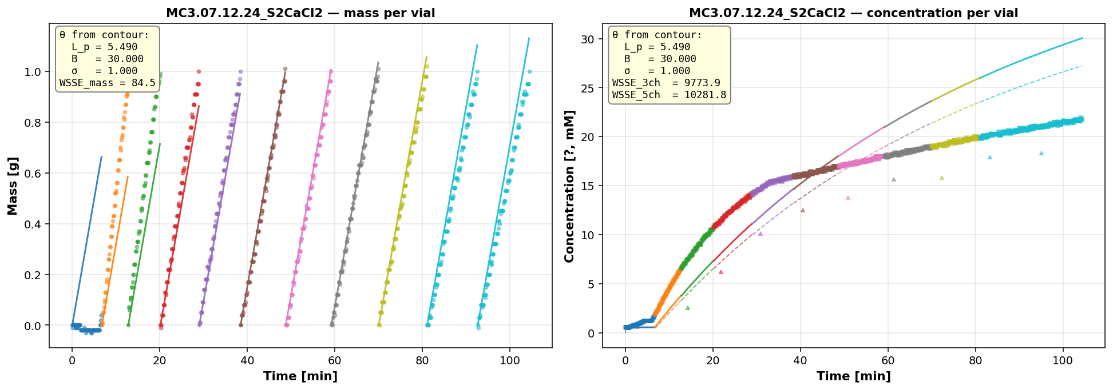
MC3.07.12.24_S2CaCl2
Stage 2 · CaCl₂ (σ pinned, channel split)
θ_consistent (from 2D contour argmin of mass+cp+cr): L_p=5.490 B=30.000 σ=1.000 WSSE_3ch=9773.9 WSSE_5ch=10281.8

Slide 15
Stage 3 · LaCl₃ (not estimable, wrong-model bias)

Slide 16
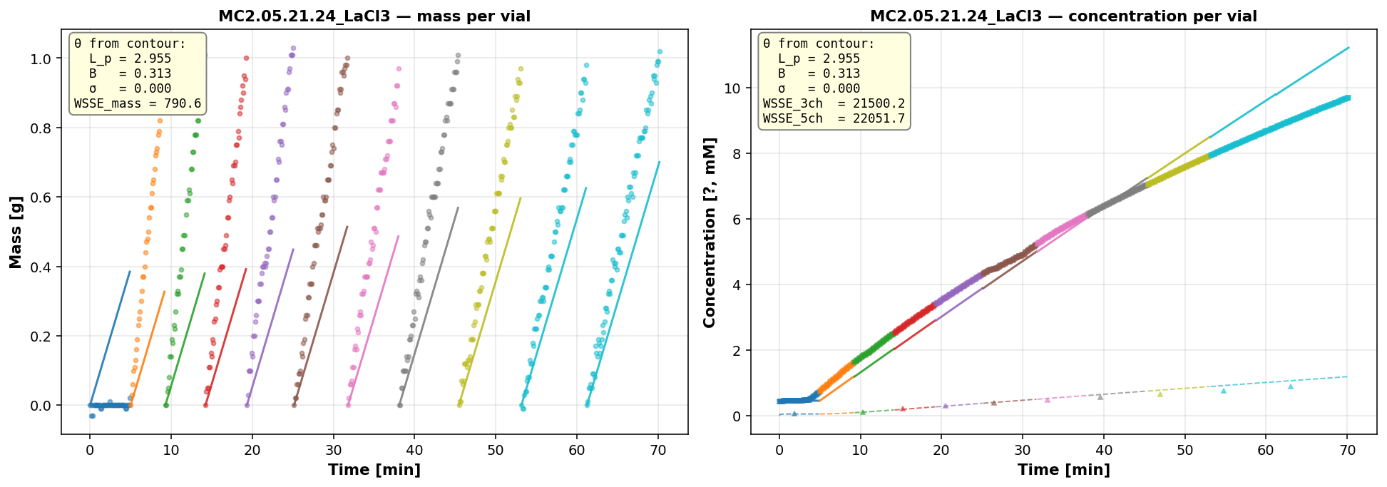
MC2.05.21.24_LaCl3
Stage 3 · LaCl₃ (not estimable, wrong-model bias)
θ_consistent (from 2D contour argmin of mass+cp+cr): L_p=2.955 B=0.313 σ=0.000 WSSE_3ch=21500.2 WSSE_5ch=22051.7

Slide 17
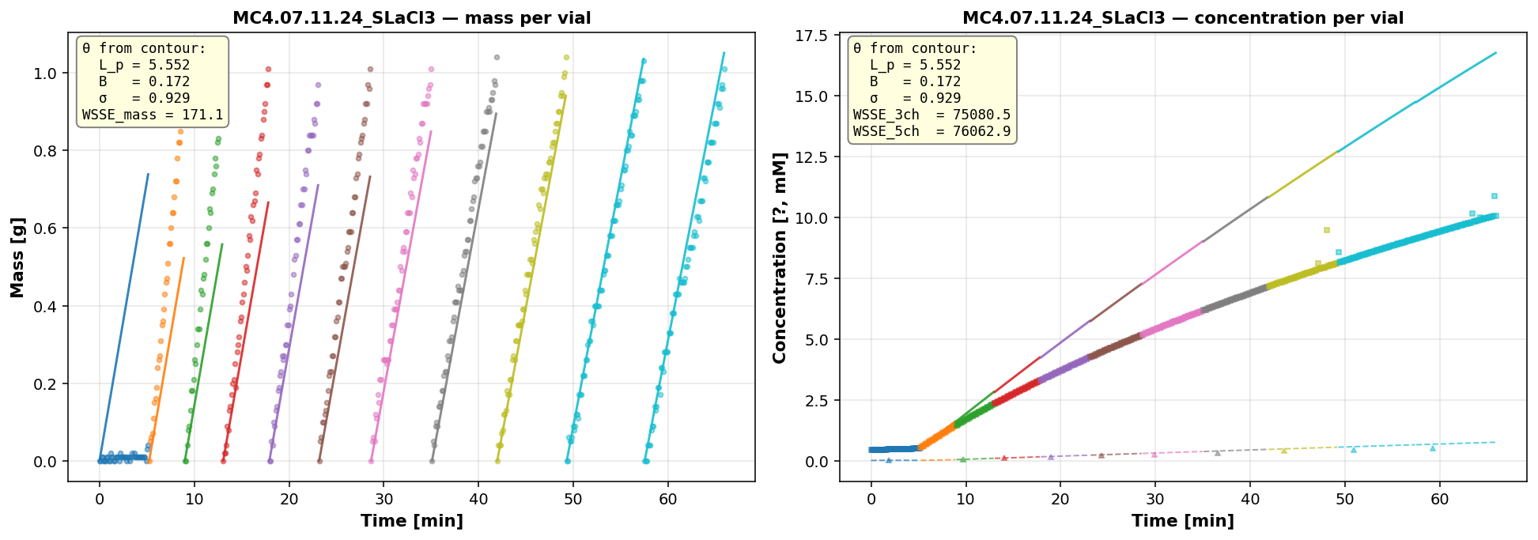
MC4.07.11.24_SLaCl3
Stage 3 · LaCl₃ (not estimable, wrong-model bias)
θ_consistent (from 2D contour argmin of mass+cp+cr): L_p=5.552 B=0.172 σ=0.929 WSSE_3ch=75080.5 WSSE_5ch=76062.9

