Slide 1
DATA3 — Contour Diagnostics
Three stages of parameter identifiability on NF270 single-salt fits
STAGE 1
STAGE 2
STAGE 3
Well-identified
Inconsistent
Not estimable
MC2 NaCl
MC2 CaCl₂
MC2 LaCl₃
4 of 5 objective channels
converge at the warm-start θ
Channels each find a minimum,
but at opposite (σ, Lp) walls
Every channel argmins at a
different Lp — no shared basin
Discussion · 2026-06-04

Slide 2
01
01 · CONTEXT — parameter bounds
L_p ∈ [0.5, 50] and σ ∈ [0, 1] inherited from DATA1/DATA2 KCl; per-salt B bounds
KCl baseline (inherited): L_p ∈ [0.5, 50] L/(m²·hr·bar), B ∈ [0, 30] µm/s, σ ∈ [0, 1]
Per-salt B upper bound (physics-informed — halve per +1 valence):
Salt | B bound [µm/s] | Basis
NaCl | [0, 30] | monovalent — same as KCl
CaCl₂ | [0, 15] | divalent counter-ion — halved
LaCl₃ | [0, 10] | trivalent — third
How the contour panels below are built: for every (σ, Lp) grid point we forward-simulate the full Spiegler-Kedem DAE (B and the state initialization fixed at warm-start values), then compute the weighted sum-of-squared-residuals per channel. 5 channels per panel: mass + permeate concentration + retentate concentration + permeate conductivity + retentate conductivity. No fitting — pure forward-simulation diagnostics.

Slide 3
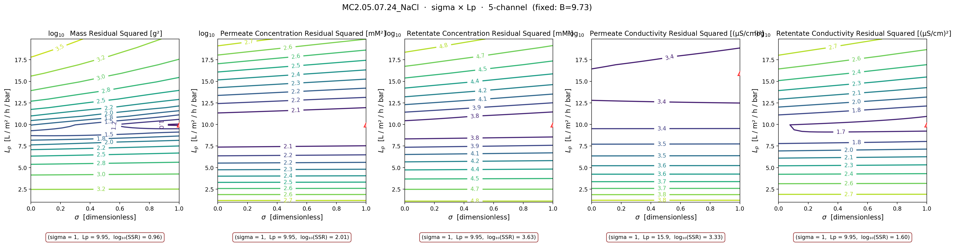
02
02 · MC2 NaCl — Well-identified case
STAGE 1 · Well-identified
B fixed at warm-start (9.73 µm/s) · σ × Lp swept · all 5 channel SSRs evaluated at every cell
Takeaway: 4 of 5 channels converge at the warm-start θ = (σ=1, Lp=9.95): mass, permeate concentration, retentate concentration, and retentate conductivity all argmin at the same point. The five channels collectively pin down (σ, Lp) — the parameters are well-identified by the data. (Permeate conductivity wants Lp ≈ 15.9 — a subtle wrinkle revisited later.)

Slide 4
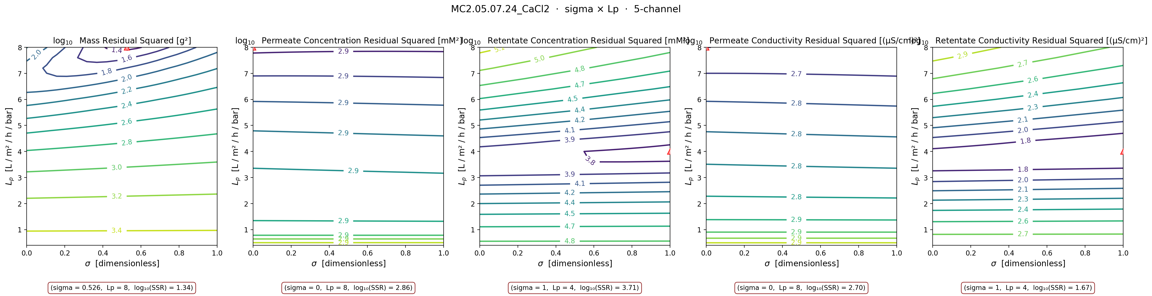
03
03 · MC2 CaCl₂ — Inconsistent across channels
STAGE 2 · Inconsistent
B fixed at warm-start (0.51 µm/s) · σ × Lp swept · channels split by side of the membrane
Takeaway: Each channel finds its own minimum — the objective is minimized, but at inconsistent (σ, Lp). Both permeate channels (concentration + conductivity) argmin at σ=0 wall, Lp=8. Both retentate channels argmin at σ=1 wall, Lp=4. Mass disagrees with all — interior σ ≈ 0.53. The channels can be fit individually but no shared θ satisfies all of them.

Slide 5
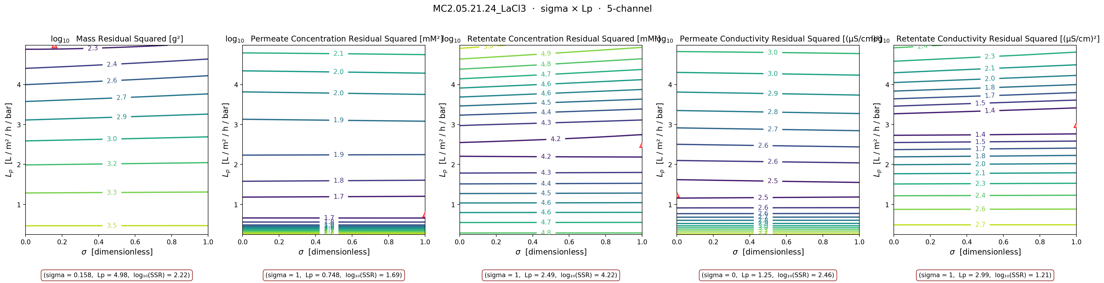
04
04 · MC2 LaCl₃ — Parameters not estimable
STAGE 3 · Not estimable
B fixed at warm-start (0.31 µm/s) · σ × Lp swept · every channel argmins at a different Lp
Takeaway: Every channel argmins at a different Lp: mass=4.98, perm conc=0.75, ret conc=2.49, perm cond=1.25, ret cond=2.99. The objective is bumpy across the entire (σ, Lp) plane — no consistent basin. Single-point ParmEst will pick whichever channel dominates the weighted sum. Path forward: ion-pairing physics (LaCl²⁺/LaCl⁺ equilibria) + σ(cF) sub-model — slide 12 of v10 deck.

Slide 6
05
05 · CROSS-SHEET SUMMARY — argmin per channel
valence progression — the same σ × Lp sweep applied to three sheets
Argmin L_p [L/(m²·hr·bar)] per channel
Sheet | Mass | Perm conc | Ret conc | Perm cond | Ret cond | Warm-start Lp
NaCl ✓ | 9.95 | 9.95 | 9.95 | 15.93 ↑ | 9.95 | 9.95
CaCl₂ ⚠ | 8.00 | 8.00 | 4.00 | 8.00 | 4.00 | 4.00
LaCl₃ ✗ | 4.98 | 0.75 | 2.49 | 1.25 | 2.99 | 2.49
Argmin σ per channel
Sheet | Mass | Perm conc | Ret conc | Perm cond | Ret cond
NaCl ✓ | 1.00 | 1.00 | 1.00 | 1.00 | 1.00
CaCl₂ ⚠ | 0.53 interior | 0.00 wall | 1.00 wall | 0.00 wall | 1.00 wall
LaCl₃ ✗ | 0.16 interior | 1.00 wall | 1.00 wall | 0.00 wall | 1.00 wall
Identifiability degrades monotonically with cation valence: NaCl (well-identified) → CaCl₂ (inconsistent, σ pinned at opposite walls per channel) → LaCl₃ (not estimable).

Slide 7
06
06 · MC2 NaCl REVISITED — limits of 'well-identified'
STAGE 1 · Well-identified
what if we also sweep B (in addition to σ × Lp at fixed B)?
Argmin (x, y, log₁₀ SSR) per channel × parameter-pair sweep
Pair (x × y) | Mass | Perm conc | Ret conc | Perm cond | Ret cond
σ × Lp (B fixed = 9.73) | σ=1.00 Lp=9.95 log₁₀=0.96 | σ=1.00 Lp=9.95 log₁₀=2.01 | σ=1.00 Lp=9.95 log₁₀=3.63 | σ=1.00 Lp=15.93 ↑ log₁₀=3.33 | σ=1.00 Lp=9.95 log₁₀=1.60
B × Lp (σ fixed = 1.00) | B=4.74 Lp=10.95 log₁₀=0.76 | B=26.84 Lp=6.97 log₁₀=1.95 | B=30.00 ↑ Lp=10.95 log₁₀=3.62 | B=1.58 Lp=19.91 ↑ log₁₀=2.40 | B=30.00 ↑ Lp=10.95 log₁₀=1.59
B × σ (Lp fixed = 9.95) | B=0.00 σ=0.32 (int) log₁₀=0.90 | B=9.47 σ=1.00 log₁₀=2.01 | B=17.37 σ=1.00 log₁₀=3.63 | B=1.58 σ=0.00 log₁₀=2.70 | B=15.79 σ=1.00 log₁₀=1.60
Takeaway: When σ is pinned at the σ=1 wall (B × Lp row), both retentate channels want B = 30 — the upper bound. When Lp is pinned at the warm-start (B × σ row), mass argmins at interior σ ≈ 0.32 with B near 0. Even the 'well-identified' σ × Lp picture has subtle limits — the σ=1 wall on Stage 1 was hiding a B-vs-Lp trade-off. Worth flagging: the NaCl identifiability is good but not perfect.

Slide 8
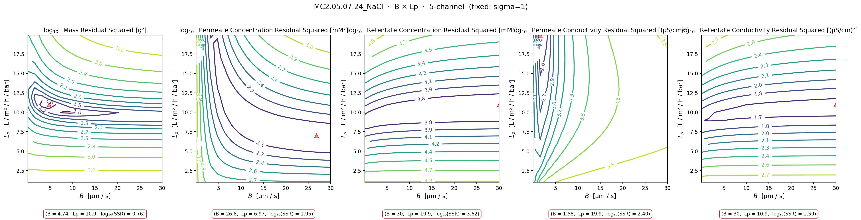
07A
07A · MC2 NaCl B × Lp contour
STAGE 1 · Well-identified
σ fixed at warm-start (σ=1) · B × Lp swept · supports slide 06

Slide 9
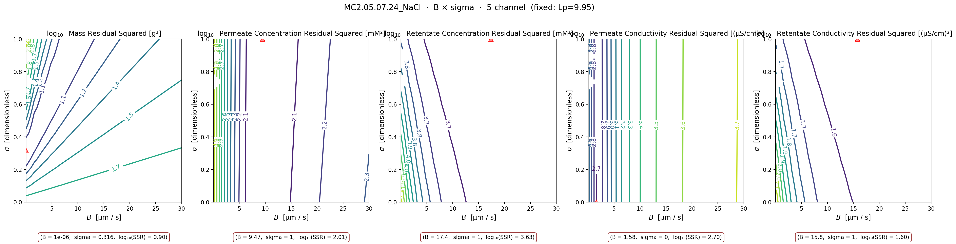
07B
07B · MC2 NaCl B × σ contour
STAGE 1 · Well-identified
Lp fixed at warm-start (Lp=9.95) · B × σ swept · supports slide 06

Slide 10
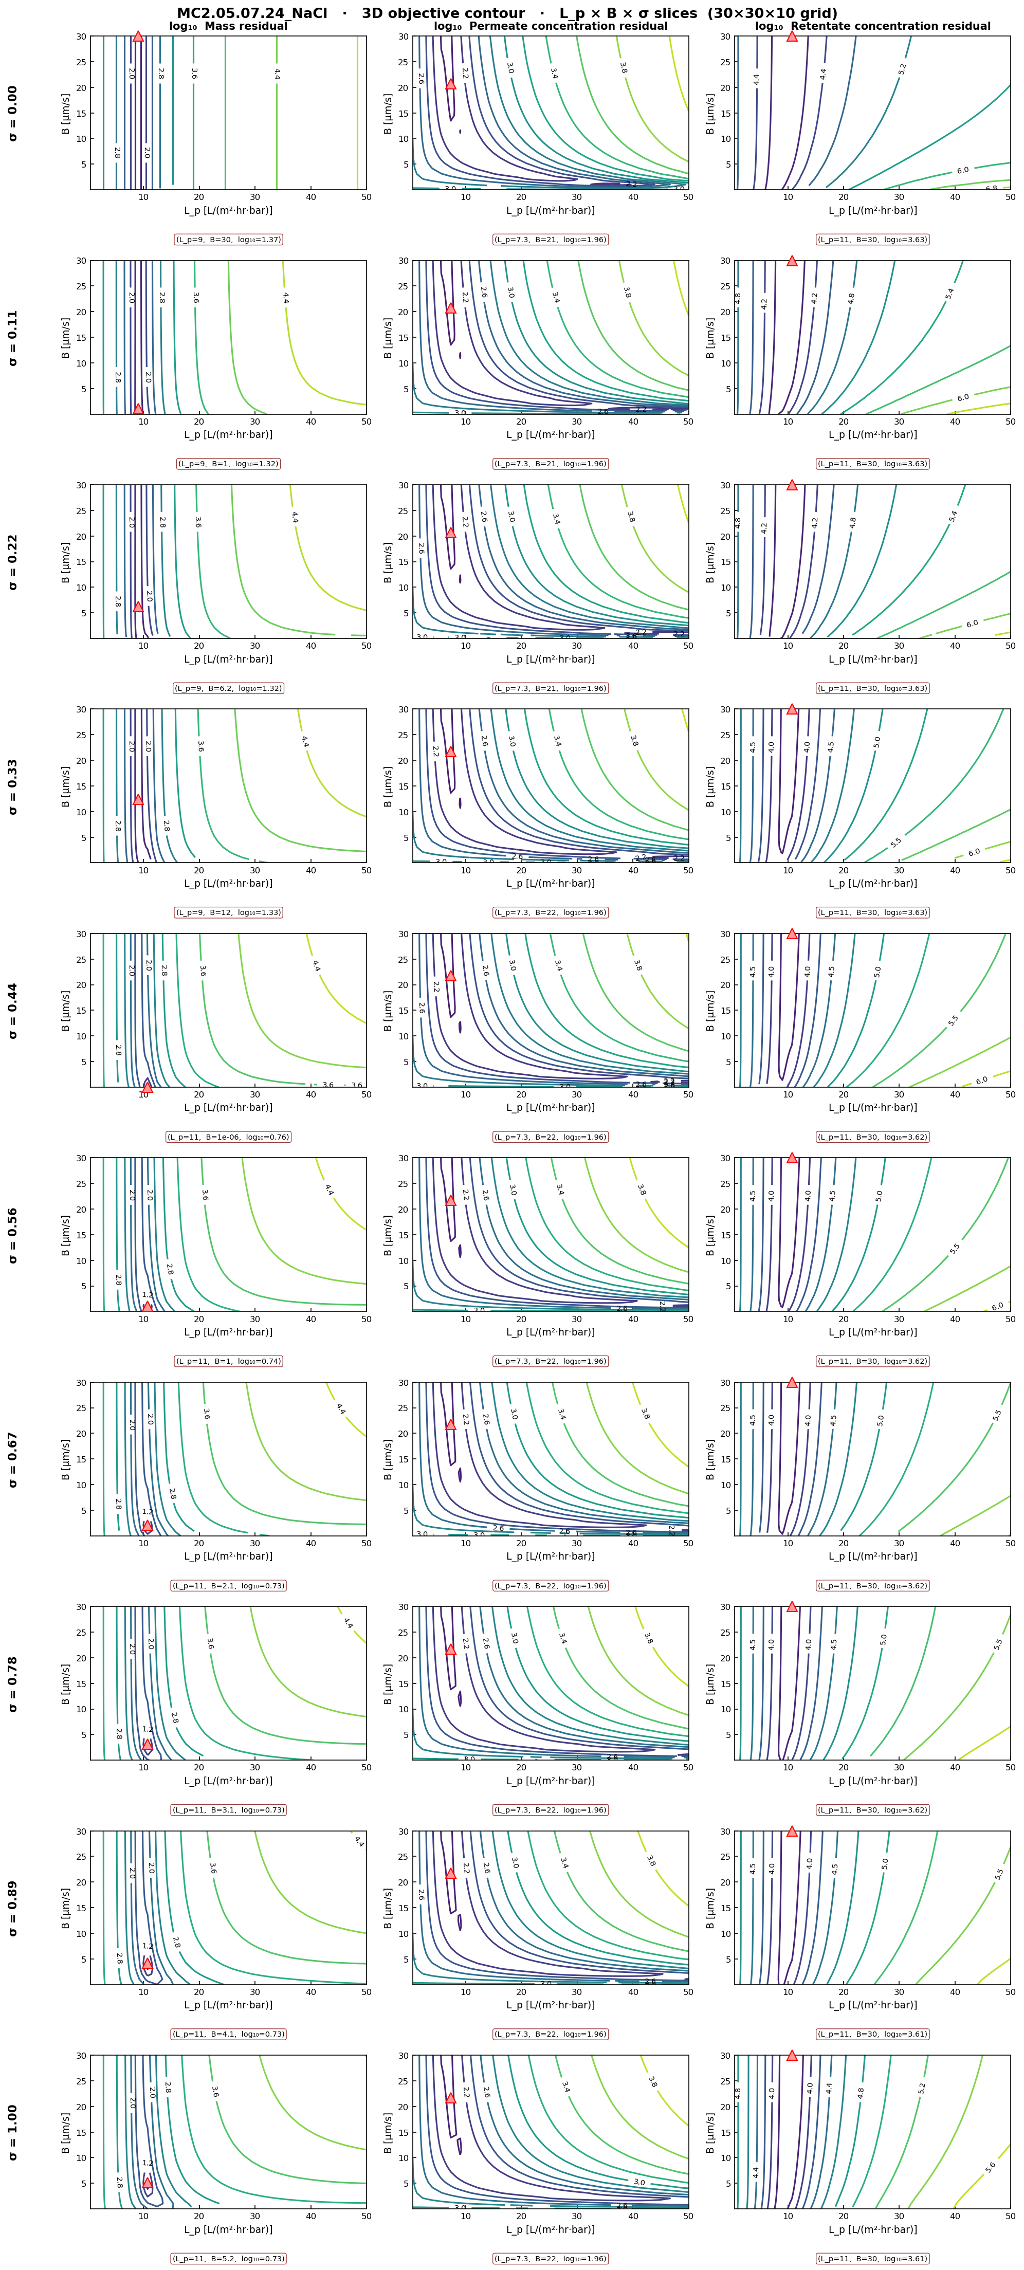
08A
08A · 3D L_p × B × σ — NaCl
10 σ-slices × 3 channels. Confirms the σ × Lp basin structure of slide 02.

Slide 11
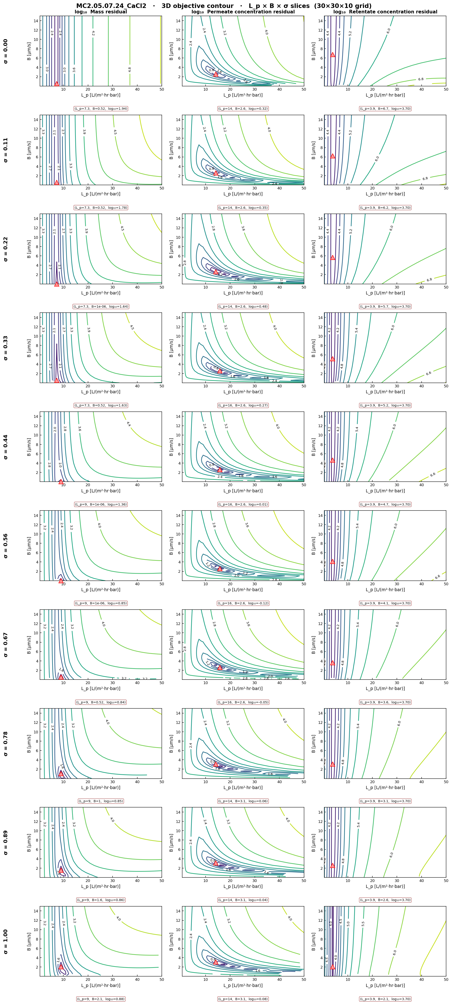
08B
08B · 3D L_p × B × σ — CaCl₂
10 σ-slices × 3 channels. Note how basin shape morphs between σ=0 and σ=1 — the side-split of slide 03.

Slide 12
09
09 · QUESTIONS FOR DISCUSSION
what I'd like your sanity check on before publishing
1.
Three-stage diagnostic story
Does the well-identified → inconsistent → not-estimable framing match what you'd intuit from the underlying physics (anionic NF270 + chloride co-ion + increasing cation valence)?
2.
Permeate conductivity divergence on NaCl
Even the well-identified Stage 1 has permeate conductivity wanting Lp ≈ 15.9 vs all others at 9.95. Is this (a) m.cH-vs-cV physics that the warm-start under-fits, or (b) Shedlovsky-forward calibration?
3.
Per-salt B bounds in the optimizer
We've landed NaCl [0,30], CaCl₂ [0,15], LaCl₃ [0,10] in the library. Anything you'd revise before re-running the full fit campaign?
4.
LaCl₃ ion-pairing fix
Stage 3 confirms slide 12's 'physics gap' diagnosis. Should we (a) parameterize σ(cF) explicitly, (b) add an ion-pairing equilibrium block, or (c) fit only the diluting-regime portion?
5.
Which subset for the next campaign meeting?
Lead with the three-stage roadmap (slide 1) + the three Stage slides? Or save Stage 1 wrinkles (slide 06) and the 3D appendix for follow-up?

