Slide 1

DATA3 — Contour Diagnostics
Three stages of parameter identifiability across all 11 NF270 single-salt sheets
STAGE 1
STAGE 2
STAGE 3
Well-identified
Inconsistent
Not estimable
2 sheets · NaCl: MC3 SNaCl + MC5 S2NaCl
7 sheets: 4 NaCl + 3 CaCl₂
2 sheets: MC2 + MC4 LaCl₃
Lp identified two ways:
(a) interior σ via concentrating run,
(b) σ-harmless via diluting run
Channels each find a minimum,
but at different (σ, Lp) walls.
Lp tight, σ rail-pinned.
Same wrong-model bias on both:
the constant-(σ,B) Spiegler-Kedem
cannot represent La³⁺ ion-pairing.
What we trust most → what we trust least. Agreement across the 5 measurement channels = trust.
Discussion · 2026-06-04

Slide 2
01
CONTEXT — parameter bounds in play
L_p ∈ [0.5, 50] and σ ∈ [0, 1] inherited from DATA1/DATA2 KCl; per-salt B bound is the only new knob
KCl baseline (inherited from DATA1/DATA2): L_p ∈ [0.5, 50] L/(m²·hr·bar), B ∈ [0, 30] µm/s, σ ∈ [0, 1]
Per-salt B upper bound — halve per +1 of cation charge:
Salt | B bound [µm/s] | Basis
NaCl | [0, 30] | monovalent — same as KCl
CaCl₂ | [0, 15] | divalent — halved
LaCl₃ | [0, 10] | trivalent — third
How the contour panels are built: at every (σ, Lp) grid point we forward-simulate the full Spiegler-Kedem DAE (B fixed at warm-start, S0/S also at warm-start), then evaluate the weighted sum-of-squared-residuals per channel. 5 channels per panel: mass, permeate concentration, retentate concentration, permeate conductivity, retentate conductivity. No fitting — pure forward-simulation diagnostics.

Slide 3
02
ALL 11 SHEETS — warm-start θ summary
where the optimizer landed on every sheet — color-coded by stage
Warm-start fits across the campaign (sorted by salt, then by sheet ID):
Sheet | Salt | L_p | B [µm/s] | σ | WSSE | Stage assignment
MC2.05.07.24_NaCl | NaCl | 9.95 | 9.73 | 1.00 ↑ | 4357 | Stage 2 · σ wall, concentrating regime
MC3.07.22.24_SNaCl | NaCl | 8.22 | 14.68 | 0.45 | 556 | Stage 1 · interior σ — concentrating run probed σ-sensitive regime (gold)
MC4.07.11.24_SNaCl | NaCl | 7.79 | 2.02 | 0.00 ↓ | 9536 | Stage 2 · σ=0, diluting regime BUT poor WSSE — data-quality issue
MC5.07.23.24_NaCl | NaCl | 10.02 | 3.70 | 1.00 ↑ | 5794 | Stage 2 · σ wall, concentrating regime
MC5.07.23.24_SNaCl | NaCl | 9.45 | 3.07 | 1.00 ↑ | 4764 | Stage 2 · σ wall, concentrating regime
MC5.07.23.24_S2NaCl | NaCl | 7.38 | 10.14 | 0.00 ↓ | 830 | Stage 1 · σ=0 harmless — diluting run, Lp identified by mass (2nd best WSSE)
MC2.05.07.24_CaCl2 | CaCl₂ | 4.00 | 0.51 | 1.00 ↑ | 6717 | Stage 2 · channels split by side
MC3.07.11.24_SCaCl2 | CaCl₂ | 5.53 | 9.11 | 1.00 ↑ | 4080 | Stage 2 · σ at wall
MC3.07.12.24_S2CaCl2 | CaCl₂ | 4.63 | 30.00 | 1.00 ↑ | 9252 | Stage 2 · σ AND B at walls
MC2.05.21.24_LaCl3 | LaCl₃ | 2.49 | 0.31 | 1.00 ↑ | 17711 | Stage 3 · wrong model — every channel disagrees
MC4.07.11.24_SLaCl3 | LaCl₃ | 2.78 | 0.17 | 1.00 ↑ | 21345 | Stage 3 · wrong model — replicate of MC2
↑ / ↓ marks parameters pinned at a bound. Only MC3.07.22.24_SNaCl landed at an interior σ — that's our reference case for 'well-identified'.

Slide 4
03
TWO PATHS TO WELL-IDENTIFIED
STAGE 1 · Well-identified
the same Lp can be pinned by the data two completely different ways
There are two physically distinct ways the data can pin (Lp, σ, B): either we run conditions that PROBE σ directly so the contour shows an interior σ minimum, OR we run conditions where σ doesn't matter so we don't need to probe it. Both give us a usable Lp. The campaign has one sheet in each category.
PATH A · probe σ directly
PATH B · bypass σ (diluting regime)
MC3.07.22.24_SNaCl
MC5.07.23.24_S2NaCl
Lp = 8.22 B = 14.68 σ = 0.45 WSSE = 556
Lp = 7.38 B = 10.14 σ = 0.00 ↓ WSSE = 830
Concentrating regime, but the run conditions excited σ — probably a wider pressure-driving-force sweep, lower feed, or a pressure step. σ leaves a fingerprint in the data, so the optimizer finds an interior minimum at σ = 0.45. All 5 channels converge. This is the textbook well-identified case.
Diluting regime — cF shrinks over the run, so σ · Δπ → 0 by the end no matter what σ is. σ literally cannot leave a fingerprint here. Optimizer drifts to σ = 0 because the gradient is flat, not because data says σ = 0. Lp is still pinned tightly by the mass channel. WSSE = 830 — 2nd best in the campaign.
Takeaway: Same destination, two different roads. Path A needs careful experimental design; Path B comes free if you happen to run a diluting experiment. Either way Lp is trustworthy. Knowing which path each sheet is on tells us where the σ value can be trusted (Path A) and where σ is unconstrained but irrelevant (Path B).

Slide 5
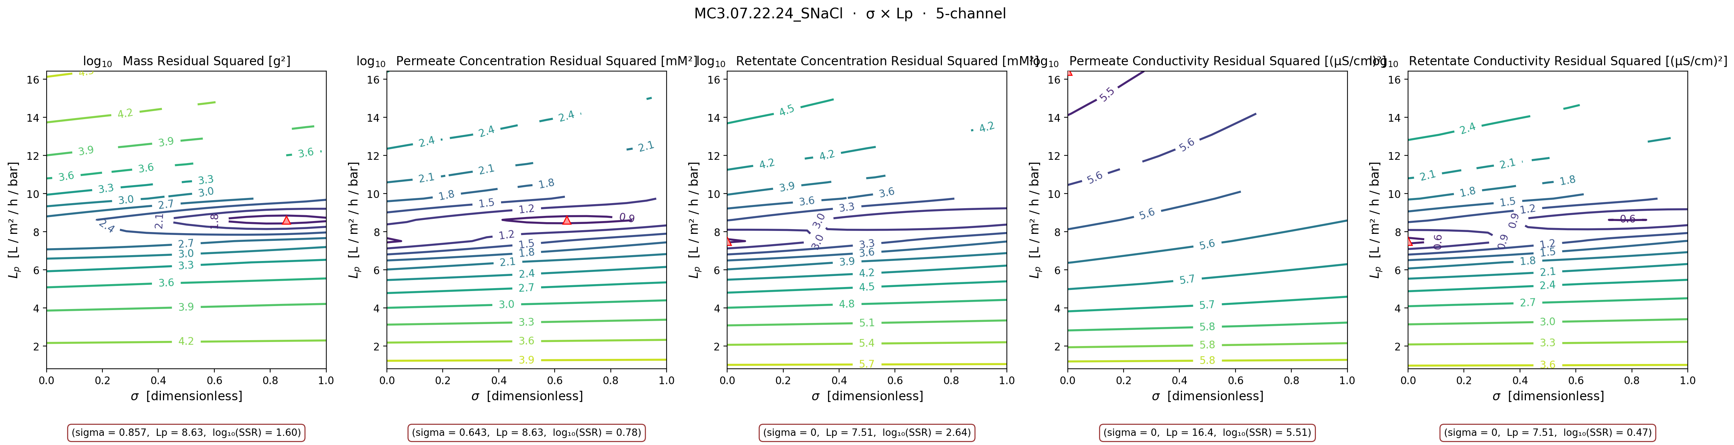
04
STAGE 1 (path A) — MC3.07.22.24_SNaCl
STAGE 1 · Well-identified
interior σ via concentrating run — the gold standard fit (WSSE = 556)
Takeaway: Look at the mass and permeate-concentration panels — both argmin at interior σ (0.86 and 0.64) near Lp ≈ 8.6. Retentate channels still pin at σ=0 (the 0.3 % cF over-weighting effect), but the joint WSSE is dominated by mass + perm-conc, so the warm-start θ landed interior at σ = 0.45. This is the only NaCl sheet where σ leaves a real fingerprint.

Slide 6
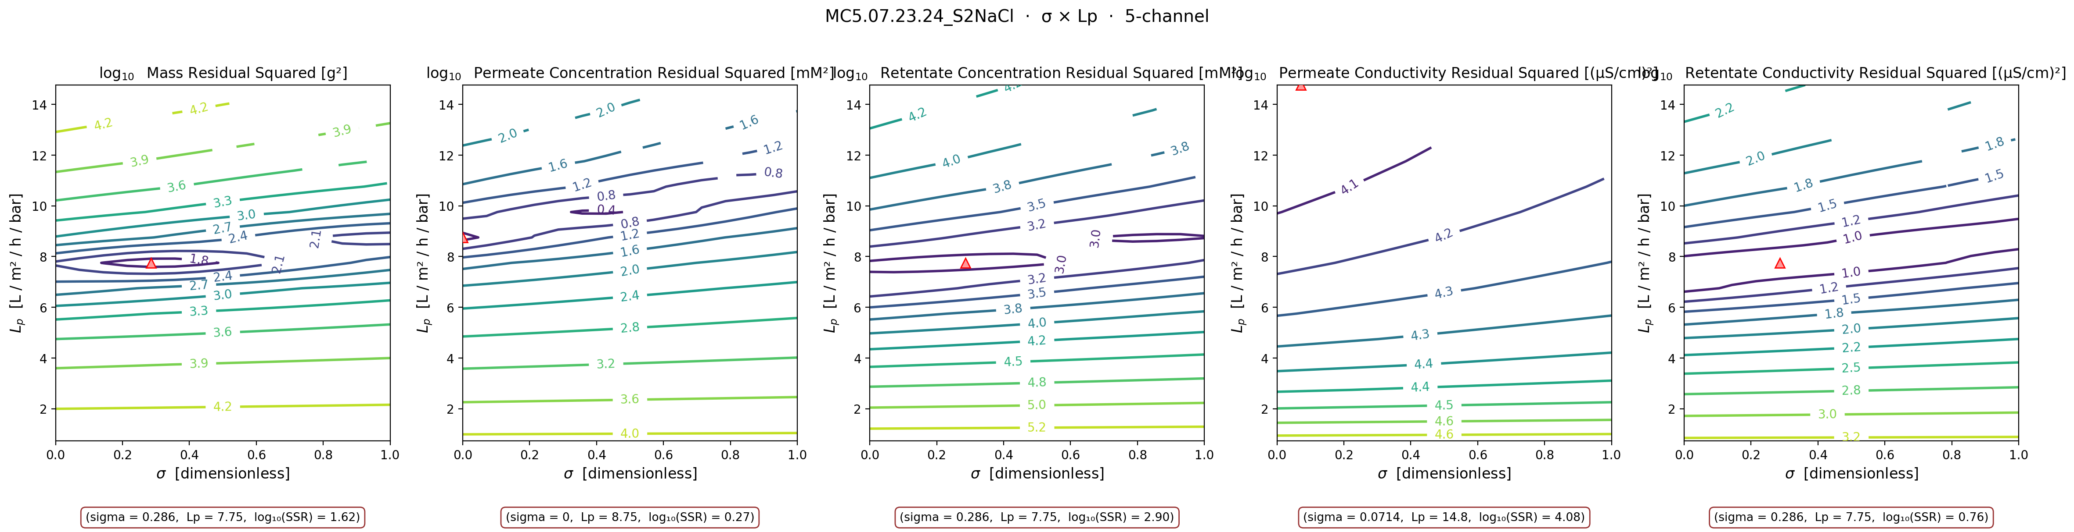
05
STAGE 1 (path B) — MC5.07.23.24_S2NaCl
STAGE 1 · Well-identified
diluting run — σ harmless, Lp pinned anyway (WSSE = 830)
Takeaway: Four channels argmin at Lp ≈ 7.7 — tight cluster. σ slides to ~0 because the gradient is flat in the diluting regime (σ·Δπ → 0 at end of run), but Lp is well-identified by the mass channel. WSSE = 830 — 2nd best in the entire campaign. Diluting experiments are 'free' identifiability for Lp.

Slide 7
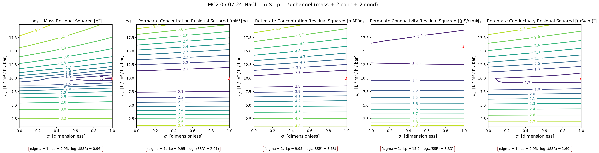
06
STAGE 2 — NaCl (the 4 concentrating-regime sheets at the σ=1 wall)
STAGE 2 · Inconsistent
Lp tight (8.6 ± 1.1) but σ pinned — these sheets ran concentrating without probing σ-sensitive conditions
Takeaway: MC2 NaCl shown here — same story on MC5 NaCl, MC5 SNaCl, and the concentrating part of MC4 SNaCl. 4 of 5 channels converge on Lp ≈ 9.95 (Lp well-identified), but σ pins at the σ=1 wall and the wall is hiding a B-vs-Lp trade-off. Concentrating regime + no σ-probing conditions = inconsistent across channels.

Slide 8
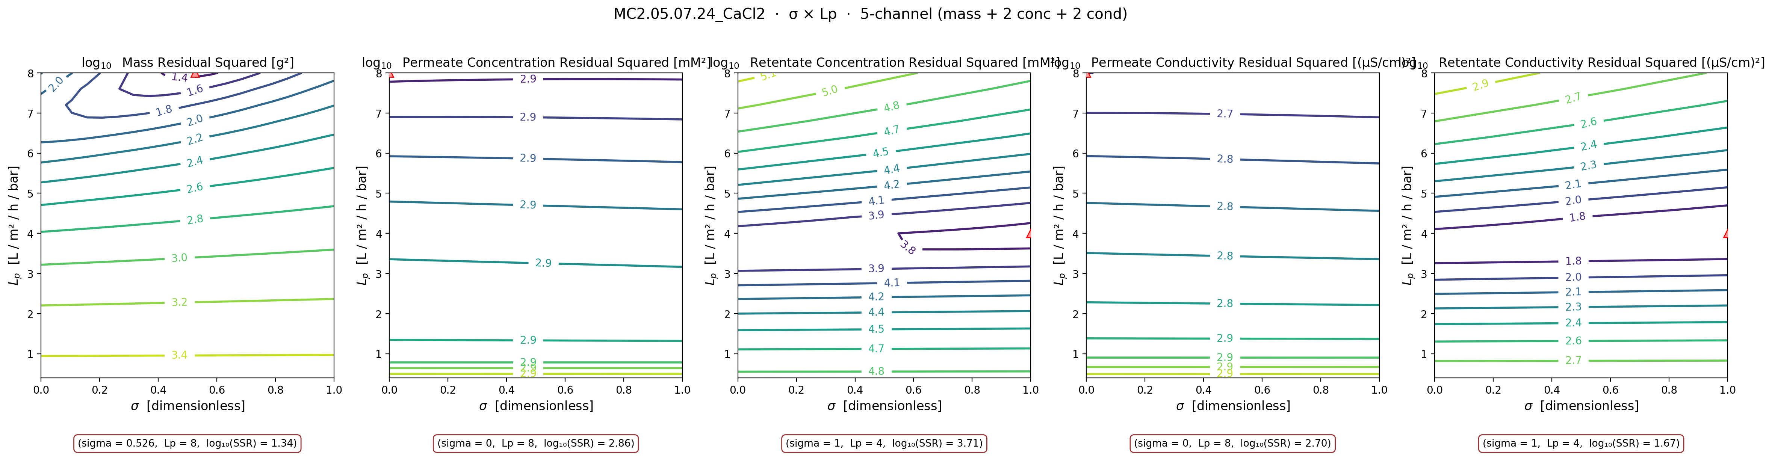
07
STAGE 2 — CaCl₂ (all 3 sheets)
STAGE 2 · Inconsistent
every sheet pins σ at σ=1 wall in the warm-start fit; contour shows channels split by membrane side
Takeaway: All 3 CaCl₂ sheets pin σ at σ=1 (and one pins B at the upper bound too). Physics expects interior σ (divalent counter-ion → weaker Donnan exclusion → lower σ on NF270) — pinning at σ=1 is a weighting problem, not a model-form problem. Both permeate channels want σ=0; both retentate channels want σ=1. Split by membrane side, not by physics.

Slide 9
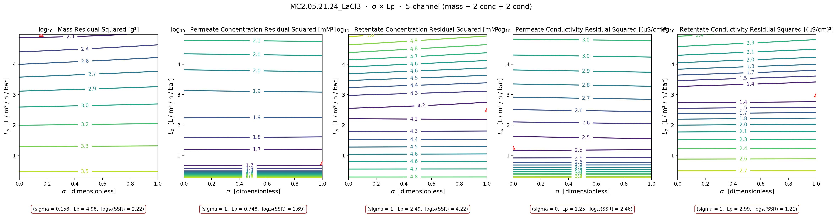
08
STAGE 3 — LaCl₃ (both sheets)
STAGE 3 · Not estimable
warm-start θ nearly identical between sheets, but WSSE ~20× worse than NaCl gold standard → shared wrong-model bias
Takeaway: Both LaCl₃ sheets warm-start to nearly identical θ — but fit the data ~20× worse than NaCl MC3 SNaCl. Same wrong-model bias both times, not measurement noise. The constant-(σ, B) Spiegler-Kedem model is structurally wrong for trivalent ions — probably because of LaCl²⁺ / LaCl⁺ ion-pairing the model can't see. AND we only have 2 sheets: that's an anecdote, not a sample size.

Slide 10
09
WHAT DATA SHOULD WE COLLECT
what would unblock the campaign — prioritized by leverage
PRIORITY 1
Pure-water L_p before and after every run
Single highest-leverage experiment. Pins L_p independently of the salt-transport data so σ and B don't have to compensate for it. Also doubles as a fouling check — if pre-run and post-run L_p drift, we know the membrane changed during the experiment and the constant-parameter fit was never going to work.
PRIORITY 2
Multi-pressure sweeps within a single run + dilute concentration runs
Pinning σ for CaCl₂ and LaCl₃ requires breaking the σ-B correlation. σ couples to Δπ, B doesn't — so stepping ΔP across a wide range during one run changes the relative leverage of σ vs B. Dilute runs (1-5 mM NaCl, sub-mM LaCl₃) push into the diffusion-limited regime where σ identifies.
PRIORITY 3
3-5 more LaCl₃ sheets + retentate-side conductivity probe + UV-Vis / ICP speciation
n = 2 LaCl₃ sheets is not statistics — we need at least 5 before any 'not estimable' claim carries weight. Adding high-frequency conductivity on the retentate (we only have it on permeate) eliminates the CaCl₂ side-split weighting problem. Speciation directly tests the LaCl²⁺ / LaCl⁺ ion-pairing hypothesis rather than inferring it from model failure.

Slide 11
10
QUESTIONS FOR DISCUSSION
what I'd like your read on before the campaign re-run
1.
Does the 3-stage diagnosis match what you'd intuit physically?
Anionic NF270 + chloride co-ion + increasing cation valence → identifiability should degrade with valence. That's what we see. But is the σ=1 wall on the NaCl/CaCl₂ sheets really a regime problem, or is it the 0.3 % cF scaling forcing the optimizer there?
2.
MC3 SNaCl and MC5 S2NaCl — two different paths to well-identified
MC3 SNaCl probed σ-sensitive conditions and got interior σ = 0.45. MC5 S2NaCl ran diluting so σ was irrelevant — same Lp identifiability for free. What do the run-sheet metadata show that's different from the other 4 NaCl sheets? Pressure span, feed concentration, run duration?
2b.
MC4 SNaCl — diluting but poor fit (WSSE = 9536)
MC4 SNaCl looks like a diluting-regime run (σ = 0 wall), but its WSSE is ~10× worse than MC5 S2NaCl. Same regime, same salt, same membrane — different fit quality. Likely a data-quality issue (fouling, leak, calibration drift) rather than a model issue. Worth a closer look.
3.
LaCl₃ ion-pairing fix
Stage 3 confirms the v10-deck slide 12 'physics gap' diagnosis. Should we (a) parameterize σ(cF) explicitly, (b) add an ion-pairing equilibrium block with LaCl²⁺ / LaCl⁺ partition, or (c) fit only the diluting-regime portion? Need at least 3-5 more LaCl₃ sheets either way.
4.
Priority 1 data — pure-water L_p calibration
I think this is the single highest-leverage experiment. Is it feasible to add to every NF270 run going forward? Roughly: 10 minutes of DI water at the operating ΔP before and after the salt run.
5.
Per-salt B bounds in the optimizer
We've landed NaCl [0, 30], CaCl₂ [0, 15], LaCl₃ [0, 10] in the library (Architecture.md §17). Anything you'd revise before re-running the full campaign?

Slide 12
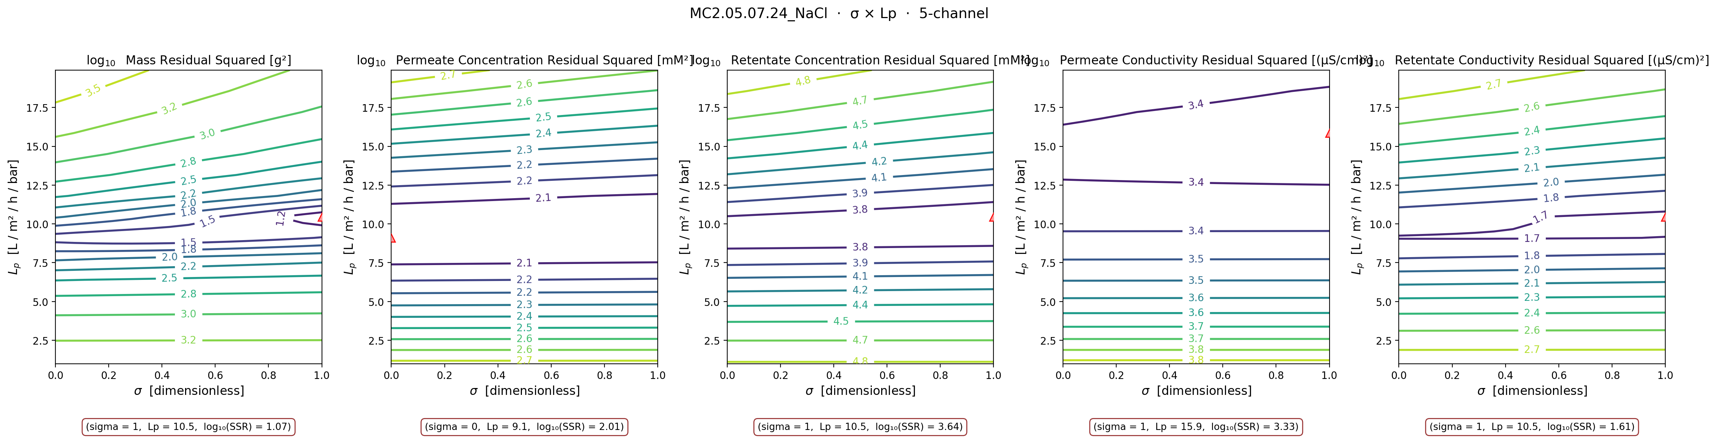
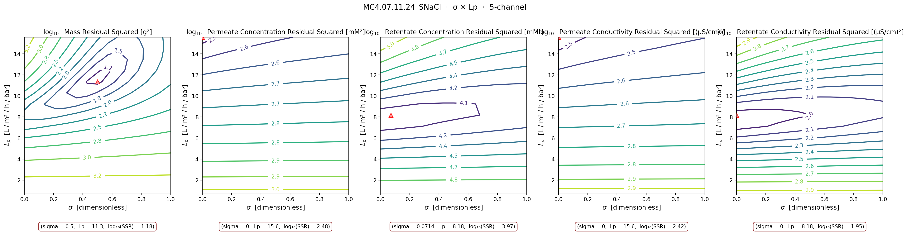
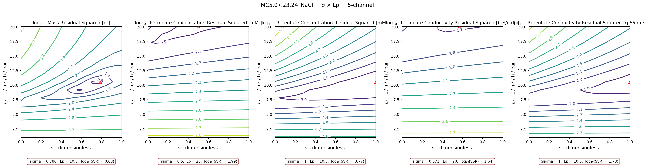
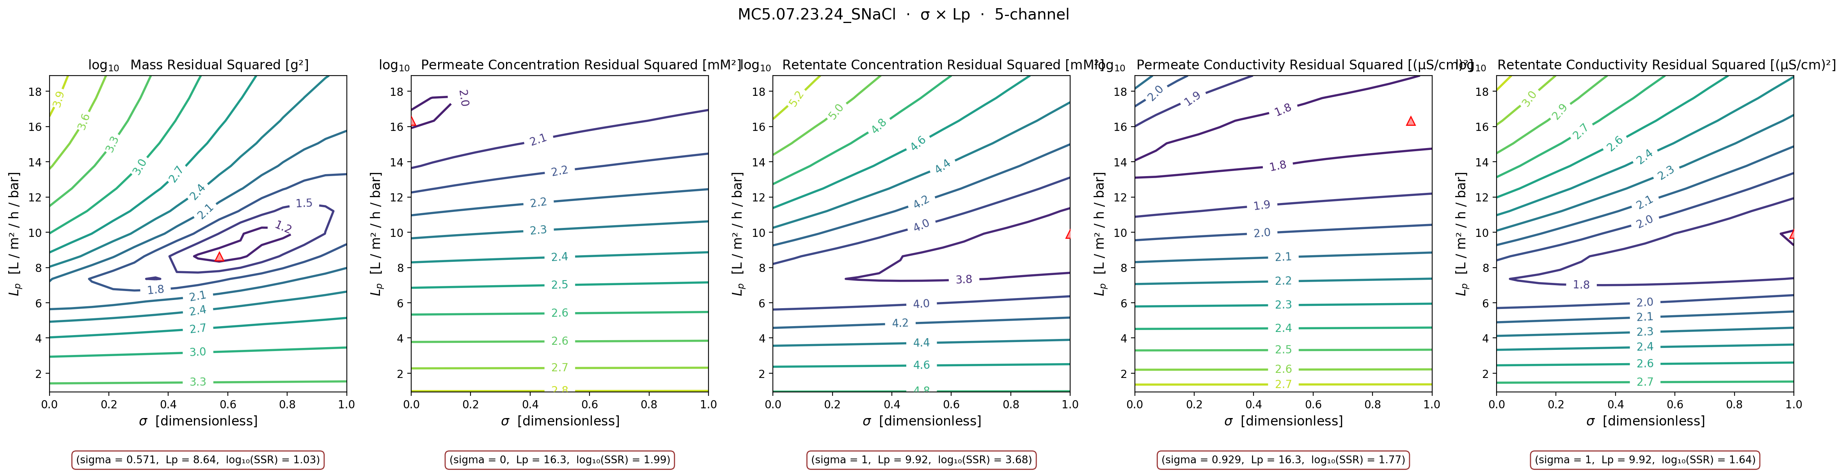
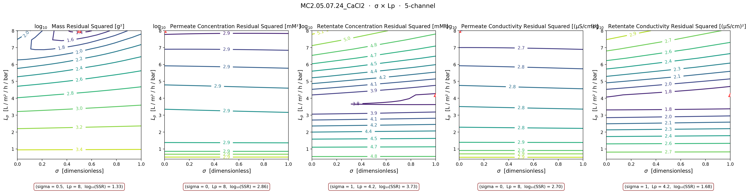
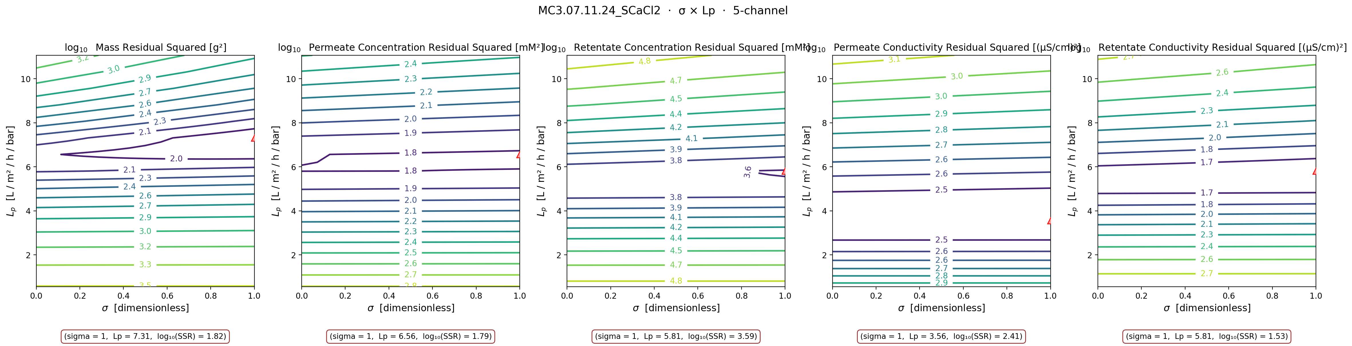
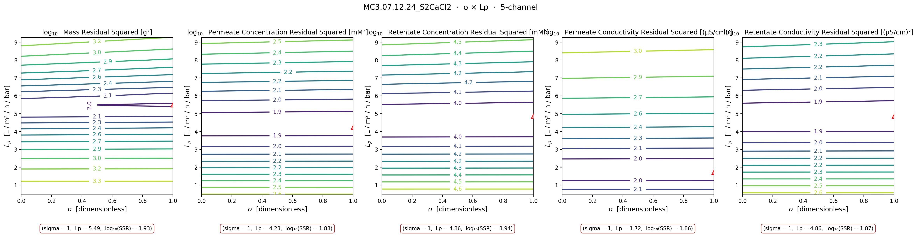
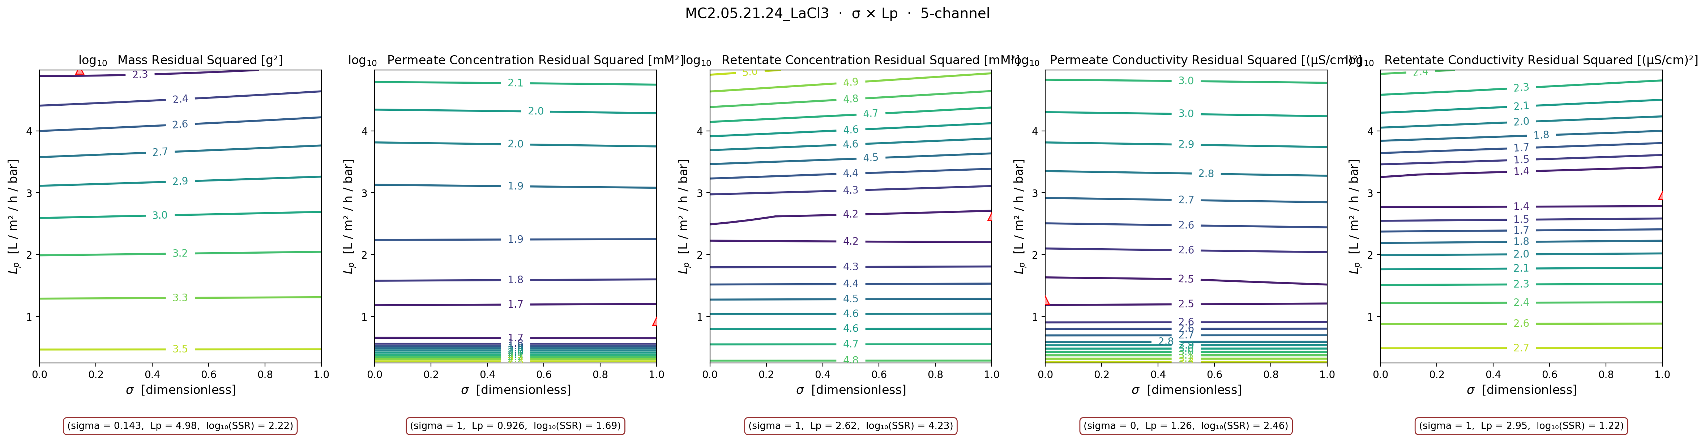
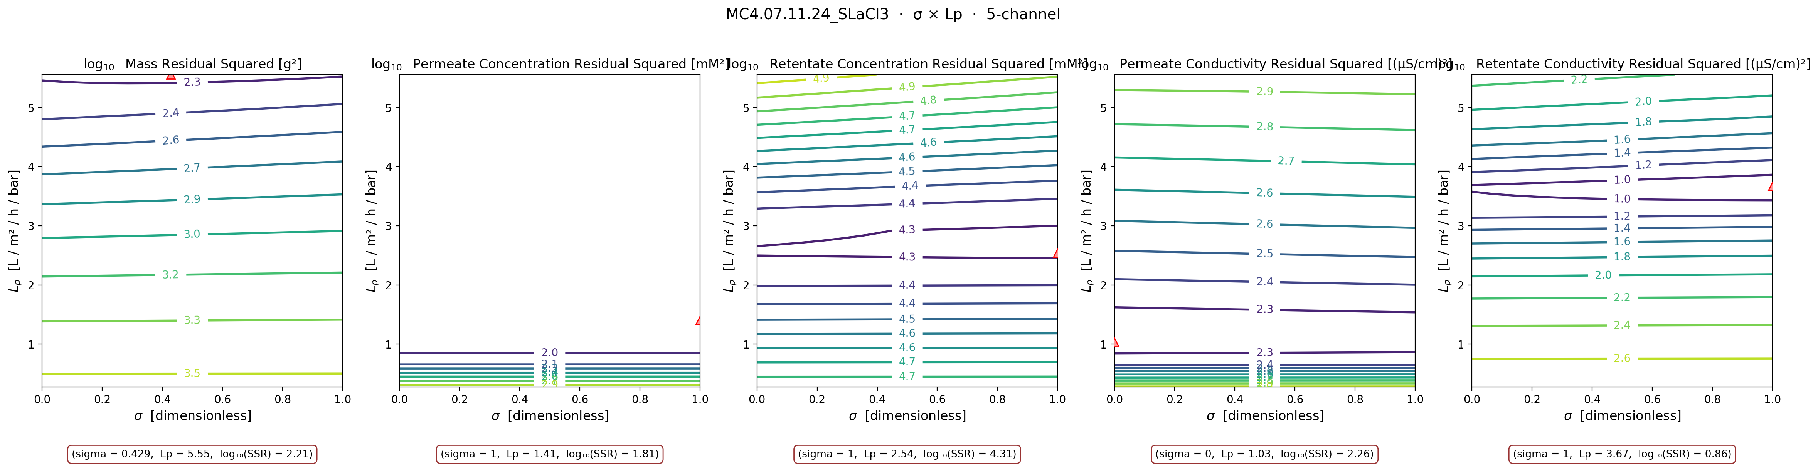
11
ALL 11 SHEETS — σ × Lp small-multiples
every sheet's contour, color-tabbed by stage — visual evidence for the categorization
MC3 SNaCl
MC5 S2NaCl
MC2 NaCl
MC4 SNaCl ⚠
MC5 NaCl
MC5 SNaCl
MC2 CaCl₂
MC3 SCaCl₂
MC3 S2CaCl₂
MC2 LaCl₃
MC4 SLaCl₃

Slide 13
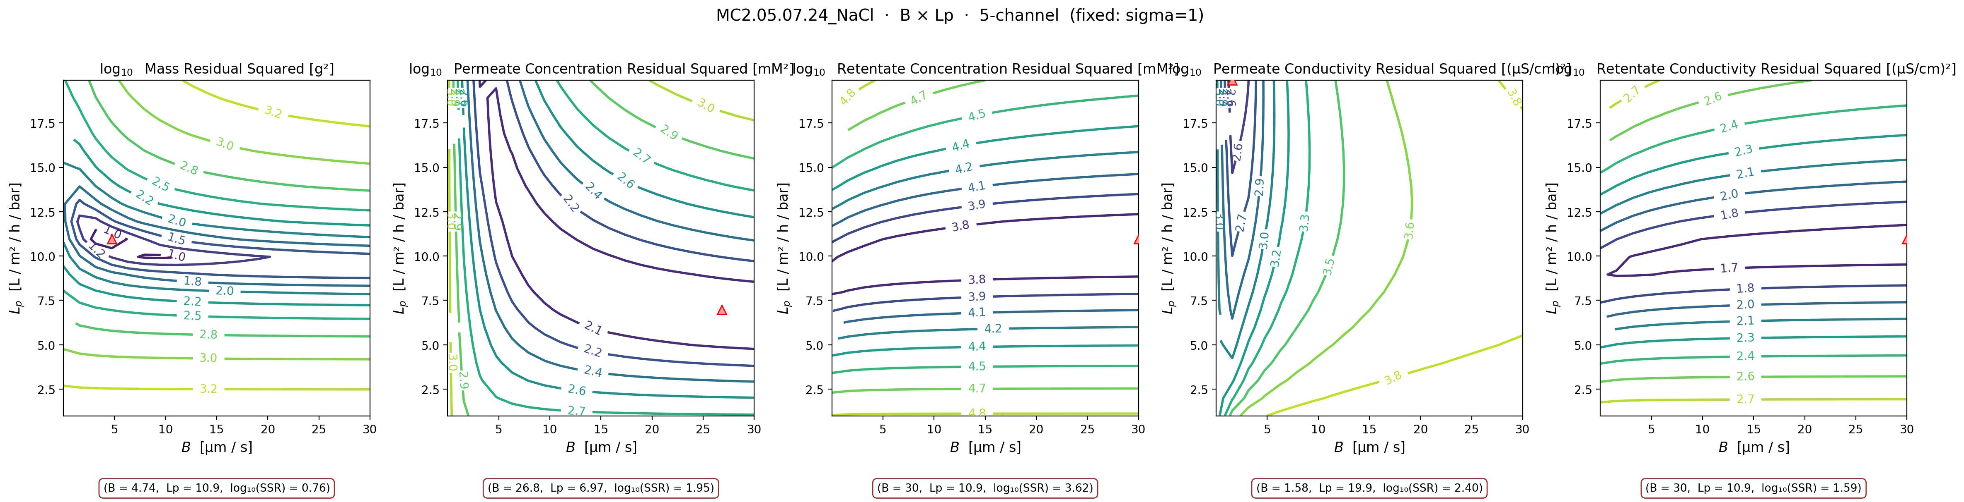
A1
APPENDIX — MC2 NaCl B × Lp contour
σ fixed at warm-start (σ=1) · B × Lp swept · supports the 'σ=1 wall hides B-Lp trade-off' claim

Slide 14
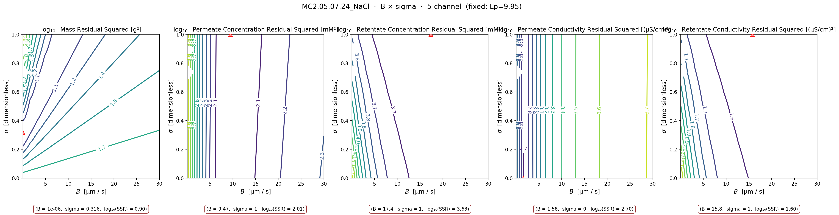
A2
APPENDIX — MC2 NaCl B × σ contour
Lp fixed at warm-start (Lp=9.95) · B × σ swept · mass argmins at interior σ ≈ 0.32 — interesting

Slide 15
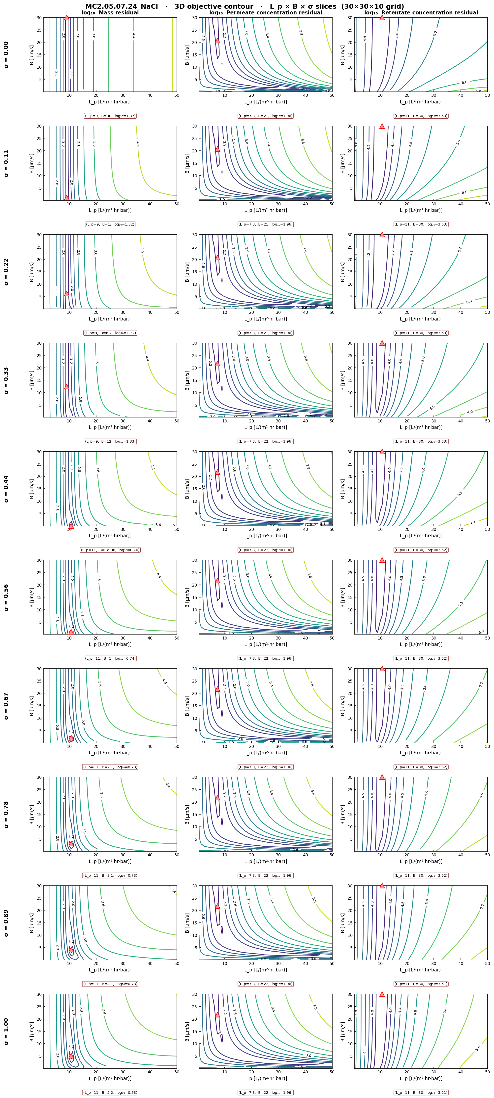
A3
APPENDIX — 3D L_p × B × σ slice composite, NaCl
10 σ-slices × 3 channels. Confirms the σ × Lp basin structure.

Slide 16
A3
APPENDIX — 3D L_p × B × σ slice composite, NaCl
10 σ-slices × 3 channels. Confirms the σ × Lp basin structure.

Slide 17
A3
APPENDIX — 3D L_p × B × σ slice composite, NaCl
10 σ-slices × 3 channels. Confirms the σ × Lp basin structure.

Slide 18
A3
APPENDIX — 3D L_p × B × σ slice composite, NaCl
10 σ-slices × 3 channels. Confirms the σ × Lp basin structure.

Slide 19
A3
APPENDIX — 3D L_p × B × σ slice composite, NaCl
10 σ-slices × 3 channels. Confirms the σ × Lp basin structure.

Slide 20
A3
APPENDIX — 3D L_p × B × σ slice composite, NaCl
10 σ-slices × 3 channels. Confirms the σ × Lp basin structure.

Slide 21
A3
APPENDIX — 3D L_p × B × σ slice composite, NaCl
10 σ-slices × 3 channels. Confirms the σ × Lp basin structure.

Slide 22
A3
APPENDIX — 3D L_p × B × σ slice composite, NaCl
10 σ-slices × 3 channels. Confirms the σ × Lp basin structure.

Slide 23
A3
APPENDIX — 3D L_p × B × σ slice composite, NaCl
10 σ-slices × 3 channels. Confirms the σ × Lp basin structure.

Slide 24
A3
APPENDIX — 3D L_p × B × σ slice composite, NaCl
10 σ-slices × 3 channels. Confirms the σ × Lp basin structure.

Slide 25
A3
APPENDIX — 3D L_p × B × σ slice composite, NaCl
10 σ-slices × 3 channels. Confirms the σ × Lp basin structure.

Slide 26
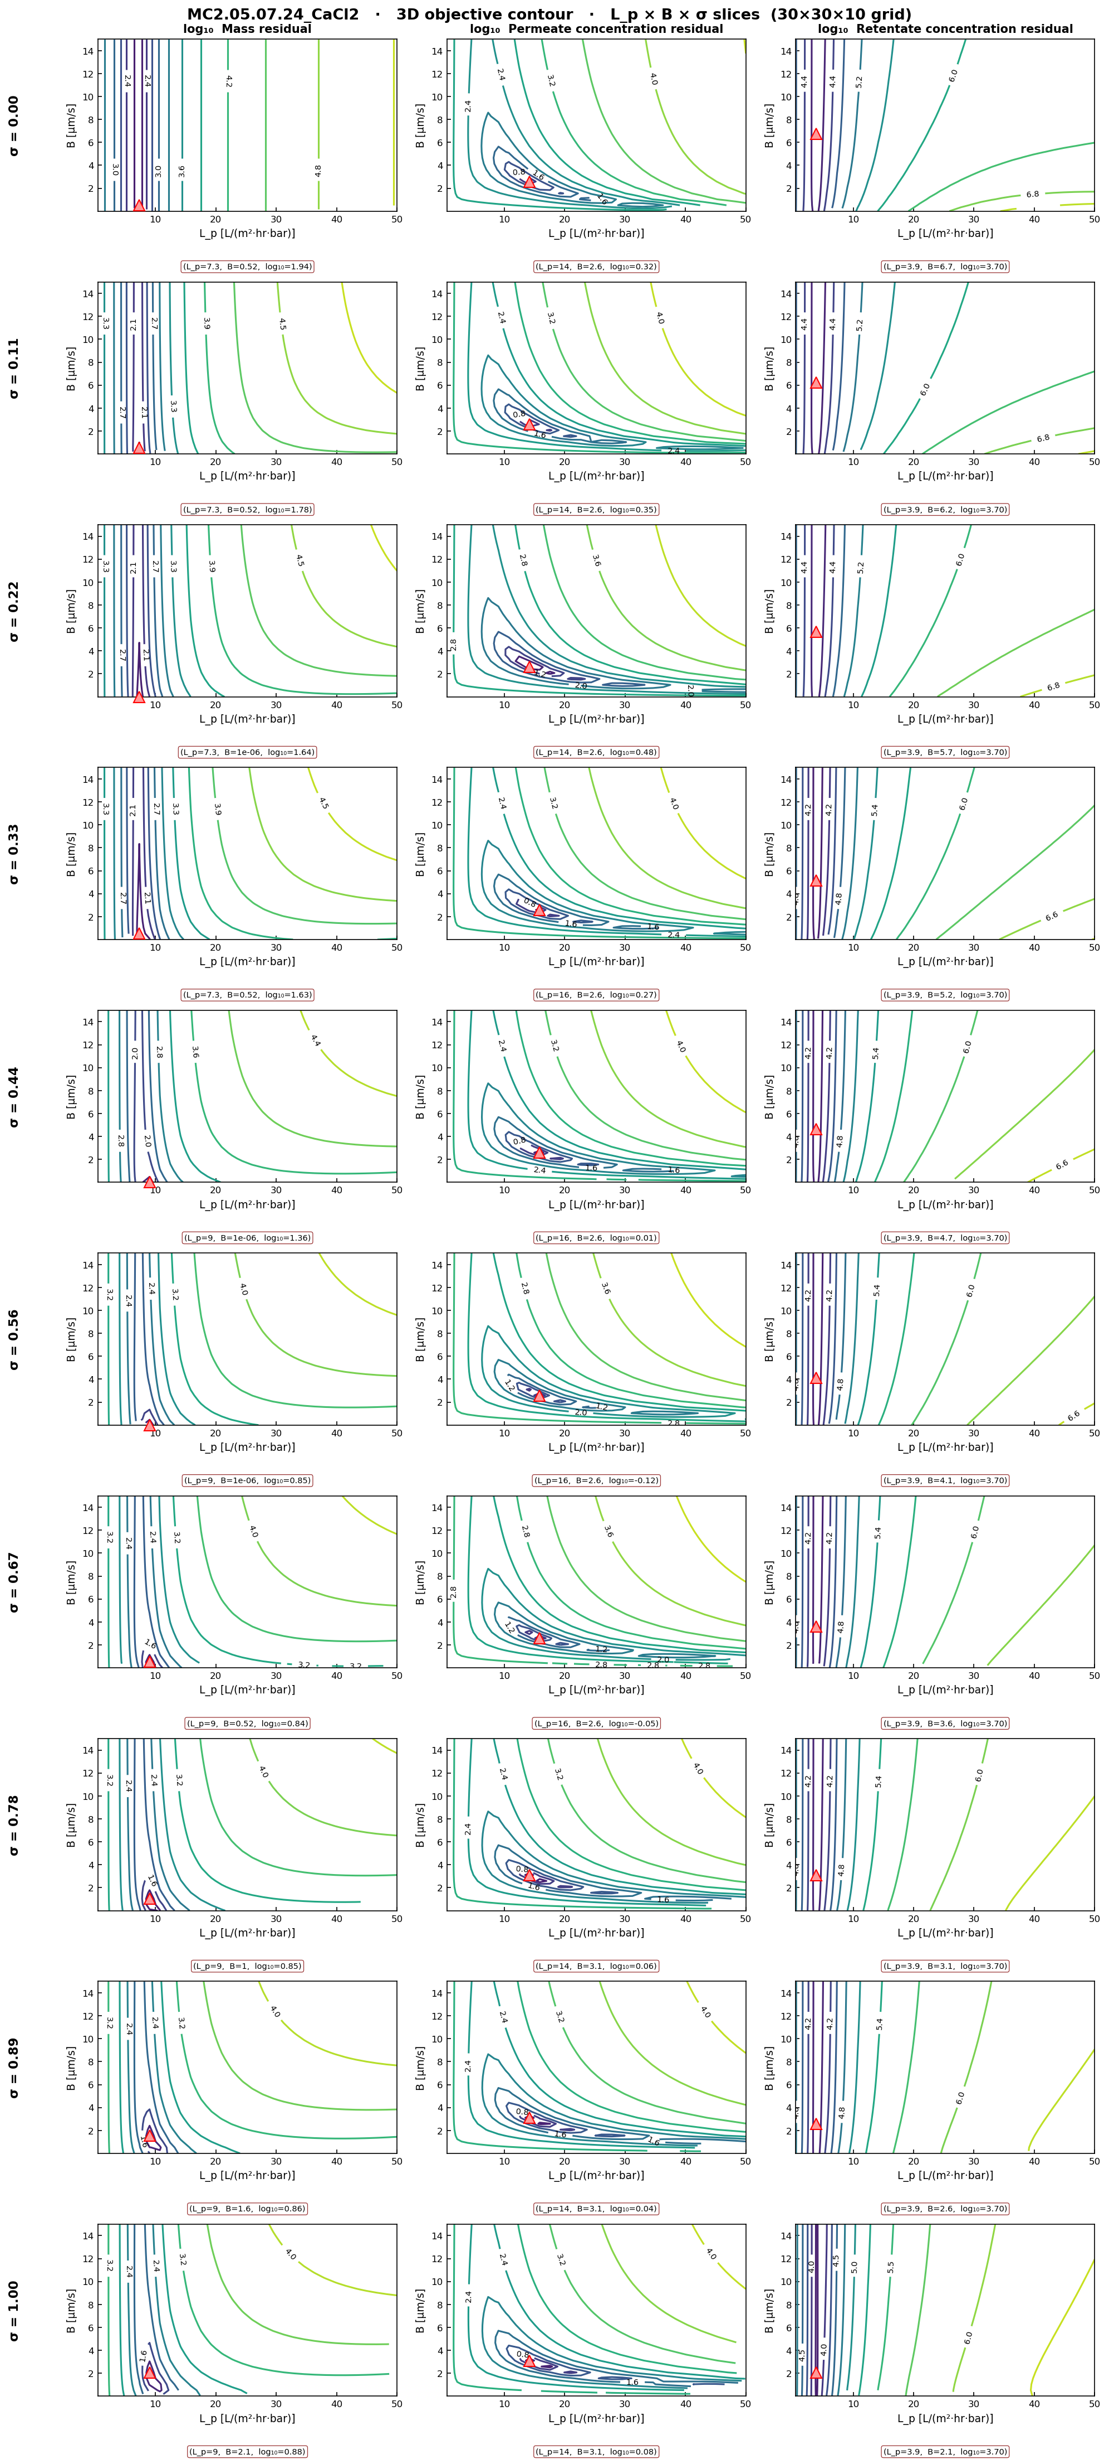
A4
APPENDIX — 3D L_p × B × σ slice composite, CaCl₂
Basin shape morphs between σ=0 and σ=1 — the side-split on slide 05 made visible across σ.

Slide 27
A4
APPENDIX — 3D L_p × B × σ slice composite, CaCl₂
Basin shape morphs between σ=0 and σ=1 — the side-split on slide 05 made visible across σ.

Slide 28
A4
APPENDIX — 3D L_p × B × σ slice composite, CaCl₂
Basin shape morphs between σ=0 and σ=1 — the side-split on slide 05 made visible across σ.

Slide 29
A4
APPENDIX — 3D L_p × B × σ slice composite, CaCl₂
Basin shape morphs between σ=0 and σ=1 — the side-split on slide 05 made visible across σ.

Slide 30
A4
APPENDIX — 3D L_p × B × σ slice composite, CaCl₂
Basin shape morphs between σ=0 and σ=1 — the side-split on slide 05 made visible across σ.

Slide 31
A4
APPENDIX — 3D L_p × B × σ slice composite, CaCl₂
Basin shape morphs between σ=0 and σ=1 — the side-split on slide 05 made visible across σ.

Slide 32
A4
APPENDIX — 3D L_p × B × σ slice composite, CaCl₂
Basin shape morphs between σ=0 and σ=1 — the side-split on slide 05 made visible across σ.

Slide 33
A4
APPENDIX — 3D L_p × B × σ slice composite, CaCl₂
Basin shape morphs between σ=0 and σ=1 — the side-split on slide 05 made visible across σ.

Slide 34
A4
APPENDIX — 3D L_p × B × σ slice composite, CaCl₂
Basin shape morphs between σ=0 and σ=1 — the side-split on slide 05 made visible across σ.

Slide 35
A4
APPENDIX — 3D L_p × B × σ slice composite, CaCl₂
Basin shape morphs between σ=0 and σ=1 — the side-split on slide 05 made visible across σ.

Slide 36
A4
APPENDIX — 3D L_p × B × σ slice composite, CaCl₂
Basin shape morphs between σ=0 and σ=1 — the side-split on slide 05 made visible across σ.

