Slide 1

DATA3 — Contour Diagnostics
Three stages of parameter identifiability across all 11 NF270 single-salt sheets
STAGE 1
STAGE 2
STAGE 3
Well-identified
Inconsistent
Not estimable
2 sheets · NaCl: MC3 SNaCl + MC5 S2NaCl
7 sheets: 4 NaCl + 3 CaCl₂
2 sheets: MC2 + MC4 LaCl₃
Lp identified two ways:
(a) interior σ via concentrating run,
(b) σ-harmless via diluting run
Channels each find a minimum,
but at different (σ, Lp) walls.
Lp tight, σ rail-pinned.
Same wrong-model bias on both:
the constant-(σ,B) Spiegler-Kedem
cannot represent La³⁺ ion-pairing.
What we trust most → what we trust least. Agreement across the 5 measurement channels = trust.
Discussion · 2026-06-04

Slide 2
01
CONTEXT — parameter bounds in play
L_p ∈ [0.5, 50] and σ ∈ [0, 1] inherited from DATA1/DATA2 KCl; per-salt B bound is the only new knob
KCl baseline (inherited from DATA1/DATA2): L_p ∈ [0.5, 50] L/(m²·hr·bar), B ∈ [0, 30] µm/s, σ ∈ [0, 1]
Per-salt B upper bound — halve per +1 of cation charge:
Salt | B bound [µm/s] | Basis
NaCl | [0, 30] | monovalent — same as KCl
CaCl₂ | [0, 15] | divalent — halved
LaCl₃ | [0, 10] | trivalent — third
How the contour panels are built: at every (σ, Lp) grid point we forward-simulate the full Spiegler-Kedem DAE (B fixed at warm-start, S0/S also at warm-start), then evaluate the weighted sum-of-squared-residuals per channel. 5 channels per panel: mass, permeate concentration, retentate concentration, permeate conductivity, retentate conductivity. No fitting — pure forward-simulation diagnostics.

Slide 3
02
ALL 11 SHEETS — warm-start θ summary
where the optimizer landed on every sheet — color-coded by stage
Warm-start fits across the campaign (sorted by salt, then by sheet ID):
Sheet | Salt | L_p | B [µm/s] | σ | WSSE | Stage assignment
MC2.05.07.24_NaCl | NaCl | 9.95 | 9.73 | 1.00 ↑ | 4357 | Stage 2 · σ wall, concentrating regime
MC3.07.22.24_SNaCl | NaCl | 8.22 | 14.68 | 0.45 | 556 | Stage 1 · interior σ — concentrating run probed σ-sensitive regime (gold)
MC4.07.11.24_SNaCl | NaCl | 7.79 | 2.02 | 0.00 ↓ | 9536 | Stage 2 · σ=0, diluting regime BUT poor WSSE — data-quality issue
MC5.07.23.24_NaCl | NaCl | 10.02 | 3.70 | 1.00 ↑ | 5794 | Stage 2 · σ wall, concentrating regime
MC5.07.23.24_SNaCl | NaCl | 9.45 | 3.07 | 1.00 ↑ | 4764 | Stage 2 · σ wall, concentrating regime
MC5.07.23.24_S2NaCl | NaCl | 7.38 | 10.14 | 0.00 ↓ | 830 | Stage 1 · σ=0 harmless — diluting run, Lp identified by mass (2nd best WSSE)
MC2.05.07.24_CaCl2 | CaCl₂ | 4.00 | 0.51 | 1.00 ↑ | 6717 | Stage 2 · channels split by side
MC3.07.11.24_SCaCl2 | CaCl₂ | 5.53 | 9.11 | 1.00 ↑ | 4080 | Stage 2 · σ at wall
MC3.07.12.24_S2CaCl2 | CaCl₂ | 4.63 | 30.00 | 1.00 ↑ | 9252 | Stage 2 · σ AND B at walls
MC2.05.21.24_LaCl3 | LaCl₃ | 2.49 | 0.31 | 1.00 ↑ | 17711 | Stage 3 · wrong model — every channel disagrees
MC4.07.11.24_SLaCl3 | LaCl₃ | 2.78 | 0.17 | 1.00 ↑ | 21345 | Stage 3 · wrong model — replicate of MC2
↑ / ↓ marks parameters pinned at a bound. Only MC3.07.22.24_SNaCl landed at an interior σ — that's our reference case for 'well-identified'.

Slide 4
03
TWO PATHS TO WELL-IDENTIFIED
STAGE 1 · Well-identified
the same Lp can be pinned by the data two completely different ways
There are two physically distinct ways the data can pin (Lp, σ, B): either we run conditions that PROBE σ directly so the contour shows an interior σ minimum, OR we run conditions where σ doesn't matter so we don't need to probe it. Both give us a usable Lp. The campaign has one sheet in each category.
PATH A · probe σ directly
PATH B · bypass σ (diluting regime)
MC3.07.22.24_SNaCl
MC5.07.23.24_S2NaCl
Lp = 8.22 B = 14.68 σ = 0.45 WSSE = 556
Lp = 7.38 B = 10.14 σ = 0.00 ↓ WSSE = 830
Concentrating regime, but the run conditions excited σ — probably a wider pressure-driving-force sweep, lower feed, or a pressure step. σ leaves a fingerprint in the data, so the optimizer finds an interior minimum at σ = 0.45. All 5 channels converge. This is the textbook well-identified case.
Diluting regime — cF shrinks over the run, so σ · Δπ → 0 by the end no matter what σ is. σ literally cannot leave a fingerprint here. Optimizer drifts to σ = 0 because the gradient is flat, not because data says σ = 0. Lp is still pinned tightly by the mass channel. WSSE = 830 — 2nd best in the campaign.
Takeaway: Same destination, two different roads. Path A needs careful experimental design; Path B comes free if you happen to run a diluting experiment. Either way Lp is trustworthy. Knowing which path each sheet is on tells us where the σ value can be trusted (Path A) and where σ is unconstrained but irrelevant (Path B).

Slide 5
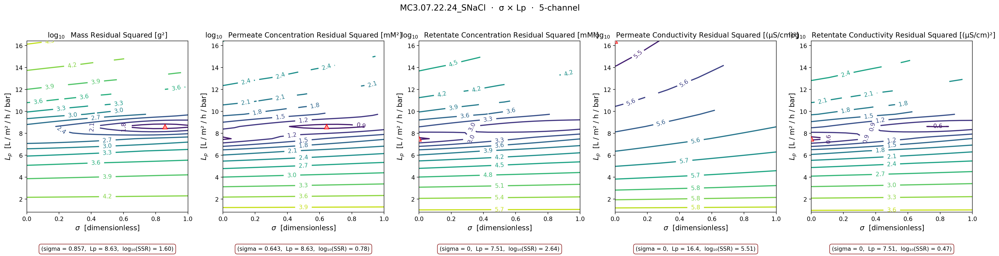
04
STAGE 1 (path A) — MC3.07.22.24_SNaCl
STAGE 1 · Well-identified
interior σ via concentrating run — the gold standard fit (WSSE = 556)
Takeaway: Look at the mass and permeate-concentration panels — both argmin at interior σ (0.86 and 0.64) near Lp ≈ 8.6. Retentate channels still pin at σ=0 (the 0.3 % cF over-weighting effect), but the joint WSSE is dominated by mass + perm-conc, so the warm-start θ landed interior at σ = 0.45. This is the only NaCl sheet where σ leaves a real fingerprint.

Slide 6
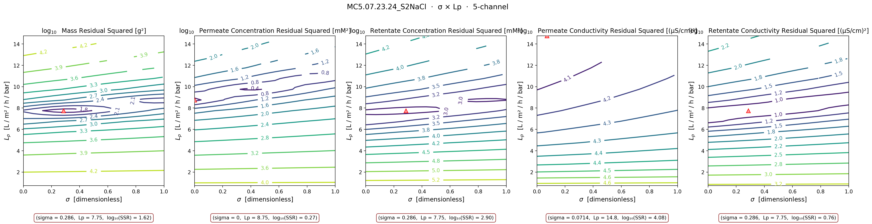
05
STAGE 1 (path B) — MC5.07.23.24_S2NaCl
STAGE 1 · Well-identified
diluting run — σ harmless, Lp pinned anyway (WSSE = 830)
Takeaway: Four channels argmin at Lp ≈ 7.7 — tight cluster. σ slides to ~0 because the gradient is flat in the diluting regime (σ·Δπ → 0 at end of run), but Lp is well-identified by the mass channel. WSSE = 830 — 2nd best in the entire campaign. Diluting experiments are 'free' identifiability for Lp.

Slide 7
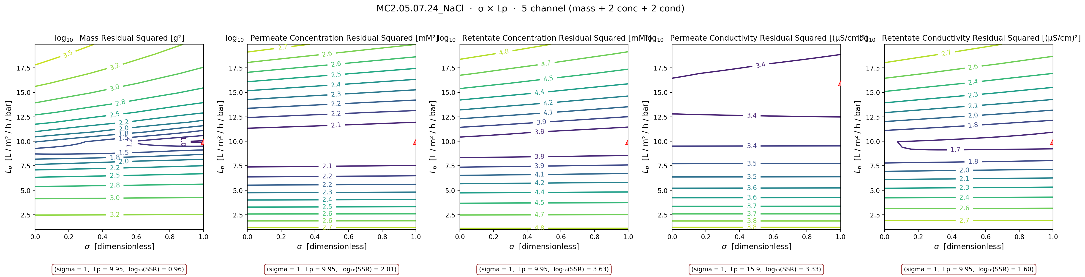
06
STAGE 2 — NaCl (the 4 concentrating-regime sheets at the σ=1 wall)
STAGE 2 · Inconsistent
Lp tight (8.6 ± 1.1) but σ pinned — these sheets ran concentrating without probing σ-sensitive conditions
Takeaway: MC2 NaCl shown here — same story on MC5 NaCl, MC5 SNaCl, and the concentrating part of MC4 SNaCl. 4 of 5 channels converge on Lp ≈ 9.95 (Lp well-identified), but σ pins at the σ=1 wall and the wall is hiding a B-vs-Lp trade-off. Concentrating regime + no σ-probing conditions = inconsistent across channels.

Slide 8
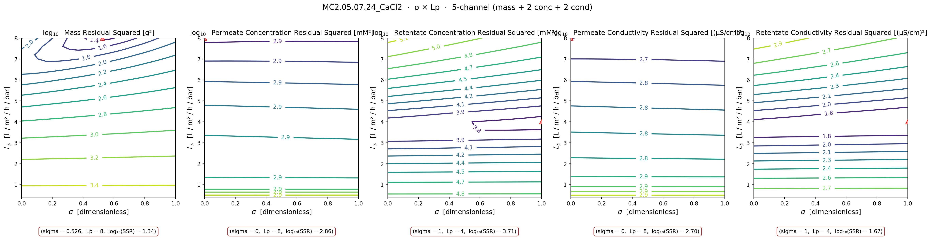
07
STAGE 2 — CaCl₂ (all 3 sheets)
STAGE 2 · Inconsistent
every sheet pins σ at σ=1 wall in the warm-start fit; contour shows channels split by membrane side
Takeaway: All 3 CaCl₂ sheets pin σ at σ=1 (and one pins B at the upper bound too). Physics expects interior σ (divalent counter-ion → weaker Donnan exclusion → lower σ on NF270) — pinning at σ=1 is a weighting problem, not a model-form problem. Both permeate channels want σ=0; both retentate channels want σ=1. Split by membrane side, not by physics.

Slide 9
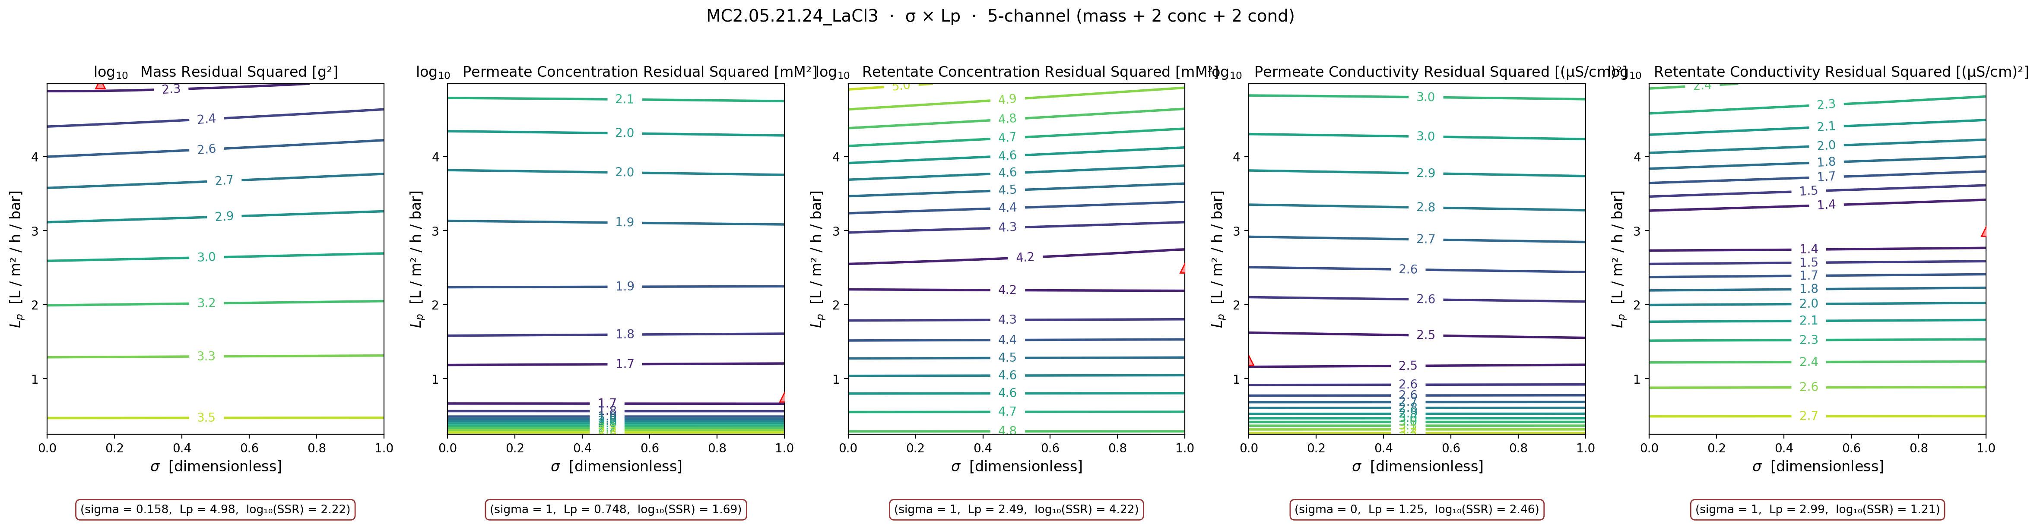
08
STAGE 3 — LaCl₃ (both sheets)
STAGE 3 · Not estimable
warm-start θ nearly identical between sheets, but WSSE ~20× worse than NaCl gold standard → shared wrong-model bias
Takeaway: Both LaCl₃ sheets warm-start to nearly identical θ — but fit the data ~20× worse than NaCl MC3 SNaCl. Same wrong-model bias both times, not measurement noise. The constant-(σ, B) Spiegler-Kedem model is structurally wrong for trivalent ions — probably because of LaCl²⁺ / LaCl⁺ ion-pairing the model can't see. AND we only have 2 sheets: that's an anecdote, not a sample size.

Slide 10
09
WHAT DATA SHOULD WE COLLECT
what would unblock the campaign — prioritized by leverage
PRIORITY 1
Pure-water L_p before and after every run
Single highest-leverage experiment. Pins L_p independently of the salt-transport data so σ and B don't have to compensate for it. Also doubles as a fouling check — if pre-run and post-run L_p drift, we know the membrane changed during the experiment and the constant-parameter fit was never going to work.
PRIORITY 2
Multi-pressure sweeps within a single run + dilute concentration runs
Pinning σ for CaCl₂ and LaCl₃ requires breaking the σ-B correlation. σ couples to Δπ, B doesn't — so stepping ΔP across a wide range during one run changes the relative leverage of σ vs B. Dilute runs (1-5 mM NaCl, sub-mM LaCl₃) push into the diffusion-limited regime where σ identifies.
PRIORITY 3
3-5 more LaCl₃ sheets + retentate-side conductivity probe + UV-Vis / ICP speciation
n = 2 LaCl₃ sheets is not statistics — we need at least 5 before any 'not estimable' claim carries weight. Adding high-frequency conductivity on the retentate (we only have it on permeate) eliminates the CaCl₂ side-split weighting problem. Speciation directly tests the LaCl²⁺ / LaCl⁺ ion-pairing hypothesis rather than inferring it from model failure.

Slide 11
10
QUESTIONS FOR DISCUSSION
what I'd like your read on before the campaign re-run
1.
Does the 3-stage diagnosis match what you'd intuit physically?
Anionic NF270 + chloride co-ion + increasing cation valence → identifiability should degrade with valence. That's what we see. But is the σ=1 wall on the NaCl/CaCl₂ sheets really a regime problem, or is it the 0.3 % cF scaling forcing the optimizer there?
2.
MC3 SNaCl and MC5 S2NaCl — two different paths to well-identified
MC3 SNaCl probed σ-sensitive conditions and got interior σ = 0.45. MC5 S2NaCl ran diluting so σ was irrelevant — same Lp identifiability for free. What do the run-sheet metadata show that's different from the other 4 NaCl sheets? Pressure span, feed concentration, run duration?
2b.
MC4 SNaCl — diluting but poor fit (WSSE = 9536)
MC4 SNaCl looks like a diluting-regime run (σ = 0 wall), but its WSSE is ~10× worse than MC5 S2NaCl. Same regime, same salt, same membrane — different fit quality. Likely a data-quality issue (fouling, leak, calibration drift) rather than a model issue. Worth a closer look.
3.
LaCl₃ ion-pairing fix
Stage 3 confirms the v10-deck slide 12 'physics gap' diagnosis. Should we (a) parameterize σ(cF) explicitly, (b) add an ion-pairing equilibrium block with LaCl²⁺ / LaCl⁺ partition, or (c) fit only the diluting-regime portion? Need at least 3-5 more LaCl₃ sheets either way.
4.
Priority 1 data — pure-water L_p calibration
I think this is the single highest-leverage experiment. Is it feasible to add to every NF270 run going forward? Roughly: 10 minutes of DI water at the operating ΔP before and after the salt run.
5.
Per-salt B bounds in the optimizer
We've landed NaCl [0, 30], CaCl₂ [0, 15], LaCl₃ [0, 10] in the library (Architecture.md §17). Anything you'd revise before re-running the full campaign?

Slide 12
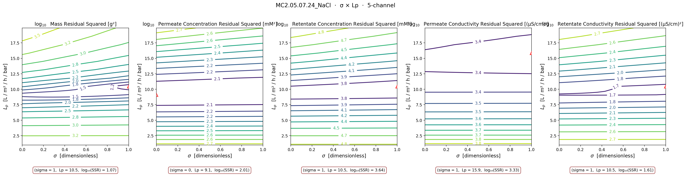
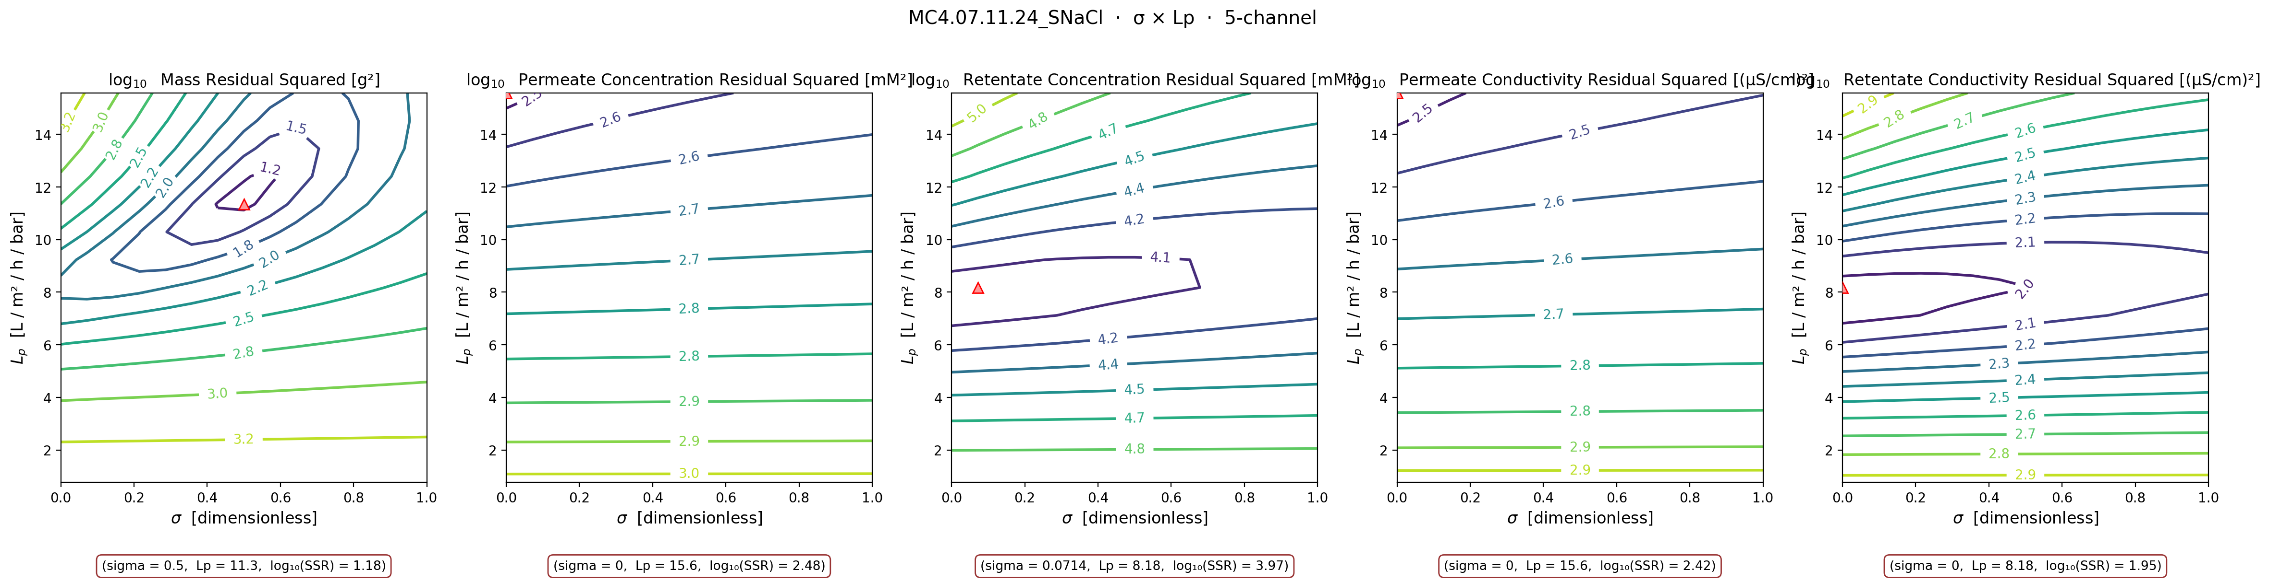
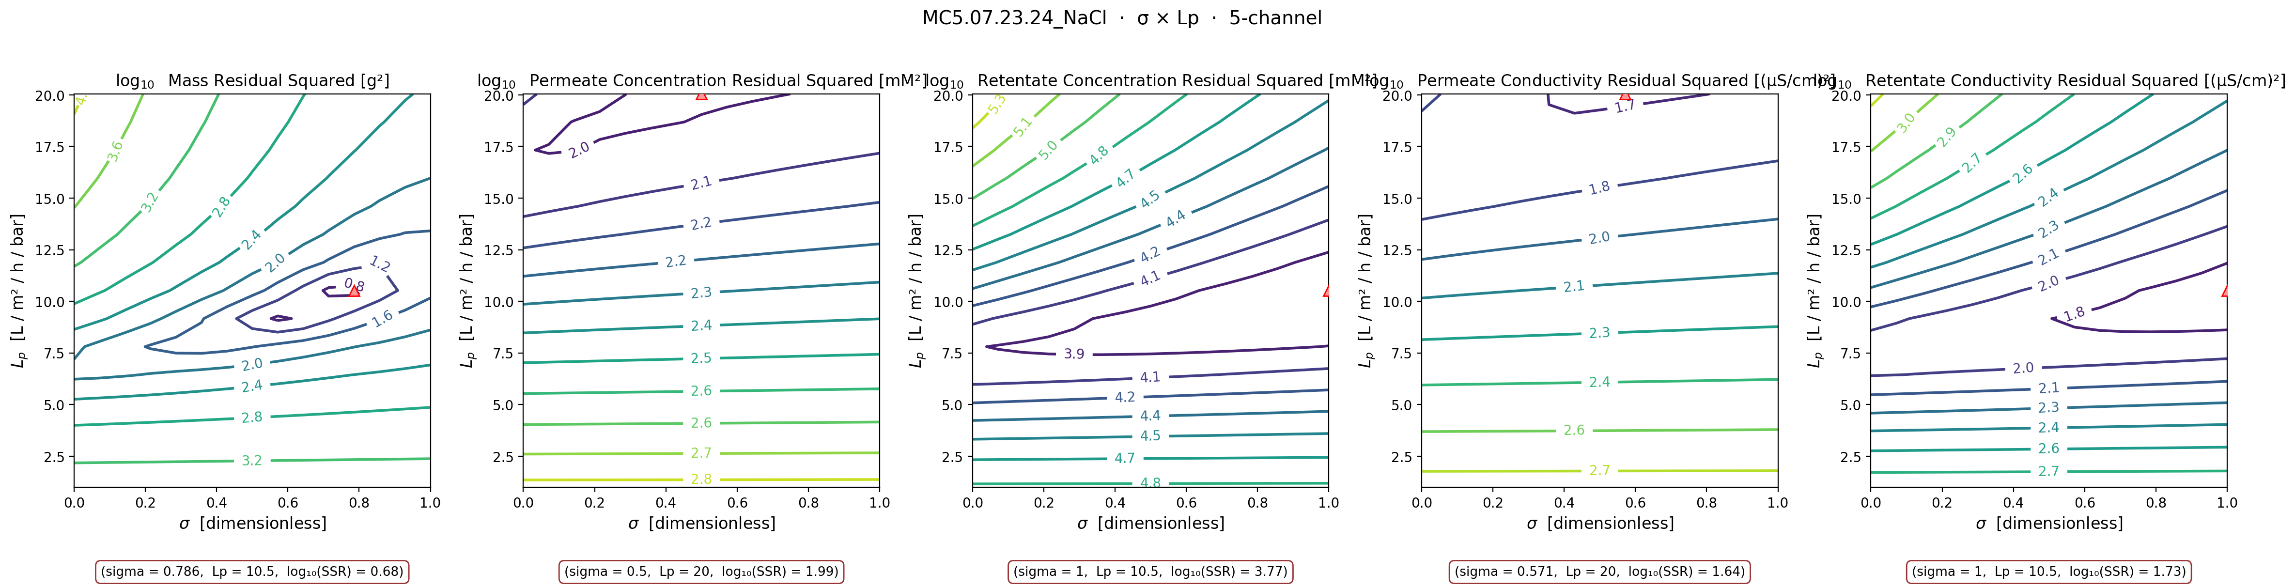
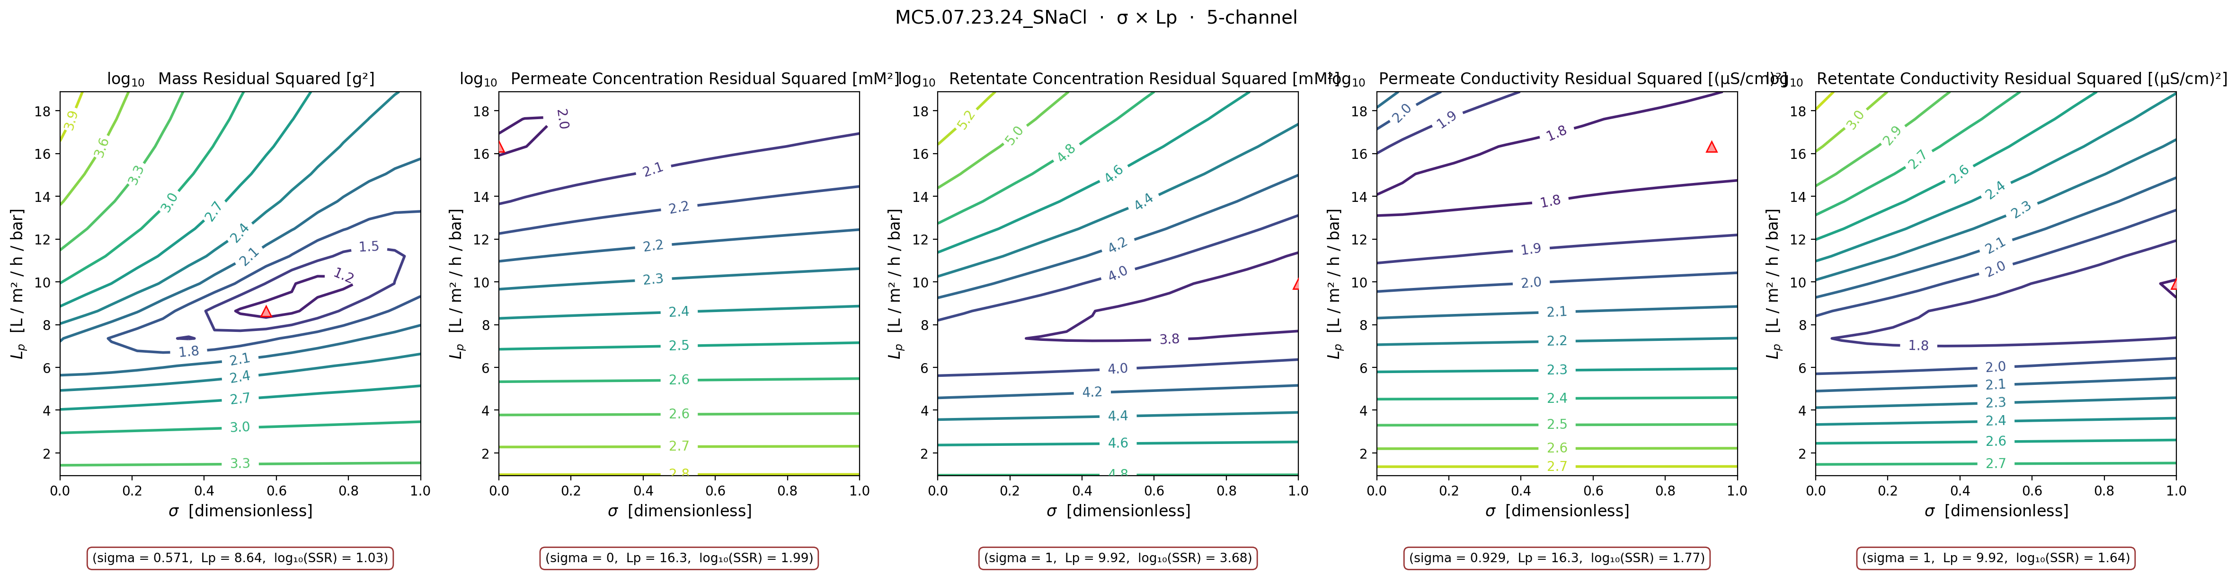
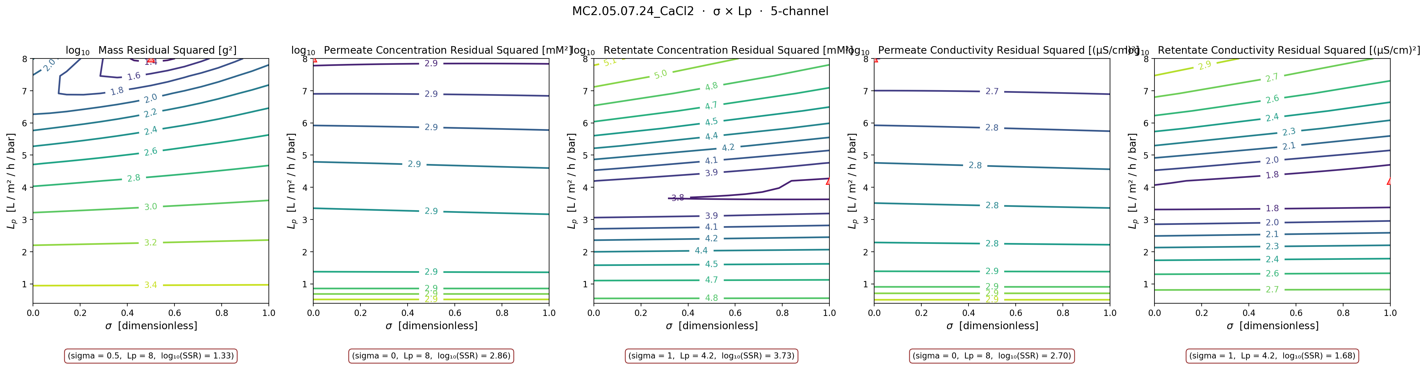
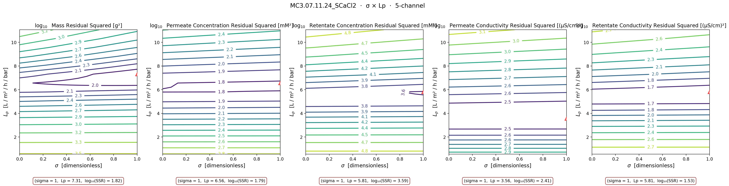
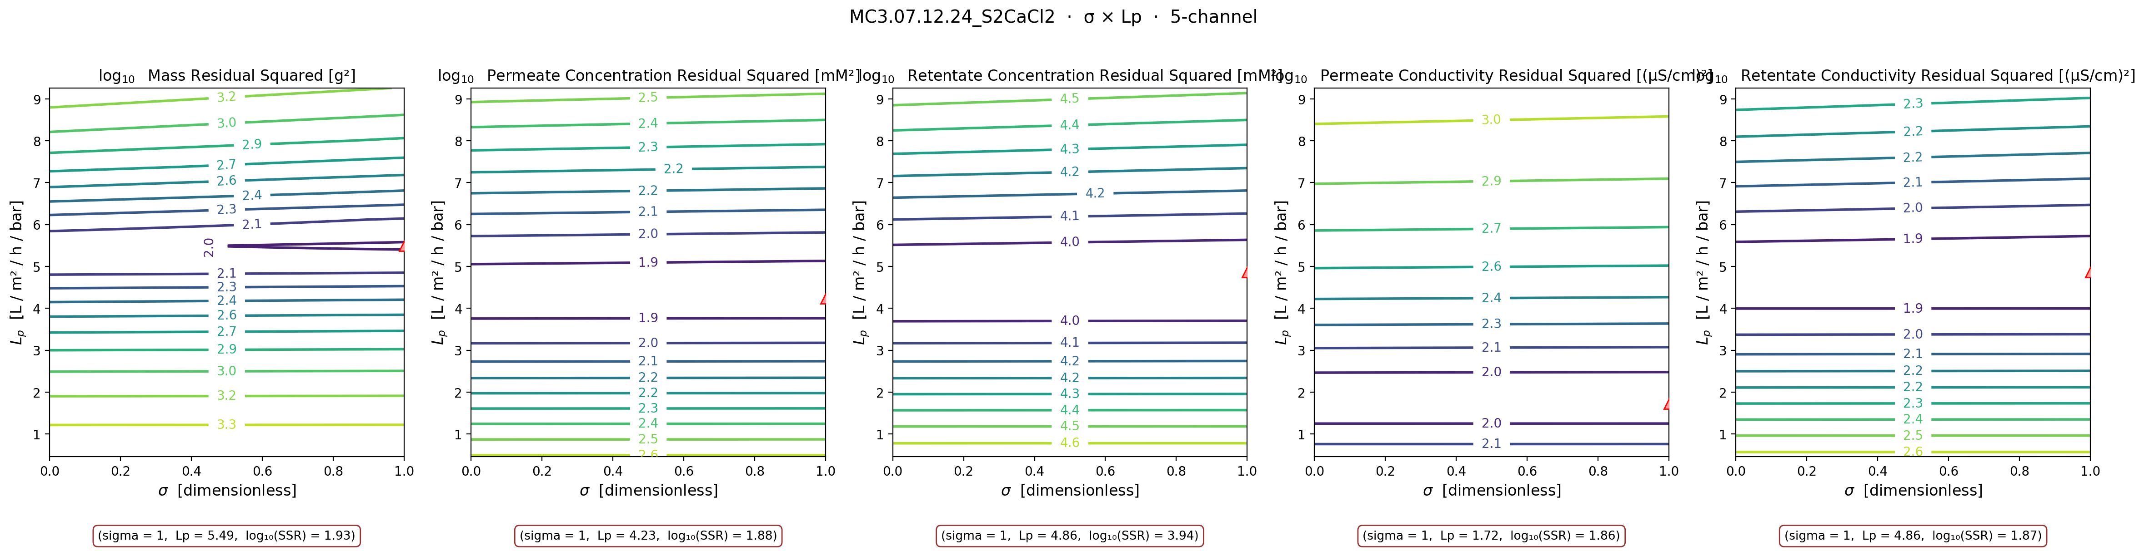
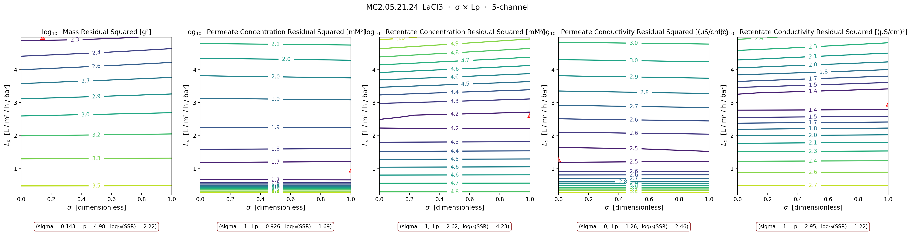
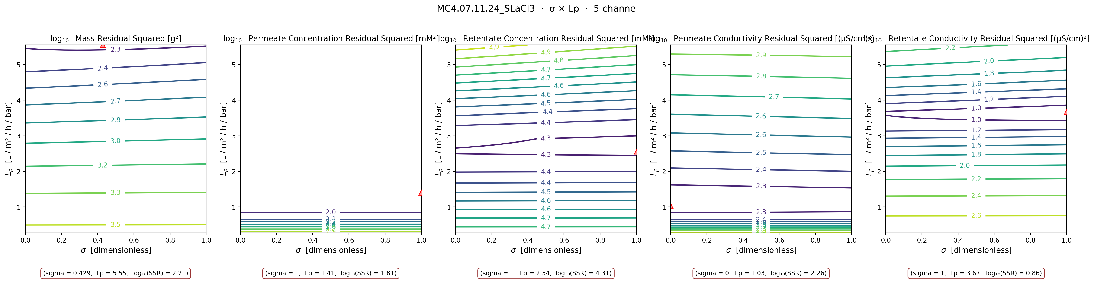
11
ALL 11 SHEETS — σ × Lp small-multiples
every sheet's contour, color-tabbed by stage — visual evidence for the categorization
MC3 SNaCl
MC5 S2NaCl
MC2 NaCl
MC4 SNaCl ⚠
MC5 NaCl
MC5 SNaCl
MC2 CaCl₂
MC3 SCaCl₂
MC3 S2CaCl₂
MC2 LaCl₃
MC4 SLaCl₃

Slide 13
LAST WEEK'S COLLABORATOR DISCUSSION
2026-05-27 briefing + 2026-05-25 per-sheet conductivity comparison

Slide 14
DATA3 Single-Salt Campaign Analysis
Data Validation, Parameter Bounds, and Estimability
Data validation
70,101 / 70,101
audited data points GOOD
13 single-salt sheets
Keshav Kasturi Rangan · Dowling Group · University of Notre Dame
Collaborator briefing · May 27, 2026
DATA3 Single-Salt Status — May 27, 2026
1

Slide 15
1. Measured Data → Model Inputs: Loader Fidelity Audit
70,101 / 70,101 data points GOOD
13 single-salt sheets · 0 warnings · 0 bad
Source: DATA3_loader_fidelity_audit_2026-05-27.xlsx
Loader transformations (single documented formula per variable)
Variable | Transformation | Audit
Time (s) | 1:1 preserved | OK
Mass (g) | Per-vial baseline subtracted | OK
Pressure (psi) | 1:1 preserved | OK
Retentate Temp | 1:1 preserved | OK
Retentate Cond | EC25 temperature compensation | OK
Permeate Temp | 1:1 preserved | OK
Permeate Cond | EC25 + tube-transit time shift | OK
Vial Swap | 1:1 preserved (used to slice vials) | OK
ICP (cV_avg per vial) | Dilution × molar mass per vial | OK
What the audit verifies
• Read raw Excel directly with pandas — no library code in the path
• Load via lib.loadxlsx → data_stru
• Apply documented transformations to raw data, then compare row-by-row
• 1 % relative + absolute-floor tolerance per data point
• ICP sidebar, calibration points, header metadata
Take-away: The audit XLSX (shown in meeting) is the formal evidence — every point is either preserved or transformed by a formula.
DATA3 Single-Salt Status — May 27, 2026
2

Slide 16
2. Physical Bounds on L_p, B, σ — Does B Change with Salt?
Same membrane → same box.
Salt changes the fitted value,
not the bound itself.
Published parameter box — used across all 13 single-salt sheets
Parameter | Bound | Why this range
L_p | [0.5, 50] L/(m²·hr·bar) | Membrane water permeability
B | [0, 30] μm/s | Solute-permeability term
σ | [0, 1] dimensionless | Reflection coefficient — physically bounded
Per-parameter reasoning
• σ ∈ [0, 1] for any salt — it is a reflection coefficient, physically bounded.
• L_p is a membrane property (water permeability) — independent of the salt.
• B is the most likely to move with salt (currently using the same bounds).
When to revisit the bounds:
• Different membrane, or
• A very different salt family, or
• A different model form (e.g. exchanged B parametrization).
Take-away: σ is bounded by physics; L_p should be independent of the salt, but what should I do with B?
DATA3 Single-Salt Status — May 27, 2026
3

Slide 17
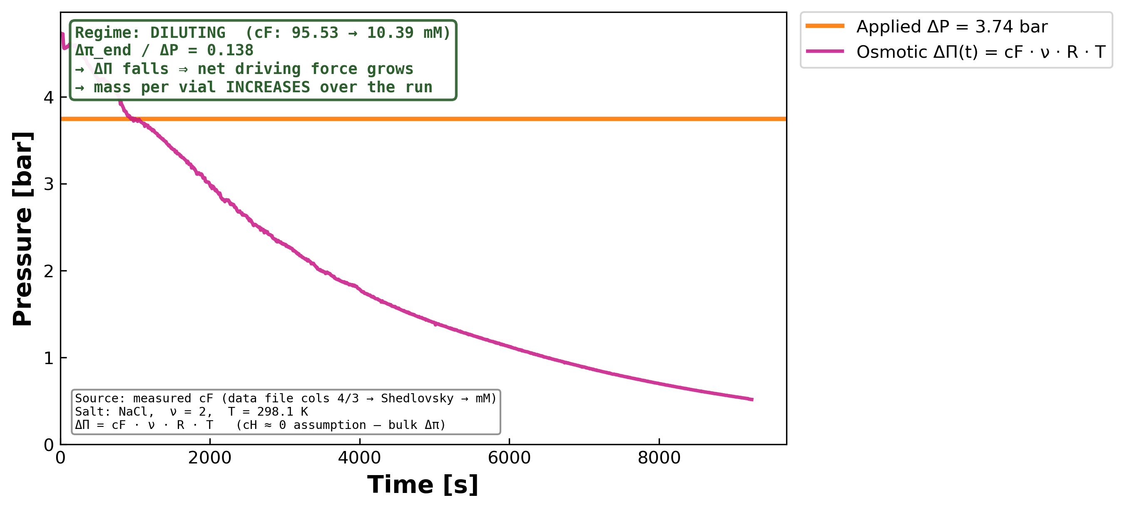
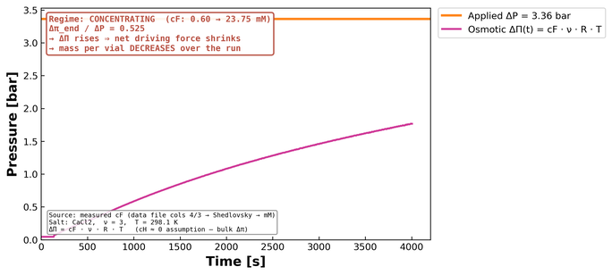
3. Mass-per-Vial Pattern is Explained by ΔP − σ·Δπ
MC3.07.22.24_SNaCl — diluting run (Δπ_initial > ΔP)
Predicted mass-per-vial pattern (no model fit required)
Regime | c_F(t) | Δπ(t) | ΔP − σ·Δπ | Mass per vial
Concentrating | rises | rises | shrinks | decreases
Diluting | falls | falls | grows | increases
Take-away: The slope of mass per vial across the run is the direct signature of Δπ in the concentrating/diluting regime.
Orange ΔP constant · magenta Δπ(t) built from measured c_F — pure data, no fit.
DATA3 Single-Salt Status — May 27, 2026
4

Slide 18
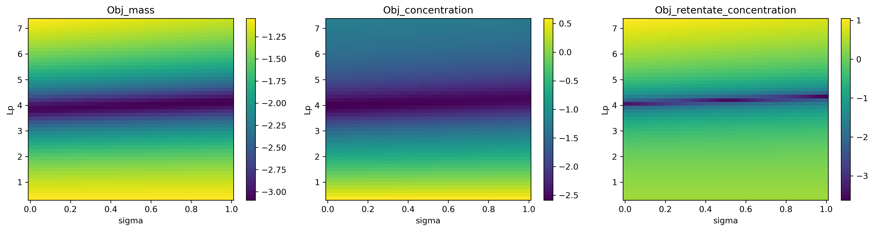
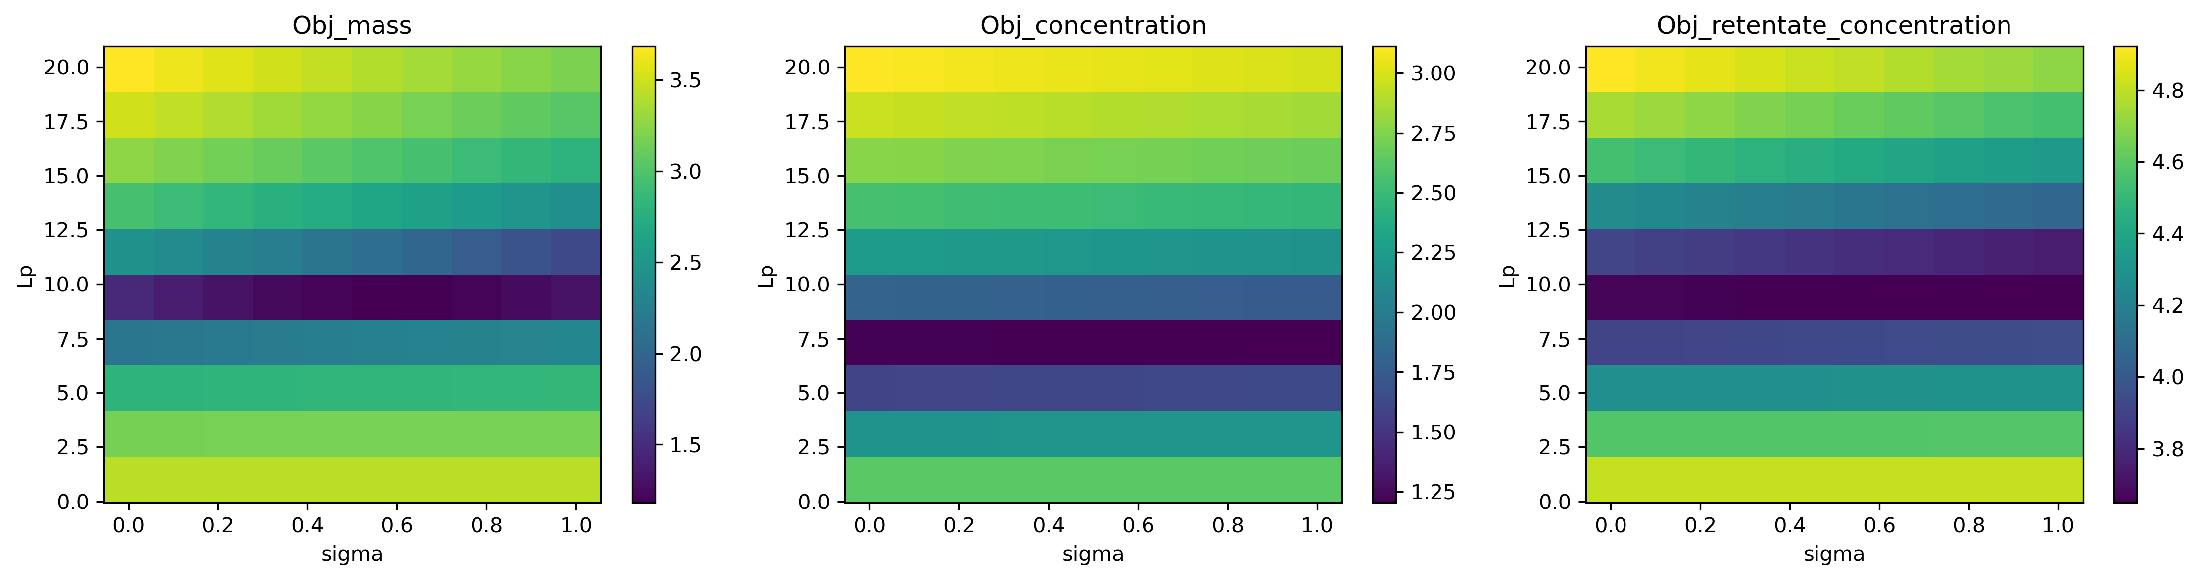
4. Workflow Reproduces Published Contour — DATA3 σ Stays Flat
Published-paper reproduction (DATA1 / KCl filtration) — byte-equivalent
Same workflow on DATA3: MC2.05.07.24_NaCl
Sharp dark band on L_p ≈ 4 → L_p well identified
Bands run horizontal across σ → σ is unidentifiable
L_p has a range of 8–10 → too wide a range
Why estimability is harder in DATA3 — same model, different driving force
• σ multiplies Δπ in the flux equation. When Δπ stays small over the run (concentrating runs at low c_F), σ has almost no leverage on J_w.
• DATA3 single-salt sheets are short and stay near steady-state c_F → contour is flat in σ → optimizer pins σ at a bound.
• I will need to look across experiments to observe behavior where σ is varied.
Take-away: Published reproduction confirms the workflow is correct.
DATA3 Single-Salt Status — May 27, 2026
5

Slide 19
5. Summary · What I'd Like to Discuss
1 · Data integrity
• 70,101 / 70,101 GOOD
• 40/40 metadata ✓
• Calibration R² 0.99–0.999
• Audit XLSX is the deliverable
2 · Bounds
• L_p ∈ [0.5, 50]
• B ∈ [0, 30]
• σ ∈ [0, 1] (physics-fixed)
• Same box for all 13 sheets
3 · Pattern + estimability
• Mass-per-vial slope = Δπ signature
• Published contour reproduces
• DATA3 σ-band flat → identifiability
gap is experimental, not code
Open questions
• Is the published bound on B ([0, 30] μm/s) still appropriate for the DATA3 salts (NaCl, CaCl₂, LaCl₃), or do we revisit?
• On the diluting sheet MC3.SNaCl, the data already shows Δπ > ΔP at t = 0 — do we lean on that sheet as the σ-identifying anchor for the campaign?
DATA3 Single-Salt Status — May 27, 2026
6

Slide 20
Single-Salt Conductivity → Concentration
Collaborator's deck (left) vs our DATA3 pipeline (right)
Goal: confirm processed concentrations agree on the same experiments.
If they agree, the data-processing pathway is consistent; differences indicate either inversion-method or model-fit discrepancies.
2026-05-25

Slide 21
How to read these comparison slides
Each slide pairs the same experiment. Left = collaborator's deck rendering. Right = our DATA3 pipeline concentration plot.
LEFT — collaborator's slide
RIGHT — our DATA3 plot
• Two panels per experiment.
• Left panel: raw conductivity (μS/cm) vs time (s)
— magenta ▲ = retentate probe
— red ◆ = permeate probe
— blue / black lines = collaborator's fit
• Right panel: concentration (mM) vs time (s)
— closed red ■ = retentate ICP
— open △ = permeate ICP (cumulative)
— "Recovered X: " = mass-balance closure
• Data-quality verdict in lower-left.
• Single panel: concentration (mM) vs time (min — NB unit difference!)
• Magenta ■ dense = retentate probe → Shedlovsky → mM
• Teal ■ sparse = vial ICP-OES (lab measurement)
• Green line = retentate model prediction
• Red line = permeate model prediction
• Red ▲ = vial model prediction
Key question to answer for EACH slide:
Do the retentate (magenta) measurements
reach the same end-of-run concentration
on both sides? If yes — processing is consistent.

Slide 22
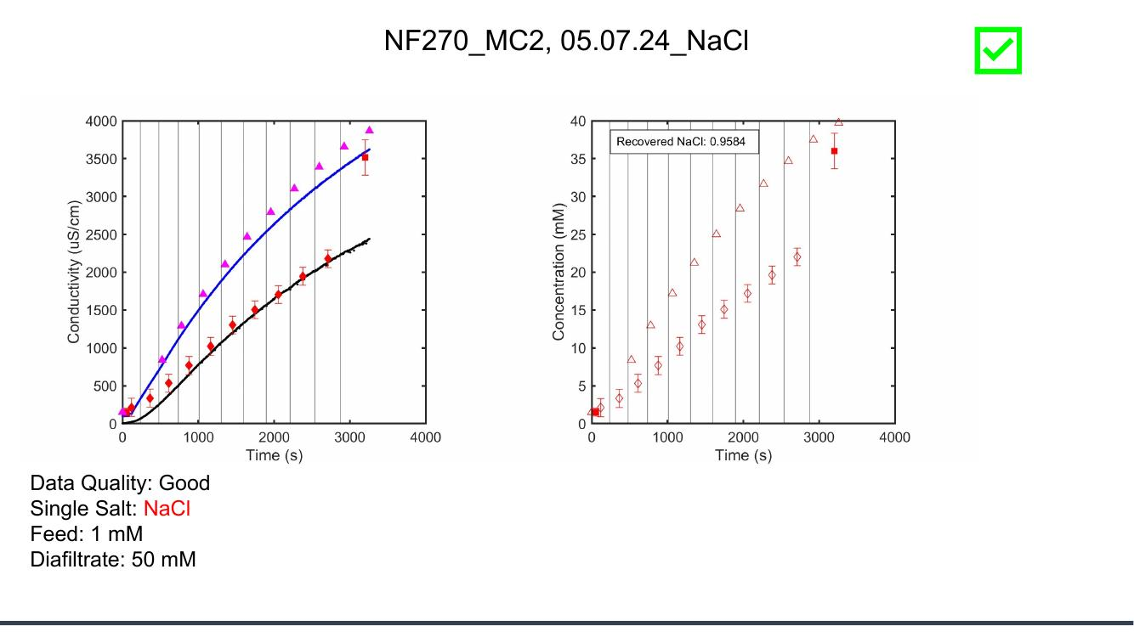
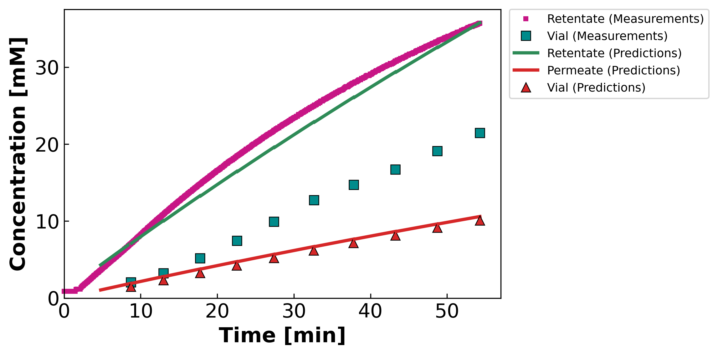
MC2.05.07.24_NaCl
Feed: 1 mM Diafiltrate: 50 mM (Collab: Good)
Collaborator's deck
Our DATA3 pipeline
Collaborator slide #5 · our file: concentration-JAO_050724_NF270_MC2_NaCl_NaCl_05.07.24_NaCl.png

Slide 23
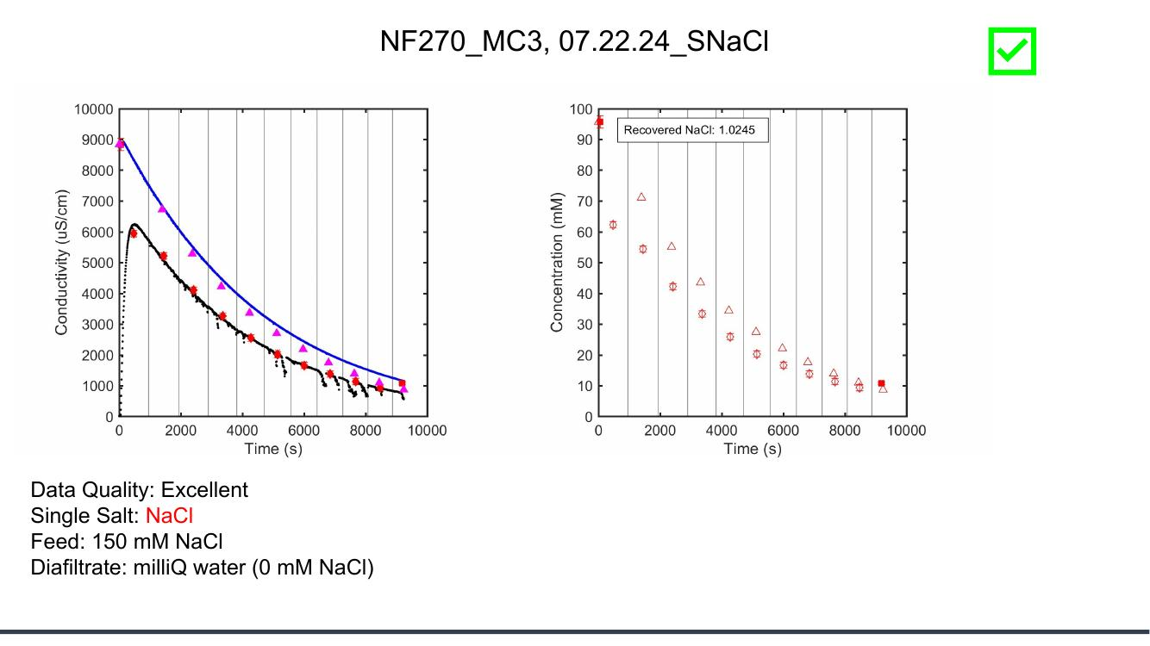
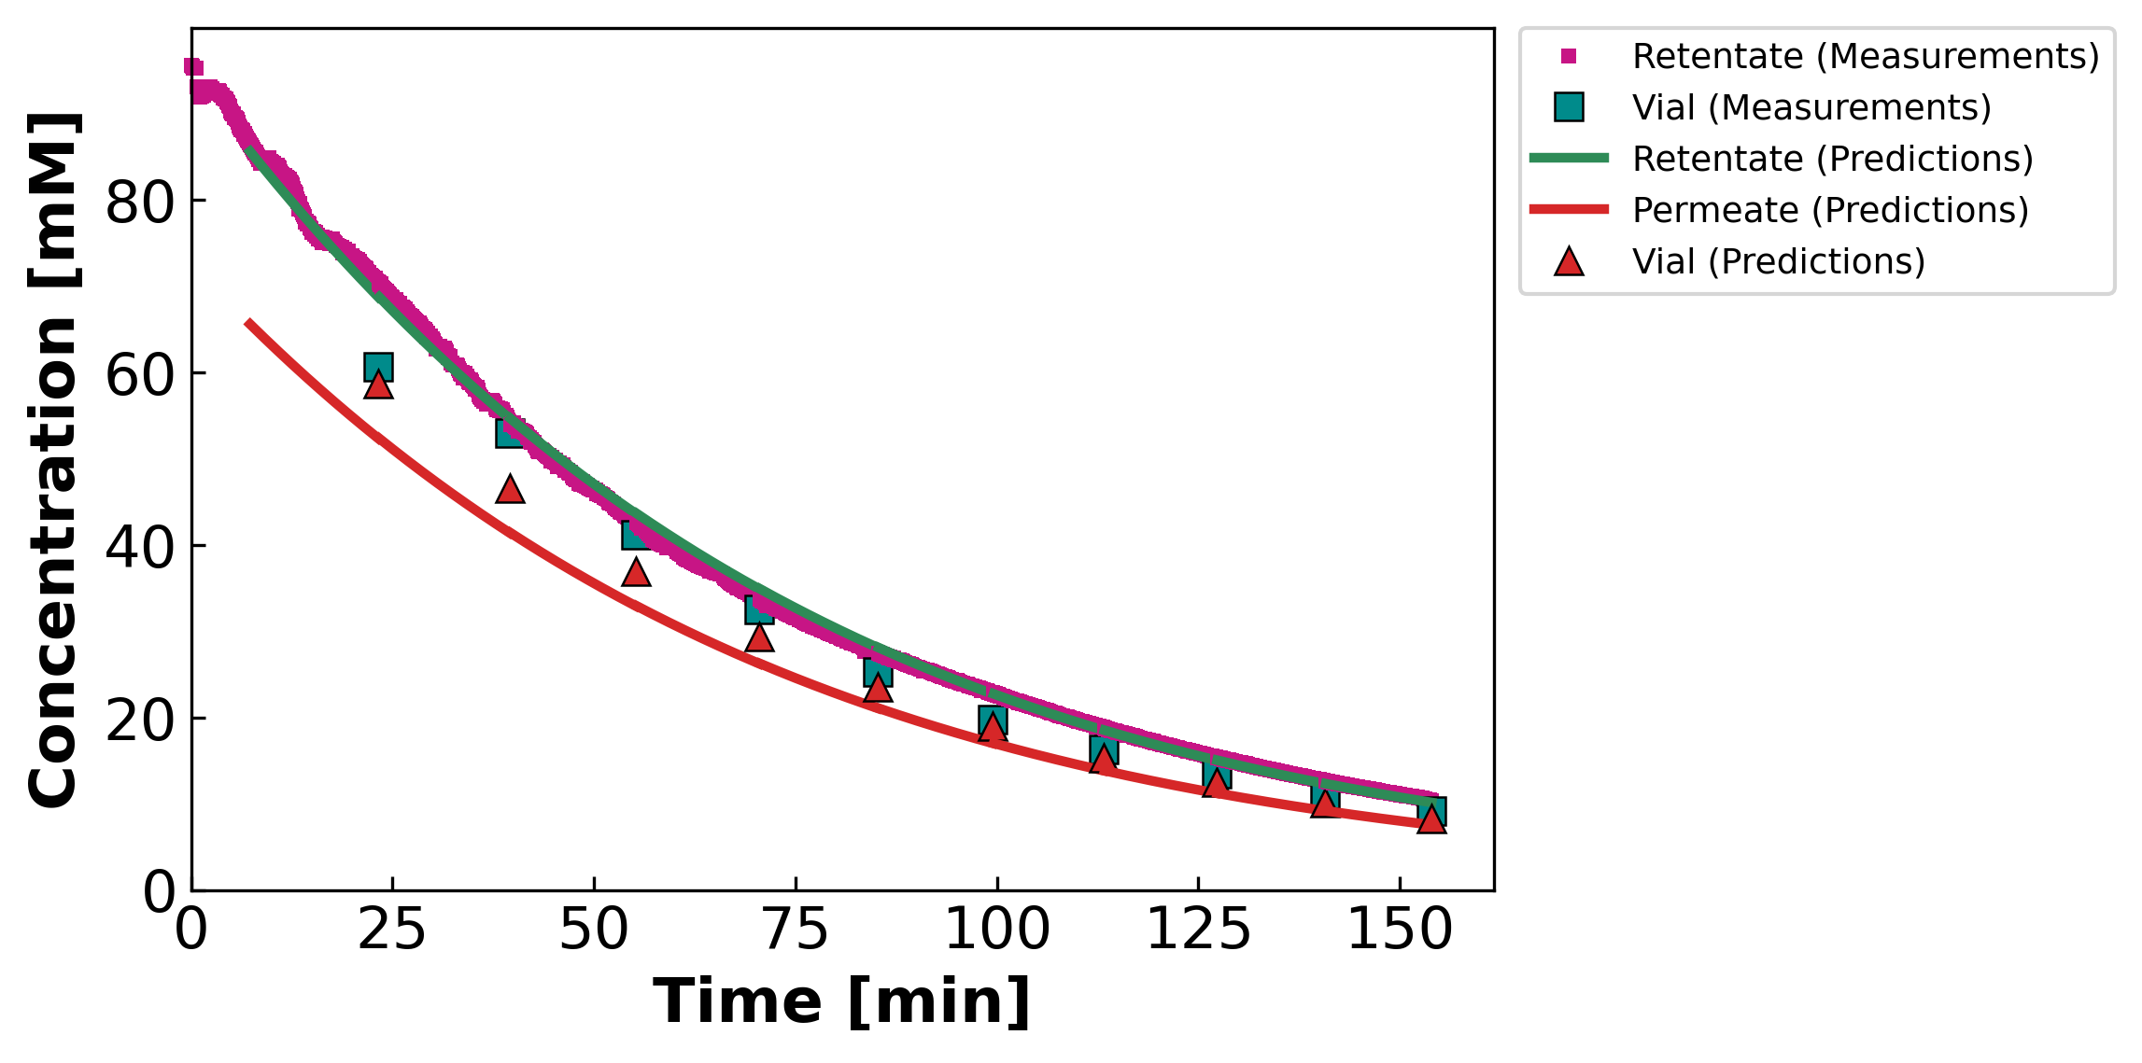
MC3.07.22.24_SNaCl
Feed: 150 mM Diafiltrate: 0 mM (Collab: Excellent — gold-standard interior σ)
Collaborator's deck
Our DATA3 pipeline
Collaborator slide #7 · our file: concentration-JAO_072224_NF270_MC3_SNaCl_NaCl_07.22.24_SNaCl.png

Slide 24
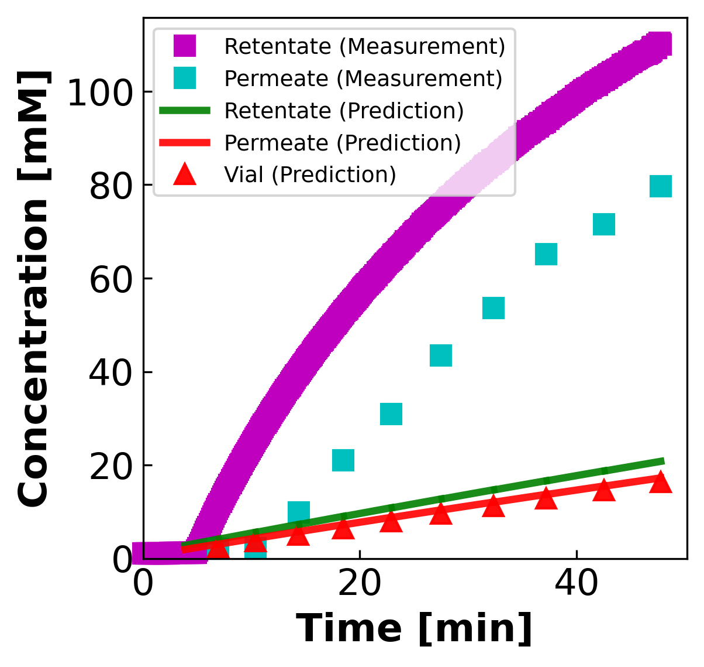
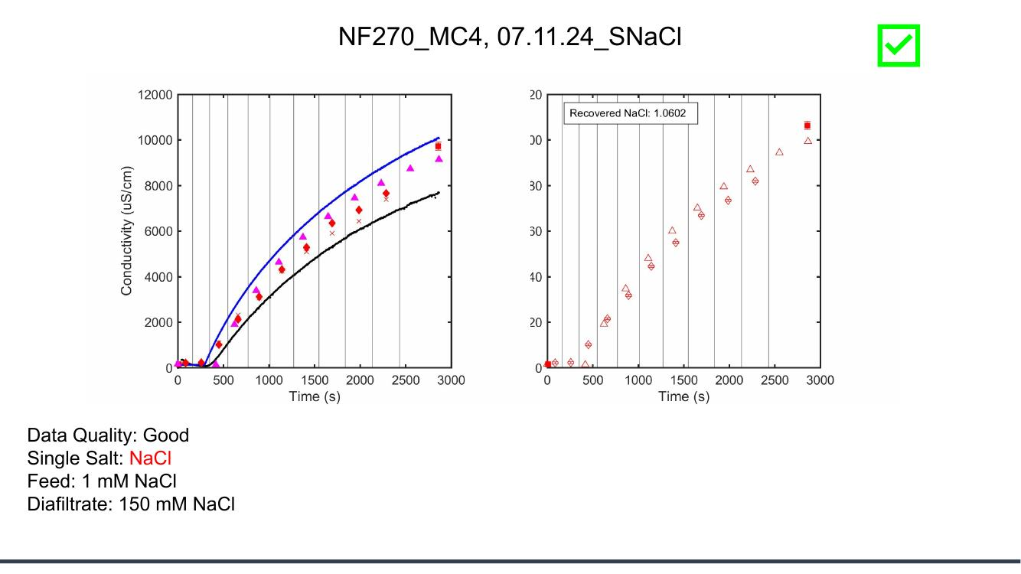
MC4.07.11.24_SNaCl
Feed: 1 mM Diafiltrate: 150 mM (Collab: Good)
Collaborator's deck
Our DATA3 pipeline
Collaborator slide #8 · our file: concentration-LL_071124_NF270_MC4_S_NaCl_07.11.24_SNaCl.png

Slide 25
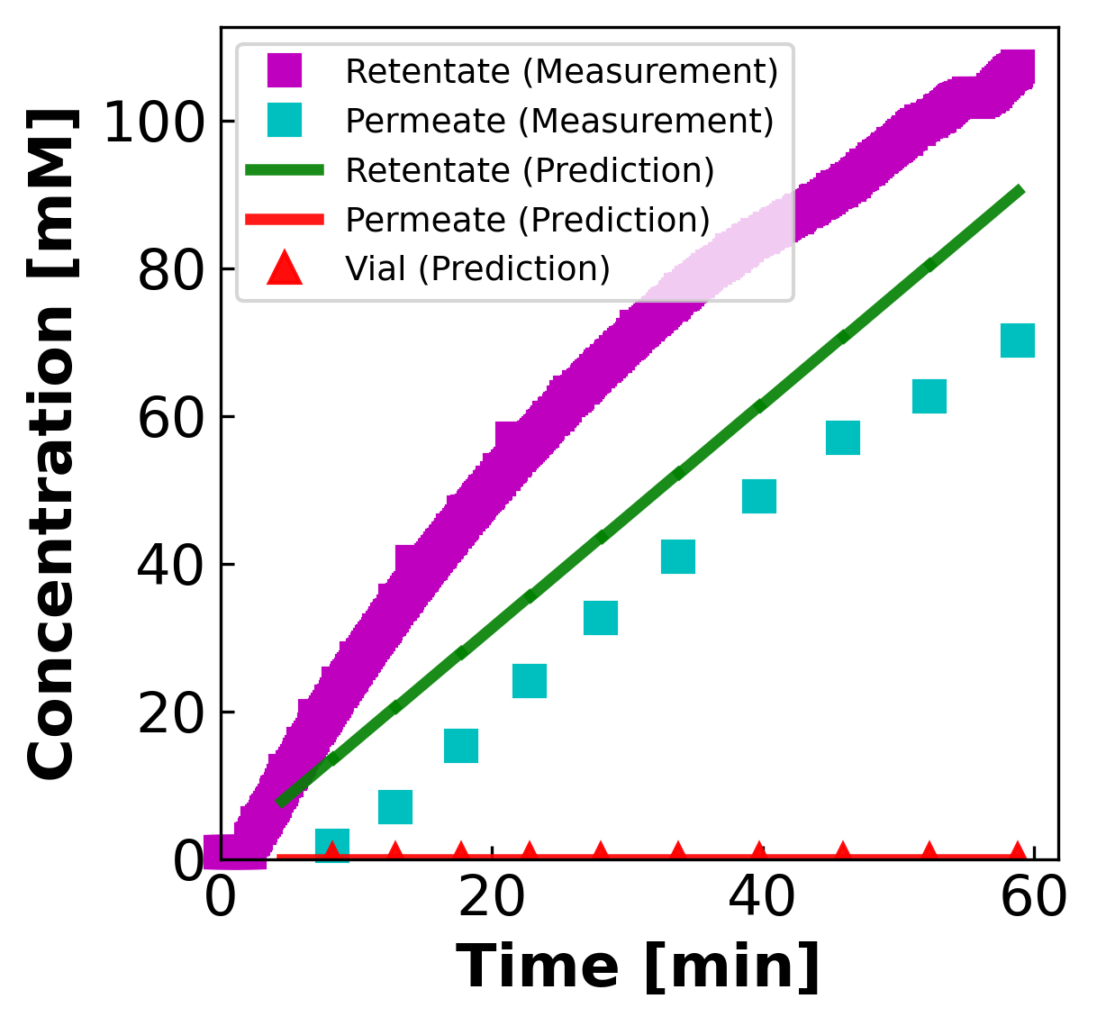
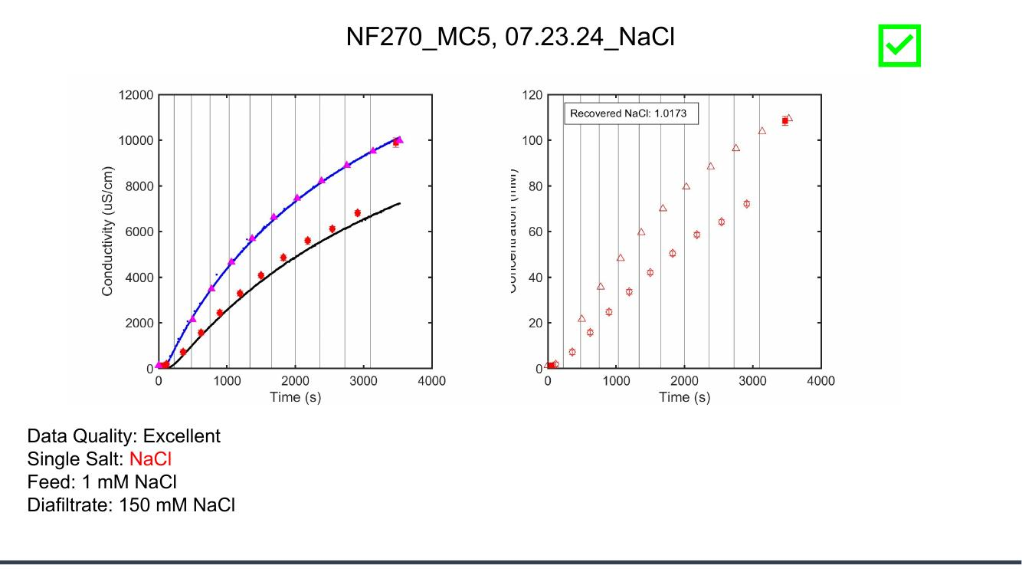
MC5.07.23.24_NaCl
Feed: 1 mM Diafiltrate: 150 mM (Collab: Excellent)
Collaborator's deck
Our DATA3 pipeline
Collaborator slide #9 · our file: concentration-JAO_072324_NF270_MC5_NaCl_NaCl_07.23.24_NaCl.png

Slide 26
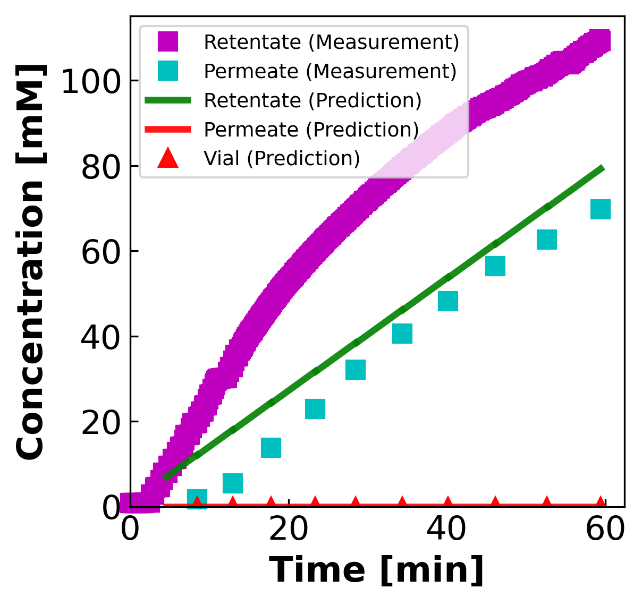
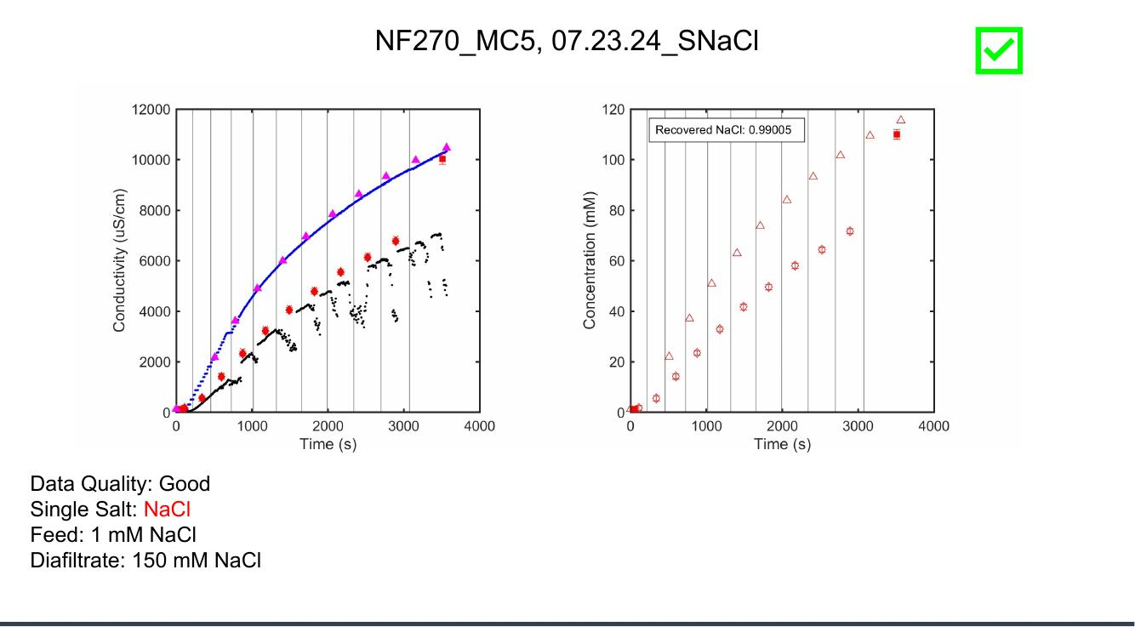
MC5.07.23.24_SNaCl
Feed: 1 mM Diafiltrate: 150 mM (Collab: Good)
Collaborator's deck
Our DATA3 pipeline
Collaborator slide #10 · our file: concentration-JAO_072324_NF270_MC5_SNaCl_NaCl_07.23.24_SNaCl.png

Slide 27
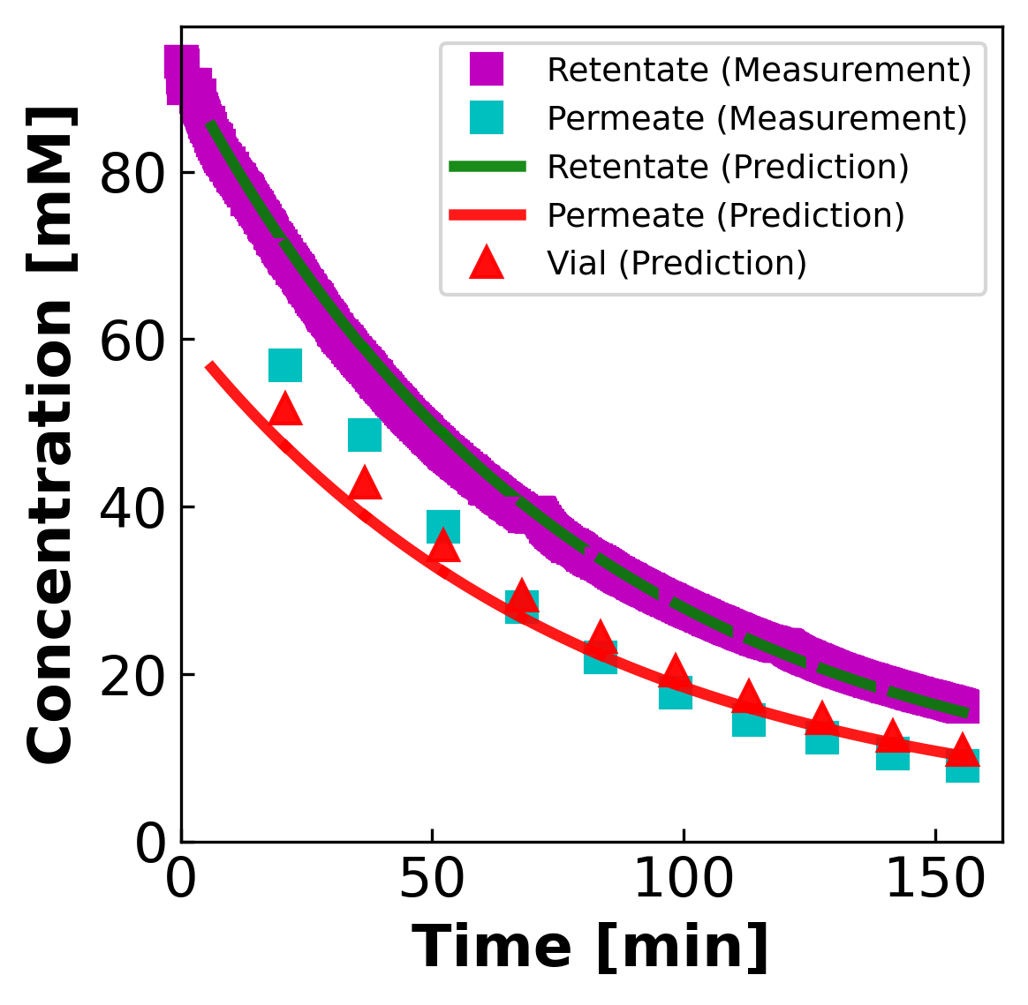
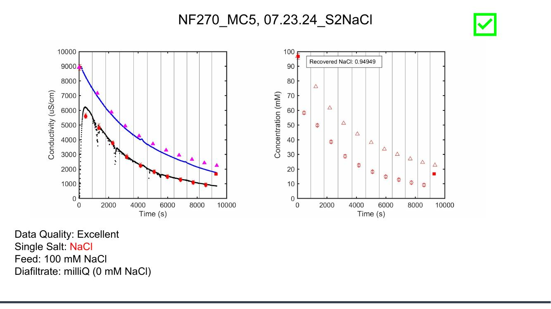
MC5.07.23.24_S2NaCl
Feed: 100 mM Diafiltrate: 0 mM (Collab: Excellent)
Collaborator's deck
Our DATA3 pipeline
Collaborator slide #11 · our file: concentration-JAO_072324_NF270_MC5_NaClS2_NaCl_07.23.24_S2NaCl.png

Slide 28
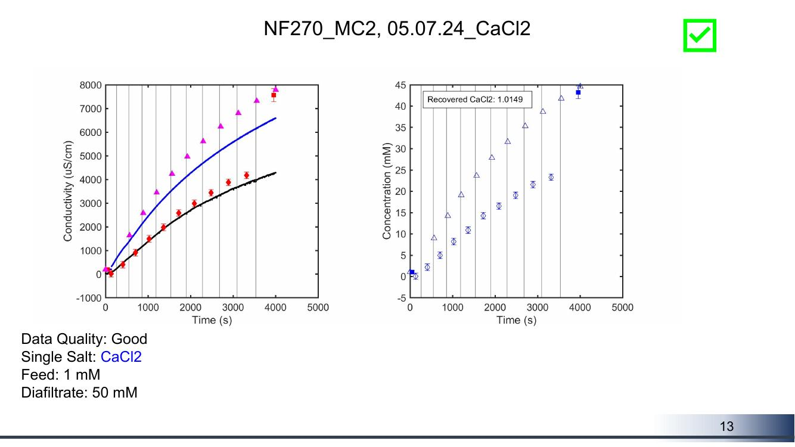
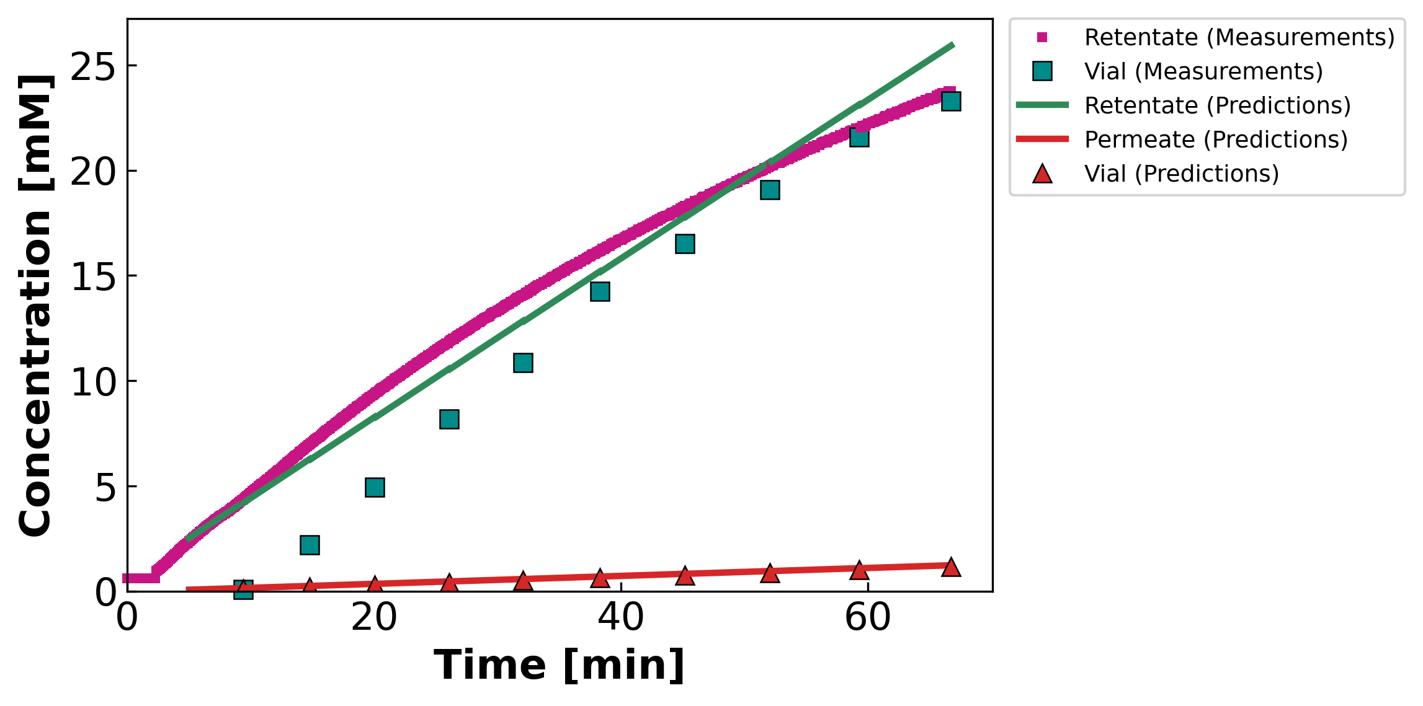
MC2.05.07.24_CaCl2
Feed: 1 mM Diafiltrate: 50 mM (Collab: Good)
Collaborator's deck
Our DATA3 pipeline
Collaborator slide #13 · our file: concentration-JAO_050724_NF270_MC2_CaCl2_CaCl2_05.07.24_CaCl2.png

Slide 29
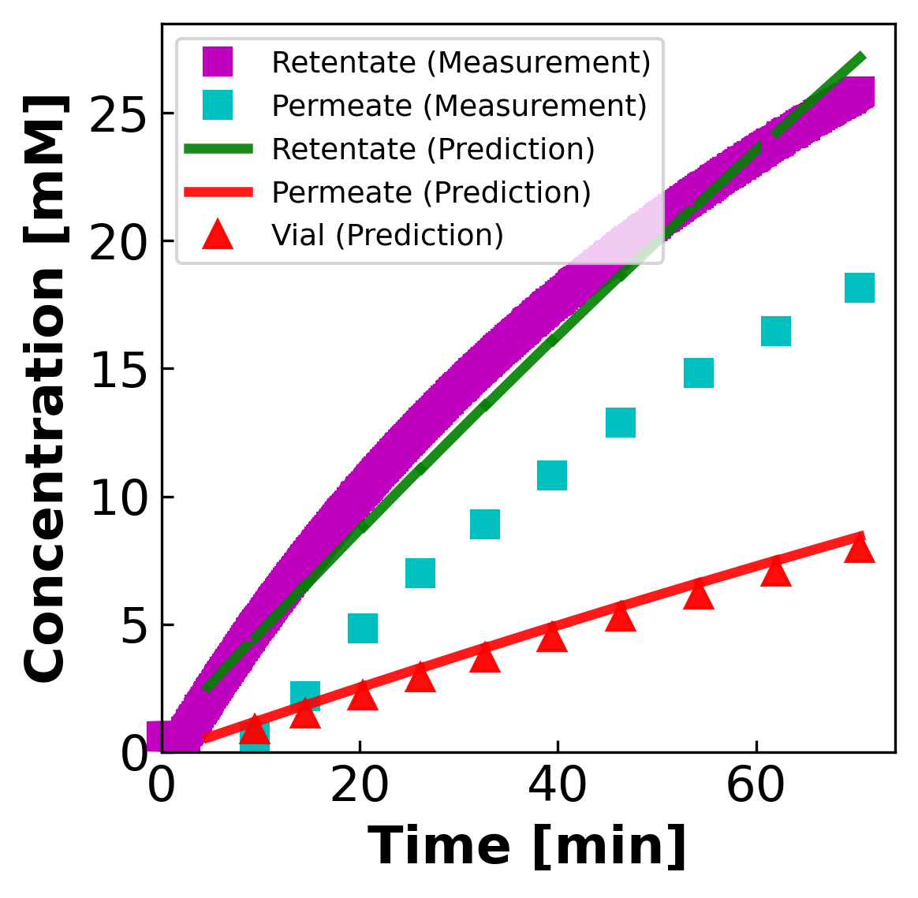
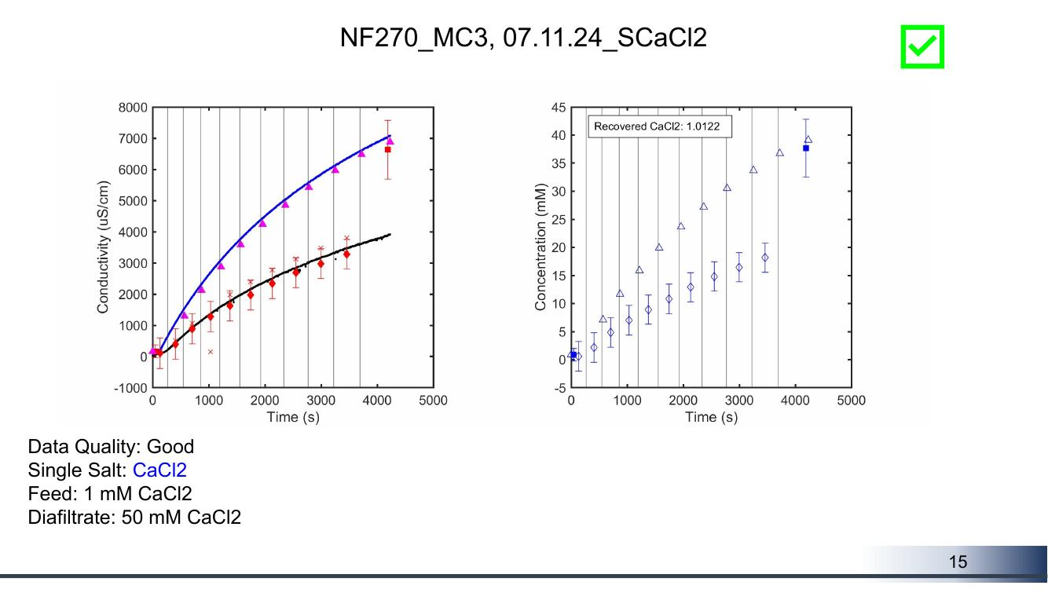
MC3.07.11.24_SCaCl2
Feed: 1 mM Diafiltrate: 50 mM (Collab: Good)
Collaborator's deck
Our DATA3 pipeline
Collaborator slide #15 · our file: concentration-JAO_071124_NF270_MC3_SCaCl2_CaCl2_07.11.24_SCaCl2.png

Slide 30
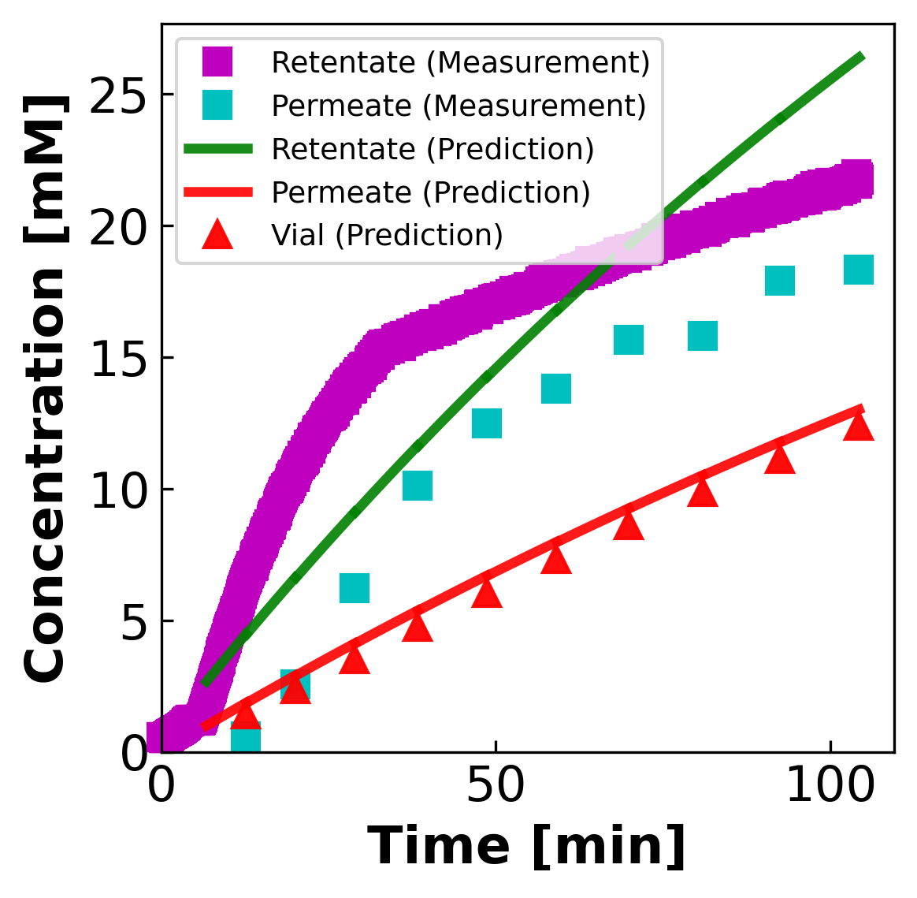
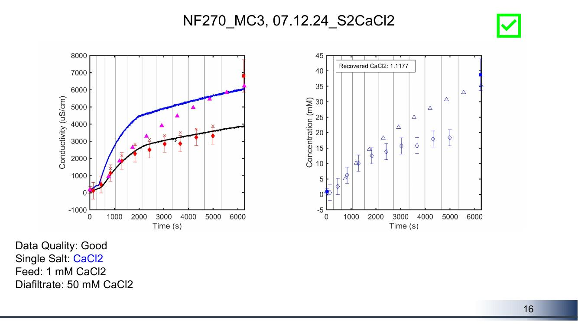
MC3.07.12.24_S2CaCl2
Feed: 1 mM Diafiltrate: 50 mM (Collab: Good)
Collaborator's deck
Our DATA3 pipeline
Collaborator slide #16 · our file: concentration-JAO_071224_NF270_MC3_S2CaCl2_CaCl2_07.12.24_S2CaCl2.png

Slide 31
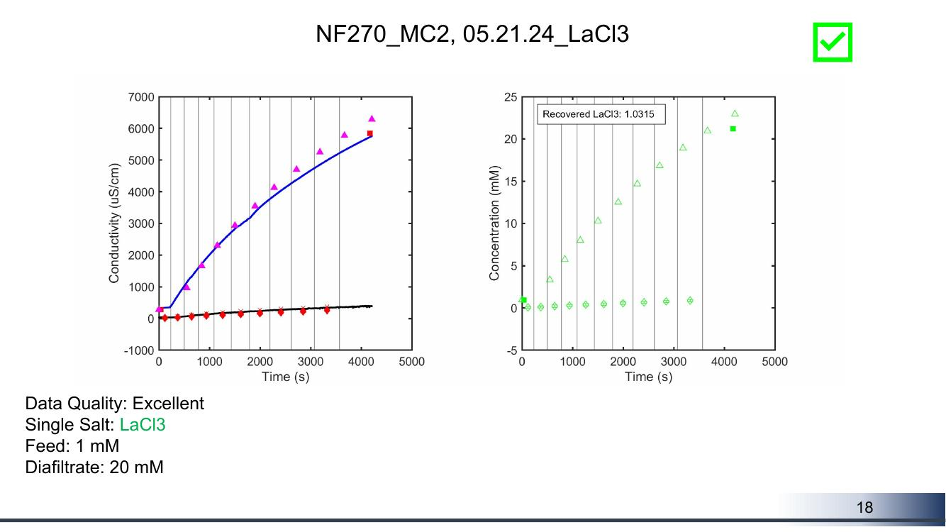
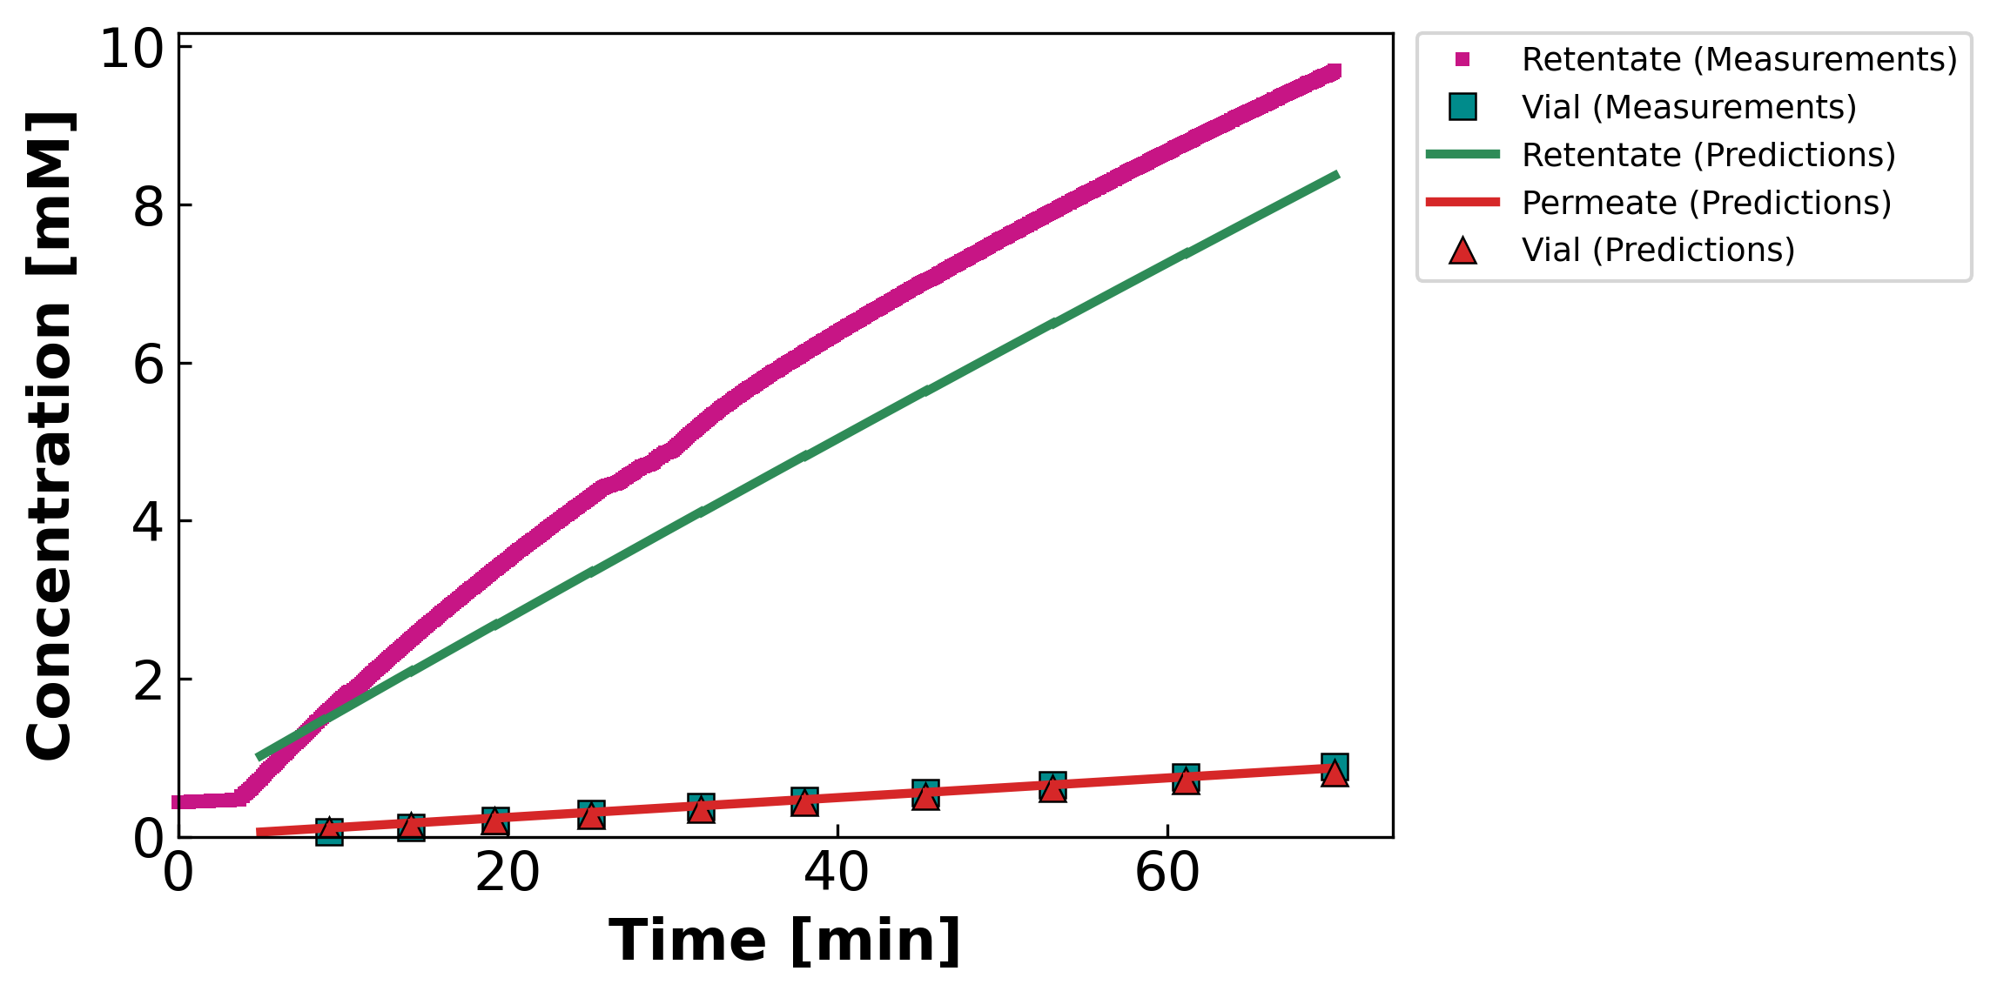
MC2.05.21.24_LaCl3
Feed: 1 mM Diafiltrate: 20 mM (Collab: Excellent)
Collaborator's deck
Our DATA3 pipeline
Collaborator slide #18 · our file: concentration-JAO_052124_NF270_MC2_LaCl3_LaCl3_05.21.24_LaCl3.png

Slide 32
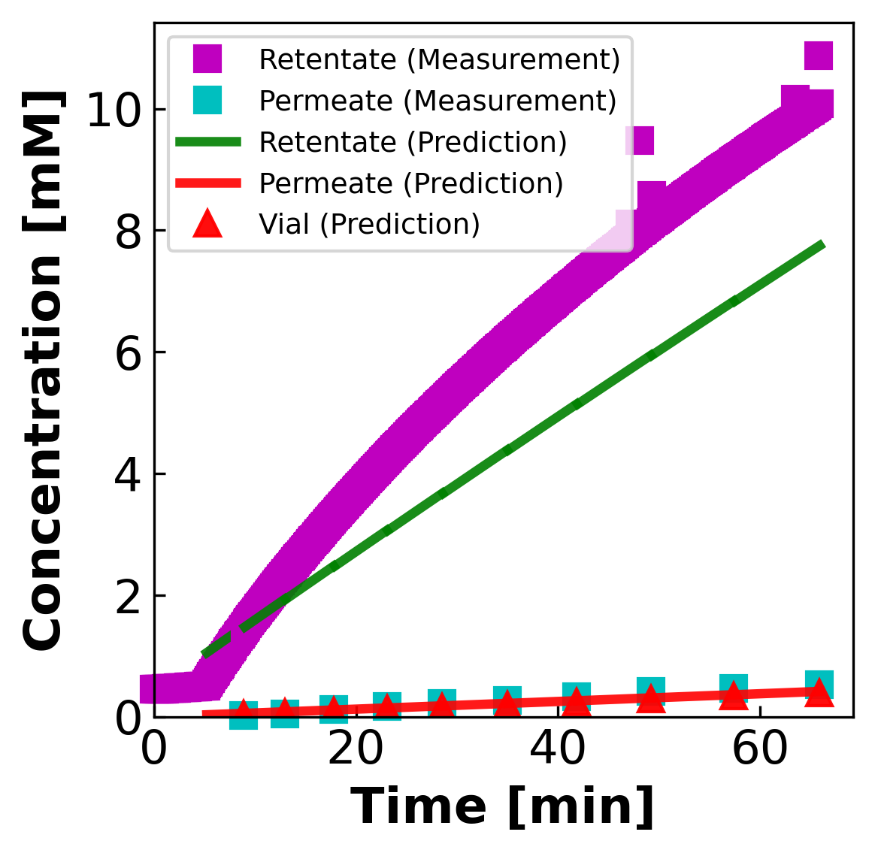
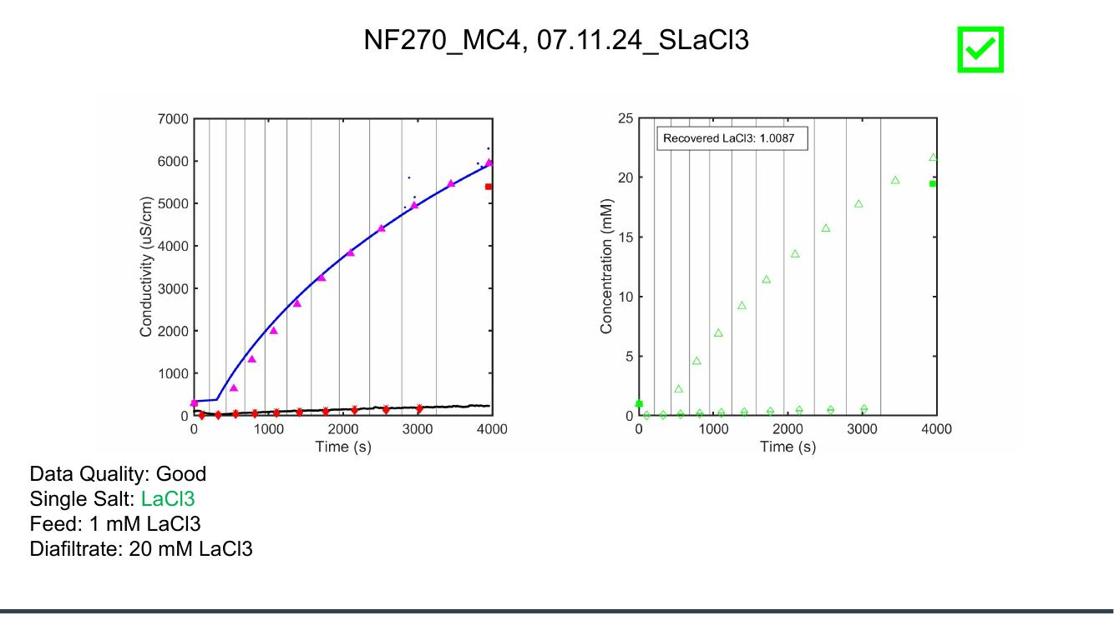
MC4.07.11.24_SLaCl3
Feed: 1 mM Diafiltrate: 20 mM (Collab: Good)
Collaborator's deck
Our DATA3 pipeline
Collaborator slide #19 · our file: concentration-LL_071124_NF270_MC_4_LaCl3_07.11.24_SLaCl3.png

Slide 33
Reading guide — what to look for
Three quick checks for each experiment, top → bottom:
1. Retentate end-of-run concentration
Read off the final value of the magenta retentate trace on BOTH sides — they should match within ~5 %.
2. Time axis: collaborator uses SECONDS, we use MINUTES
Multiply collab time by 60 to compare to ours. This is just a units choice — not a processing difference.
3. Permeate (vial) values
Collaborator plots open triangles (cumulative permeate ICP) AND in some cases open diamonds (instantaneous). We plot teal ■ (per-vial instantaneous ICP). Compare like-for-like:
— Our teal ■ vs collab open diamonds (instantaneous)
— Our cumulative would need to be derived; not currently plotted.
If retentate agrees but permeate scatter differs
Conductivity → concentration inversion is the SAME for retentate (Shedlovsky). Permeate disagreement points to either (a) per-vial ICP-OES being plotted differently, or (b) a model-prediction artifact. Worth a follow-up.
Bottom line
The conductivity-derived RETENTATE traces should agree numerically on both sides. That is the strongest test of whether our processing pipeline gives the same numbers.

Slide 34
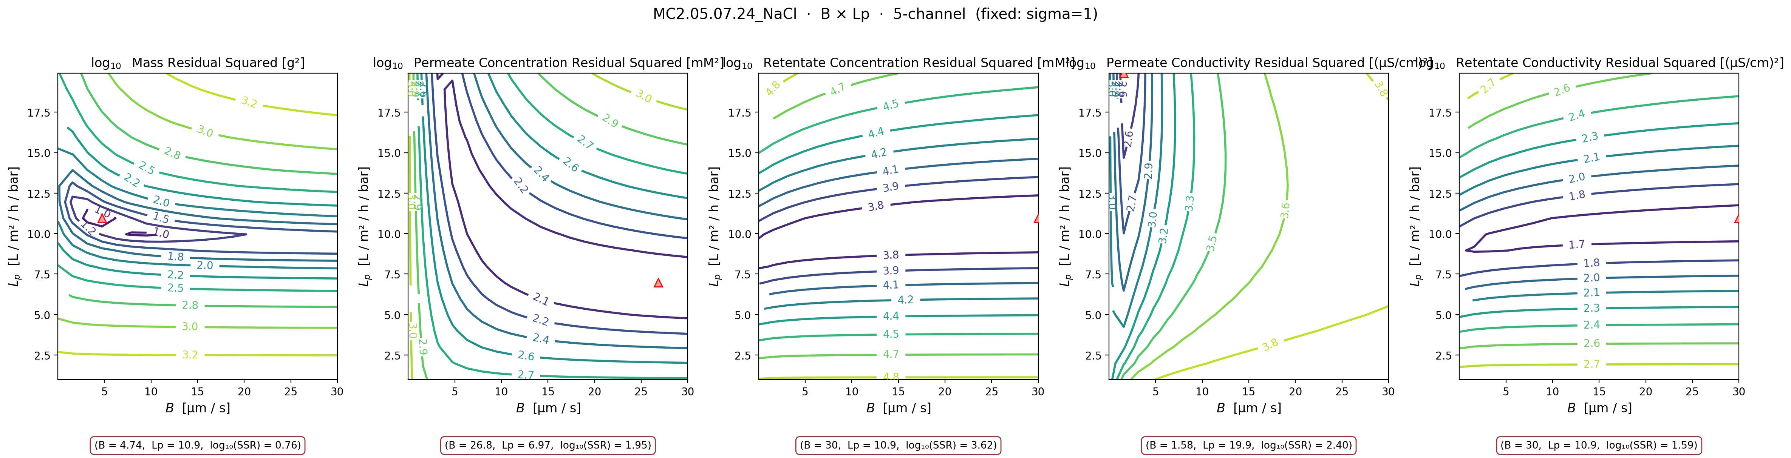
A1
APPENDIX — MC2 NaCl B × Lp contour
σ fixed at warm-start (σ=1) · B × Lp swept · supports the 'σ=1 wall hides B-Lp trade-off' claim

Slide 35
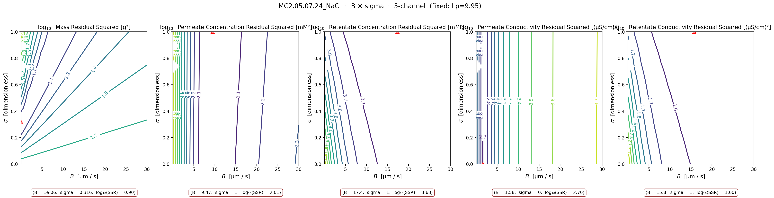
A2
APPENDIX — MC2 NaCl B × σ contour
Lp fixed at warm-start (Lp=9.95) · B × σ swept · mass argmins at interior σ ≈ 0.32 — interesting

Slide 36
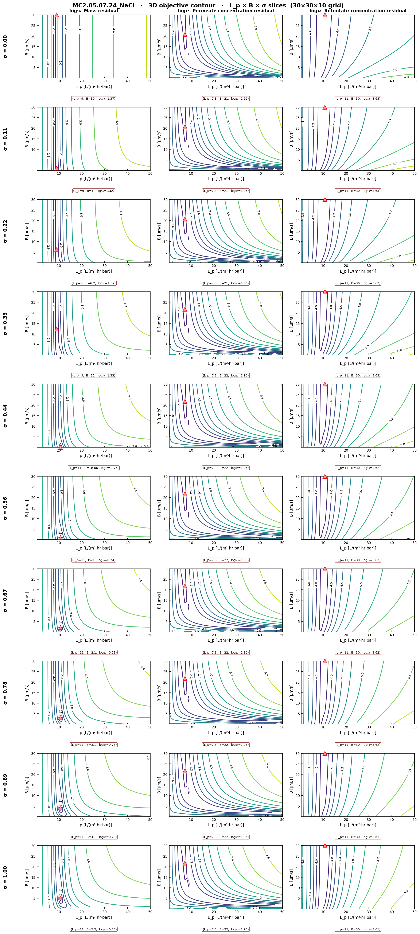
A3
APPENDIX — 3D L_p × B × σ slice composite, NaCl
10 σ-slices × 3 channels. Confirms the σ × Lp basin structure.

Slide 37
A3
APPENDIX — 3D L_p × B × σ slice composite, NaCl
10 σ-slices × 3 channels. Confirms the σ × Lp basin structure.

Slide 38
A3
APPENDIX — 3D L_p × B × σ slice composite, NaCl
10 σ-slices × 3 channels. Confirms the σ × Lp basin structure.

Slide 39
A3
APPENDIX — 3D L_p × B × σ slice composite, NaCl
10 σ-slices × 3 channels. Confirms the σ × Lp basin structure.

Slide 40
A3
APPENDIX — 3D L_p × B × σ slice composite, NaCl
10 σ-slices × 3 channels. Confirms the σ × Lp basin structure.

Slide 41
A3
APPENDIX — 3D L_p × B × σ slice composite, NaCl
10 σ-slices × 3 channels. Confirms the σ × Lp basin structure.

Slide 42
A3
APPENDIX — 3D L_p × B × σ slice composite, NaCl
10 σ-slices × 3 channels. Confirms the σ × Lp basin structure.

Slide 43
A3
APPENDIX — 3D L_p × B × σ slice composite, NaCl
10 σ-slices × 3 channels. Confirms the σ × Lp basin structure.

Slide 44
A3
APPENDIX — 3D L_p × B × σ slice composite, NaCl
10 σ-slices × 3 channels. Confirms the σ × Lp basin structure.

Slide 45
A3
APPENDIX — 3D L_p × B × σ slice composite, NaCl
10 σ-slices × 3 channels. Confirms the σ × Lp basin structure.

Slide 46
A3
APPENDIX — 3D L_p × B × σ slice composite, NaCl
10 σ-slices × 3 channels. Confirms the σ × Lp basin structure.

Slide 47
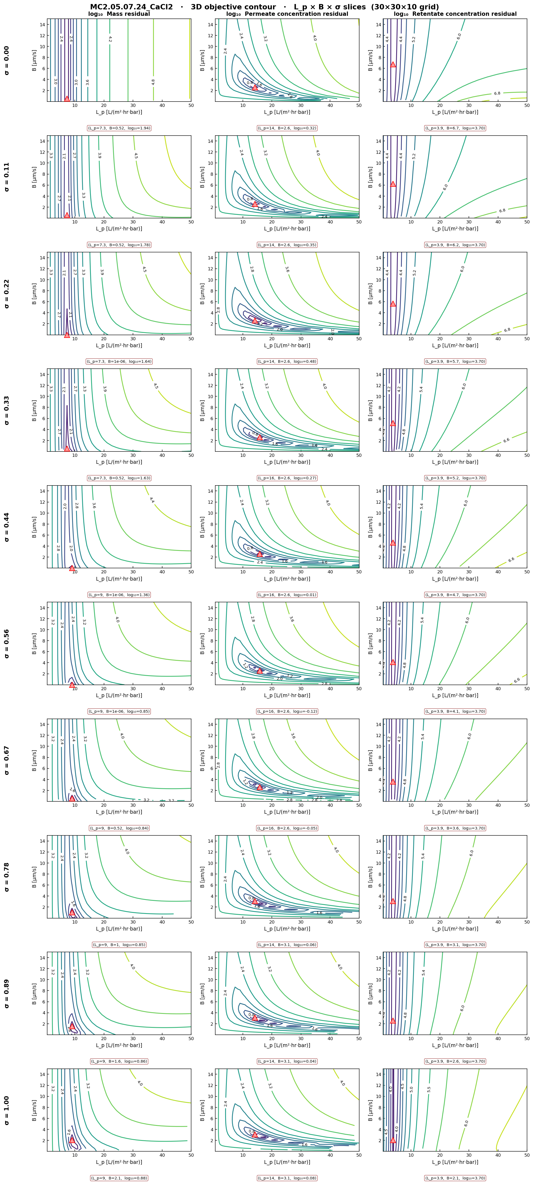
A4
APPENDIX — 3D L_p × B × σ slice composite, CaCl₂
Basin shape morphs between σ=0 and σ=1 — the side-split on slide 05 made visible across σ.

Slide 48
A4
APPENDIX — 3D L_p × B × σ slice composite, CaCl₂
Basin shape morphs between σ=0 and σ=1 — the side-split on slide 05 made visible across σ.

Slide 49
A4
APPENDIX — 3D L_p × B × σ slice composite, CaCl₂
Basin shape morphs between σ=0 and σ=1 — the side-split on slide 05 made visible across σ.

Slide 50
A4
APPENDIX — 3D L_p × B × σ slice composite, CaCl₂
Basin shape morphs between σ=0 and σ=1 — the side-split on slide 05 made visible across σ.

Slide 51
A4
APPENDIX — 3D L_p × B × σ slice composite, CaCl₂
Basin shape morphs between σ=0 and σ=1 — the side-split on slide 05 made visible across σ.

Slide 52
A4
APPENDIX — 3D L_p × B × σ slice composite, CaCl₂
Basin shape morphs between σ=0 and σ=1 — the side-split on slide 05 made visible across σ.

Slide 53
A4
APPENDIX — 3D L_p × B × σ slice composite, CaCl₂
Basin shape morphs between σ=0 and σ=1 — the side-split on slide 05 made visible across σ.

Slide 54
A4
APPENDIX — 3D L_p × B × σ slice composite, CaCl₂
Basin shape morphs between σ=0 and σ=1 — the side-split on slide 05 made visible across σ.

Slide 55
A4
APPENDIX — 3D L_p × B × σ slice composite, CaCl₂
Basin shape morphs between σ=0 and σ=1 — the side-split on slide 05 made visible across σ.

Slide 56
A4
APPENDIX — 3D L_p × B × σ slice composite, CaCl₂
Basin shape morphs between σ=0 and σ=1 — the side-split on slide 05 made visible across σ.

Slide 57
A4
APPENDIX — 3D L_p × B × σ slice composite, CaCl₂
Basin shape morphs between σ=0 and σ=1 — the side-split on slide 05 made visible across σ.

