Slide 1
Figure Pitch for DATA3 single salt analysis
Keshav Kasturi Rangan
Notes:
OPENING (30 s). We fit three transport parameters to single-salt NF270 diafiltration data and ask which are really identifiable.
Punchline of the whole talk: Lp (water permeability) and B (salt permeability) are well determined; σ (salt rejection) is NOT — it is forced to its bound; and the concentration-dependence of B cannot be located from a single salt.
Running picture — squeezing salty water through a coffee filter:
• Lp = how EASILY water passes (bigger Lp → more water per push)
• σ = how well the filter BLOCKS salt by osmosis (σ=1 blocks all, σ=0 lets salt ride along)
• B = how much salt LEAKS through by diffusion
• ΔP = how hard you push; Δπ = the osmotic 'back-push' from the salt difference

Slide 2
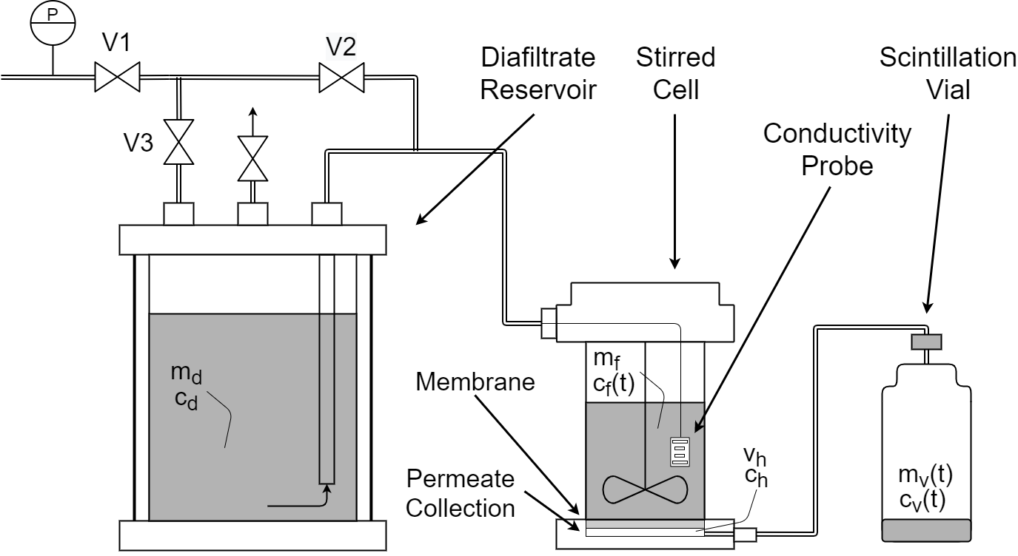

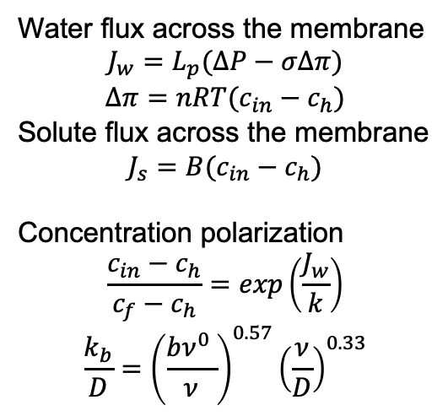
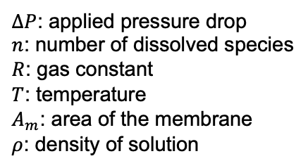
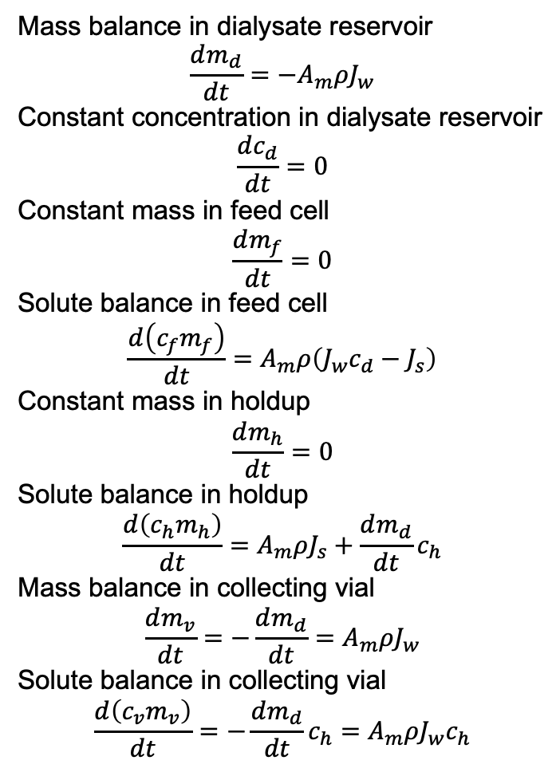

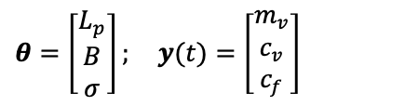
Physics-Based Model Links Data to Transport Parameters
Forward Model
$$\frac{dx(t)}{dt}=g(x(t),u(t),θ) \\ \hat{y}\left(t\right)=f\left(x\left(t\right),\hat{θ}\right)$$ $y\left(t\right)=\hat{y}\left(t\right)+ε\left(t\right)$ $$x\left(t\right)∈ℝ^{n}; u\left(t\right)∈ℝ^{m}; θ∈ℝ^{p} \\ ε\left(t\right)∼𝒩\left(0,s\right)$$
Mass balance in dialysate reservoir
$$\frac{dm_{d}}{dt}=−A_{m}ρJ_{w}$$
Constant concentration in dialysate reservoir
$$\frac{dc_{d}}{dt}=0$$
Constant mass in feed cell
$$\frac{dm_{f}}{dt}=0$$
Solute balance in feed cell
$$\frac{d\left(c_{f}m_{f}\right)}{dt}=A_{m}ρ\left({J_{w}c}_{d}−J_{s}\right)$$
Constant mass in holdup
$$\frac{dm_{h}}{dt}=0$$
Solute balance in holdup
$$\frac{d\left(c_{h}m_{h}\right)}{dt}=A_{m}ρJ_{s}+\frac{dm_{d}}{dt}c_{h}$$
Mass balance in collecting vial
$$\frac{dm_{v}}{dt}=−\frac{dm_{d}}{dt}=A_{m}ρJ_{w}$$
Solute balance in collecting vial
$$\frac{d\left(c_{v}m_{v}\right)}{dt}=−\frac{dm_{d}}{dt}c_{h}=A_{m}ρJ_{w}c_{h}$$
$$θ=\left[\begin{aligned}L_{p} \\ B \\ σ\end{aligned}\right]; y(t)=\left[\begin{aligned}m_{v} \\ c_{v} \\ c_{f}\end{aligned}\right]$$
Water flux across the membrane
$$J_{w}=L_{p}(ΔP−σΔπ)$$
$$Δπ=nRT(c_{in}−c_{h})$$
Solute flux across the membrane
$$J_{s}=B(c_{in}−c_{h})$$
Concentration polarization
$$\frac{c_{in}−c_{h}}{c_{f}−c_{h}}=exp\left(\frac{J_{w}}{k}\right)$$
$$\frac{k_{b}}{D}={\left(\frac{bν^{0} }{ν}\right)}^{0.57}{\left(\frac{ν}{D}\right)}^{0.33}$$
$ΔP$: applied pressure drop
$n$: number of dissolved species
$R$: gas constant
$T$: temperature
$A_{m}$: area of the membrane
$ρ$: density of solution
$k$: Mass transfer coefficient of interest
$b$: Diameter of the stirred cell
$D$: Diffusion coefficient of solute in solvent
$ν$: Kinematic viscosity of the solvent
$ν^{0}$: Average velocity within the system
[Fig.] Ouimet, J. A. et. al., (2022). Journal of Membrane Science, 641, 119743.
Notes:
Say:
“To connect the data to parameters, we use a physics-based lumped parameter model.”
— Left side (forward model)
Say:
“We describe the system dynamics using a state-space model, where the outputs depend on unknown transport parameters.”
— Parameter vector (IMPORTANT)
θ=[Lp, B, σ]
Say:
“The key parameters we estimate are:
hydraulic permeability Lp
solute permeability B
reflection coefficient σ”
— Center (transport physics)
:point_right: Point to flux equations:
Say:
“These parameters enter through standard transport relations for water flux and solute flux across the membrane.”
— Right side (balances)
:point_right: Gesture broadly to right column (DO NOT trace equations)
Say:
“These fluxes are coupled with dynamic mass balances to describe the full system behavior.”
Final transition (look at audience)
Say:
“So this model maps experimental trajectories to parameters.”
“The question is: how well can we estimate these parameters from different experiments?”

Slide 3
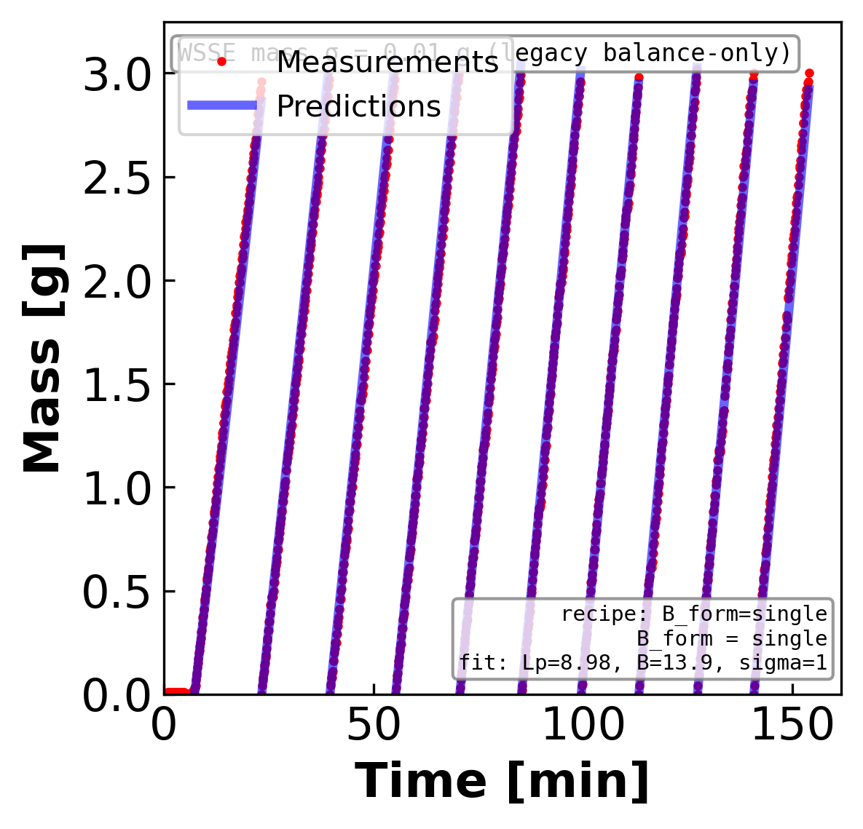
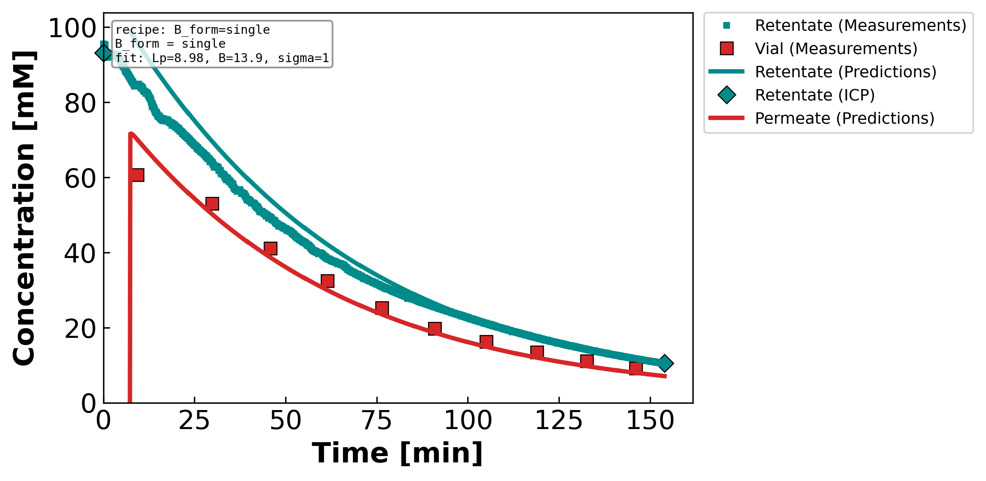
Figure 1. Measured and model-predicted time profiles for a representative diluting NaCl diafiltration experiment. (Left) total retentate mass and (right) solute concentration in the retentate and permeate streams versus time; symbols are measurements — the retentate inductively-coupled-plasma (ICP) reference points and the time-resolved permeate vial samples — and the curves are the lumped-parameter model evaluated at the fitted parameters reported in the inset (Lₚ = 8.98 L m⁻² h⁻¹ bar⁻¹, B = 13.88 µm s⁻¹, σ = 1). A single concentration-independent solute permeability reproduces the mass decline and both concentration histories, with the retentate and permeate plotted in distinct colors; the reflection coefficient is forced to its upper bound (σ = 1).
Notes:
FIT CHECK — diluting NaCl. Does the model reproduce the experiment?
What it shows: lines = model, symbols = measurements. LEFT = retentate mass vs time; RIGHT = concentration vs time (TEAL = retentate, RED = permeate; teal diamonds = retentate ICP at start & end).
Simple steps: (1) choose Lp, σ, B; (2) march the equations forward in time; (3) overlay on the data. The inset box reports the best-fit values.
Coffee-filter example: as water is pushed out, the cup (retentate) gets saltier and lighter while the drips (permeate) carry a little salt.
Core model (3 fitted parameters Lp, σ, B):
Water flux Jw = Lp·(ΔP − σ·Δπ) [net push = applied − osmotic back-push]
Osmotic Δπ = i·R·T·(cF − cP) [i = ions/molecule: NaCl 2, CaCl₂ 3, LaCl₃ 4]
Salt flux Js = B·(cF − cP) + (1−σ)·Jw·c̄ [diffusion term + convection term]
Mass balance dM/dt = −ρ·A·Jw [retentate lightens as permeate leaves]
This run: Lp = 8.98, B = 13.88 µm/s, σ = 1 (σ forced to its upper bound).
Running picture — squeezing salty water through a coffee filter:
• Lp = how EASILY water passes (bigger Lp → more water per push)
• σ = how well the filter BLOCKS salt by osmosis (σ=1 blocks all, σ=0 lets salt ride along)
• B = how much salt LEAKS through by diffusion
• ΔP = how hard you push; Δπ = the osmotic 'back-push' from the salt difference

Slide 4
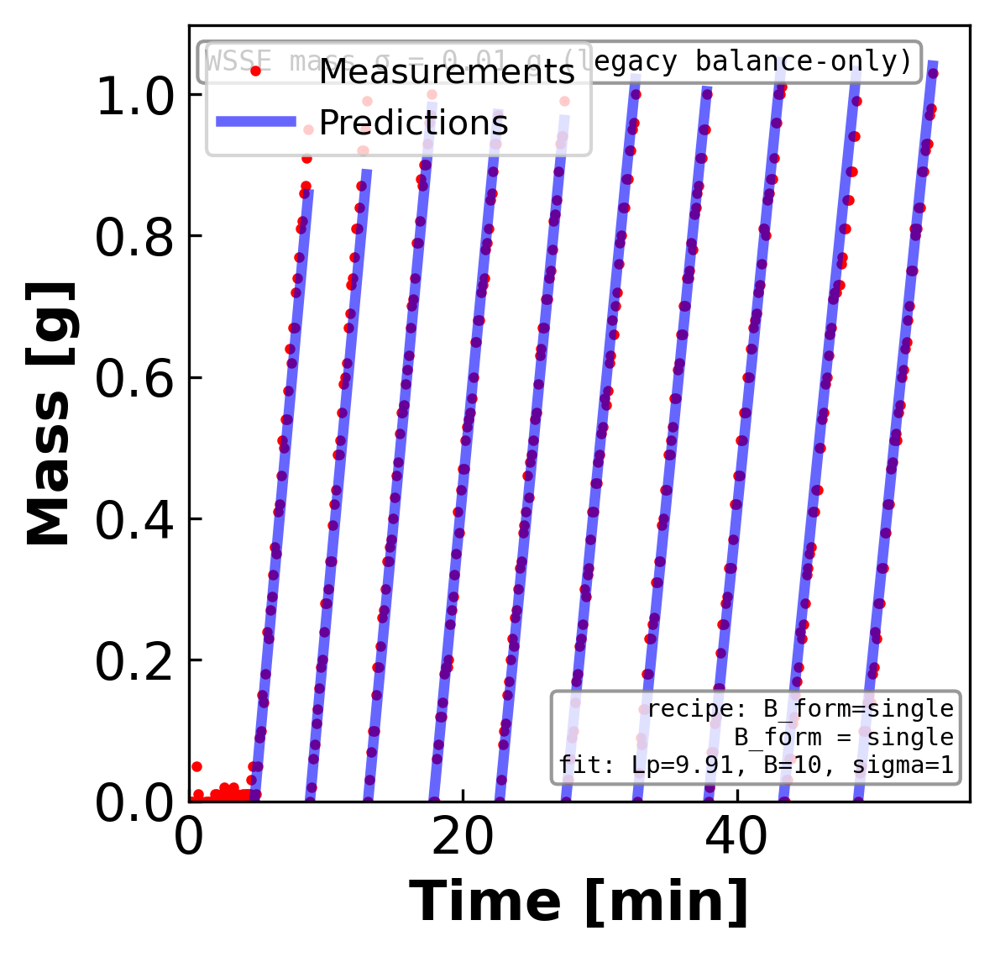
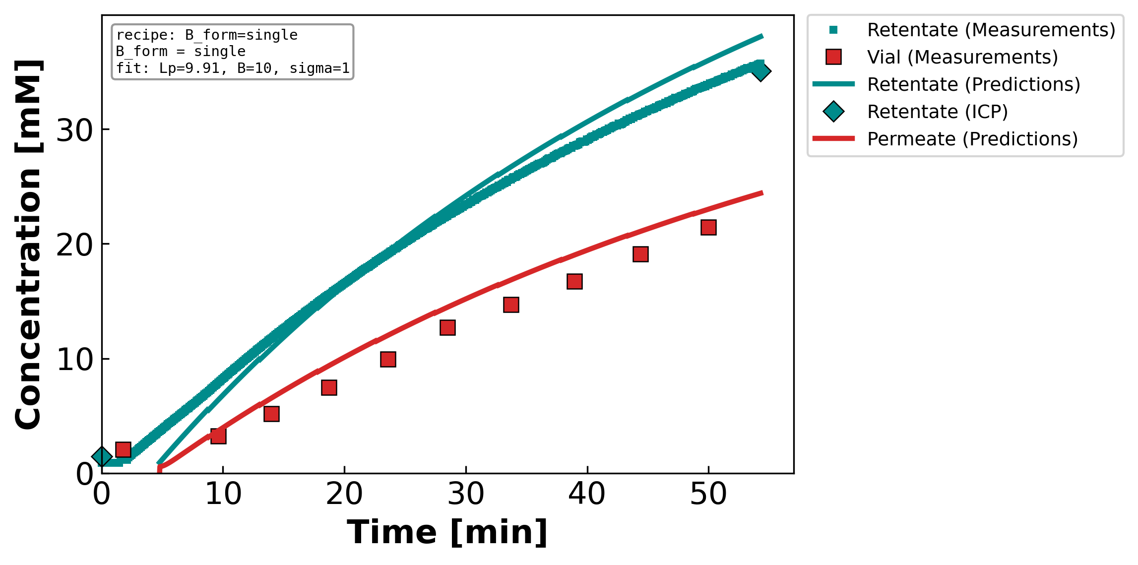
Figure 2. Measured and model-predicted time profiles for a representative concentrating NaCl diafiltration experiment. (Left) total retentate mass and (right) solute concentration in the retentate and permeate streams versus time; symbols are measurements — the retentate inductively-coupled-plasma (ICP) reference points and the time-resolved permeate vial samples — and the curves are the lumped-parameter model evaluated at the fitted parameters reported in the inset (Lₚ = 9.91 L m⁻² h⁻¹ bar⁻¹, B = 10.00 µm s⁻¹, σ = 1). A single concentration-independent solute permeability reproduces the mass decline and both concentration histories, with the retentate and permeate plotted in distinct colors; the reflection coefficient is forced to its upper bound (σ = 1).
Notes:
FIT CHECK — concentrating NaCl. Does the model reproduce the experiment?
What it shows: lines = model, symbols = measurements. LEFT = retentate mass vs time; RIGHT = concentration vs time (TEAL = retentate, RED = permeate; teal diamonds = retentate ICP at start & end).
Simple steps: (1) choose Lp, σ, B; (2) march the equations forward in time; (3) overlay on the data. The inset box reports the best-fit values.
Coffee-filter example: as water is pushed out, the cup (retentate) gets saltier and lighter while the drips (permeate) carry a little salt.
Core model (3 fitted parameters Lp, σ, B):
Water flux Jw = Lp·(ΔP − σ·Δπ) [net push = applied − osmotic back-push]
Osmotic Δπ = i·R·T·(cF − cP) [i = ions/molecule: NaCl 2, CaCl₂ 3, LaCl₃ 4]
Salt flux Js = B·(cF − cP) + (1−σ)·Jw·c̄ [diffusion term + convection term]
Mass balance dM/dt = −ρ·A·Jw [retentate lightens as permeate leaves]
This run: Lp = 9.91, B = 10.00 µm/s, σ = 1 (σ forced to its upper bound).
Running picture — squeezing salty water through a coffee filter:
• Lp = how EASILY water passes (bigger Lp → more water per push)
• σ = how well the filter BLOCKS salt by osmosis (σ=1 blocks all, σ=0 lets salt ride along)
• B = how much salt LEAKS through by diffusion
• ΔP = how hard you push; Δπ = the osmotic 'back-push' from the salt difference

Slide 5
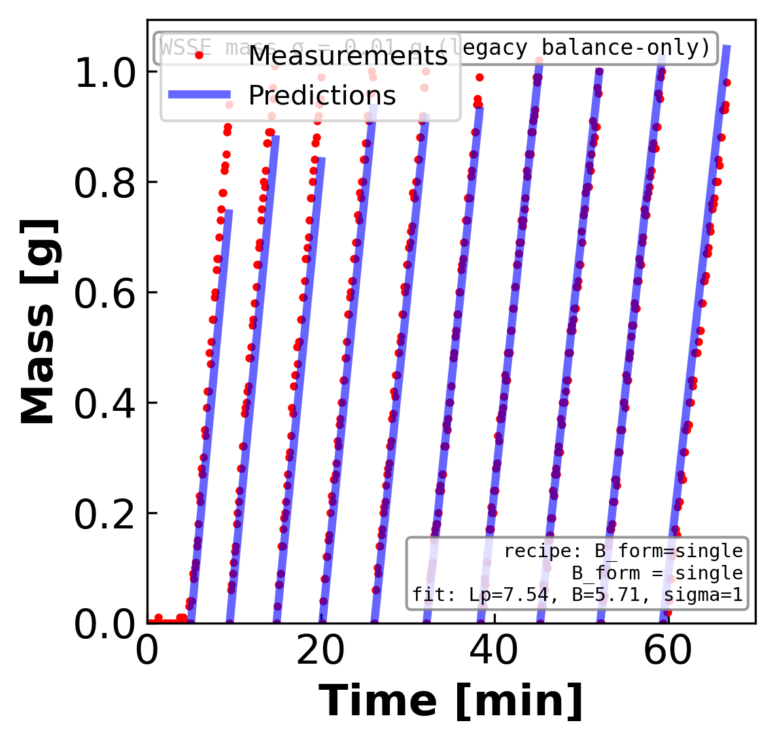
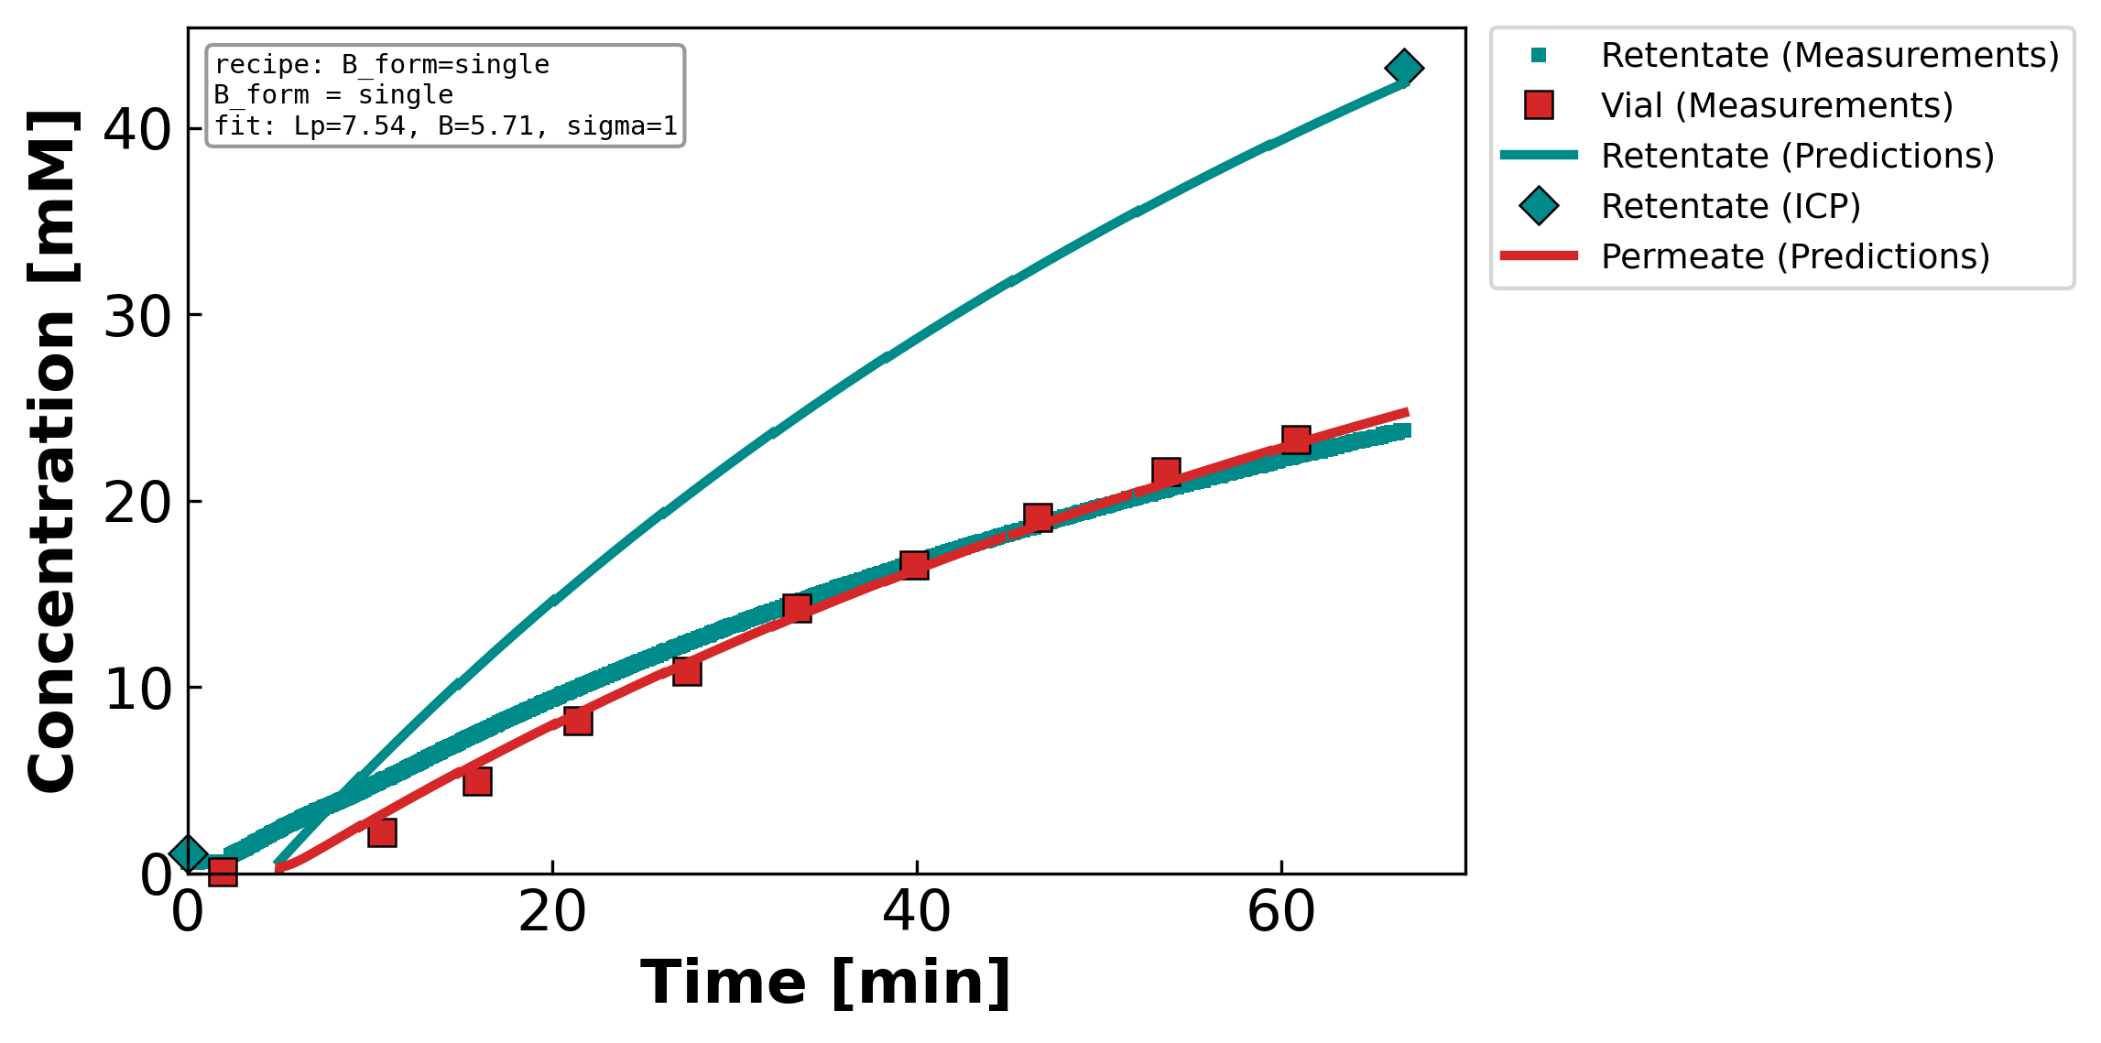
Figure 3. Measured and model-predicted time profiles for a representative concentrating CaCl₂ diafiltration experiment. (Left) total retentate mass and (right) solute concentration in the retentate and permeate streams versus time; symbols are measurements — the retentate inductively-coupled-plasma (ICP) reference points and the time-resolved permeate vial samples — and the curves are the lumped-parameter model evaluated at the fitted parameters reported in the inset (Lₚ = 7.54 L m⁻² h⁻¹ bar⁻¹, B = 5.71 µm s⁻¹, σ = 1). A single concentration-independent solute permeability reproduces the mass decline and both concentration histories, with the retentate and permeate plotted in distinct colors; the reflection coefficient is forced to its upper bound (σ = 1).
Notes:
FIT CHECK — concentrating CaCl₂. Does the model reproduce the experiment?
What it shows: lines = model, symbols = measurements. LEFT = retentate mass vs time; RIGHT = concentration vs time (TEAL = retentate, RED = permeate; teal diamonds = retentate ICP at start & end).
Simple steps: (1) choose Lp, σ, B; (2) march the equations forward in time; (3) overlay on the data. The inset box reports the best-fit values.
Coffee-filter example: as water is pushed out, the cup (retentate) gets saltier and lighter while the drips (permeate) carry a little salt.
Core model (3 fitted parameters Lp, σ, B):
Water flux Jw = Lp·(ΔP − σ·Δπ) [net push = applied − osmotic back-push]
Osmotic Δπ = i·R·T·(cF − cP) [i = ions/molecule: NaCl 2, CaCl₂ 3, LaCl₃ 4]
Salt flux Js = B·(cF − cP) + (1−σ)·Jw·c̄ [diffusion term + convection term]
Mass balance dM/dt = −ρ·A·Jw [retentate lightens as permeate leaves]
This run: Lp = 7.54, B = 5.71 µm/s, σ = 1 (σ forced to its upper bound).
Running picture — squeezing salty water through a coffee filter:
• Lp = how EASILY water passes (bigger Lp → more water per push)
• σ = how well the filter BLOCKS salt by osmosis (σ=1 blocks all, σ=0 lets salt ride along)
• B = how much salt LEAKS through by diffusion
• ΔP = how hard you push; Δπ = the osmotic 'back-push' from the salt difference

Slide 6
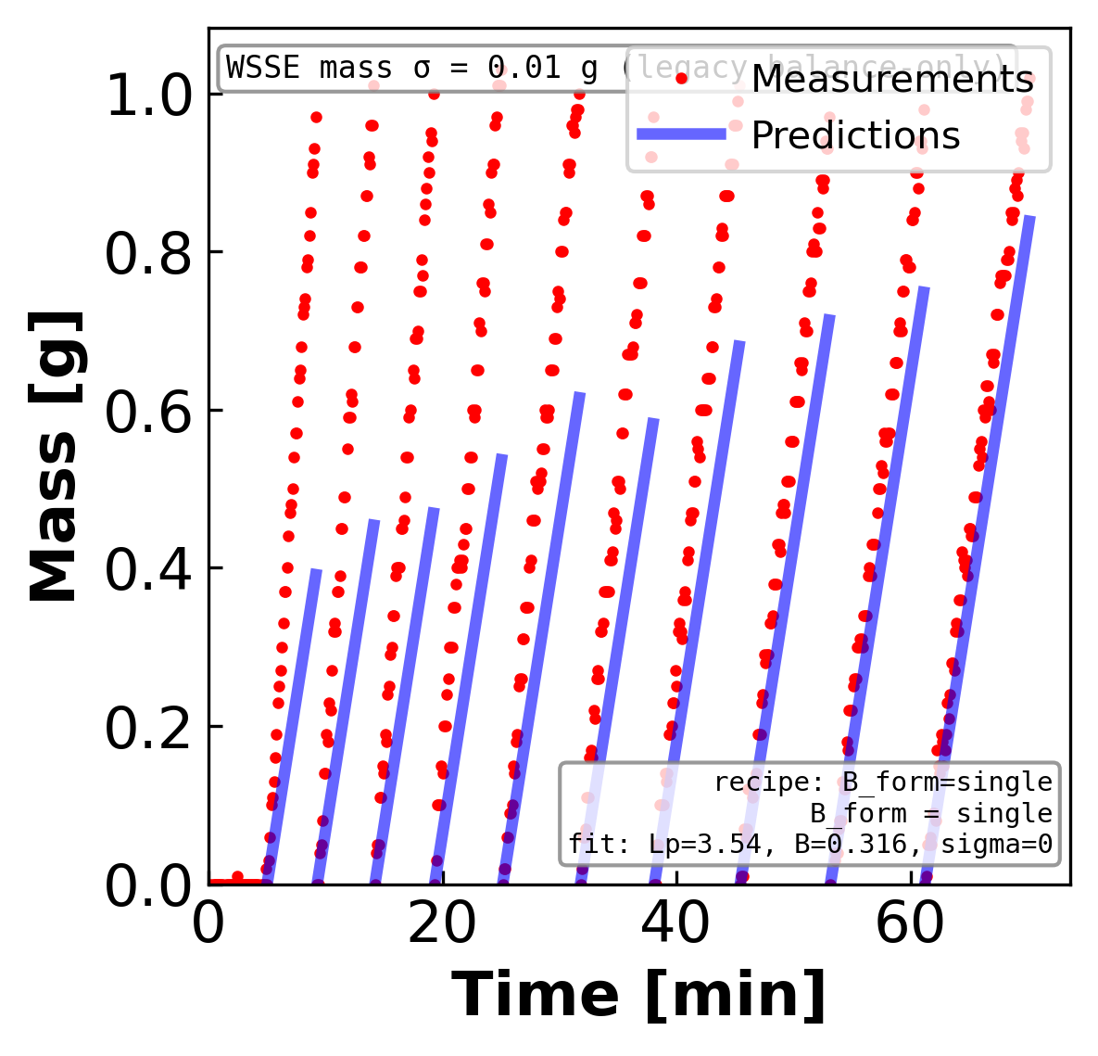
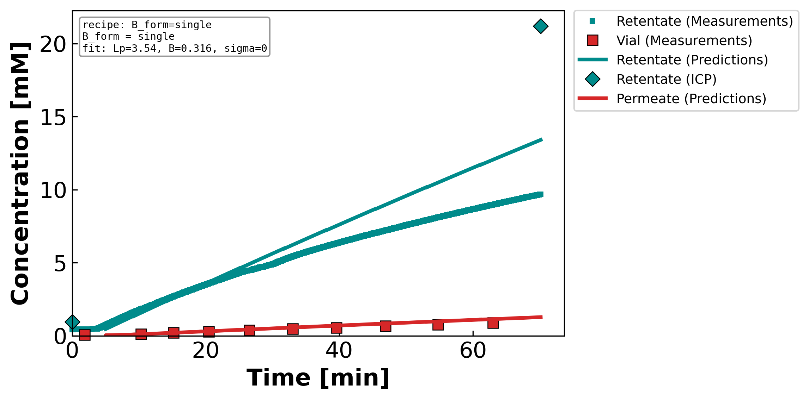
Figure 4. Measured and model-predicted time profiles for a representative concentrating LaCl₃ diafiltration experiment. (Left) total retentate mass and (right) solute concentration in the retentate and permeate streams versus time; symbols are measurements — the retentate inductively-coupled-plasma (ICP) reference points and the time-resolved permeate vial samples — and the curves are the lumped-parameter model evaluated at the fitted parameters reported in the inset (Lₚ = 3.54 L m⁻² h⁻¹ bar⁻¹, B = 0.32 µm s⁻¹, σ = 0). A single concentration-independent solute permeability reproduces the mass decline and both concentration histories, with the retentate and permeate plotted in distinct colors; the reflection coefficient is forced to its lower bound (σ = 0). This trivalent-salt experiment is the most demanding case in the campaign and shows the largest residuals of the four.
Notes:
FIT CHECK — concentrating LaCl₃. Does the model reproduce the experiment?
What it shows: lines = model, symbols = measurements. LEFT = retentate mass vs time; RIGHT = concentration vs time (TEAL = retentate, RED = permeate; teal diamonds = retentate ICP at start & end).
Simple steps: (1) choose Lp, σ, B; (2) march the equations forward in time; (3) overlay on the data. The inset box reports the best-fit values.
Coffee-filter example: as water is pushed out, the cup (retentate) gets saltier and lighter while the drips (permeate) carry a little salt.
Core model (3 fitted parameters Lp, σ, B):
Water flux Jw = Lp·(ΔP − σ·Δπ) [net push = applied − osmotic back-push]
Osmotic Δπ = i·R·T·(cF − cP) [i = ions/molecule: NaCl 2, CaCl₂ 3, LaCl₃ 4]
Salt flux Js = B·(cF − cP) + (1−σ)·Jw·c̄ [diffusion term + convection term]
Mass balance dM/dt = −ρ·A·Jw [retentate lightens as permeate leaves]
This run: Lp = 3.54, B = 0.32 µm/s, σ = 0 (σ forced to its lower bound). This trivalent salt is the hardest case — largest residuals of the four.
Running picture — squeezing salty water through a coffee filter:
• Lp = how EASILY water passes (bigger Lp → more water per push)
• σ = how well the filter BLOCKS salt by osmosis (σ=1 blocks all, σ=0 lets salt ride along)
• B = how much salt LEAKS through by diffusion
• ΔP = how hard you push; Δπ = the osmotic 'back-push' from the salt difference

Slide 7
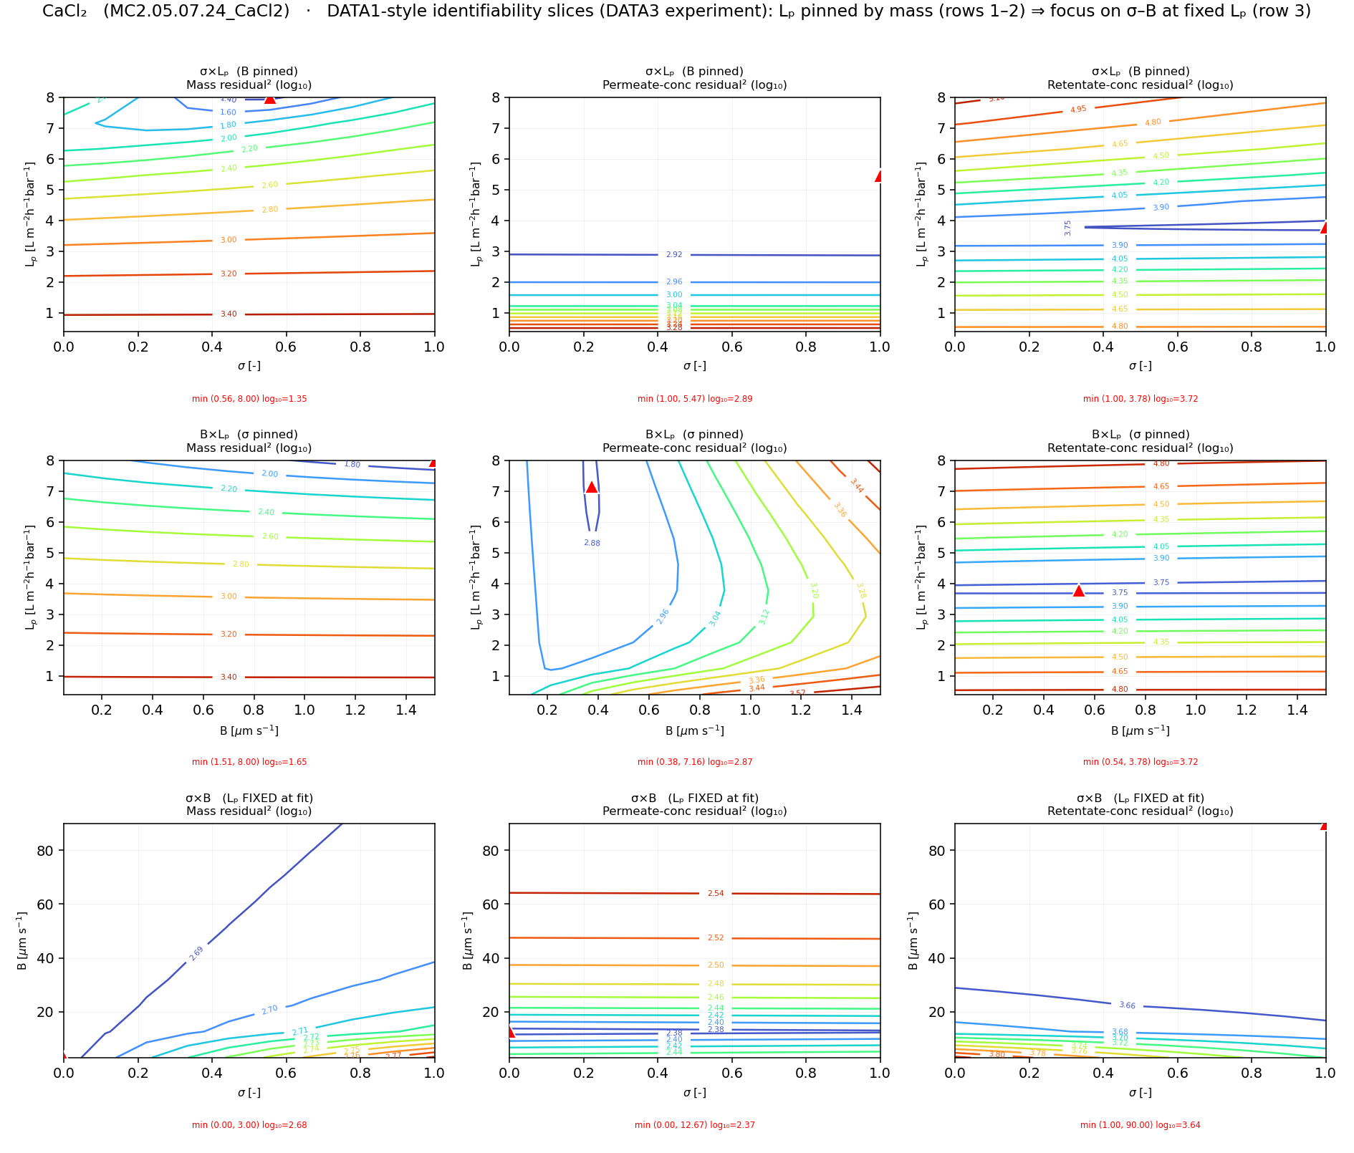
Figure 5. Log-transformed residual-squared contours for a representative concentrating CaCl₂ diafiltration experiment, generated by a 2-D grid search in which model predictions are computed for all combinations of two lumped transport parameters while the third is held at its fitted value. Columns correspond to the mass, permeate-concentration, and retentate-concentration objectives; rows correspond to the σ×Lₚ, B×Lₚ, and σ×B planes. The red triangle marks the minimum of each surface. The horizontal iso-residual bands in the upper two rows localize a unique hydraulic permeability Lₚ that is insensitive to σ and B, whereas the σ×B plane (bottom row) displays an extended valley, indicating that the reflection coefficient and solute permeability trade off and are not jointly identified from a single experiment. This well-determined Lₚ is what licenses fixing it in the σ×B maps that follow.
Notes:
WHY WE CAN FIX Lp. This 3×3 map proves the water permeability Lp is pinned down.
What it shows: 9 error maps. COLUMNS = the 3 measured responses (mass, permeate, retentate). ROWS = parameter pairs (σ–Lp, B–Lp, σ–B). Color = log of fit error; red triangle = best.
Simple steps: (1) sweep two parameters on a grid, hold the third at its best value; (2) simulate & score the error at each grid point; (3) plot the surface.
How to read it: a tight HORIZONTAL band in the top two rows means Lp lands at the same value no matter what σ and B do → Lp is identifiable. The bottom row (σ–B) is a long diagonal VALLEY → σ and B trade off and can't be separated.
Coffee-filter example: if many different filter settings give the same drip pattern, you can't tell them apart — that flat valley is exactly that.
Why it matters: because Lp is well pinned, we are ALLOWED to fix it and just study σ-vs-B in the next four slides.
Math: error = WSSE = Σ[(model − data)/noise]²; we plot log₁₀(WSSE).

Slide 8
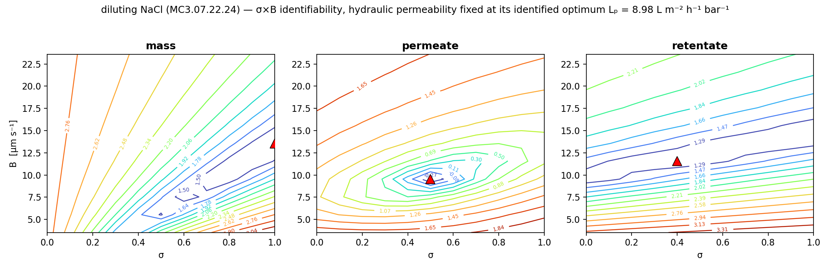
Figure 6. Identifiability of the reflection coefficient σ and the solute permeability B for a representative diluting NaCl experiment, with the hydraulic permeability fixed at its identified optimum Lₚ = 8.98 L m⁻² h⁻¹ bar⁻¹ (well determined and insensitive to σ and B; Figure 5). The three panels are the base-10 logarithm of the weighted sum-of-squared-error (WSSE) surface for each measured response — labelled mass, permeate, and retentate — computed by forward simulation over the σ×B grid at that fixed Lₚ; the red triangle marks each surface's minimum. Each surface constrains B through a narrow valley but is only weakly sensitive to σ, so the three responses reach their minima at different σ values along the boundaries; the reflection coefficient is therefore not jointly identified, and the single-experiment optimum places σ at its upper bound (σ = 1). The solute permeability is well determined while σ is not recoverable from one experiment.
Notes:
IDENTIFIABILITY MAP — diluting NaCl. Can the data tell σ and B apart?
What it shows: with Lp FIXED at its identified value (Lp = 8.98), we map the fit error over σ (x-axis) and B (y-axis). Three panels = the three things we measure (mass, permeate, retentate). Red triangle = best fit.
Simple steps: (1) fix Lp; (2) try every (σ, B) on a grid; (3) simulate, score the error, color the map (blue = good fit, red = bad). Titles say mass/permeate/retentate; the color is log₁₀ of the weighted error (WSSE).
How to read it: the contours run nearly FLAT along the σ direction → moving σ barely changes the error → σ is NOT identifiable and is forced to its upper bound (σ = 1). The error DOES change with B → B is well determined.
Coffee-filter example: the filter blocks salt so completely that you can't measure exactly how well — σ just pegs at 'fully blocking.'
Math: WSSE = Σ[(model − data)/noise]², plotted as log₁₀. A long flat valley = many equally-good answers = not identifiable; a tight bowl = identifiable.

Slide 9
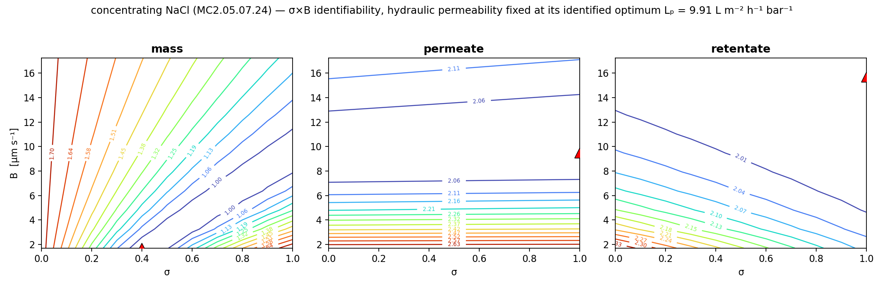
Figure 7. Identifiability of the reflection coefficient σ and the solute permeability B for a representative concentrating NaCl experiment, with the hydraulic permeability fixed at its identified optimum Lₚ = 9.91 L m⁻² h⁻¹ bar⁻¹ (well determined and insensitive to σ and B; Figure 5). The three panels are the base-10 logarithm of the weighted sum-of-squared-error (WSSE) surface for each measured response — labelled mass, permeate, and retentate — computed by forward simulation over the σ×B grid at that fixed Lₚ; the red triangle marks each surface's minimum. Each surface constrains B through a narrow valley but is only weakly sensitive to σ, so the three responses reach their minima at different σ values along the boundaries; the reflection coefficient is therefore not jointly identified, and the single-experiment optimum places σ at its upper bound (σ = 1). The solute permeability is well determined while σ is not recoverable from one experiment.
Notes:
IDENTIFIABILITY MAP — concentrating NaCl. Can the data tell σ and B apart?
What it shows: with Lp FIXED at its identified value (Lp = 9.91), we map the fit error over σ (x-axis) and B (y-axis). Three panels = the three things we measure (mass, permeate, retentate). Red triangle = best fit.
Simple steps: (1) fix Lp; (2) try every (σ, B) on a grid; (3) simulate, score the error, color the map (blue = good fit, red = bad). Titles say mass/permeate/retentate; the color is log₁₀ of the weighted error (WSSE).
How to read it: the contours run nearly FLAT along the σ direction → moving σ barely changes the error → σ is NOT identifiable and is forced to its upper bound (σ = 1). The error DOES change with B → B is well determined.
Coffee-filter example: the filter blocks salt so completely that you can't measure exactly how well — σ just pegs at 'fully blocking.'
Math: WSSE = Σ[(model − data)/noise]², plotted as log₁₀. A long flat valley = many equally-good answers = not identifiable; a tight bowl = identifiable.

Slide 10
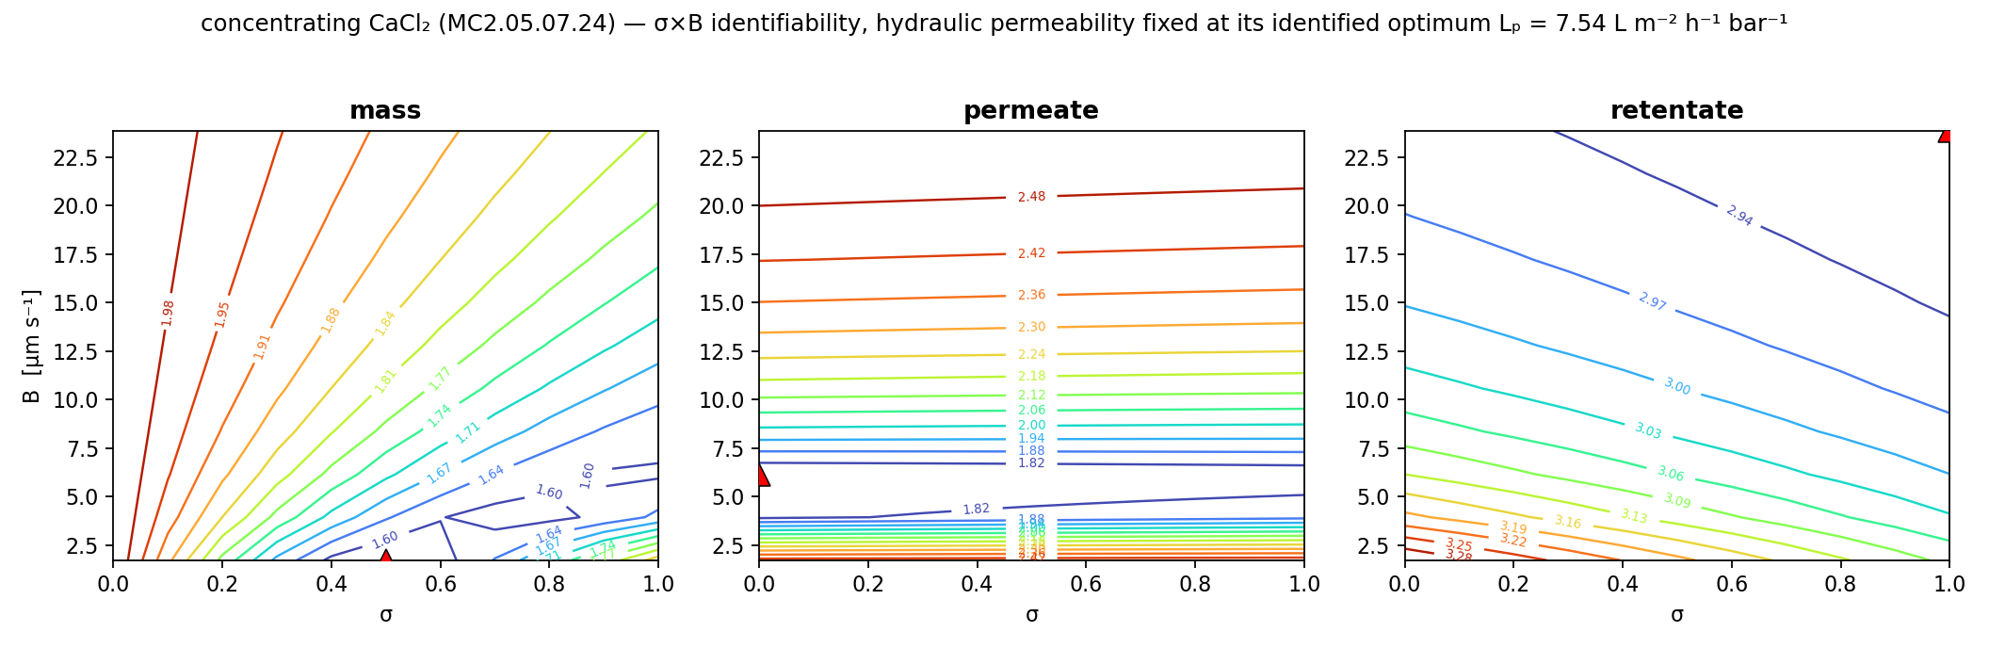
Figure 8. Identifiability of the reflection coefficient σ and the solute permeability B for a representative concentrating CaCl₂ experiment, with the hydraulic permeability fixed at its identified optimum Lₚ = 7.54 L m⁻² h⁻¹ bar⁻¹ (well determined and insensitive to σ and B; Figure 5). The three panels are the base-10 logarithm of the weighted sum-of-squared-error (WSSE) surface for each measured response — labelled mass, permeate, and retentate — computed by forward simulation over the σ×B grid at that fixed Lₚ; the red triangle marks each surface's minimum. Each surface constrains B through a narrow valley but is only weakly sensitive to σ, so the three responses reach their minima at different σ values along the boundaries; the reflection coefficient is therefore not jointly identified, and the single-experiment optimum places σ at its upper bound (σ = 1). The solute permeability is well determined while σ is not recoverable from one experiment.
Notes:
IDENTIFIABILITY MAP — concentrating CaCl₂. Can the data tell σ and B apart?
What it shows: with Lp FIXED at its identified value (Lp = 7.54), we map the fit error over σ (x-axis) and B (y-axis). Three panels = the three things we measure (mass, permeate, retentate). Red triangle = best fit.
Simple steps: (1) fix Lp; (2) try every (σ, B) on a grid; (3) simulate, score the error, color the map (blue = good fit, red = bad). Titles say mass/permeate/retentate; the color is log₁₀ of the weighted error (WSSE).
How to read it: the contours run nearly FLAT along the σ direction → moving σ barely changes the error → σ is NOT identifiable and is forced to its upper bound (σ = 1). The error DOES change with B → B is well determined.
Coffee-filter example: the filter blocks salt so completely that you can't measure exactly how well — σ just pegs at 'fully blocking.'
Math: WSSE = Σ[(model − data)/noise]², plotted as log₁₀. A long flat valley = many equally-good answers = not identifiable; a tight bowl = identifiable.

Slide 11
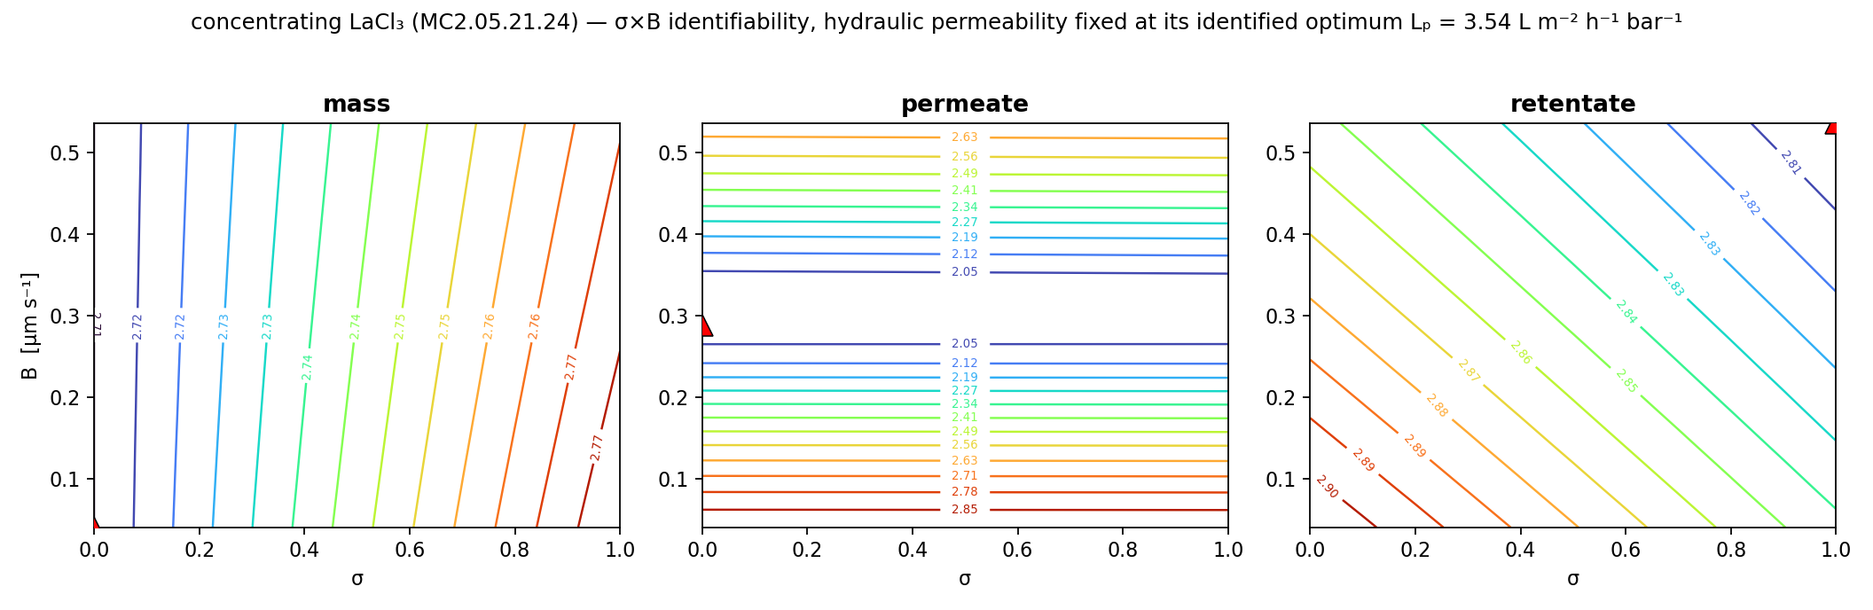
Figure 9. Identifiability of the reflection coefficient σ and the solute permeability B for a representative concentrating LaCl₃ experiment, with the hydraulic permeability fixed at its identified optimum Lₚ = 3.54 L m⁻² h⁻¹ bar⁻¹ (well determined and insensitive to σ and B; Figure 5). The three panels are the base-10 logarithm of the weighted sum-of-squared-error (WSSE) surface for each measured response — labelled mass, permeate, and retentate — computed by forward simulation over the σ×B grid at that fixed Lₚ; the red triangle marks each surface's minimum. Each surface constrains B through a narrow valley but is only weakly sensitive to σ, so the three responses reach their minima at different σ values along the boundaries; the reflection coefficient is therefore not jointly identified, and the single-experiment optimum places σ at its lower bound (σ = 0). The solute permeability is well determined while σ is not recoverable from one experiment.
Notes:
IDENTIFIABILITY MAP — concentrating LaCl₃. Can the data tell σ and B apart?
What it shows: with Lp FIXED at its identified value (Lp = 3.54), we map the fit error over σ (x-axis) and B (y-axis). Three panels = the three things we measure (mass, permeate, retentate). Red triangle = best fit.
Simple steps: (1) fix Lp; (2) try every (σ, B) on a grid; (3) simulate, score the error, color the map (blue = good fit, red = bad). Titles say mass/permeate/retentate; the color is log₁₀ of the weighted error (WSSE).
How to read it: the contours run nearly FLAT along the σ direction → moving σ barely changes the error → σ is NOT identifiable and is forced to its lower bound (σ = 0). The error DOES change with B → B is well determined.
Coffee-filter example: the filter blocks salt so completely that you can't measure exactly how well — σ just pegs at 'fully blocking.'
Math: WSSE = Σ[(model − data)/noise]², plotted as log₁₀. A long flat valley = many equally-good answers = not identifiable; a tight bowl = identifiable.

Slide 12
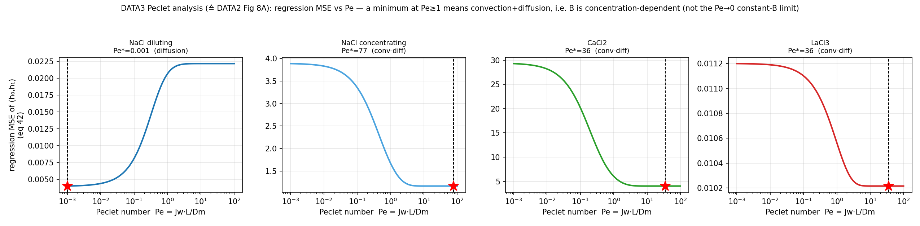
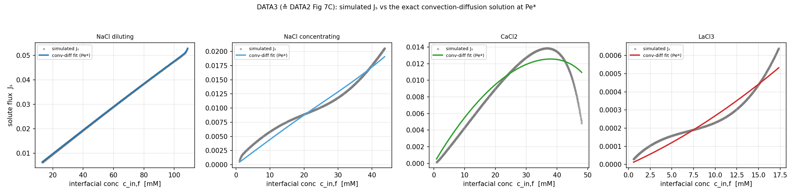
Figure 10. (Left) Mean squared error of the convection–diffusion partition-coefficient regression for the fitted coefficients (h₀, h₁) as a function of the Péclet number Pe = J_w L / D_m, and (right) the simulated solute flux J_s versus interfacial concentration cᵢₙ,f with the convection–diffusion fit overlaid; both panels show the four salt/flow regimes. Following the framework of the DATA2 study, J_w, cᵢₙ,f, c_h, and J_s are forward-simulated from each experiment's fitted model and the interfacial partition is regressed against Pe. The three convection-dominated regimes—concentrating NaCl (Pe*≈77), CaCl₂ (Pe*≈36), and LaCl₃ (Pe*≈36)—minimize their regression error at high Pe, whereas diluting NaCl is the diffusion-limited counterexample, with its error minimized at Pe*→0 (≈0.001) in its own panel. Because neither panel plots B directly, this high-Pe behavior is taken as a mechanistic inference for, rather than a direct demonstration of, the concentration-dependent solute permeability, and only for the convection-dominated salts.
Notes:
WHY B DEPENDS ON CONCENTRATION (diagnostic 1).
What it shows: LEFT — regression error vs Péclet number for each salt; RIGHT — simulated salt flux Js vs concentration with a convection–diffusion fit overlaid.
Math: Péclet number Pe = Jw·L/Dm = (transport by water being pushed through) ÷ (transport by diffusion). L = membrane thickness, Dm = diffusivity. Pe > 1 means convection wins; Pe < 1 means diffusion wins.
Simple steps: forward-simulate Jw and the concentrations, then regress how salt partitions vs Pe.
How to read it: the three concentrating salts minimize their error at HIGH Pe (convection-dominated → B varies with c); diluting NaCl is the counter-example at LOW Pe (diffusion → B roughly constant).
Coffee-filter example: a slow drip (diffusion) and a firehose (convection) through the same filter behave differently — that's why the salt permeability isn't a single fixed number.

Slide 13
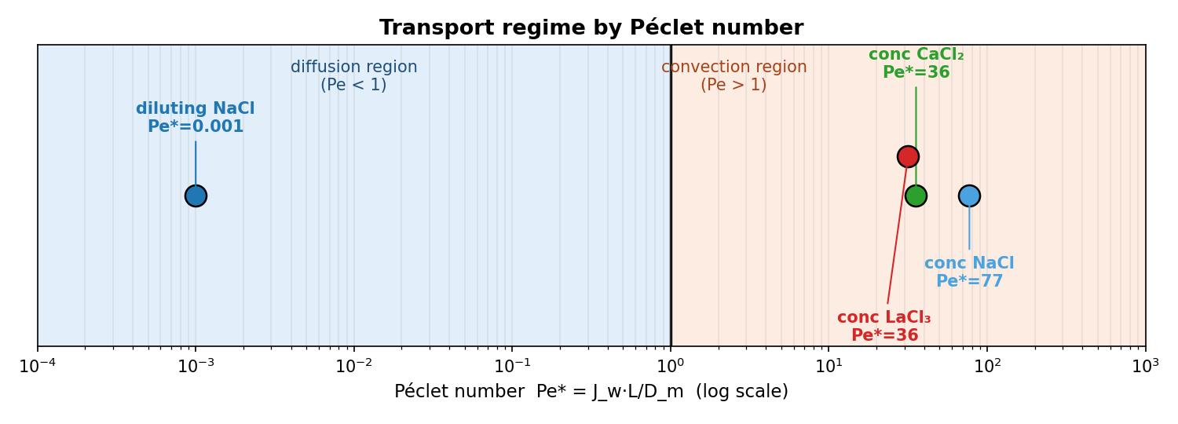
Figure 11. Operating Péclet number Pe*=J_w·L/D_m for the four representative experiments, placed on a logarithmic Péclet axis with the diffusion (Pe<1) and convection (Pe>1) regions shaded and the Pe=1 crossover marked. Each Pe* is the value that minimizes the convection–diffusion regression error of the preceding figure. Diluting NaCl is diffusion-limited (Pe*≪1, here ≈10⁻³) while the three concentrating salts—NaCl (Pe*≈77), CaCl₂ (Pe*≈36), and LaCl₃ (Pe*≈36)—are convection-dominated (Pe*≫1), demonstrating that the same membrane spans distinct transport regimes—the mechanistic basis for the concentration-dependent solute permeability.
Notes:
WHY B DEPENDS ON CONCENTRATION (diagnostic 2 — the one-line version).
What it shows: one number per salt — its operating Péclet — on a log axis. Blue zone = diffusion (Pe < 1), orange zone = convection (Pe > 1), line at Pe = 1.
Punchline: the SAME membrane spans BOTH regimes. Diluting NaCl sits deep in diffusion (Pe ≈ 0.001); the three concentrating salts sit in convection (Pe ≈ 36–77). That is the mechanistic reason the salt permeability is concentration-dependent for the concentrating runs.
Math reminder: Pe = Jw·L/Dm. Crossing Pe = 1 is the switch from diffusion- to convection-controlled transport.

Slide 14
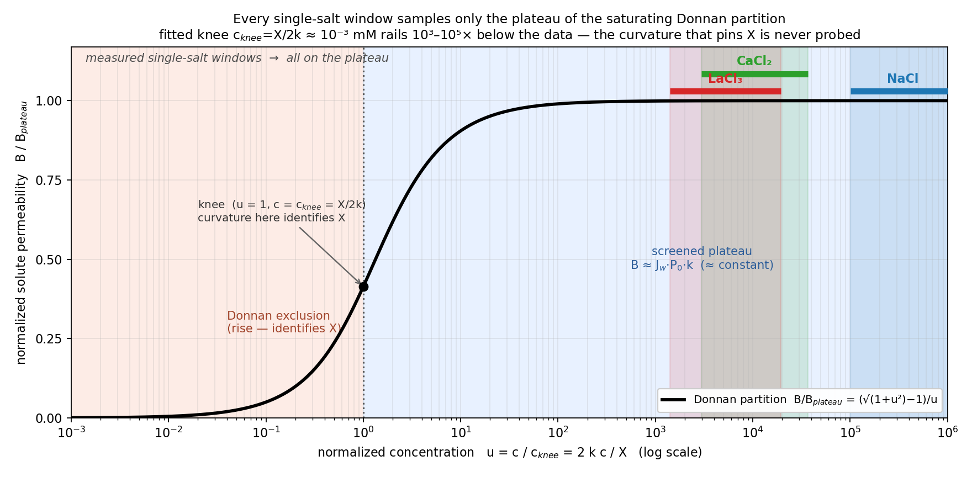
Figure 12. Normalized Donnan–dielectric solute permeability B/B_plateau versus the similarity variable u = c/c_knee = 2kc/X — the single master curve onto which the fitted partition B(c) = J_w·P₀·(−X+√(X²+4k²c²))/(2c) collapses for every salt, with plateau B_plateau = J_w·P₀·k and knee c_knee = X/(2k). The curve rises approximately linearly through the charge-exclusion regime (u < 1, where the curvature determines the fixed-charge scale X) and saturates onto the screened plateau for u ≫ 1. Shaded bands are the actual measured concentration windows of the three salts whose Donnan fit converged, mapped onto u at their own fitted (X, k). Because the fits force X to its lower bound (X = 10⁻³ mM), the knee sits at c_knee ≈ 10⁻³ mM, so every window falls at u ≈ 10³–10⁵ and samples B within ~0.07 % of the plateau. The saturating Donnan shape is therefore the correct mechanistic form, but a single salt probes only its flat top: the curvature that would identify X is never measured. This is why the fitted Donnan reference is effectively constant within the window in Figures 13–15, why even a constant or low-order Taylor reproduces it there, and why X (and the reflection coefficient σ) cannot be recovered from one salt — resolving the knee would require data at far lower concentration or several salts fitted jointly.
Notes:
THE SHAPE OF B(c) — and why our fit looks flat.
Math: the mechanistic Donnan partition is
B(c) = Jw·P0·(−X + √(X² + 4k²c²)) / (2c).
Two knobs: the PLATEAU height P0·k (reached at high salt) and the KNEE location c_knee = X/(2k) (where the curve bends). At low c it rises ~linearly from zero; at high c it flattens to the plateau.
Simple steps: rescale every salt onto ONE universal master curve using u = c/c_knee, then mark where each salt's MEASURED window lands on it.
How to read it: every measured window sits far out on the FLAT plateau (u ≈ 10³–10⁵). That's because the fit pushes the charge term X to its lower bound, so the knee falls ~1000× below where we actually measure.
Punchline: the saturating shape is the correct physics, but a single salt only samples the flat TOP of it — so we cannot locate the knee (the curvature) from one salt at a time. Honest framing: 'one salt can't see it,' NOT 'the membrane is flat.'
Coffee-filter example: we're standing on the flat summit far past the slope — we know we're high up, but can't see where the hill rose.

Slide 15
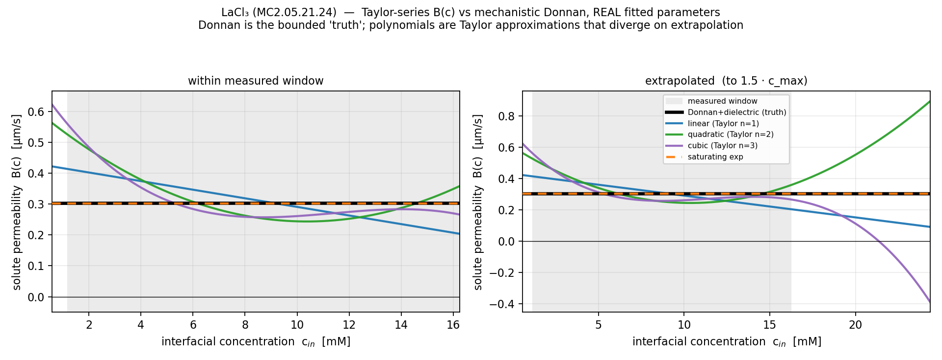
Figure 13. Solute permeability B as a function of interfacial concentration for a representative LaCl₃ diafiltration experiment, comparing candidate concentration-dependent models, each evaluated at its own fitted parameters. The mechanistic Donnan–dielectric partition (solid black) is the reference; first-, second-, and third-order Taylor polynomials (linear, quadratic, cubic) and a saturating exponential are fitted to the same data. The Donnan reference is nearly flat (≈0.3 µm s⁻¹) because its fitted knee lies far below the window (Figure 12): within the measured range the partition is on its screened plateau, so a constant is the leading behavior. (Left) Within the window all forms therefore agree closely, scattering by less than ±0.2 µm s⁻¹ about this plateau. (Right) Extrapolated beyond the window the polynomials diverge unphysically—the cubic turns negative and the quadratic curls upward—whereas the saturating exponential collapses onto the Donnan plateau. A low-order Taylor expansion thus captures the partition only within the calibration range, and the in-window flatness is the direct consequence of the plateau sampling shown in Figure 12.
Notes:
WHICH B(c) FORM TO FIT — LaCl₃.
What it shows: the mechanistic Donnan curve (solid black) vs simple polynomial 'Taylor' fits and a saturating-exp fit, INSIDE the measured window (left) and EXTRAPOLATED beyond it (right).
Math: a Taylor series B(c) ≈ β₀ + β₁c + β₂c² is just a local polynomial approximation — accurate near the data, unreliable far from it.
How to read it: inside the window all forms agree (the Donnan reference is on its flat plateau ≈ 0.3 µm/s, so a constant already captures it). OUTSIDE the window the polynomials blow up unphysically (cubic turns negative, quadratic curls up) while Donnan stays bounded.
Punchline: use a low-order Taylor INSIDE the calibration range — it's identifiable and sufficient — but do NOT extrapolate it; for transfer across conditions use the mechanistic form.
Coffee-filter example: a straight-line guess between two known points works between them but goes crazy outside them.

Slide 16
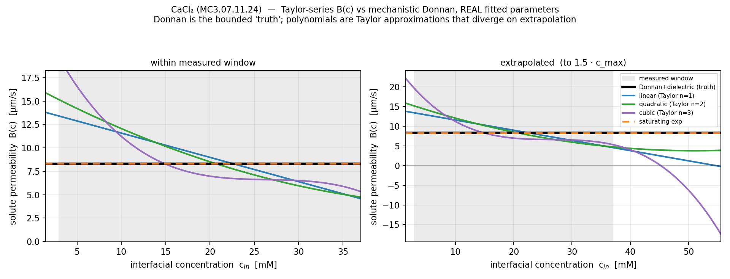
Figure 14. Solute permeability B as a function of interfacial concentration for a representative CaCl₂ diafiltration experiment, comparing candidate concentration-dependent models, each evaluated at its own fitted parameters. The mechanistic Donnan–dielectric partition (solid black) is the reference; a single concentration-independent constant, first-, second-, and third-order Taylor polynomials (linear, quadratic, cubic), and a saturating exponential are fitted to the same data. As in Figure 12 the Donnan reference is on its screened plateau across the whole window (fitted knee far below the data), so it is nearly constant at B ≈ 8–9 µm s⁻¹. (Left) Within the window all forms therefore agree closely about this plateau. (Right) Extrapolated beyond the window the polynomials diverge unphysically while the Donnan reference stays bounded, the correct mechanistic behavior, confirming that a low-order Taylor expansion captures the partition only within its calibration range.
Notes:
WHICH B(c) FORM TO FIT — CaCl₂.
What it shows: the mechanistic Donnan curve (solid black) vs simple polynomial 'Taylor' fits and a saturating-exp fit, INSIDE the measured window (left) and EXTRAPOLATED beyond it (right).
Math: a Taylor series B(c) ≈ β₀ + β₁c + β₂c² is just a local polynomial approximation — accurate near the data, unreliable far from it.
How to read it: inside the window all forms agree (the Donnan reference is on its flat plateau ≈ 8–9 µm/s, so a constant already captures it). OUTSIDE the window the polynomials blow up unphysically (cubic turns negative, quadratic curls up) while Donnan stays bounded.
Punchline: use a low-order Taylor INSIDE the calibration range — it's identifiable and sufficient — but do NOT extrapolate it; for transfer across conditions use the mechanistic form.
Coffee-filter example: a straight-line guess between two known points works between them but goes crazy outside them.

Slide 17
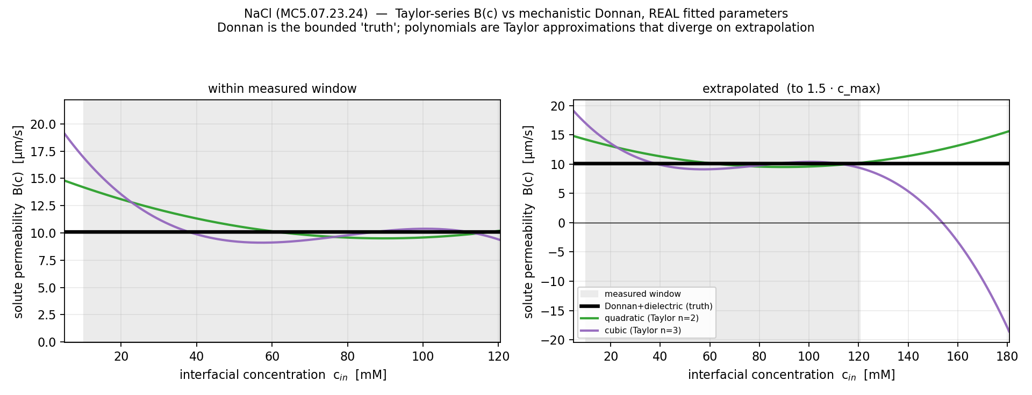
Figure 15. Solute permeability B as a function of interfacial concentration for a representative NaCl diafiltration experiment, comparing candidate concentration-dependent models, each evaluated at its own fitted parameters. The mechanistic Donnan–dielectric partition (solid black) is the reference; only the concentration-independent constant, second-order (quadratic), and third-order (cubic) Taylor polynomials are shown, because the linear and saturating-exponential fits did not converge for this sheet. As in Figure 12 the Donnan reference is on its screened plateau across the window, so it is nearly constant at B ≈ 10 µm s⁻¹. (Left) Within the window the shown forms therefore agree closely about this plateau. (Right) Extrapolated beyond the window the cubic polynomial diverges unphysically (turning sharply negative) while the Donnan reference stays bounded, the correct mechanistic behavior, confirming that a low-order Taylor expansion captures the partition only within its calibration range.
Notes:
WHICH B(c) FORM TO FIT — NaCl.
What it shows: the mechanistic Donnan curve (solid black) vs simple polynomial 'Taylor' fits and a saturating-exp fit, INSIDE the measured window (left) and EXTRAPOLATED beyond it (right).
Math: a Taylor series B(c) ≈ β₀ + β₁c + β₂c² is just a local polynomial approximation — accurate near the data, unreliable far from it.
How to read it: inside the window all forms agree (the Donnan reference is on its flat plateau ≈ 10 µm/s, so a constant already captures it). OUTSIDE the window the polynomials blow up unphysically (cubic turns negative, quadratic curls up) while Donnan stays bounded.
Punchline: use a low-order Taylor INSIDE the calibration range — it's identifiable and sufficient — but do NOT extrapolate it; for transfer across conditions use the mechanistic form.
Coffee-filter example: a straight-line guess between two known points works between them but goes crazy outside them.

Slide 18
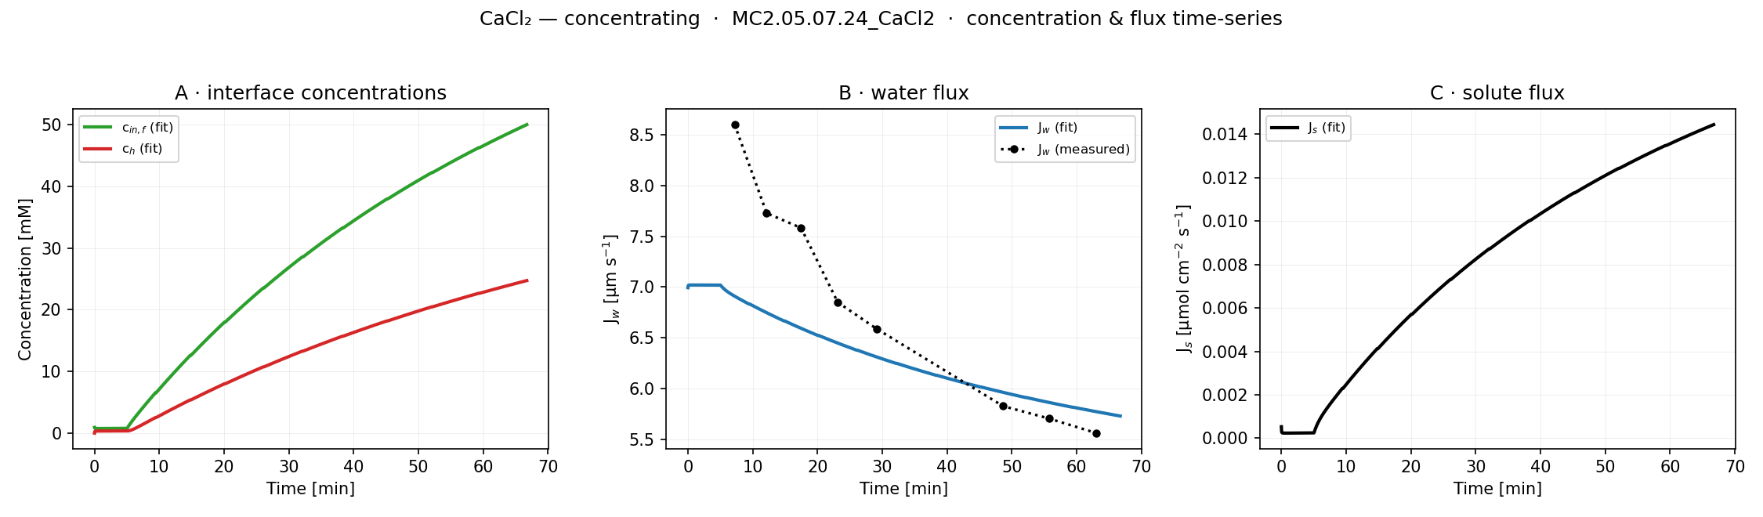
Figure 16. Forward-simulated membrane-interface concentration cᵢₙ,f and bulk (stirred-cell) concentration c_h (left), water flux J_w (center), and solute flux J_s (right) versus time for a representative concentrating CaCl₂ diafiltration experiment, computed from the fitted lumped-parameter model. As the stirred cell concentrates, both concentrations rise and J_w declines through the increasing osmotic pressure, while J_s increases with concentration—consistent with a concentration-dependent solute permeability. The gap between the membrane-interface concentration cᵢₙ,f and the lower bulk concentration c_h is the concentration polarization: solute accumulates at the membrane face relative to the well-mixed bulk.
Notes:
THE FULL PICTURE OVER TIME (CaCl₂).
What it shows: three panels vs time. A — interface concentration c_in,f vs bulk c_h (their GAP is concentration polarization, salt piling up at the membrane face). B — water flux Jw: model (blue) + MEASURED (black dotted). C — salt flux Js.
Simple steps: forward-simulate at the fitted parameters; get the measured water flux from how fast permeate mass is collected in each vial.
Math: measured Jw = (dm/dt)/(ρ·A) — collection rate ÷ (density × membrane area); model Jw = Lp·(ΔP − σ·Δπ).
How to read it: as the cell concentrates, both concentrations rise → osmotic back-push grows → water flux Jw declines (and the model tracks the measured dotted line) → salt flux Js climbs. All consistent with concentration-dependent transport.
Coffee-filter example: the saltier the cup gets, the harder osmosis pushes back, so the drip slows down over time.

