Slide 1
DATA3 · NF270 SINGLE-SALT CAMPAIGN
Identifiability & Analysis — Follow-up
Paper-justified measurement error · σ-identifiability sensitivity · axis convention · B(ionic strength) & per-band θ
Keshav Kasturi Rangan
Post-meeting analysis · June 11, 2026

Slide 2
FOLLOW-UP · MEASUREMENT ERROR
The cF weight was physically unjustified — and σ depends on it
Paper: Lilonfe et al., 'Soft Sensors…', ChemRxiv 2026 (doi:10.26434/chemrxiv.15002541/v1)
Per-channel measurement error (DATA3)
σ flips with the weight (multistart-verified)
Retentate cF
0.3% → 2%
MC3 SNaCl: σ 0.42 (interior, 0.3%) → 1.0 (wall, 2%)
MC5 S2NaCl: σ 0.0 (wall, 0.3%) → 0.35 (interior, 2%)
σ's global minimizer is weight-dependent → σ is poorly identified.
conductivity soft-sensor MAPE ⊕ cell-const
Permeate cV
3% (kept)
ICP-OES reference — already physical
Mass m
0.01 g (kept)
balance resolution
Takeaway
The interior σ we reported was partly an artifact of the over-tight 0.3% cF weight. With the honest 2% error, σ is revealed to be not robustly identifiable from single-salt runs.
→ This is a sensitivity result, not a fit fix. σ needs better EXPERIMENTS (high-cF, multi-ΔP DoE), not reweighting. The weight now feeds objective + Fisher-information + parmest consistently; DATA1/DATA2 byte-identical.
DATA3 single-salt · identifiability & fits · collaborator meeting · June 11 2026
2 / 42

Slide 3
FOLLOW-UP · DIRECTIONS
Where this points: B(ionic strength) and per-band θ
Concentration-dependent transport, made salt-transferable and band-resolved
β(c) → β(I)
Per-band / per-vial θ
Axis convention
B = J_w[β₀ + β₁·c + β₂·c²]
group vials by cF band → one θ per band
Y-priority Lₚ > B > σ
plot β₀/β₁ vs Lₚ or σ (not lumped B)
mask the objective to a band's vials
animations + contours regenerated
I = k_I·c (NaCl 1 · CaCl₂ 3 · LaCl₃ 6)
B_form='pervial' already gives per-vial B
σ-scrub now Lₚ × B (Lₚ on Y)
B(I) ≡ B(c) per salt (β rescaled), but β become transferable across salts → multisalt
correlate band θ with contour basins → σ-drift with concentration
rule of thumb going forward
DATA3 single-salt · identifiability & fits · collaborator meeting · June 11 2026
3 / 42

Slide 4
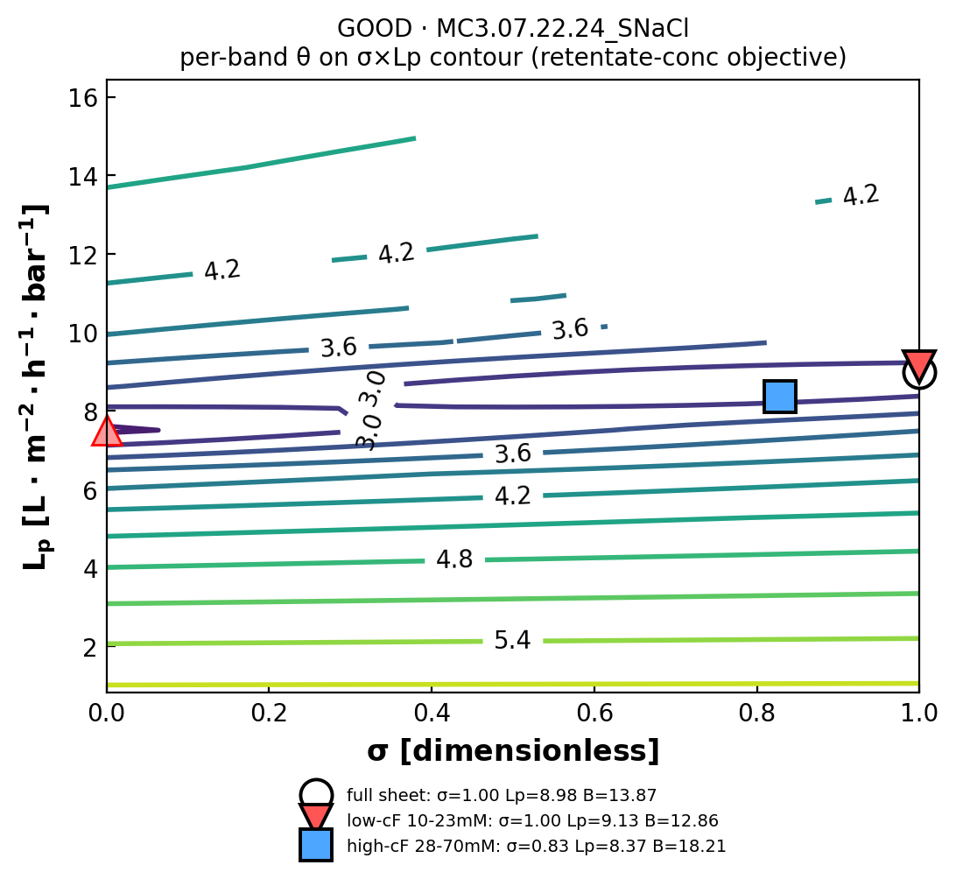
FOLLOW-UP RESULT · PER-BAND θ
Split by concentration: the high-cF band recovers the interior σ
Fit one θ per cF band by masking the objective to that band's vials (solve_model_per_concentration_band)
σ: whole-sheet vs high-cF band
experiment
full σ
high-cF band σ
GOOD MC3 SNaCl
1.00 ⊣
0.83 interior
OKAY MC2 NaCl
1.00 ⊣
0.56 interior
POOR MC2 LaCl₃
0.00 ⊣
0.00 still wall
σ's information lives in the high-Δπ (high-cF) vials; pooling all vials lets the low-cF vials drag σ to the wall. Within MC3 SNaCl B also rises 12.9 → 18.2 µm/s low→high band.
Takeaway
Estimate σ from the high-cF band. All per-band FIMs are non-singular; per-band WSSE is NOT comparable across bands. POOR LaCl₃ rails to opposite σ bounds in the two bands (flat surface) — banding can't manufacture identifiability.
DATA3 single-salt · identifiability & fits · collaborator meeting · June 11 2026
4 / 42

Slide 5
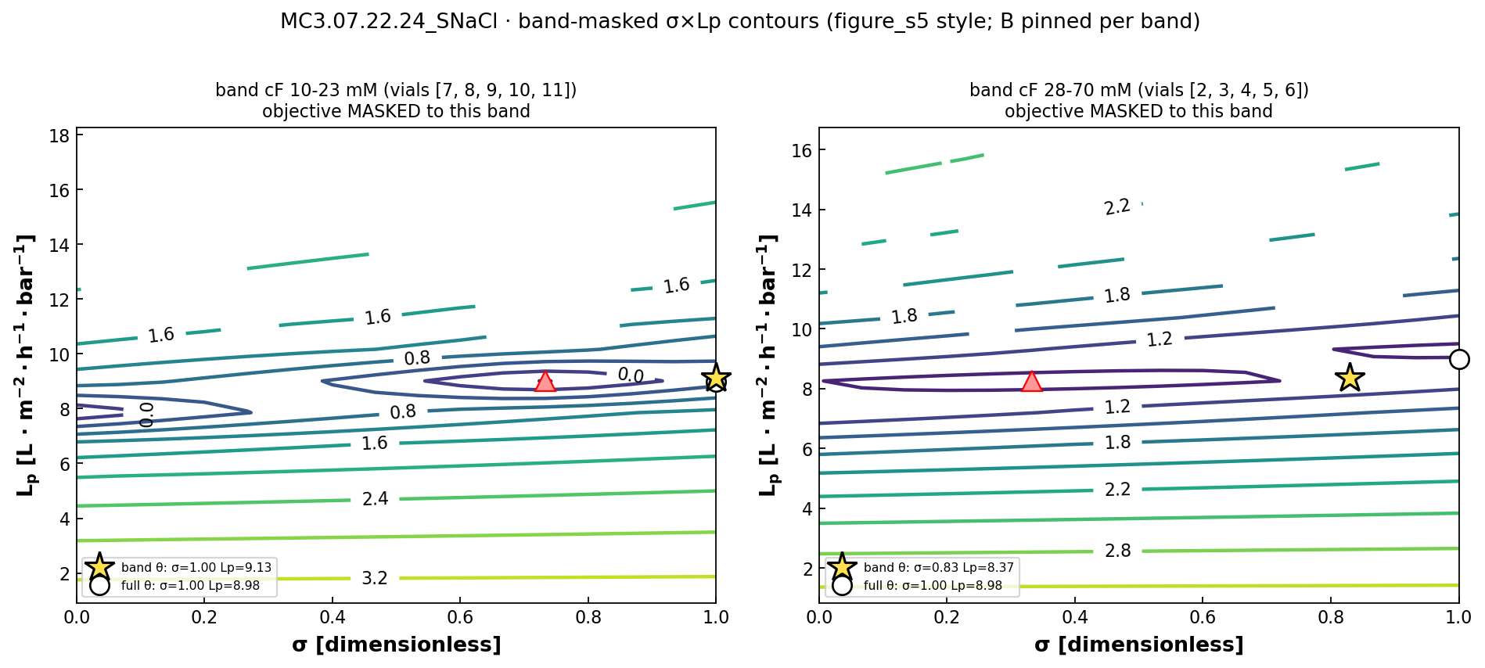
FOLLOW-UP RESULT · BAND-MASKED CONTOURS
The two bands occupy genuinely different basins
Re-run the σ×Lₚ sweep with the objective masked to each band — low-cF flat in σ, high-cF curved (interior min)
Left (low-cF 10–23 mM): the objective is flat in σ → σ rails to 1. Right (high-cF 28–70 mM): a curved basin with an interior minimum at σ ≈ 0.83. Same sheet, opposite identifiability.
DATA3 single-salt · identifiability & fits · collaborator meeting · June 11 2026
5 / 42

Slide 6
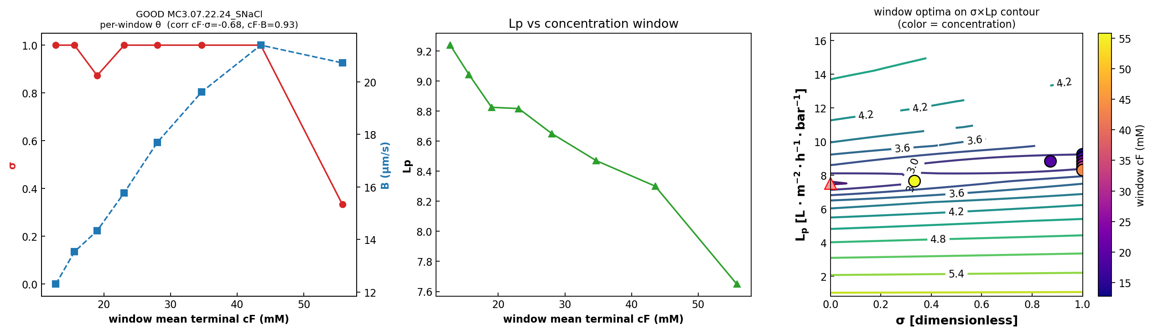
FOLLOW-UP RESULT · PER-VIAL θ TREND
B rises with concentration within a single experiment
Rolling 3-vial windows (low→high cF) through the band mask — the empirical basis for per-concentration seeding
MC3 SNaCl: B climbs 12 → 21 µm/s as window cF goes 13 → 56 mM (corr +0.93) — direct per-vial evidence of concentration-dependent B (the B(I) signal). σ only leaves the σ=1 wall in the highest-cF window; right panel colours each window's optimum on the σ×Lₚ contour by concentration (vial↔contour-group correlation).
DATA3 single-salt · identifiability & fits · collaborator meeting · June 11 2026
6 / 42

Slide 7
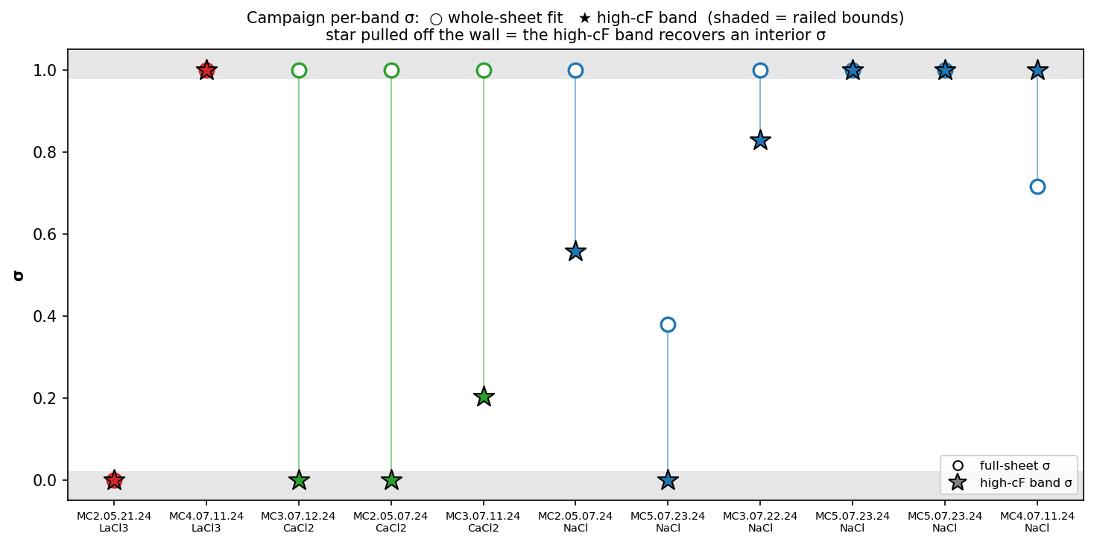
FOLLOW-UP RESULT · CAMPAIGN-WIDE
σ-recovery is sheet-specific; B-drift is the robust signal
All 11 single-salt sheets via solve_model_per_concentration_band (2-band split)
high-cF band recovers an interior σ (full fit railed): 3 / 11 — sheet-specific (needs high-cF Δπ + a non-flat σ surface). B rises with concentration low→high band: 9 / 11 — the generalizable signal (concentration-dependent B → the B(I) law).
DATA3 single-salt · identifiability & fits · collaborator meeting · June 11 2026
7 / 42

Slide 8
FOLLOW-UP RESULT · B = f(IONIC STRENGTH)
Exact per salt — but ionic strength doesn't unify B
B_form_rule3: cIn → k_I·cIn (NaCl 1 · CaCl₂ 3 · LaCl₃ 6), gated DATA3, byte-identical off
✓ Single-salt rescale identity
✗ Cross-salt transfer
B(c) at (β₀,β₁) ≡ B(I) at (β₀, β₁/k_I)
max rel-diff across channels:
NaCl 0 · CaCl₂ 2e-15 · LaCl₃ 3e-15 → identical to machine precision
A B(I) fit on one salt is a pure rescaling β_k → β_k/k_I^k.
β₀ spans 1.5 / 0.32 / 0.11 (NaCl/CaCl₂/LaCl₃)
CV(β₁_I)=3.45 > CV(β₁_c)=1.92 — slopes even flip sign
B is far more salt-specific than k_I predicts
(multivalent ions are much more strongly rejected).
Takeaway
B(I) is necessary but not sufficient for multisalt. The ionic-strength reparameterization is exact and makes the per-salt fit invariant, but a shared β across salts is refuted by the data — the next step is a salt/valence-specific exclusion term (or a joint multisalt fit sharing β in I-space with per-salt Lₚ/σ).
DATA3 single-salt · identifiability & fits · collaborator meeting · June 11 2026
8 / 42

Slide 9
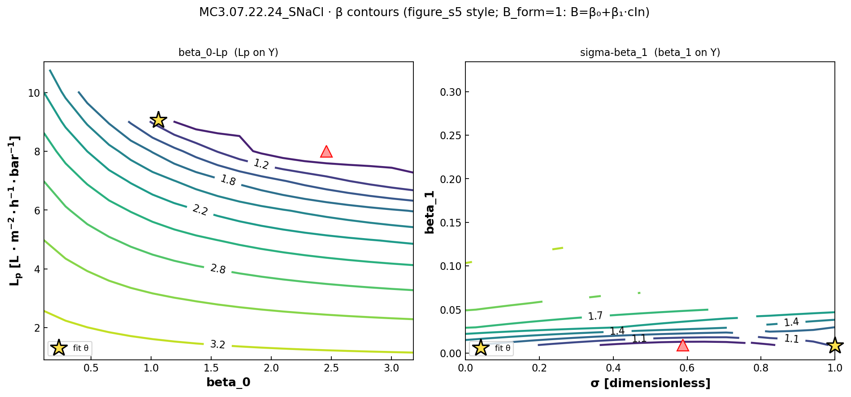
FOLLOW-UP RESULT · β CONTOURS
Sweeping the β coefficients instead of the lumped B
B_form=1 centering fit (B = β₀ + β₁·cIn) on the gold sheet — β slices replace the lumped-B slices when B_form is numeric
Left: β₀×Lₚ — the basin mirrors the lumped B×Lₚ slice (β₀ carries the constant part of B). Right: σ×β₁ — the feasible β₁ band is narrow (B = β₀ + β₁·cIn must stay within its physical bounds over the sheet's 10–70 mM span), and σ stays unidentified at fixed β₁.
DATA3 single-salt · identifiability & fits · collaborator meeting · June 11 2026
9 / 42

Slide 10
THE GOAL
Different experiments pin different parameters — use that
Each run identifies some of θ = (Lₚ, B, σ) well and others not at all. Two questions follow:
Q1 · Combine
Q2 · Design
Can we combine experiments into a better initial guess for the joint fit — taking each parameter from the run that actually constrains it?
Which new experiments would break the correlations that leave σ and B unidentified for the harder salts?
The logic flow of this talk
STEP 1
STEP 2
STEP 3
STEP 4
STEP 5
Model
Diagnose
Read where θ is pinned
Combine → seed
Design new experiments
→
→
→
→
θ = (Lₚ, B, σ) in Spiegler–Kedem
WSSE contour maps + animations
good / okay / poor per experiment
better initial guess per salt
break σ–B, pin Lₚ
Takeaway up front: the campaign already contains everything we need to seed every salt's fit — and tells us exactly which two experiments would close the gaps.
DATA3 single-salt · identifiability & fits · collaborator meeting · June 11 2026
10 / 42

Slide 11
01 · THE MODEL
What we simulate and what we estimate
Spiegler–Kedem transport through the NF membrane — three parameters per experiment: θ = (Lₚ, B, σ)
Water flux · Eq. (1)
$$J_{w}=L_{p}\left(ΔP−σ Δπ\right)$$
σ scales how much osmotic back-pressure opposes the applied ΔP
Osmotic pressure · van 't Hoff
$$Δπ=nRT\left(c_{in}−c_{h}\right)$$
n = dissolved species per formula unit (NaCl 2 · CaCl₂ 3 · LaCl₃ 4)
Concentration polarization · Eq. (3)
$$c_{in}=\left(c_{f}−c_{h}\right)exp​\left(\frac{J_{w}}{k}\right)+c_{h}$$
wall enrichment from the boundary layer (mass-transfer coefficient k)
Solute flux · Eq. (2)
$$J_{s}=B\left(c_{in}−c_{h}\right)$$
diffusion-dominant; B = solute permeability coefficient
Same notation as the DATA1 / DATA2 papers. Concentration fits curve because the state ODEs are nonlinear; DATA3 also allows B = B(c_f) (B_form = 1) when a constant B underfits.
DATA3 single-salt · identifiability & fits · collaborator meeting · June 11 2026
11 / 42

Slide 12
01 · CONFIRM FIRST
The parameter bounds I'm changing
Lₚ and σ inherited from the DATA1/DATA2 KCl baseline — the per-salt B upper bound is the only new knob
Inherited baseline (KCl · DATA1/DATA2)
New: per-salt B upper bound — halve per +1 cation charge
Lₚ ∈ [0.5, 50] L/(m²·hr·bar)
σ ∈ [0, 1] (dimensionless reflection coeff.)
B ∈ [0, 30] µm/s — unchanged for monovalent
NaCl
[0, 30] µm/s
monovalent — same as KCl
CaCl₂
[0, 15] µm/s
divalent — halved
LaCl₃
[0, 10] µm/s
trivalent — a third
How the contour panels are built
At every (σ, Lₚ) grid point we forward-simulate the full Spiegler–Kedem DAE (B fixed at warm-start, S₀/S at warm-start)
then evaluate the weighted sum-of-squared-residuals for each channel.
5 channels per panel: mass · permeate conc. · retentate conc. · permeate conductivity · retentate conductivity
This is a diagnostic, not a fit — pure forward-simulation. Where the 5 channels agree on a minimum, the data identify the parameters; where they split, they don't.
DATA3 single-salt · identifiability & fits · collaborator meeting · June 11 2026
12 / 42

Slide 13
02 · DIAGNOSE
Map every parameter, then read what's identified
Forward-simulated WSSE contours + animations — good · okay · poor, per experiment

Slide 14
02 · THE DIAGNOSTIC
Contour maps = forward-simulated WSSE, no fitting
We sweep a parameter grid, simulate the full DAE at each node, and score the weighted residual per channel
Weighted sum of squared residuals, summed over the 3 fitted channels (mass · permeate cᵥ · retentate cᵣ)
WSSE(θ)=ch ∈ {m,cv,cr}​1Nchi​yi model(θ)−yi exp2
Best fit
Contour-consistent seed
$$θ^{*}=arg\min_{θ} WSSE(θ)$$
$$θ_{init}=arg\min_{(σ, L_{p})}\left[{WSSE}_{m}+{WSSE}_{c_{v}}+{WSSE}_{c_{r}}\right]$$
θ = (Lₚ, B, σ). If the minimum is a sharp interior point, θ is identified; if it lies on a wall or in a flat valley, it is not.
Read the joint 2-D minimum straight off the contour (B, S₀, S held at warm-start) and use it to seed the full fit.
Two views of the same objective, both shown in this deck
• Static σ × Lₚ panels — all 5 measurement channels at once (mass, perm/ret conc, perm/ret conductivity). Where channels agree → trust.
• Animated scrubs — hold one parameter and sweep it; watch whether the 2-D basin for the other two stays put. This is how to read a good initial guess for each experiment.
① B × Lₚ basin as σ : 0 → 1 ② σ × Lₚ basin as B : 0 → B_max
DATA3 single-salt · identifiability & fits · collaborator meeting · June 11 2026
14 / 42

Slide 15
02 · IDENTIFIABILITY
Three stages of identifiability across all 11 sheets
Agreement across the 5 measurement channels = trust. What we trust most → what we trust least.
STAGE 1
STAGE 2
STAGE 3
Well-identified
Inconsistent
Not estimable
2 sheets · NaCl
7 sheets · 4 NaCl + 3 CaCl₂
2 sheets · LaCl₃
Both are diluting NaCl runs that start at high cf (~95 mM). High concentration → large Δπ → σ is elucidated (DATA1 §4.3.2), and Lₚ is pinned by mass. MC3 SNaCl keeps an interior σ; MC5 S2NaCl's σ drifts but Lₚ holds.
Lₚ tight, but σ rail-pinned at a wall. Channels each find a minimum, but at different (σ, Lₚ) walls — a weighting split, not a model-form failure.
Same wrong-model bias on both sheets; WSSE ~20× the NaCl gold standard. Constant-(σ,B) Spiegler–Kedem can't represent La³⁺ ion-pairing.
fit quality: GOOD
fit quality: OKAY
fit quality: POOR
DATA3 single-salt · identifiability & fits · collaborator meeting · June 11 2026
15 / 42

Slide 16
02 · IDENTIFIABILITY
Where the optimizer landed on every sheet
Warm-start θ across the campaign, colour-coded by stage. ↑/↓ = parameter pinned at a bound.
Sheet
Lₚ
B [µm/s]
σ
WSSE₃ch
Stage assignment
MC3 · 07.22.24 · SNaCl
8.63
14.68
0.79
560
Stage 1A · interior σ — gold standard
MC5 · 07.23.24 · S2NaCl
7.75
10.14
0.29
888
Stage 1B · diluting, σ harmless
MC4 · 07.11.24 · SNaCl
11.35
2.02
0.50
19,508
Stage 1B-ish · diluting BUT poor WSSE ⚠
MC2 · 05.07.24 · NaCl
10.45
9.73
1.00 ↑
4,528
Stage 2 · σ wall, concentrating
MC5 · 07.23.24 · NaCl
10.52
3.70
0.79
7,024
Stage 2 · σ wall, concentrating
MC5 · 07.23.24 · SNaCl
8.64
3.07
0.57
5,870
Stage 2 · σ wall, concentrating
MC2 · 05.07.24 · CaCl₂
8.00
0.51
0.50
97,213
Stage 2 · channels split by side
MC3 · 07.11.24 · SCaCl₂
6.56
9.11
1.00 ↑
6,139
Stage 2 · σ at wall
MC3 · 07.12.24 · S2CaCl₂
5.49
30.00 ↑
1.00 ↑
9,774
Stage 2 · σ AND B at walls
MC2 · 05.21.24 · LaCl₃
2.95
0.31
0.00 ↓
21,500
Stage 3 · wrong model — all channels disagree
MC4 · 07.11.24 · SLaCl₃
5.55
0.17
0.93
75,080
Stage 3 · wrong model — replicate
Only MC3 SNaCl landed at an interior σ — that is the reference 'well-identified' case.
DATA3 single-salt · identifiability & fits · collaborator meeting · June 11 2026
16 / 42

Slide 17
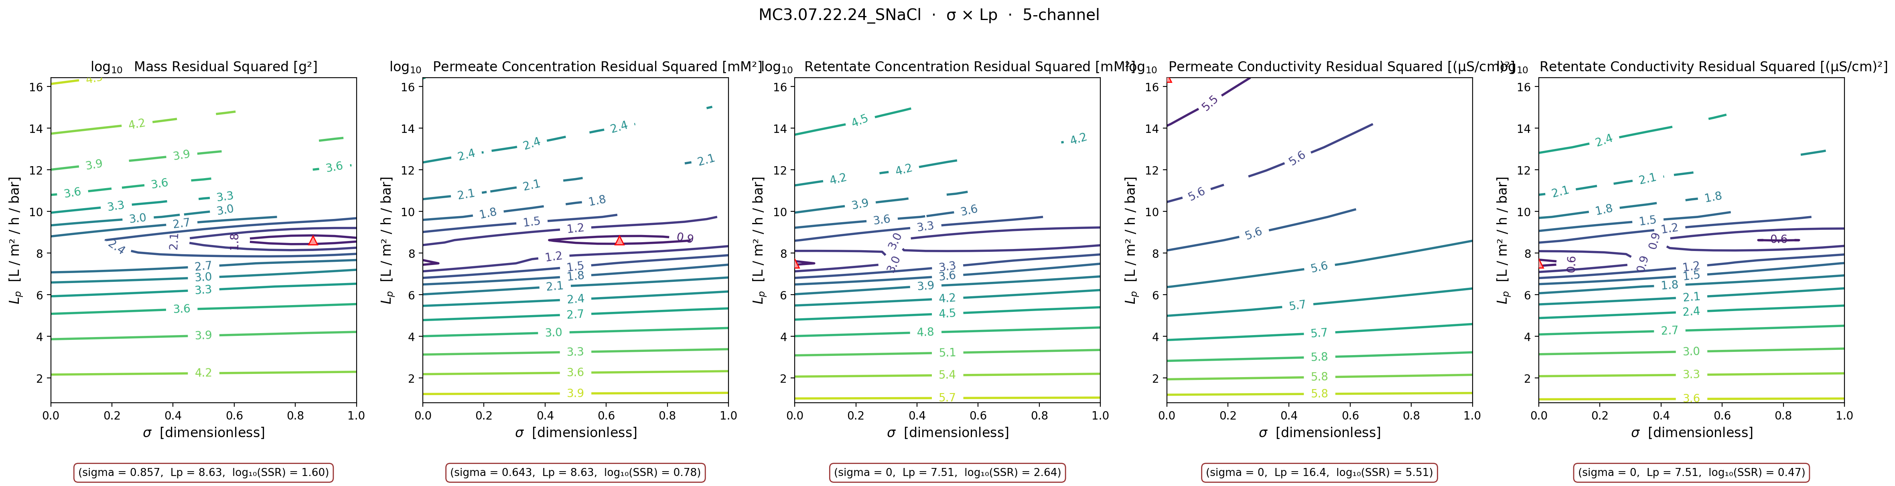
STAGE 1 · WELL-IDENTIFIED
Identifiability: GOOD
GOOD — interior σ from a high-cf diluting run (gold standard)
MC3 · 07.22.24 · SNaCl · σ × Lₚ, 5 channels
Legend: ▲ = per-panel minimum (argmin) contour lines = log₁₀ weighted SSR (cooler → better fit) each panel = one measurement channel panels agree → identifiable
θ here:
$$L_{p}=8.63, B=14.68 μm/s, σ=0.79, {WSSE}_{3ch}=560$$
A diluting NaCl run starting at cf ≈ 95 mM, so Δπ is large early and σ leaves a real fingerprint (DATA1 §4.3.2). All 5 channels at the warm-start B; mass and permeate-concentration both argmin at an interior σ near Lₚ ≈ 8.6. This is the only NaCl sheet where σ is genuinely identified, and the cleanest fit in the campaign.
DATA3 single-salt · identifiability & fits · collaborator meeting · June 11 2026
17 / 42

Slide 18
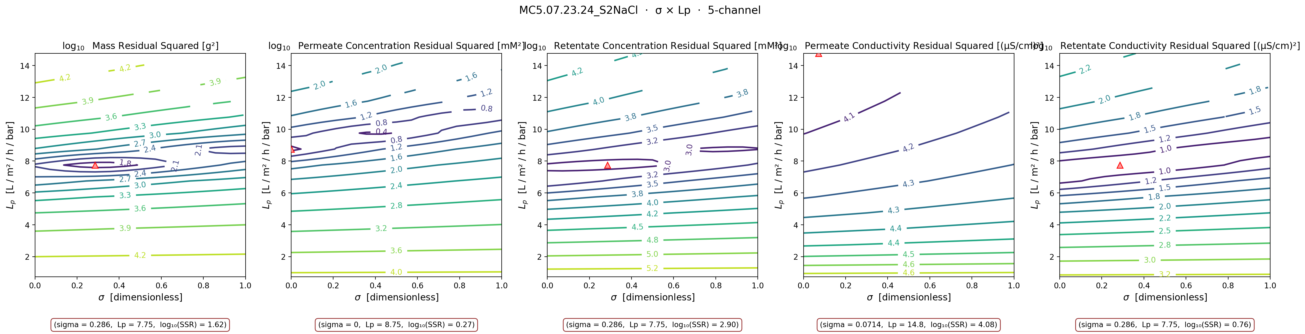
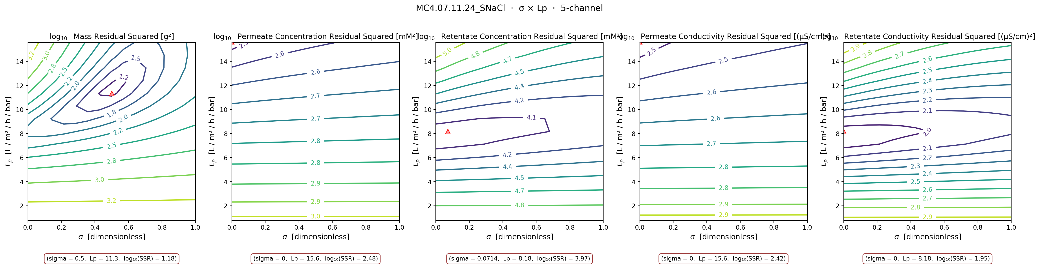
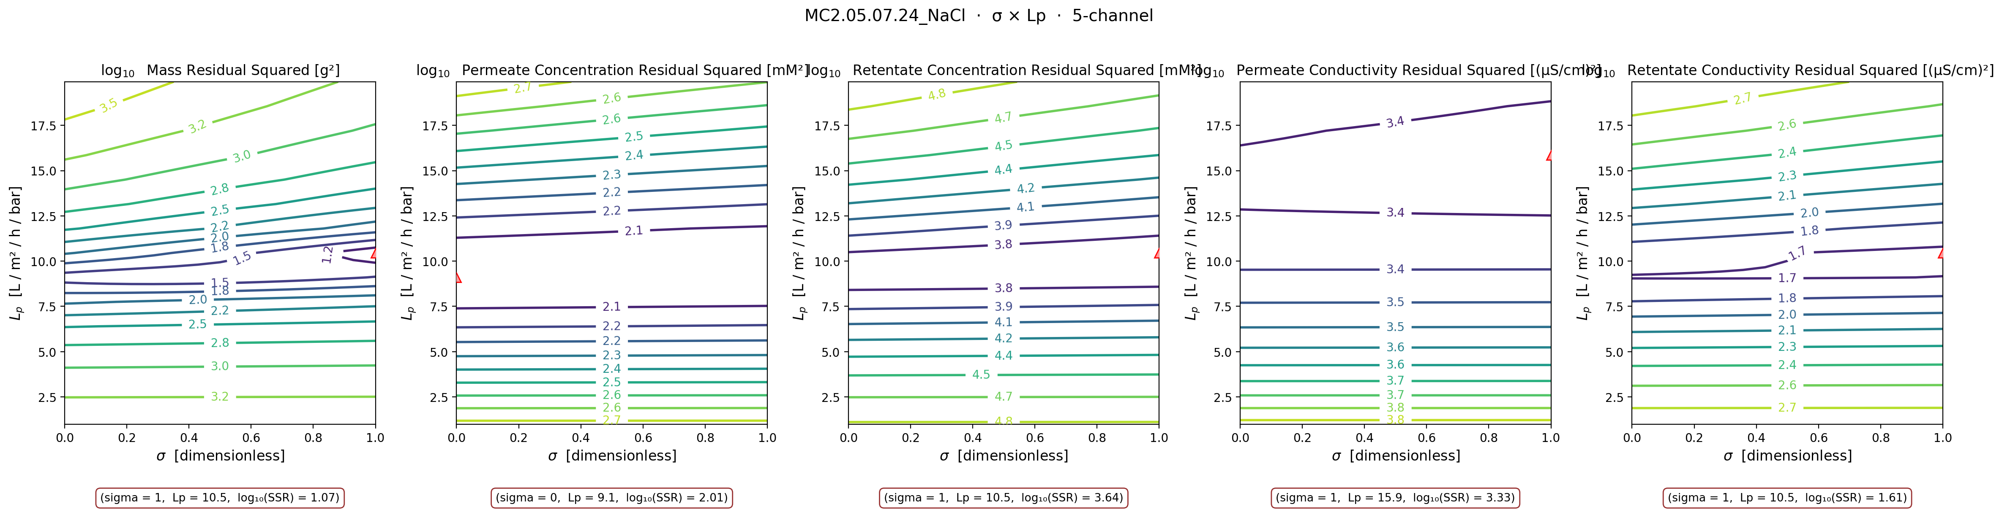
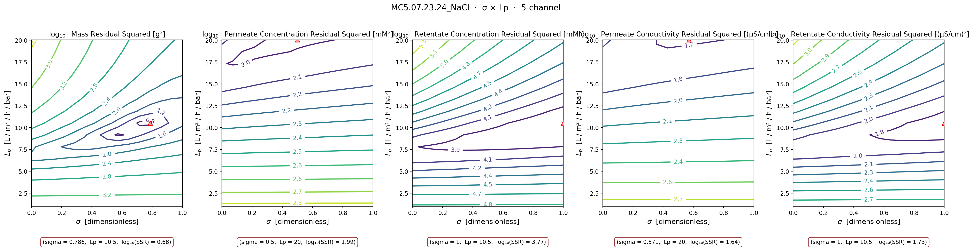
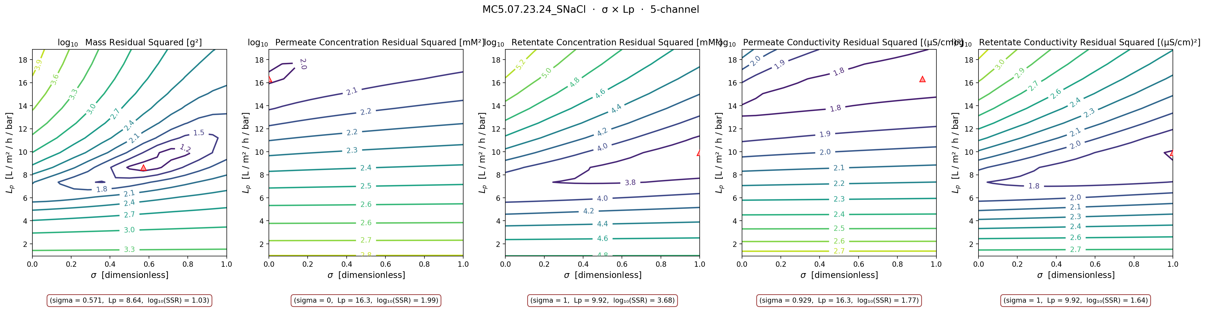
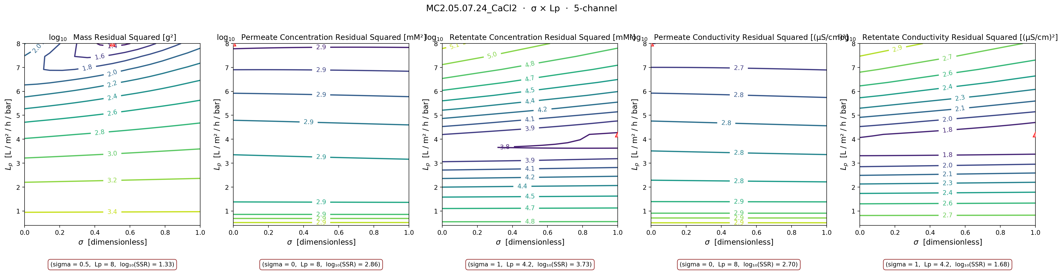
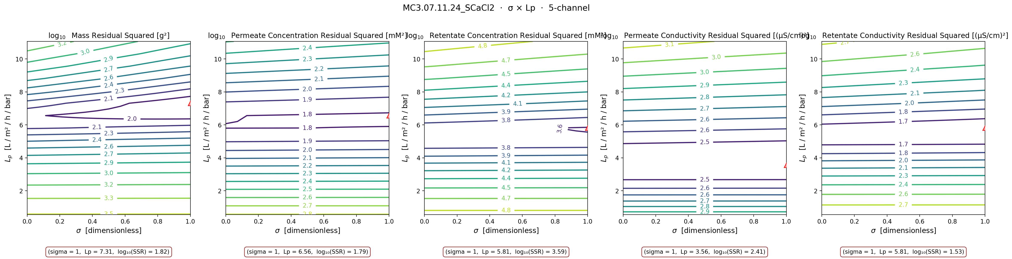
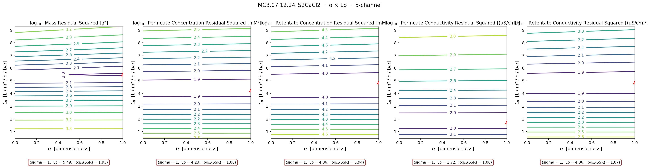
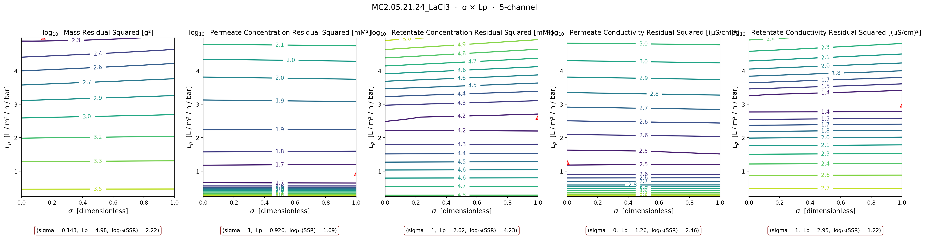
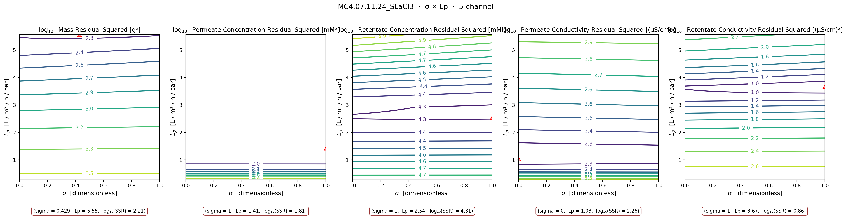
02 · IDENTIFIABILITY
Every sheet's σ × Lₚ contour, colour-tabbed by stage
Basin consistent (Stage 1) → split (Stage 2) → absent (Stage 3). Each tile: 5 channels, contour = log₁₀ WSSE, ▲ = argmin.
Stage 1 well-id.
Stage 2 inconsist.
Stage 3 not-est.
MC3 · 07.22.24 · SNaCl
MC5 · 07.23.24 · S2NaCl
MC4 · 07.11.24 · SNaCl
MC2 · 05.07.24 · NaCl
MC5 · 07.23.24 · NaCl
MC5 · 07.23.24 · SNaCl
MC2 · 05.07.24 · CaCl₂
MC3 · 07.11.24 · SCaCl₂
MC3 · 07.12.24 · S2CaCl₂
MC2 · 05.21.24 · LaCl₃
MC4 · 07.11.24 · SLaCl₃
DATA3 single-salt · identifiability & fits · collaborator meeting · June 11 2026
18 / 42

Slide 19
02 · WHY EXPERIMENTS DIFFER
σ leaves a fingerprint only when osmotic pressure is large
The sensitivity of the data to σ is set by Δπ — so the operating regime decides what each run can identify
σ enters the model only through σ·Δπ, so
$$\frac{∂J_{w}}{∂σ}=−L_{p} Δπ=−L_{p} nRT\left(c_{in}−c_{h}\right)$$
High c_f → σ visible
Low c_f → Lₚ only
σ–B coupling
$$Δπ=nRT c_{f} (c_{h}≈0)$$
$$c_{f}→0 ⇒ J_{w}=L_{p} ΔP$$
$$\frac{dc_{f}}{dt}=\frac{A_{m}}{m_{f}}\left(J_{w}c_{d}−J_{s}\right)$$
Large cf → large Δπ → ∂Jw/∂σ large → σ leaves a fingerprint (DATA1 §4.3.2). Both gold sheets are diluting runs starting at cf ≈ 95 mM.
Δπ → 0: Lₚ reads directly from mass, independent of σ and B. This is a pure-water run, or the end of any diluting run.
σ acts only through Jw, B only through Js — but both drive c_f(t). Vary ΔP (hence Jw) and their relative pull changes, separating them.
So: a diluting run from high cf pins Lₚ AND σ; a concentrating run from low cf pins only Lₚ; a pressure sweep separates σ from B.
DATA3 single-salt · identifiability & fits · collaborator meeting · June 11 2026
19 / 42

Slide 20
03 · IN MOTION
Read the initial guess off the moving basin
Two sweeps per experiment: ① B×Lₚ as σ:0→1 ② σ×Lₚ as B:0→Bₘₐₓ

Slide 21
03 · IDENTIFIABILITY IN MOTION
Watch the objective basin move
Same 5-channel diagnostic, animated — hold one parameter fixed and sweep it frame by frame
How to read the scrub animations
Each frame fixes one parameter and shows the objective basin for the other two, across 3 channels (mass · permeate-conc · retentate-conc). The red ▲ marks the per-frame minimum.
Read the motion as identifiability: a basin that stays put and the 3 channels agree → identifiable. A minimum that slides along a wall, or channels that disagree → not.
GOOD — basin stays, channels agree
OKAY — minimum slides to a wall
POOR — no coherent basin
▶ These slides contain animated GIFs — they play automatically in PowerPoint slideshow mode. The σ-sweep (B × Lₚ basin moving through σ) is the one to watch: it is the animated twin of the static σ × Lₚ panels.
DATA3 single-salt · identifiability & fits · collaborator meeting · June 11 2026
21 / 42

Slide 22
STAGE 1 · WELL-IDENTIFIED
Identifiability: GOOD
GOOD — the basin holds under both sweeps
MC3 · 07.22.24 · SNaCl · read the joint minimum off both sweeps
① Lₚ × B basin as σ : 0 → 1 (Lₚ on Y)
Initial guess to read off
$$L_{p}≈8.6$$
$$B≈14.7 μm/s$$
$$σ≈0.79$$
joint argmin of mass + cᵥ + cᵣ
② σ × Lₚ basin as B : 0 → B_max
Across both sweeps the minimum stays anchored (Lₚ ≈ 8.6, interior σ) and the channels track together. A sharp, stationary basin = a trustworthy seed. This is the gold-standard read: take all three parameters from this run.
(σ × Lₚ sweep renders once the 3-D grid finishes)
Legend: ▲ = per-panel minimum (argmin) contour lines = log₁₀ weighted SSR (cooler → better fit) each panel = one measurement channel panels agree → identifiable
DATA3 single-salt · identifiability & fits · collaborator meeting · June 11 2026
22 / 42

Slide 23
STAGE 2 · INCONSISTENT (NaCl)
Identifiability: OKAY
OKAY — Lₚ holds, σ slides to the wall
MC2 · 05.07.24 · NaCl · read the joint minimum off both sweeps
① Lₚ × B basin as σ : 0 → 1 (Lₚ on Y)
Initial guess to read off
$$L_{p}≈10.5$$
$$B≈9.7 μm/s$$
$$σ≈1.00$$
joint argmin of mass + cᵥ + cᵣ
② σ × Lₚ basin as B : 0 → B_max
Sweep ① : the B×Lₚ minimum keeps the same Lₚ but drifts to the σ=1 wall. Sweep ② : as B varies the σ×Lₚ minimum barely moves in Lₚ — Lₚ is solid. Take Lₚ from here; do NOT trust σ — get σ from the gold-standard run instead.
Legend: ▲ = per-panel minimum (argmin) contour lines = log₁₀ weighted SSR (cooler → better fit) each panel = one measurement channel panels agree → identifiable
DATA3 single-salt · identifiability & fits · collaborator meeting · June 11 2026
23 / 42

Slide 24
STAGE 2 · INCONSISTENT (CaCl₂)
Identifiability: OKAY
OKAY — Lₚ usable, σ and B trade off
MC2 · 05.07.24 · CaCl₂ · read the joint minimum off both sweeps
① Lₚ × B basin as σ : 0 → 1 (Lₚ on Y)
Initial guess to read off
$$L_{p}≈8.0$$
$$B≈0.5 μm/s$$
$$σ≈0.50$$
joint argmin of mass + cᵥ + cᵣ
② σ × Lₚ basin as B : 0 → B_max
The two sweeps show the σ–B trade-off directly: moving B shifts where σ wants to sit. Lₚ is still the reliable read; σ and B are correlated and need a pressure sweep to separate. Seed Lₚ from here, σ from the σ-probing run, B from its bound.
Legend: ▲ = per-panel minimum (argmin) contour lines = log₁₀ weighted SSR (cooler → better fit) each panel = one measurement channel panels agree → identifiable
DATA3 single-salt · identifiability & fits · collaborator meeting · June 11 2026
24 / 42

Slide 25
STAGE 3 · NOT ESTIMABLE
Identifiability: POOR
POOR — no stationary basin under either sweep
MC2 · 05.21.24 · LaCl₃ · read the joint minimum off both sweeps
① Lₚ × B basin as σ : 0 → 1 (Lₚ on Y)
Initial guess to read off
$$L_{p}≈3.0$$
$$B≈0.3 μm/s$$
$$σ≈0.00$$
joint argmin of mass + cᵥ + cᵣ
② σ × Lₚ basin as B : 0 → B_max
Neither sweep produces a consistent minimum and the channels never agree — the constant-(σ,B) model can't represent La³⁺. Don't read a seed from this run; it needs a model fix (ion-pairing) and more replicates before any θ is meaningful.
Legend: ▲ = per-panel minimum (argmin) contour lines = log₁₀ weighted SSR (cooler → better fit) each panel = one measurement channel panels agree → identifiable
DATA3 single-salt · identifiability & fits · collaborator meeting · June 11 2026
25 / 42

Slide 26
04 · FITS
Mass & concentration fits from the contour seed
θ from the joint contour argmin · variable B (B_form = 1) → curved cₕ(t)

Slide 27
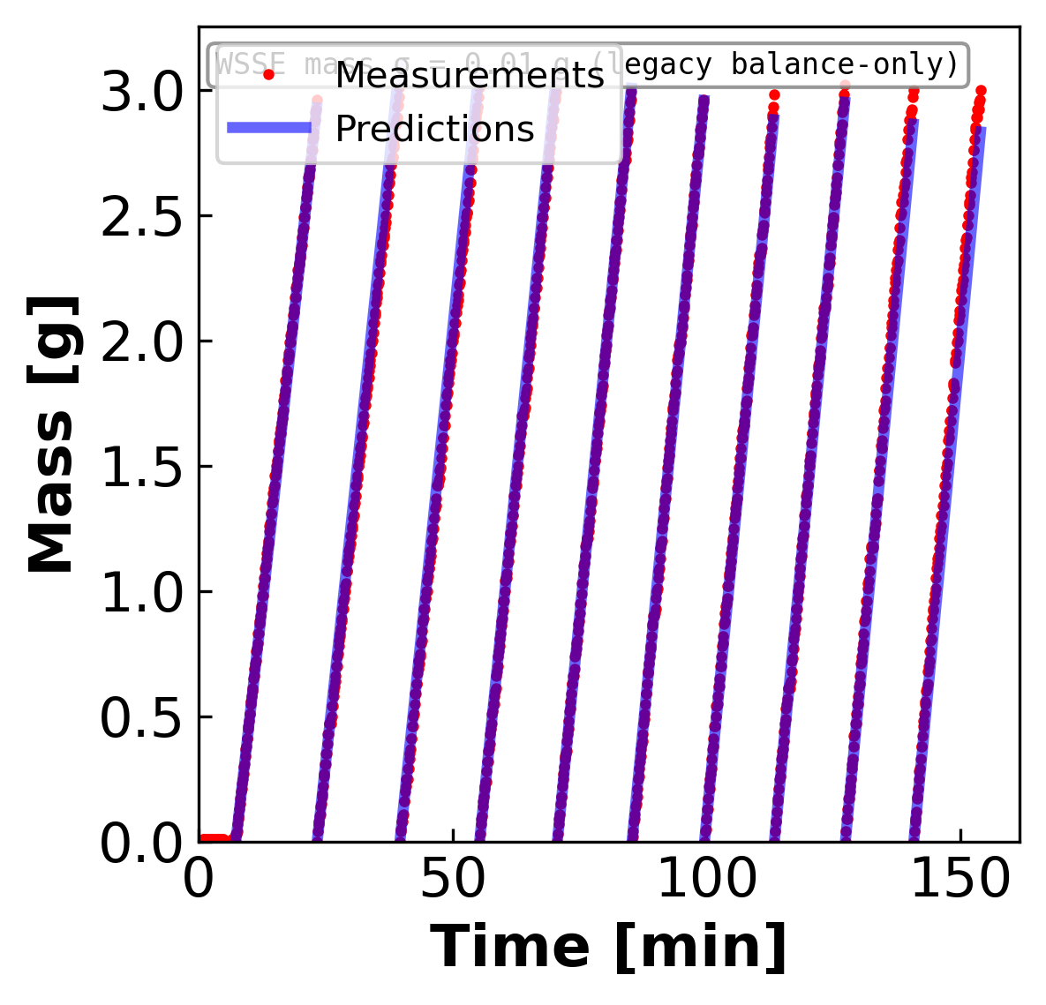
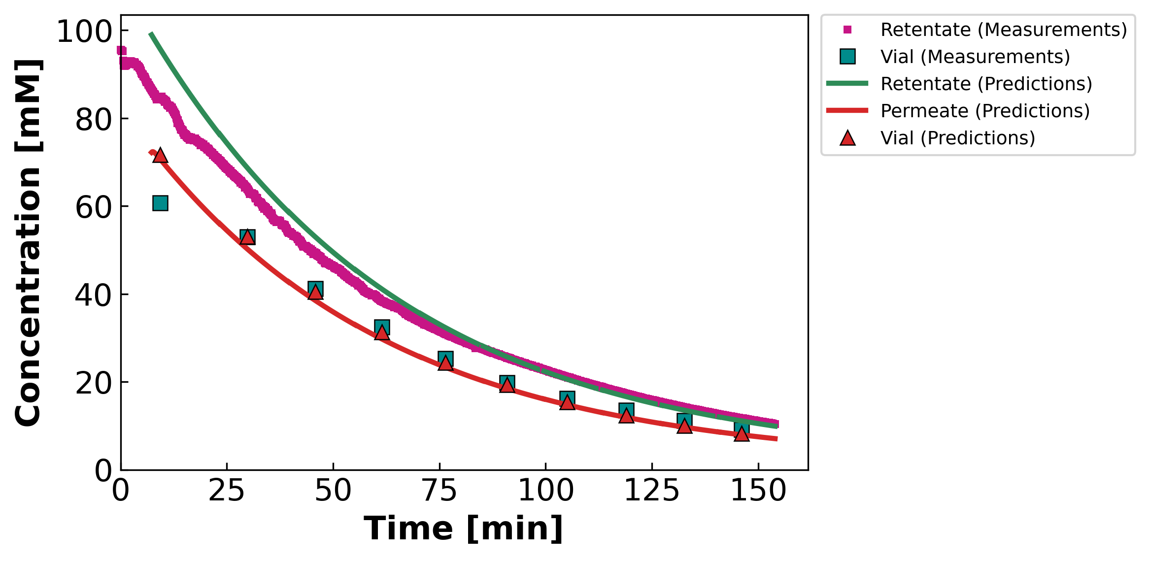
04 · CONTOUR-CONSISTENT FIT
STAGE 1A · well-identified
MC3 · 07.22.24 · SNaCl
Mass & concentration per vial · DATA2-style · prediction shown only where permeate is collected
θ (contour-consistent)
$$L_{p}=8.63$$
$$B=14.68 μm/s$$
$$σ=0.79$$
WSSE₃ch
$$560$$
Identifiability: GOOD
Gold standard. Interior σ → both mass and cᶠ tracked. Variable B (B_form = 1): the concentration curve bends — a constant-B model would draw a straight line here.
Leading hold-up / startup vial excluded (nv0 = 2): the model integrates Jw across the hold-up to carry the cell state, but mass is plotted only where permeate is collected in the vial — DATA1/DATA2 convention.
Concentration legend is built into the panel (retentate / vial / permeate, measurement vs prediction).
DATA3 single-salt · identifiability & fits · collaborator meeting · June 11 2026
27 / 42

Slide 28
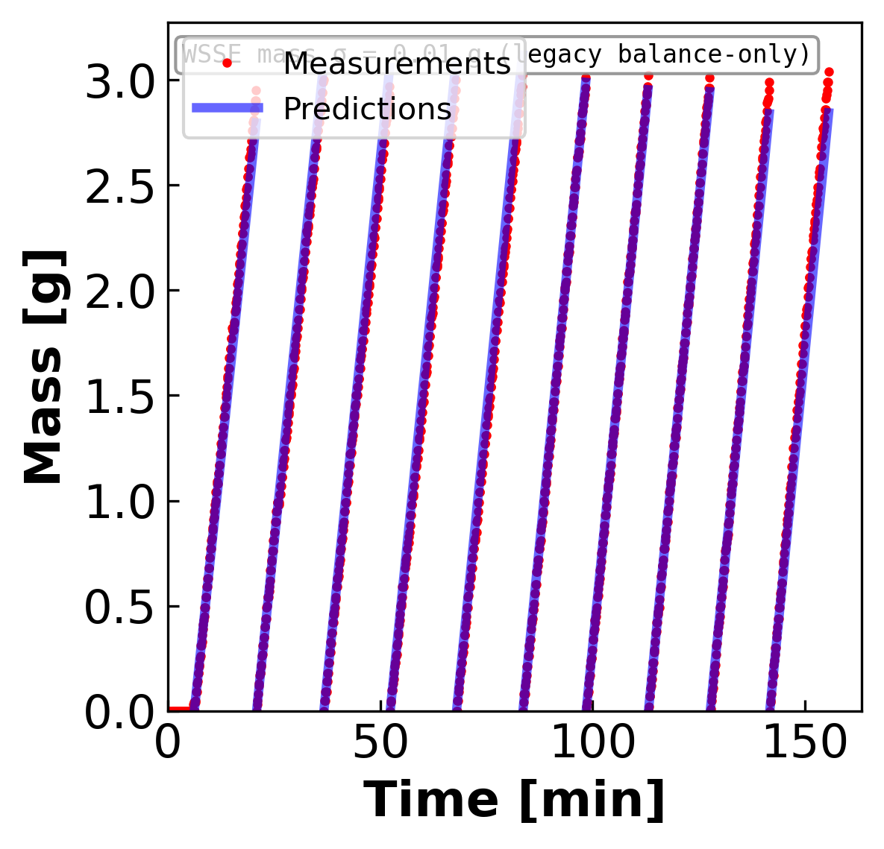
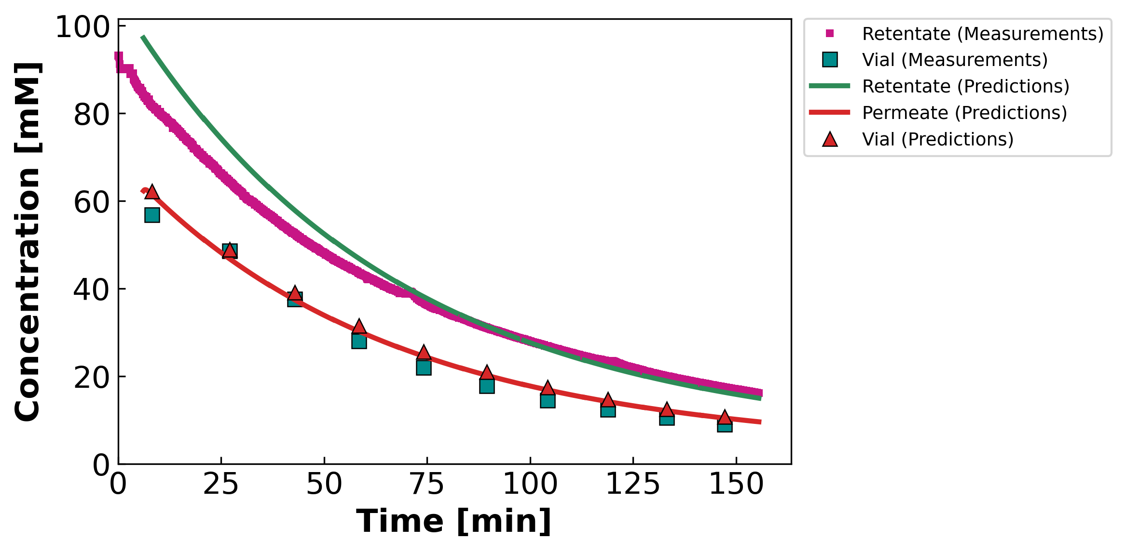
04 · CONTOUR-CONSISTENT FIT
STAGE 1B · diluting
MC5 · 07.23.24 · S2NaCl
Mass & concentration per vial · DATA2-style · prediction shown only where permeate is collected
θ (contour-consistent)
$$L_{p}=7.75$$
$$B=10.14 μm/s$$
$$σ=0.29$$
WSSE₃ch
$$888$$
Identifiability: GOOD
Diluting run → cᶠ falls. Lₚ pinned by mass; σ irrelevant. Variable B (B_form = 1): the concentration curve bends — a constant-B model would draw a straight line here.
Leading hold-up / startup vial excluded (nv0 = 2): the model integrates Jw across the hold-up to carry the cell state, but mass is plotted only where permeate is collected in the vial — DATA1/DATA2 convention.
Concentration legend is built into the panel (retentate / vial / permeate, measurement vs prediction).
DATA3 single-salt · identifiability & fits · collaborator meeting · June 11 2026
28 / 42

Slide 29
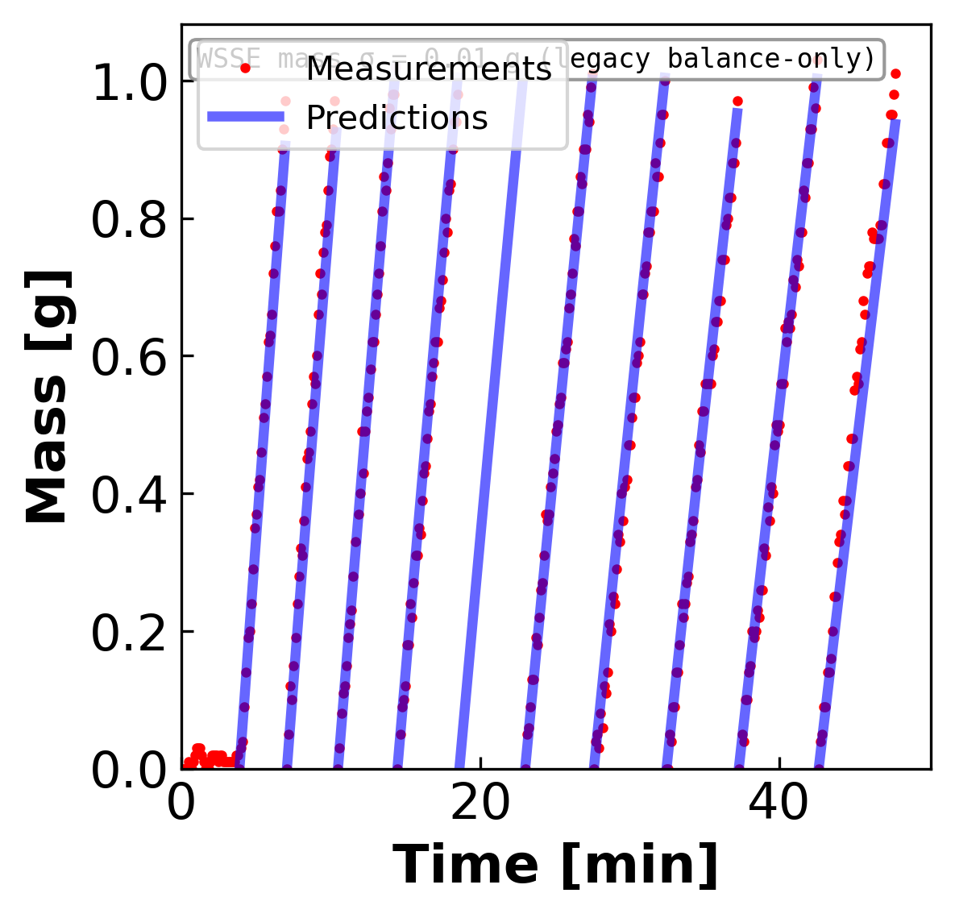
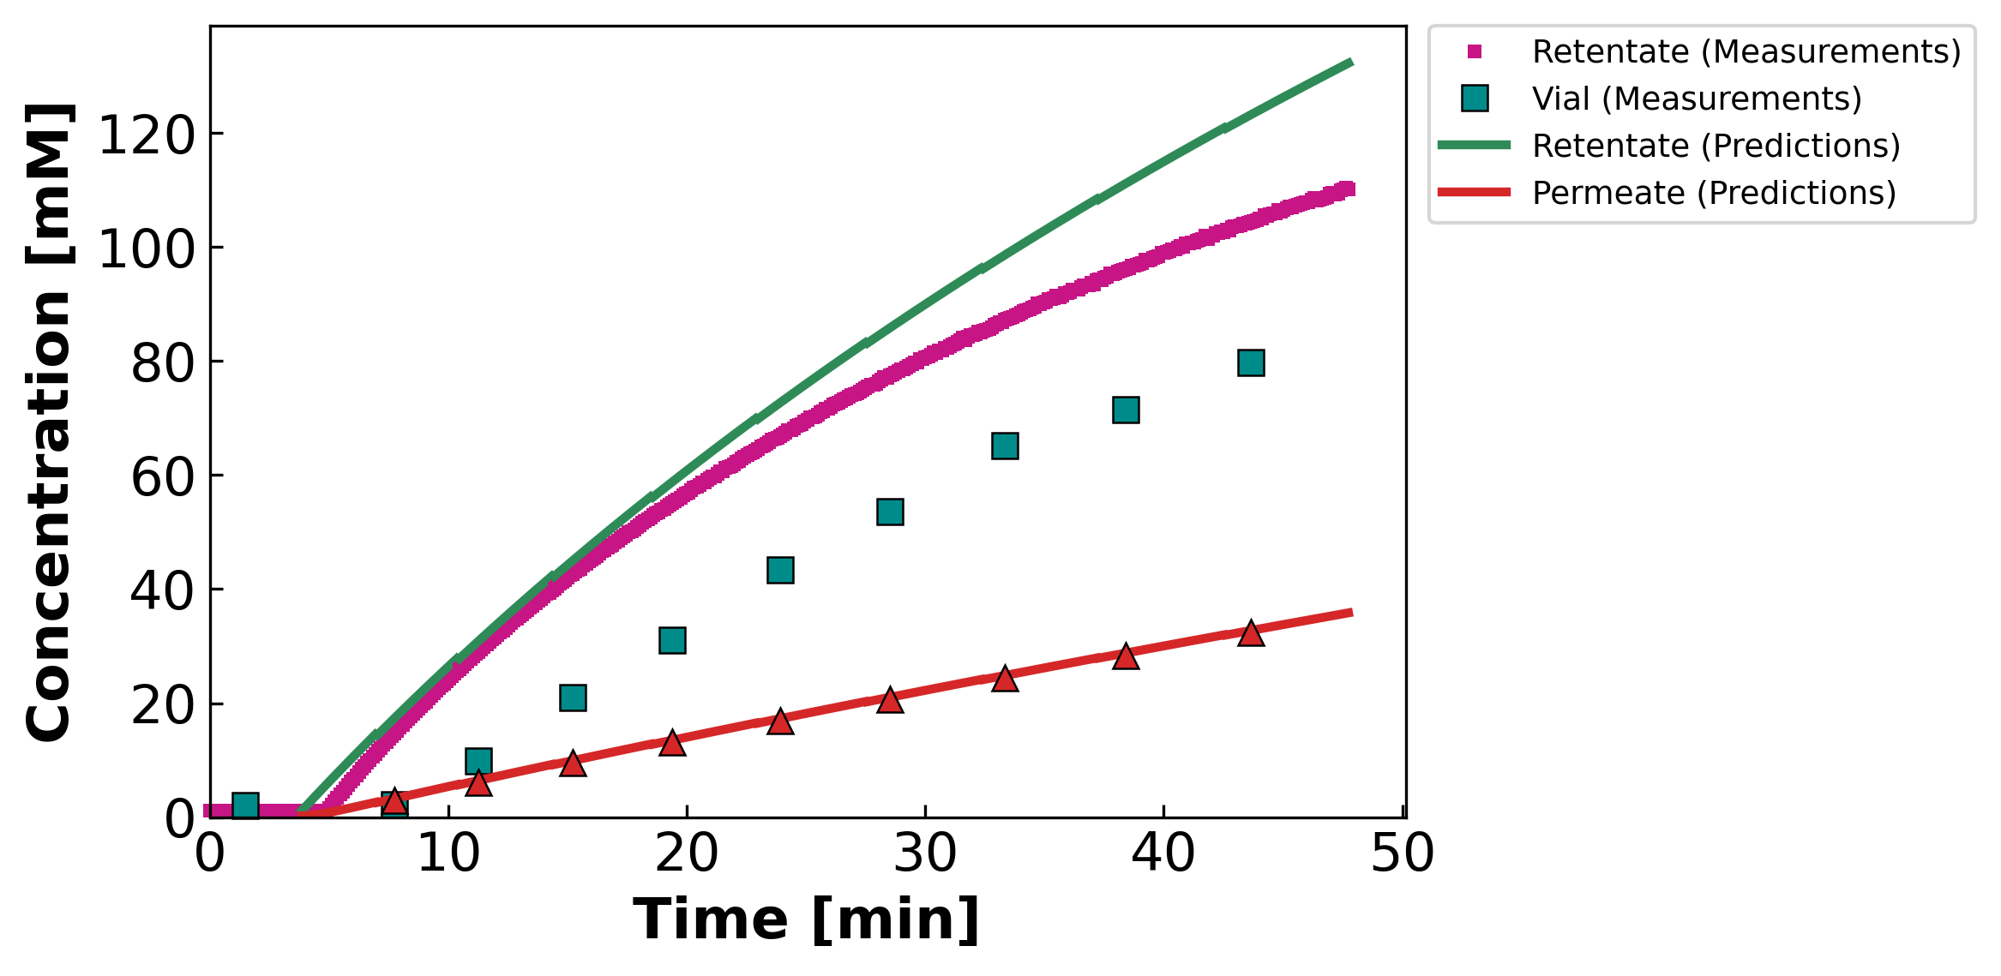
04 · CONTOUR-CONSISTENT FIT
STAGE 1B · diluting ⚠
MC4 · 07.11.24 · SNaCl
Mass & concentration per vial · DATA2-style · prediction shown only where permeate is collected
θ (contour-consistent)
$$L_{p}=11.35$$
$$B=2.02 μm/s$$
$$σ=0.50$$
WSSE₃ch
$$19,508$$
Identifiability: OKAY
Diluting but WSSE ~10× worse — suspected data-quality issue. Variable B (B_form = 1): the concentration curve bends — a constant-B model would draw a straight line here.
Leading hold-up / startup vial excluded (nv0 = 2): the model integrates Jw across the hold-up to carry the cell state, but mass is plotted only where permeate is collected in the vial — DATA1/DATA2 convention.
Concentration legend is built into the panel (retentate / vial / permeate, measurement vs prediction).
DATA3 single-salt · identifiability & fits · collaborator meeting · June 11 2026
29 / 42

Slide 30
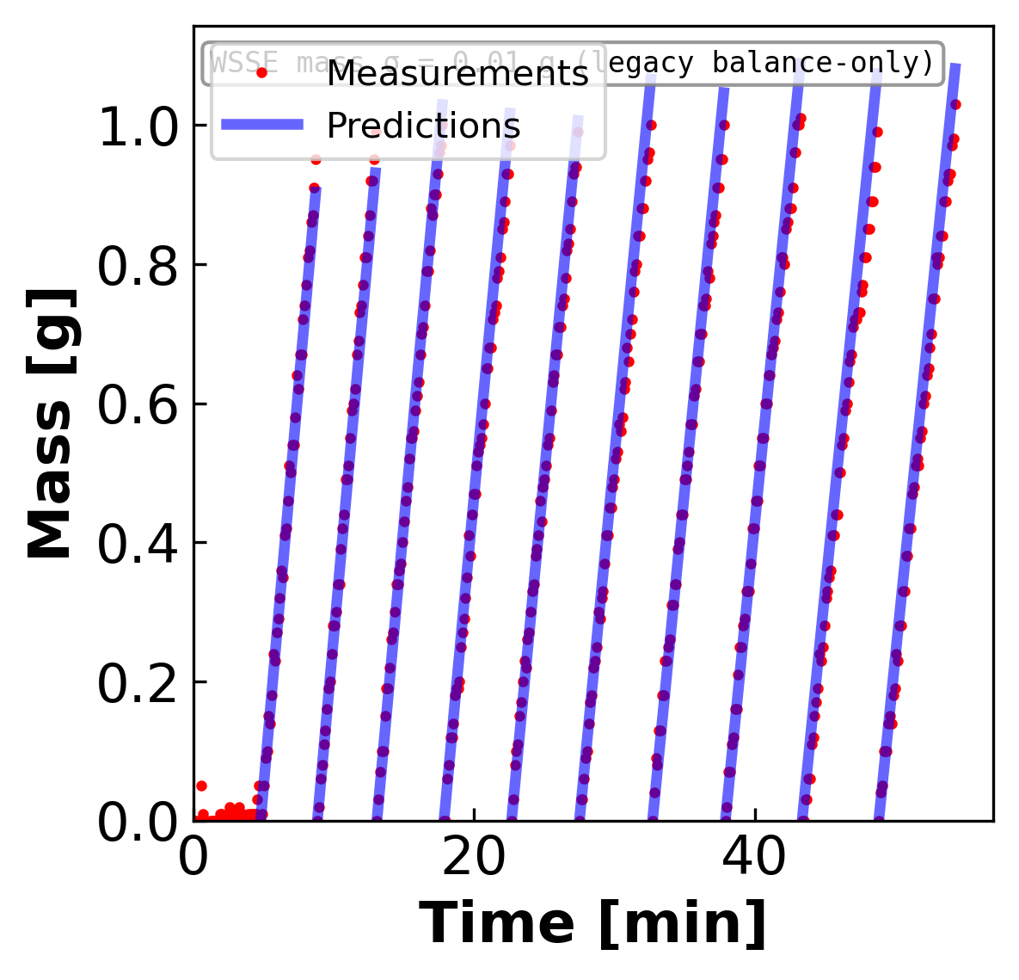
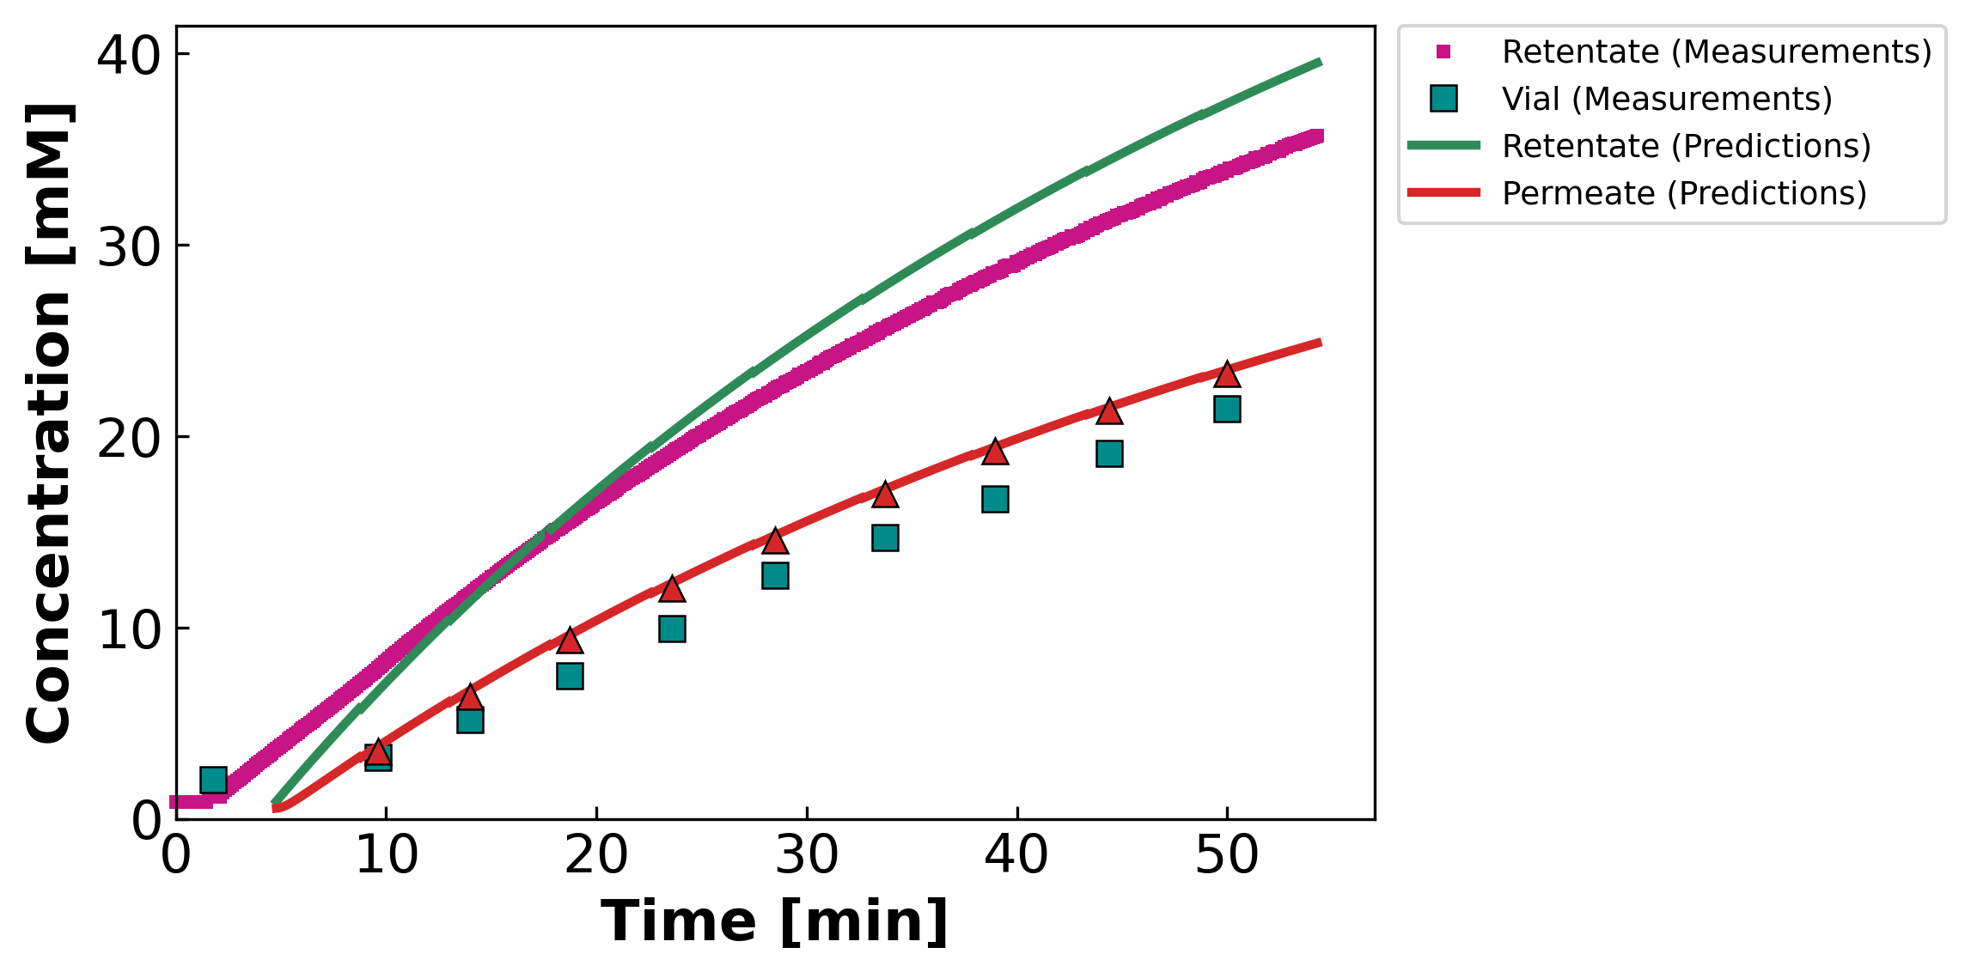
04 · CONTOUR-CONSISTENT FIT
STAGE 2 · NaCl, σ=1 wall
MC2 · 05.07.24 · NaCl
Mass & concentration per vial · DATA2-style · prediction shown only where permeate is collected
θ (contour-consistent)
$$L_{p}=10.45$$
$$B=9.73 μm/s$$
$$σ=1.00 ↑$$
WSSE₃ch
$$4,528$$
Identifiability: OKAY
Mass fit good; concentration biased by σ pinned at 1. Variable B (B_form = 1): the concentration curve bends — a constant-B model would draw a straight line here.
Leading hold-up / startup vial excluded (nv0 = 2): the model integrates Jw across the hold-up to carry the cell state, but mass is plotted only where permeate is collected in the vial — DATA1/DATA2 convention.
Concentration legend is built into the panel (retentate / vial / permeate, measurement vs prediction).
DATA3 single-salt · identifiability & fits · collaborator meeting · June 11 2026
30 / 42

Slide 31
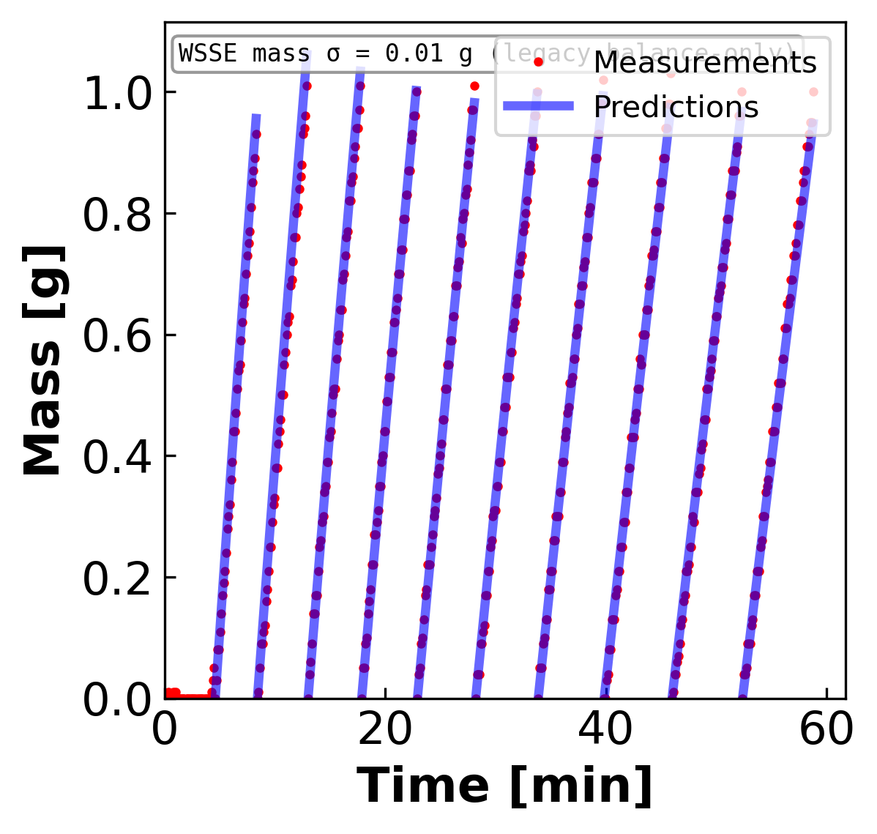
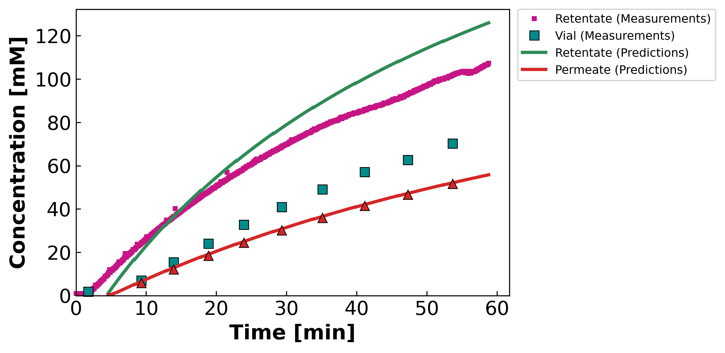
04 · CONTOUR-CONSISTENT FIT
STAGE 2 · NaCl, σ=1 wall
MC5 · 07.23.24 · NaCl
Mass & concentration per vial · DATA2-style · prediction shown only where permeate is collected
θ (contour-consistent)
$$L_{p}=10.52$$
$$B=3.70 μm/s$$
$$σ=0.79$$
WSSE₃ch
$$7,024$$
Identifiability: OKAY
Concentrating; σ at wall. Variable B (B_form = 1): the concentration curve bends — a constant-B model would draw a straight line here.
Leading hold-up / startup vial excluded (nv0 = 2): the model integrates Jw across the hold-up to carry the cell state, but mass is plotted only where permeate is collected in the vial — DATA1/DATA2 convention.
Concentration legend is built into the panel (retentate / vial / permeate, measurement vs prediction).
DATA3 single-salt · identifiability & fits · collaborator meeting · June 11 2026
31 / 42

Slide 32
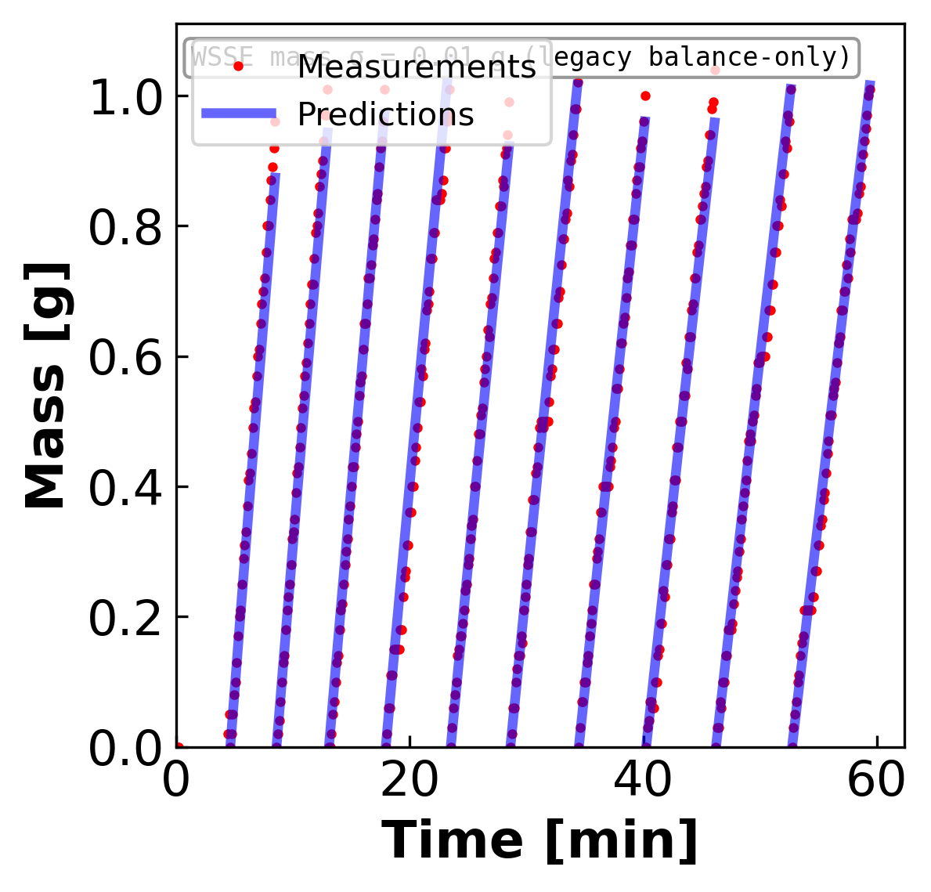
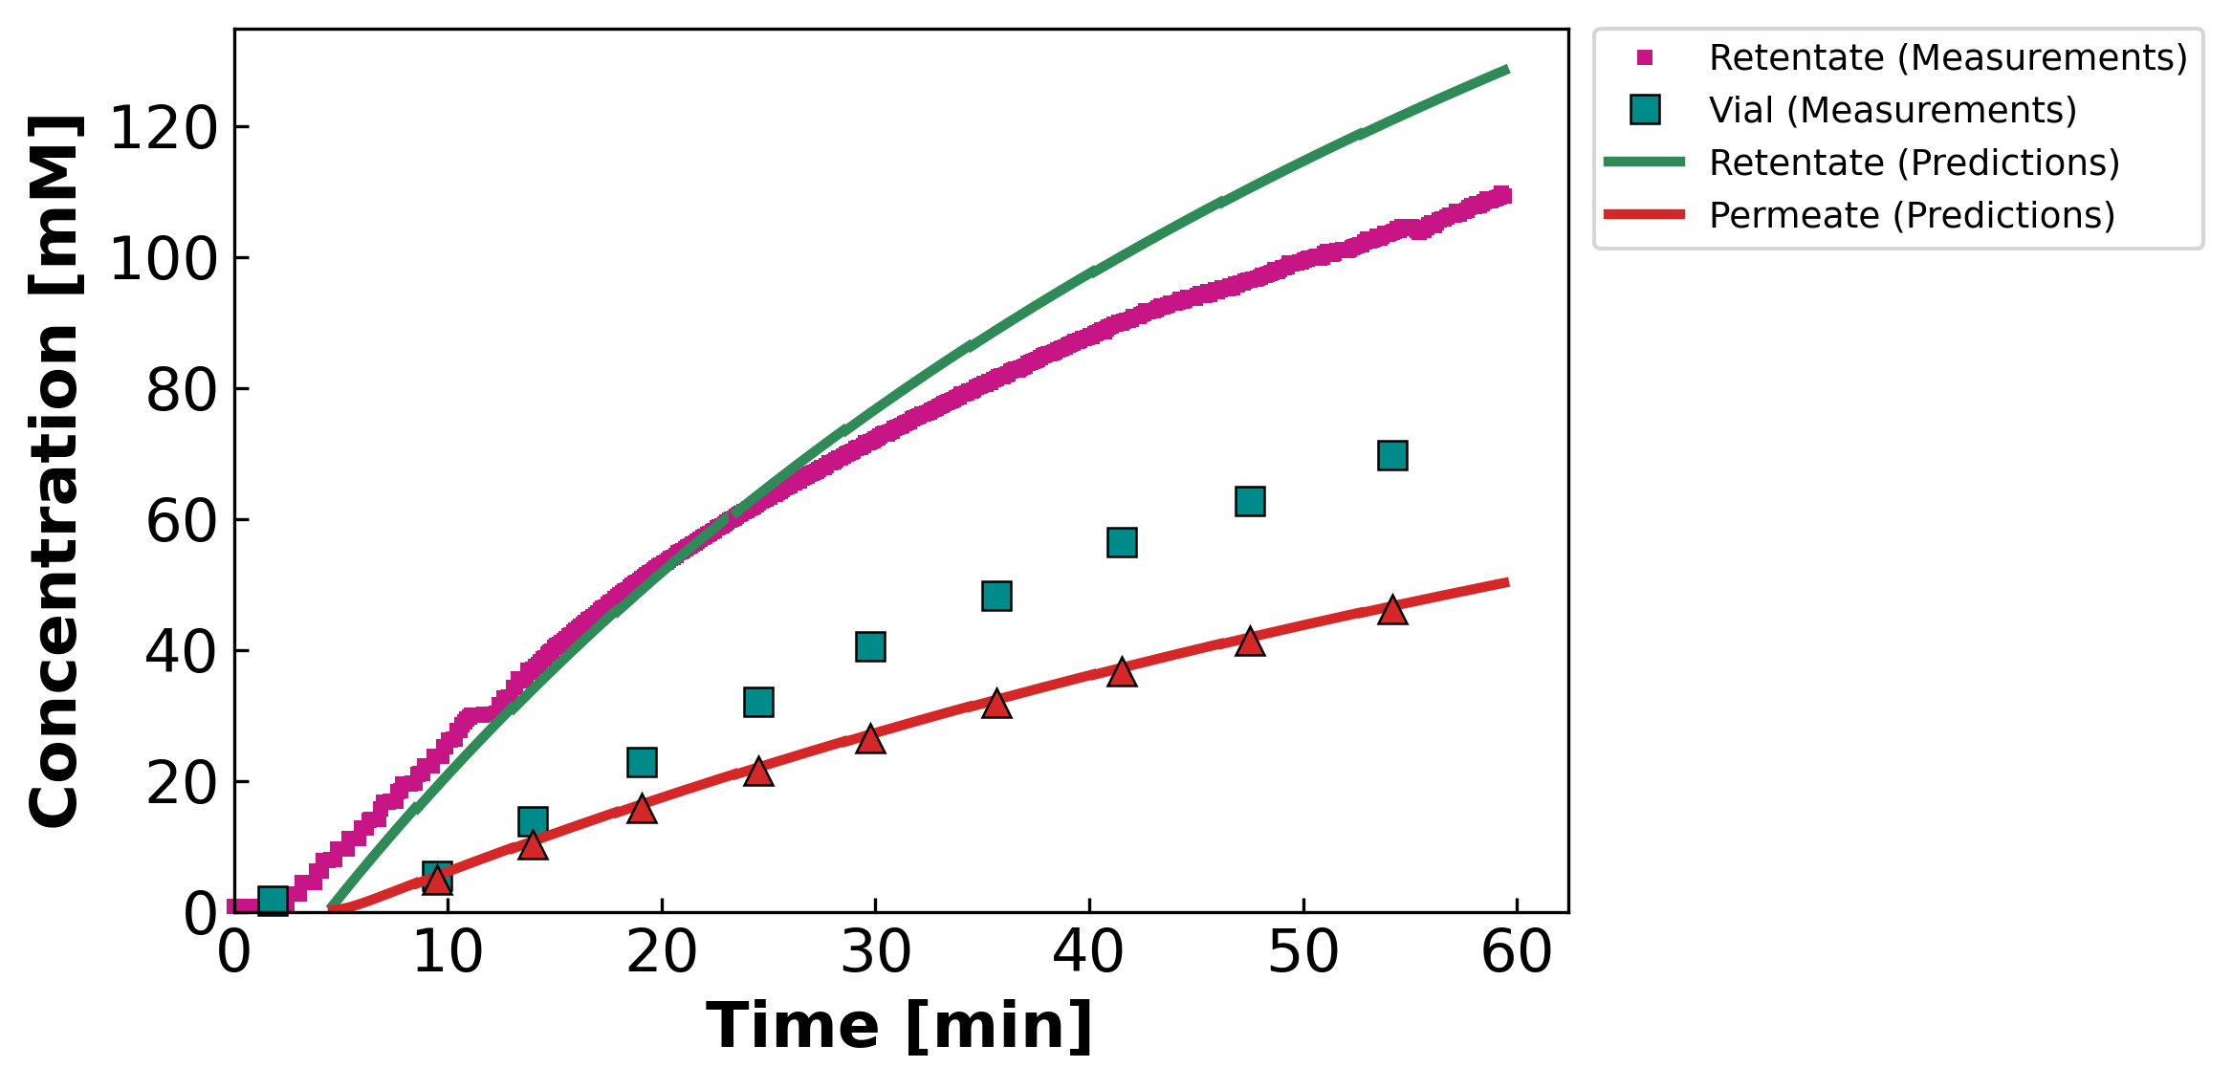
04 · CONTOUR-CONSISTENT FIT
STAGE 2 · NaCl, σ=1 wall
MC5 · 07.23.24 · SNaCl
Mass & concentration per vial · DATA2-style · prediction shown only where permeate is collected
θ (contour-consistent)
$$L_{p}=8.64$$
$$B=3.07 μm/s$$
$$σ=0.57$$
WSSE₃ch
$$5,870$$
Identifiability: OKAY
Concentrating; σ at wall. Variable B (B_form = 1): the concentration curve bends — a constant-B model would draw a straight line here.
Leading hold-up / startup vial excluded (nv0 = 2): the model integrates Jw across the hold-up to carry the cell state, but mass is plotted only where permeate is collected in the vial — DATA1/DATA2 convention.
Concentration legend is built into the panel (retentate / vial / permeate, measurement vs prediction).
DATA3 single-salt · identifiability & fits · collaborator meeting · June 11 2026
32 / 42

Slide 33
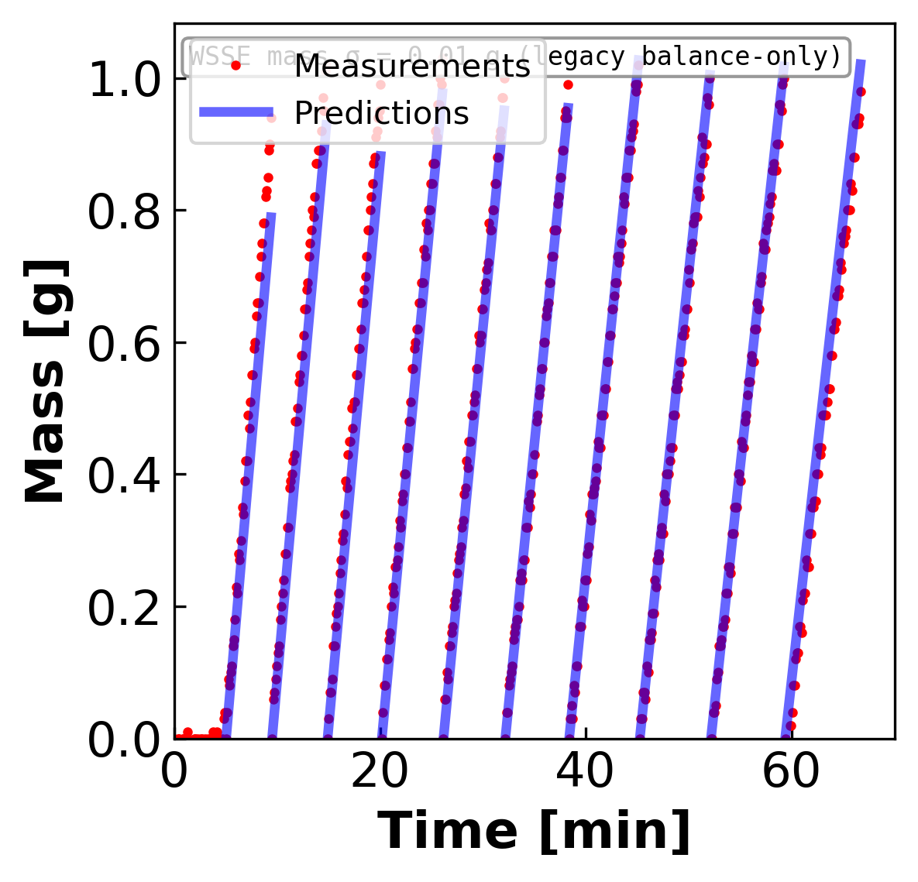
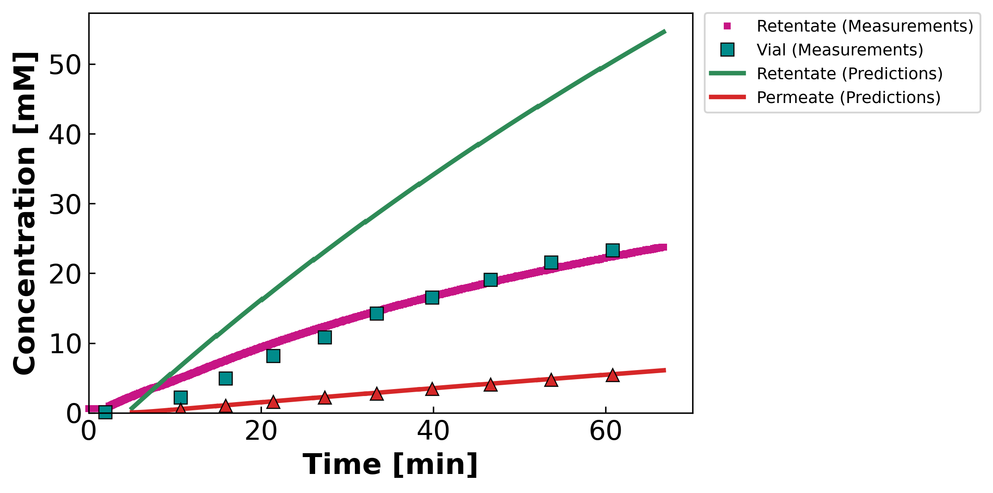
04 · CONTOUR-CONSISTENT FIT
STAGE 2 · CaCl₂
MC2 · 05.07.24 · CaCl₂
Mass & concentration per vial · DATA2-style · prediction shown only where permeate is collected
θ (contour-consistent)
$$L_{p}=8.00$$
$$B=0.51 μm/s$$
$$σ=0.50$$
WSSE₃ch
$$97,213$$
Identifiability: OKAY
Channel side-split; high retentate-conc WSSE. Variable B (B_form = 1): the concentration curve bends — a constant-B model would draw a straight line here.
Leading hold-up / startup vial excluded (nv0 = 2): the model integrates Jw across the hold-up to carry the cell state, but mass is plotted only where permeate is collected in the vial — DATA1/DATA2 convention.
Concentration legend is built into the panel (retentate / vial / permeate, measurement vs prediction).
DATA3 single-salt · identifiability & fits · collaborator meeting · June 11 2026
33 / 42

Slide 34
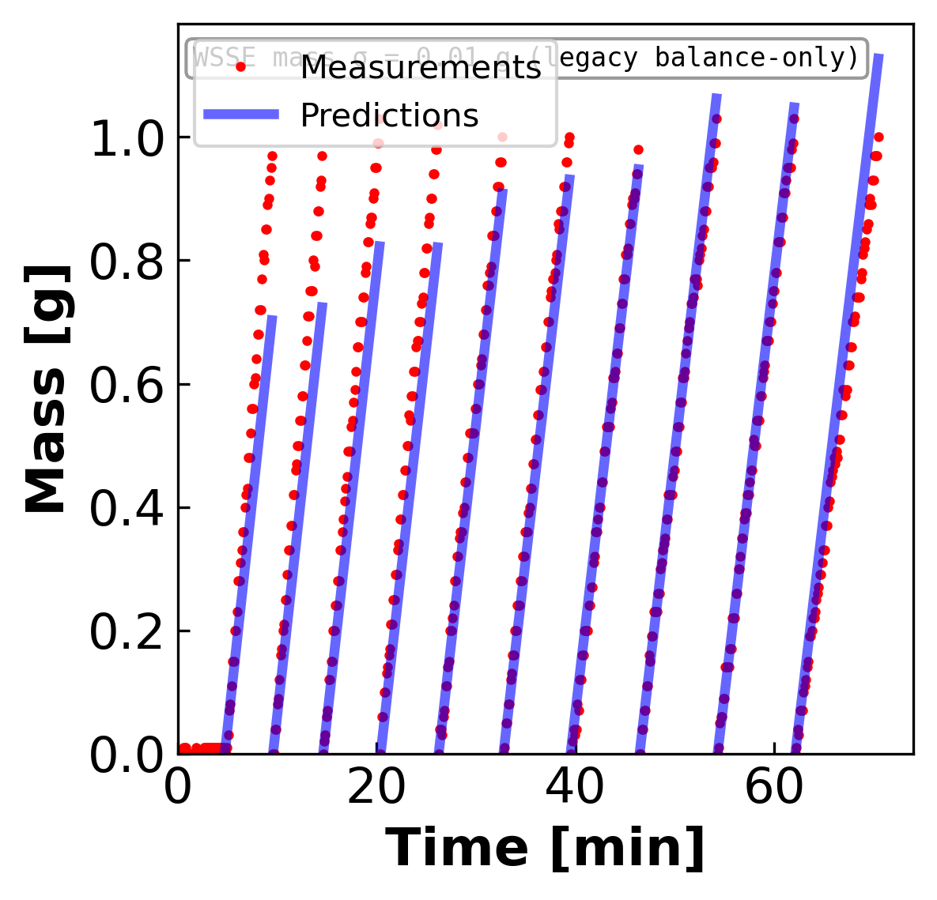
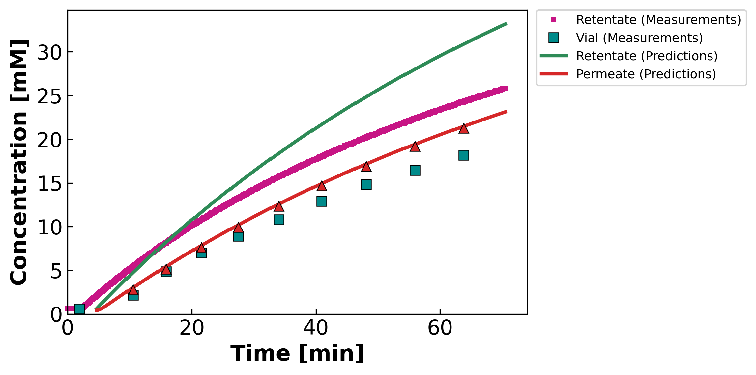
04 · CONTOUR-CONSISTENT FIT
STAGE 2 · CaCl₂
MC3 · 07.11.24 · SCaCl₂
Mass & concentration per vial · DATA2-style · prediction shown only where permeate is collected
θ (contour-consistent)
$$L_{p}=6.56$$
$$B=9.11 μm/s$$
$$σ=1.00 ↑$$
WSSE₃ch
$$6,139$$
Identifiability: OKAY
σ at wall. Variable B (B_form = 1): the concentration curve bends — a constant-B model would draw a straight line here.
Leading hold-up / startup vial excluded (nv0 = 2): the model integrates Jw across the hold-up to carry the cell state, but mass is plotted only where permeate is collected in the vial — DATA1/DATA2 convention.
Concentration legend is built into the panel (retentate / vial / permeate, measurement vs prediction).
DATA3 single-salt · identifiability & fits · collaborator meeting · June 11 2026
34 / 42

Slide 35
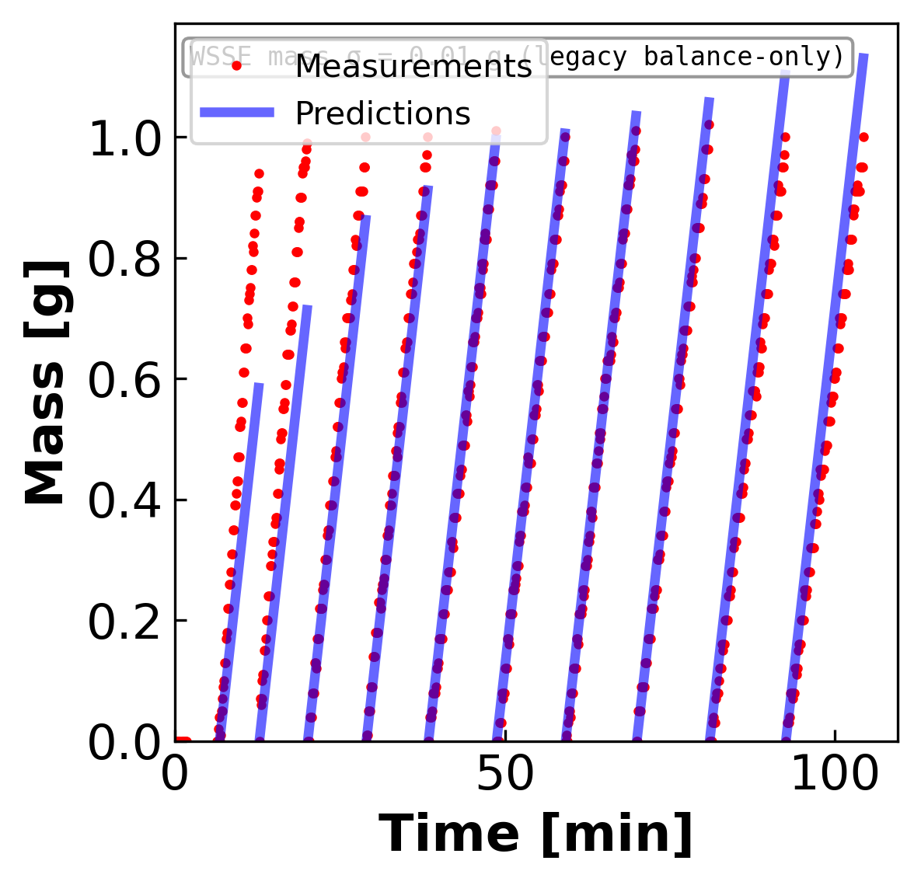
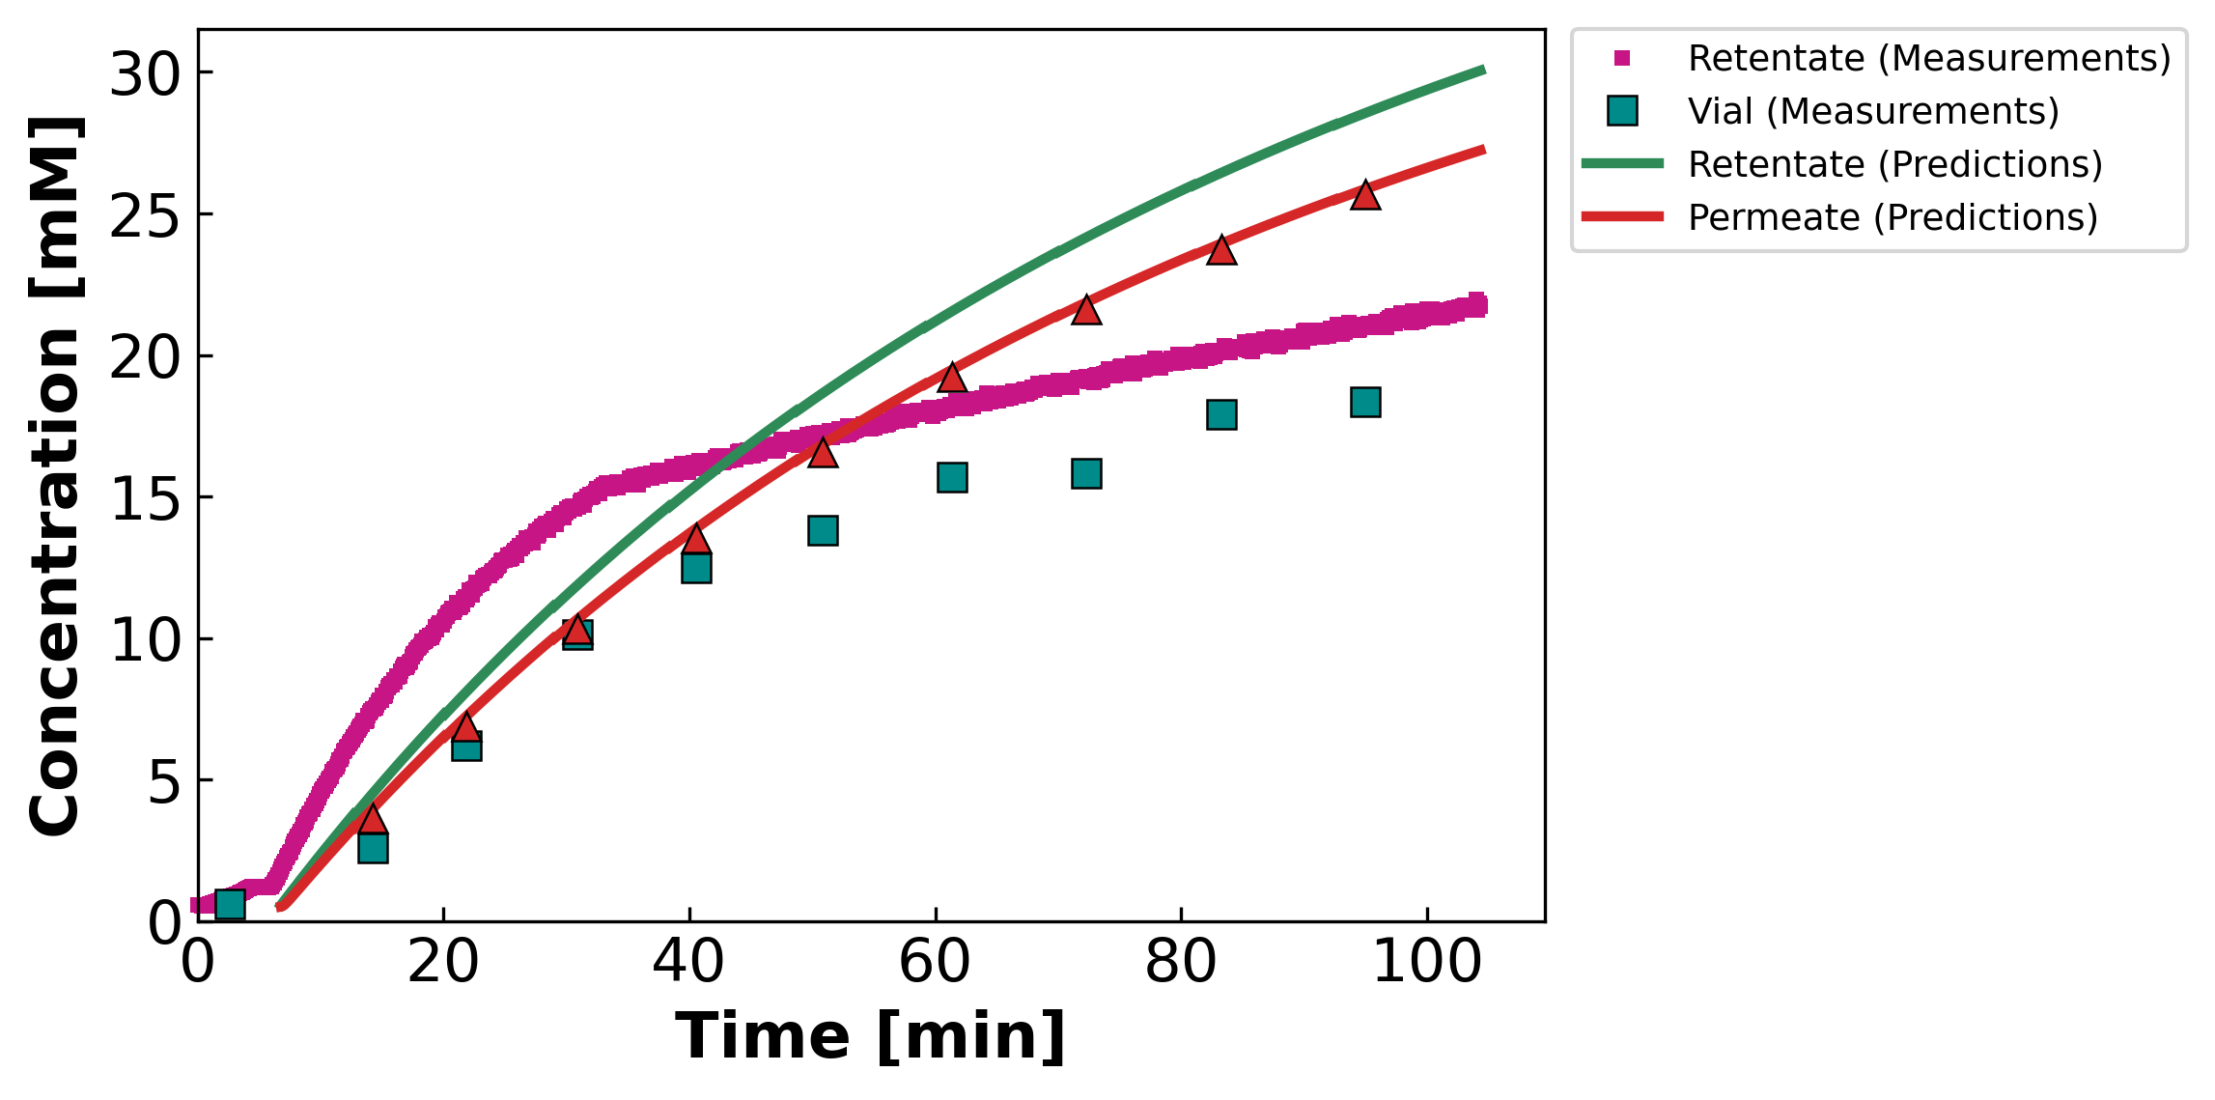
04 · CONTOUR-CONSISTENT FIT
STAGE 2 · CaCl₂
MC3 · 07.12.24 · S2CaCl₂
Mass & concentration per vial · DATA2-style · prediction shown only where permeate is collected
θ (contour-consistent)
$$L_{p}=5.49$$
$$B=30.00 ↑ μm/s$$
$$σ=1.00 ↑$$
WSSE₃ch
$$9,774$$
Identifiability: OKAY
σ AND B pinned at walls (B=30). Variable B (B_form = 1): the concentration curve bends — a constant-B model would draw a straight line here.
Leading hold-up / startup vial excluded (nv0 = 2): the model integrates Jw across the hold-up to carry the cell state, but mass is plotted only where permeate is collected in the vial — DATA1/DATA2 convention.
Concentration legend is built into the panel (retentate / vial / permeate, measurement vs prediction).
DATA3 single-salt · identifiability & fits · collaborator meeting · June 11 2026
35 / 42

Slide 36
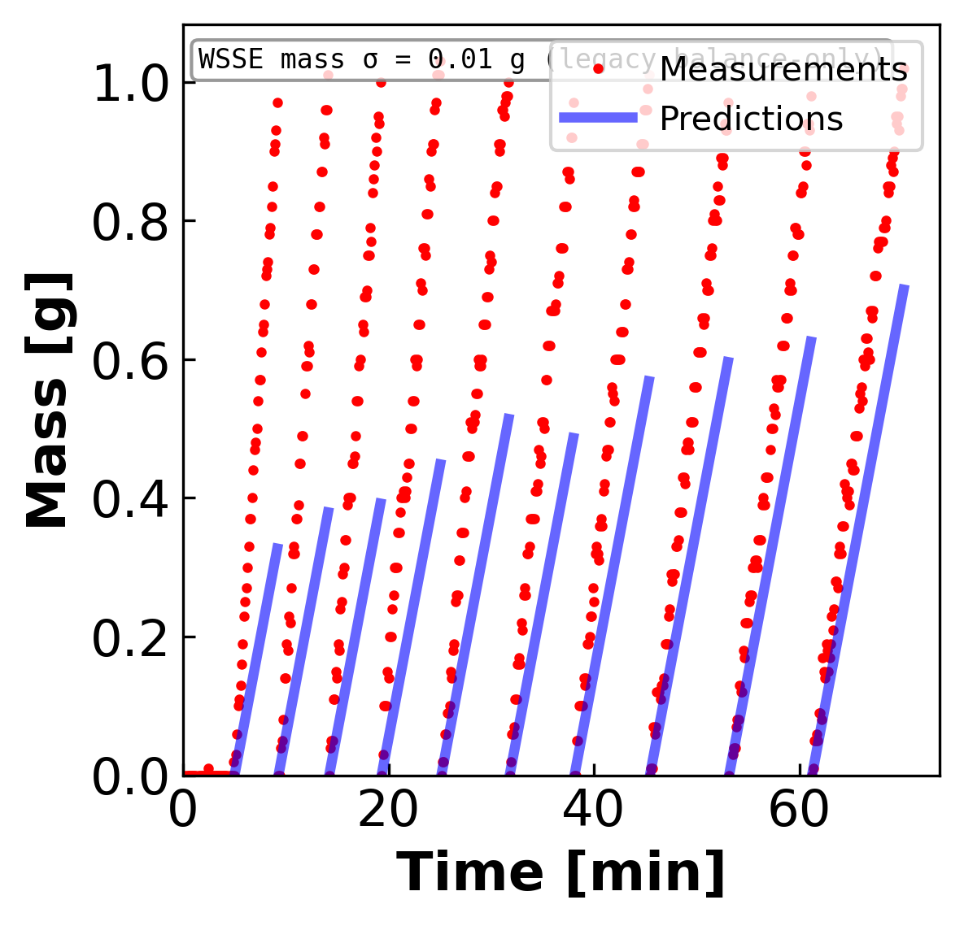
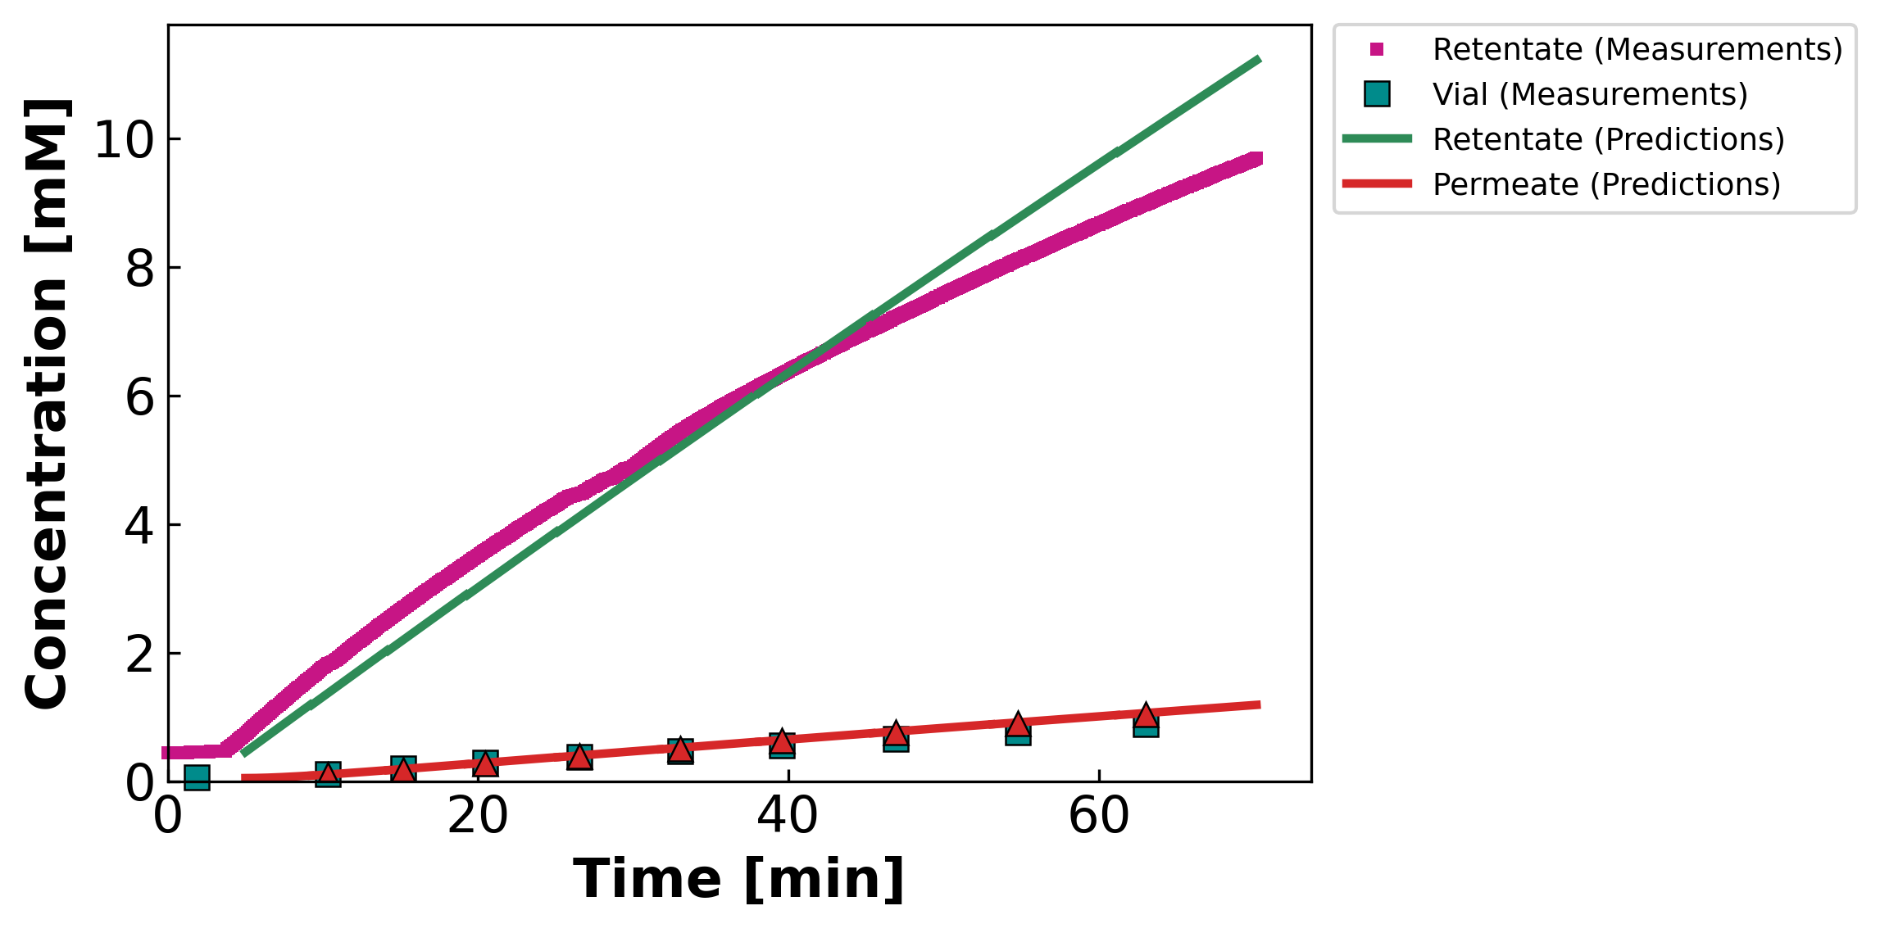
04 · CONTOUR-CONSISTENT FIT
STAGE 3 · LaCl₃
MC2 · 05.21.24 · LaCl₃
Mass & concentration per vial · DATA2-style · prediction shown only where permeate is collected
θ (contour-consistent)
$$L_{p}=2.95$$
$$B=0.31 μm/s$$
$$σ=0.00 ↓$$
WSSE₃ch
$$21,500$$
Identifiability: POOR
Wrong-model bias — model can't track cᶠ. Variable B (B_form = 1): the concentration curve bends — a constant-B model would draw a straight line here.
Leading hold-up / startup vial excluded (nv0 = 2): the model integrates Jw across the hold-up to carry the cell state, but mass is plotted only where permeate is collected in the vial — DATA1/DATA2 convention.
Concentration legend is built into the panel (retentate / vial / permeate, measurement vs prediction).
DATA3 single-salt · identifiability & fits · collaborator meeting · June 11 2026
36 / 42

Slide 37
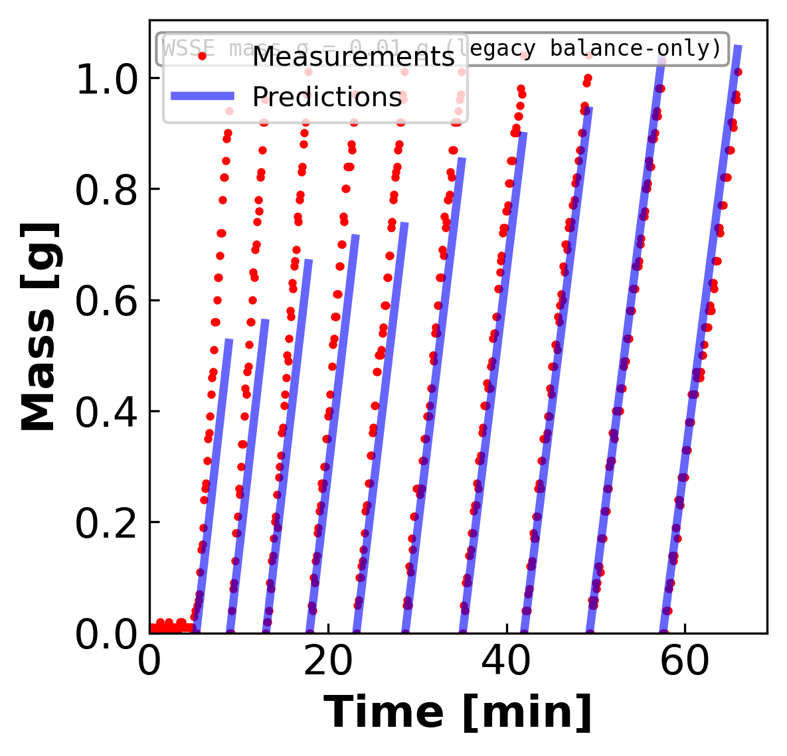
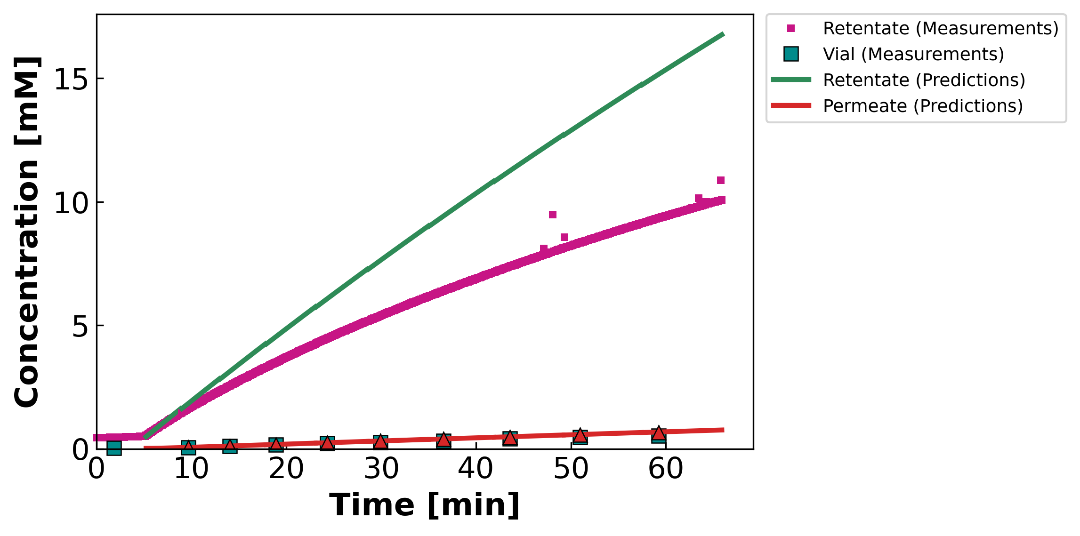
04 · CONTOUR-CONSISTENT FIT
STAGE 3 · LaCl₃
MC4 · 07.11.24 · SLaCl₃
Mass & concentration per vial · DATA2-style · prediction shown only where permeate is collected
θ (contour-consistent)
$$L_{p}=5.55$$
$$B=0.17 μm/s$$
$$σ=0.93$$
WSSE₃ch
$$75,080$$
Identifiability: POOR
Replicate wrong-model bias. Variable B (B_form = 1): the concentration curve bends — a constant-B model would draw a straight line here.
Leading hold-up / startup vial excluded (nv0 = 2): the model integrates Jw across the hold-up to carry the cell state, but mass is plotted only where permeate is collected in the vial — DATA1/DATA2 convention.
Concentration legend is built into the panel (retentate / vial / permeate, measurement vs prediction).
DATA3 single-salt · identifiability & fits · collaborator meeting · June 11 2026
37 / 42

Slide 38
05 · THE TAKEAWAY
Combine what we have, then design what we're missing
Q1 — a better initial guess from the existing runs · Q2 — the experiments that close the gaps

Slide 39
Q1 · COMBINE
Take each parameter from the run that pins it
Same θ = (Lₚ, B, σ), but each component seeded from the experiment whose data actually constrain it
$$J_{w}=L_{p} ΔP$$
Δπ ≈ 0 → Lₚ falls straight out of the mass data, untouched by σ or B.
Lₚ
from: Pure-water run, or any diluting run's mass channel
$$arg\min_{σ} WSSE$$
Only where Δπ/ΔP is appreciable does σ leave an interior minimum.
σ
from: A high-cf (diluting) run — MC3 SNaCl, σ ≈ 0.79
$$J_{s}=B\left(c_{in}−c_{h}\right)$$
Tighten with the per-salt bound (halve per +1 cation charge).
B
from: The low-residual solute channel where Jw spans a range
θ_init per salt = ( Lₚ : water / diluting · σ : σ-probing run · B : clean solute channel )
Transfer across salts of the same valence, then run the joint multistart from this seed instead of a blind LHS.
DATA3 single-salt · identifiability & fits · collaborator meeting · June 11 2026
39 / 42

Slide 40
Q2 · DESIGN
New experiments, chosen to fix exactly what the math says is missing
Each one targets a specific identifiability gap from the sensitivity analysis
Pure-water Lₚ before & after every run
PRIORITY 1
$$J_{w}=L_{p} ΔP$$
→ pins Lₚ
Δπ = 0 isolates Lₚ so σ and B can't compensate for it. Doubles as a fouling check (pre/post drift).
Multi-ΔP sweep within a run + dilute runs
PRIORITY 2
$$\frac{∂J_{w}}{∂σ}=−L_{p} Δπ$$
→ separates σ–B
Stepping ΔP changes Jw, shifting how σ (via Jw) and B (via Js) each act on c_f — breaking their correlation. Dilute runs raise Δπ/ΔP so σ identifies for CaCl₂/LaCl₃.
More LaCl₃ + retentate conductivity + ICP speciation
PRIORITY 3
$$n_{eff}=? \left({La}^{3+}⇌{LaCl}^{2+}\right)$$
→ tests model form
n = 2 is an anecdote (need ≥5). Retentate-side conductivity kills the CaCl₂ side-split; speciation tests the ion-pairing hypothesis directly.
DATA3 single-salt · identifiability & fits · collaborator meeting · June 11 2026
40 / 42

Slide 41
QUESTIONS FOR DISCUSSION
What I'd like your read on before the re-run
1
Does the 3-stage diagnosis match your physical intuition? Increasing cation valence → identifiability degrades. Is the σ=1 wall a regime problem, or the cᶠ weighting forcing it there?
2
Two paths to well-identified — MC3 SNaCl (interior σ = 0.79) vs MC5 S2NaCl (diluting, σ irrelevant). What in the run-sheet metadata differs from the other NaCl sheets?
3
MC4 SNaCl is diluting but fits ~10× worse (WSSE ≈ 19.5k). Likely a data-quality issue (fouling / leak / calibration) rather than model — worth a closer look?
4
LaCl₃ fix: parameterize σ(cᶠ), add an ion-pairing equilibrium block, or fit only the diluting portion? Either way we need 3–5 more sheets.
5
Per-salt B bounds — NaCl [0,30], CaCl₂ [0,15], LaCl₃ [0,10]. Anything you'd revise before re-running the full campaign?

Slide 42
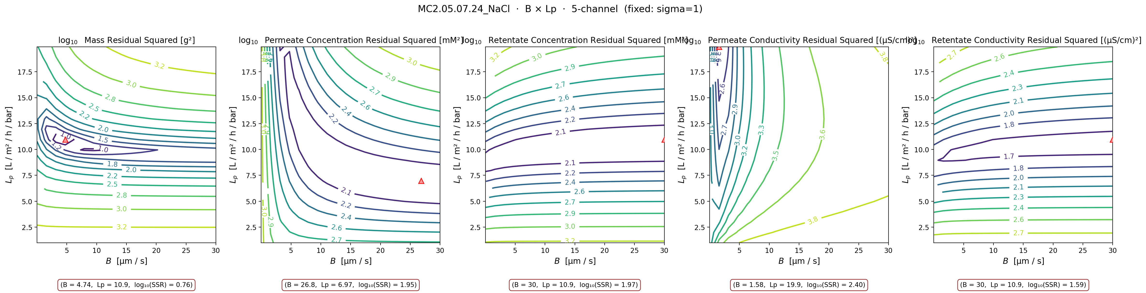
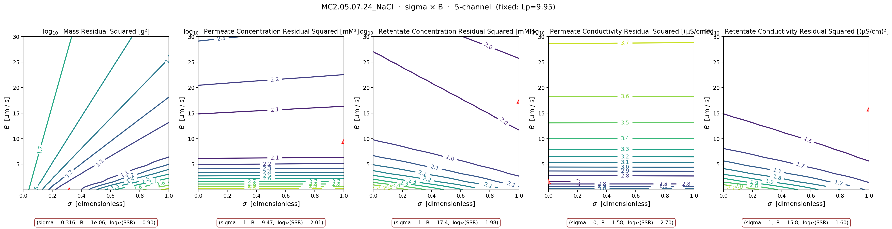
APPENDIX
MC2 NaCl — B-direction contours behind the σ=1 wall
The σ=1 wall on the Stage-2 NaCl sheets hides a B–Lₚ trade-off
B × Lₚ (σ fixed at warm-start = 1) — Lₚ on Y
σ × B (Lₚ fixed) — B on Y per axis convention
DATA3 single-salt · identifiability & fits · collaborator meeting · June 11 2026
42 / 42

