Slide 1
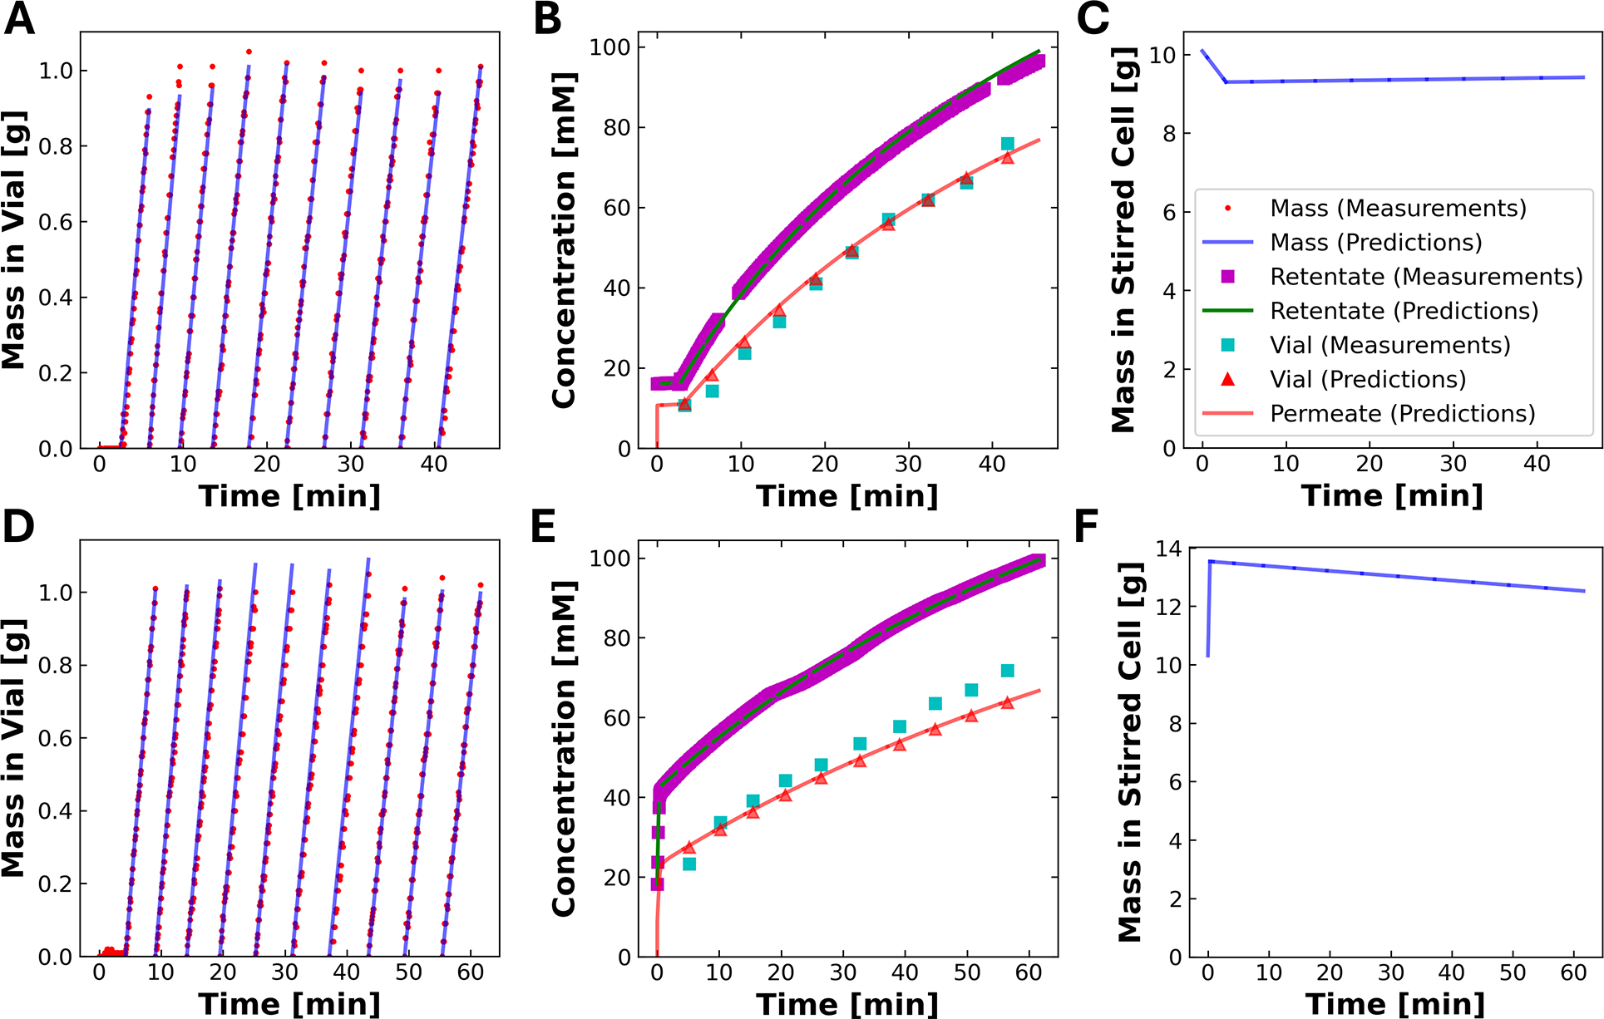
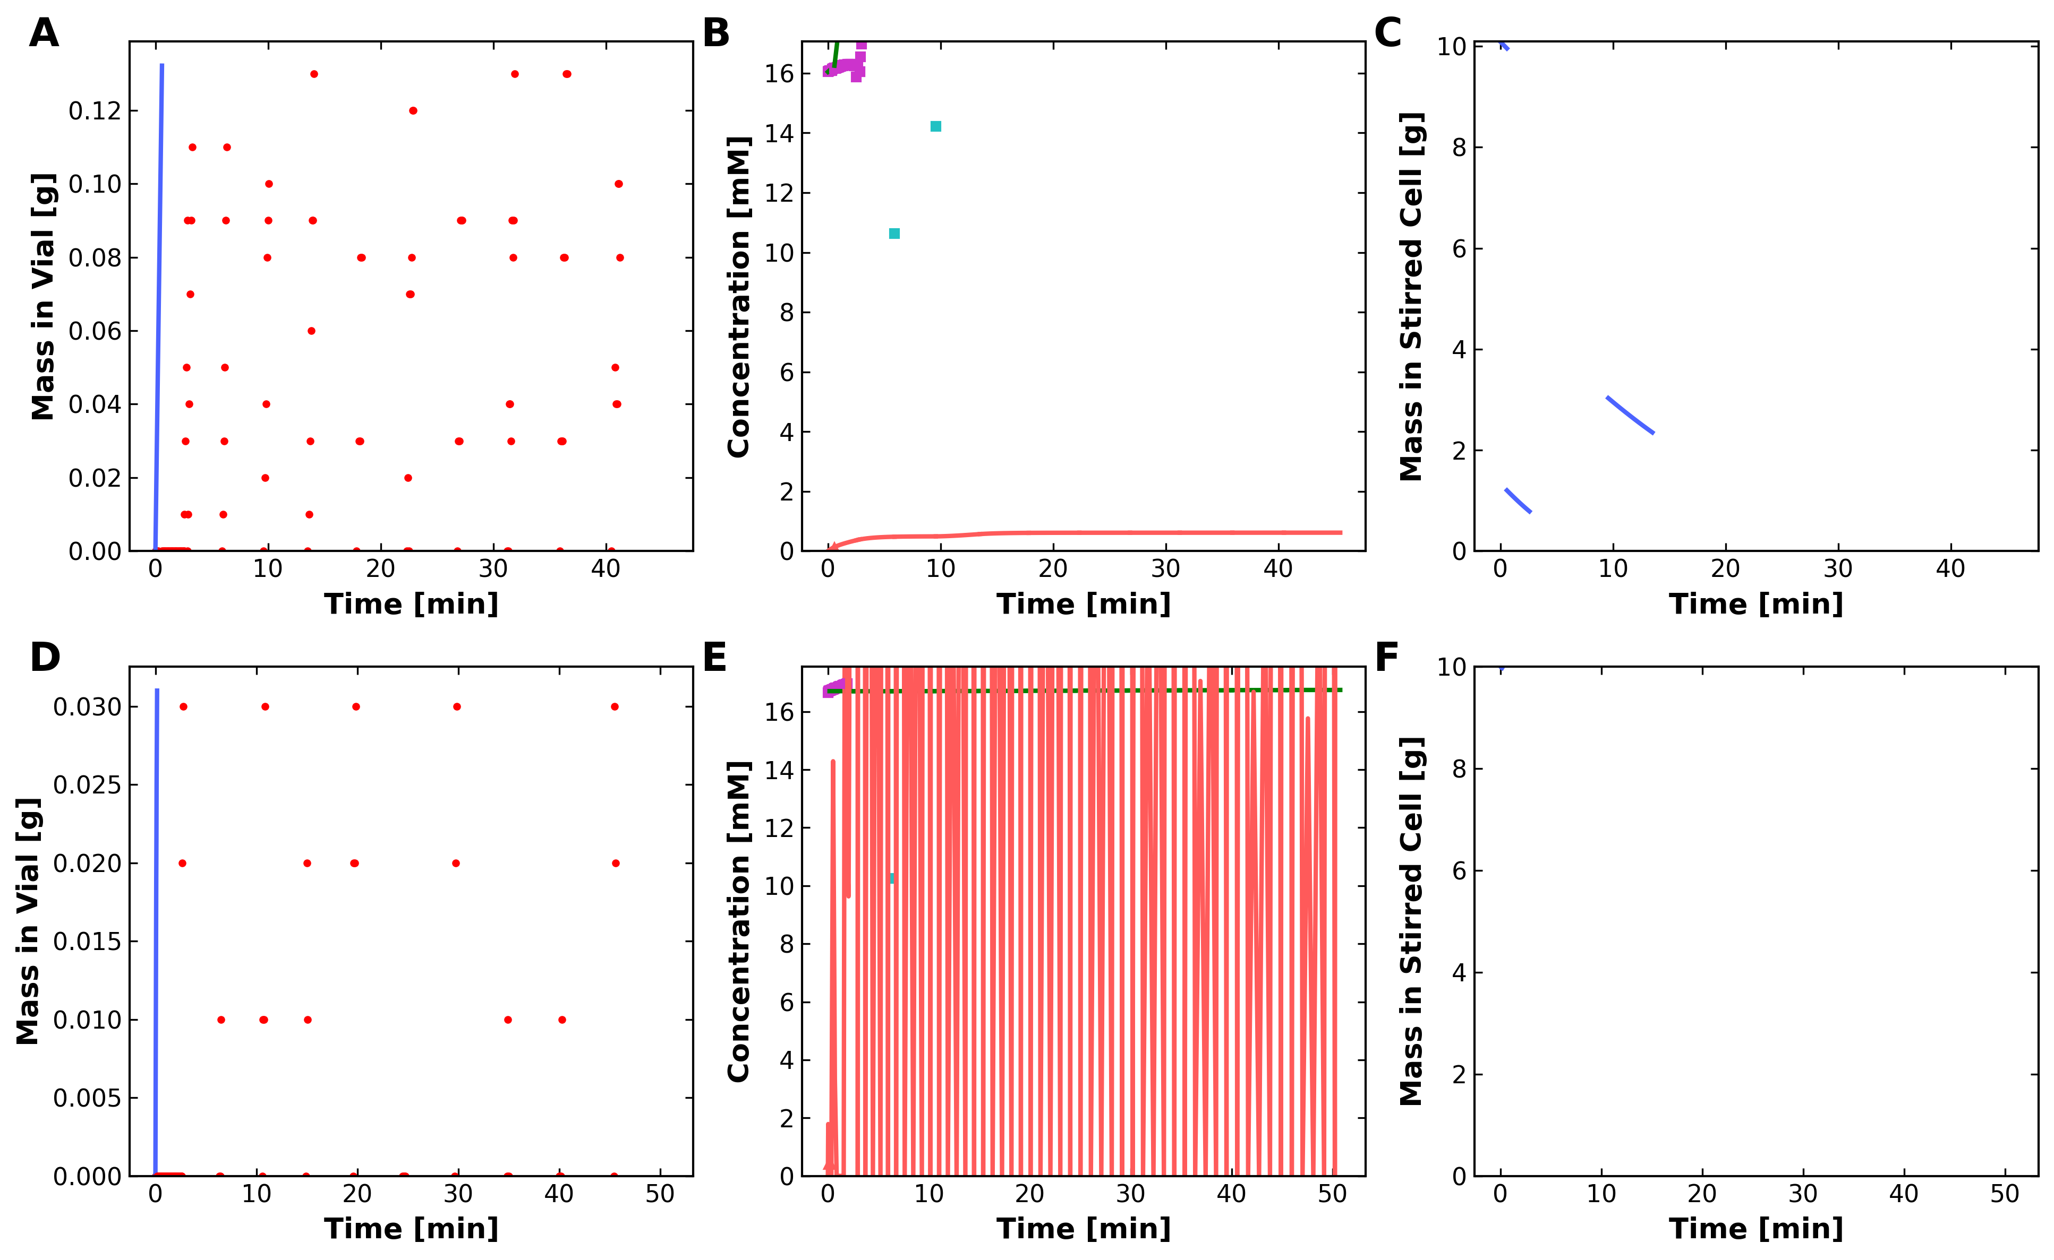
DATA2 Figure 7
Published
Unified Regenerated
Published figure on the left and current unified-codebase regeneration on the right.

Slide 2
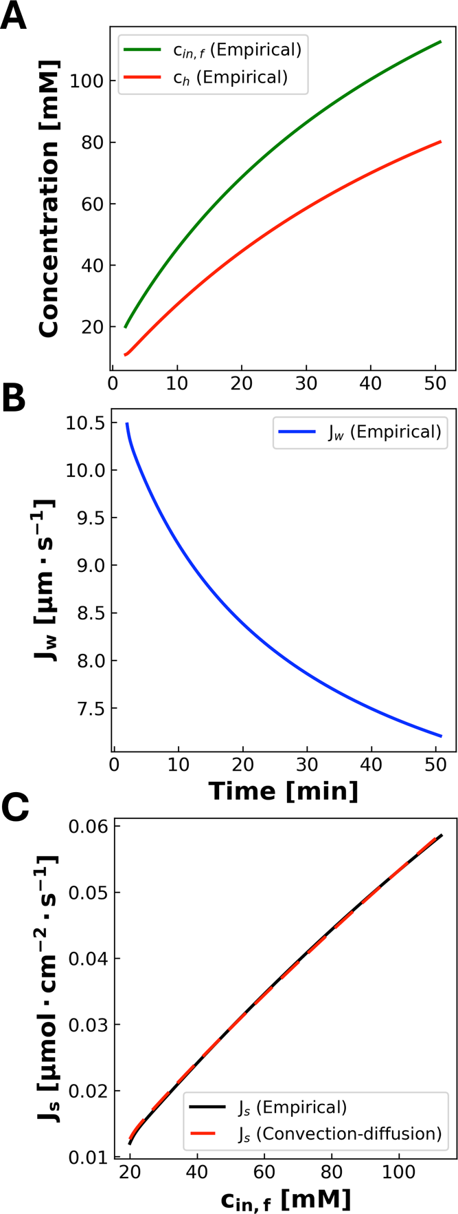
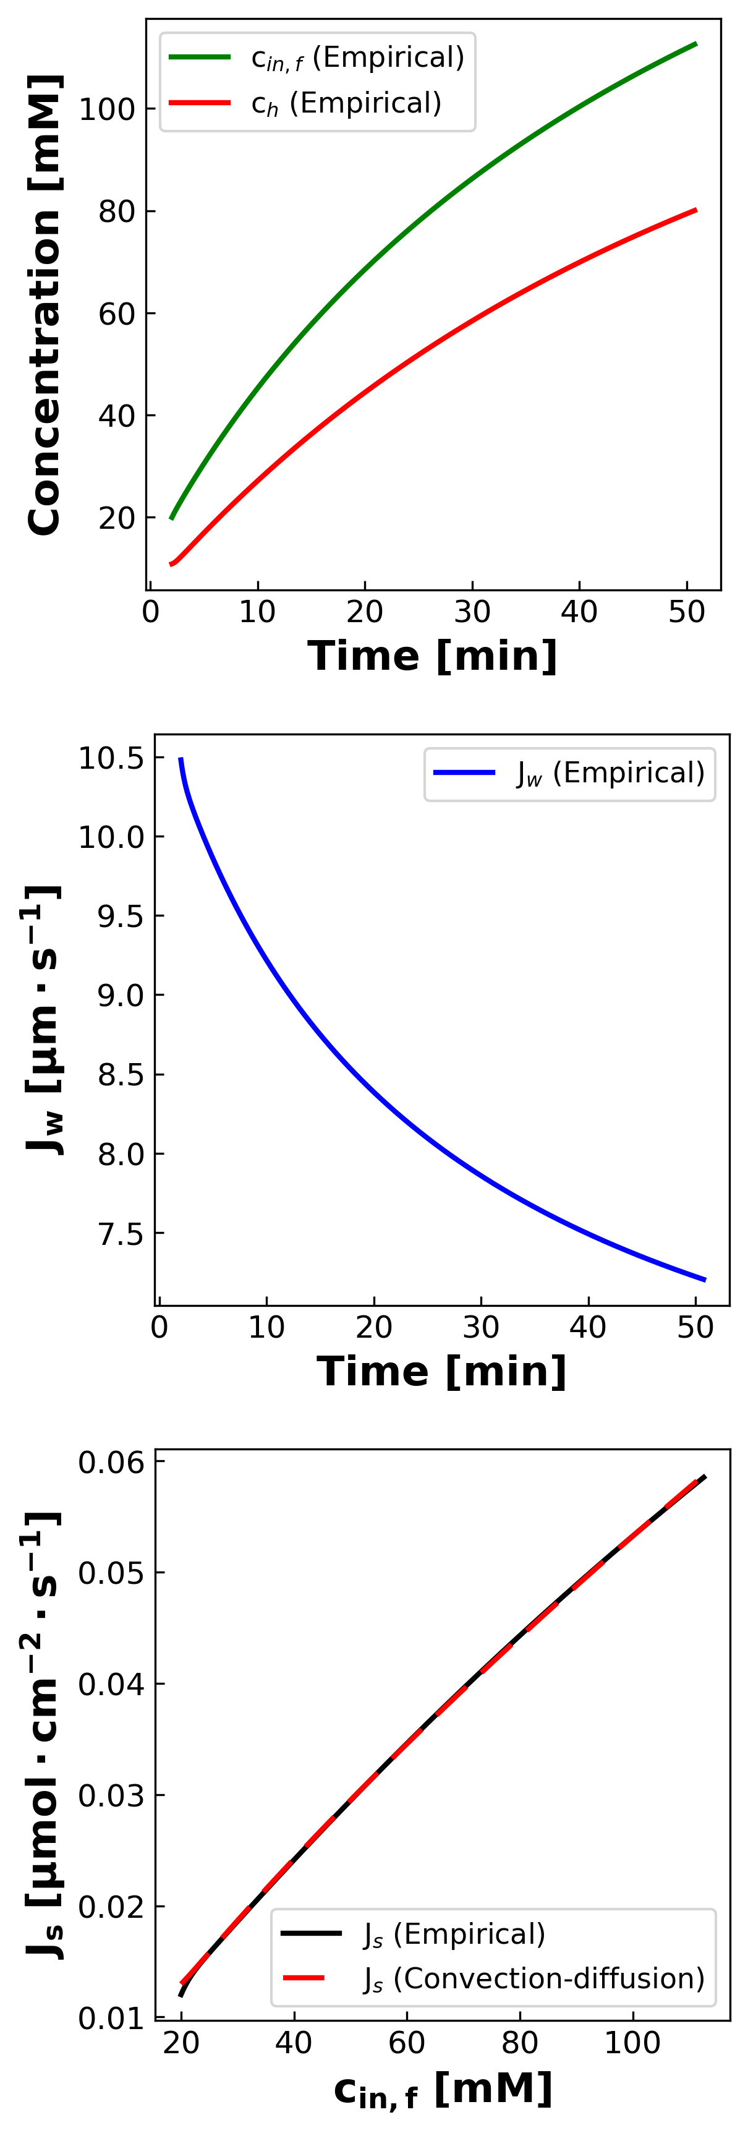
DATA2 Figure 8
Published
Unified Regenerated
Unified workflow reproduces the three published panels using the current DATA2 artifact path.

Slide 3
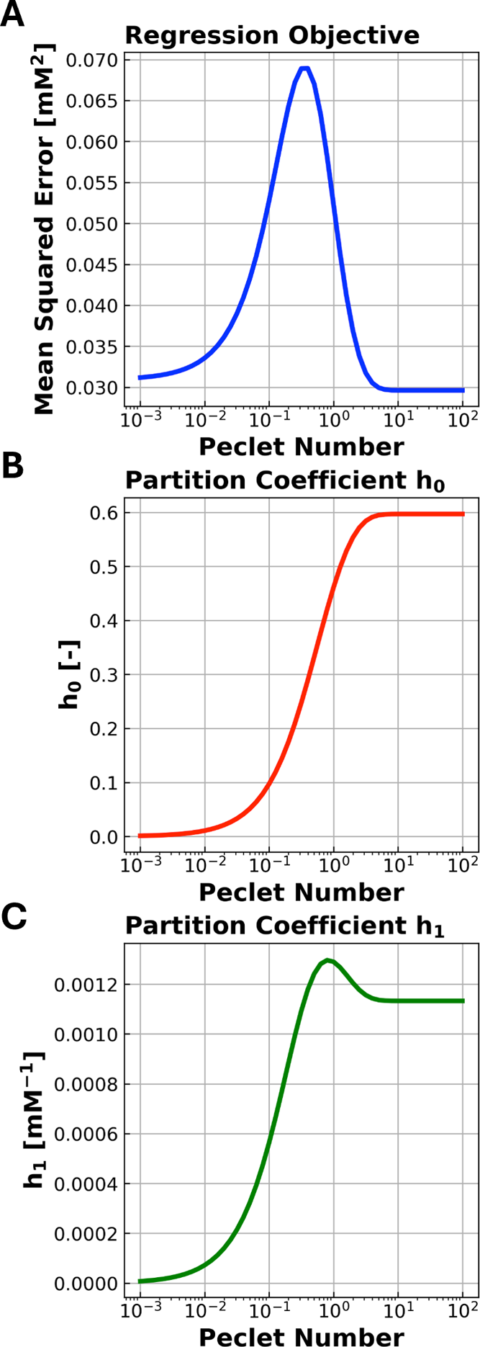
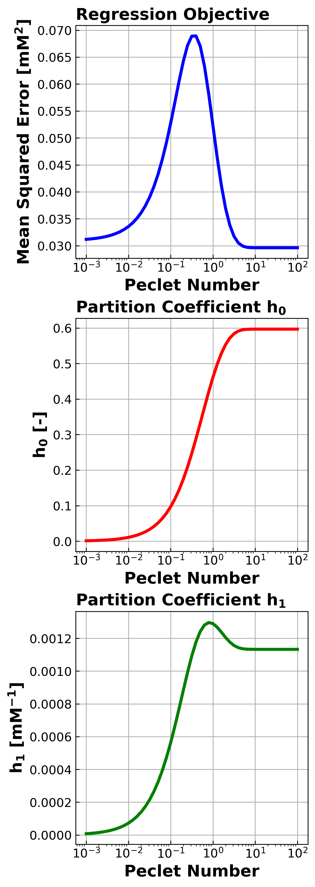
DATA2 Figure 9
Published
Unified Regenerated
Unified workflow reproduces the partition-sensitivity contour figure.

Slide 4
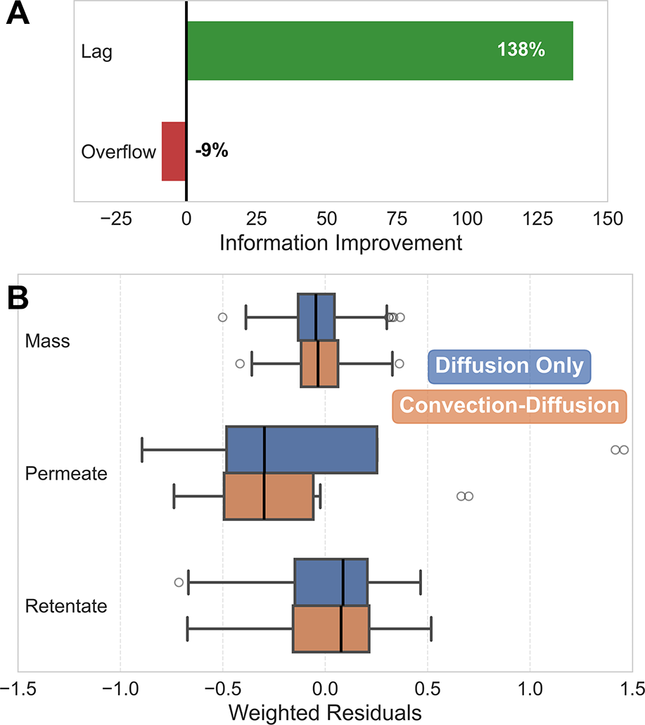
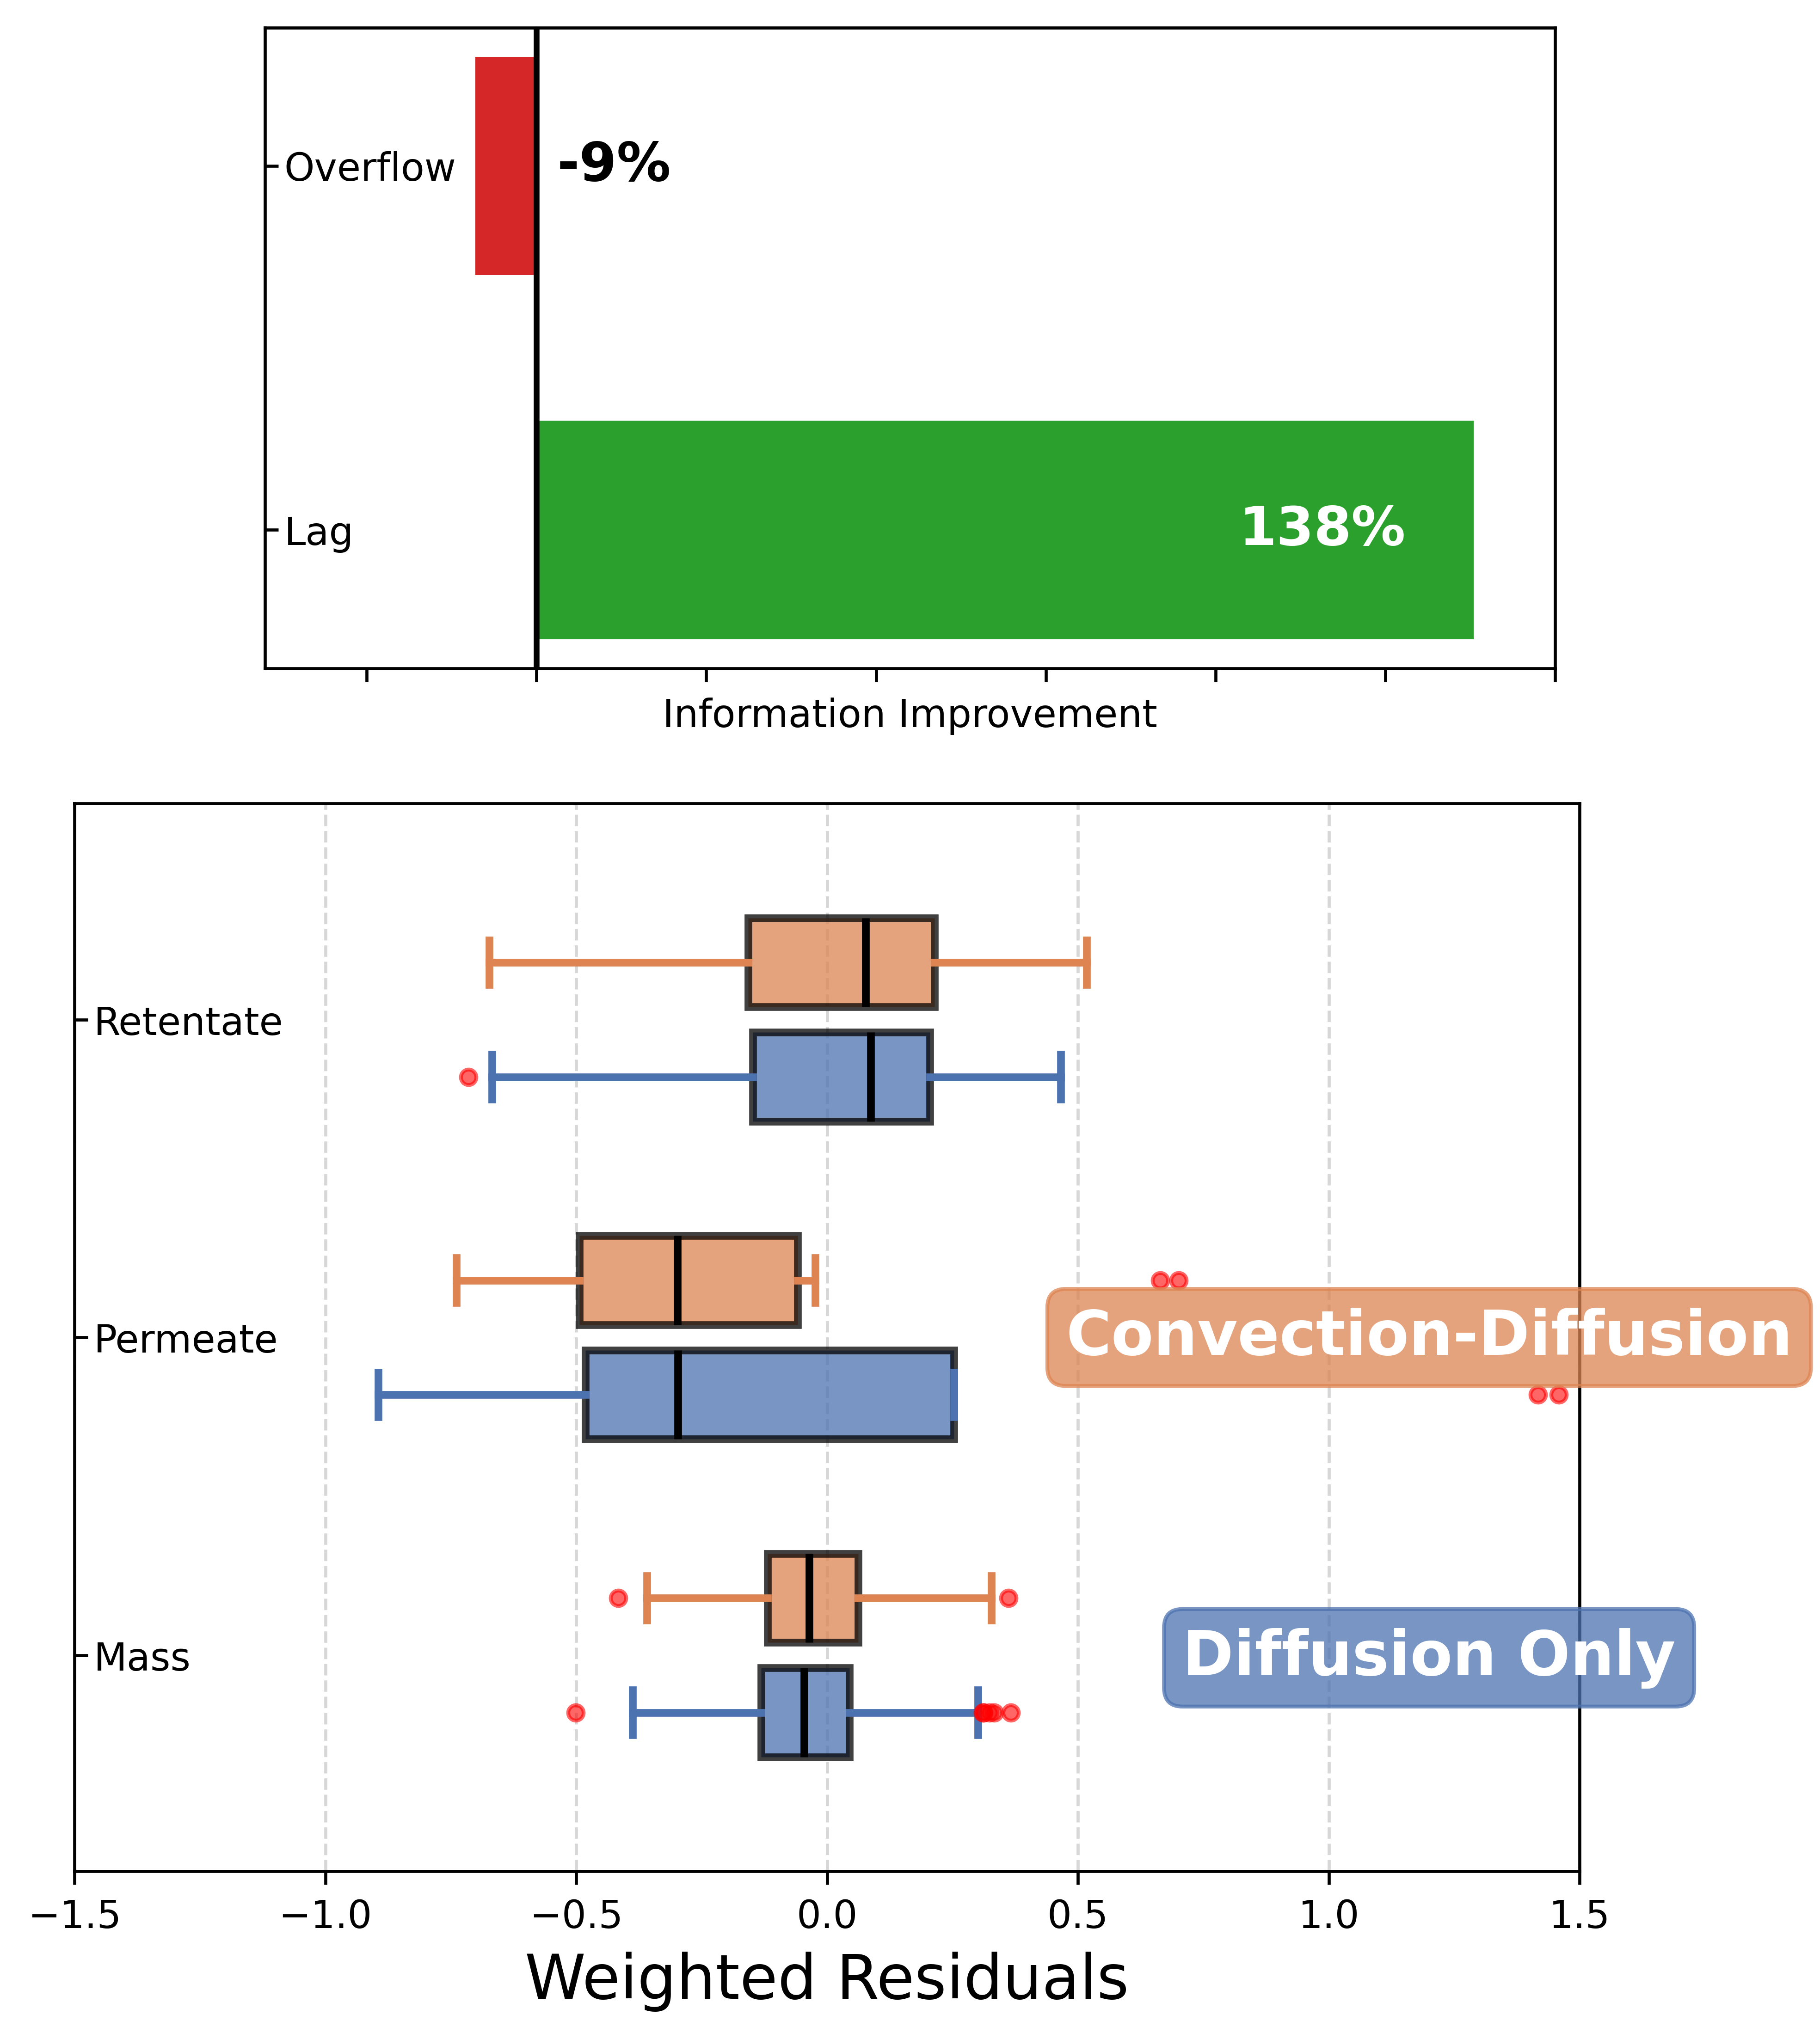
DATA2 Figure 10
Published
Unified Regenerated
Unified workflow reproduces the startup-improvement panel and residuals boxplot.

Slide 5
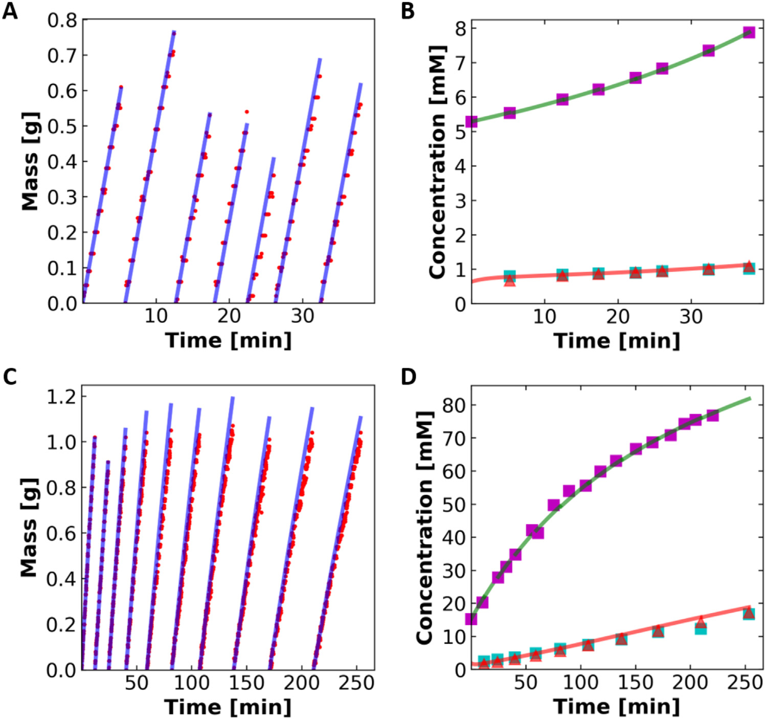
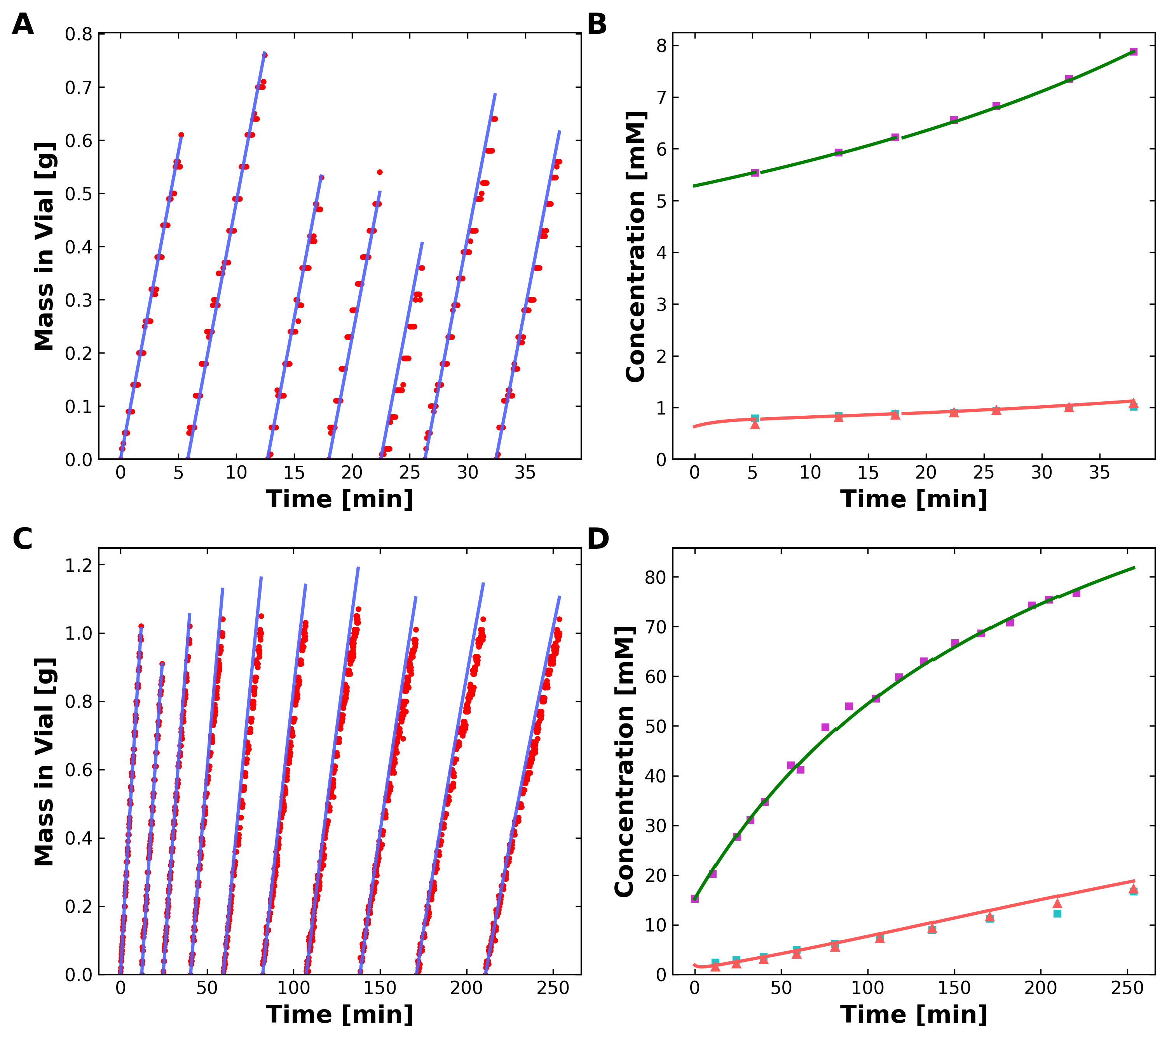
DATA1 Figure 2
Published
Unified Regenerated
Unified workflow reproduces the four-panel mass and concentration comparison figure.

Slide 6
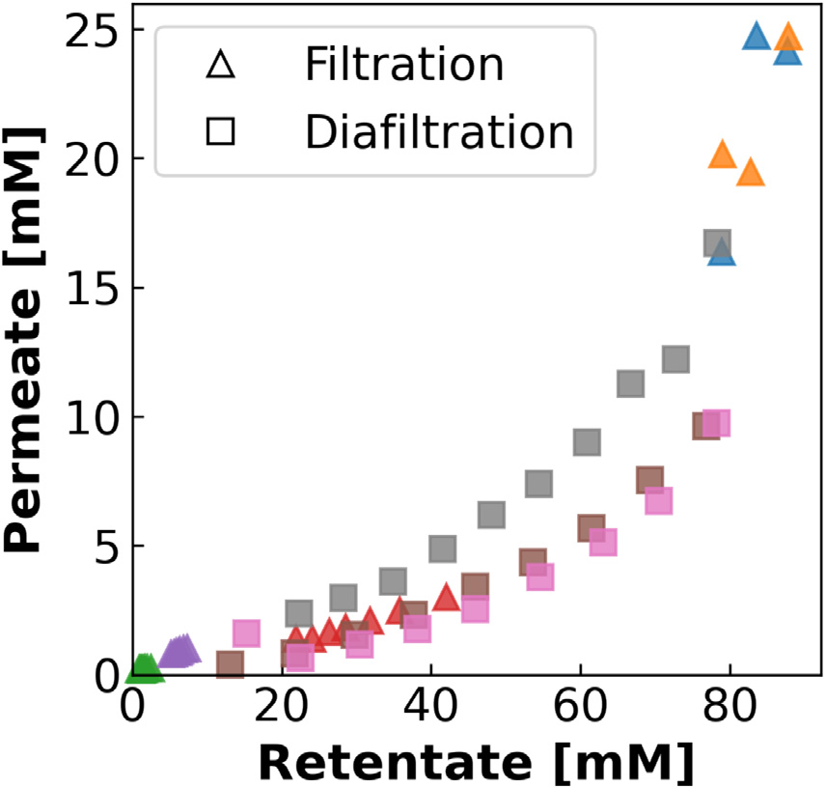
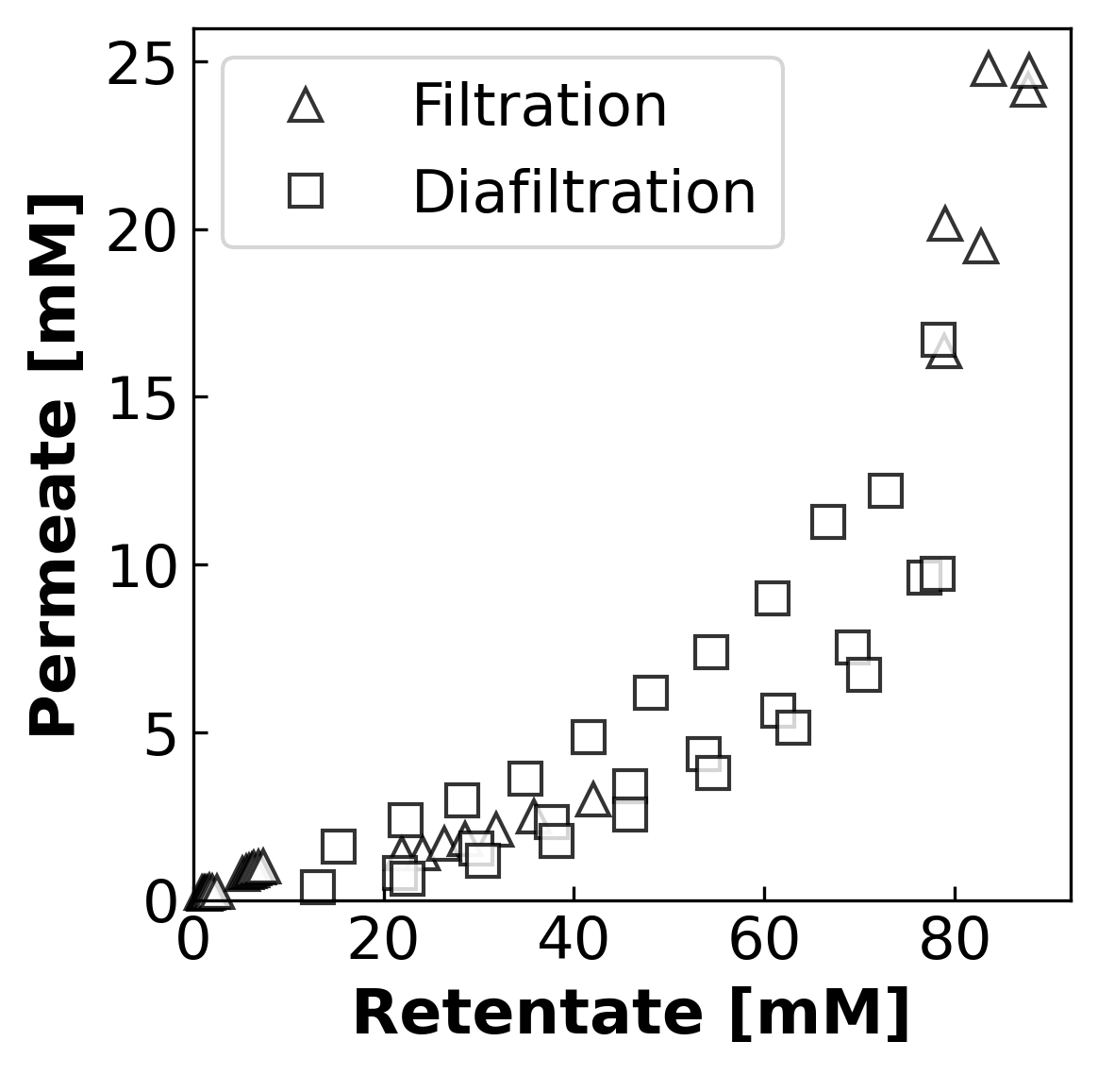
DATA1 Figure 3
Published
Unified Regenerated
Unified workflow reproduces the experiment-space concentration-range figure.

Slide 7
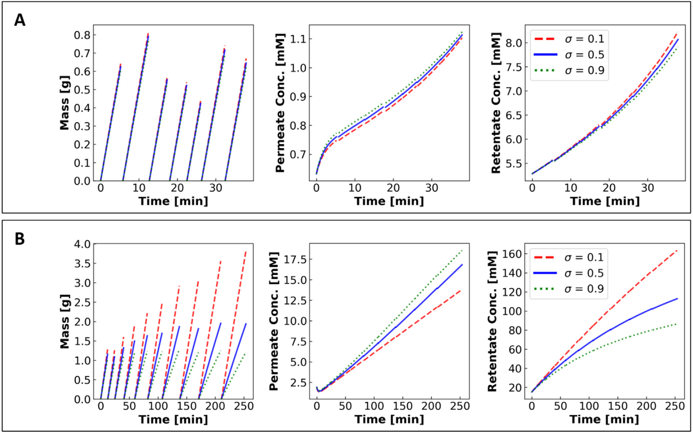
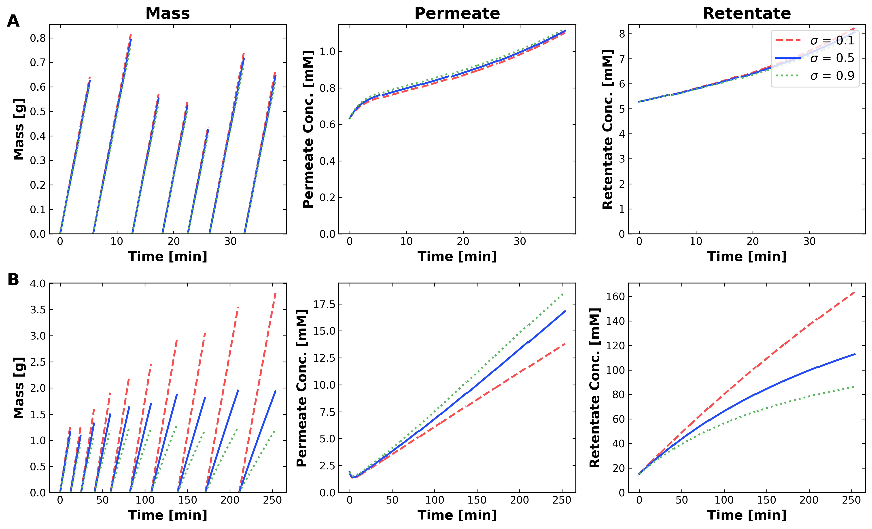
DATA1 Figure 4
Published
Unified Regenerated
Unified workflow reproduces the sigma-sensitivity figure across mass, permeate, and retentate panels.

Slide 8
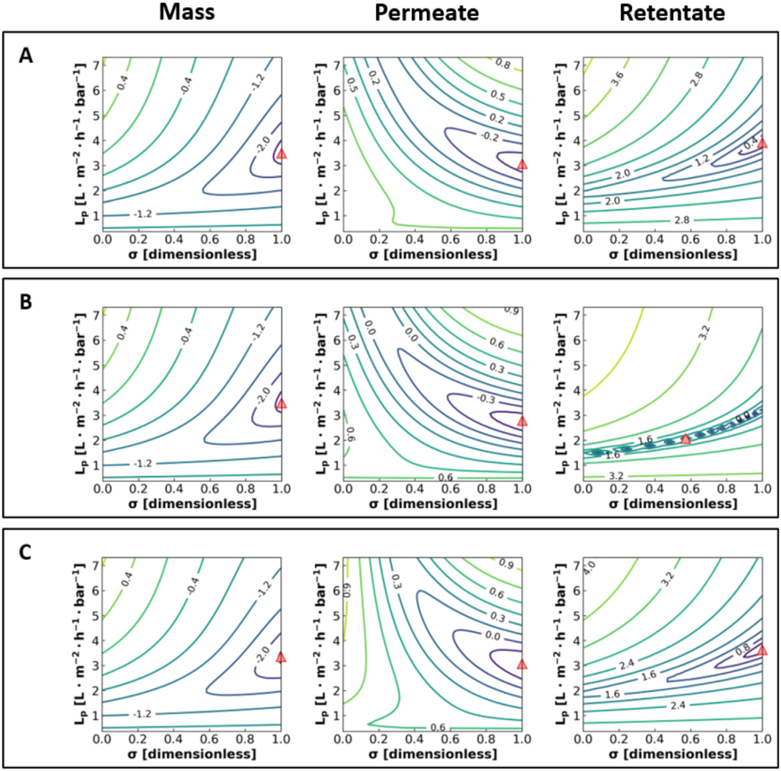
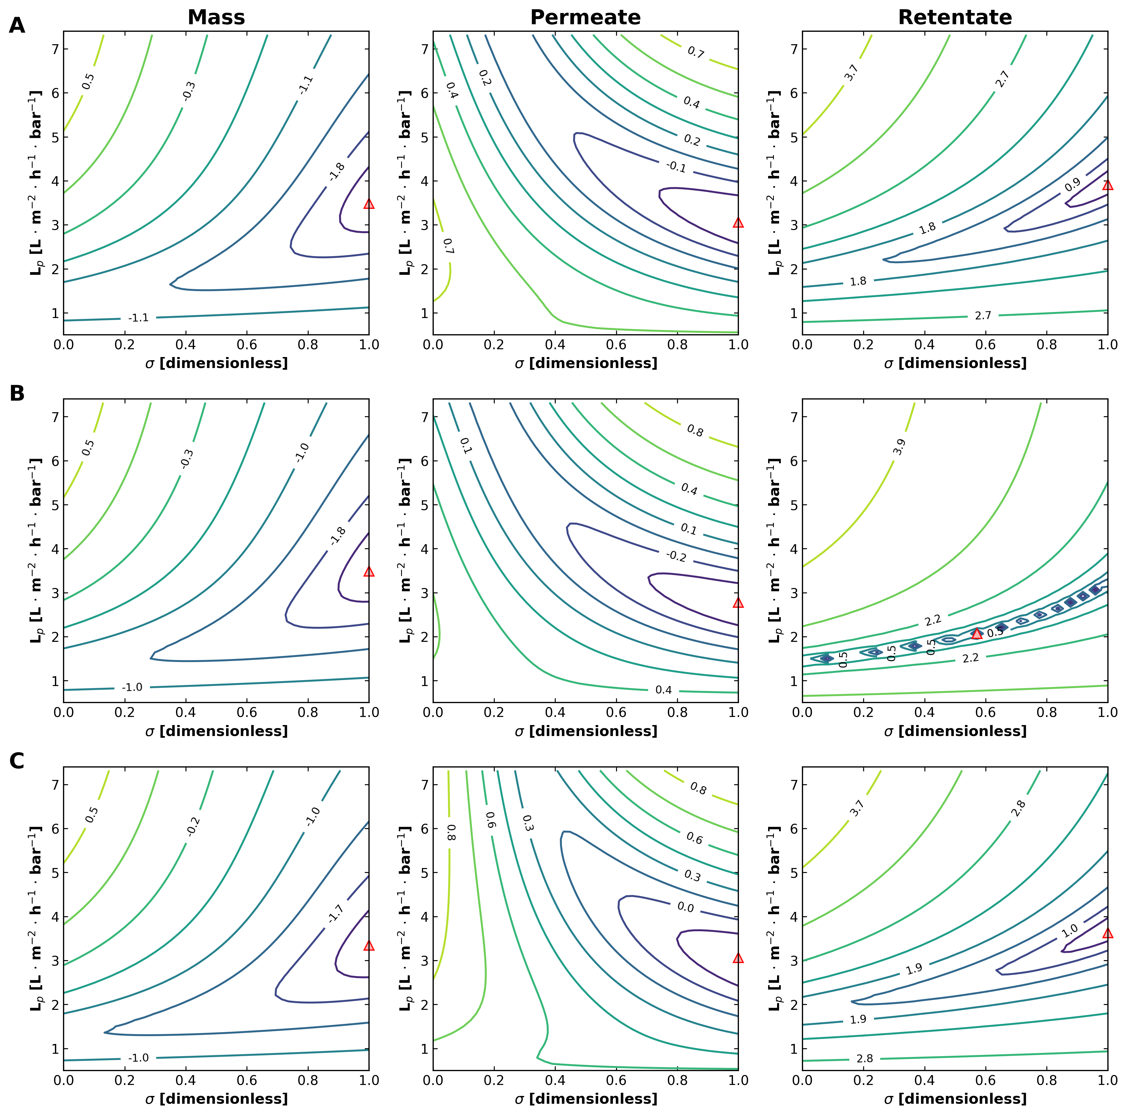
DATA1 Figure 5
Published
Unified Regenerated
Unified workflow reproduces the fixed-sigma contour maps over sigma and Lp-style sweeps.

Slide 9
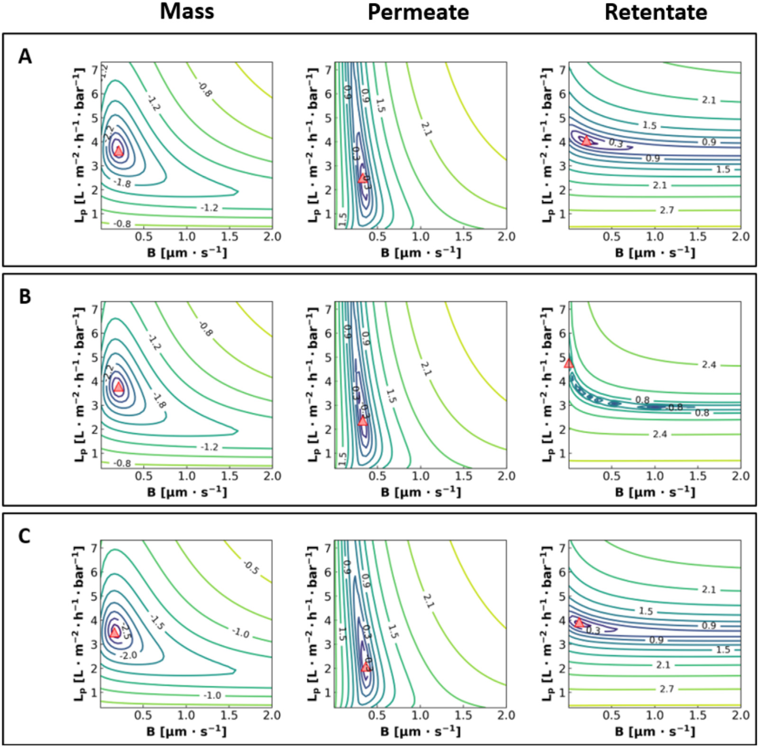
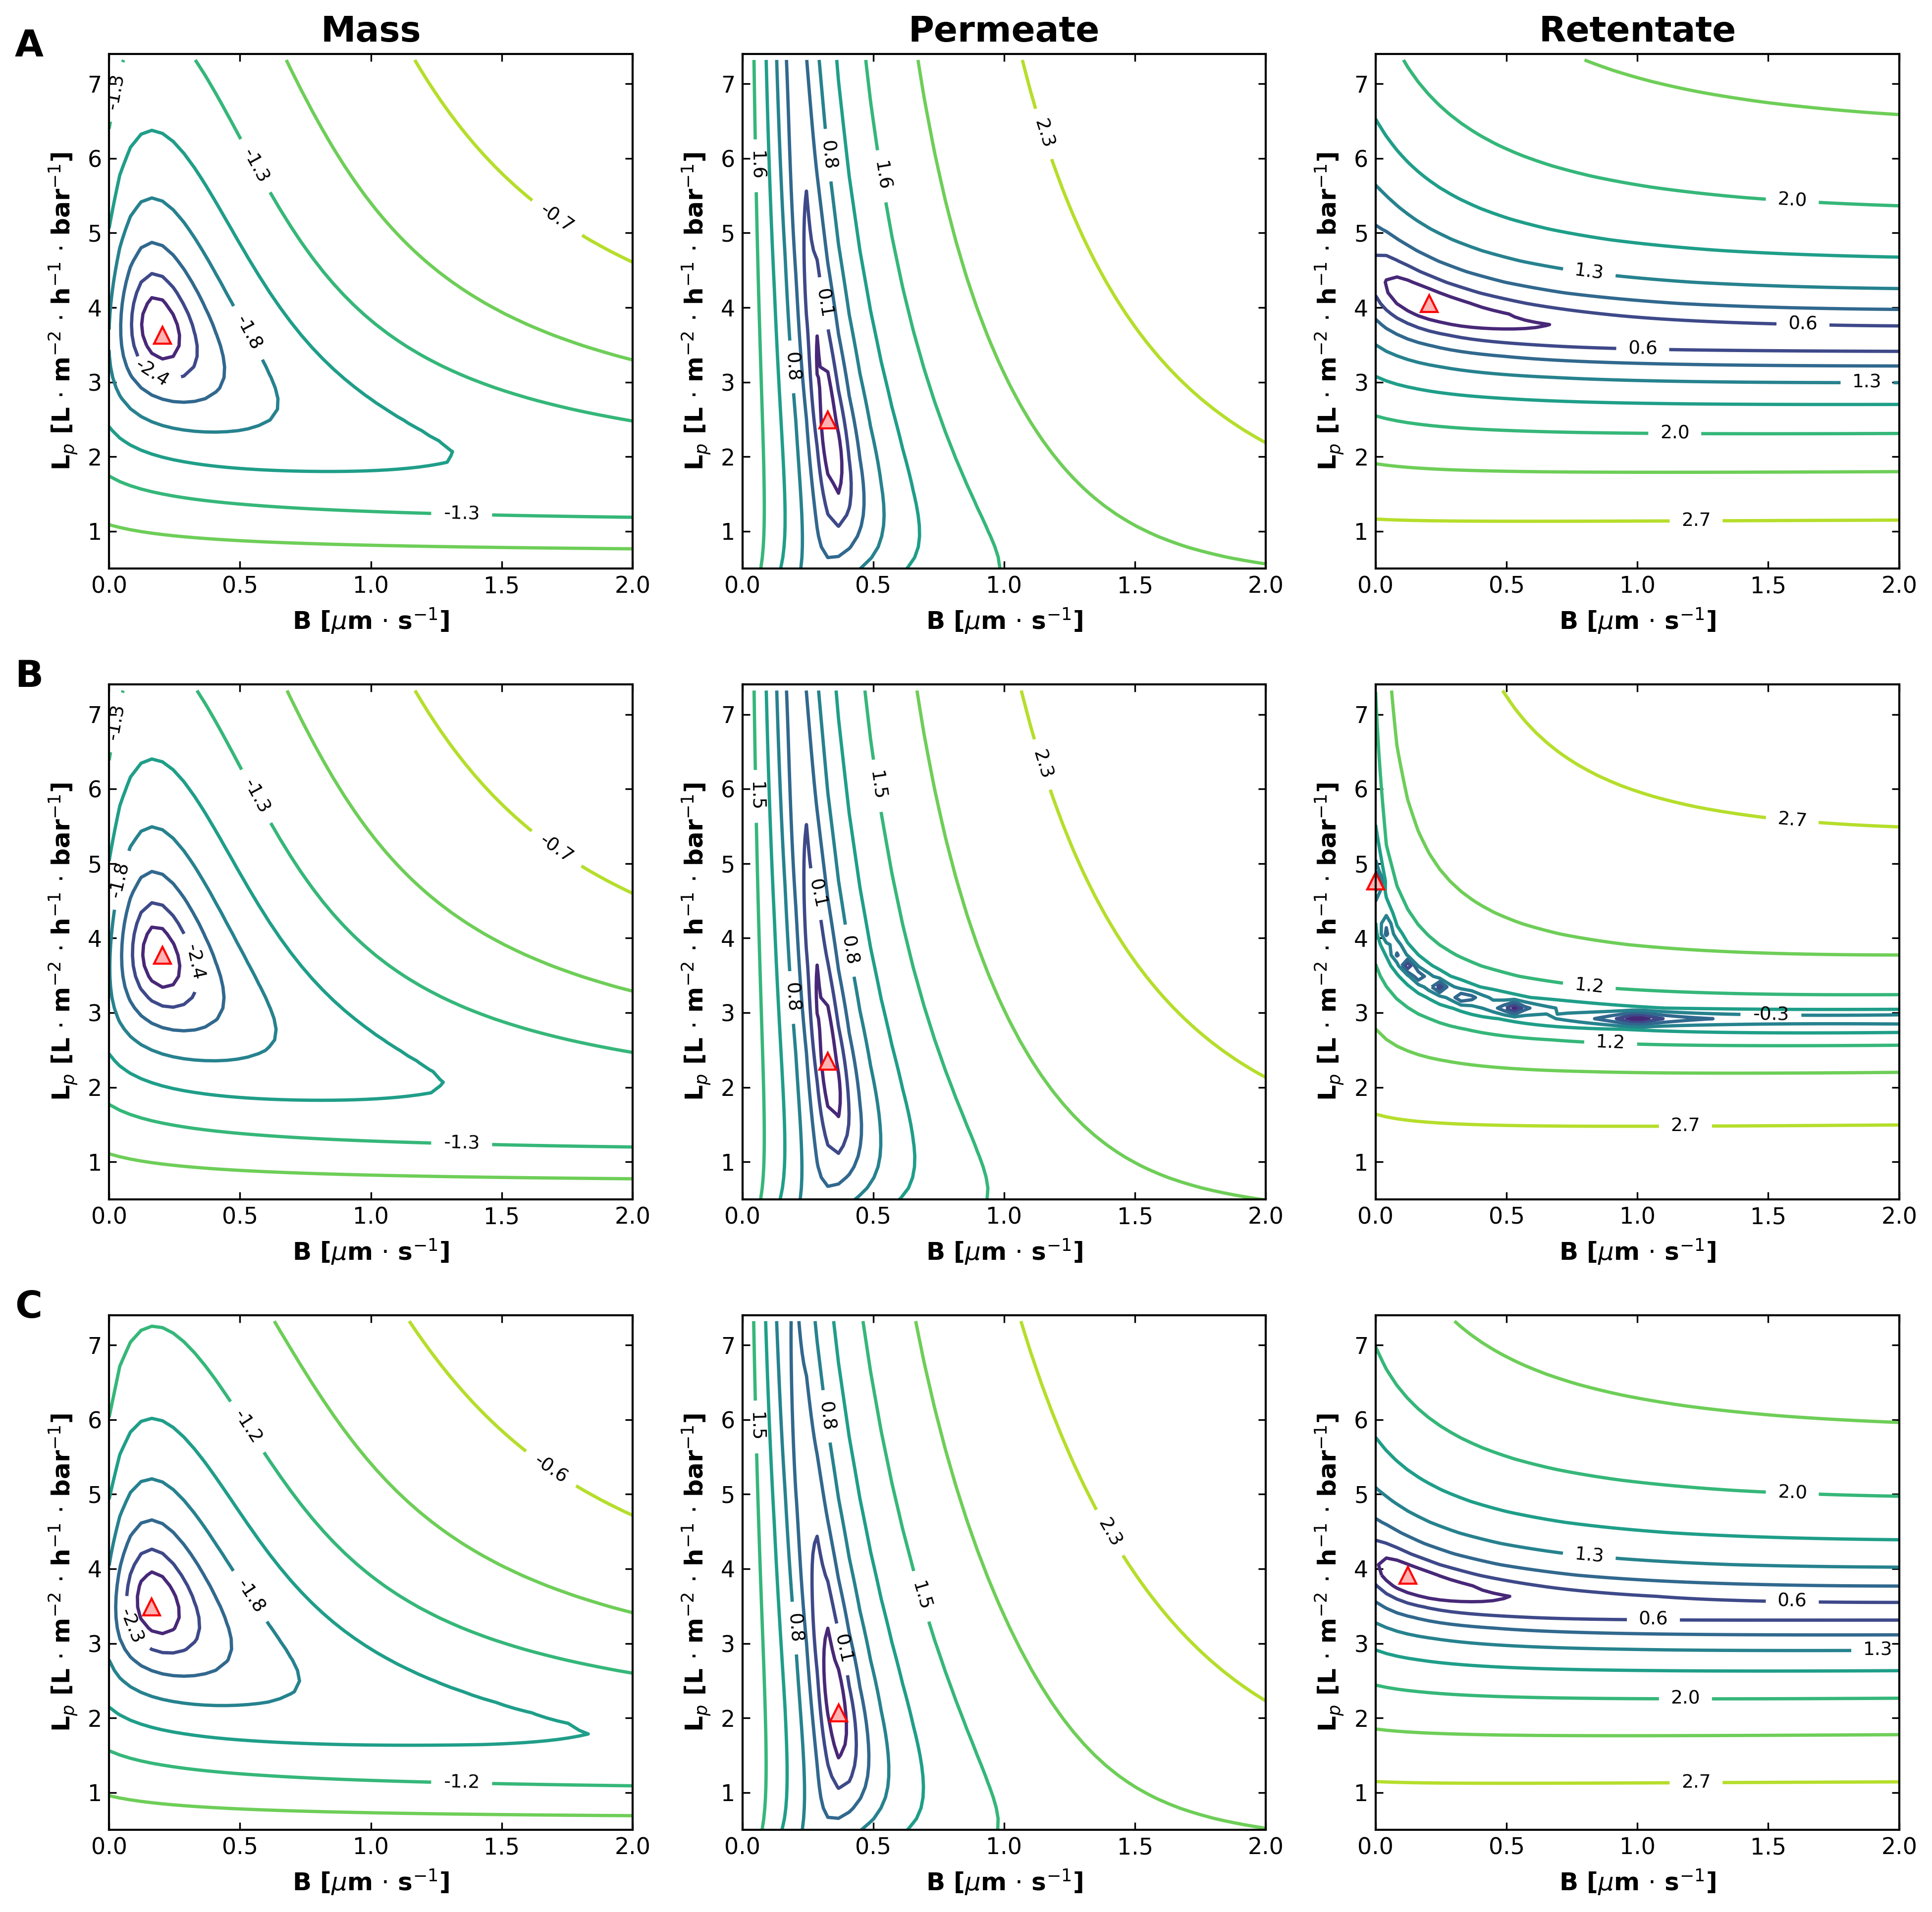
DATA1 Figure 6
Published
Unified Regenerated
Unified workflow reproduces the fixed-B contour maps over B and Lp sweeps.

