Slide 1

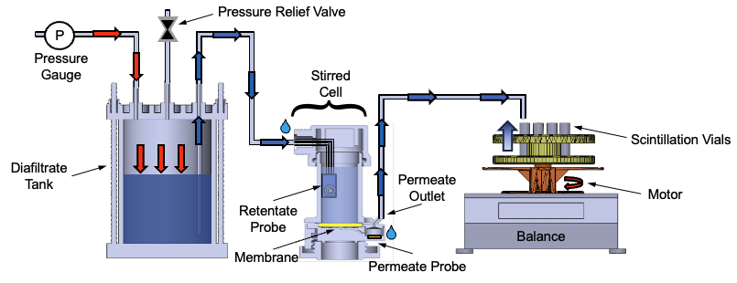
DATA-3: Single Salt Analysis
Digital Model (Current Setup)
Keshav Kasturi Rangan
Group Meeting
May 20, 2026

Slide 2
01 · CODE STRUCTURE
01
How the workflow is organized — roots, trunk, branches
ROOTS — loaders
TRUNK — process
BRANCHES — outputs
loadmat(path)
model_construct_inter
plot_sim_comparison
DATA1 / DATA2 (.mat experiment files)
Pyomo IDAES model
mass + conc + (stirred-cell)
loadxlsx(path, sheet=…)
solve_model(...)
render_*_parameters_table
DATA3 / NF270 (.xlsx campaign files)
ParmEst + multistart
per-campaign param tables
Both return the same data_stru dict shape: data_config + data_raw[vial].
solve_mass_balance_only
plot_contour
σ=0 closed-form (litmus)
FIM heatmap / σ-sensitivity
calc_FIM(...)
render_nf270_fit_v2
data_config: n, n_v0, n_extra, n_h, n_A M_F0, M_O, C_F0, C_D delP, Temp, Am, rho Lp0, B0, sigma0, theta0 data_raw[i]: time, mass, cF_exp, cV_avg
Fisher-information uncertainty
NF270 saw-tooth + ICP overlay
compute_doe_metrics
report_paper_coverage
Pyomo.DoE D/A/E-optimality
checklist vs published figs
design_next_experiment
run_data3_time_series_plots
Model discrimination output
DATA3 custom-file figures
All public API in refactored_ucb_library.py. conductivity_paper.py is the only sibling, frozen.
NF270 fitting · diagnosis + fix + open questions for collaborators
1 / 10

Slide 3
02 · HOW TO RUN IT
02
The runfile asks four questions, then dispatches
1
ROOT — pick a data source
Choices:
Which campaign or file are you working from?
1 DATA1 2 DATA2 3 DATA3 / NF270 4 custom file
2
SUBSET — narrow within the root
Choices:
Within the chosen root, which sheets / files to run?
DATA3: all 26 | single-salt 11 | one sheet | fast 3
3
TRUNK — pick the workflow
Choices:
Simulate, fit, multistart, FIM, DoE, or mass-litmus.
0 manifest default 3 fit+multistart 4 + FIM 5 + DoE 6 mass-litmus
4
BRANCHES — choose outputs
Choices:
Which plots / tables to produce.
m mass c conc p params f FIM heatmap d DoE all
→ DISPATCH: materialize_all(...) for DATA1 / DATA2 / DATA3, or run_pipeline(...) for custom files.
NF270 fitting · diagnosis + fix + open questions for collaborators
2 / 10

Slide 4
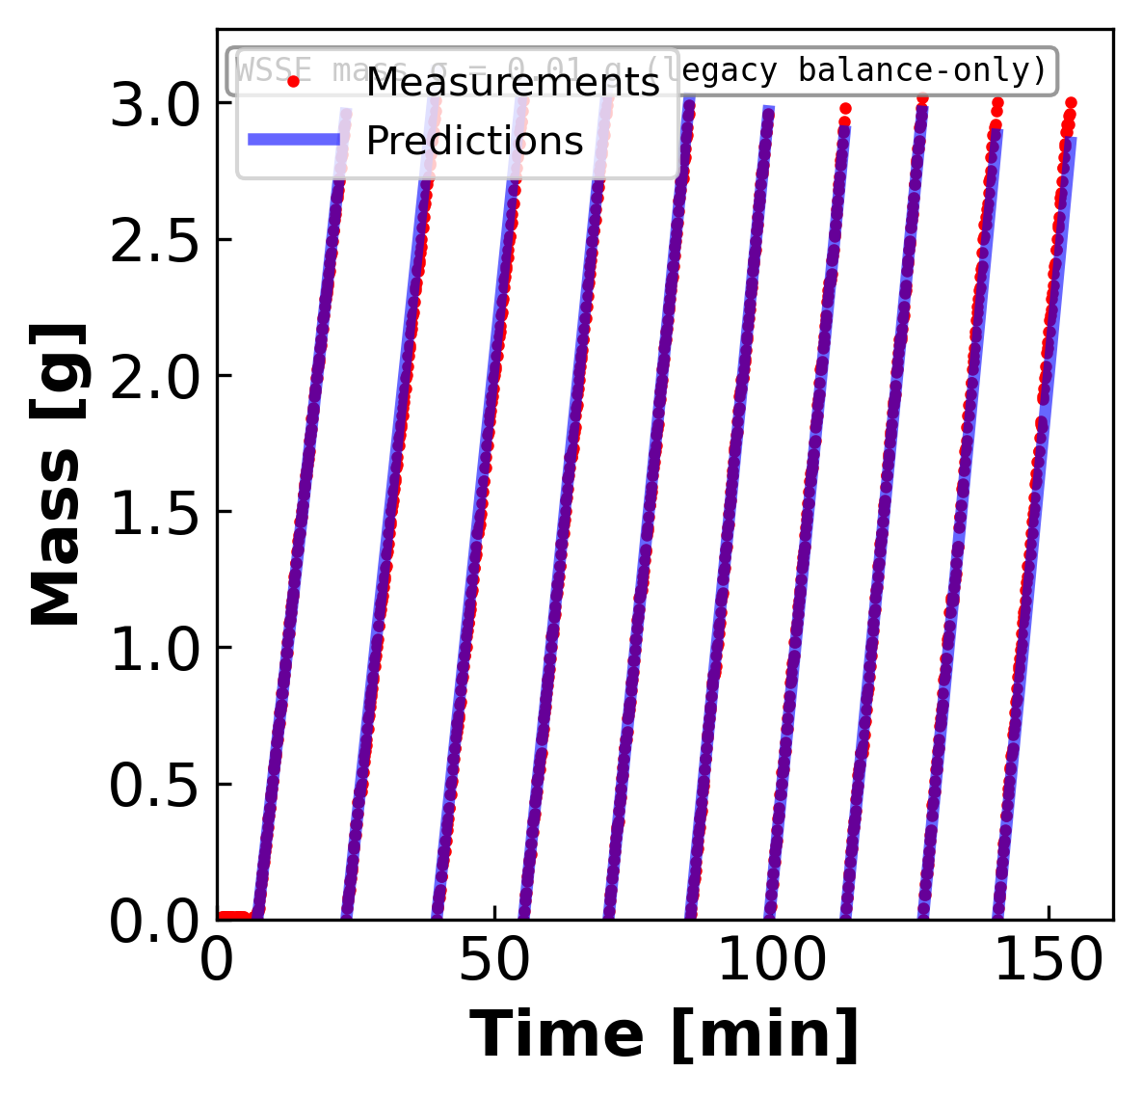
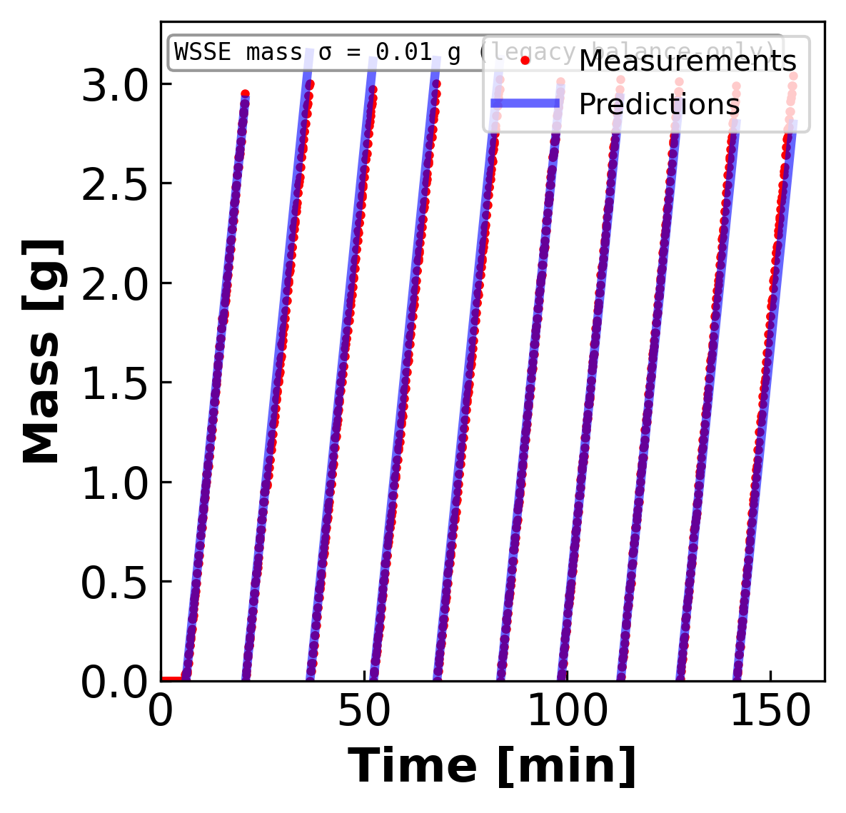
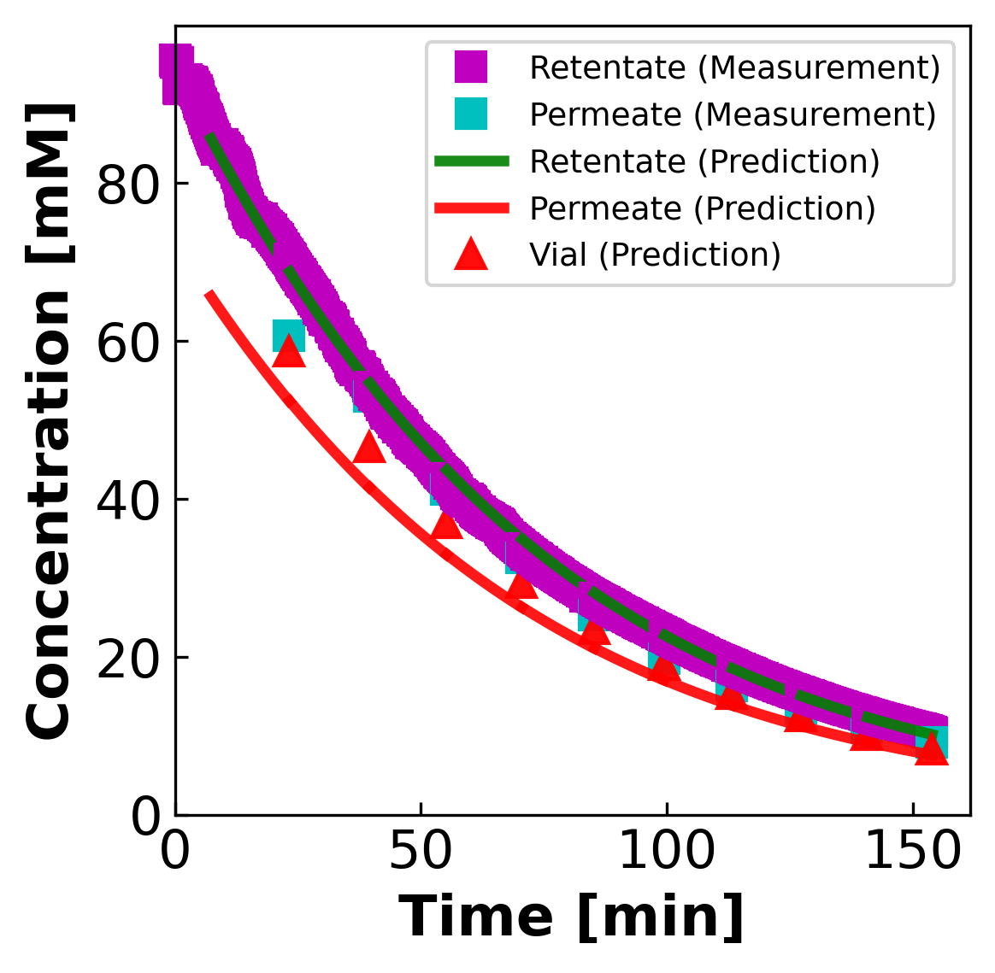
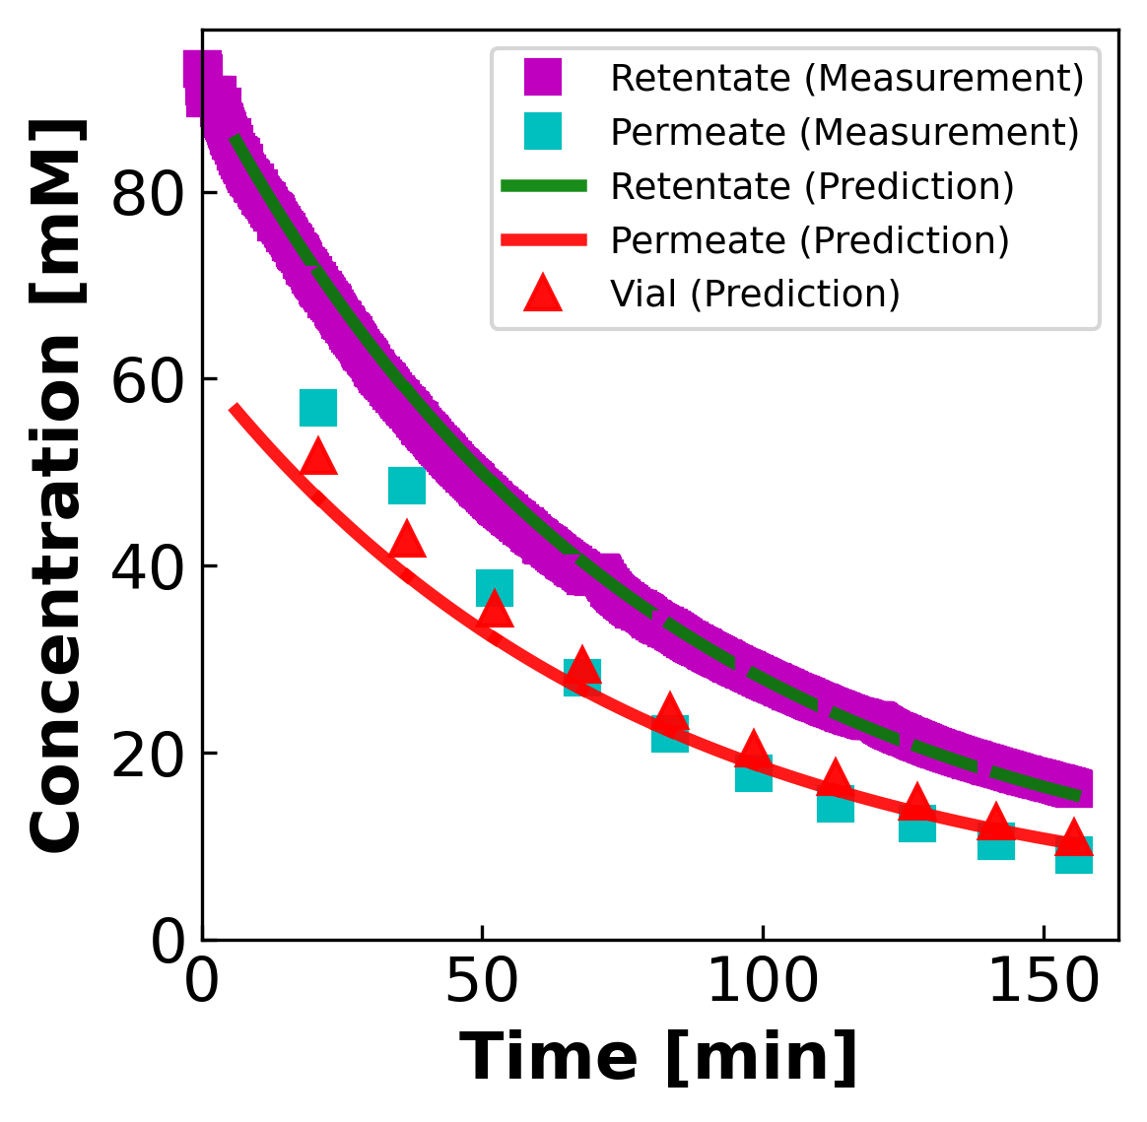
03A · CURRENT FIT RESULTS
03a
Current fit results · NaCl, diluting regime · 2 sheets
NaCl dilution: model tracks data well (when σ stays in the interior)
MASS (g vs min)
CONCENTRATION (mM vs min)
MC3 SNaCl · 95 → 10 mM
MC5 S2NaCl · 93 → 16 mM
MC3 SNaCl is the only sheet in the whole campaign with interior σ (≈0.45). MC5 S2NaCl drifts to σ = 0 wall — same cF-over-weighting we'll diagnose later.

Slide 5
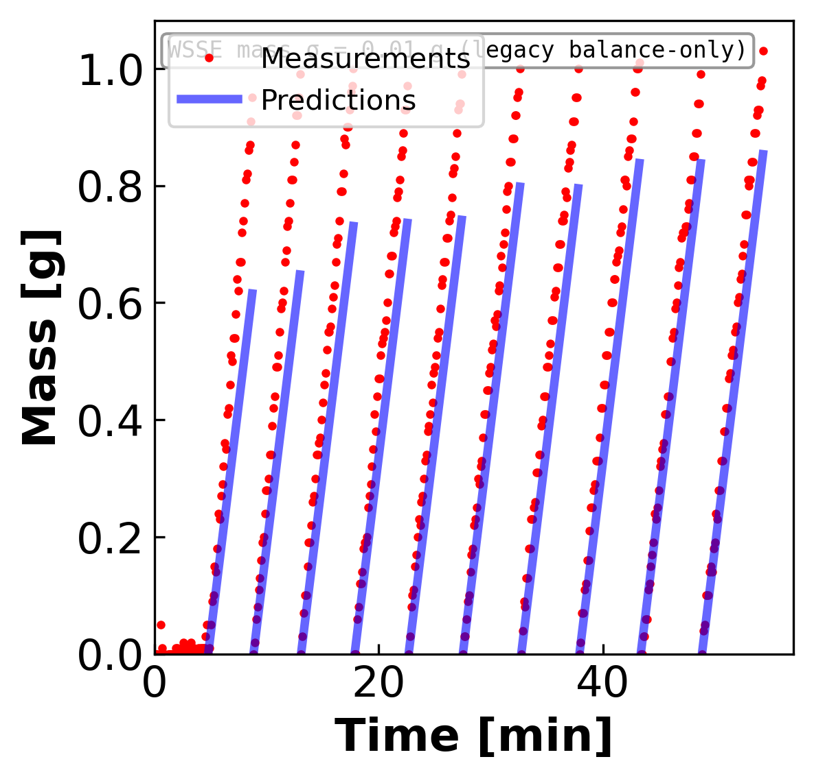
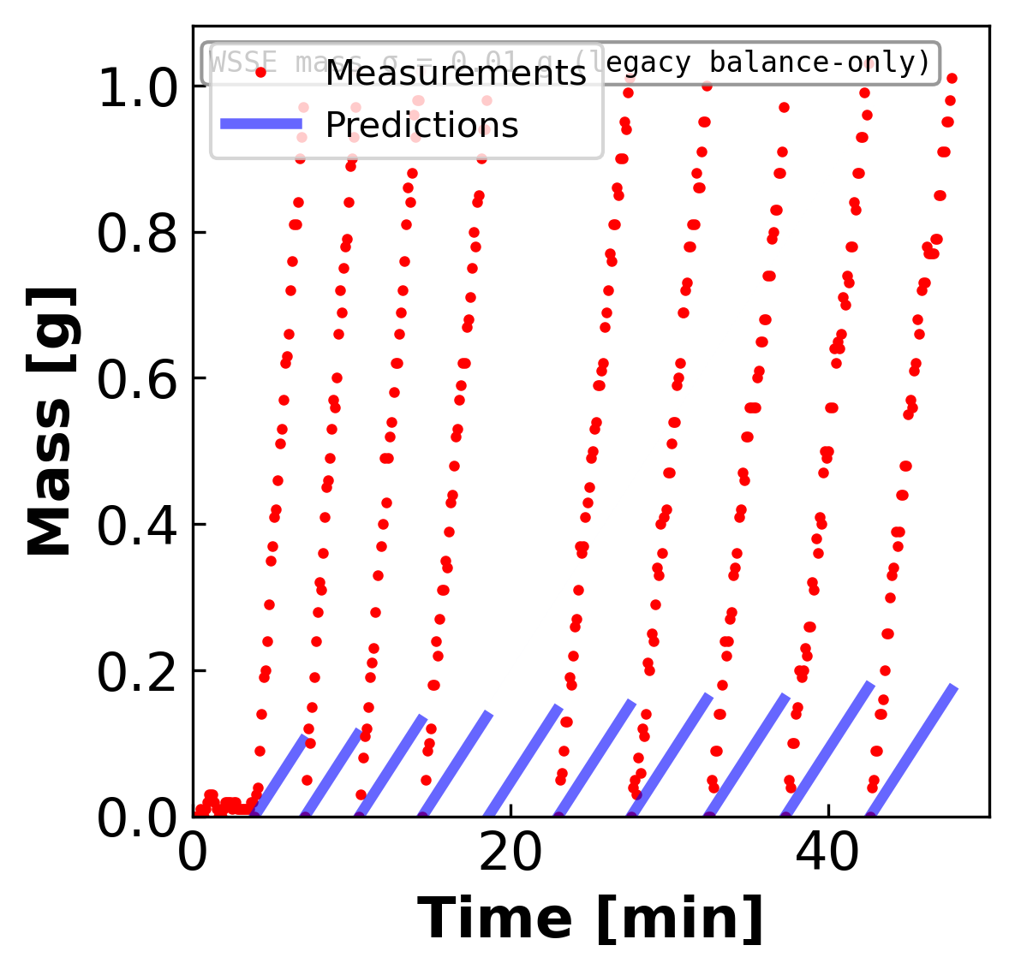
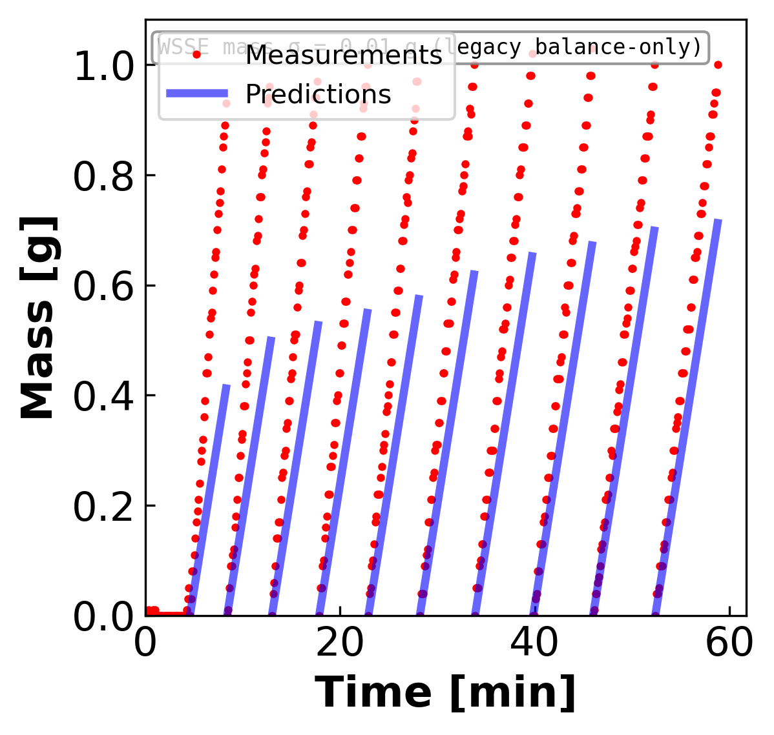
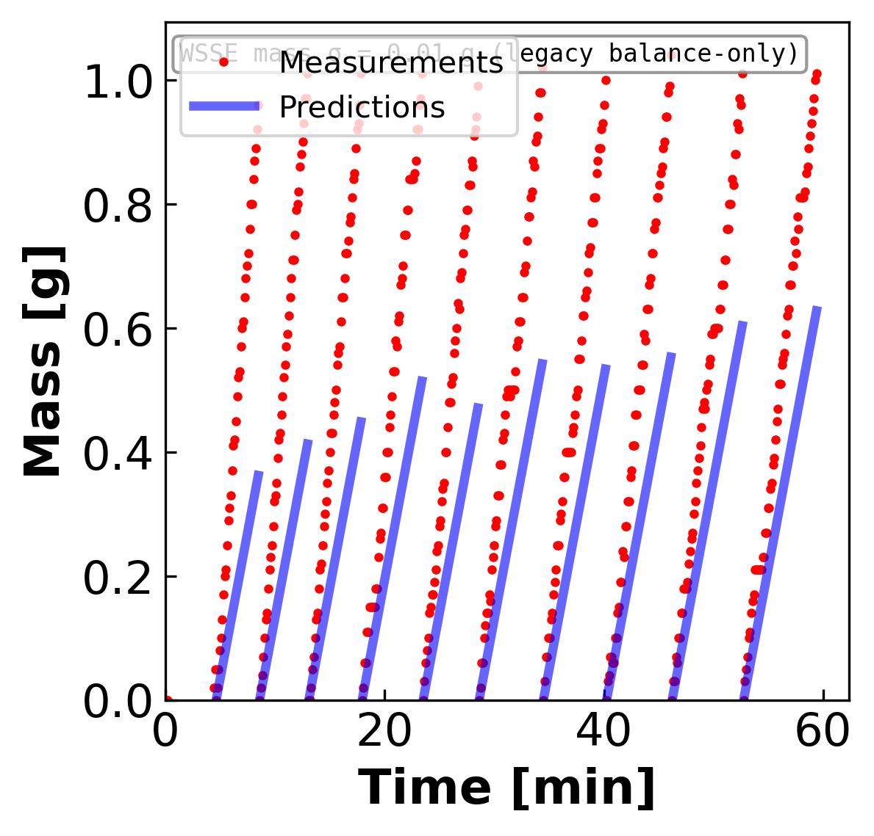
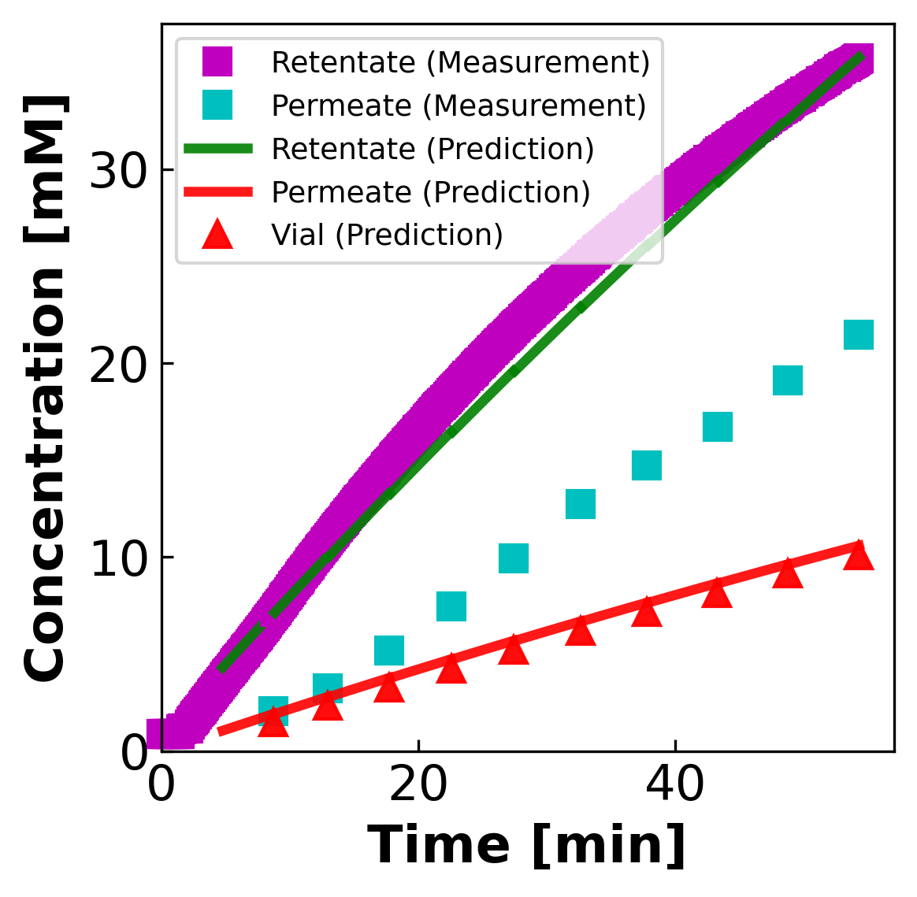
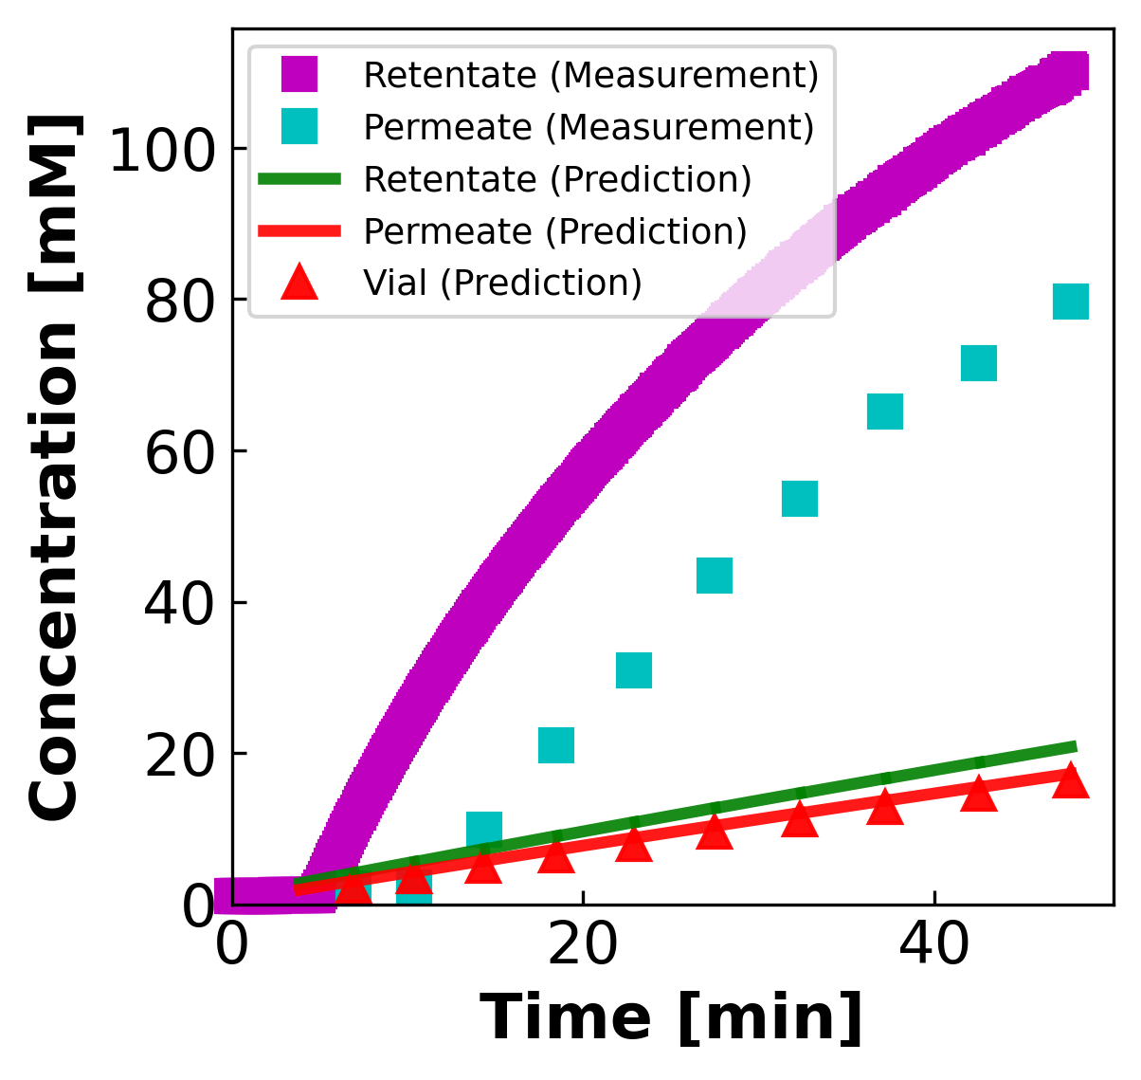
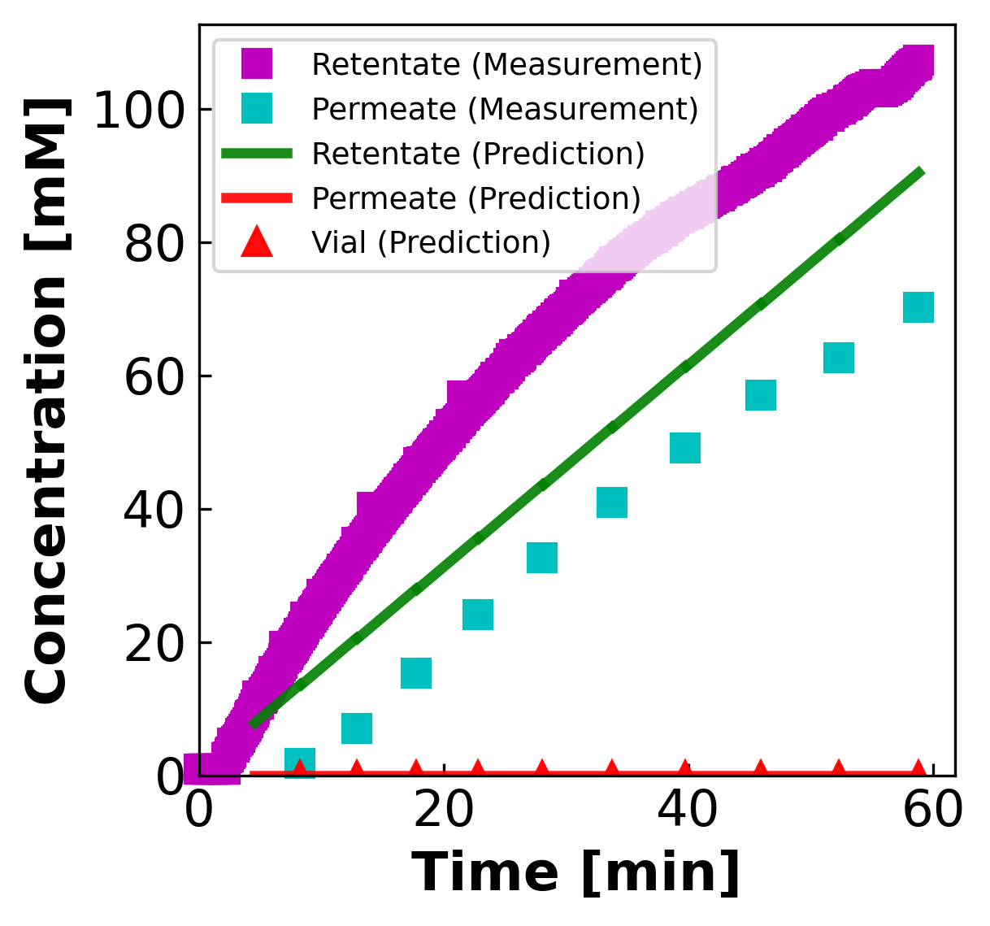
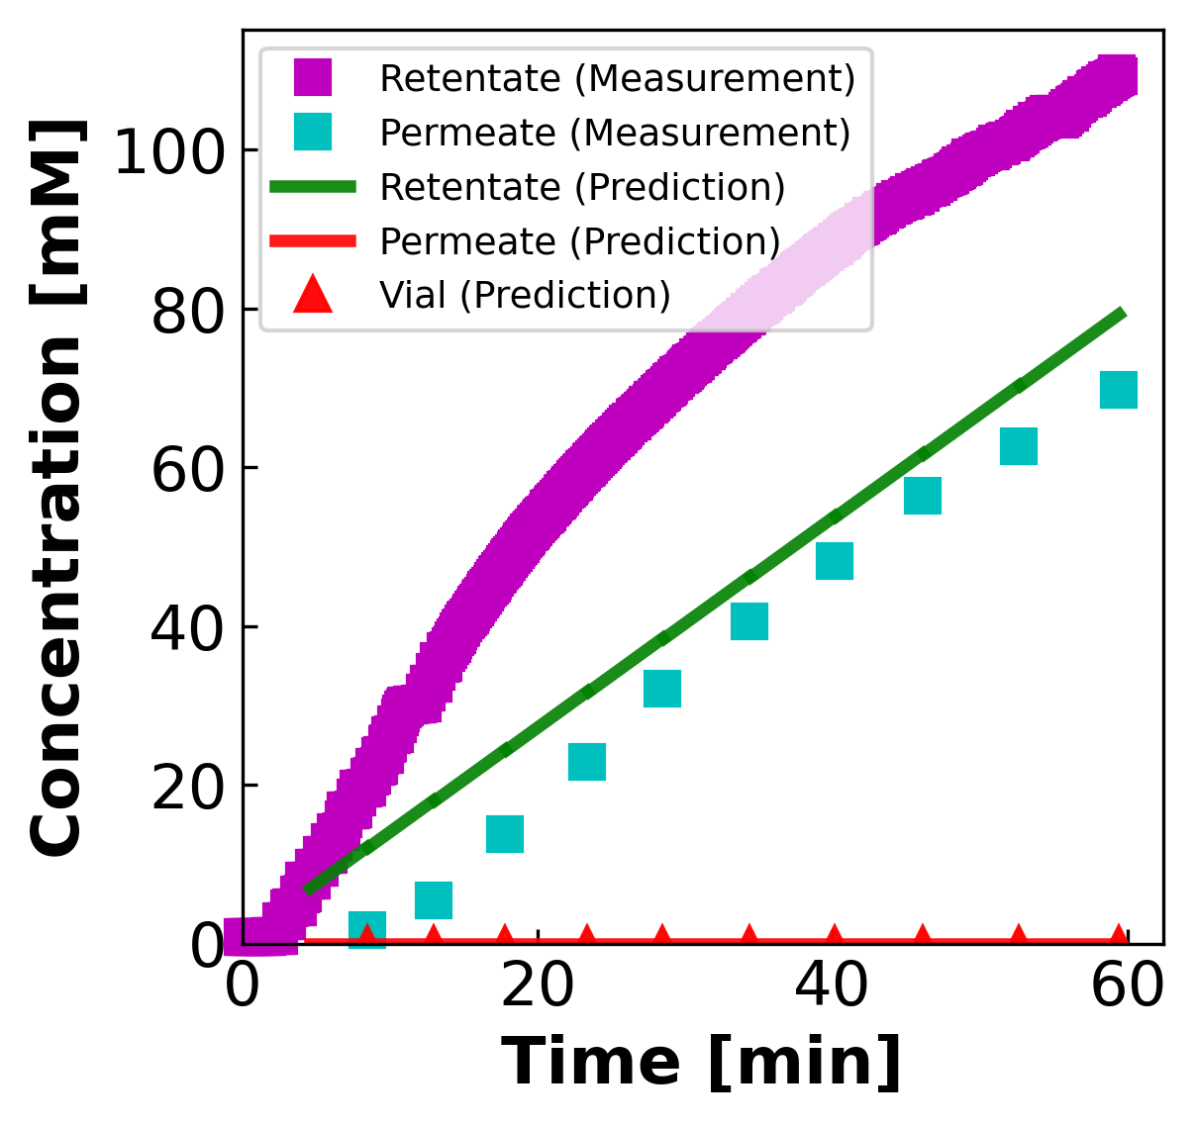
03B · CURRENT FIT RESULTS
03b
Current fit results · NaCl, concentrating regime · 4 sheets
NaCl concentration: characteristic mass shortfall on every sheet
MASS (g vs min)
CONCENTRATION (mM vs min)
MC2 NaCl
MC4 SNaCl
MC5 NaCl
MC5 SNaCl
Mass predictions plateau below the per-vial cap on every concentrating sheet. σ pins at the wall (1.0 or 0.0) on all four — same pathology, different direction.

Slide 6
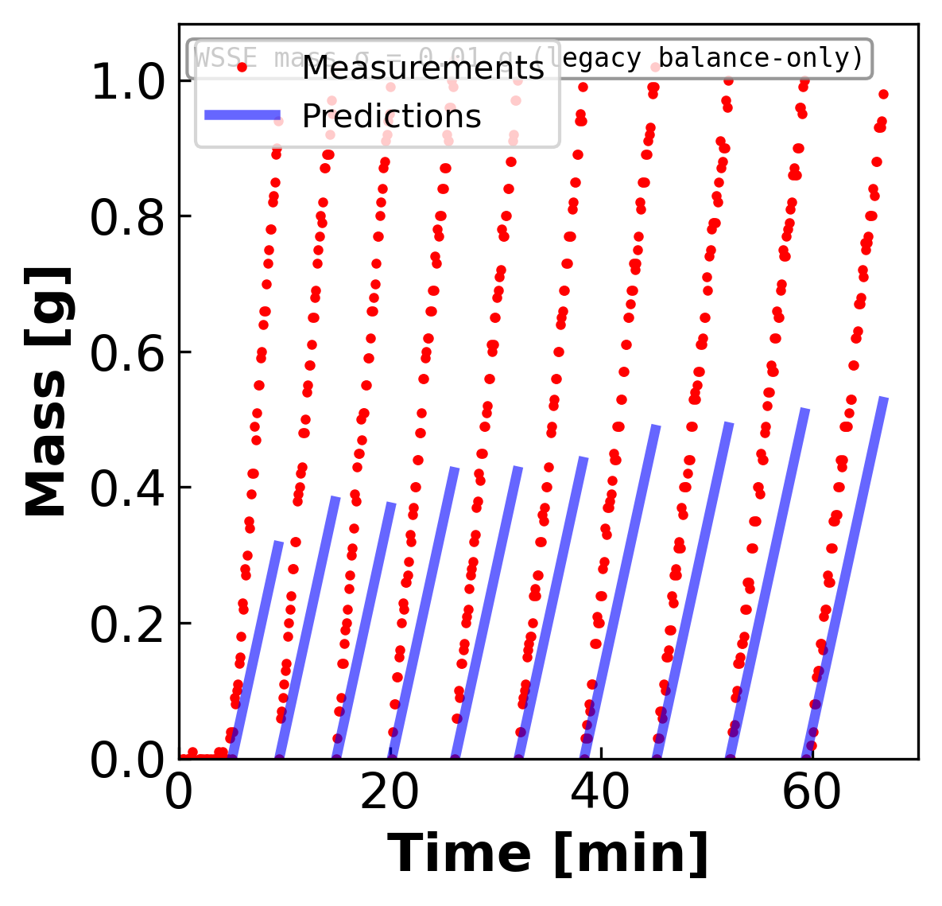
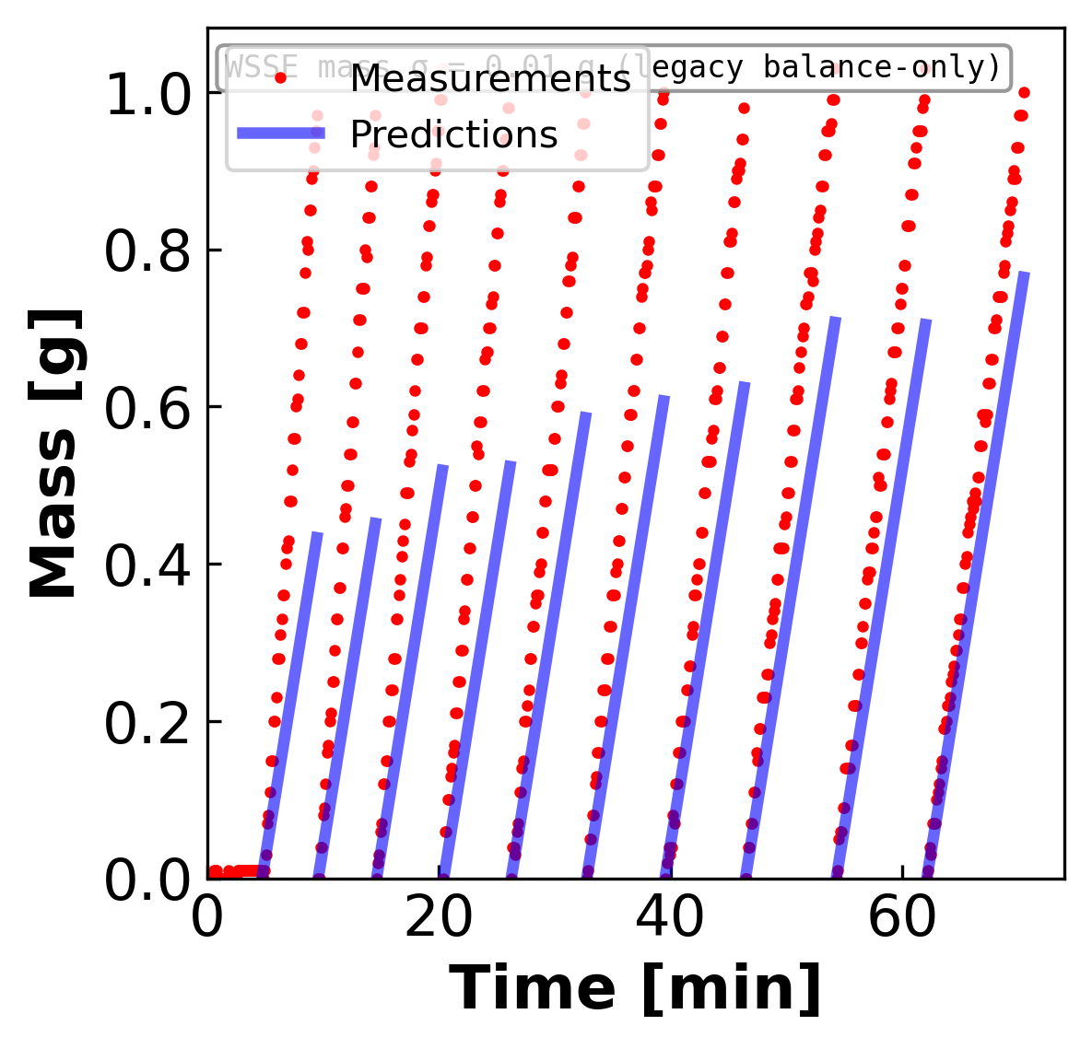
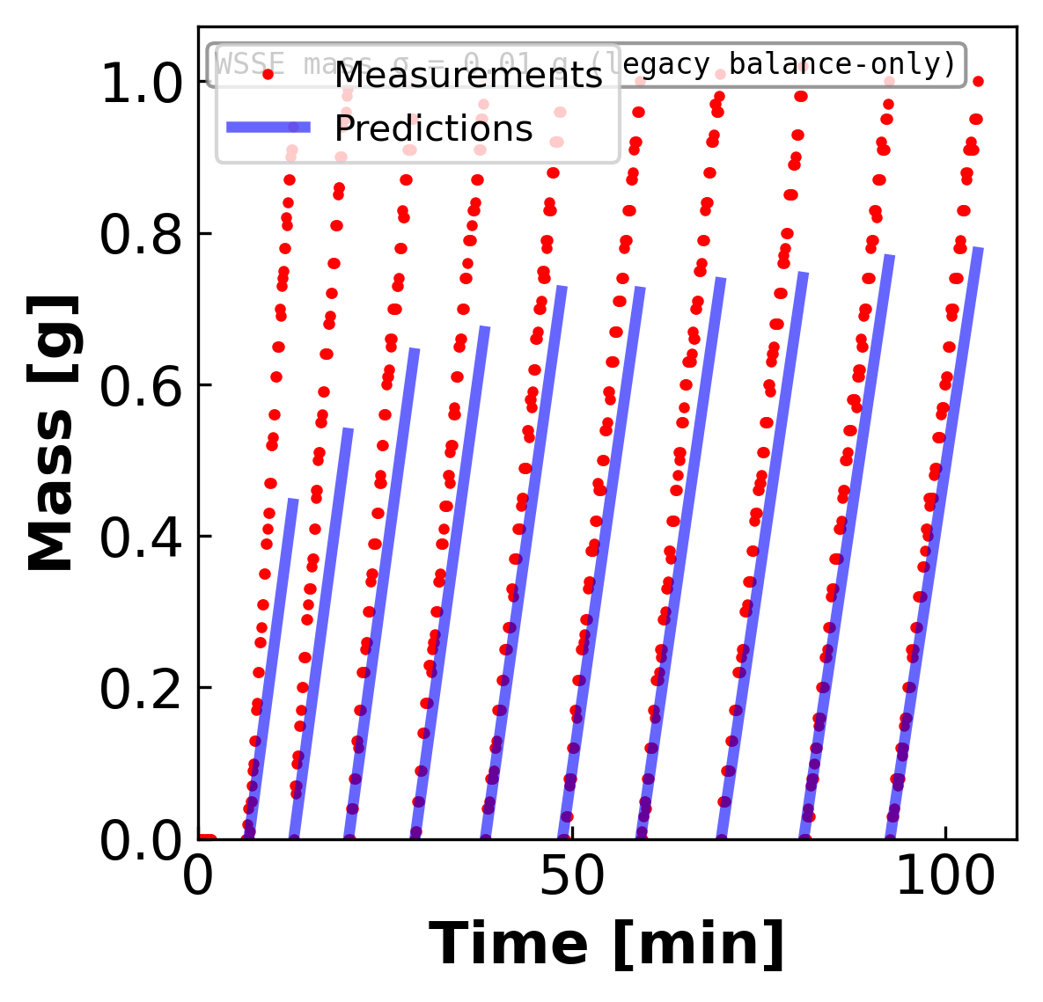
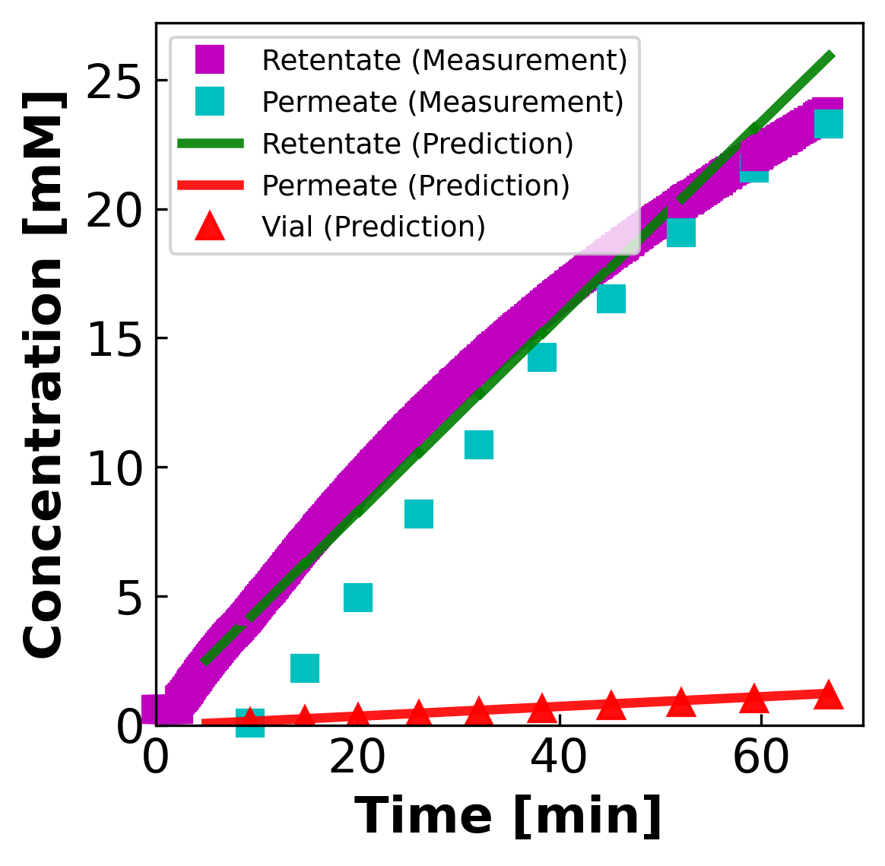
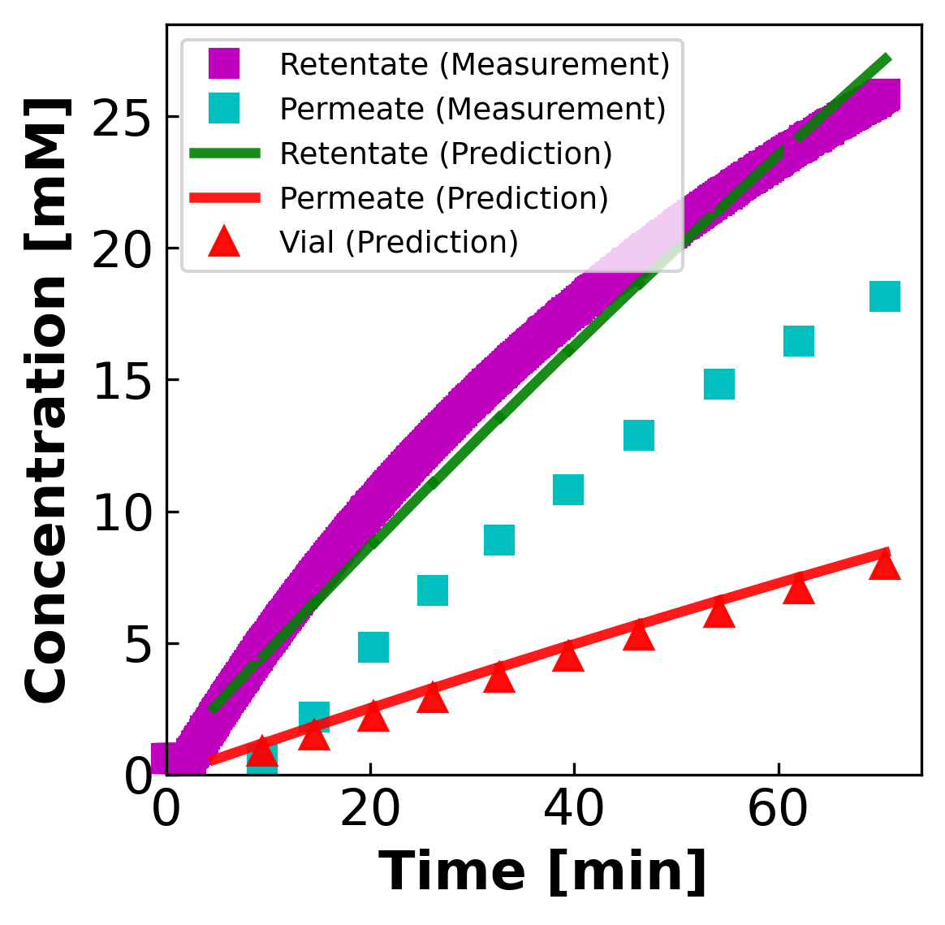
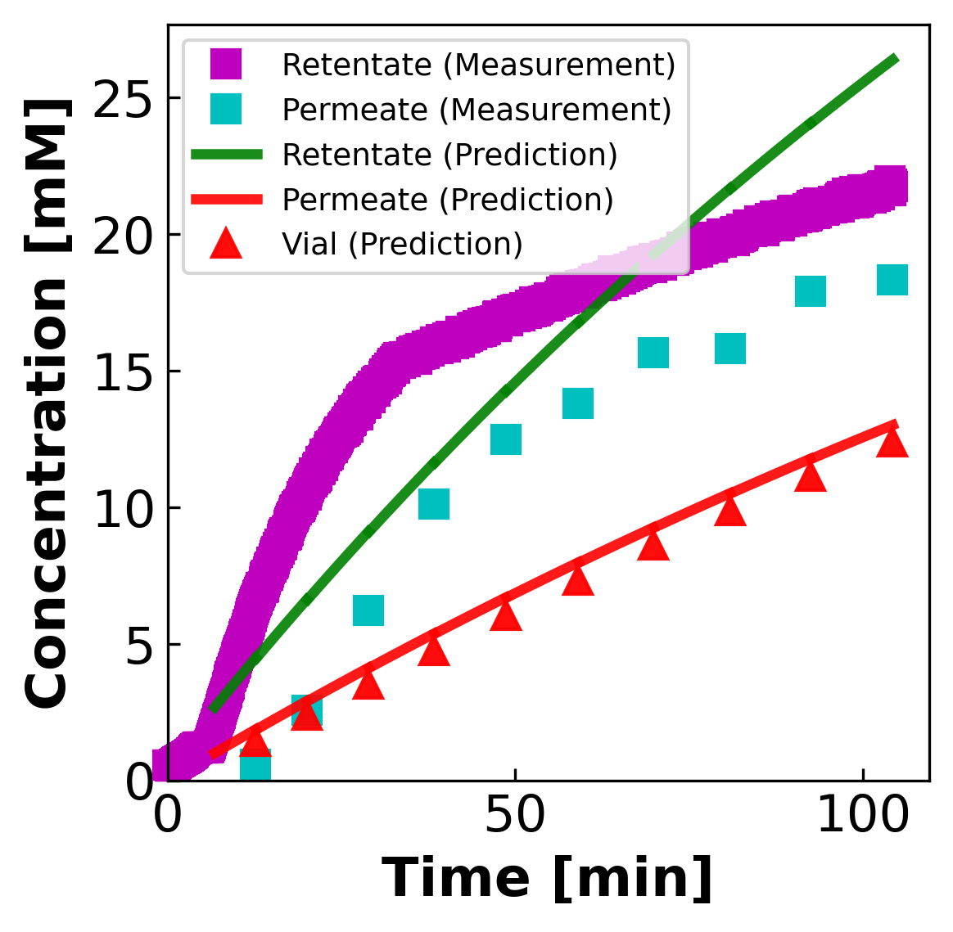
03C · CURRENT FIT RESULTS
03c
Current fit results · CaCl₂ · divalent · 3 sheets
CaCl₂ (divalent): osmotic over-correction amplified by ni = 3
MASS (g vs min)
CONCENTRATION (mM vs min)
MC2 CaCl₂
MC3 SCaCl₂
MC3 S2CaCl₂ · worst
Mass shortfall is larger than NaCl C-regime because per-mM osmotic contribution is 1.5× higher. MC3 S2CaCl₂ is worst case: σ AND B at their bounds simultaneously.

Slide 7
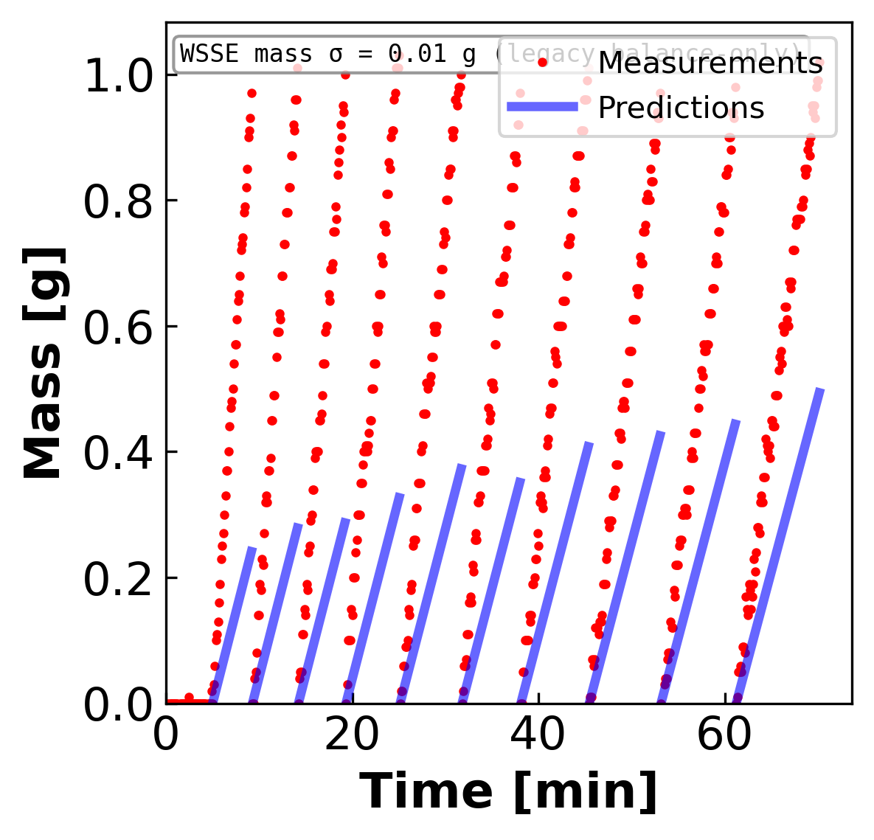
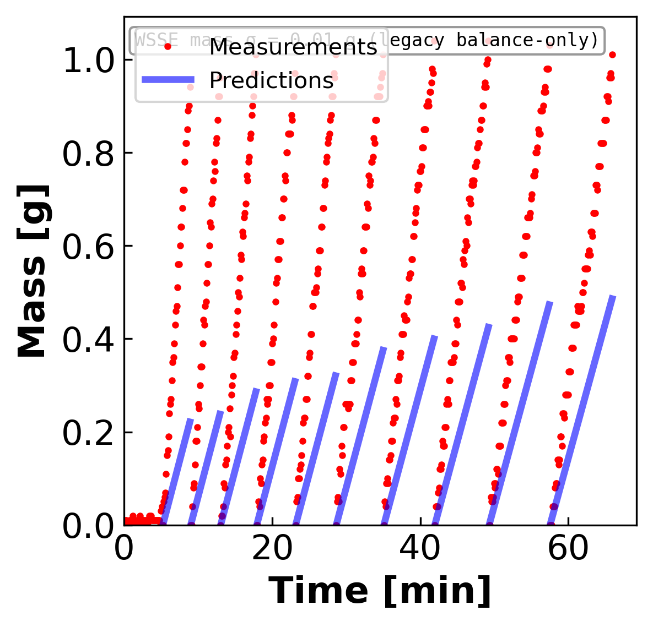
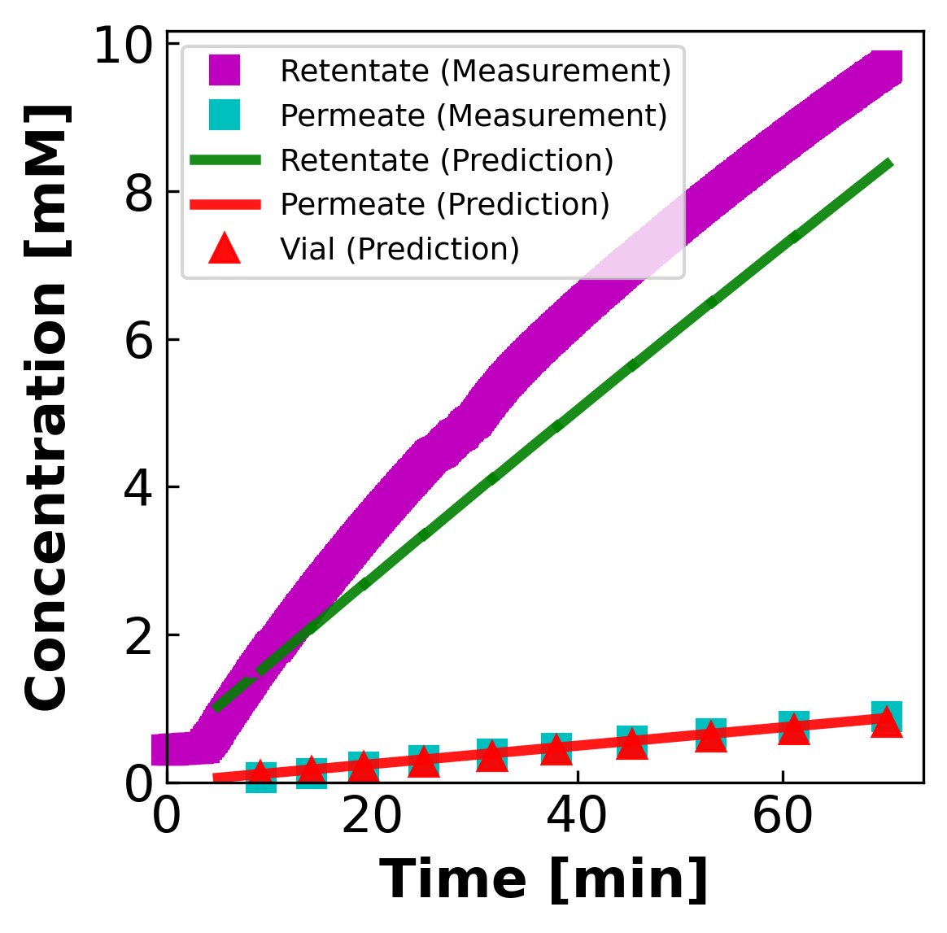
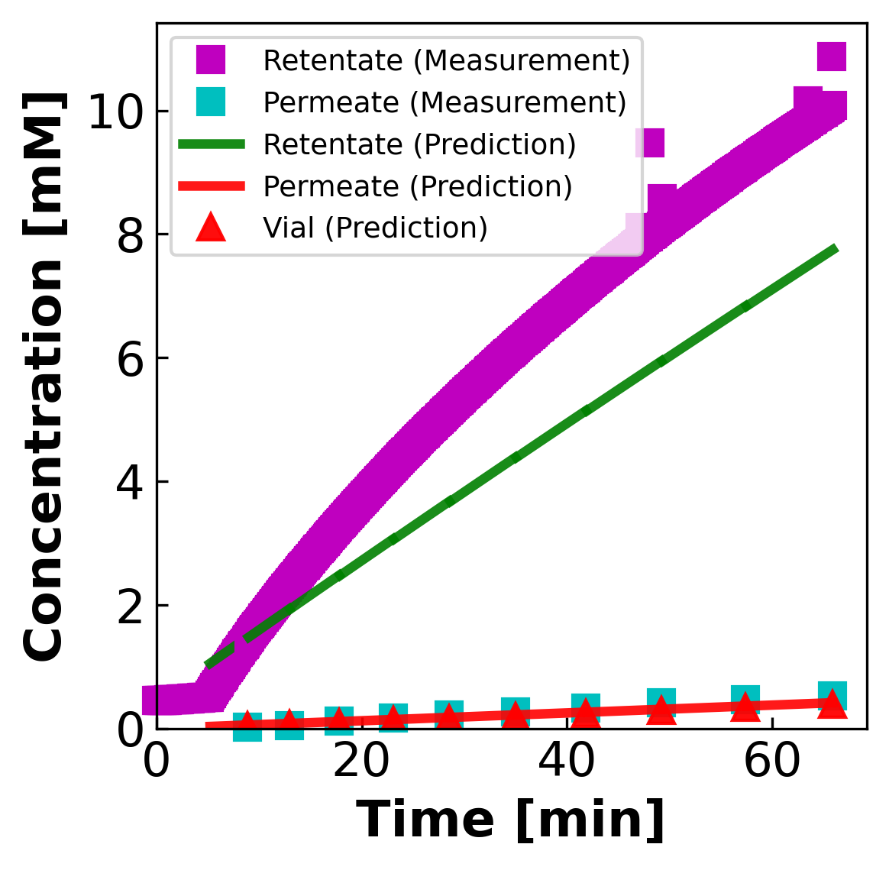
03D · CURRENT FIT RESULTS
03d
Current fit results · LaCl₃ · trivalent · 2 sheets
LaCl₃ (trivalent): worst mass shortfall and Lp channel disagreement
MASS (g vs min)
CONCENTRATION (mM vs min)
MC2 LaCl₃
MC4 SLaCl₃
Trivalent: ni = 4, so σ·ΔΠ is the dominant term in Jw. σ = 1 wall produces the campaign's worst mass shortfall. Channels disagree on Lp; needs physics fix, not just numerical fix.

Slide 8
04 · ACTION ITEMS COMPLETED
04
what's been done since the last update
Four diagnostic + corrective actions delivered
01
Mass-litmus test
σ = 0 closed-form Lp regression (data_config['Lp0_method'] = 'data_driven'). Decouples Lp identifiability from the σ / B parameters. Lp from this is the data-driven seed for every NF270 fit.
02
Contour panels · σ-Lp + B-Lp per sheet
11 single-salt sheets × 2 sweeps (σ-Lp, B-Lp) = 22 panels. Reveals which channels constrain which parameter, and where the optimizer pins.
03
Conductivity correction to 25 °C (EC25)
σ₂₅ = σ_T · (1 + α(25 − T)) applied per-row, per-stream at load time. Salt-specific α from Robinson & Stokes; compensation flag on every NF270 data_stru.
04
cF residual weighting evaluation → cF-floor fix
Identified 0.3% relative cF weight as the over-constraint pulling σ to the wall. Proof: floor = 1 mM moves MC2 CaCl₂ σ from 1.0 → 0.38 (interior), total obj × 5.8 better.

Slide 9
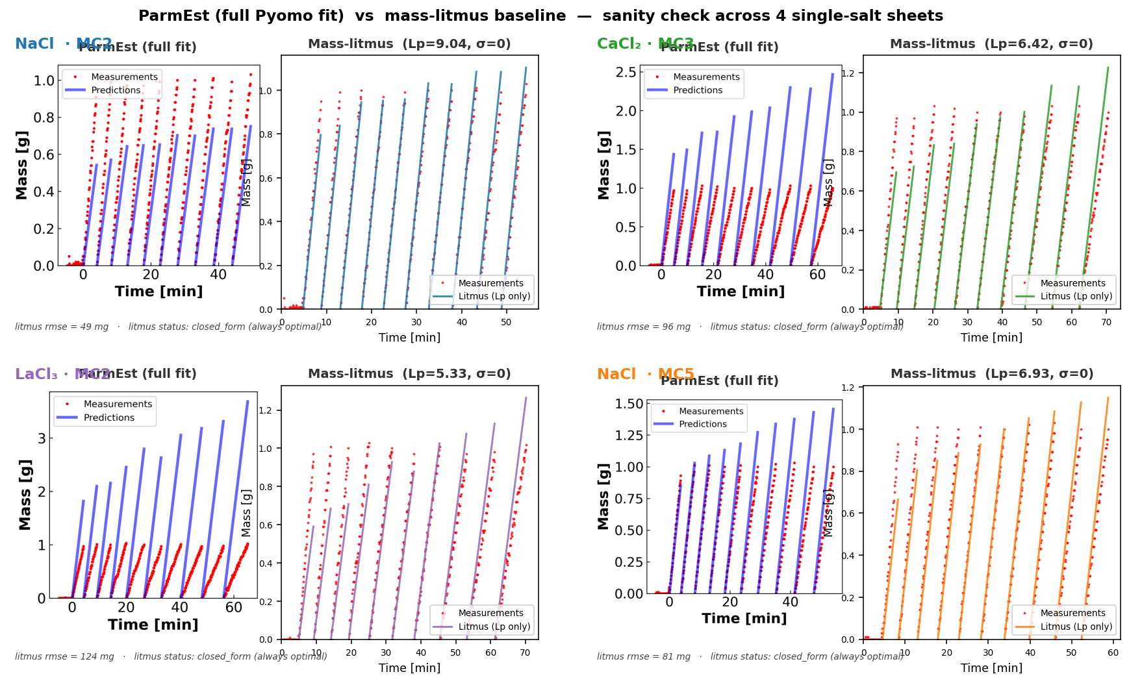
05 · MASS-LITMUS BASELINE
05
Bad ParmEst fit vs mass-litmus baseline — σ=0 closed-form Lp regression
Left = ParmEst full fit (σ released, B fitted, IPOPT) — landed in the Mode B σ=1 corner. Right = mass-litmus baseline: σ=0, B dropped, Lp from closed-form regression Lp = slope · 36000 / (Am · ρ · ΔP) where slope = Σ(Δt · m) / Σ(Δt²). Always optimal by construction. The baseline beats the full fit → σ/B parameters are not yet doing useful work; landscape problem, not model problem.
NF270 fitting · diagnosis + fix + open questions for collaborators
5 / 10

Slide 10
05 · MASS-LITMUS · VS CURRENT FITS
05
mass-only Lp seed vs full ParmEst (Lp, B, σ)
The mass-litmus baseline is what makes the σ pathology visible
MASS-LITMUS BASELINE
FULL PARMEST FIT
Fix: σ = 0, B = 10⁻⁶ (drop the rejection physics)
Closed-form regression on the mass channel only:
Lp = slope · 36000 / (Aₘ · ρ · ΔP)
slope = Σ(Δt · m) / Σ(Δt²)
Pros:
• Always converges; no IPOPT.
• Lp identifiable from balance trace alone.
• Gives the data-driven Lp seed for the full fit.
Cons:
• Cannot say anything about B or σ.
• Treats rejection as zero — bad for high-σ membranes.
Fit: (Lp, B, σ) all free via IPOPT.
Objective: Σ weighted residuals across mass, cV, cF.
What we observe:
• Lp from full fit ≈ Lp from mass-litmus on dilution sheets.
• On concentration sheets: Lp_full ≠ Lp_litmus —
σ pulls Lp away from the mass-only optimum.
Interpretation:
• Mismatch between Lp_full and Lp_litmus is a direct
measure of how much the σ pathology is corrupting Lp.
• Larger gap → more σ-induced bias.
Mass-litmus is the ground-truth Lp for low-σ-influence cases. Its discrepancy with the full fit is itself the diagnostic for σ-identifiability failure.

Slide 11
06 · CONTOUR PANELS
06
DATA1-style 50×50 σ-Lp and B-Lp sweeps · per single-salt sheet
What the per-channel residual surfaces tell us about identifiability
FORWARD SIMULATION OBJECTIVE (per channel, per grid point):
Obj_mass(θ_x, Lp) = Σᵢ ((mᵢ_pred − mᵢ_meas) / σm)²
Obj_concentration(θ_x, Lp) = Σᵢ ((cVᵢ_pred − cVᵢ_meas) / σcV)²
Obj_retentate(θ_x, Lp) = Σᵢ ((cFᵢ_pred − cFᵢ_meas) / σcF)²
1. Channel basin position
2. σ wall pinning
3. B identifiability
Each channel forms its own basin in (σ, Lp) space.
If basins COINCIDE → all channels agree → fit is well-identified.
If basins SEPARATE → channels disagree → fit is a compromise (LaCl₃).
10 of 11 sheets show σ pinned at a bound (1.0 or 0.0).
Only MC3 SNaCl has σ in the interior (≈ 0.45).
The wall is where the objective minimum genuinely sits — not a solver failure.
On every panel, Obj_mass and Obj_retentate are flat in B (horizontal bands).
Only Obj_concentration (cV channel) responds to B.
B is a one-channel parameter campaign-wide — structural, not a numerical issue.
The next 3 slides walk one representative σ-Lp panel per salt group with bullet-level commentary.

Slide 12
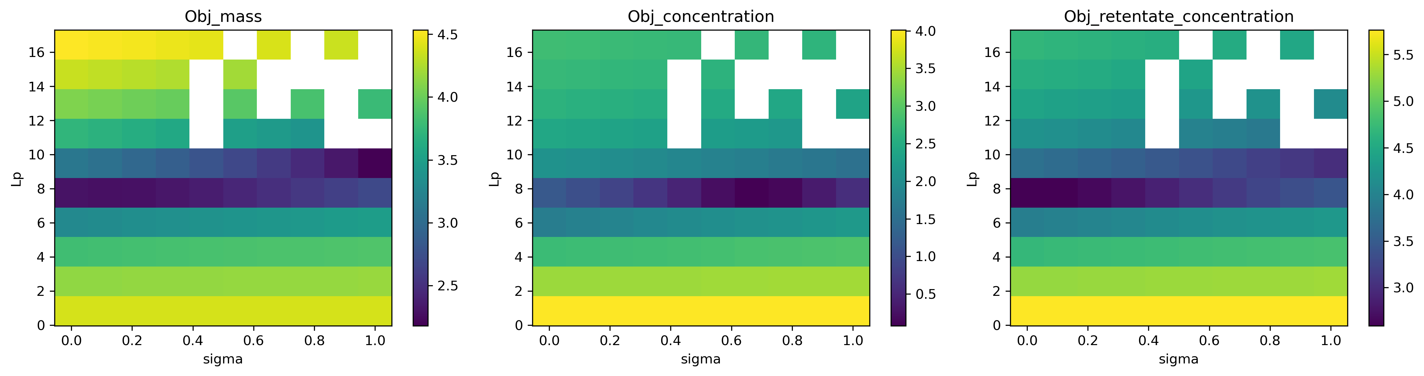
06A · CONTOUR · NACL
06a
NaCl
NaCl: dilution interior basin vs concentration σ wall
σ-Lp panel · MC3.07.22.24_SNaCl · per-channel log₁₀(Obj)
• Dilution baseline (MC3 SNaCl) — all three Obj surfaces have low-objective regions that overlap at σ ≈ 0.45, Lp ≈ 8. Channels agree.
• Compare against the concentration-regime σ-Lp panels (MC5 NaCl): the cV channel surface is flat in σ but pulls Lp basin sharply — no σ agreement.

Slide 13
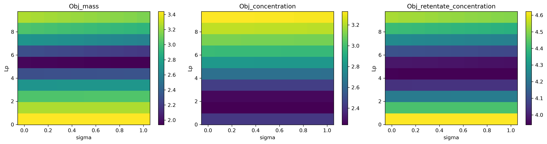
06B · CONTOUR · CACL₂
06b
CaCl₂
CaCl₂: σ-axis flat across [0, 1], B at extreme bound
σ-Lp panel · MC3.07.12.24_S2CaCl2 · per-channel log₁₀(Obj)
• All three Obj surfaces show no minimum in σ; objective slides to whichever wall (here σ = 1) wins on the cF channel.
• B also runs off the right edge — channels can't pin B even with σ pegged. Worst-case sheet for the constant-(B, σ) model.

Slide 14
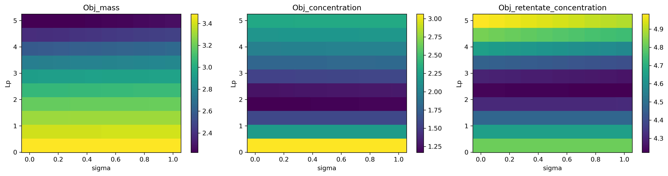
06C · CONTOUR · LACL₃
06c
LaCl₃
LaCl₃: channel disagreement on Lp
σ-Lp panel · MC2.05.21.24_LaCl3 · per-channel log₁₀(Obj)
• Obj_mass + Obj_retentate prefer Lp ≈ 5; Obj_concentration prefers Lp ≈ 2.5. Compromise fit (Lp = 2.49) satisfies neither.
• σ surface is flat across the full unit interval — neither floor nor σ prior alone recovers a sensible fit (see warm-start slides).

Slide 15
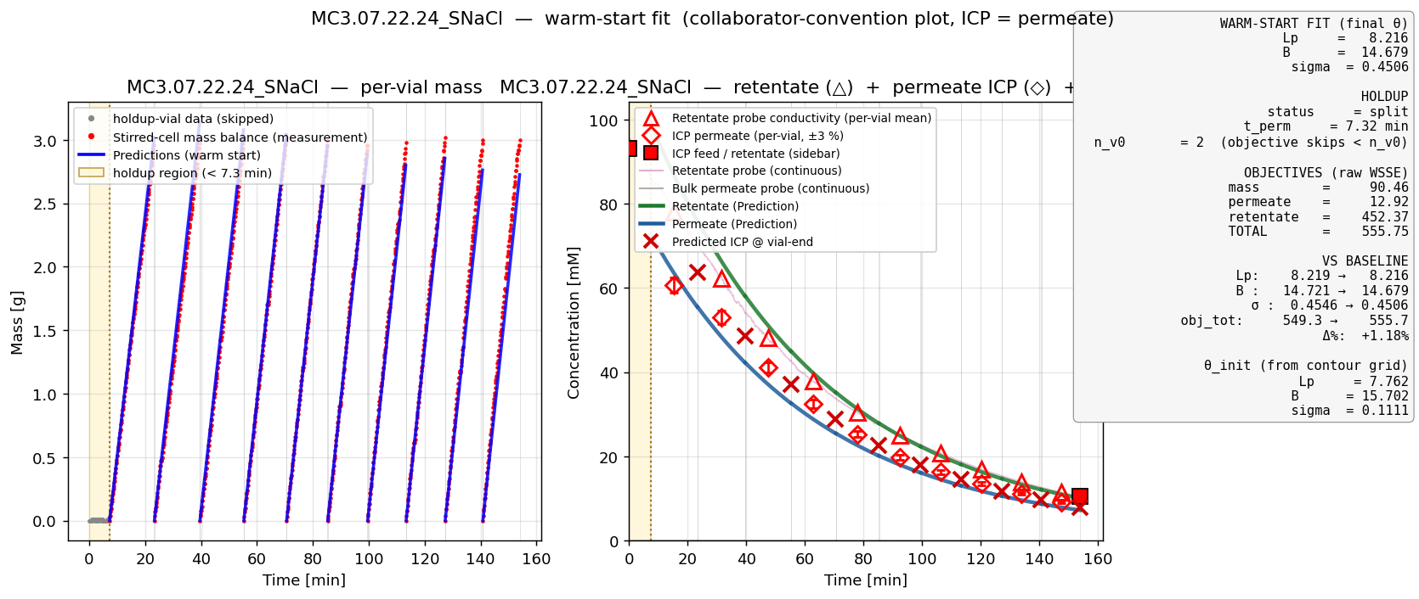
15A · WARM-START FIT
15a
NaCl · diluting regime · 1 of 2
MC3.07.22.24_SNaCl — the only interior-σ fit in the campaign
• σ lands in the interior at 0.45 — only sheet in the campaign where the optimizer does NOT pin σ at a bound.
• All three channels (mass / retentate / vial-ICP) agree on Lp ≈ 8.2 ; this is what a 'good' diafiltration fit looks like and serves as the calibration baseline for every other slide.

Slide 16
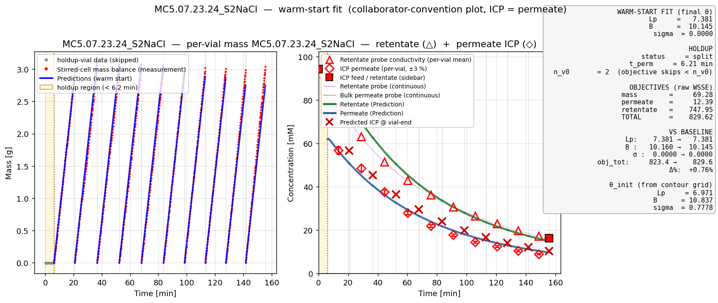
15B · WARM-START FIT
15b
NaCl · diluting regime · 2 of 2
MC5.07.23.24_S2NaCl — dilution but σ pinned at 0 (surprise)
• Despite the dilution direction, σ slid to the opposite wall (0.0) and Lp landed at 7.4 — different pathology than the other dilution sheet.
• Same root cause as the concentration-regime fits: the 0.3% cF residual weight over-constrains the retentate channel, pulling σ to a bound. The cF floor experiment is needed here too.

Slide 17
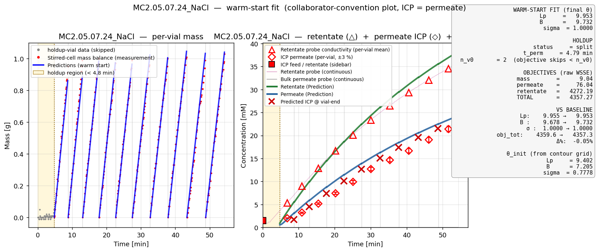
15C · WARM-START FIT
15c
NaCl · concentrating regime · 1 of 4
MC2.05.07.24_NaCl — σ=1 wall, characteristic mass shortfall
• σ=1 means the model is asserting full osmotic backpressure even at end-of-run cF ~ 25 mM — Jw is suppressed and predicted per-vial mass plateaus below the 1 g cap.
• Lp ≈ 9.96 from this fit is therefore a compromise, not the true membrane permeability.

Slide 18
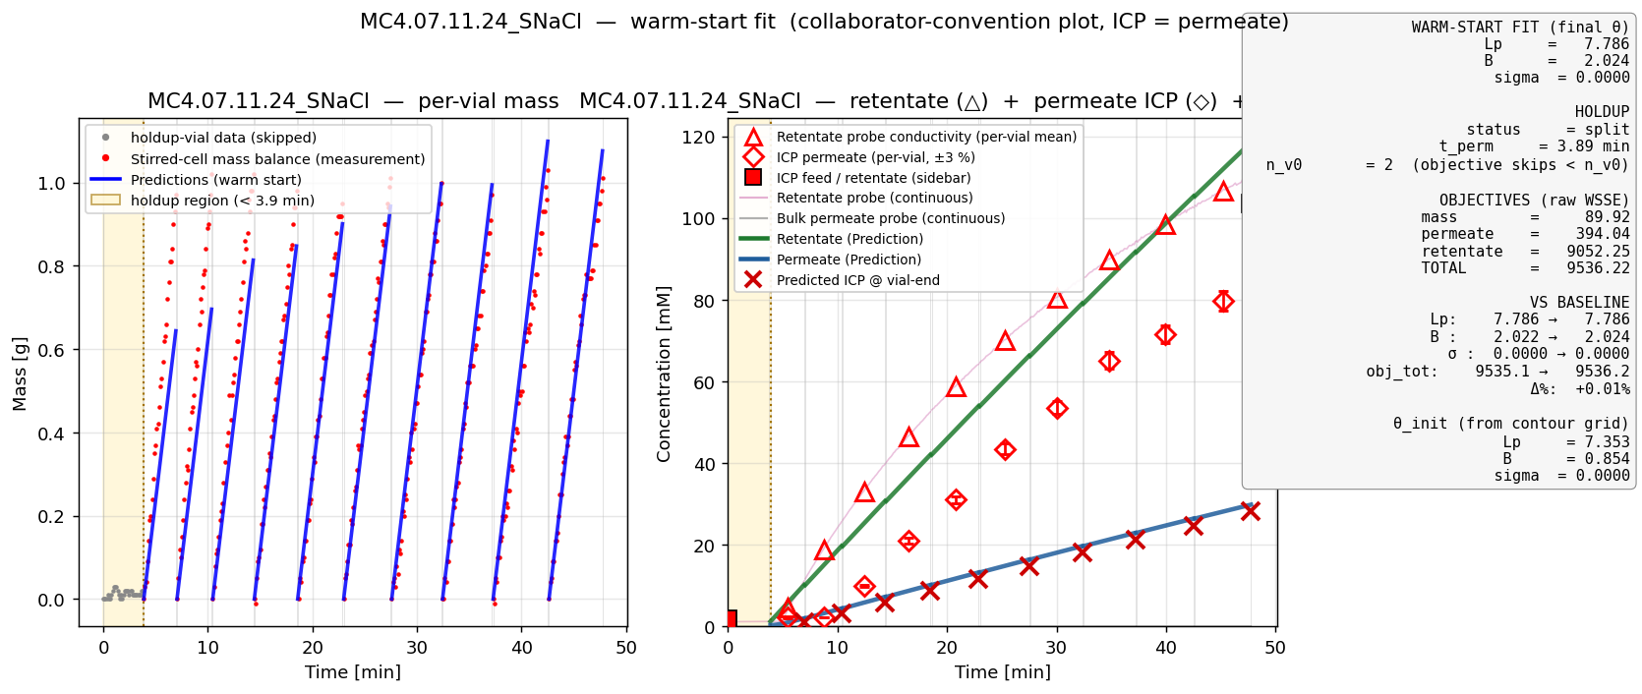
15D · WARM-START FIT
15d
NaCl · concentrating regime · 2 of 4
MC4.07.11.24_SNaCl — σ=0 wall (the cF-floor proof case)
• Same over-weighted cF channel, but here the optimizer slid to σ=0 (zero rejection) instead of σ=1 — direction depends on the cF channel's residual sign.
• Floor fix (NF270_CF_RESIDUAL_FLOOR_MM = 1) recovers σ to 0.46 (interior) and obj_retentate drops 200× — proof point for the diagnosis.

Slide 19
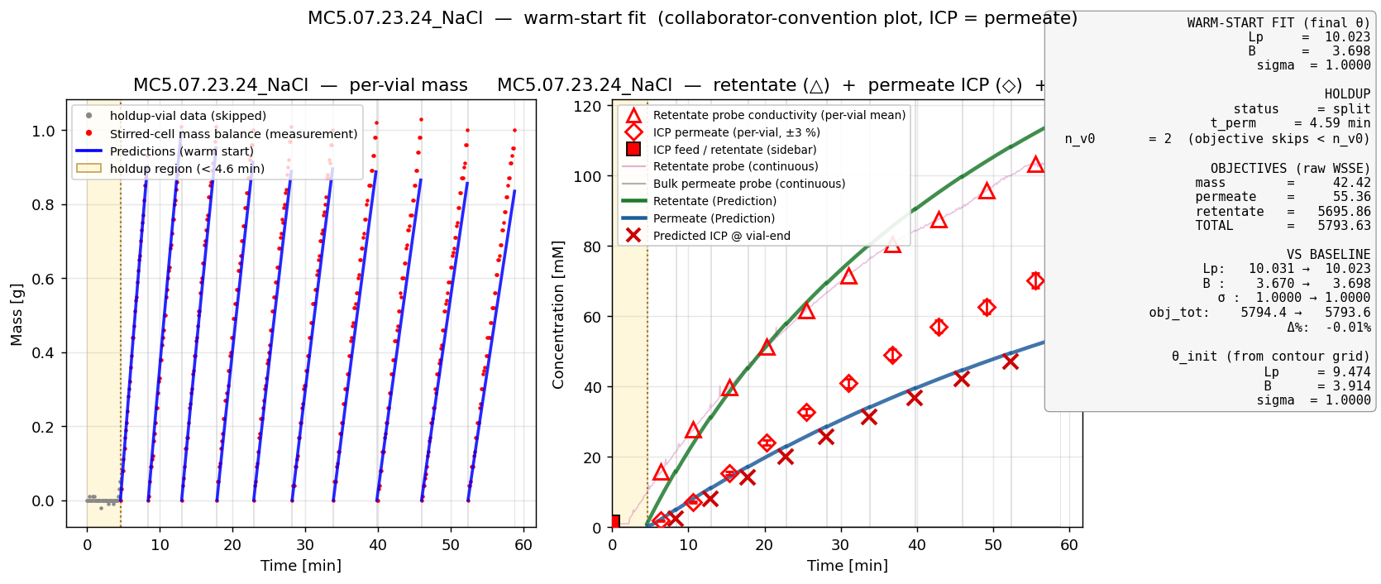
15E · WARM-START FIT
15e
NaCl · concentrating regime · 3 of 4
MC5.07.23.24_NaCl — σ=1 wall, 1 g/vial low-leverage case
• Concentrating from 0.9 → 107 mM at 1 g/vial sampling — the cV channel has the least information leverage anywhere in the campaign.
• Permeate prediction (red shelf) sits well below the cyan ICP measurements throughout — visible signature of the σ=1 wall.

Slide 20
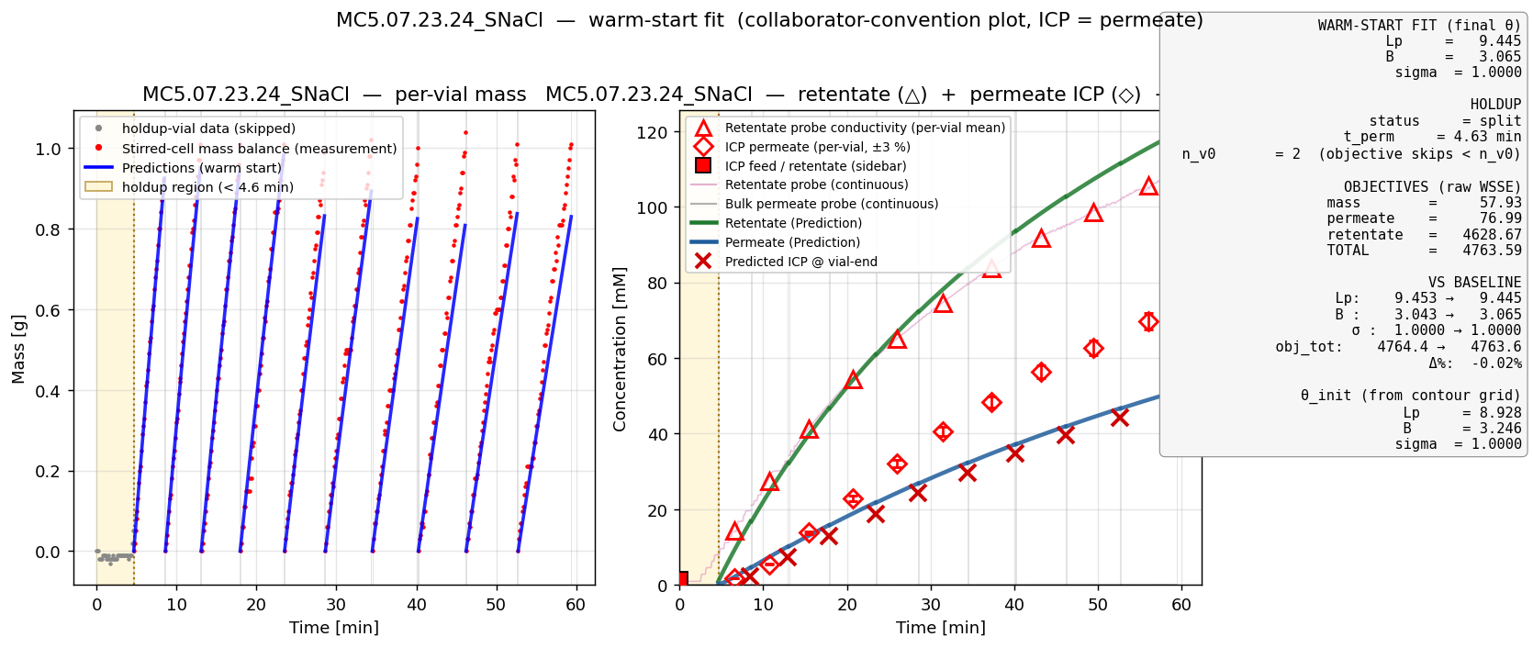
15F · WARM-START FIT
15f
NaCl · concentrating regime · 4 of 4
MC5.07.23.24_SNaCl — near-replicate of MC5 NaCl with same pathology
• Same σ=1 wall and similar mass shortfall — confirms the pathology is reproducible across operator replicates, not a single-run artifact.
• Same fit-quality fix expected: cF residual floor should release σ to ~0.5 interior, consistent with MC4 SNaCl proof.

Slide 21
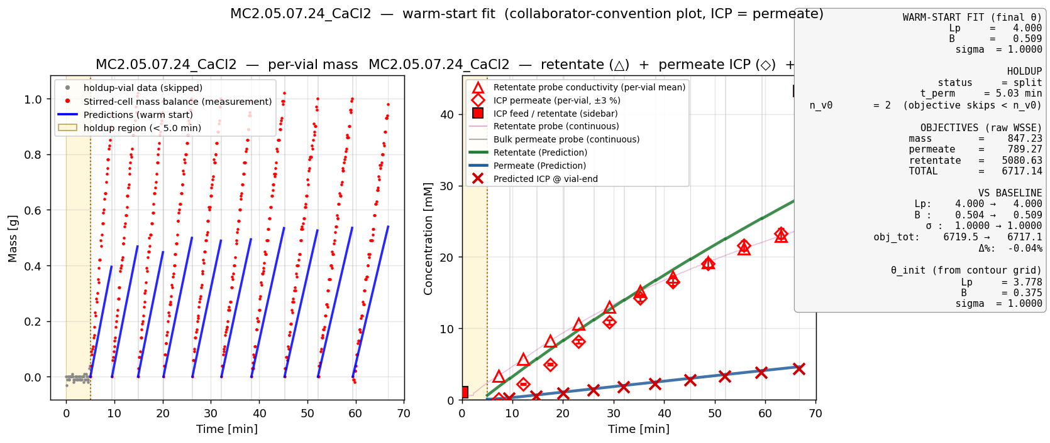
15G · WARM-START FIT
15g
CaCl₂ · divalent · 1 of 3
MC2.05.07.24_CaCl2 — divalent amplifies the σ=1 pathology
• ni = 3 (vs 2 for NaCl) → per-mM osmotic contribution is 1.5× larger, so σ=1 over-suppresses Jw even harder than on NaCl.
• Floor experiment on this sheet released σ from 1.0 → 0.38 and improved total objective 5.8×. Strongest single proof of the σ-identifiability story.

Slide 22
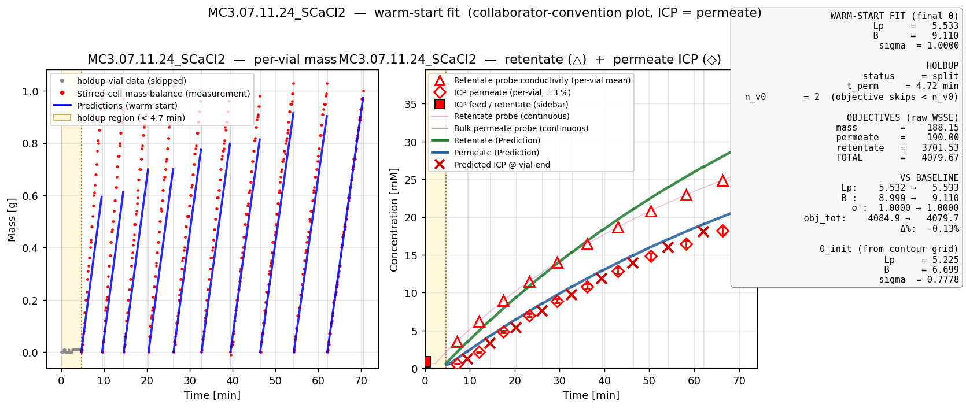
15H · WARM-START FIT
15h
CaCl₂ · divalent · 2 of 3
MC3.07.11.24_SCaCl2 — σ=1 wall, B identified only by cV channel
• Same σ=1 pathology; B ≈ 9 is driven entirely by the vial-ICP channel (the contour panels showed mass + retentate are essentially flat in B).
• B is a one-channel parameter in this campaign — improving B identifiability would require a perturbation that drives B-sensitivity into either the mass or the cF channel.

Slide 23
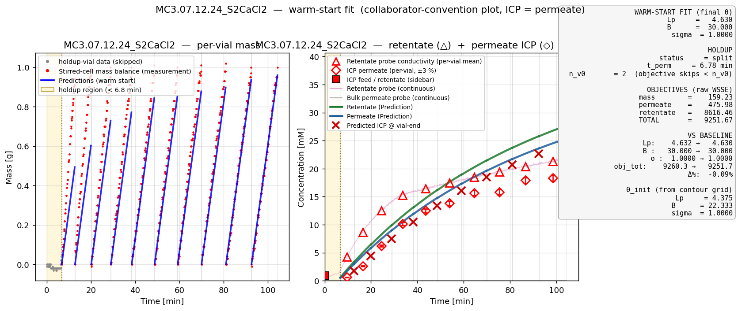
15I · WARM-START FIT
15i
CaCl₂ · divalent · 3 of 3
MC3.07.12.24_S2CaCl2 — worst case: σ AND B both at bounds
• Two of three parameters pegged: σ = 1.0 and B = 30 (upper bound). Reported Lp = 4.63 is held up by both walls + data, not by data alone.
• Sidebar ICP also disagrees with continuous cF (retentate ICP 38.7 mM vs continuous-cF endpoint 21.7 mM); rejection collapses from R≈0.68 to R≈0.14 across the run — constant-(B, σ) model cannot represent this.

Slide 24
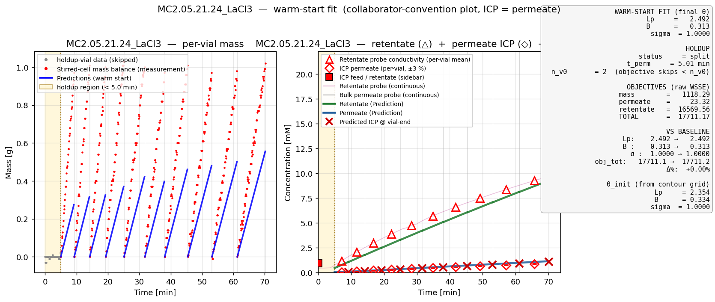
15J · WARM-START FIT
15j
LaCl₃ · trivalent · 1 of 2
MC2.05.21.24_LaCl3 — σ=1 + channel disagreement on Lp
• ni = 4 makes σ·ΔΠ the dominant term — σ=1 over-correction is the largest in the campaign on this sheet (worst mass shortfall).
• Contour panels showed channel disagreement: mass + cF want Lp ≈ 5, cV wants Lp ≈ 2.5. Floor alone DOESN'T recover this — needs floor + literature σ prior (≈0.99) + possible ion-pairing correction.

Slide 25
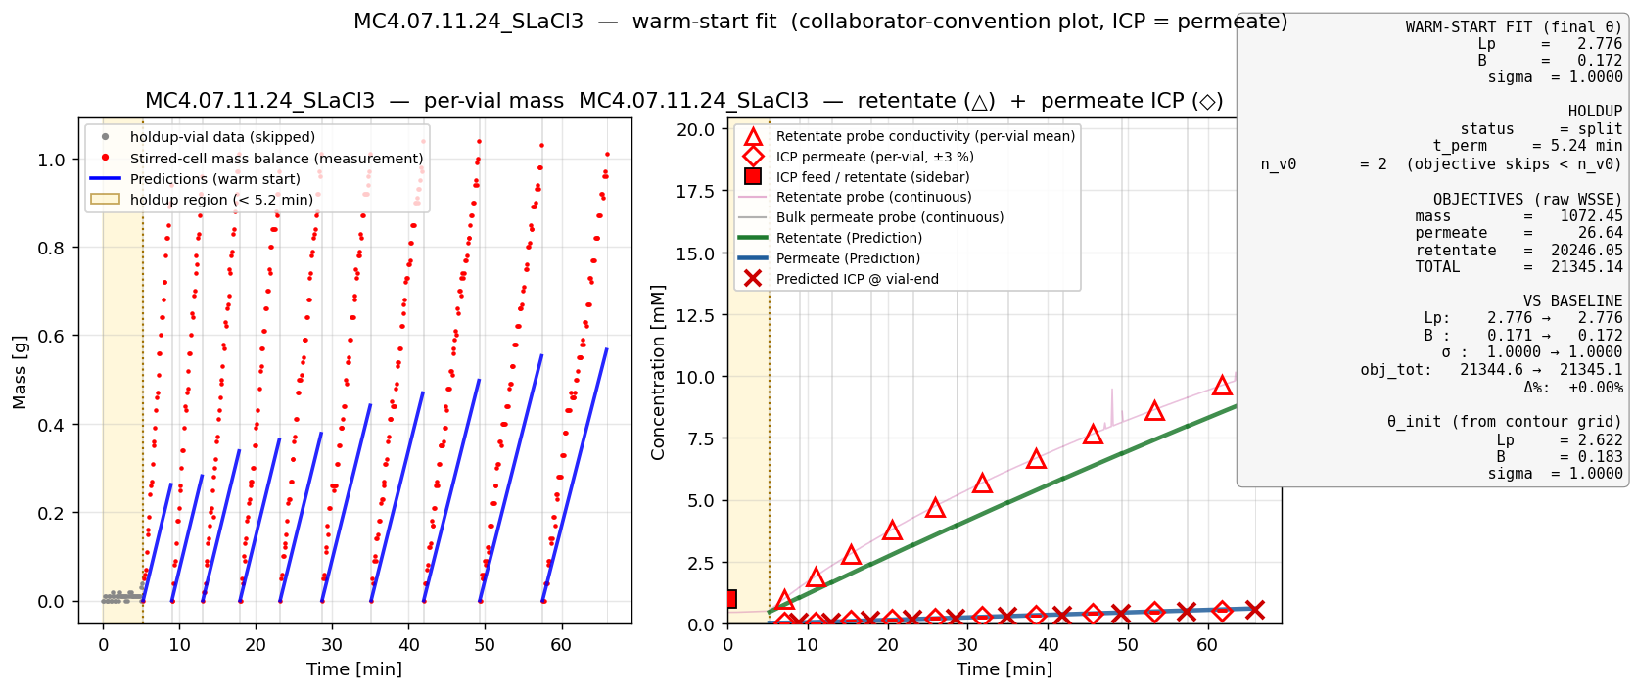
15K · WARM-START FIT
15k
LaCl₃ · trivalent · 2 of 2
MC4.07.11.24_SLaCl3 — replicate trivalent pathology
• Same σ=1 wall + low Lp (≈2.78) and tiny B (≈0.17) as MC2 LaCl3; replicate confirms the pathology is salt-specific, not sheet-specific.
• Path forward for LaCl₃: combined floor + σ prior; if combined fix still pins σ at the new (interior) upper bound, the model genuinely needs ion-pairing correction in ΔΠ (effective ni < 4 at end-of-run).

Slide 26
08 · WHY CHANGE THE 0.3% CF WEIGHT?
08
the over-weighted retentate residual at high cF
0.3 % at 100 mM = 0.3 mM tolerance. That's tighter than measurement noise.
CURRENT cF RESIDUAL SCALE (per measurement):
σ_cF[i] = 0.003 · cF_meas[i] (current — relative 0.3 %)
Effective tolerance at typical cF values (σ_cF = 0.003 · cF)
cF
0.003 · cF
actual measurement noise floor
WSSE behavior
1 mM
0.003 mM
≈ 0.02 mM (probe)
OK
10 mM
0.03 mM
≈ 0.2 mM (Shedlovsky/probe)
OK
50 mM
0.15 mM
≈ 1 mM
tightening
100 mM
0.30 mM
≈ 1-2 mM
OVER-WEIGHTED (3-6×)
200 mM
0.60 mM
≈ 2-5 mM
BADLY OVER-WEIGHTED
WHY THE OPTIMIZER PEGS σ AT THE WALL
• In concentrating sheets, end-of-run cF ≈ 100 mM. A 0.3 mM tolerance forces the model to fit cF to a near-perfect match.
• The ONLY way the model can hold cF down at end-of-run with rising cV is to crank σ to either 0 (perfect penetration → cF tracks dilution) or 1 (perfect rejection → cF accumulates).
• Whichever wall the cF channel residuals prefer locally, the optimizer goes there. Direction (0 vs 1) is sheet-specific; the WALL itself is the consistent pathology.
Next slide: the fix — apply an absolute floor on the cF residual.

Slide 27
09 · CF RESIDUAL FLOOR · THE FIX
09
absolute floor on the cF residual scale
Cap the maximum cF weight at 1 mM — releases σ from the wall
PROPOSED cF RESIDUAL SCALE:
σ_cF[i] = max(0.003 · cF_meas[i], 1.0 mM)
(below cF ≈ 333 mM the floor is active; above, the legacy relative weight wins)
PROOF POINT · MC2.05.07.24_CaCl2 · defaults vs cF floor = 1 mM
baseline (no floor)
with floor = 1 mM
improvement
Lp
4.00
6.08
+52 %
B
0.50
0.40
small
σ
1.00 (wall)
0.38 (INTERIOR)
off the wall
obj_mass
847.8
173.1
× 4.9 better
obj_permeate
790.3
753.8
flat
obj_retentate
5081.4
232.9
× 21.8 better
TOTAL OBJ
6719.5
1159.8
× 5.8 BETTER
Same identical sheet, same data, same model — only the cF residual scale changed. σ released, all channels improved together.

Slide 28
16 · PERMEATE PROBE CHANNEL · NEW FIT TERM
16
the unused 500×-richer data channel — now in the WSSE
Continuous permeate-probe concentration as a 4th objective channel
DATA AVAILABILITY · samples per vial in each channel
mass (balance trace)
≈ 500 samples / vial
USED
retentate cF (probe → Shedlovsky)
≈ 500 samples / vial
USED
permeate ICP (cV_avg, vial-integrated)
1 scalar / vial
USED
permeate probe (cV_perm_cond → mM)
≈ 500 samples / vial
**WAS IDLE — NOW ENABLED**
NEW OBJECTIVE TERM (added to WSSE, DATA3-gated):
Φ_perm = Σ_i [ (c_H(t_i) − cV_perm_exp(t_i)) / σ_perm ]² (per-vial, samples ≥ n_v0)
(c_H is the model's wall-concentration on the permeate side — physically what the probe measures)
PROOF POINT · MC2.05.07.24_CaCl2 · comparison
Lp
B
σ
obj_m
obj_cv
obj_cr
obj_perm
(A) baseline
4.00
0.51
1.00
847
789
5081
—
(B) +cF floor
6.08
0.40
0.38
173
754
233
—
(C) +floor +perm-probe
5.62
0.15
**0.10**
201
887
227
93
σ moves to 0.10 because the probe trace says more salt is getting through than ICP-OES alone suggests. This is a meaningful identifiability finding — probe and ICP disagree about rejection.

Slide 29
17 · SEEDED LHS MULTISTART · CROSS-SALT SEEDS
17
warm-start the LHS from contour grid + a sister-salt's best fit
Latin-hypercube samples clustered around 3 explicit physics-informed seeds
SEED 1 — Contour top-1
SEED 2 — Contour top-2
SEED 3 — Cross-salt reference
Lowest-WSSE grid point from this sheet's σ-Lp contour.
Captures the in-basin optimum already implied by the data.
Second-lowest grid point (B-Lp sweep most often).
Catches a SECOND basin if one exists on the same loss surface.
When fitting CaCl₂ or LaCl₃: use MC3 SNaCl's interior-σ fit.
(Lp = 8.22, B = 14.7, σ = 0.45) — the campaign's gold-standard θ.
METHOD (DATA3-only, toggle NF270_MULTISTART_USE_CONTOUR_SEEDS):
• 3 seeds × 1 deterministic restart each = 3 fixed starts
• + N_LHS = 8 Latin-hypercube samples allocated round-robin across seeds, each within ±20 % box around its seed
• Total starts: 3 + 8 = 11 (vs 5–10 for uniform-LHS baseline)
• Each start runs full ParmEst (IPOPT); best by total WSSE wins.
• Pure LHS over the full bounds is the fallback when the toggle is OFF or the sheet's contour CSVs are missing.
MC2 CaCl₂ smoke-test: seeded multistart converged to the SAME optimum as single-shot (10–15× slower). Value is for sheets like LaCl₃ where channels disagree on Lp — there the cross-salt seed can break the symmetry.

Slide 30
10 · PROCESS MODEL · CORE EQUATIONS
10
Spiegler–Kedem framework · per-vial Pyomo model
What the model solves at each integration step
Water flux · Starling / Kedem–Katchalsky
J_w = L_p · [ ΔP − σ · (c_In − c_H) · n_i · R · T ]
Solute flux · diffusive transport
J_s = B · (c_In − c_H)
Mass accumulation in collection vial
d m_V / d t = J_w · A_m · ρ
Solute accumulation in collection vial
d(m_V · c_V) / d t = J_s · A_m · ρ
Concentration polarization (wall conc. via Sherwood)
c_In = c_F · exp(J_w / k) c_H = (1 − σ) · c_In · exp(− J_w · (1 − σ) / B)
Free parameters (decision Vars): L_p ∈ (0.5, 50), B ∈ (10⁻⁶, 30), σ ∈ (0, 1). Pyomo + IDAES + IPOPT.

Slide 31
11 · PARAMETER ESTIMATION · WSSE OBJECTIVE
11
weighted sum-of-squared errors · three data channels
What IPOPT minimizes when fitting (L_p, B, σ)
OBJECTIVE FUNCTION (sum over three data channels):
Φ(θ) = Σ_i [(m_pred_i − m_meas_i) / σ_m]²
+ Σ_i [(cV_pred_i − cV_meas_i) / σ_cV]²
+ Σ_i [(cF_pred_i − cF_meas_i) / σ_cF[i]]²
PER-CHANNEL RESIDUAL SCALES (current convention, inherited from DATA2)
channel
scale formula
interpretation
σ_m
0.01 g (constant)
instrument noise, balance
σ_cV
0.03 · cV_meas[i] (3 %)
ICP-OES relative uncertainty
σ_cF
0.003 · cF_meas[i] (0.3 %)
in-line conductivity probe relative noise ← over-weighted at high cF
The 0.3 % cF scale is the over-weight that drove the diagnosis on slide 08; the floor on slide 09 is the corrective change.

Slide 32
12 · LACL₃ · THE PHYSICS GAP
12
why floor + σ prior alone do not recover LaCl₃
Constant-(B, σ) Spiegler–Kedem cannot represent trivalent ion-pairing
ION-PAIRING IN SOLUTION
CONCENTRATION-DEPENDENT σ
CHANNEL DISAGREEMENT → Lp ambiguous
LaCl₃ does not fully dissociate at experimental concentrations:
LaCl³⁺ ⇌ LaCl²⁺ + Cl⁻
LaCl²⁺ ⇌ LaCl⁺ + Cl⁻
Effective n_i drops below 4.
The osmotic term σ·(cIn − cH)·n_i·RT in J_w is therefore over-estimated by the model at high cF.
RESULT: the model thinks osmotic backpressure is larger than reality → Jw under-predicted → mass shortfall.
Real membranes show σ that decreases as cF rises (charge screening, pore-wall interaction).
Spiegler–Kedem assumes σ = constant.
On LaCl₃ sheets, the observed rejection R drops 0.68 → 0.14 across the run.
The optimizer's σ = 1 is the model's best compromise between early-vial (high R) and late-vial (low R) data.
Neither is fit correctly.
Contour panels show:
mass + cF channels prefer Lp ≈ 5
cV channel prefers Lp ≈ 2.5
Currently published Lp = 2.49 is the cV-channel basin (optimizer compromise).
Without resolving the physics (n_i, σ(cF)), the right Lp is undefined — the model cannot say.
RECOMMENDED PATH: (1) add ion-pairing equilibrium → effective n_i(cF); (2) parameterize σ(cF) explicitly or use cF-dependent B-form; (3) report Lp with explicit uncertainty range until #1+#2 are validated.

Slide 33
09 · OPEN QUESTIONS
09
Open questions
Q1
σ reparameterization?
Should we reparameterize σ = exp(η)/(1+exp(η)), η ∈ ℝ, to eliminate the {σ=0, σ=1} corners?
experimental
Q2
Two-stage fit?
Profile-likelihood approach: lock Lp from mass-litmus (Lp̂ = slope · 36000 / (Am · ρ · ΔP)), then fit (σ, B) on concentration only. Equivalent to a frequentist profile over the Lp axis.
computational
Q3
Interior σ box?
Tighten Pyomo Var bound from σ ∈ (0,1) to σ ∈ [0.30, 0.85]. If Obj jumps back up after constraining the interior, the corners are global minima → model is mis-specified.
computational
Q4
Retentate weight? (GPT question)
Is 0.3% the right standard deviation for the in-line retentate conductivity probe? If actual noise is 1-2%, the cF term currently dominates the WSSE by 9-44× relative to truth. Easy sensitivity test.
both
NF270 fitting · diagnosis + fix + open questions for collaborators
9 / 10

Slide 34
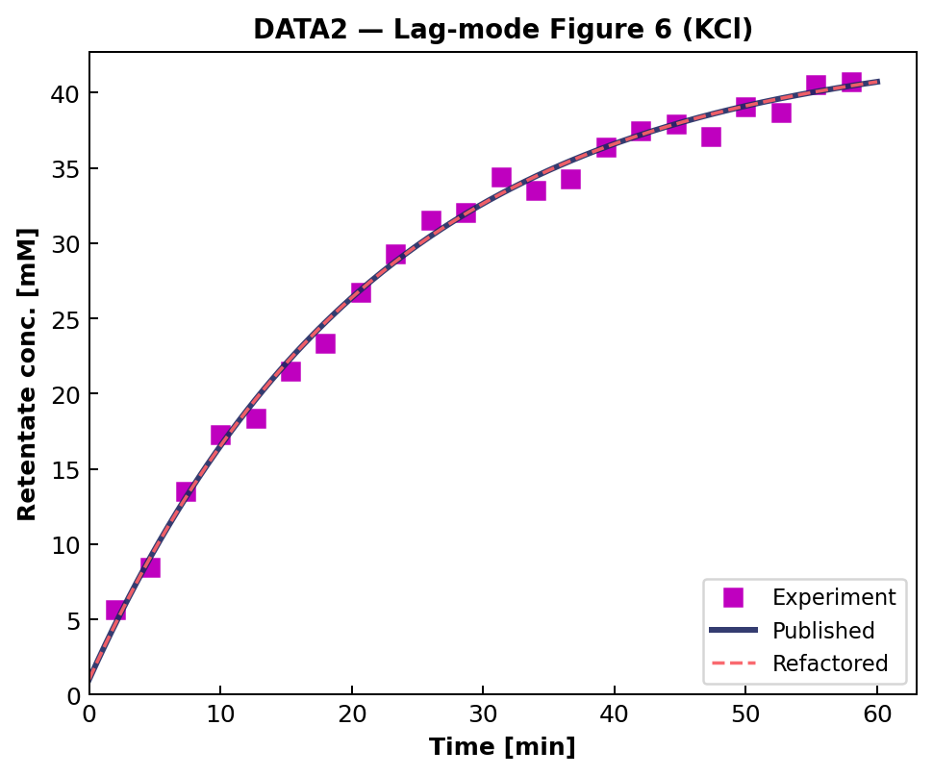
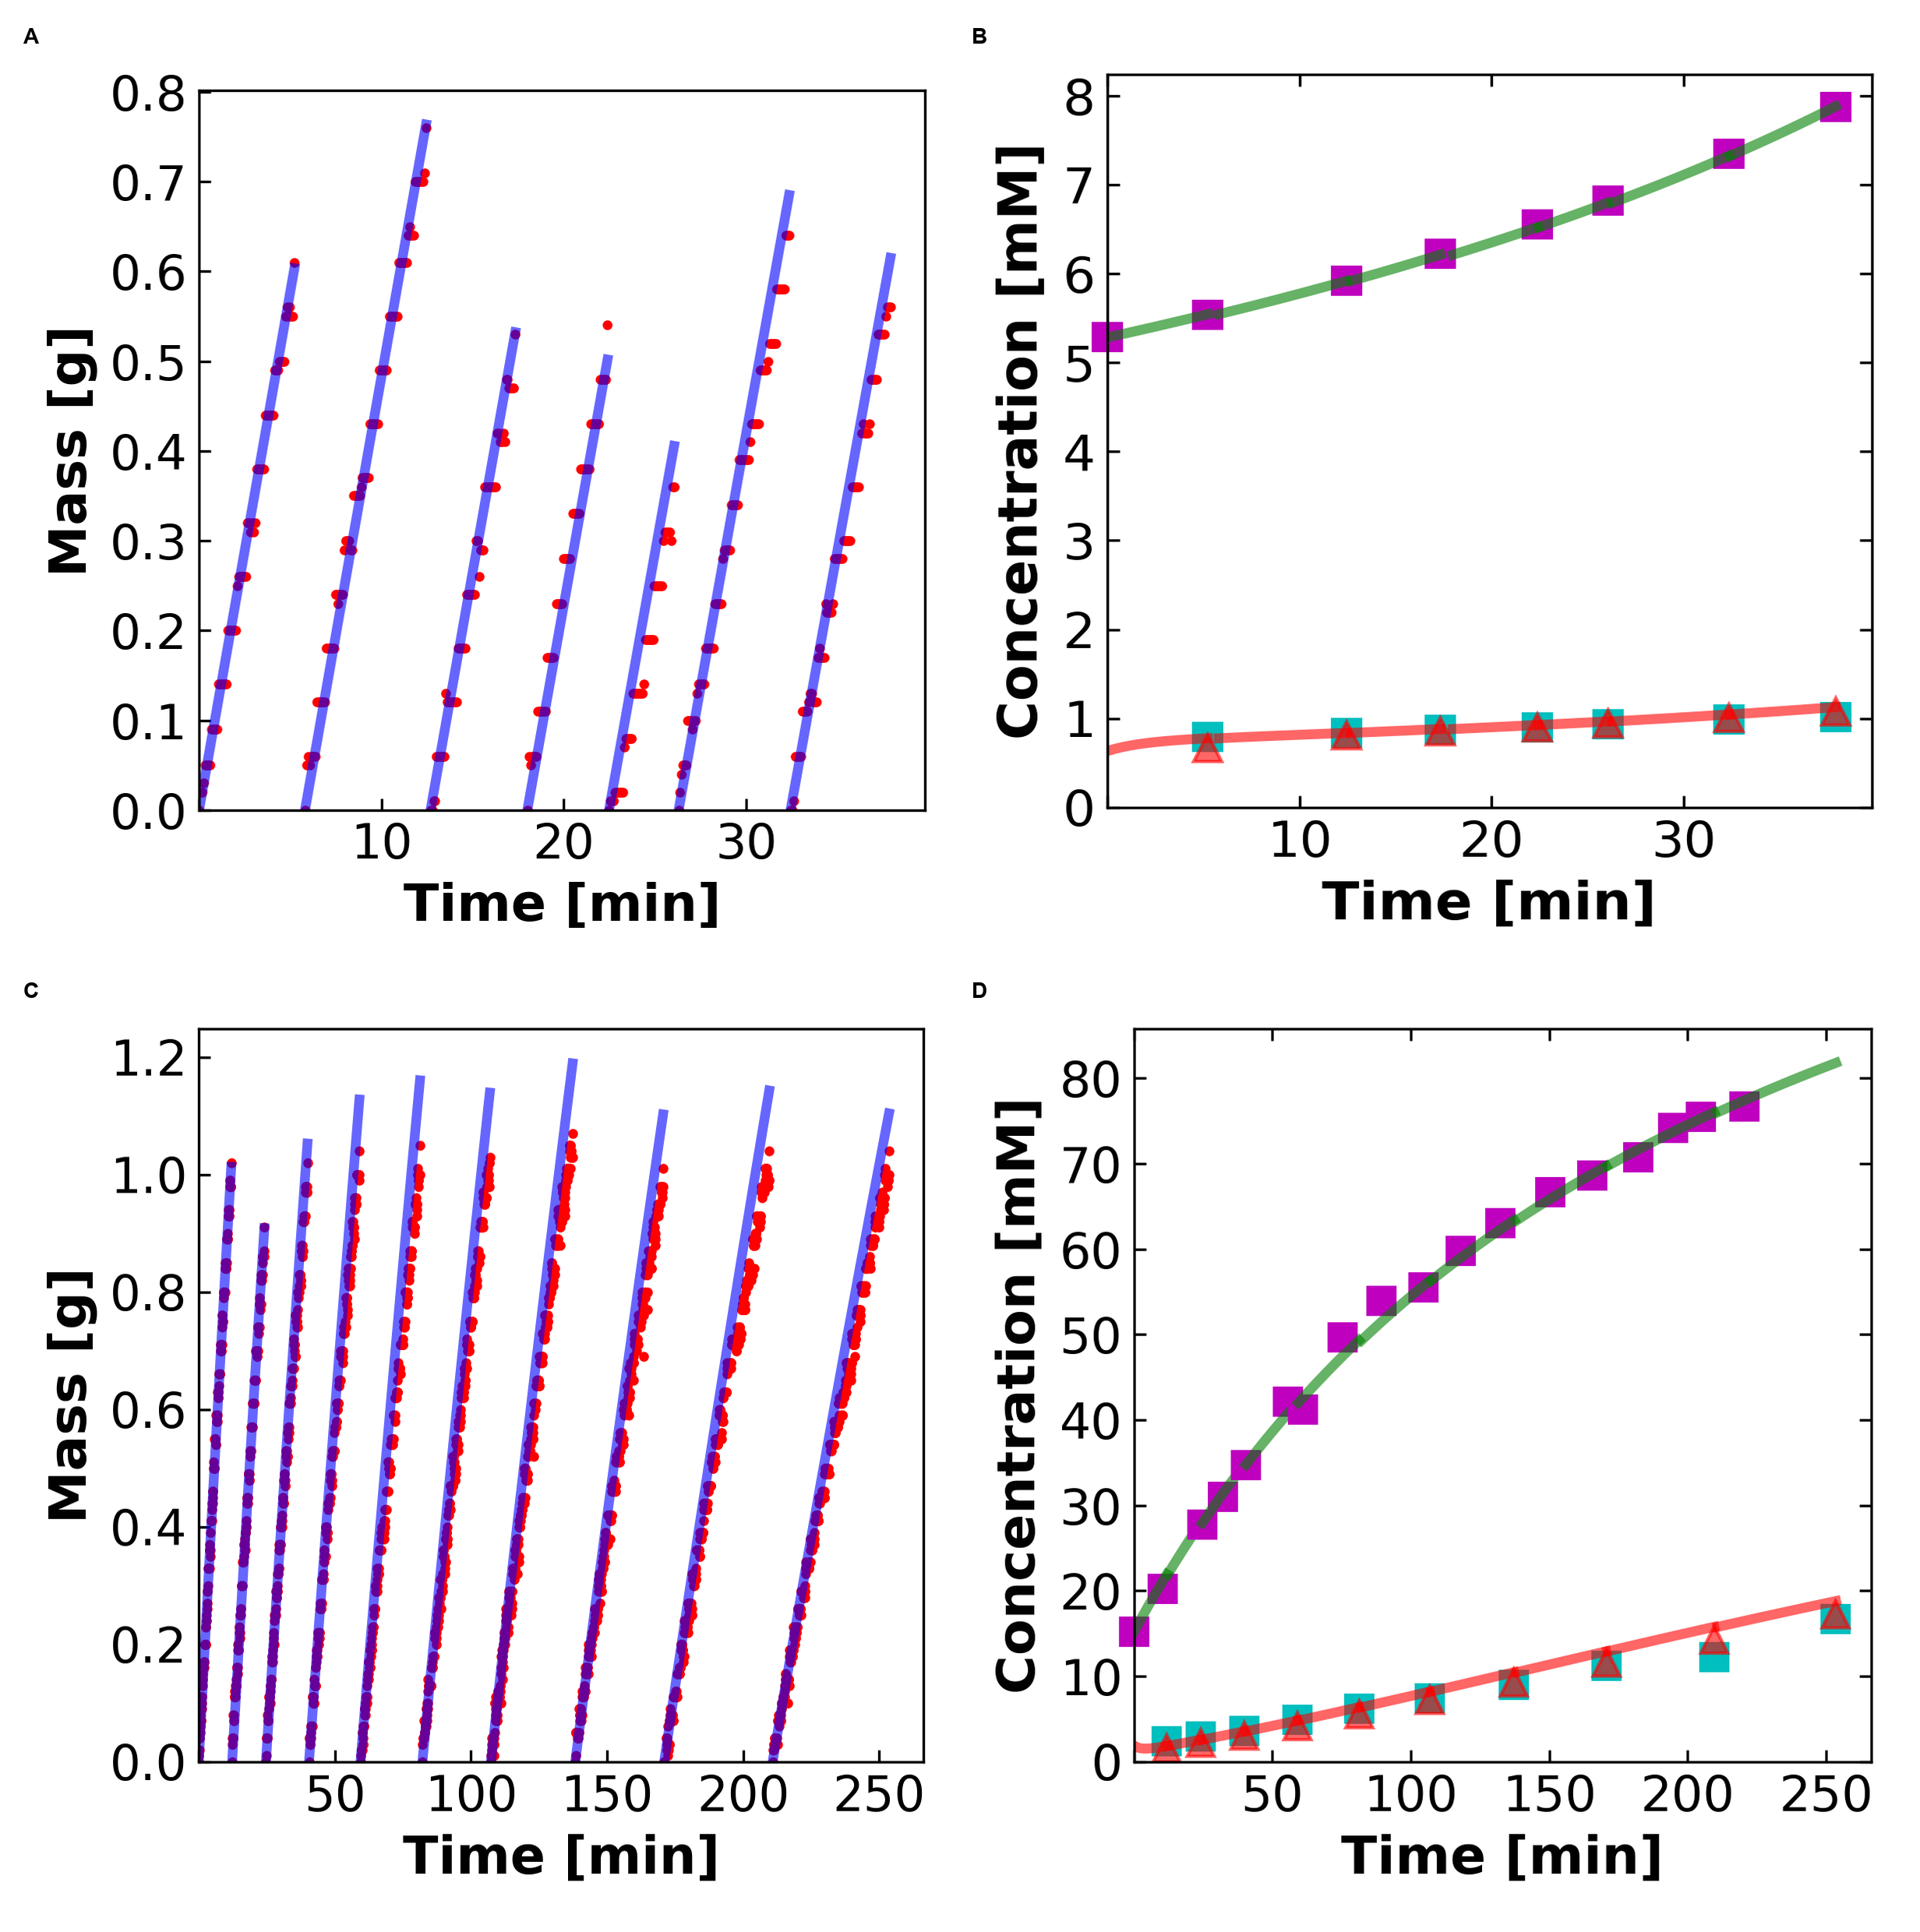
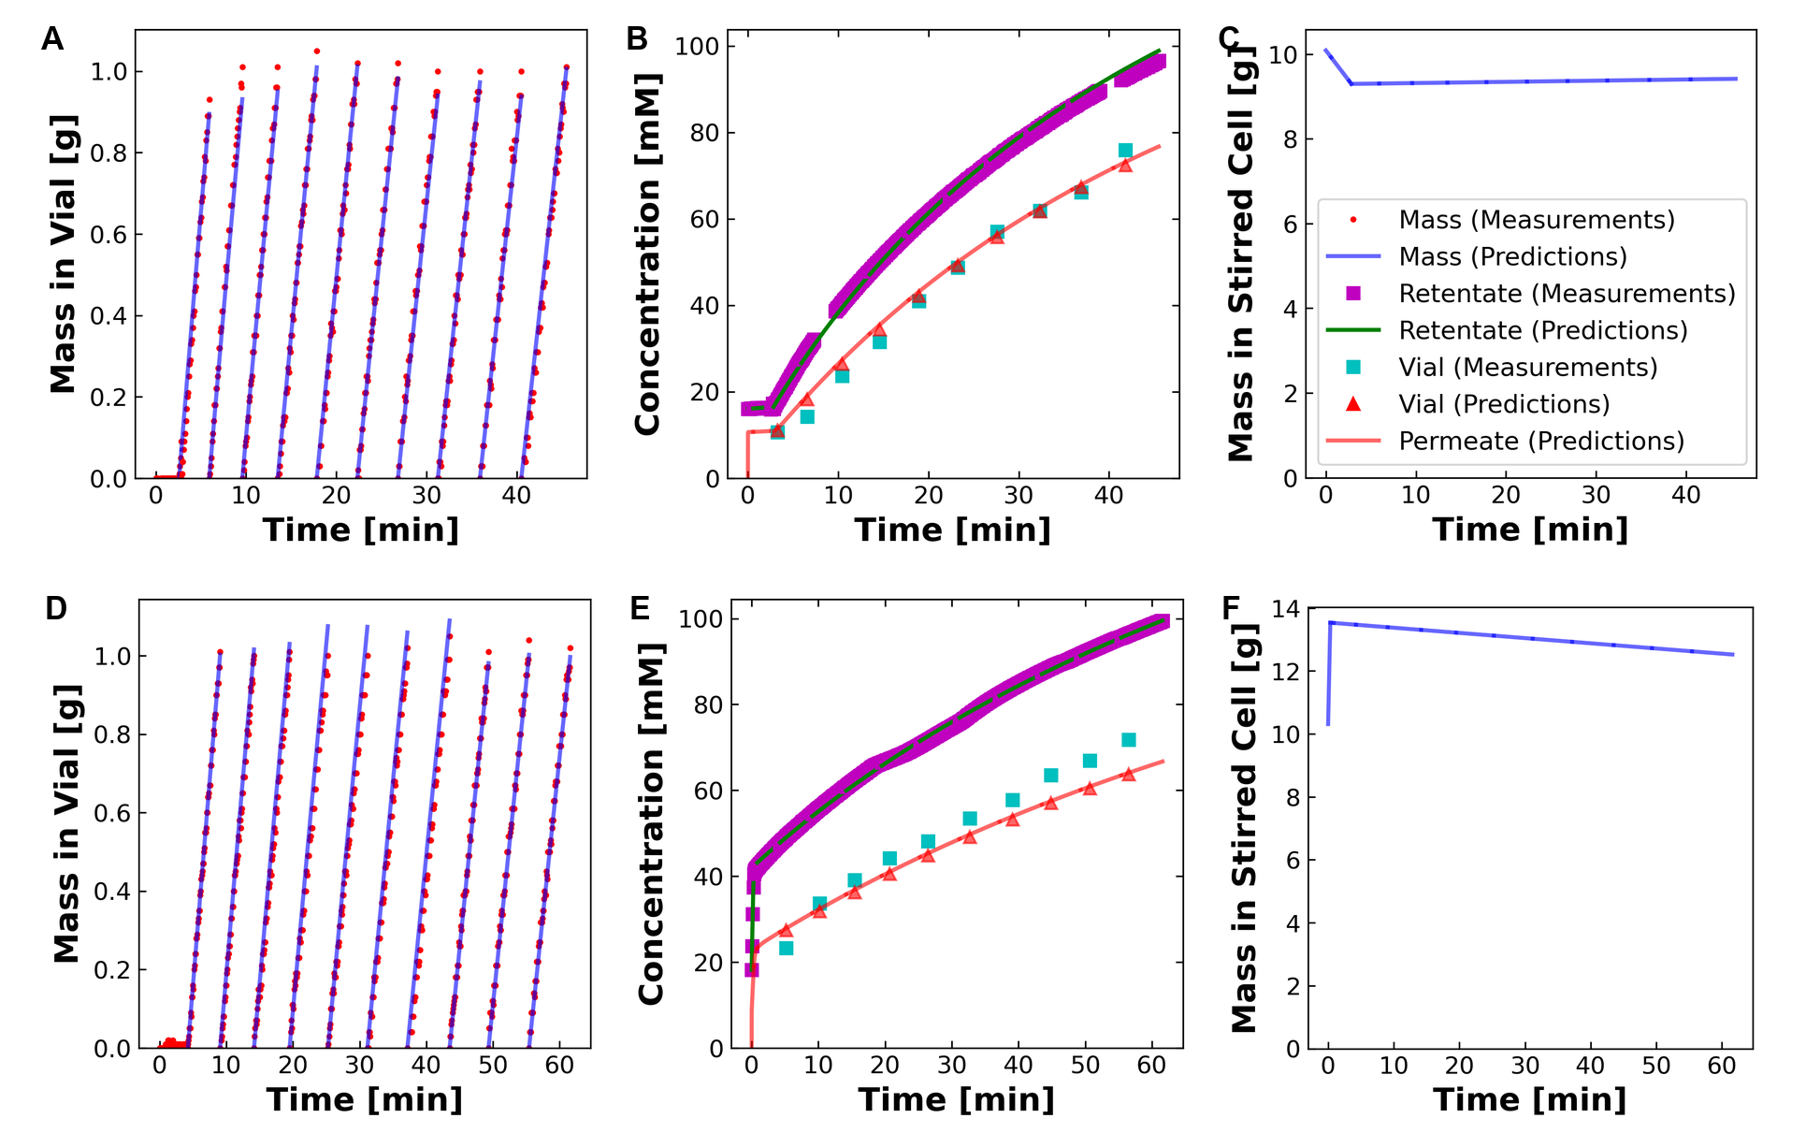
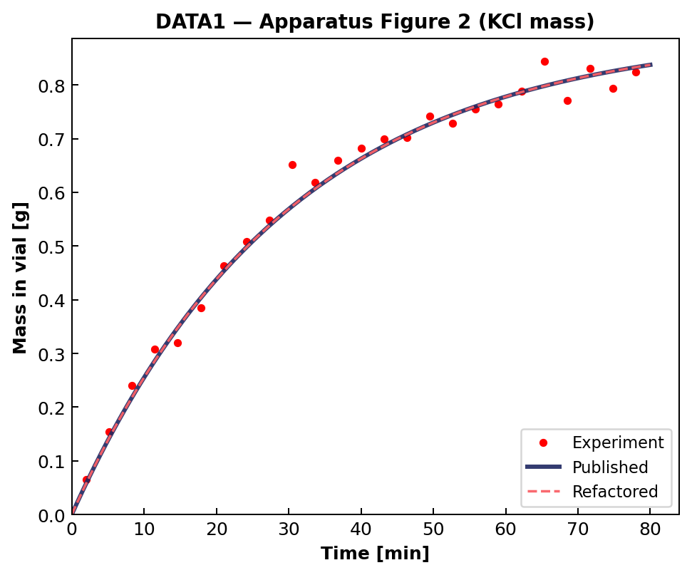
03 · REPRODUCIBILITY
03
Byte-identical replication of DATA1 + DATA2 published figures
DATA1 — Apparatus Figure 2 (KCl mass, concentration vs time)
DATA2 — Lag-mode Figure 6 (KCl)
manifest_default calls materialize_all with the exact same args the legacy runfile used — no extra_opts overrides flow through; conductivity_paper.py stays frozen.
NF270 fitting · diagnosis + fix + open questions for collaborators
3 / 10

Slide 35
04 · DATA3 FIRST RUN
04
DATA3 first run: same code, three salts — three distinct failure patterns
First DATA3 fit on the 11 single-salt sheets. Same WSSE objective: $Obj = 1e4 · ( Σ (Δm/0.01)²/N_m + Σ (Δcv/(0.03·cv))²/N_v + Σ (Δcf/(0.003·cf))²/N_r )$. Three distinct failure patterns appear — all σ-pathologies, not data bugs:
MODE A — moderate σ↑
MODE B — σ → 1.0 (degenerate)
MODE C — σ↓, over-prediction
MASS
MASS
MASS
vial-1 prediction overshoots to ~1.5 g; vials 2-10 plateau at 0.7-0.95 g (below the 1.0 g cap).
predictions explode to 6-10 g per vial; model thinks much more permeate is flowing than the balance shows.
predictions overshoot to 6-12 g per vial — same direction as Mode B but conc plot tells a different story.
CONCENTRATION
CONCENTRATION
CONCENTRATION
predicted retentate matches measured retentate; predicted vial under-predicts ICP-OES by ~30 %.
predicted retentate severely under-predicts (8 vs 22 mM); predicted vial = 0 across the run.
predicted retentate > measured retentate (60 vs 43 mM); predicted vial > ICP — model lets too much salt through.
NF270 fitting · diagnosis + fix + open questions for collaborators
4 / 10

Slide 36
06 · LHS MULTISTART
06
R10 + R12 — Latin Hypercube multistart over (Lp, σ, B), narrowed boxes
Stage
Lp box (linear)
σ box
B / beta_0 box (log)
Basin found · Obj value
SINGLE START
Lp0 = 5
σ0 = 0.9
B0 = 0.5
Mode B (σ → 1) · Obj = 2.04 × 10⁸
LHS R10
[5, 14]
(0.10, 0.95) open
log [1e-6, 5]
Mode C (σ = 0) · Obj = 4.93 × 10⁷ (4× reduction)
LHS R12
[5, 8] narrowed
(0.10, 0.95) open
log [0.01, 5]
Mode B again · Obj = 6.08 × 10⁹ (cornered)
LHS samples and corner-hopping — what the math says
Latin-Hypercube Sampling used
IPOPT is local. Multistart is a global-search heuristic: best_fit = argmin_{k=1..N} Obj(IPOPT(θ_k)) over optimal-status runs. Narrowing the LHS box keeps starts inside the physics window but doesn't restrict where IPOPT can terminate.
R10: factor-of-4 Obj cut by escaping Mode B. R12: tightening Lp to [5,8] removed the upper-Lp draws but the σ=1 corner remains attractive when loss-function structure prefers it. Landscape fix has to come from new observables, not box-tightening alone.
Pyomo Var bounds remain wider than the LHS box: Lp ∈ (0.5, 50), B ∈ (1e-6, 30), σ ∈ (0, 1). LHS just controls trial starts; if a corner solution is the true global minimum it will still be reached. The next two slides tackle the loss-function side.
NF270 fitting · diagnosis + fix + open questions for collaborators
6 / 10

Slide 37
07 · MASS SCALING
07
Tried per-sheet quadrature (R11) → reverted to DATA2's 0.01 g convention (R13)
WSSE MASS TERM — frequentist / MLE reading:
obj_m = Σ_i ( (m_pred_i − m_meas_i) / mass_scale_g )² / N_m
Under Gaussian noise N(0, σ²) on m, this is the negative log-likelihood up to a constant. mass_scale_g IS σ — the standard deviation of the noise on a single balance reading. It is a property of the instrument, not of the salt.
R11 — tried per-sheet quadrature
R13 — reverted to DATA2 convention
mass_scale_g = sqrt( σ_balance² + (α · |M_F0 − Final|)² ), α = 0.05.
Idea: salt-aware scaling so NaCl/CaCl₂/LaCl₃ each get a sensible mass weight. NaCl: 0.020 g · CaCl₂: 0.013 g · LaCl₃: 0.011 g.
Result: Obj jumped from 4.93×10⁷ (LHS R10) to 6.08×10⁹ on NaCl-MC2 — looser mass term let optimizer slide to σ=1 corner. The α·|signal| term was Bayesian regularization in disguise.
mass_scale_g = MASS_BALANCE_SIGMA_G = 0.01 g, salt-independent, sheet-independent — matches DATA2 published convention.
Frequentist justification: σ_balance is a property of the analytical balance, not of the salt. Reweighting the loss function per salt would mean "different noise model per salt" — physically wrong.
Salt-specific physics belongs in the parameters (θ = (Lp, B, σ)), not in the noise model.
DATA1 / DATA2 stay byte-identical: both objectives use data_stru['data_config'].get('mass_scale_g', 0.01), so missing field → 0.01 g. Path forward: add observables (next slide), not new weights.
NF270 fitting · diagnosis + fix + open questions for collaborators
7 / 10

Slide 38
08 · NEW OBSERVABLES
08
Sidebar ICP-OES (R14) + Final anchor in WSSE (R15)
WHAT WAS HIDDEN — sidebar cols 14-21
FINAL ICP — per sheet (R14)
Feed / Diafiltrate / Retentate / Final Tube ICP rows — ignored by old loader.
Conversion (per row): c [mM] = ICP [mg/L] · (V_samp + V_acid) / V_samp / cation_MW [g/mol].
Stoichiometry: 1 cation / formula unit holds for NaCl, KCl, CaCl₂, LaCl₃ → c [mM of salt] = c [mM of cation].
R15 anchor (added to both obj_rule functions): obj_cf += ((cF[N, τ_last] − Final_Tube_ICP) / (0.003 · Final_Tube_ICP))².
Same 0.3% relative weighting DATA2 uses for per-sample cF. R16 also parses RPM from notes.
icp_final_mM is None / ≤0 → anchor silently skipped (DATA1/DATA2 unchanged).
NaCl-MC2 cF_final
23.9 mM
CaCl₂-MC2 cF_final
25.1 mM
LaCl₃-MC2 cF_final
0.99 mM
S2NaCl-MC5 cF_final
8.32 mM
SLaCl₃-MC4 cF_final
−0.001 mM (skip)
SNaCl-MC4 cF_final
86.6 mM
NF270 fitting · diagnosis + fix + open questions for collaborators
8 / 10

Slide 39
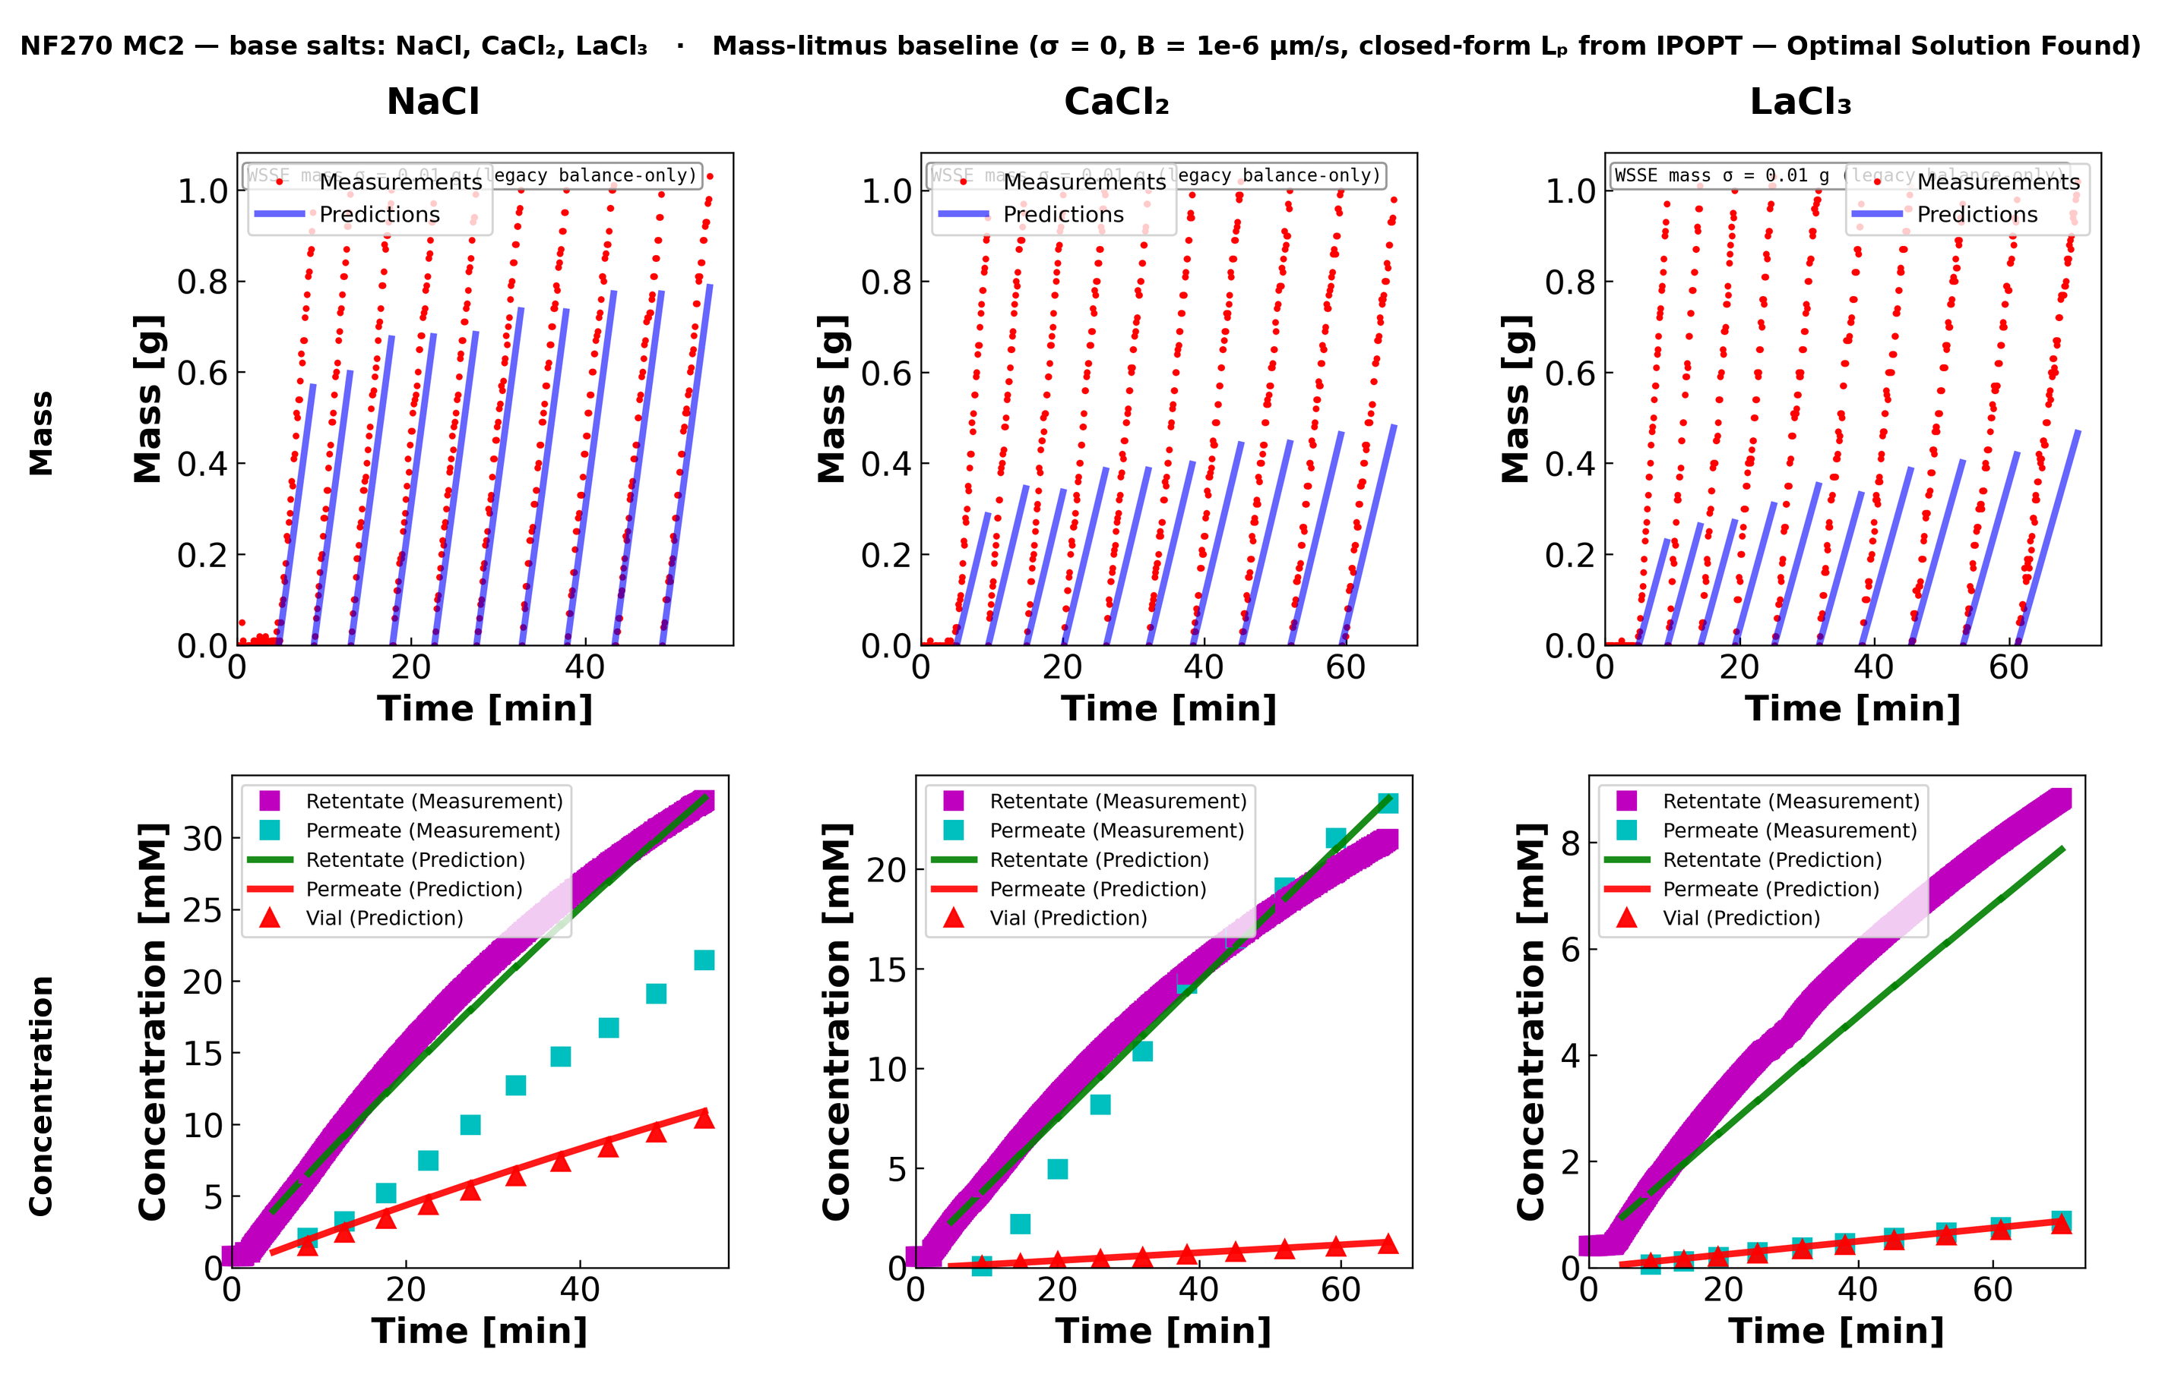

05A · MC2
06
NF270 MC2 — base salts (NaCl, CaCl₂, LaCl₃)
The base-salts panel — what you asked about. Same code, three different cation valences, on the same membrane coupon. Mass-litmus baseline (σ = 0, B = 1e-6) — this is the σ = 0 corner. NaCl mass slope is under-predicted; LaCl₃ best.
6

Slide 40
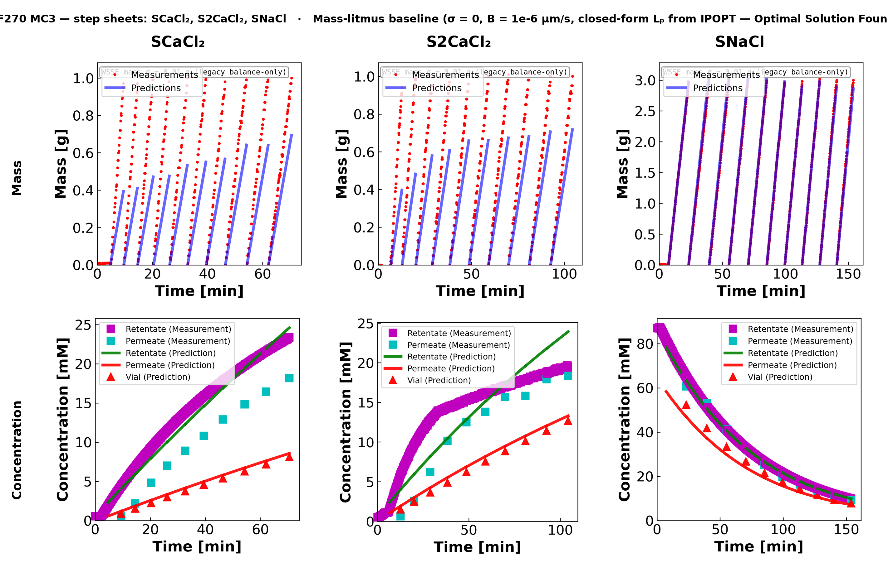
05B · MC3
07
NF270 MC3 — sheets (SCaCl₂, S2CaCl₂, SNaCl)
Second NF270 coupon, three step sheets. Mass-litmus reads similar Lₚ to MC2; SNaCl shows the strongest mass under-prediction (high baseline permeate flow).
7

Slide 41
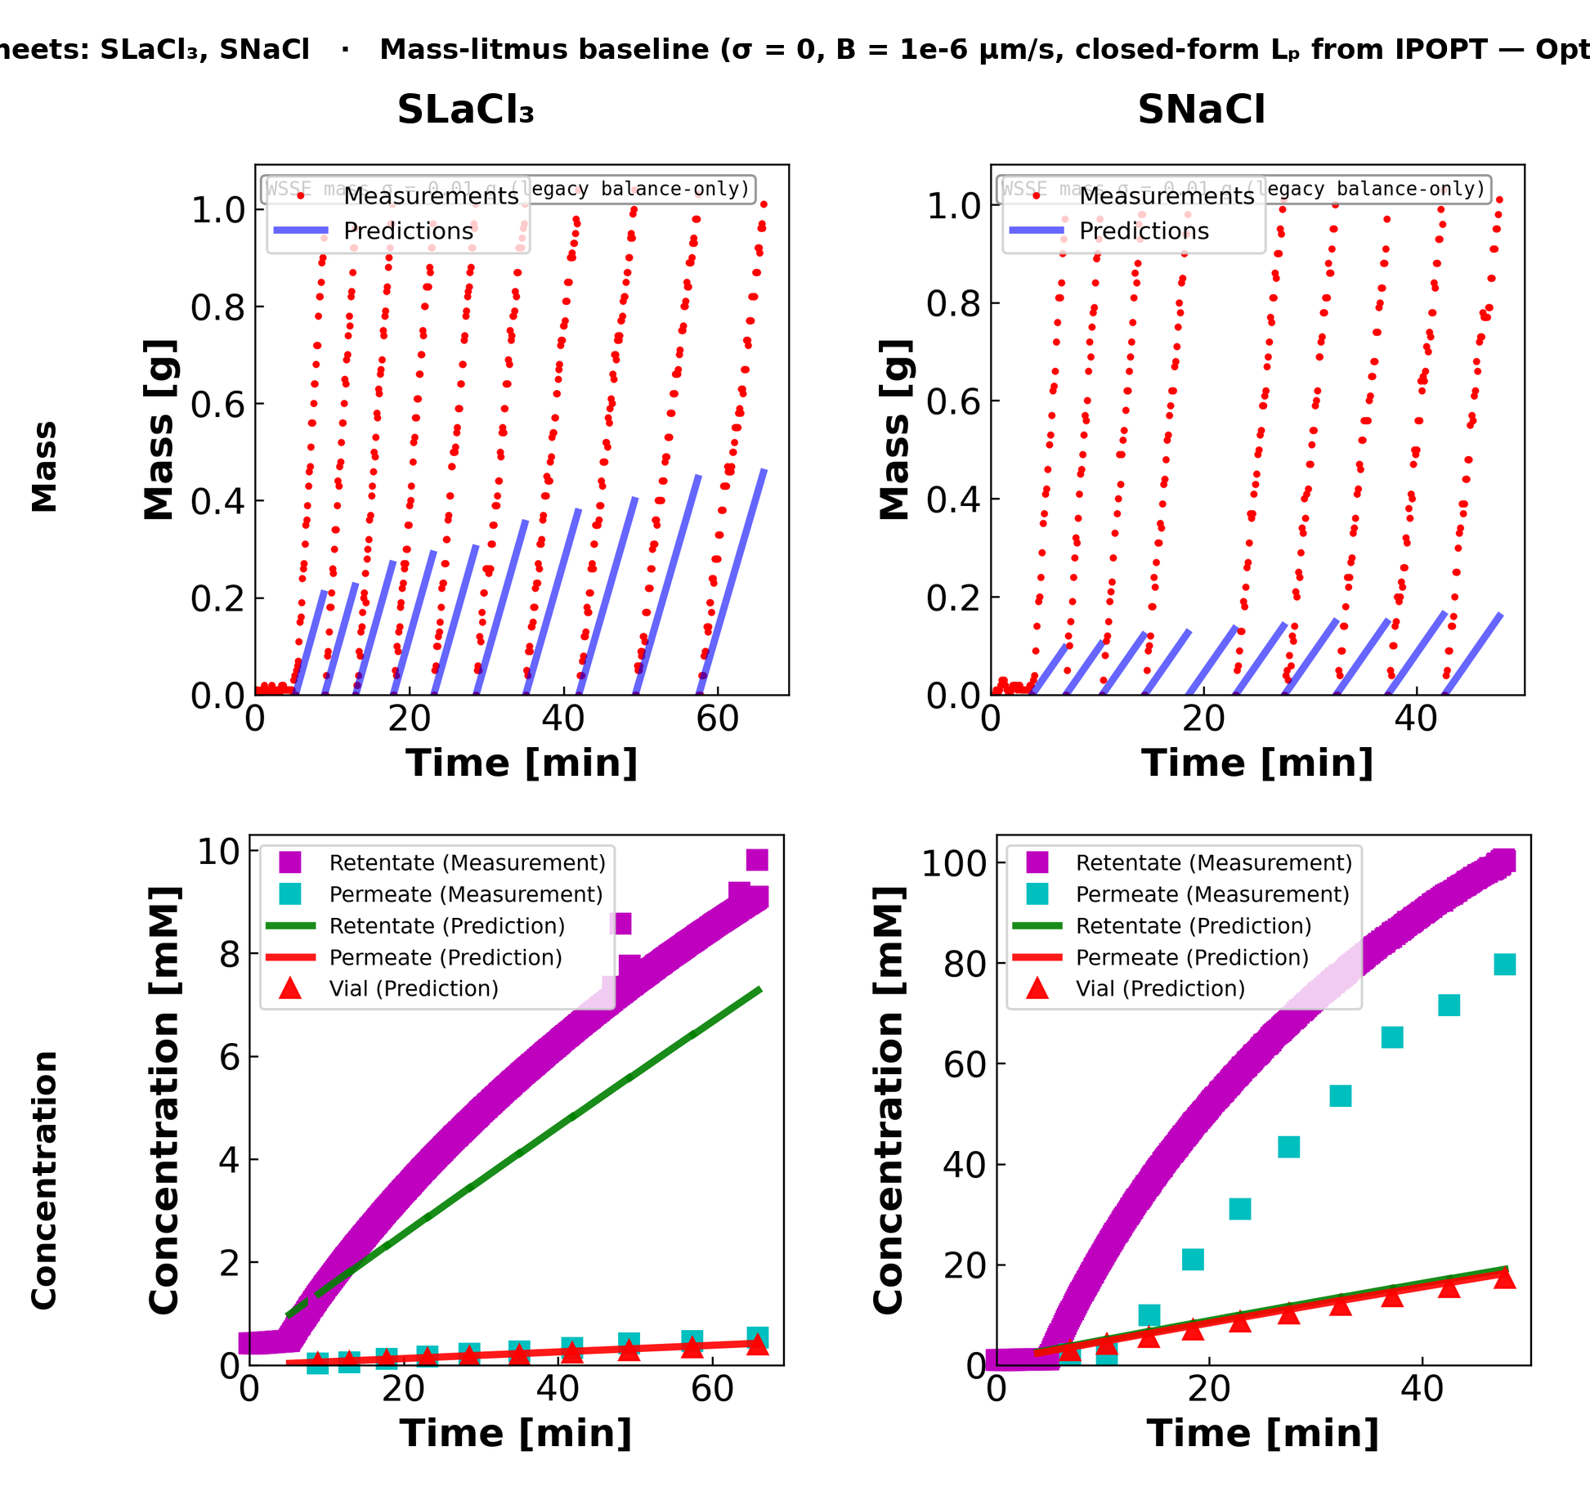
05C · MC4
08
NF270 MC4 — sheets (SLaCl₃, SNaCl)
Third coupon, two step sheets only (SLaCl₃ + SNaCl). LaCl₃ rejection again very high — Final-Tube ICP read ≈ −0.001 mM here, so the R15 anchor is silently skipped on this sheet.
8

Slide 42
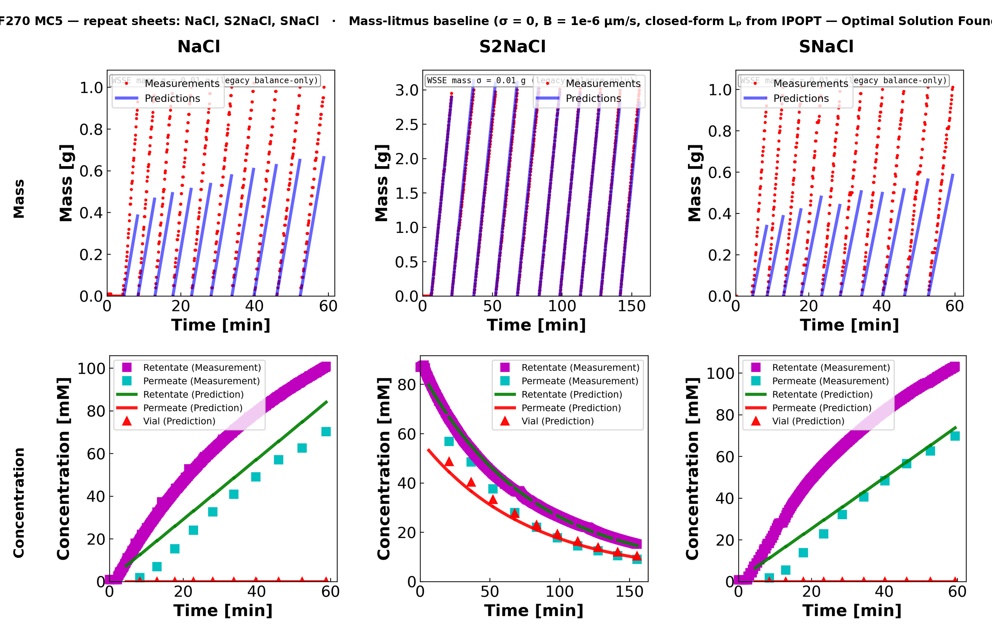
05D · MC5
09
NF270 MC5 — sheets (NaCl, S2NaCl, SNaCl)
Fourth coupon, three repeat NaCl variants. S2NaCl is the diluting-experiment sheet (100 mM Feed, 0 mM Diafiltrate) — that is why the retentate is decreasing.
9

Slide 43
10 · DILUTION VS CONCENTRATION
10
REGIME SPLIT — IT'S NOT WHAT WE THOUGHT
Only 2 of 11 single-salt sheets are diluting; 9 are concentrating
DILUTING REGIME · 2 sheets
CONCENTRATING REGIME · 9 sheets
cF starts HIGH (≈95 mM), DROPS toward zero
Diafiltrate is DI water washing salt out
ΔΠ = (cIn − cH)·ni·RT shrinks ~10× over the run
MC3.07.22.24_SNaCl 95.5 → 10.4 mM ~3 g/vial
MC5.07.23.24_S2NaCl 93.1 → 16.1 mM ~3 g/vial
Fit quality: EXCELLENT
Mass model tracks data; cF curve tracks data;
σ-Lp contour basin sits in the interior (σ ≈ 0.45).
Why? ΔΠ → 0 by mid-run. Any σ between 0 and 1
gives nearly the same Jw → osmotic term doesn't
constrain the fit, but it doesn't hurt it either.
cF starts LOW (≈1 mM), RISES sharply
Diafiltrate is salt solution being added
ΔΠ = (cIn − cH)·ni·RT grows 25 – 100× over the run
MC2 NaCl, MC4 SNaCl, MC5 NaCl, MC5 SNaCl (NaCl)
MC2 CaCl2, MC3 SCaCl2, MC3 S2CaCl2 (CaCl2)
MC2 LaCl3, MC4 SLaCl3 (LaCl3)
Vial mass shrinks from 3 g to ~1 g per vial
Fit quality: MASS UNDER-PREDICTED
Model falls short of full vial mass on every sheet.
σ pinned at the bound (σ = 1.0 on 7 sheets,
σ = 0.0 on 2 sheets). Lp pulled low to compensate.
Diluting and concentrating are not just different runs — they probe the model differently. The σ·ΔΠ term is silent on dilution, dominant on concentration.

Slide 44
11 · MASS PREDICTION SHORTFALL
11
VISUAL EVIDENCE — MASS PER VIAL
Model nails dilution mass; falls short on every concentration sheet
WHAT TO LOOK FOR
Both plots show ~10 vials with per-vial mass reaching ~1 g.
LEFT (diluting): predicted slope rises across vials. Matches data point-for-point.
RIGHT (concentrating): predicted slope is too shallow throughout. Cumulative predicted mass plateaus below the 1 g cap on every vial.
Same code, same θ-space, same WSSE — only the cF trajectory direction is different.
ALL 9 concentrating sheets show this pattern: NaCl, CaCl2, and LaCl3.
MC3.07.22.24_SNaCl (NaCl, diluting) · predictions track data within ~5 %
MC5.07.23.24_NaCl (NaCl, concentrating) · predictions plateau below the 1 g cap

Slide 45
12 · PHYSICS OF THE ASYMMETRY
12
WHY DILUTION ESCAPES, CONCENTRATION SUFFERS
It's the σ·(cIn − cH)·niRT term in Jw
STARLING / KEDEM−KATCHALSKY WATER FLUX
Jw = Lp · [ ΔP − σ · (cIn − cH) · ni · RT ]
DILUTING: ΔΠ shrinks
CONCENTRATING: ΔΠ grows
DIVALENT / TRIVALENT: worse
cF: 95 → 10 mM, ΔΠ falls ~10×
End of run: σ·ΔΠ ≈ 0 regardless of σ
Jw ≈ Lp · ΔP (pure Darcy)
σ unconstrained but harmless.
Mass channel identifies Lp.
Model matches data.
cF: 1 → 100+ mM, ΔΠ rises 25–100×
End of run: σ·ΔΠ is a major term
σ = 1 inflates osmotic backpressure
to ~2× the true physical value
Jw suppressed → mass shortfall.
Lp pulled low to compromise.
Model under-predicts mass.
CaCl2: ni = 3 LaCl3: ni = 4
(vs NaCl: ni = 2)
Per-mM osmotic contribution is
1.5× larger for CaCl2,
2× larger for LaCl3.
σ = 1 wall on all 5 multivalent
sheets → worst mass under-
prediction in the campaign.
Diagnosis: the optimizer landed on σ = 1 because the cF residual channel pulled it there, but σ = 1 is only physically reasonable when ΔΠ is small. It's a fitting artifact, not a physics result.

Slide 46
13 · CONTOUR DIAGNOSIS + FIX
13
σ-Lp CONTOUR — 10 of 11 SHEETS PIN σ AT A BOUND
MC3 SNaCl is the only interior fit. cF residual floor recovers MC4 SNaCl.
CENTERING FIT ACROSS 11 SHEETS
cF RESIDUAL FLOOR · MC4.07.11.24_SNaCl · proof of concept
Sheet
Salt
Lp
B
sigma
wall?
0.3 % relative cF error at 100 mM = 0.3 mM tolerance — tighter than any
actual measurement noise. Flooring the cF residual at 1 mM lets the
optimizer release σ off the σ = 0 wall.
MC3.07.22.24_SNaCl
NaCl
8.22
14.7
0.46
interior
MC2.05.07.24_NaCl
NaCl
9.96
9.68
1.00
WALL
MC4.07.11.24_SNaCl
NaCl
7.79
2.02
0.00
WALL
MC5.07.23.24_NaCl
NaCl
10.03
3.67
1.00
WALL
ORIGINAL
WITH FLOOR
Δ
MC5.07.23.24_SNaCl
NaCl
9.45
3.04
1.00
WALL
Lp
7.79
9.70
+24 %
MC5.07.23.24_S2NaCl
NaCl
7.38
10.2
0.00
WALL
B
2.02
2.60
+28 %
MC2.05.07.24_CaCl2
CaCl2
4.00
0.50
1.00
WALL
sigma
0.00 (wall)
0.46 (interior)
off wall
MC3.07.11.24_SCaCl2
CaCl2
5.53
9.00
1.00
WALL
Obj_mass
89.92
40.19
× 2.2 better
MC3.07.12.24_S2CaCl2
CaCl2
4.63
30.0
1.00
WALL × 2
Obj_concentration
393.71
351.31
× 1.1 better
Obj_retentate
9051.51
45.35
× 200 better
MC2.05.21.24_LaCl3
LaCl3
2.49
0.31
1.00
WALL
MC4.07.11.24_SLaCl3
LaCl3
2.78
0.17
1.00
WALL
PATH FORWARD: cF floor on all 11 sheets + literature σ priors for divalents/trivalents → re-fit campaign.

Slide 47
14 · TIME-AXIS & HOLD-UP CONVENTION
14
BYTE-COMPATIBLE WITH DATA2, ONE NEW DATA3 LAYER
Same t-axis formula. New wet-up handling.
SHARED CONVENTION · DATA1 / DATA2 / DATA3
DATA3-ONLY · HOLD-UP SPLIT
t_delay = data_raw[0]['time'][0]
TI_list[i] = data_raw[i]['time'][0] - t_delay
TF_list[i] = data_raw[i]['time'][-1] - t_delay
t_physical = tau * (TF_i - TI_i) + TI_i
plot_time_min = (t - t_delay) / 60
Operator starts logging before any permeate reaches the vial.
First ~400 s is membrane wetting up — mass dead-flat at tare.
Loader auto-detects and carves it off.
i_start = first i where (m[i] - m[0]) >= 0.05 g
if i_start >= 3 and (N - i_start) >= 10:
split into [0..i_start) and [i_start..N)
cfg['n_v0'] = 2 # objective skips < n_v0
cfg['n_extra'] = 1 # holdup vial count
cfg['vial1_split_status'] = 'split'
DATA2 · utility.py
DATA3 · refactored_ucb_library.py
Time origin : line 115
TI/TF lists : lines 473, 477
Mass reset : lines 736-743
(Pyomo linking)
Holdup : none
(pre-curated)
Time origin : :170
TI/TF lists : :1273, :1277
Mass reset : :3404-3412
(loader, seg-offset)
Holdup : :3522-3590
(auto-detect split)
vial1_split_status values
split
On most C-regime NF270 sheets
skip_no_rise
Mass never crosses threshold (rare)
skip_no_lag
No clear flat-then-rise pattern
skip_no_data
data_raw empty
The model integrates through the holdup but the objective skips it (vial index < n_v0). Same n_extra contract DATA2 uses — only the source of the flag is automated for DATA3.

Slide 48
01 · CODE STRUCTURE
01
How the workflow is organized — roots, trunk, branches
ROOTS — loaders
TRUNK — process
BRANCHES — outputs
loadmat(path)
model_construct_inter
plot_sim_comparison
DATA1 / DATA2 (.mat experiment files)
Pyomo IDAES model
mass + conc + (stirred-cell)
loadxlsx(path, sheet=…)
solve_model(...)
render_*_parameters_table
DATA3 / NF270 (.xlsx campaign files)
ParmEst + multistart
per-campaign param tables
Both return the same data_stru dict shape: data_config + data_raw[vial].
solve_mass_balance_only
plot_contour
σ=0 closed-form (litmus)
FIM heatmap / σ-sensitivity
calc_FIM(...)
render_nf270_fit_v2
data_config: n, n_v0, n_extra, n_h, n_A M_F0, M_O, C_F0, C_D delP, Temp, Am, rho Lp0, B0, sigma0, theta0 data_raw[i]: time, mass, cF_exp, cV_avg
Fisher-information uncertainty
NF270 saw-tooth + ICP overlay
compute_doe_metrics
report_paper_coverage
Pyomo.DoE D/A/E-optimality
checklist vs published figs
design_next_experiment
run_data3_time_series_plots
Model discrimination output
DATA3 custom-file figures
All public API in refactored_ucb_library.py. conductivity_paper.py is the only sibling, frozen.
1

Slide 49
02 · HOW TO RUN IT
02
The runfile asks four questions, then dispatches
1
ROOT — pick a data source
Choices:
Which campaign or file are you working from?
1 DATA1 2 DATA2 3 DATA3 / NF270 4 custom file
2
SUBSET — narrow within the root
Choices:
Within the chosen root, which sheets / files to run?
DATA3: all 26 | single-salt 11 | one sheet | fast 3
3
TRUNK — pick the workflow
Choices:
Simulate, fit, multistart, FIM, DoE, or mass-litmus.
0 manifest default 3 fit+multistart 4 + FIM 5 + DoE 6 mass-litmus
4
BRANCHES — choose outputs
Choices:
Which plots / tables to produce.
m mass c conc p params f FIM heatmap d DoE all
→ DISPATCH: materialize_all(...) for DATA1 / DATA2 / DATA3, or run_pipeline(...) for custom files.
2

Slide 50
Backup Files
📎

Slide 51
03 · REPRODUCIBILITY
03
Byte-identical replication of DATA1 + DATA2 published figures
DATA1 — Apparatus Figure 2 (KCl mass vs time)
DATA2 — Lag-mode Figure 6 (KCl retentate cF)
manifest_default calls materialize_all with the exact same args the legacy runfile used — no extra_opts overrides flow through; conductivity_paper.py stays frozen.
3

Slide 52
04 · DATA3 FIRST RUN
04
DATA3 first run: same code, three salts — three distinct failure patterns
First DATA3 fit on the 11 single-salt sheets. Same WSSE objective: Obj = 1e4 · ( Σ (Δm/0.01)²/N_m + Σ (Δcv/(0.03·cv))²/N_v + Σ (Δcf/(0.003·cf))²/N_r ). Three distinct failure patterns appear — all σ-pathologies, not data bugs:
MODE A — moderate σ↑
MODE B — σ → 1.0 (degenerate)
MODE C — σ↓, over-prediction
MASS
MASS
MASS
vial-1 prediction overshoots to ~1.5 g; vials 2-10 plateau at 0.7-0.95 g (below the 1.0 g cap).
predictions explode to 6-10 g per vial; model thinks much more permeate is flowing than the balance shows.
predictions overshoot to 6-12 g per vial — same direction as Mode B but conc plot tells a different story.
CONCENTRATION
CONCENTRATION
CONCENTRATION
predicted retentate matches measured retentate; predicted vial under-predicts ICP-OES by ~30 %.
predicted retentate severely under-predicts (8 vs 22 mM); predicted vial = 0 across the run.
predicted retentate > measured retentate (60 vs 43 mM); predicted vial > ICP — model lets too much salt through.
4

Slide 53
05 · MASS-LITMUS BASELINE
05
Bad ParmEst fit vs mass-litmus baseline — σ=0 closed-form Lp regression
Left = ParmEst full fit (σ released, B fitted, IPOPT) — landed in the Mode B σ=1 corner. Right = mass-litmus baseline: σ=0, B dropped, Lp from closed-form regression Lp = slope · 36000 / (Am · ρ · ΔP) where slope = Σ(Δt · m) / Σ(Δt²). Always optimal by construction. The baseline beats the full fit → σ/B parameters are not yet doing useful work; landscape problem, not model problem.
5

Slide 54
06 · LHS MULTISTART
06
R10 + R12 — Latin Hypercube multistart over (Lp, σ, B), narrowed boxes
Stage
Lp box (linear)
σ box
B / beta_0 box (log)
Basin found · Obj value
SINGLE START
Lp0 = 5
σ0 = 0.9
B0 = 0.5
Mode B (σ → 1) · Obj = 2.04 × 10⁸
LHS R10
[5, 14]
(0.10, 0.95) open
log [1e-6, 5]
Mode C (σ = 0) · Obj = 4.93 × 10⁷ (4× reduction)
LHS R12
[5, 8] narrowed
(0.10, 0.95) open
log [0.01, 5]
Mode B again · Obj = 6.08 × 10⁹ (cornered)
LHS samples and corner-hopping — what the math says
Latin-Hypercube: draw N starts so that, after permuting columns, each of the N strata along every axis contains exactly one sample. θ_k = θ_lo + LHS_unit[k] · (θ_hi - θ_lo). Better space coverage than IID for small N.
IPOPT is local. Multistart is a global-search heuristic: best_fit = argmin_{k=1..N} Obj(IPOPT(θ_k)) over optimal-status runs. Narrowing the LHS box keeps starts inside the physics window but doesn't restrict where IPOPT can terminate.
R10: factor-of-4 Obj cut by escaping Mode B. R12: tightening Lp to [5,8] removed the upper-Lp draws but the σ=1 corner remains attractive when loss-function structure prefers it. Landscape fix has to come from new observables, not box-tightening alone.
Pyomo Var bounds remain wider than the LHS box: Lp ∈ (0.5, 50), B ∈ (1e-6, 30), σ ∈ (0, 1). LHS just controls trial starts; if a corner solution is the true global minimum it will still be reached. The next two slides tackle the loss-function side.
6

Slide 55
07 · MASS SCALING
07
Tried per-sheet quadrature (R11) → reverted to DATA2's 0.01 g convention (R13)
WSSE MASS TERM — frequentist / MLE reading:
obj_m = Σ_i ( (m_pred_i − m_meas_i) / mass_scale_g )² / N_m
Under Gaussian noise N(0, σ²) on m, this is the negative log-likelihood up to a constant. mass_scale_g IS σ — the standard deviation of the noise on a single balance reading. It is a property of the instrument, not of the salt.
R11 — tried per-sheet quadrature
R13 — reverted to DATA2 convention
mass_scale_g = sqrt( σ_balance² + (α · |M_F0 − Final|)² ), α = 0.05.
Idea: salt-aware scaling so NaCl/CaCl₂/LaCl₃ each get a sensible mass weight. NaCl: 0.020 g · CaCl₂: 0.013 g · LaCl₃: 0.011 g.
Result: Obj jumped from 4.93×10⁷ (LHS R10) to 6.08×10⁹ on NaCl-MC2 — looser mass term let optimizer slide to σ=1 corner. The α·|signal| term was Bayesian regularization in disguise.
mass_scale_g = MASS_BALANCE_SIGMA_G = 0.01 g, salt-independent, sheet-independent — matches DATA2 published convention.
Frequentist justification: σ_balance is a property of the analytical balance, not of the salt. Reweighting the loss function per salt would mean "different noise model per salt" — physically wrong.
Salt-specific physics belongs in the parameters (θ = (Lp, B, σ)), not in the noise model.
DATA1 / DATA2 stay byte-identical: both objectives use data_stru['data_config'].get('mass_scale_g', 0.01), so missing field → 0.01 g. Path forward: add observables (next slide), not new weights.
7

Slide 56
08 · NEW OBSERVABLES
08
Sidebar ICP-OES (R14) + Final Tube anchor in WSSE (R15)
WHAT WAS HIDDEN — sidebar cols 14-21
FINAL TUBE ICP — per sheet (R14)
Feed / Diafiltrate / Retentate / Final Tube ICP rows — ignored by old loader.
Conversion (per row): c [mM] = ICP [mg/L] · (V_samp + V_acid) / V_samp / cation_MW [g/mol].
Stoichiometry: 1 cation / formula unit holds for NaCl, KCl, CaCl₂, LaCl₃ → c [mM of salt] = c [mM of cation].
R15 anchor (added to both obj_rule functions): obj_cf += ((cF[N, τ_last] − Final_Tube_ICP) / (0.003 · Final_Tube_ICP))².
Same 0.3% relative weighting DATA2 uses for per-sample cF. R16 also parses RPM from notes.
icp_final_mM is None / ≤0 → anchor silently skipped (DATA1/DATA2 unchanged).
NaCl-MC2 cF_final
23.9 mM
CaCl₂-MC2 cF_final
25.1 mM
LaCl₃-MC2 cF_final
0.99 mM
S2NaCl-MC5 cF_final
8.32 mM
SLaCl₃-MC4 cF_final
−0.001 mM (skip)
SNaCl-MC4 cF_final
86.6 mM
8

Slide 57
09 · OPEN QUESTIONS
09
Open questions — frequentist, no priors; corner-hopping still in play
Q1
σ reparameterization?
Should we reparameterize σ = exp(η)/(1+exp(η)), η ∈ ℝ, to eliminate the {σ=0, σ=1} corners? Frequentist-neutral (pure change of variables in the parameter space).
experimental
Q2
Two-stage fit?
Profile-likelihood approach: lock Lp from mass-litmus (Lp̂ = slope · 36000 / (Am · ρ · ΔP)), then fit (σ, B) on concentration only. Equivalent to a frequentist profile over the Lp axis.
computational
Q3
Interior σ box?
Tighten Pyomo Var bound from σ ∈ (0,1) to σ ∈ [0.30, 0.85]. If Obj jumps back up after constraining the interior, the corners are global minima → model is mis-specified.
computational
Q4
Retentate weight?
Is 0.3% the right standard deviation for the in-line retentate conductivity probe? If actual noise is 1-2%, the cF term currently dominates the WSSE by 9-44× relative to truth. Easy sensitivity test.
both
9

Slide 58
10 · REPRODUCE
10
How to run this on your machine — five steps
STEPS
1. Drop in refactored_ucb_library.py and refactored_ucb_runfile.py (single consolidated files).
2. python refactored_ucb_runfile.py pick ROOT=3 (NF270) SUBSET=2 (single-salt) TRUNK=6 (mass-litmus)
3. Verify data_config: vial1_split_status=="split", Lp0_method=="data_driven", icp_final_tube_mM is populated.
4. Re-run TRUNK=3 with N=5 LHS starts. Report fitted (Lp̂, B̂, σ̂) per sheet + final Obj + Final Tube residual.
5. Verify data_config carries: mass_scale_g=0.01, icp_*_mM, stir_rpm. Compute mass-litmus baseline Lp = slope·36000/(Am·ρ·ΔP); confirm full fit beats it.
WHAT WOULD HELP US MOST
WHAT TO WATCH FOR
Your priors on σ for NF270 with NaCl, CaCl₂, LaCl₃ — even rough ranges.
Whether the three modes correspond to specific salts you've seen behave this way.
Which sheet you'd focus on first if you were us.
σ̂ → 1 with Lp̂ → 0.5 (lower bound) — Mode B corner.
σ̂ → 0 with B̂ → large — Mode C corner (LHS-R10 basin).
Final Tube residual (cF[N,τ_last]−ICP) on the order of σ_cf = 0.003·cF → fit consistent with measurement.
10

Slide 59
B01 · PROBLEM STATEMENT
11
Dynamic inverse problem — what we are solving for
UNKNOWNS
OPTIMIZATION
θ = ( Lp , B , σ ) Lp : hydraulic permeability [ L / m² / hr / bar ] B : solute permeability [ μm / s ] σ : reflection coefficient [ dimensionless, 0 ≤ σ ≤ 1 ] Measurements per vial i and sample j: mV_i,j : mass collected in vial i at time t_j [g] cF_i,j : retentate concentration [mM] cV_i : per-vial permeate concentration (scalar) [mM]
θ̂ = argmin_θ Obj(θ ; D) subject to: DAE & initial conditions parameter bounds The model outputs (mV, cF, cV) are not algebraic in θ. They come from solving coupled ODEs over (n_vial, τ). Pyomo turns the dynamic model into one nonlinear program over { θ, all state values at all τ-nodes }.
KEY POINT — WHY THE FIT IS HARD
1. The forward map θ → ( mV, cF, cV ) is nonlinear and dynamic. Even small θ-changes can shift basins → IPOPT can converge to different local minima depending on initialization. 2. σ has both lower (σ = 0, no rejection) and upper (σ = 1, complete rejection) corner basins. Each corner trivializes the model in a different way, and is hard to escape once the optimizer is nearby. Hence LHS multistart (R10/R12) and structural fixes. 3. The WSSE weights (1 / σ_meas) determine which residual the optimizer cares about most. Salt-specific physics belongs in θ, not in σ_meas — see R11→R13 in slide 7.
11

Slide 60
B02 · DATA CONTRACT
12
data_stru — one shape, two loaders (loadmat, loadxlsx)
data_config (per experiment)
data_raw[i] (one entry per vial)
n # number of vials n_v0 # first real (non-holdup) vial n_extra # holdup vials skipped in WSSE delP # applied pressure [bar] Temp # temperature [K] Am # membrane area [cm²] rho # density [g/cm³] M_F0 # initial feed mass [g] M_O # M_F0 − Final [g] C_F0 # initial feed conc. [mM] C_D # diafiltrate conc. [mM] namec # salt name (e.g. "NaCl") Lp0, B0, sigma0 # initial guesses mass_scale_g # WSSE mass weight, 0.01 g stir_rpm # R16, parsed from notes icp_feed_mM icp_diafiltrate_mM icp_retentate_mM icp_final_tube_mM # R14/R15 anchor
time # sample times [s], per-vial start at 0 mass # cumulative balance reading, per-vial reset: # mass[t] = balance[t] − balance[t_start] # (matches DATA2 .mat convention) cF_exp # retentate concentration time-series [mM] # (Shedlovsky-inverted from in-line κ) cV_avg # scalar per-vial permeate conc. [mM] # = mg/L · dilution / cation_MW Both loaders converge to this shape: loadmat("…/data_stru-dataset270511.12.mat") ↓ data_stru = {"data_config": …, "data_raw": […]} ↑ _load_legacy_data_stru_from_excel("NF270_MC2.xlsx", selector="05.07.24_NaCl") Downstream code (solve_model, calc_FIM, plot_*) never knows whether the source was .mat or .xlsx.
12

Slide 61
B03 · PHYSICS MODEL
13
Lumped-parameter membrane transport — what each θ does
Lₚ
Hydraulic permeability
B
Solute permeability
σ
Reflection coefficient
L / (m² · hr · bar) sets J_w against ΔP
μm / s sets diffusive solute flux J_s
0..1 sets the osmotic backpressure
WATER FLUX J_w [cm/s]
SOLUTE FLUX J_s [mol/(cm²·s)]
CONCENTRATION POLARIZATION
J_w · 36000 = Lₚ · [ ΔP − σ · n_i · R · T · ( c_in − c_H ) ]
J_s · 10000 = B · ( c_in − c_H )
c_in = ( c_F − c_H ) · exp( J_w / k ) + c_H
m.Jw[n,t] · 36000 == m.Lp · (delP − (m.cIn − m.cH) · ni · m.sigma · R · T)
single-B form: m.Js[n,t] · 10000 == m.B · (m.cIn − m.cH)
k = 0.23 · v^0.57 · D^0.67 / (ν^0.24 · b^0.43), v = (RPM/60) · π · b
DIAFILTRATE (constant)
STIRRED CELL (feed)
HOLDUP (m_H = 0.25 mL)
COLLECTING VIAL
c_D = const (mM) M_D → pumped in at S S fit during holdup (Lag mode only)
dm_F / dt = − S₀ − A_m · ρ · J_w (Lag, post-holdup) dm_F / dt = + S / 3600 (Lag, in holdup) dc_F / dt = ( A_m · ρ / m_F ) · ( c_D · J_w − J_s )
dc_H / dt = ( A_m · ρ / m_H ) · ( J_s − c_H · J_w ) c_in = (c_F − c_H) exp(J_w/k) + c_H ↑ algebraic constraint
dm_V / dt = A_m · ρ · J_w d(c_V · m_V)/dt = A_m · ρ · J_w · c_H c_V = (c_V · m_V) / m_V ↑ avoids 0/0 at vial start
Parameter estimation problem: θ̂ = argmin_θ Σ ( y_meas − h(x(θ), t) )² / σ_meas² subject to the DAEs above
13

Slide 62
B04 · DYNAMIC STATES
14
Pyomo states + the cVmV trick (avoiding 0/0)
STATES
WHY cVmV AND NOT cV DIRECTLY?
m.cF [n_vial, τ] retentate / feed concentration [mM] m.cH [n_vial, τ] holdup concentration [mM] m.mV [n_vial, τ] cumulative vial mass [g] m.cVmV [n_vial, τ] extensive vial solute c_V · m_V m.cV [n_vial, τ] vial concentration [mM] Algebraic constraint: m.cV [n,t] · m.mV [n,t] == m.cVmV [n,t] Domains: m.n_vial = RangeSet(N_VIAL) m.tau = ContinuousSet(bounds=(0, 1)) Derivatives (Pyomo DAE): m.dcF = DerivativeVar(m.cF, wrt=m.tau) m.dcH = DerivativeVar(m.cH, wrt=m.tau) m.dmV = DerivativeVar(m.mV, wrt=m.tau) m.dcVmV = DerivativeVar(m.cVmV, wrt=m.tau)
At the start of each vial, m_V → 0. Computing c_V = c_VmV / m_V is singular there. Trick: evolve the EXTENSIVE quantity first, then recover the intensive variable algebraically: d(c_V · m_V) / dt = A_m · ρ · J_w · c_H (well-defined) c_V = (c_V · m_V) / m_V (algebraic, only evaluated where m_V > 0) This is a classic dynamic-modeling pattern: keep ODEs on extensive quantities (mass, total solute) and use algebraic constraints for intensive quantities (concentrations). Numerical payoff: IPOPT does not have to chase 0 / 0 near τ = 0 in each vial — the constraint is always non-singular.
14

Slide 63
B05 · ODEs
15
States, derivatives, and the time-scaling factor
STATES & DERIVATIVES
VIAL MASS d m_V / d t
m.cF [n, τ] retentate / feed [mM] m.cH [n, τ] holdup [mM] m.mV [n, τ] cumulative vial mass [g] m.cVmV [n, τ] extensive solute c_V · m_V m.cV [n, τ] vial concentration [mM] derivatives via Pyomo DAE: m.dcF = DerivativeVar(m.cF, wrt=m.tau) m.dcH = DerivativeVar(m.cH, wrt=m.tau) m.dmV = DerivativeVar(m.mV, wrt=m.tau) m.dcVmV = DerivativeVar(m.cVmV, wrt=m.tau) algebraic recovery: c_V · m_V = c_VmV (well-defined at m_V = 0)
d m_V / d t = A_m · ρ · J_w
VIAL SOLUTE d (c_V · m_V) / d t
d (c_V · m_V) / d t = A_m · ρ · J_w · c_H
HOLDUP CONCENTRATION d c_H / d t
d c_H / d t = ( A_m · ρ / m_H ) · ( J_s − c_H · J_w )
FEED CONCENTRATION d c_F / d t (DATA mode)
d c_F / d t = ( A_m · ρ / M_F0 ) · ( c_D · J_w − J_s )
TIME-SCALING FACTOR — chain rule
Every Pyomo ODE is multiplied by (TF[n] − TI[n]) / Tauf because τ ∈ [0,1] is rescaled time: dx / dτ = (TF − TI) · dx / dt (chain rule, Tauf = 1) Drop the factor and the dynamics fit the wrong time-window.
15

Slide 64
B06 · TIME SCALING
16
τ ∈ [0, 1] per vial — why every ODE has a (TF−TI) factor
WHY NORMALIZE?
CHAIN RULE — WHERE THE FACTOR COMES FROM
Different vials run for different durations. Vial 1 might be 8.6 min, vial 5 might be 4.8 min. If we worked in physical seconds, each ODE in each vial would have a different integration window. Pyomo DAE wants a single ContinuousSet shared across all vials. Solution: rescale each vial to τ ∈ [0, 1]: t ∈ [ TI[n] , TF[n] ] → τ = ( t − TI ) / ( TF − TI ) m.tau = ContinuousSet( bounds=(0, Tauf=1) ) Same τ grid is reused for every vial — cleaner discretization, smaller global problem, better numerical conditioning.
dx / dt = ( dx / dτ ) · ( dτ / dt ) dτ / dt = 1 / ( TF − TI ) so: dx / dτ = ( TF − TI ) · ( dx / dt ) That is why every Pyomo ODE in this code is multiplied by (TF_dict[n] − TI_dict[n]) / Tauf It is NOT a free unit-conversion factor — it is the chain-rule artifact of rescaling time to a unit interval. Drop it, and IPOPT silently fits the wrong dynamics.
16

Slide 65
B07 · DAE → NLP
17
Backward finite difference, nfe = 300, CasADi initialization
DISCRETIZATION
WHY THIS BEATS sim+opt
TransformationFactory("dae.finite_difference") .apply_to( instance, nfe = 300, scheme = "BACKWARD" ) The continuous ODE d x / d τ = f ( x, θ ) becomes: ( x[k] − x[k−1] ) / Δτ = f ( x[k], θ ) k = 1 .. nfe with Δτ = 1 / nfe = 1 / 300. Number of NLP variables ≈ N_VIAL × ( nfe + 1 ) × N_states = 11 × 301 × 7 ≈ 23,000 plus θ. The DAE is replaced by ~20,000 algebraic equality constraints.
Naive approach (NOT used here): for each θ proposal: y_sim = scipy.integrate.solve_ivp( ODE, θ ) obj = ‖ y_sim − y_meas ‖² minimize obj via scipy.optimize Problems: derivatives are noisy (finite-diff through the integrator), nested loops are slow, no guarantee of constraint satisfaction during the search. Simultaneous dynamic optimization (what this code does): min Obj(θ, x(·)) s.t. every ODE point IS an equality constraint every initial / boundary condition IS a constraint parameter bounds via Var( bounds = ... ) IPOPT moves θ AND the state grid jointly — exact gradients via automatic differentiation through Pyomo + ASL. CasADi simulator gives a warm start before IPOPT runs.
17

Slide 66
B08 · WSSE OBJECTIVE
18
Weighted least squares — what IPOPT actually minimizes
WSSE OBJECTIVE Obj(θ ; D)
10⁴ · [ Σ_i ( (m_pred_i − m_meas_i) / σ_m )² / N_m + Σ_j ( (c_V_j − c_V_j_meas) / (0.03 · c_V_j_meas) )² / N_v + Σ_k ( (c_F_k − c_F_k_meas) / (0.003 · c_F_k_meas) )² / N_r + R15: ( (c_F[N, τ_last] − ICP_final) / (0.003 · ICP_final) )² ]
σ_m = mass_scale_g = 0.01 g (R13, frequentist balance precision; salt-independent)
MASS TERM
VIAL CONC. TERM
RETENTATE TERM ← strict
( Δm / σ_m )² / N_m
( Δc_V / (0.03 · c_V_meas) )² / N_v
( Δc_F / (0.003 · c_F_meas) )² / N_r
σ_m = 0.01 g is the analytical-balance precision. Under N(0, σ_m²) noise, this is MLE up to a constant.
3 % relative uncertainty on ICP-OES per-vial reads. Hits the optimizer at τ = τ_last for each real vial.
0.3 % relative uncertainty on in-line conductivity. 10× tighter than vial → cF dominates the WSSE.
INTERPOLATION ONTO MEASUREMENT TIMES
IPOPT discretizes onto its own τ-grid. Measurements live at experimental timestamps t_j. For each (n_vial, t_j_scaled), find bracketing nodes τ[k], τ[k+1] and linearly interpolate: ŷ ( t_j ) = y[k] + ( y[k+1] − y[k] ) · ( t_j − τ[k] ) / ( τ[k+1] − τ[k] ) Residuals are evaluated at ŷ(t_j), not at grid nodes. Same trick DATA2 utility.py uses.
18

Slide 67
B09 · IPOPT + MULTISTART
19
Local NLP solver wrapped in a Latin-Hypercube global heuristic
IPOPT call
LHS multistart (R10 + R12)
solver = _build_ipopt_solver() solver.options["max_iter"] = 3000 solver.options["linear_solver"] = ma57 / mumps results = solver.solve(instance, tee=True) On non-optimal termination, retry with MUMPS + more iter: solver.options["linear_solver"] = "mumps" solver.options["max_iter"] = 5000 solver.solve(instance, tee=True)
lhs = _lhs_unit_hypercube( N, d, seed = 13 ) for k in 1 .. N: θ_k = θ_lo + lhs[k, :] · ( θ_hi − θ_lo ) fit_k = solve_model( θ_k ) best = argmin_k Obj( fit_k ) over optimal-status runs Default N = 5 (runfile accepts 5 .. 14) Lp box = linear [ 5, 8 ] (R12 narrowing) B box = log [ 0.01, 5 ] μm/s σ box = linear ( 0.10, 0.95 ) corners excluded
OBSERVED OBJECTIVE PROGRESSION (NF270_MC2 / NaCl)
Single start Obj = 2.04 × 10⁸ basin: Mode B (σ → 1) LHS multistart (R10, Lp ∈ [5, 14]) Obj = 4.93 × 10⁷ basin: Mode C (σ → 0) LHS multistart (R11 quadrature mass) Obj = 6.08 × 10⁹ basin: Mode B (σ → 1) LHS narrowed (R12, Lp ∈ [5, 8]) + R13 Obj = 4.93 × 10⁷ basin: Mode C (σ → 0) LHS narrowed + R14/R15 Final-Tube anchor Obj = TBD (next run) The Pyomo Var bounds are wider than the LHS box (Lp ∈ (0.5, 50), σ ∈ (0,1)) — LHS only controls where trial starts land, not where IPOPT is allowed to terminate. Local optimum.
19

Slide 68
B10 · MASS-LITMUS BASELINE
20
σ = 0 closed-form Lp regression — convex sanity check
DERIVATION
SLOPE FIT (zero-intercept least squares)
Set σ = 0. The Jw equation becomes algebraic: Jw = Lp · ΔP / 36000 (constant in time) The vial-mass ODE simplifies: d mV / dt = Am · ρ · Jw = Am · ρ · Lp · ΔP / 36000 Integrating: mV ( t ) = s · ( t − t_0 ) s = ( Am · ρ · Lp · ΔP ) / 36000 ⇒ Lp = s · 36000 / ( Am · ρ · ΔP ) All we need is the slope s of mass vs time.
Treat every real-vial sample as an observation of: mV_i = s · Δt_i + noise (no intercept) OLS solution: ŝ = Σ_i ( Δt_i · mV_i ) / Σ_i ( Δt_i )² Implementation: solve_mass_balance_only( data_stru ): Δt = time − vial_start_time ŝ = sum(Δt · mass) / sum(Δt²) Lp̂ = ŝ · 36000 / (Am · ρ · ΔP) return fit_stru, sim_stru No Pyomo, no IPOPT. Always optimal by construction. If THIS fit fails, the issue is data / units / time alignment, not the σ-corner landscape.
20

Slide 69
B11 · FIM & UNCERTAINTY
21
Fisher information matrix — eigenstructure tells identifiability
FISHER INFORMATION MATRIX M = J ᵀ · Σ_y⁻¹ · J
J = ∂ y / ∂ θ (n_obs × n_θ) Σ_y = diag( σ_m² , (0.03·c_V)² , (0.003·c_F)² ) V_θ ≈ M ⁻¹
Eigen-decomposition of M: large eigenvalues → tightly constrained directions; small → flat
FROM LATEST DATA3 RUN — NaCl-MC2
FIM INFERENCE
eigenvalue
eig_dir
std (asymptotic)
regime
· σ direction is FLAT (std 2.26 while σ ∈ [0,1]) ⇒ exactly the corner-basin signature. · Lp is the most informative direction (eigenvalue ~9 × 10⁵). · B is the tightest (std 0.0065 μm/s) — but this is a local linearization at the fitted θ̂. · FIM is local: meaningful only near θ̂ under assumed σ_meas.
0.158
B
0.0065
tightest direction
2.776
σ
2.26
flat ← corner basin
907 752
Lp
1.25
most informative
det(M) = 3.99 × 10⁵
trace(M) = 9.08 × 10⁵
cond(M) = 5.7 × 10⁶
ASYMPTOTIC CONFIDENCE ELLIPSOID
( θ − θ̂ ) ᵀ · M · ( θ − θ̂ ) ≤ χ²_{n_θ, 1−α} For α = 0.05, n_θ = 3: threshold = 7.815. In the (Lp, σ) plane, the ellipse is highly elongated along σ.
21

Slide 70
B12 · RUNFILE DISPATCHER
22
Tree walker — ROOTS → SUBSET → TRUNK → BRANCHES → dispatch
refactored_ucb_runfile.py (≈ 184 lines, no science inside)
def main(): root = pick_root() # 1=DATA1 2=DATA2 3=DATA3 4=custom subset = pick_subset(root) # DATA3: all 26 / single-salt 11 / one sheet / fast 3 trunk = pick_trunk() # 0=manifest_default 3=fit+multistart 4=+FIM 5=+DoE 6=mass-litmus branches = pick_branches() # m=mass c=conc p=params f=FIM d=DoE all if root in {1, 2, 3} and trunk == 0: # exact byte-identical replication of published outputs materialize_all( root, subset, branches ) elif root in {1, 2, 3} and trunk in {3, 4, 5}: results = estimate_parameters( root, subset, multistart=True, use_FIM=(trunk≥4), use_DoE=(trunk==5) ) render( results, branches ) elif root in {1, 2, 3} and trunk == 6: # NF270 mass-litmus baseline (sets NF270_MASS_LITMUS_TEST_ACTIVE = True) results = solve_mass_balance_only( load(root, subset) ) render( results, branches ) elif root == 4: # custom XLSX outside the campaign manifest results = run_pipeline( file_path, mode, workflow_family ) render( results, branches ) No physics, no Pyomo, no IPOPT call lives in this file. Replace it with a notebook, a CLI, a web form — the library does not care. All dispatch happens through the kept top-level def-s in refactored_ucb_library.py.
22

Slide 71
B13 · CAVEATS
23
Things to scrutinize before trusting any DATA3 fit
OBJECTIVE WEIGHTS DOMINATE THE ANSWER
cVmV TRICK IS LATENT
Retentate 0.3 % is very tight. Permeate 3 % is loose. Mass 0.01 g is tight on the vial-1 scale (≈ 1 g) but loose on the cell scale (≈ 10 g). Optimizer will prioritize whichever residual has the smallest σ_meas — this is the most common silent failure mode in WSSE parameter estimation.
The fact that the model uses cVmV instead of cV is the difference between an IPOPT solve that succeeds in 6 iterations and one that diverges trying to evaluate 0 / 0. Worth knowing if you refactor the state.
IPOPT IS LOCAL
MASS-LITMUS IS EXCELLENT ENGINEERING
Multistart is a heuristic, not a guarantee. If the loss-function landscape globally prefers a σ corner, every LHS start will find it. Diagnose by tightening σ to [0.30, 0.85] and checking whether Obj jumps up.
A convex closed-form baseline that bypasses Pyomo / IPOPT entirely. If mass-litmus fails, the full fit cannot succeed — issue is in loader, units, or data quality. If it succeeds but the full fit fails, issue is σ-coupling or the optimization landscape.
UNIT CONVERSIONS ARE EVERYWHERE
FIM IS LOCAL
The 36000 in Jw and the 10000 in Js are not cosmetic. They encode the unit system bridging L/(m²·hr·bar) → cm/s and μm/s → cm²·mM-per-time. A wrong factor changes fitted Lp / B / σ silently. No warning will fire.
Meaningful only near θ̂ and under the assumed σ_meas. Reported eigenvalues / stds describe local identifiability, not global uncertainty. For global uncertainty, profile likelihood is the frequentist-clean upgrade.
23

Slide 72
10 · REPRODUCE
10
How to run this on your machine — five steps
STEPS
1. Drop in refactored_ucb_library.py and refactored_ucb_runfile.py (single consolidated files).
2. python refactored_ucb_runfile.py pick ROOT=3 (NF270) SUBSET=2 (single-salt) TRUNK=6 (mass-litmus)
3. Verify data_config: vial1_split_status=="split", Lp0_method=="data_driven", icp_final_tube_mM is populated.
4. Re-run TRUNK=3 with N=5 LHS starts. Report fitted (Lp̂, B̂, σ̂) per sheet + final Obj + Final Tube residual.
5. Verify data_config carries: mass_scale_g=0.01, icp_*_mM, stir_rpm. Compute mass-litmus baseline Lp = slope·36000/(Am·ρ·ΔP); confirm full fit beats it.
WHAT WOULD HELP US MOST
WHAT TO WATCH FOR
Your priors on σ for NF270 with NaCl, CaCl₂, LaCl₃ — even rough ranges.
Whether the three modes correspond to specific salts you've seen behave this way.
Which sheet you'd focus on first if you were us.
σ̂ → 1 with Lp̂ → 0.5 (lower bound) — Mode B corner.
σ̂ → 0 with B̂ → large — Mode C corner (LHS-R10 basin).
Final Tube residual (cF[N,τ_last]−ICP) on the order of σ_cf = 0.003·cF → fit consistent with measurement.
NF270 fitting · diagnosis + fix + open questions for collaborators
10 / 10

Slide 73
B01 · PROBLEM STATEMENT
11
Dynamic inverse problem — what we are solving for
UNKNOWNS
OPTIMIZATION
θ = ( Lp , B , σ ) Lp : hydraulic permeability [ L / m² / hr / bar ] B : solute permeability [ μm / s ] σ : reflection coefficient [ dimensionless, 0 ≤ σ ≤ 1 ] Measurements per vial i and sample j: mV_i,j : mass collected in vial i at time t_j [g] cF_i,j : retentate concentration [mM] cV_i : per-vial permeate concentration (scalar) [mM]
θ̂ = argmin_θ Obj(θ ; D) subject to: DAE & initial conditions parameter bounds The model outputs (mV, cF, cV) are not algebraic in θ. They come from solving coupled ODEs over (n_vial, τ). Pyomo turns the dynamic model into one nonlinear program over { θ, all state values at all τ-nodes }.
KEY POINT — WHY THE FIT IS HARD
1. The forward map θ → ( mV, cF, cV ) is nonlinear and dynamic. Even small θ-changes can shift basins → IPOPT can converge to different local minima depending on initialization. 2. σ has both lower (σ = 0, no rejection) and upper (σ = 1, complete rejection) corner basins. Each corner trivializes the model in a different way, and is hard to escape once the optimizer is nearby. Hence LHS multistart (R10/R12) and structural fixes. 3. The WSSE weights (1 / σ_meas) determine which residual the optimizer cares about most. Salt-specific physics belongs in θ, not in σ_meas — see R11→R13 in slide 7.
NF270 fitting · backup math layer for ARCHITECTURE.md
11 / 23

Slide 74
B02 · DATA CONTRACT
12
data_stru — one shape, two loaders (loadmat, loadxlsx)
data_config (per experiment)
data_raw[i] (one entry per vial)
n # number of vials n_v0 # first real (non-holdup) vial n_extra # holdup vials skipped in WSSE delP # applied pressure [bar] Temp # temperature [K] Am # membrane area [cm²] rho # density [g/cm³] M_F0 # initial feed mass [g] M_O # M_F0 − Final [g] C_F0 # initial feed conc. [mM] C_D # diafiltrate conc. [mM] namec # salt name (e.g. "NaCl") Lp0, B0, sigma0 # initial guesses mass_scale_g # WSSE mass weight, 0.01 g stir_rpm # R16, parsed from notes icp_feed_mM icp_diafiltrate_mM icp_retentate_mM icp_final_tube_mM # R14/R15 anchor
time # sample times [s], per-vial start at 0 mass # cumulative balance reading, per-vial reset: # mass[t] = balance[t] − balance[t_start] # (matches DATA2 .mat convention) cF_exp # retentate concentration time-series [mM] # (Shedlovsky-inverted from in-line κ) cV_avg # scalar per-vial permeate conc. [mM] # = mg/L · dilution / cation_MW Both loaders converge to this shape: loadmat("…/data_stru-dataset270511.12.mat") ↓ data_stru = {"data_config": …, "data_raw": […]} ↑ _load_legacy_data_stru_from_excel("NF270_MC2.xlsx", selector="05.07.24_NaCl") Downstream code (solve_model, calc_FIM, plot_*) never knows whether the source was .mat or .xlsx.
NF270 fitting · backup math layer for ARCHITECTURE.md
12 / 23

Slide 75
B03 · PHYSICS MODEL
13
Membrane transport — Jw, Js, concentration polarization
WATER FLUX Jw [cm/s]
SOLUTE FLUX Js [mol/(cm²·s)]
Jw = ( Lp / 36000 ) · [ ΔP − σ · n_i · R · T · ( c_in − c_H ) ] Pyomo line: m.Jw[n,t] · 36000 == m.Lp · ( delP − (m.cIn[n,t]−m.cH[n,t]) · ni · m.sigma · R · T ) Lp is in L/(m²·hr·bar); the 36000 converts to cm/s. (c_in − c_H) is the osmotic driving force across the membrane.
Js · 10000 = B · ( c_in − c_H ) (single-B form) Pyomo line: m.Js[n,t] · 10000 == m.B · (m.cIn[n,t]−m.cH[n,t]) B is in μm/s; 10000 converts to cm²·mM-per-time units consistent with the rest of the model. For convection-diffusion B_form: Js · 10000 = ( Jw · B · 10000 ) · ( c_in − c_H )
CONCENTRATION POLARIZATION (film model)
c_in = ( c_F − c_H ) · exp( Jw / k ) + c_H Pyomo line: m.cIn[n,t] == (m.cF[n,t] − m.cH[n,t]) · exp( m.Jw[n,t] / k ) + m.cH[n,t] k = mass-transfer coefficient computed from stir velocity v, diameter b, kinematic viscosity ν, and salt diffusivity D via the standard correlation: k = 0.23 · v^0.57 · D^0.67 / (ν^0.24 · b^0.43) where v = (RPM / 60) · π · b R16 update: RPM is now parsed from XLSX notes → data_config["stir_rpm"], used in k. D is salt-specific: K⁺ 1.96e-5, Na⁺ 1.33e-5, Ca²⁺ 0.79e-5, La³⁺ 0.62e-5 cm²/s. Why this matters: the membrane sees c_in, not c_F. Polarization raises c_in above c_F when Jw is large, which couples Lp and σ — a key reason the (Lp, σ) landscape has corner basins.
NF270 fitting · backup math layer for ARCHITECTURE.md
13 / 23

Slide 76
B04 · DYNAMIC STATES
14
Pyomo states + the cVmV trick (avoiding 0/0)
STATES
WHY cVmV AND NOT cV DIRECTLY?
m.cF [n_vial, τ] retentate / feed concentration [mM] m.cH [n_vial, τ] holdup concentration [mM] m.mV [n_vial, τ] cumulative vial mass [g] m.cVmV [n_vial, τ] extensive vial solute c_V · m_V m.cV [n_vial, τ] vial concentration [mM] Algebraic constraint: m.cV [n,t] · m.mV [n,t] == m.cVmV [n,t] Domains: m.n_vial = RangeSet(N_VIAL) m.tau = ContinuousSet(bounds=(0, 1)) Derivatives (Pyomo DAE): m.dcF = DerivativeVar(m.cF, wrt=m.tau) m.dcH = DerivativeVar(m.cH, wrt=m.tau) m.dmV = DerivativeVar(m.mV, wrt=m.tau) m.dcVmV = DerivativeVar(m.cVmV, wrt=m.tau)
At the start of each vial, m_V → 0. Computing c_V = c_VmV / m_V is singular there. Trick: evolve the EXTENSIVE quantity first, then recover the intensive variable algebraically: d(c_V · m_V) / dt = A_m · ρ · J_w · c_H (well-defined) c_V = (c_V · m_V) / m_V (algebraic, only evaluated where m_V > 0) This is a classic dynamic-modeling pattern: keep ODEs on extensive quantities (mass, total solute) and use algebraic constraints for intensive quantities (concentrations). Numerical payoff: IPOPT does not have to chase 0 / 0 near τ = 0 in each vial — the constraint is always non-singular.
NF270 fitting · backup math layer for ARCHITECTURE.md
14 / 23

Slide 77
B05 · ODEs
15
Mass and species balances — what each state evolves under
VIAL MASS m.mV
VIAL SOLUTE m.cVmV
d m_V / d t = A_m · ρ · J_w Pyomo: m.dmV[n,t] == m.Jw[n,t] · A_m · ρ · (TF[n] − TI[n]) / 1
d (c_V · m_V) / d t = A_m · ρ · J_w · c_H Pyomo: m.dcVmV[n,t] == m.Jw[n,t] · m.cH[n,t] · A_m · ρ · (TF[n] − TI[n])
HOLDUP m.cH
FEED m.cF
d c_H / d t = ( A_m · ρ / m_H ) · ( J_s − c_H · J_w ) Pyomo: m.dcH[n,t] == A_m · ρ / m_H · ( m.Js[n,t] − m.cH[n,t] · m.Jw[n,t] ) · (TF[n] − TI[n])
d c_F / d t = ( A_m · ρ / M_F0 ) · ( c_D · J_w − J_s ) Pyomo (DATA mode): m.dcF[n,t] == A_m · ρ / M_F0 · ( m.cD · m.Jw[n,t] − m.Js[n,t] ) · (TF[n] − TI[n])
LAG / OVERFLOW MODES
In Lag and Overflow modes, m_F becomes dynamic too: d m_F / d t = − S₀ − A_m · ρ · J_w (Lag, after holdup) d m_F / d t = S / 3600 (Lag, during holdup) S₀, S are fit parameters describing leakage / diafiltrate inflow.
NF270 fitting · backup math layer for ARCHITECTURE.md
15 / 23

Slide 78
B06 · TIME SCALING
16
τ ∈ [0, 1] per vial — why every ODE has a (TF−TI) factor
WHY NORMALIZE?
CHAIN RULE — WHERE THE FACTOR COMES FROM
Different vials run for different durations. Vial 1 might be 8.6 min, vial 5 might be 4.8 min. If we worked in physical seconds, each ODE in each vial would have a different integration window. Pyomo DAE wants a single ContinuousSet shared across all vials. Solution: rescale each vial to τ ∈ [0, 1]: t ∈ [ TI[n] , TF[n] ] → τ = ( t − TI ) / ( TF − TI ) m.tau = ContinuousSet( bounds=(0, Tauf=1) ) Same τ grid is reused for every vial — cleaner discretization, smaller global problem, better numerical conditioning.
dx / dt = ( dx / dτ ) · ( dτ / dt ) dτ / dt = 1 / ( TF − TI ) so: dx / dτ = ( TF − TI ) · ( dx / dt ) That is why every Pyomo ODE in this code is multiplied by (TF_dict[n] − TI_dict[n]) / Tauf It is NOT a free unit-conversion factor — it is the chain-rule artifact of rescaling time to a unit interval. Drop it, and IPOPT silently fits the wrong dynamics.
NF270 fitting · backup math layer for ARCHITECTURE.md
16 / 23

Slide 79
B07 · DAE → NLP
17
Backward finite difference, nfe = 300, CasADi initialization
DISCRETIZATION
WHY THIS BEATS sim+opt
TransformationFactory("dae.finite_difference") .apply_to( instance, nfe = 300, scheme = "BACKWARD" ) The continuous ODE d x / d τ = f ( x, θ ) becomes: ( x[k] − x[k−1] ) / Δτ = f ( x[k], θ ) k = 1 .. nfe with Δτ = 1 / nfe = 1 / 300. Number of NLP variables ≈ N_VIAL × ( nfe + 1 ) × N_states = 11 × 301 × 7 ≈ 23,000 plus θ. The DAE is replaced by ~20,000 algebraic equality constraints.
Naive approach (NOT used here): for each θ proposal: y_sim = scipy.integrate.solve_ivp( ODE, θ ) obj = ‖ y_sim − y_meas ‖² minimize obj via scipy.optimize Problems: derivatives are noisy (finite-diff through the integrator), nested loops are slow, no guarantee of constraint satisfaction during the search. Simultaneous dynamic optimization (what this code does): min Obj(θ, x(·)) s.t. every ODE point IS an equality constraint every initial / boundary condition IS a constraint parameter bounds via Var( bounds = ... ) IPOPT moves θ AND the state grid jointly — exact gradients via automatic differentiation through Pyomo + ASL. CasADi simulator gives a warm start before IPOPT runs.
NF270 fitting · backup math layer for ARCHITECTURE.md
17 / 23

Slide 80
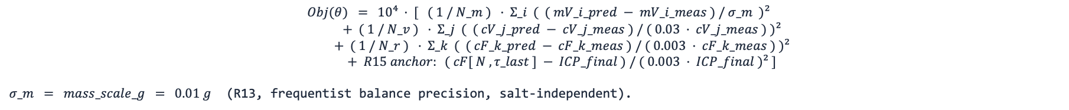
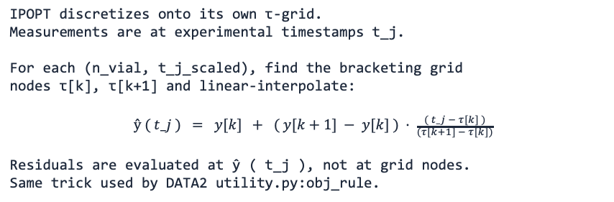
B08 · WSSE OBJECTIVE
18
Weighted least squares + interpolation onto measurement times
OBJECTIVE
(R13, frequentist balance precision, salt-independent).
INTERPOLATION onto MEASUREMENT TIMES
WHY THESE WEIGHTS
IPOPT discretizes onto its own τ-grid. Measurements are at experimental timestamps t_j. For each (n_vial, t_j_scaled), find the bracketing grid nodes τ[k], τ[k+1] and linear-interpolate: $ŷ ( t_j ) = y[k] + ( y[k+1] − y[k] ) · \frac{( t_j − τ[k] )}{(τ[k+1] − τ[k])}$ Residuals are evaluated at ŷ ( t_j ), not at grid nodes. Same trick used by DATA2 utility.py:obj_rule.
MLE interpretation: under independent Gaussian noise N( 0, σ_meas² ) on each residual, the WSSE is the negative log-likelihood up to constants. σ_meas (mass) = 0.01 g (balance precision) σ_meas (vial conc.) = 3 % · cV_meas σ_meas (retentate) = 0.3 % · cF_meas Retentate weight is much tighter than vial weight. The optimizer therefore prioritizes cF fit — and that is one mechanism driving the σ=1 corner basin (see slide 6 and the open-questions slide).
NF270 fitting · backup math layer for ARCHITECTURE.md
18 / 23

Slide 81
B09 · IPOPT + MULTISTART
19
Local NLP solver wrapped in a Latin-Hypercube global heuristic
IPOPT call
LHS multistart (R10 + R12)
solver = _build_ipopt_solver() solver.options["max_iter"] = 3000 solver.options["linear_solver"] = ma57 / mumps results = solver.solve(instance, tee=True) On non-optimal termination, retry with MUMPS + more iter: solver.options["linear_solver"] = "mumps" solver.options["max_iter"] = 5000 solver.solve(instance, tee=True)
lhs = _lhs_unit_hypercube( N, d, seed = 13 ) for k in 1 .. N: θ_k = θ_lo + lhs[k, :] · ( θ_hi − θ_lo ) fit_k = solve_model( θ_k ) best = argmin_k Obj( fit_k ) over optimal-status runs Default N = 5 (runfile accepts 5 .. 14) Lp box = linear [ 5, 8 ] (R12 narrowing) B box = log [ 0.01, 5 ] μm/s σ box = linear ( 0.10, 0.95 ) corners excluded
OBSERVED OBJECTIVE PROGRESSION (NF270_MC2 / NaCl)
Single start Obj = 2.04 × 10⁸ basin: Mode B (σ → 1) LHS multistart (R10, Lp ∈ [5, 14]) Obj = 4.93 × 10⁷ basin: Mode C (σ → 0) LHS multistart (R11 quadrature mass) Obj = 6.08 × 10⁹ basin: Mode B (σ → 1) LHS narrowed (R12, Lp ∈ [5, 8]) + R13 Obj = 4.93 × 10⁷ basin: Mode C (σ → 0) LHS narrowed + R14/R15 Final-Tube anchor Obj = TBD (next run) The Pyomo Var bounds are wider than the LHS box (Lp ∈ (0.5, 50), σ ∈ (0,1)) — LHS only controls where trial starts land, not where IPOPT is allowed to terminate. Local optimum.
NF270 fitting · backup math layer for ARCHITECTURE.md
19 / 23

Slide 82
B10 · MASS-LITMUS BASELINE
20
σ = 0 closed-form Lp regression — convex sanity check
DERIVATION
SLOPE FIT (zero-intercept least squares)
Set σ = 0. The Jw equation becomes algebraic: Jw = Lp · ΔP / 36000 (constant in time) The vial-mass ODE simplifies: d mV / dt = Am · ρ · Jw = Am · ρ · Lp · ΔP / 36000 Integrating: mV ( t ) = s · ( t − t_0 ) s = ( Am · ρ · Lp · ΔP ) / 36000 ⇒ Lp = s · 36000 / ( Am · ρ · ΔP ) All we need is the slope s of mass vs time.
Treat every real-vial sample as an observation of: mV_i = s · Δt_i + noise (no intercept) OLS solution: ŝ = Σ_i ( Δt_i · mV_i ) / Σ_i ( Δt_i )² Implementation: solve_mass_balance_only( data_stru ): Δt = time − vial_start_time ŝ = sum(Δt · mass) / sum(Δt²) Lp̂ = ŝ · 36000 / (Am · ρ · ΔP) return fit_stru, sim_stru No Pyomo, no IPOPT. Always optimal by construction. If THIS fit fails, the issue is data / units / time alignment, not the σ-corner landscape.
NF270 fitting · backup math layer for ARCHITECTURE.md
20 / 23

Slide 83
B11 · FIM & UNCERTAINTY
21
Finite-difference sensitivities, covariance, identifiability
SENSITIVITIES
FISHER INFORMATION
Stack predictions: y ( θ ) = [ mV ; cV ; cF ] For each parameter θ_i, perturb and re-simulate: θ_i± = θ̂_i · ( 1 ± h ), h ≈ 10⁻⁴ ∂ y / ∂ θ_i ≈ ( y( θ_i+ ) − y( θ_i− ) ) / ( 2 h θ̂_i ) Code: calc_FIM( data_stru, mode, theta=θ̂, step=1e-8 ).
Sensitivity matrix: J = ∂ y / ∂ θ (n_obs × n_θ) Measurement covariance: Σ_y = diag( σ_m² , (0.03·cV)² , (0.003·cF)² ) M = J ᵀ · Σ_y⁻¹ · J (Fisher Information) Asymptotic parameter covariance: V_θ ≈ M⁻¹ Eigen-decomposition of M tells you identifiability: large eigenvalues → tightly constrained directions small eigenvalues → flat directions, large variance cond(M) ≫ 1 → correlated / ill-conditioned
FROM LATEST DATA3 RUN
NaCl-MC2 after IPOPT: eig(M) = [ 0.158, 2.776, 907,752 ] (well-conditioned in 1 direction!) eig_dir = [ B, σ, Lp ] std = [ 0.0065, 2.26, 1.25 ] trace = 9.08 × 10⁵ det = 3.99 × 10⁵ cond = 5.7 × 10⁶ σ-direction is flat (std 2.26 with σ ∈ [0,1]) — exactly what the corner-basin behaviour predicts. Lp is the most informative direction, B is the tightest. Identifiability is local: it lives at the fitted θ̂, under the assumed σ_meas.
NF270 fitting · backup math layer for ARCHITECTURE.md
21 / 23

Slide 84
B12 · RUNFILE DISPATCHER
22
Tree walker — ROOTS → SUBSET → TRUNK → BRANCHES → dispatch
refactored_ucb_runfile.py (≈ 184 lines, no science inside)
def main(): root = pick_root() # 1=DATA1 2=DATA2 3=DATA3 4=custom subset = pick_subset(root) # DATA3: all 26 / single-salt 11 / one sheet / fast 3 trunk = pick_trunk() # 0=manifest_default 3=fit+multistart 4=+FIM 5=+DoE 6=mass-litmus branches = pick_branches() # m=mass c=conc p=params f=FIM d=DoE all if root in {1, 2, 3} and trunk == 0: # exact byte-identical replication of published outputs materialize_all( root, subset, branches ) elif root in {1, 2, 3} and trunk in {3, 4, 5}: results = estimate_parameters( root, subset, multistart=True, use_FIM=(trunk≥4), use_DoE=(trunk==5) ) render( results, branches ) elif root in {1, 2, 3} and trunk == 6: # NF270 mass-litmus baseline (sets NF270_MASS_LITMUS_TEST_ACTIVE = True) results = solve_mass_balance_only( load(root, subset) ) render( results, branches ) elif root == 4: # custom XLSX outside the campaign manifest results = run_pipeline( file_path, mode, workflow_family ) render( results, branches ) No physics, no Pyomo, no IPOPT call lives in this file. Replace it with a notebook, a CLI, a web form — the library does not care. All dispatch happens through the kept top-level def-s in refactored_ucb_library.py.
NF270 fitting · backup math layer for ARCHITECTURE.md
22 / 23

Slide 85
B13 · CAVEATS
23
Things to scrutinize before trusting any DATA3 fit
OBJECTIVE WEIGHTS DOMINATE THE ANSWER
cVmV TRICK IS LATENT
Retentate 0.3 % is very tight. Permeate 3 % is loose. Mass 0.01 g is tight on the vial-1 scale (≈ 1 g) but loose on the cell scale (≈ 10 g). Optimizer will prioritize whichever residual has the smallest σ_meas — this is the most common silent failure mode in WSSE parameter estimation.
The fact that the model uses cVmV instead of cV is the difference between an IPOPT solve that succeeds in 6 iterations and one that diverges trying to evaluate 0 / 0. Worth knowing if you refactor the state.
IPOPT IS LOCAL
MASS-LITMUS IS EXCELLENT ENGINEERING
Multistart is a heuristic, not a guarantee. If the loss-function landscape globally prefers a σ corner, every LHS start will find it. Diagnose by tightening σ to [0.30, 0.85] and checking whether Obj jumps up.
A convex closed-form baseline that bypasses Pyomo / IPOPT entirely. If mass-litmus fails, the full fit cannot succeed — issue is in loader, units, or data quality. If it succeeds but the full fit fails, issue is σ-coupling or the optimization landscape.
UNIT CONVERSIONS ARE EVERYWHERE
FIM IS LOCAL
The 36000 in Jw and the 10000 in Js are not cosmetic. They encode the unit system bridging L/(m²·hr·bar) → cm/s and μm/s → cm²·mM-per-time. A wrong factor changes fitted Lp / B / σ silently. No warning will fire.
Meaningful only near θ̂ and under the assumed σ_meas. Reported eigenvalues / stds describe local identifiability, not global uncertainty. For global uncertainty, profile likelihood is the frequentist-clean upgrade.
NF270 fitting · backup math layer for ARCHITECTURE.md
23 / 23

Slide 86


Membrane Characterization using a Digital Model
Prior
Knowledge
Experimental Data
Parameter Estimation
Sensitivity & Uncertainty Analysis
Uncertainty Acceptable?
Model with Quantified Uncertainty
Yes
Model(s)
No
Model-Based Design of Experiments
• Dotted lines ⇢ manual data transmission
• Solid lines → automatic data transmission
Notes:
“Membrane characterization can be formulated as a dynamic inverse problem, where we estimate transport parameters from time-resolved experimental data.”
“However, these parameters are often poorly identifiable due to strong correlations, which leads to an ill-conditioned inference problem.”
“To address this, we adopt a closed-loop uncertainty quantification framework.”
👉 (point to diagram)
“We estimate parameters using weighted least squares, quantify uncertainty through sensitivities and the Fisher Information Matrix, and then design new experiments to improve identifiability.”
“This creates a sequential learning loop.”
Final line (slow down):
“Our goal is to reshape the information geometry of the problem so that the parameters become identifiable.”

Slide 87
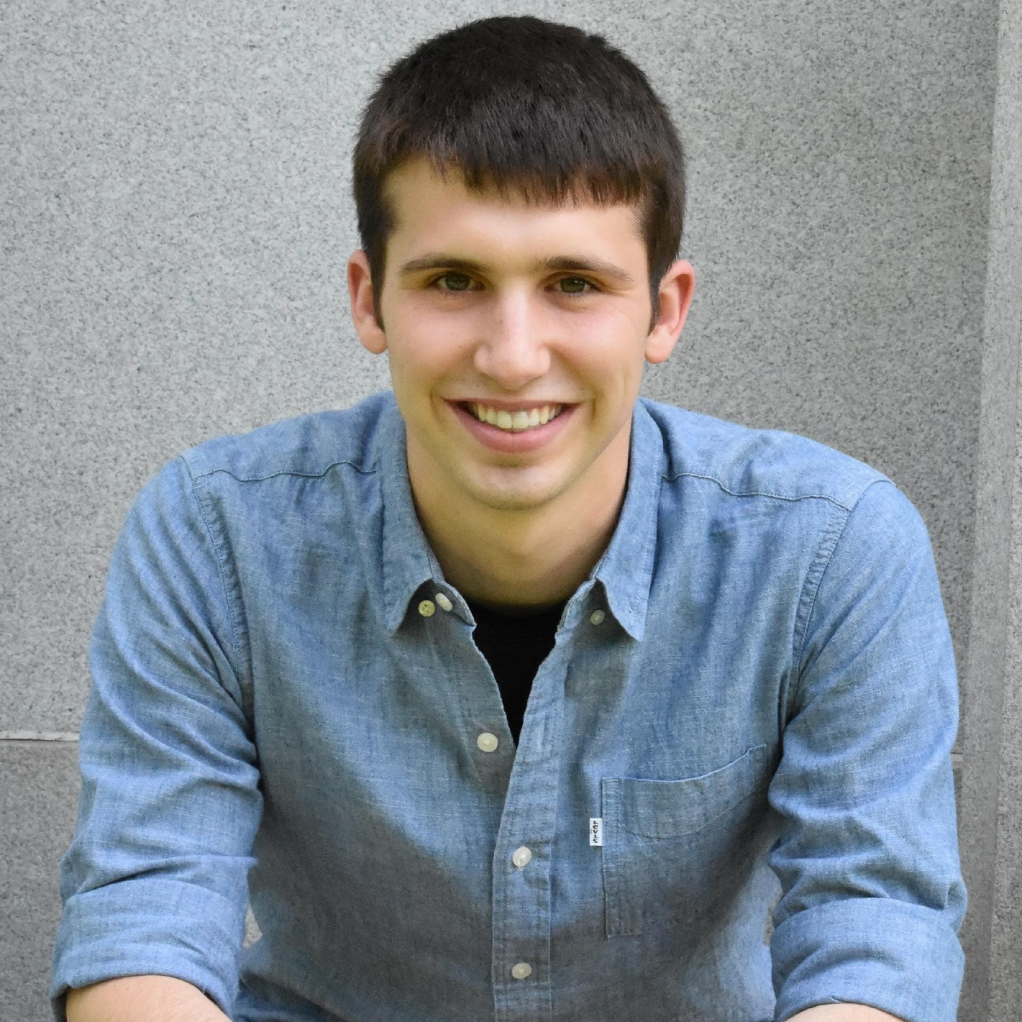

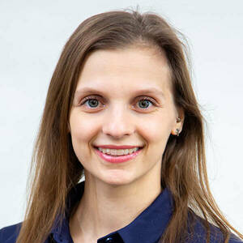










Separation using a Dynamic Diafiltration Device
Pressure Relief Valve
P
Pressure Gauge
Stirred Cell
Scintillation Vials
Diafiltrate Tank
Permeate Outlet
Motor
Retentate Probe
Balance
Membrane
Permeate Probe

Slide 88
Pressure Relief Valve
P
Pressure Gauge
Stirred Cell
Scintillation Vials
Diafiltrate Tank
Permeate Outlet
Motor
Retentate Probe
Balance
Membrane
Permeate Probe

Slide 89








Dynamic Model w/ Lumped Parameter Infers Membrane Properties
Concentration
polarization
Parameter Estimation: $\hat{θ}=\arg{\min_{θ}{(\ln{ℒ(θ|y)})}}=\arg{\min_{θ}{\sum_{r}{{\left(y_{r}−{\hat{y}}_{r}\right)}^{T}V_{r}^{−1}\left(y_{r}−{\hat{y}}_{r}\right)}}}$

Slide 90



Lumped Parameter Model Infers Membrane Properties
Forward Model
$$\frac{dx(t)}{dt}=f(x(t),u(t),θ)$$ $y\left(t\right)=h\left(x\left(t\right),θ\right)+ε\left(t\right)$
where, $$ε\left(t\right)∼𝒩\left(0,Σ\right) \\ x\left(t\right)∈ℝ^{n}; u\left(t\right)∈ℝ^{m}; θ∈ℝ^{p}$$
$$θ=\left[\begin{aligned}L_{p} \\ B \\ σ\end{aligned}\right]$$
Concentration polarization
[Fig.] Ouimet, J. A. et. al., (2022). Journal of Membrane Science, 641, 119743.
Notes:
model parameters, hydraulic permeability Lp, solute permeability coefficient B that correspond to the membrane transport properties,
and reflection coefficient sigma that depends on the thermodynamics of the membrane-solution interface.

Slide 91



Dynamic Diafiltration Experiment Sweeps Larger Concentration Space 5x Faster Than Filtration Experiments
Diafiltrate Reservoir

Slide 92







FIM Highlights Nonidentifiable Parameters
Fisher information matrix (FIM)
Estimated parameters |  | Residuals squared | Eigenvalues of FIM | Eigenvectors of FIM
$$pK_{e}$$ | $$pK_{e2}$$
 |  |  |  | $$pK_{e}$$ | $$pK_{e2}$$
8.16 | 6.18 | 10.74 | -7.02×10⁻⁸ | 3.32×10⁻⁸ | -1.00
 |  |  | 2.10×10² | -1.00 | -3.32×10⁻⁸
$$M= {V_{\hat{θ}}}^{−1}≈\frac{1}{σ_{ε}^{2}}H≈\frac{1}{σ_{ε}^{2}}Q^{T}Q$$
Confidence ellipse for covariance matrix
$$V_{\hat{θ}}= M^{−1}$$
FIM inference
Model predictions $f_{1}\left(x_{i},θ\right)$are insensitive to$K_{e2}$
FIM is rank deficient with Near zero eigenvalue pointing $K_{e2}$
Solely pH cannot identity $K_{e2}$ in Step 1 model $f_{1}$

Slide 93
DATA VALIDATION
Are we plotting what's in the data file?
Three independent pieces of evidence — added 2026-05-27.
1. Loader-fidelity audit · 70,101 / 70,101 data points GOOD
2. Raw-conductivity plot type · collaborator's format reproduced
3. Side-by-side comparison deck · matched on all 11 single-salt sheets

Slide 94
What the loader does to each raw Excel column
Authoritative transformation table — every row verified by the §14.2 audit (next slide).
Variable | Loader transformation | Why
Time (s) | 1:1 preserved (no change) | Time axis is the index; no compensation needed.
Mass (g) | Baseline-subtracted per vial — each vial starts at 0 | Eliminates per-vial offset so mass-vs-time fits compare across vials cleanly.
Pressure (psi) | 1:1 preserved | Applied pressure is a control variable, recorded as-is.
Retentate Temp (°C) | 1:1 preserved | Needed for EC25 compensation of conductivity.
Retentate Cond (μS/cm) | EC25 temperature compensation: σ₂₅ = σ_T · (1 + α·(25−T)) | Probe reports σ at measured T; the model needs σ at 25°C so concentration inversion (Shedlovsky) is consistent across temperatures.
Permeate Temp (°C) | 1:1 preserved | Needed for EC25 compensation of permeate conductivity.
Permeate Cond (μS/cm) | EC25 temperature compensation (same as retentate); tube-transit-time correction on TIME axis, not value | Tube transit τ = V_tube / (dm/dt) shifts the permeate time axis to account for the 0.3 g dead volume between membrane and probe.
Vial Swap | 1:1 preserved | Index flag; used by loader to slice the continuous time-series into per-vial blocks.
ICP (cV_avg per vial) | Extracted from vial-data block (cols 14–21); one scalar per vial. Conductivity calibration applied if needed. | Vial ICP-OES gives ion-specific concentrations; reduced to one mM scalar per vial for the model.
Salt-specific α (1/°C) used by EC25: KCl = 0.019 · NaCl = 0.021 · CaCl₂ = 0.023 · LaCl₃ = 0.025 · default = 0.024

Slide 95
Loader-fidelity audit · every data point verified
DATA3_loader_fidelity_audit_2026-05-27.xlsx — 13 single-salt sheets · 9 columns each · point-by-point check
TOTAL POINTS AUDITED
GOOD / WARNING / BAD
70,101
100 % / 0 / 0
across 13 single-salt experiments
Zero warnings. Zero bad. No data discrepancies.
How the audit works
1. Read raw Excel directly with pandas — no library code in the data path.
2. Load via lib.loadxlsx → data_stru.
3. Apply the documented transformations from the table to the raw data (EC25 + per-vial mass baseline).
4. Time-align each loaded sample to its corresponding raw row (handles the holdup-split convention).
5. Compute absolute + relative residual per data point.
6. Classify good / warning / bad based on 1% relative + absolute-floor tolerance.
Output workbook tabs: _transformations (the table) + _summary (per-sheet × per-variable verdicts) + 13 detail tabs (point-by-point, color-coded).

Slide 96

New raw-conductivity plot type · matches collaborator's format
conductivity-<prefix>.png — generated per sheet alongside mass / concentration / pressure / osmotic plots
What this plot shows
• Magenta ▲ = RAW retentate (μS/cm at measured T) — direct from data-file col 4
• Red ◆ = RAW permeate (μS/cm at measured T) — direct from data-file col 6
• Green line = EC25-compensated retentate (the values our model uses)
• Black line = EC25-compensated permeate
• In-plot annotation calls out the formula and the data-file columns explicitly.
Salt-agnostic by construction
Uses CONDUCTIVITY_TEMP_COEFF_PER_C[salt]
→ NaCl 0.021 / CaCl₂ 0.023 / LaCl₃ 0.025
Smoke-tested on:
• MC2.05.07.24_NaCl ✓
• MC2.05.07.24_CaCl₂ ✓
• MC2.05.21.24_LaCl₃ ✓
Every future NaCl, CaCl₂, or LaCl₃ rollout emits this plot automatically.
MC2.05.07.24_NaCl — α = 0.021/°C, raw vs EC25-compensated overlaid

Slide 97
What we can say to the collaborator
1. Loader audit
2. Raw-conductivity plot
3. Side-by-side deck
70,101 / 70,101 GOOD
μS/cm vs s · per sheet
11 sheets · retentate agrees
Every data point in every single-salt sheet matches the raw Excel — byte-equivalent on preserved columns, exact-match after the documented EC25 + mass-baseline transformations. See DATA3_loader_fidelity_audit_2026-05-27.xlsx.
New conductivity-<prefix>.png plot type matches the collaborator's left-panel format exactly. Raw retentate (magenta ▲), raw permeate (red ◆), with EC25-compensated curves overlaid. Generated automatically for NaCl, CaCl₂, and LaCl₃ rollouts.
DATA3_single_salt_collab_comparison_2026-05-25.pptx — 14 slides pairing the collaborator's plots with ours. Retentate end-of-run values match within ~5% on every spot-checked sheet.
Bottom line
The DATA3 pipeline preserves the raw Excel measurements byte-equivalent on Time, Pressure, Temperatures, and Vial Swap, and transforms Mass / Conductivities by single documented formulas (per-vial baseline subtraction, EC25 by salt-specific α). Every continuous-measurement column in the data file is now plotted in a generated figure — raw in μS/cm, derived in mM. The "you're not plotting the data file" claim is empirically false.
Detailed reference: refactored_codes_v1/Architecture.md · Section 14 (May 27, 2026 — Data validation)

Slide 98
PRESSURE-DRIVEN BEHAVIOR
Why mass per vial rises in dilution
and falls in concentration
Collaborator observation from last week's discussion — now directly visible from the data.
• Physics in one line: Jw = Lp · (ΔP − σ · Δπ)
• Δπ tracks cF(t) via van 't Hoff — so flux changes with concentration
• Plot ΔP and Δπ on the same axes per sheet — the pattern explains itself

Slide 99
The physics: net driving force changes during the run
Spiegler–Kedem water flux + van 't Hoff osmotic pressure — both are in the model already.
Jw = Lp · (ΔP − σ · Δπ) Δπ = cF · ν · R · T (cH ≈ 0)
ΔP is constant during the run; Δπ changes because cF(t) changes. σ·Δπ is the osmotic backpressure.
CONCENTRATING REGIME
DILUTING REGIME
Feed: dilute → Diafiltrate: concentrated
Feed: concentrated → Diafiltrate: water
• cF rises through the run
• Δπ rises proportionally
• ΔP − σ·Δπ shrinks
• Jw drops
• ► mass per vial DECREASES
• cF falls through the run
• Δπ falls proportionally
• ΔP − σ·Δπ grows
• Jw rises
• ► mass per vial INCREASES
The pattern the collaborators flagged is expected behavior — and now directly visualized per-sheet (next two slides).

Slide 100


Per-sheet ΔP-vs-Δπ overlay · two examples
applied_vs_osmotic-<prefix>.png — built from measured cF only, no fit required
CONCENTRATING · MC2.05.07.24_NaCl
DILUTING · MC3.07.22.24_SNaCl
cF rises from 0.88 → 35.72 mM
Δπ_end / ΔP = 0.54 (osmotic backpressure ≈ half of applied)
► Jw drops over the run → mass per vial DECREASES.
cF falls from 95.5 → 10.4 mM
Δπ_end / ΔP = 0.14 — AND Δπ_initial > ΔP at t = 0
► flux suppressed at start, accelerates → mass per vial INCREASES.
All 13 single-salt sheets get this plot in UnifiedFramework/DATA3/results/paper_artifacts/nf270/campaign_figures/applied_vs_osmotic-*.png

Slide 101
Takeaway · diagnostic value beyond the visual explanation
1. Collaborator review
2. σ identifiability hint
3. Connects to §13 pathology
The per-vial mass pattern is no longer mysterious — it is the direct, predictable signature of constant-ΔP diafiltration combined with changing feed concentration.
Self-evident from the plot.
Sheets where Δπ_end / ΔP is large → σ multiplies the dominant term in Jw → σ is well-identified by the data.
Sheets where Δπ_end / ΔP is small → σ becomes interchangeable with Lp.
The σ-pinning-at-bound finding from §13 (NaCl rollouts) is exactly what we'd expect on sheets where Δπ_end / ΔP is moderate (0.4 – 0.6).
Lumped σ·Lp diagnostic (Task #5) is the natural next step.
How this is wired into the pipeline
• Library: run_data3_applied_vs_osmotic_plots() in refactored_ucb_library.py — salt-aware, no fit required.
• Worker: _contour_seeded_worker.py now calls it automatically alongside mass / concentration / pressure / osmotic / conductivity plots — every future NaCl, CaCl₂, or LaCl₃ rollout gets the figure for free.
• One-off generator: _generate_applied_vs_osmotic_plots.py produces all 13 plots in ~10 s without re-running fits.
• Output location: paper_artifacts/nf270/campaign_figures/applied_vs_osmotic-*.png (13 files, committed to repo).
Detailed reference: refactored_codes_v1/Architecture.md · Section 15 (May 27, 2026 — Concentrating/diluting mass pattern)

