Slide 1
Single-Salt Conductivity → Concentration
Collaborator's deck (left) vs our DATA3 pipeline (right)
Goal: confirm processed concentrations agree on the same experiments.
If they agree, the data-processing pathway is consistent; differences indicate either inversion-method or model-fit discrepancies.
2026-05-25

Slide 2
How to read these comparison slides
Each slide pairs the same experiment. Left = collaborator's deck rendering. Right = our DATA3 pipeline concentration plot.
LEFT — collaborator's slide
RIGHT — our DATA3 plot
• Two panels per experiment.
• Left panel: raw conductivity (μS/cm) vs time (s)
— magenta ▲ = retentate probe
— red ◆ = permeate probe
— blue / black lines = collaborator's fit
• Right panel: concentration (mM) vs time (s)
— closed red ■ = retentate ICP
— open △ = permeate ICP (cumulative)
— "Recovered X: " = mass-balance closure
• Data-quality verdict in lower-left.
• Single panel: concentration (mM) vs time (min — NB unit difference!)
• Magenta ■ dense = retentate probe → Shedlovsky → mM
• Teal ■ sparse = vial ICP-OES (lab measurement)
• Green line = retentate model prediction
• Red line = permeate model prediction
• Red ▲ = vial model prediction
Key question to answer for EACH slide:
Do the retentate (magenta) measurements
reach the same end-of-run concentration
on both sides? If yes — processing is consistent.

Slide 3
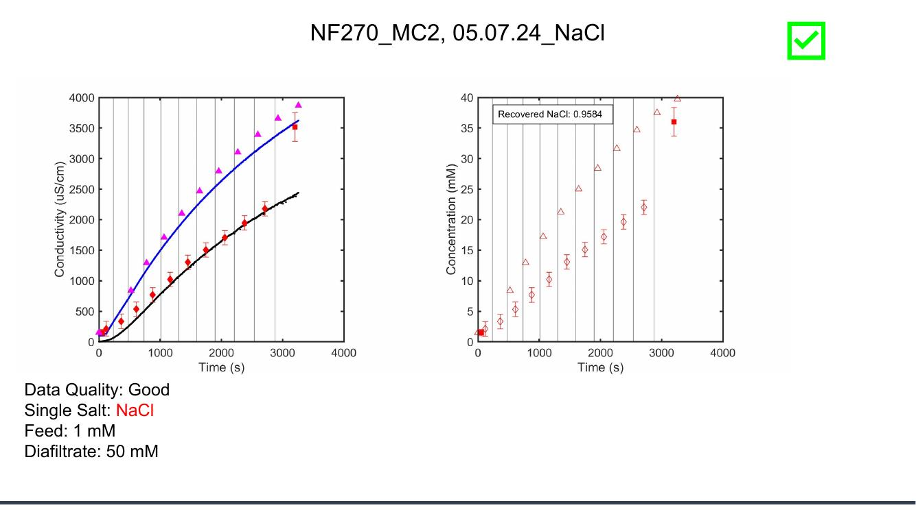
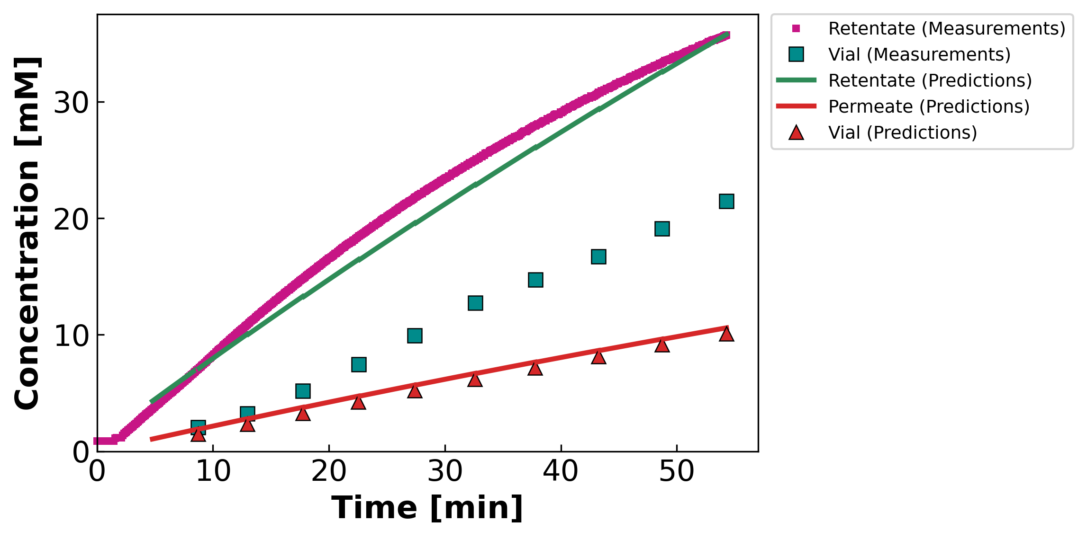
MC2.05.07.24_NaCl
Feed: 1 mM Diafiltrate: 50 mM (Collab: Good)
Collaborator's deck
Our DATA3 pipeline
Collaborator slide #5 · our file: concentration-JAO_050724_NF270_MC2_NaCl_NaCl_05.07.24_NaCl.png

Slide 4
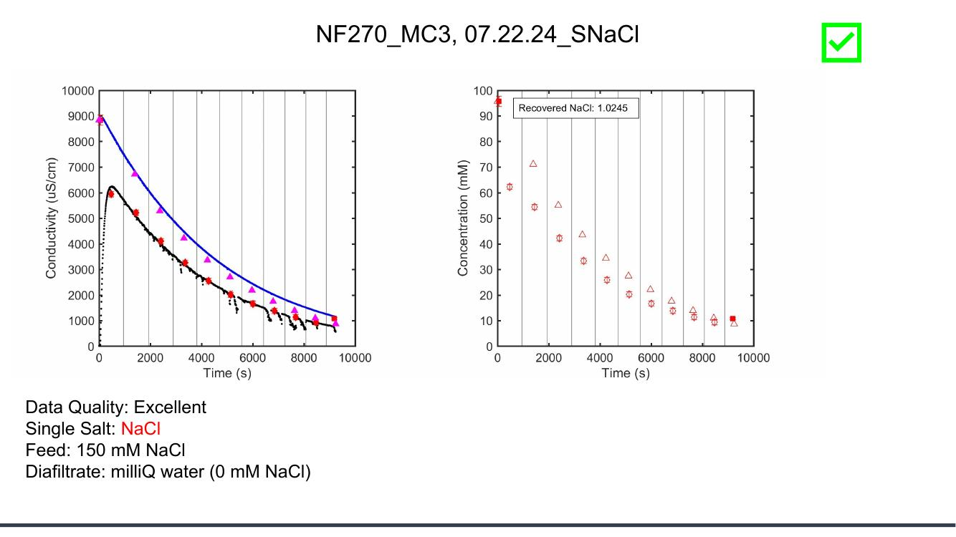
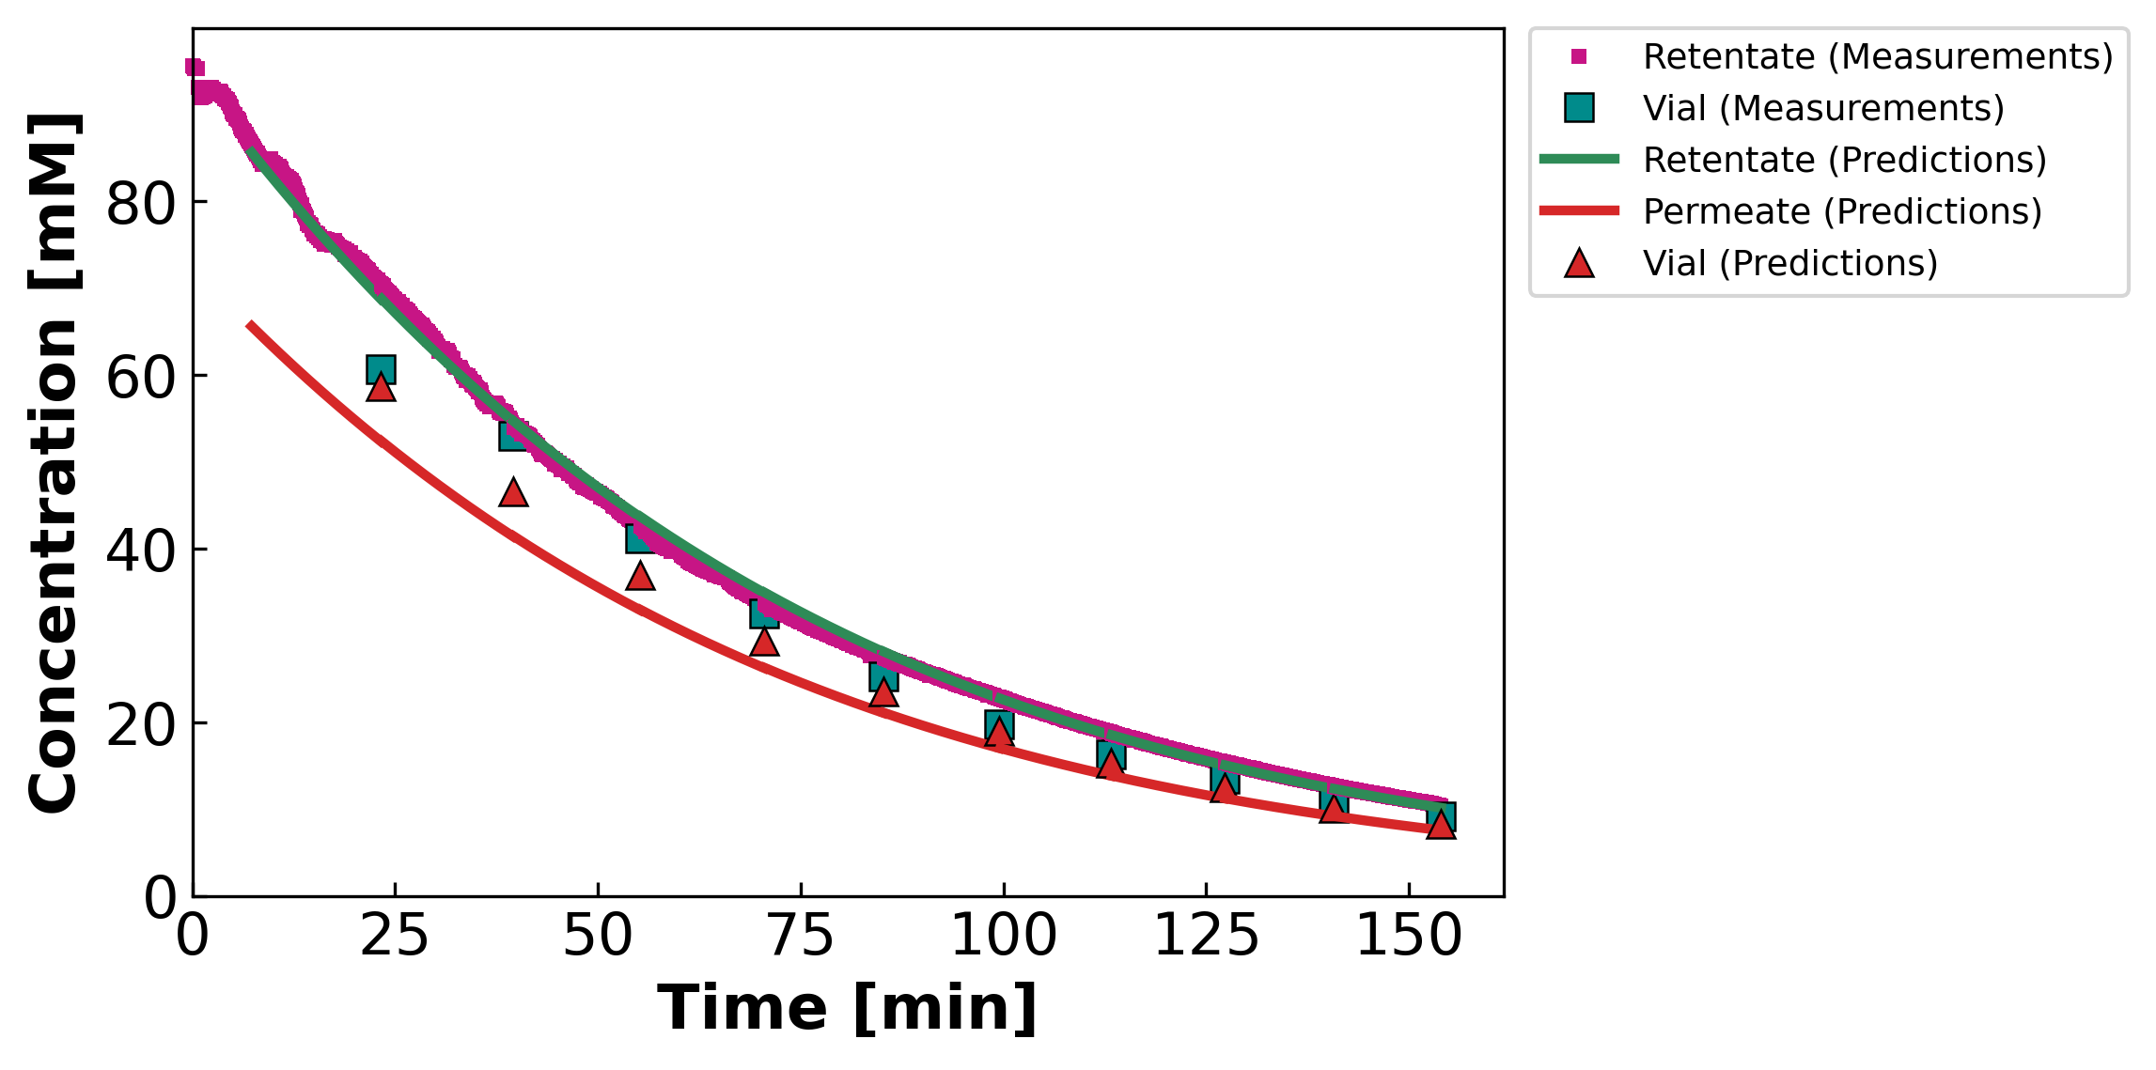
MC3.07.22.24_SNaCl
Feed: 150 mM Diafiltrate: 0 mM (Collab: Excellent — gold-standard interior σ)
Collaborator's deck
Our DATA3 pipeline
Collaborator slide #7 · our file: concentration-JAO_072224_NF270_MC3_SNaCl_NaCl_07.22.24_SNaCl.png

Slide 5
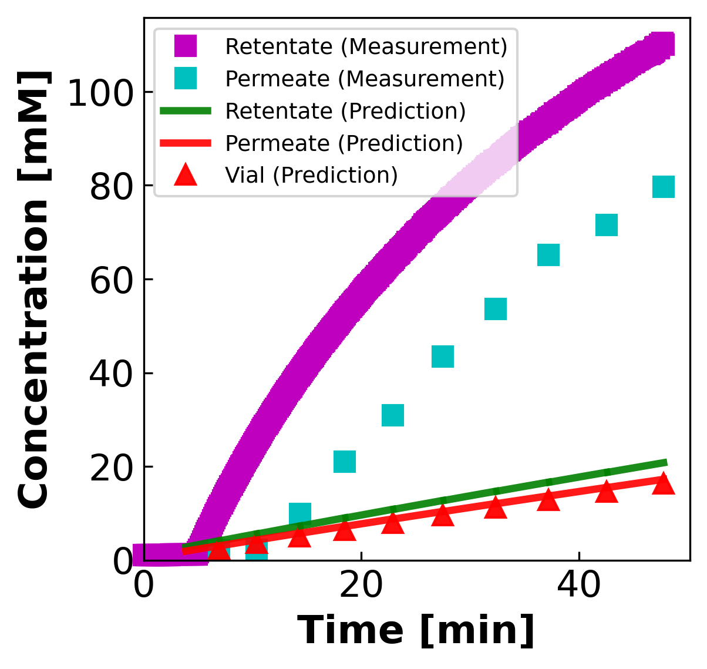
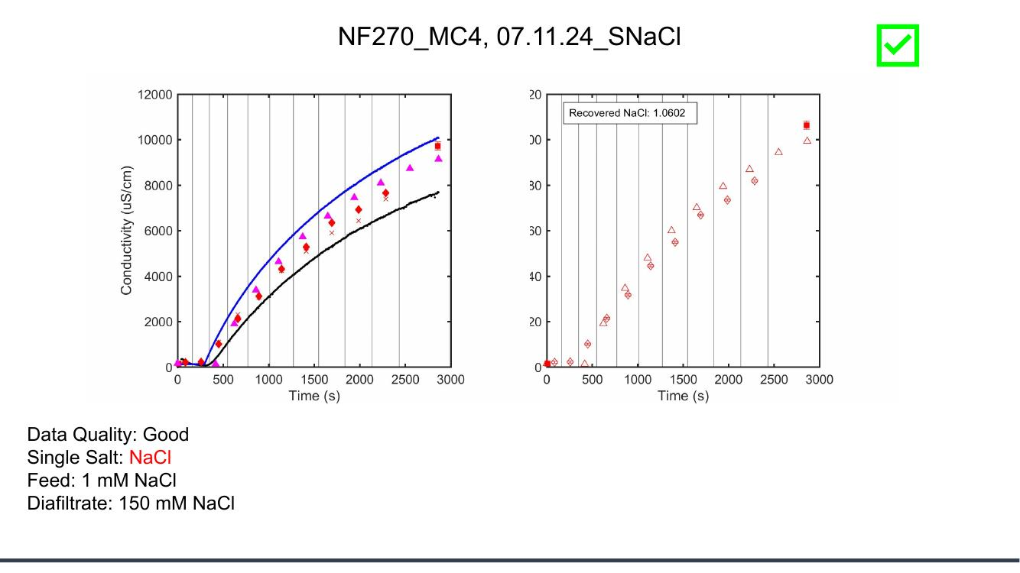
MC4.07.11.24_SNaCl
Feed: 1 mM Diafiltrate: 150 mM (Collab: Good)
Collaborator's deck
Our DATA3 pipeline
Collaborator slide #8 · our file: concentration-LL_071124_NF270_MC4_S_NaCl_07.11.24_SNaCl.png

Slide 6
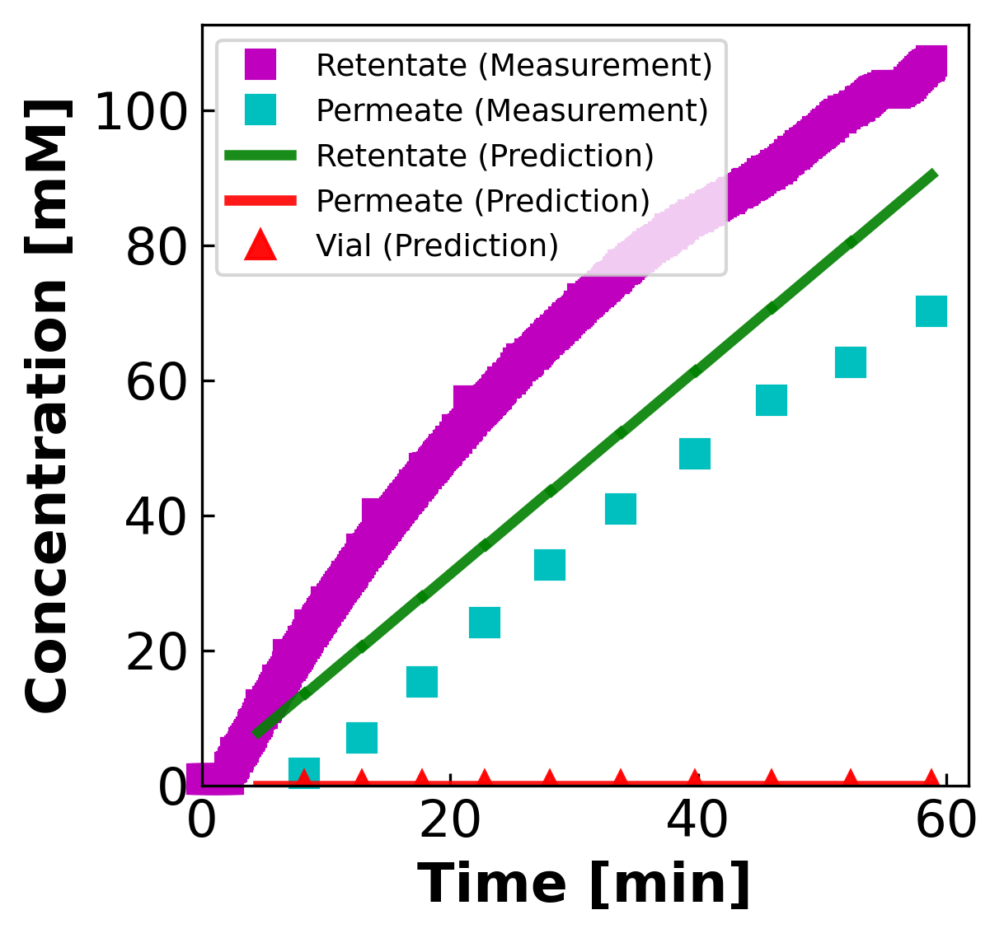
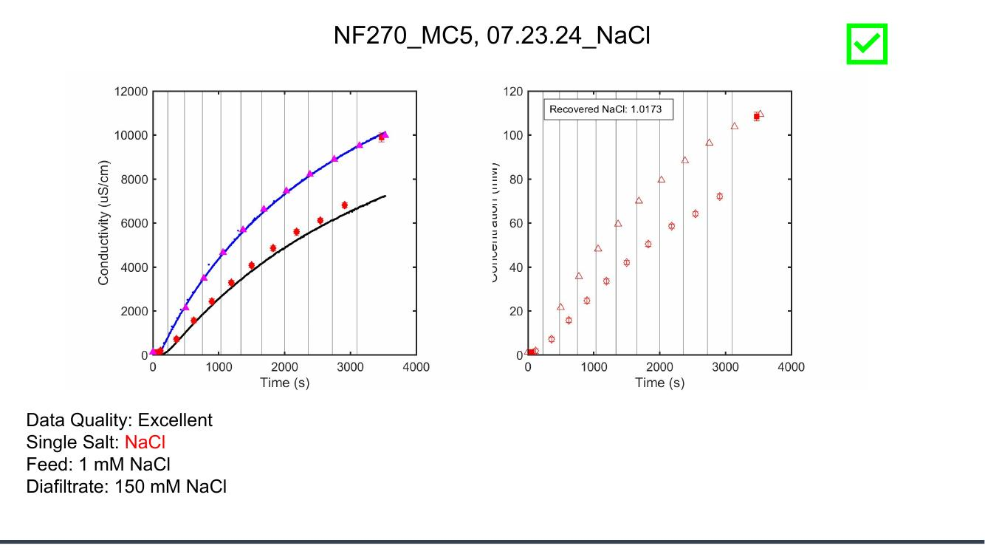
MC5.07.23.24_NaCl
Feed: 1 mM Diafiltrate: 150 mM (Collab: Excellent)
Collaborator's deck
Our DATA3 pipeline
Collaborator slide #9 · our file: concentration-JAO_072324_NF270_MC5_NaCl_NaCl_07.23.24_NaCl.png

Slide 7
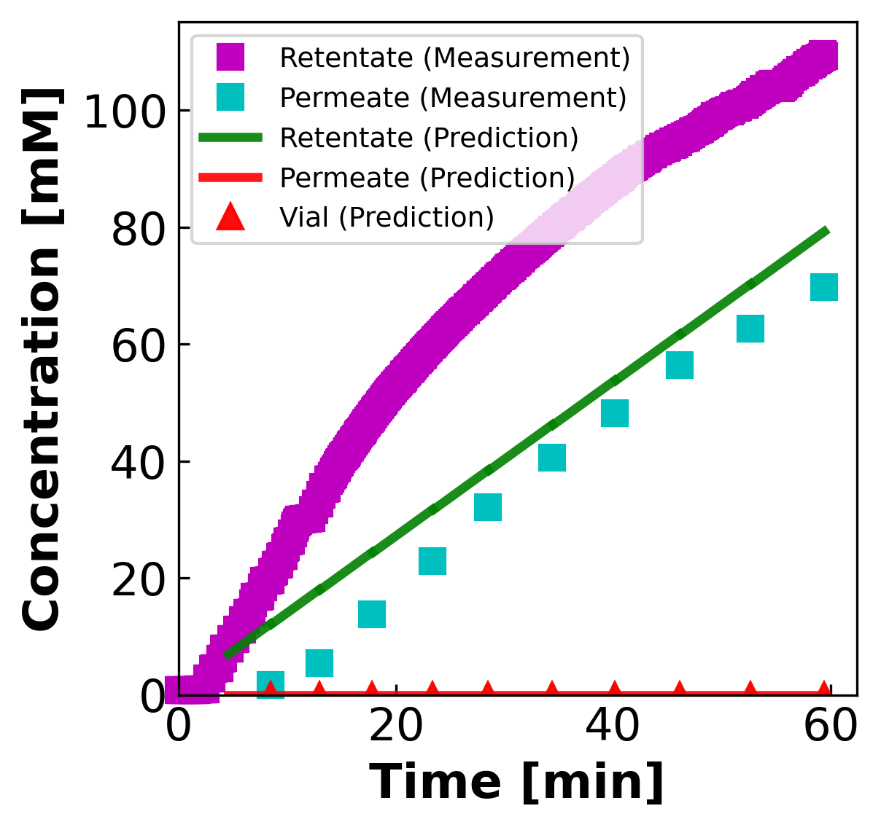
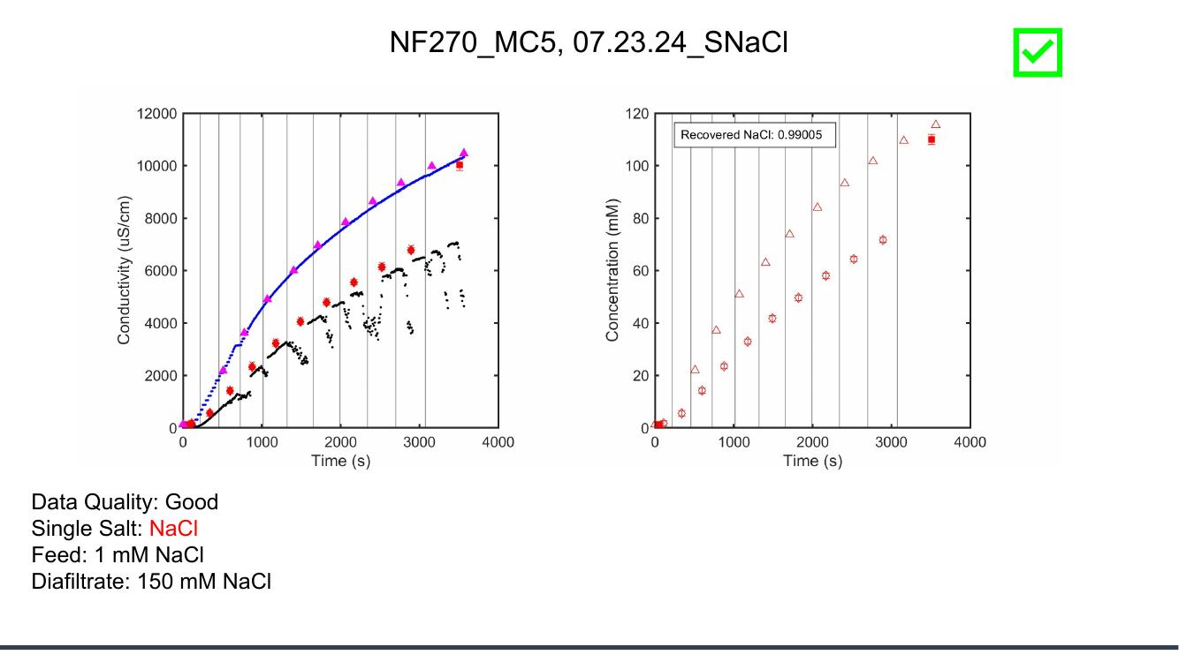
MC5.07.23.24_SNaCl
Feed: 1 mM Diafiltrate: 150 mM (Collab: Good)
Collaborator's deck
Our DATA3 pipeline
Collaborator slide #10 · our file: concentration-JAO_072324_NF270_MC5_SNaCl_NaCl_07.23.24_SNaCl.png

Slide 8
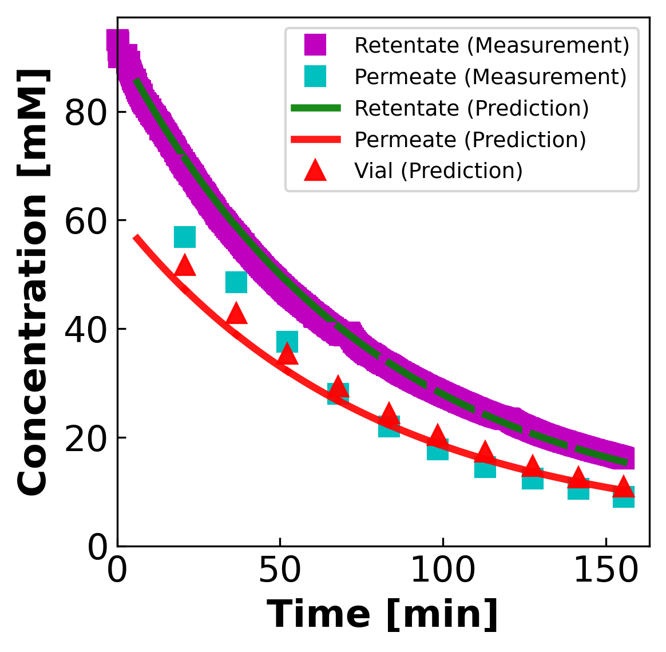
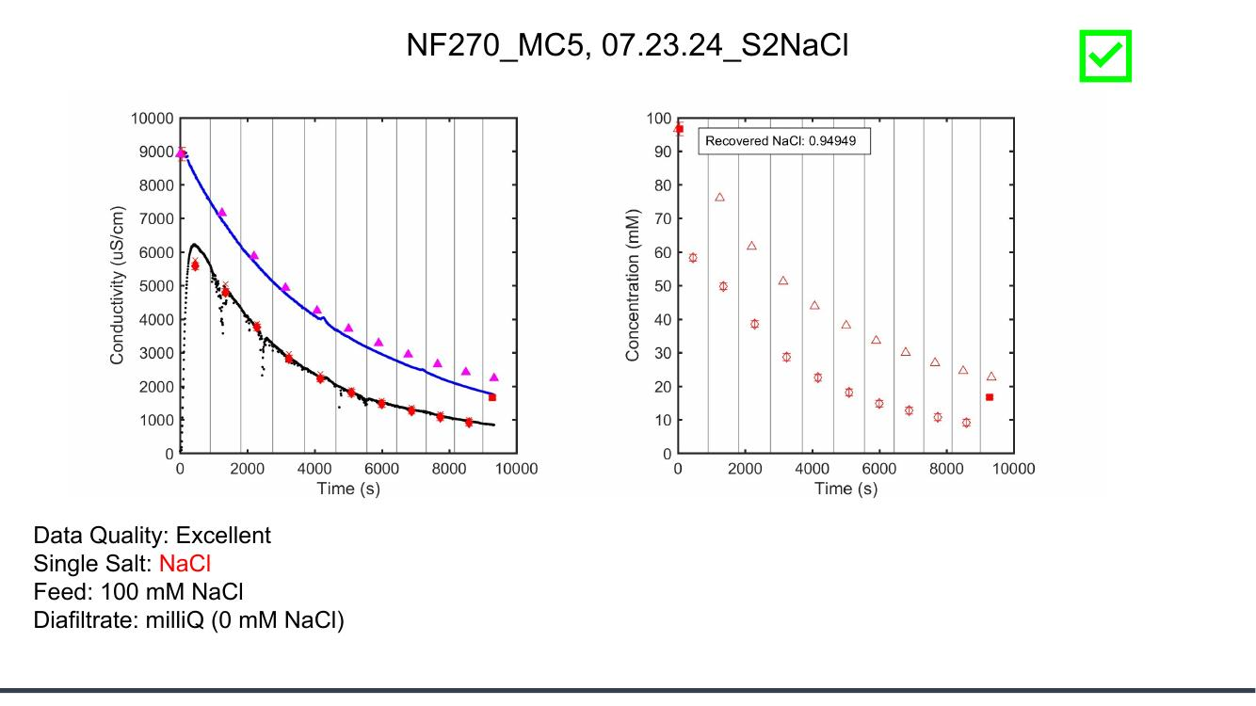
MC5.07.23.24_S2NaCl
Feed: 100 mM Diafiltrate: 0 mM (Collab: Excellent)
Collaborator's deck
Our DATA3 pipeline
Collaborator slide #11 · our file: concentration-JAO_072324_NF270_MC5_NaClS2_NaCl_07.23.24_S2NaCl.png

Slide 9
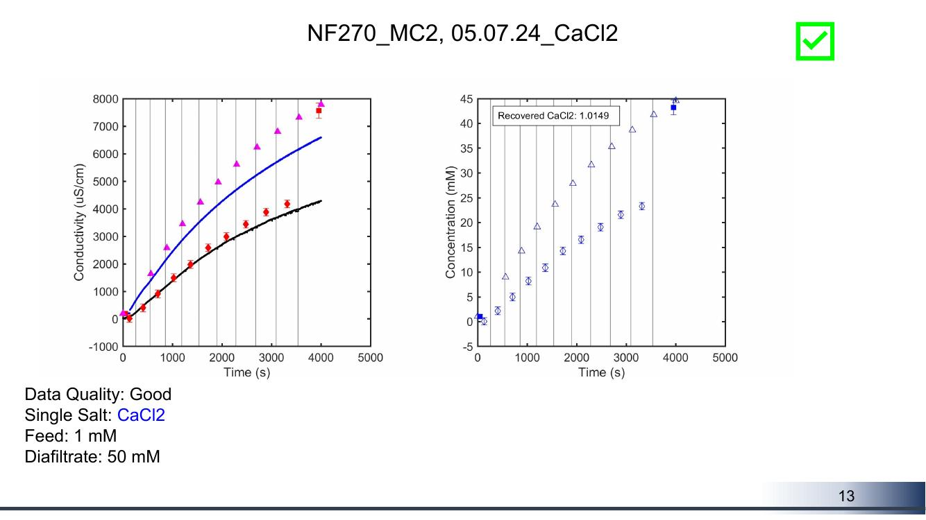
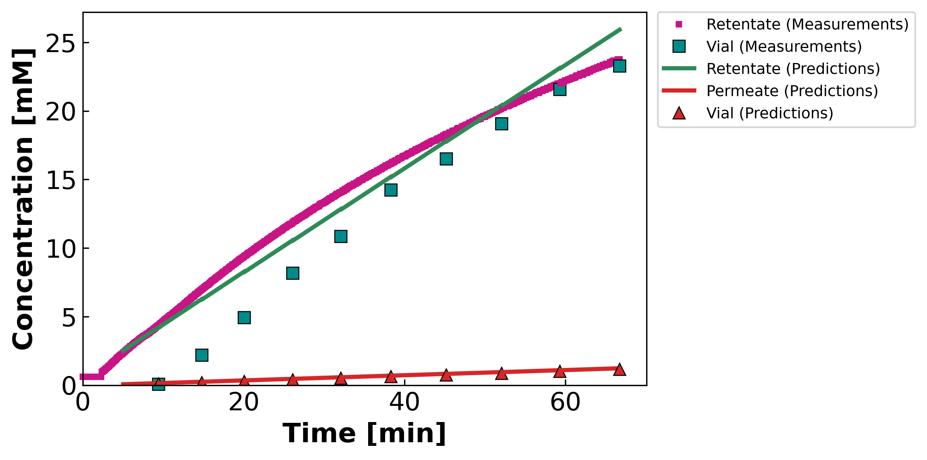
MC2.05.07.24_CaCl2
Feed: 1 mM Diafiltrate: 50 mM (Collab: Good)
Collaborator's deck
Our DATA3 pipeline
Collaborator slide #13 · our file: concentration-JAO_050724_NF270_MC2_CaCl2_CaCl2_05.07.24_CaCl2.png

Slide 10
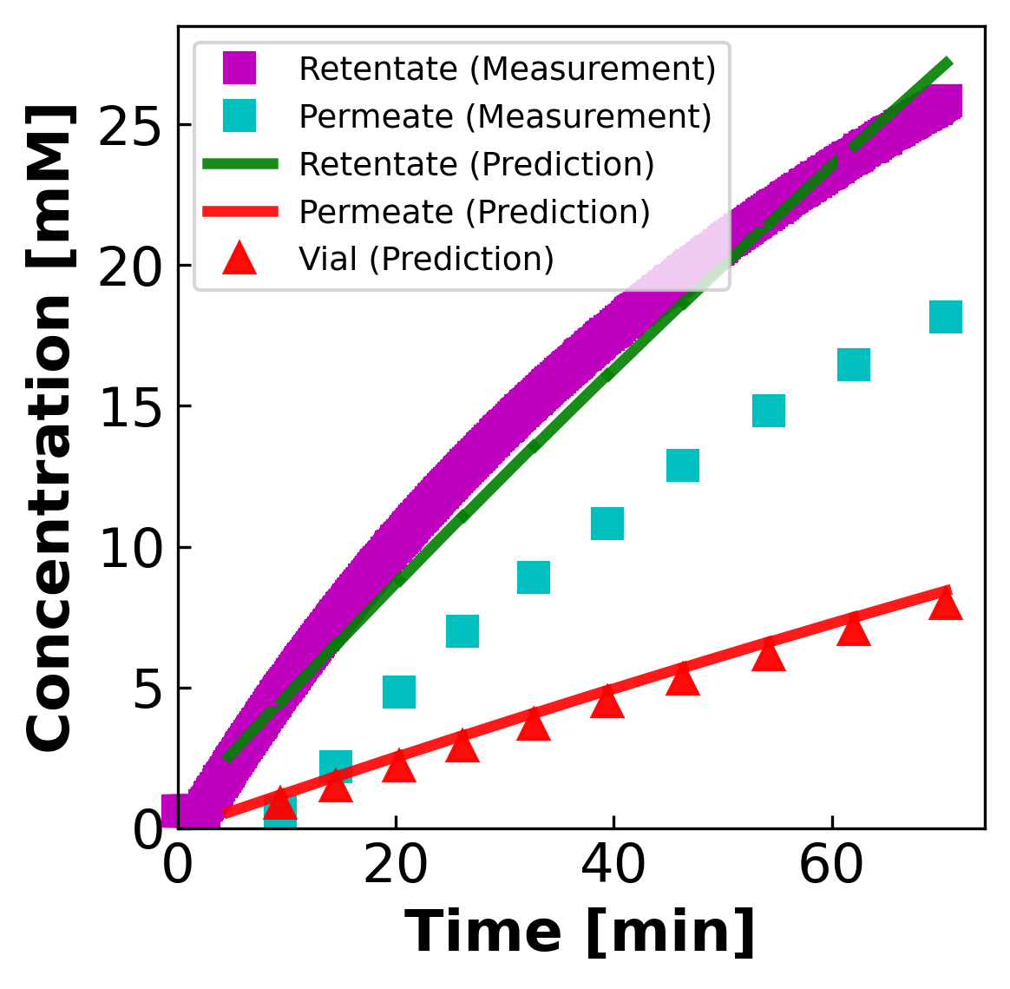
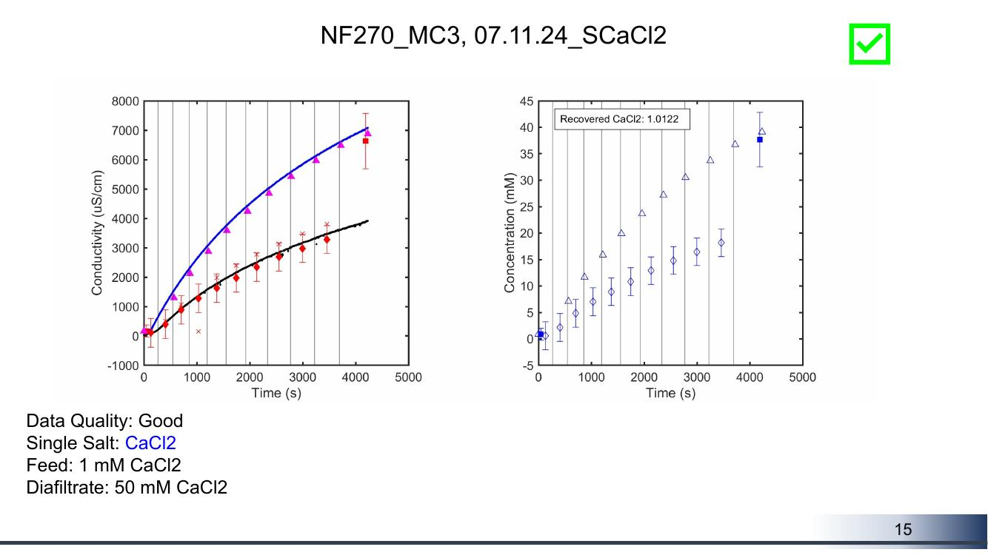
MC3.07.11.24_SCaCl2
Feed: 1 mM Diafiltrate: 50 mM (Collab: Good)
Collaborator's deck
Our DATA3 pipeline
Collaborator slide #15 · our file: concentration-JAO_071124_NF270_MC3_SCaCl2_CaCl2_07.11.24_SCaCl2.png

Slide 11
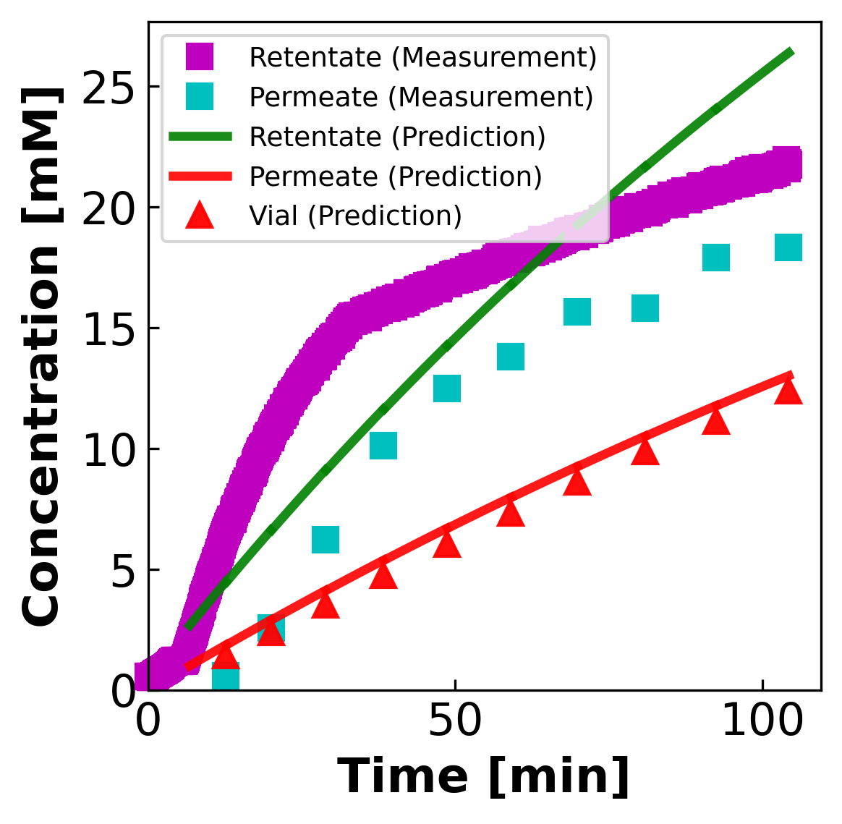
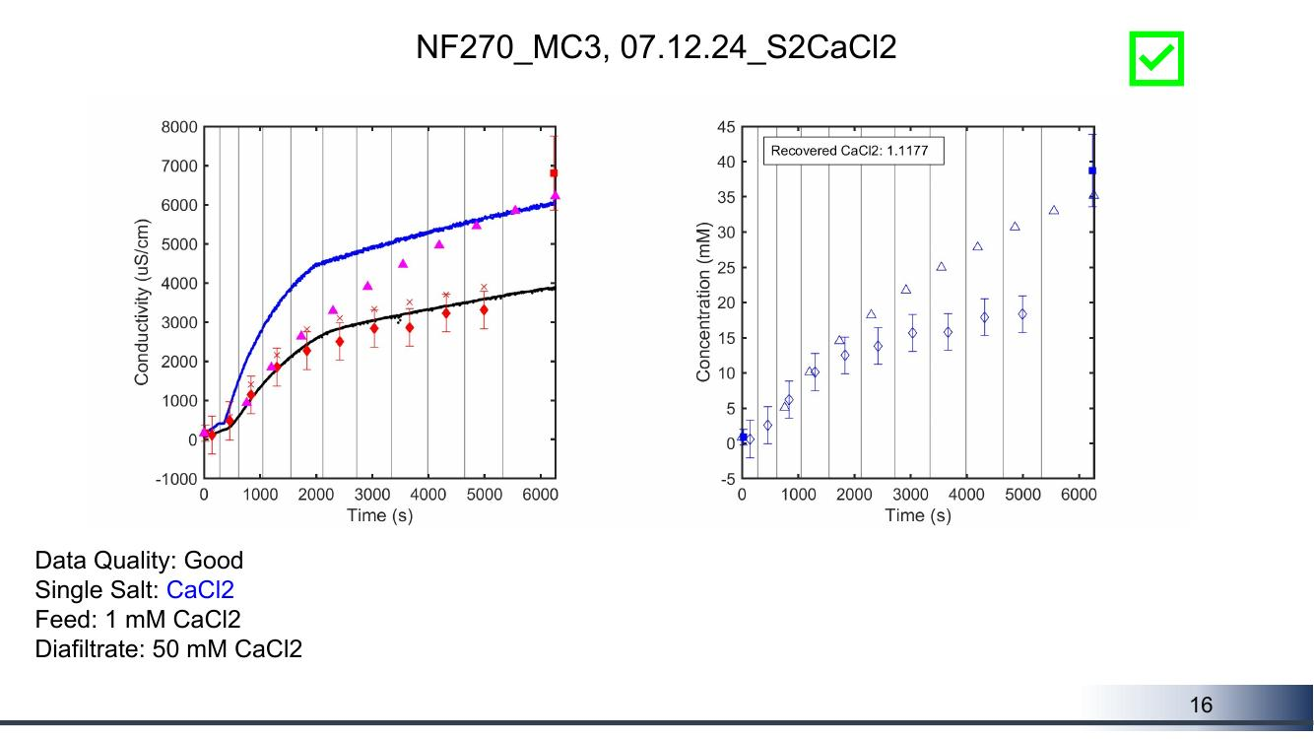
MC3.07.12.24_S2CaCl2
Feed: 1 mM Diafiltrate: 50 mM (Collab: Good)
Collaborator's deck
Our DATA3 pipeline
Collaborator slide #16 · our file: concentration-JAO_071224_NF270_MC3_S2CaCl2_CaCl2_07.12.24_S2CaCl2.png

Slide 12
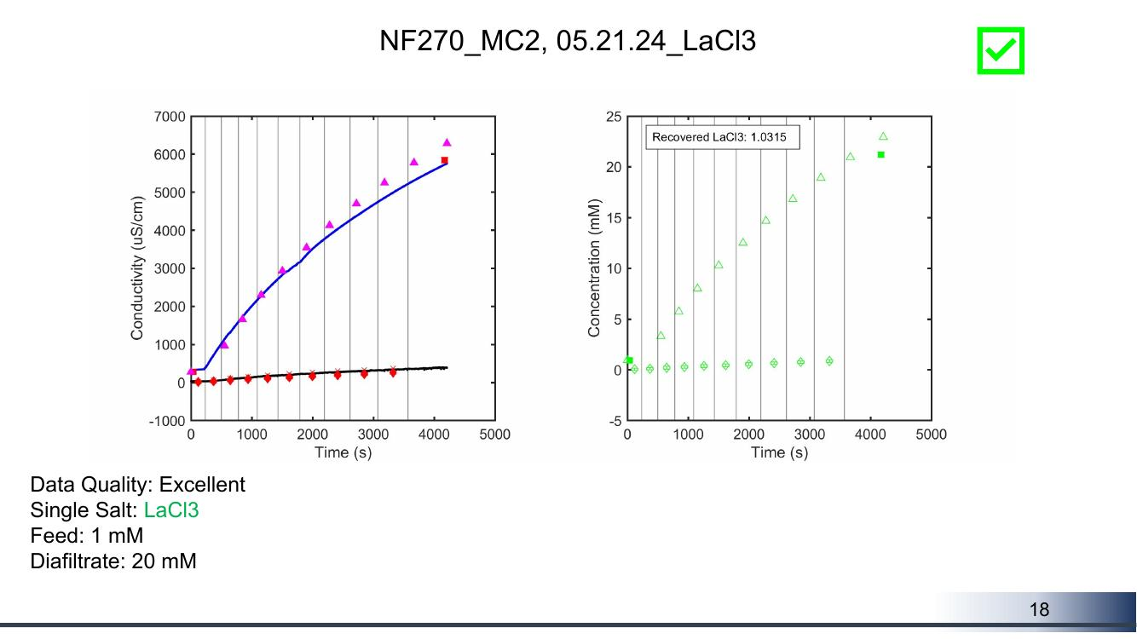
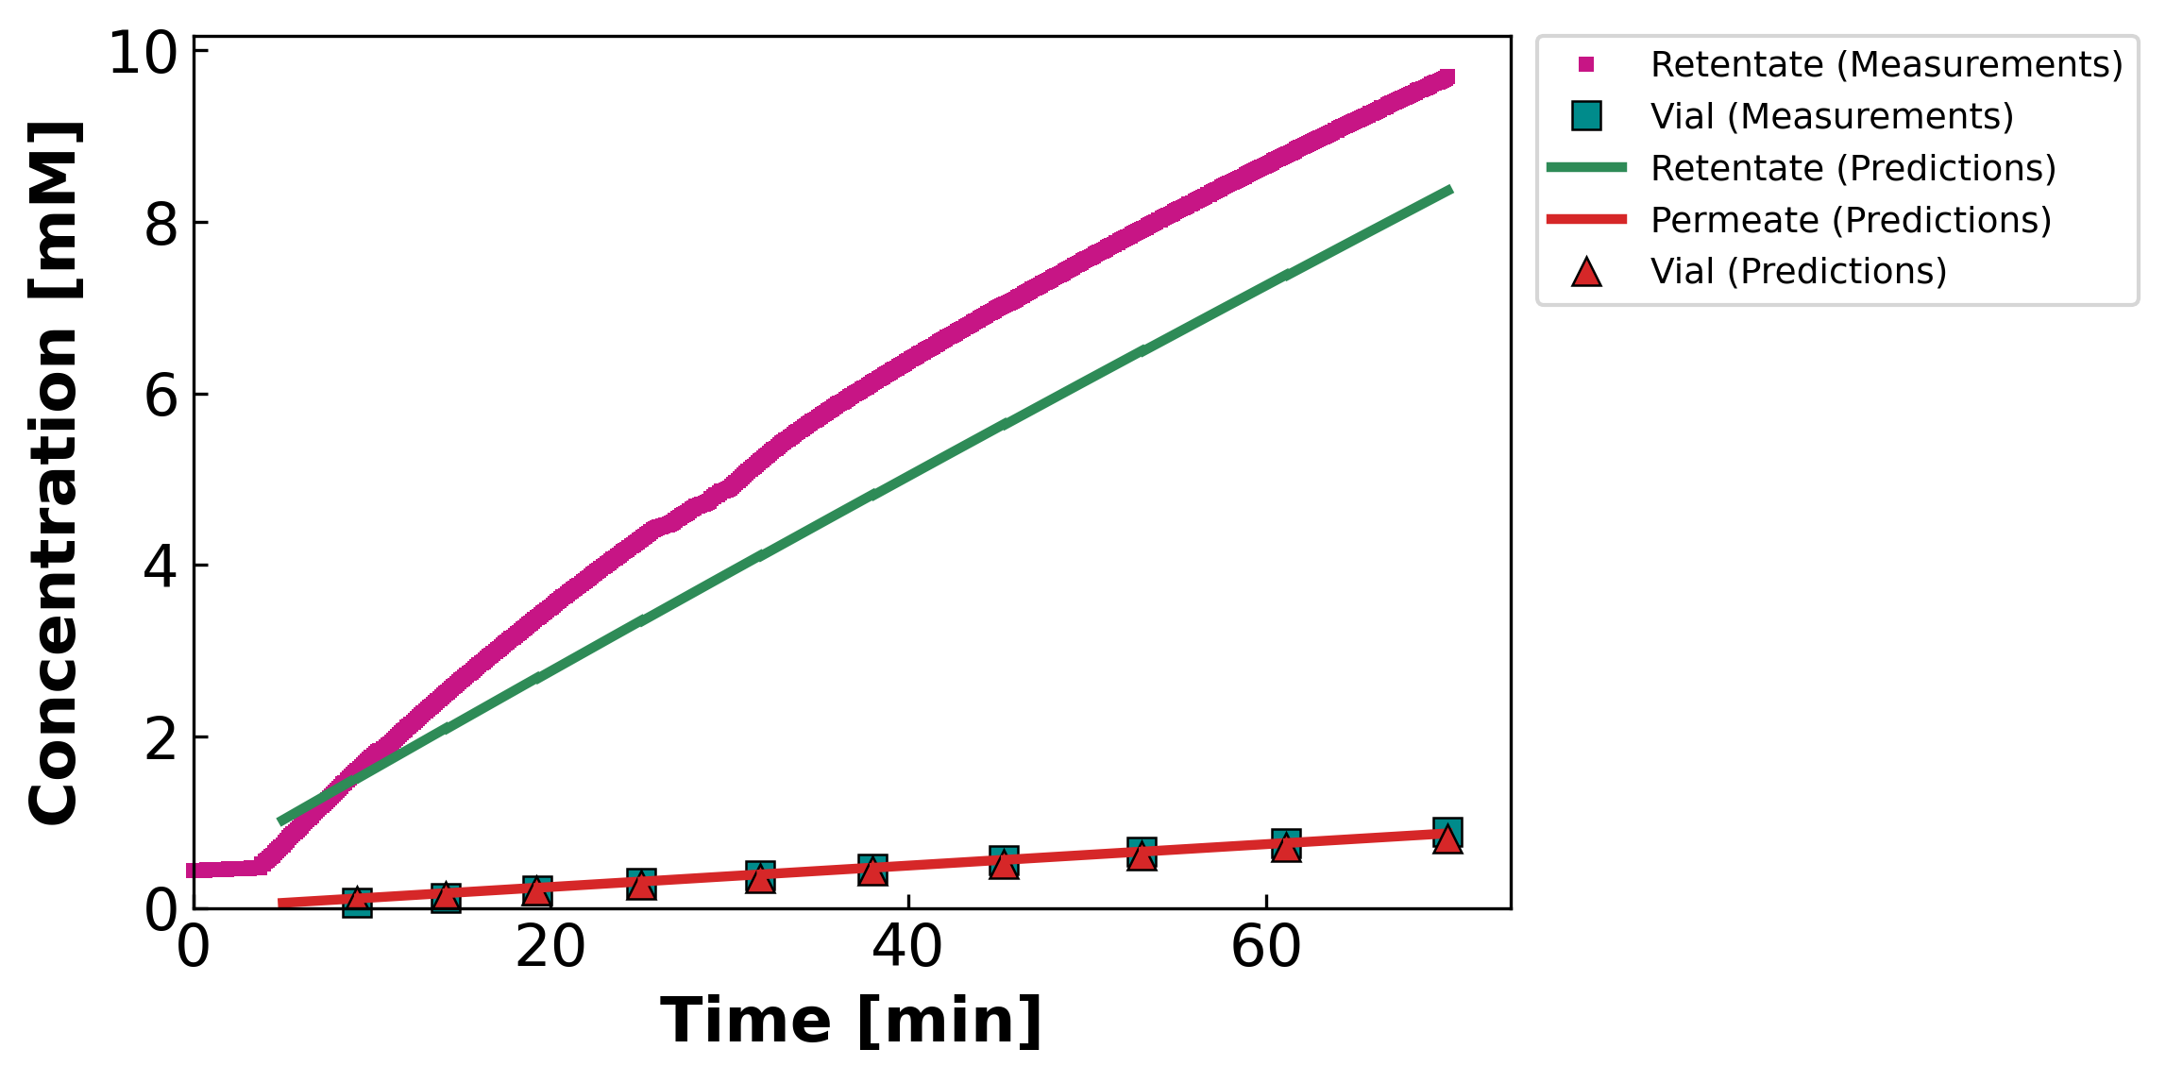
MC2.05.21.24_LaCl3
Feed: 1 mM Diafiltrate: 20 mM (Collab: Excellent)
Collaborator's deck
Our DATA3 pipeline
Collaborator slide #18 · our file: concentration-JAO_052124_NF270_MC2_LaCl3_LaCl3_05.21.24_LaCl3.png

Slide 13
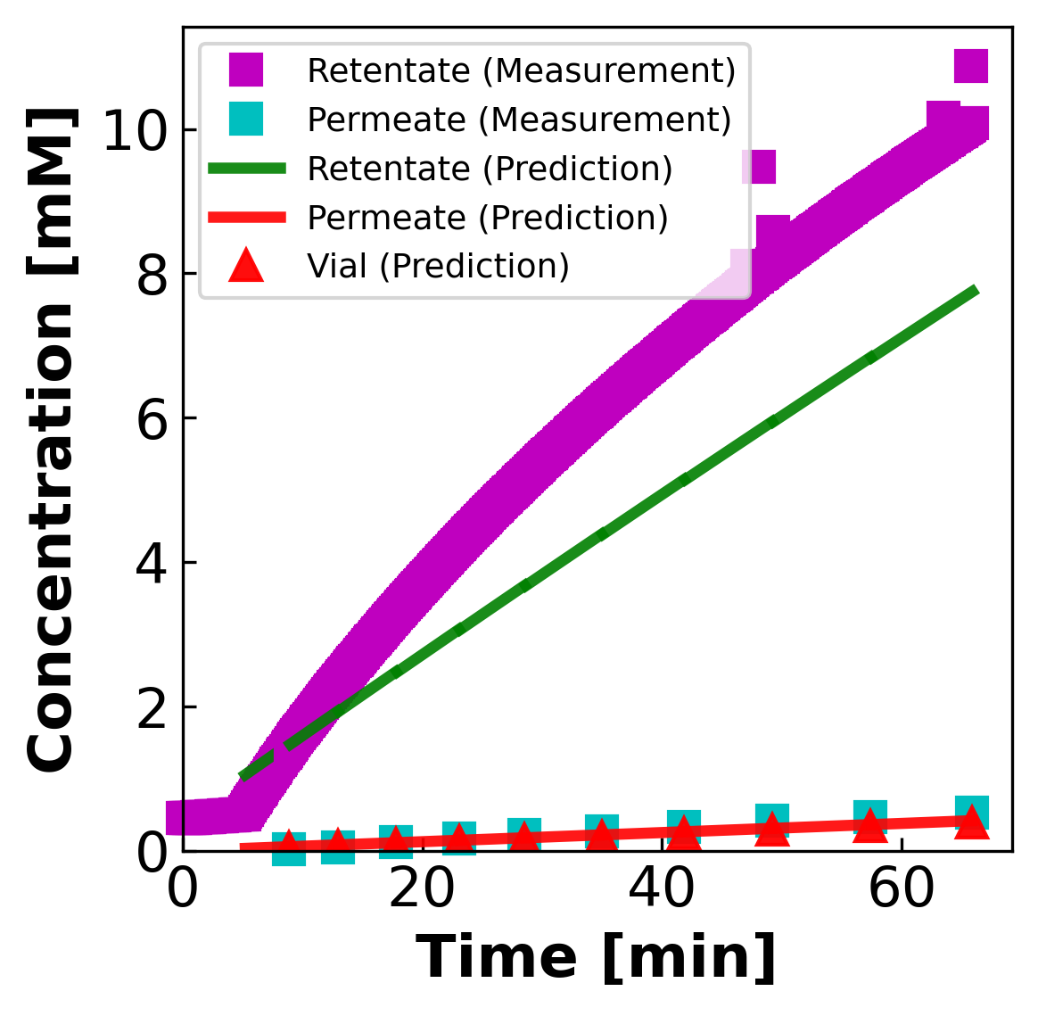
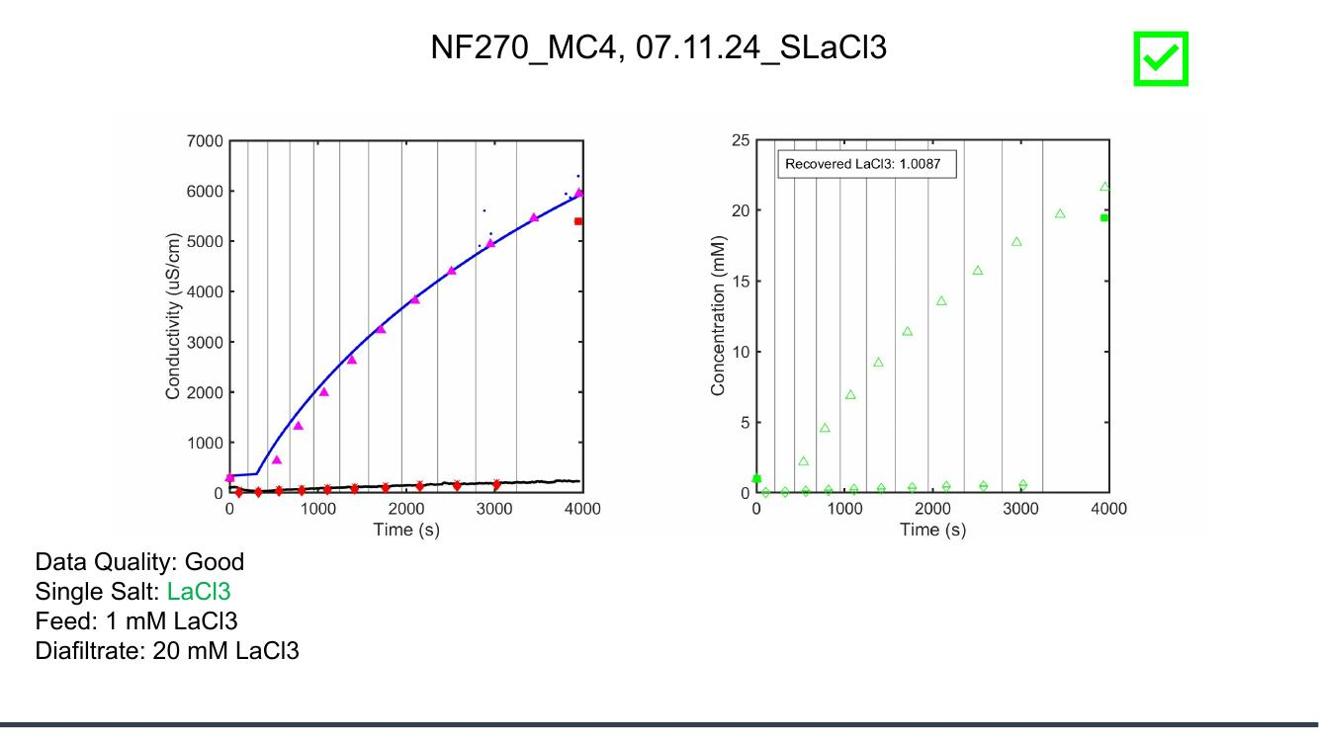
MC4.07.11.24_SLaCl3
Feed: 1 mM Diafiltrate: 20 mM (Collab: Good)
Collaborator's deck
Our DATA3 pipeline
Collaborator slide #19 · our file: concentration-LL_071124_NF270_MC_4_LaCl3_07.11.24_SLaCl3.png

Slide 14
Reading guide — what to look for
Three quick checks for each experiment, top → bottom:
1. Retentate end-of-run concentration
Read off the final value of the magenta retentate trace on BOTH sides — they should match within ~5 %.
2. Time axis: collaborator uses SECONDS, we use MINUTES
Multiply collab time by 60 to compare to ours. This is just a units choice — not a processing difference.
3. Permeate (vial) values
Collaborator plots open triangles (cumulative permeate ICP) AND in some cases open diamonds (instantaneous). We plot teal ■ (per-vial instantaneous ICP). Compare like-for-like:
— Our teal ■ vs collab open diamonds (instantaneous)
— Our cumulative would need to be derived; not currently plotted.
If retentate agrees but permeate scatter differs
Conductivity → concentration inversion is the SAME for retentate (Shedlovsky). Permeate disagreement points to either (a) per-vial ICP-OES being plotted differently, or (b) a model-prediction artifact. Worth a follow-up.
Bottom line
The conductivity-derived RETENTATE traces should agree numerically on both sides. That is the strongest test of whether our processing pipeline gives the same numbers.

