Slide 1
Rejection vs Péclet — the σ-family diagnostic
DATA3 single-salt NF270 · which reflection coefficient σ does each experiment support?
Results update · July 30, 2026
Keshav Kasturi Rangan · University of Notre Dame

Slide 2
The diagnostic: Spiegler–Kedem rejection curves
R = σ(1 − e⁻ᴾᵉ) / (1 − σ·e⁻ᴾᵉ) with Pe = Jw·L / Dₘ
One curve per σ. Each σ traces a rejection curve: R → 0 as Pe → 0 (diffusion), rising to a plateau R → σ as Pe ≫ 1 (convection).
Place each experiment at its fitted Pe* (the regression-optimal Péclet from the MSE-vs-Pe analysis) and its observed rejection R = 1 − cH/cIn.
Read-off idea: the σ-curve passing through an experiment's (Pe*, R) point is the σ that experiment 'looks like'.
Why it matters: a quick, per-experiment way to see what σ the data imply — and how tightly σ is (or isn't) pinned.
DATA3 single-salt NF270 · Rejection σ-family (Task 6)
2026-07-30 · 2

Slide 3
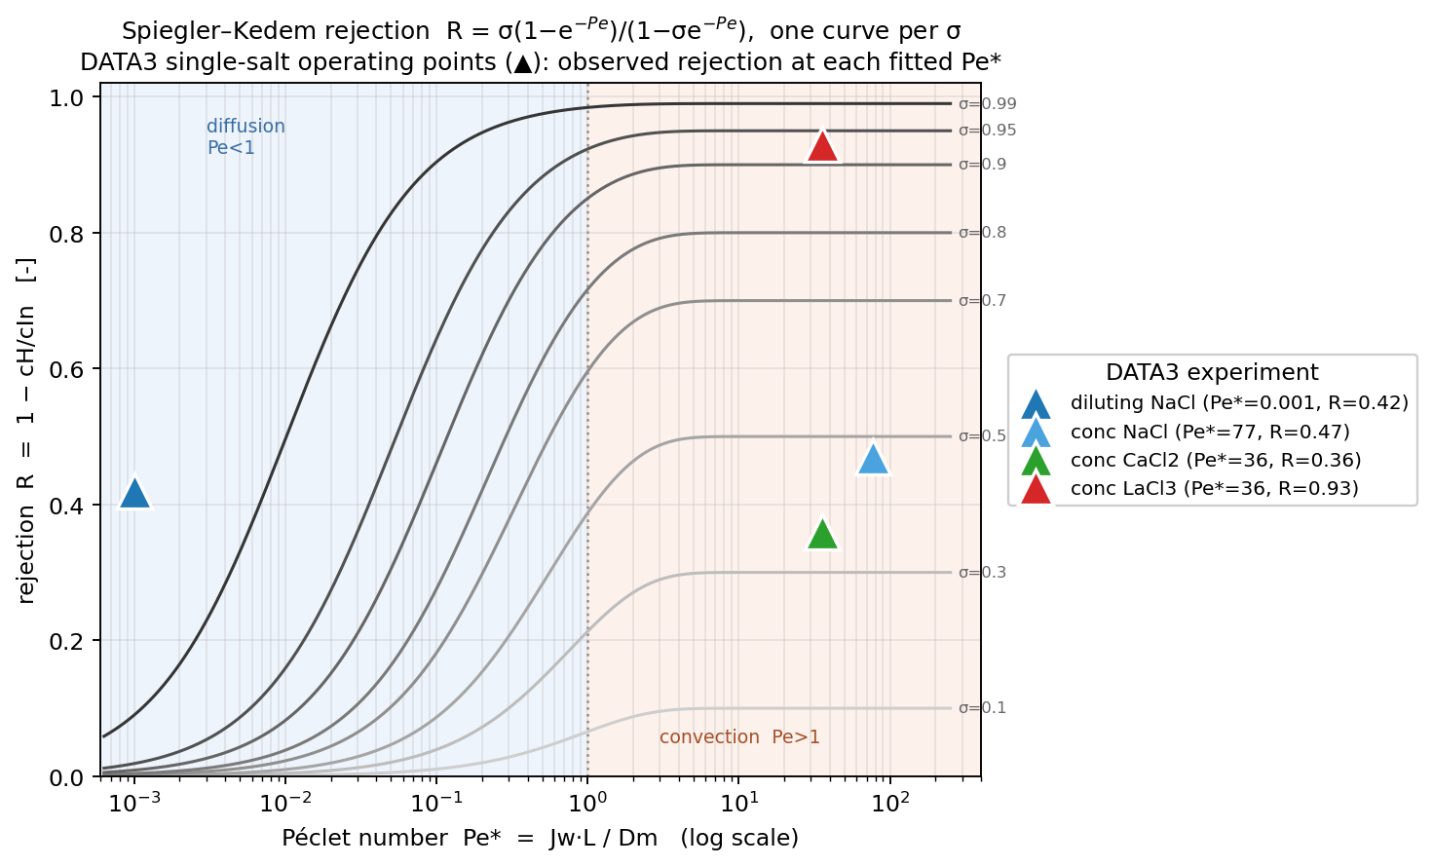
DATA3 single-salt operating points on the σ-family
DATA3 single-salt NF270 · Rejection σ-family (Task 6)
2026-07-30 · 3

Slide 4
What each experiment lands on
Experiment | Regime (Pe*) | Observed R | σ it looks like
diluting NaCl | diffusion (Pe*≈10⁻³) | 0.42 | — (off-regime; see note)
conc NaCl | convection (Pe*≈77) | 0.47 | ≈ 0.5
conc CaCl₂ | convection (Pe*≈36) | 0.36 | ≈ 0.36
conc LaCl₃ | convection (Pe*≈36) | 0.93 | ≈ 0.93
Note — diluting NaCl is diffusion-limited (Pe*→0): at that regime every σ-curve is ≈0, so its measured rejection (0.42) sits ABOVE the family. Its rejection is set by diffusion / B, not σ — this diagnostic's σ read-off only applies in the convection regime (Pe ≫ 1).
DATA3 single-salt NF270 · Rejection σ-family (Task 6)
2026-07-30 · 4

Slide 5
What it tells us — and the honest caveat
At high Pe, R → an effective σ. The three concentrating salts land on well-separated plateaus (≈0.5, 0.36, 0.93) — so the rejection IS well-measured per experiment.
But that 'σ' is confounded with B. Rejection is produced jointly by the reflection coefficient σ AND the diffusive permeability B; the fit trades one for the other along the σ–B trough (fitted σ actually railed to 1/1/1/0).
So this diagnostic pins the rejection, not the true σ. Reading σ off the family assumes B contributes nothing — it does. The single-experiment σ therefore stays unidentified, consistent with the σ×B contour finding.
Diffusion-limited runs are off-regime. Diluting NaCl (Pe*→0) can't be placed on the σ-family at all.
The lever is pooling. Separating σ from B needs data across conditions — stacking same-salt/regime experiments (summed Fisher information) to sharpen σ.
DATA3 single-salt NF270 · Rejection σ-family (Task 6)
2026-07-30 · 5

