Slide 1
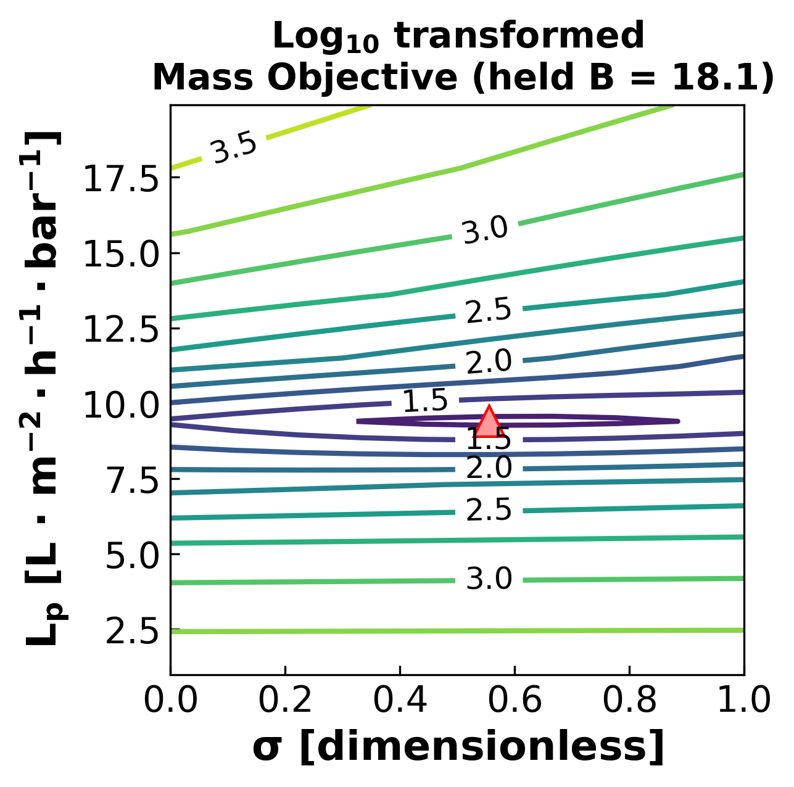
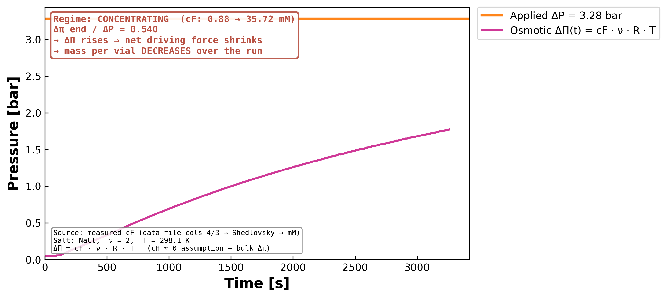
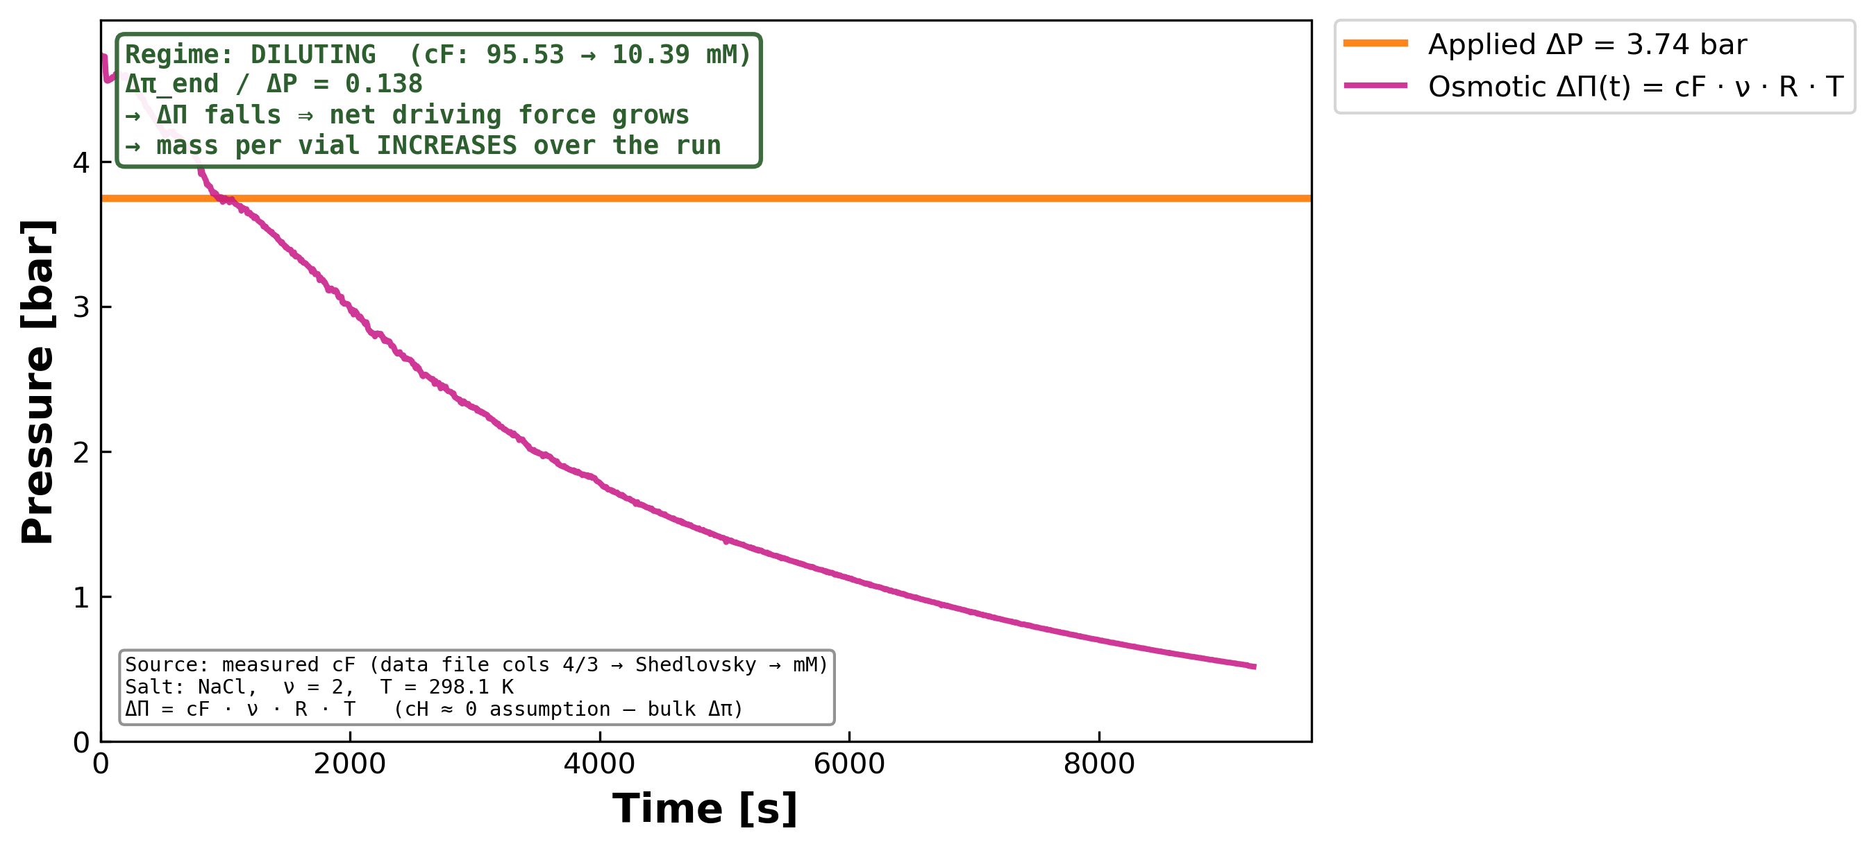
DATA3 Single-Salt Workflow
Data validation, parameter bounds, mass-pattern physics,
and parameter-estimability outlook
Keshav Kasturi Rangan
Collaborator brief · May 27, 2026
UNIVERSITY OF NOTRE DAME
1

Slide 2
Measured data processing — validated
DATA3_loader_fidelity_audit_2026-05-27.xlsx — one row per data point · one tab per experiment
Time-series columns (cols 0–7)
Header metadata (rows 0–14)
70,101 / 70,101
40 / 40 ✓
data points classified GOOD (100 %)
0 warnings · 0 bad across 13 sheets
strict-equality matches (Notes, M_F0, salt names, etc.)
+ ICP calibration R² = 0.99–0.999 across all sheets
Two documented loader transformations — everything else is byte-equivalent
1. Mass — per-vial baseline subtraction
2. Conductivity — EC25 temperature compensation
Each vial starts at 0 g so mass-vs-time fits compare cleanly across vials.
σ_25 = σ_T · (1 + α · (25 − T)) with salt-specific α
(NaCl 0.021, CaCl₂ 0.023, LaCl₃ 0.025 /°C)
Reference: Architecture.md §14 (data validation) · audit xlsx open in the meeting
UNIVERSITY OF NOTRE DAME
2

Slide 3
Parameter bounds — what changes with the salt, and what doesn't
Same model, same membrane, different salt → same bounds, different fitted values
The published parameter box used across the entire campaign:
L_p (water permeability)
B (solute permeability)
σ (reflection coefficient)
[ 0.5 , 50 ]
L · m⁻² · h⁻¹ · bar⁻¹
[ 0 , 30 ]
μmol · cm⁻² · s⁻¹ · mM⁻¹
[ 0 , 1 ]
dimensionless
Membrane property — not salt-specific.
Same bounds across the campaign.
Moves most with salt, but published
box kept constant across campaign.
Hard physical bound — true for any salt.
Reflection: 0 = transparent, 1 = perfect.
Rule of thumb
• Same model, same membrane, different salt → same bounds, different fitted values
• Different membrane, salt family, or model form → revisit the bounds
Source: refactored_ucb_library.py · model_construct_inter (Var declarations)
UNIVERSITY OF NOTRE DAME
3

Slide 4
Mass per vial — rising in dilution, falling in concentration
Spiegler–Kedem flux: Jw = Lp · (ΔP − σ · Δπ). ΔP is constant; Δπ tracks cF(t). The pattern is expected.
CONCENTRATING · MC2.05.07.24_NaCl
DILUTING · MC3.07.22.24_SNaCl
cF rises 0.88 → 35.7 mM · Δπ_end / ΔP = 0.54
→ net driving force shrinks → mass per vial DECREASES
cF falls 95.5 → 10.4 mM · Δπ_end / ΔP = 0.14
→ net driving force grows → mass per vial INCREASES
UNIVERSITY OF NOTRE DAME
4

Slide 5
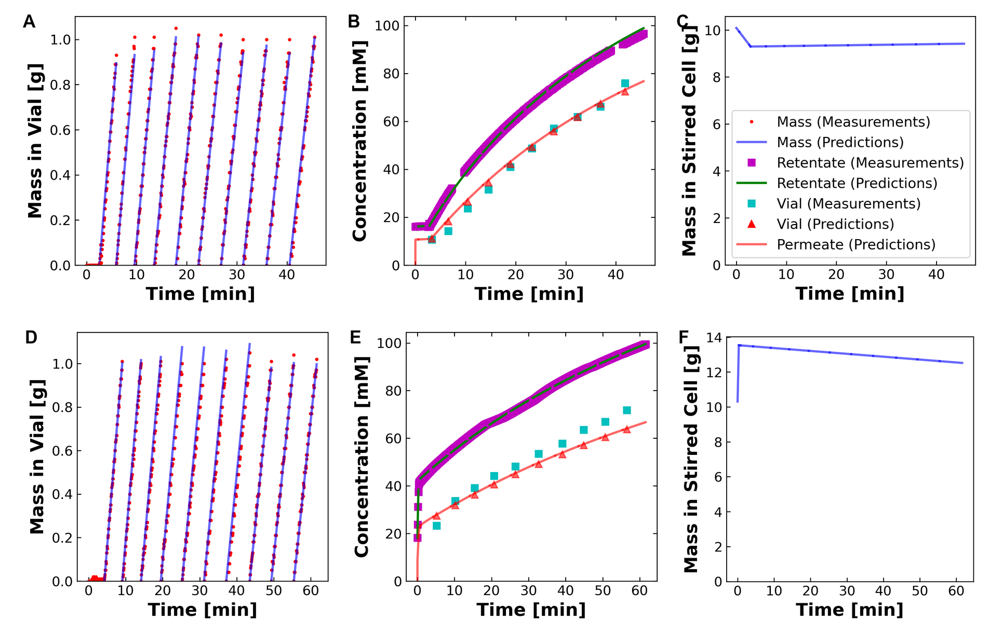
DATA2 paper figures — regenerated end-to-end
28 figures + 4 tables · pytest regression within 1 % tolerance · same fits, same plots, same paper
What this confirms
DATA1 / DATA2 workflows
• 28 DATA2 figures regenerated
• pytest: 2 PASS within 1 % tolerance in 1.24 s
• 4 guards-test cases: σ-bounds, cF-floor, perm-probe, retentate-anchor — all inert for DATA1 / DATA2
DATA3 single-salt edits
• All knobs guarded behind workflow_family == "DATA3"
• None can leak into DATA1 / DATA2 model construction
► Our DATA3 work has NOT broken the published-paper paths.
figure_6 (regenerated) — matches the published paper figure-by-figure
UNIVERSITY OF NOTRE DAME
5

Slide 6
DATA3 contour · why parameter estimability is harder here
Mass-channel objective surface on the σ – L_p plane · MC2.05.07.24_NaCl · B held at centering value (18.1)
What the heatmap shows
Long, narrow basin elongated in σ. Any σ from ~ 0.3 to ~ 0.85 gives almost the same mass-channel objective when L_p is adjusted in tandem.
DATA1 / DATA2 contrast
On DATA1 / DATA2 sheets the basin closes into a tight, well-localized minimum. Single salt + uniform regime = strong identifiability.
Consequence for DATA3
Flat σ × L_p basin + multi-salt + mixed regime ⇒ σ pins at a bound on most NaCl sheets.
Next: lumped σ·L_p diagnostic to test if the PRODUCT is well-determined when each separately is not.
paper-x_sigma-y_Lp-mass.png (regenerated from refactored workflow)
UNIVERSITY OF NOTRE DAME
6

Slide 7
Summary
Confirmed
Open / next
✓ Data processing
• DATA3 σ pinning on NaCl sheets
70,101 / 70,101 data points audited GOOD
Contour basin is flat along σ × L_p (slide 6)
✓ Parameter bounds
• Lumped σ · L_p diagnostic
L_p ∈ [0.5, 50] · B ∈ [0, 30] · σ ∈ [0, 1] (campaign-wide)
Fit σ · L_p as one parameter at a fixed-B grid;
separate σ and L_p later
✓ Mass-per-vial pattern
• Retentate ICP as 2nd anchor
Explained by ΔP-vs-Δπ; visible directly in the data
Toggle NF270_USE_RETENTATE_ICP_ANCHOR wired;
opt-in for next rollout iteration
✓ DATA1 / DATA2 unaffected
pytest within 1 % tolerance; guards-test 4/4 PASS
• CaCl₂ / LaCl₃ recipe
✓ Raw-conductivity plotting
Separate strategy planned — out of scope today
New conductivity-<prefix>.png per sheet in pipeline
► We are NOT 'not plotting the data file'.
► Next deliverable: lumped diagnostic + repeat rollout.
UNIVERSITY OF NOTRE DAME
7

